Slide 1
Business Statistics:
A First Course
5th Edition
Chapter 6
The Normal Distribution
Business Statistics: A First Course, 5e © 2009 Prentice-Hall, Inc.
Chap 6-<number>

Slide 2
Perspective
Descriptive versus Inferential Statistics
  Descriptive: Chapter 1-3
  Inferential statistics: The remainder of the book
Probability Distributions
  Frequency versus probability distributions
  Discrete versus continuous probability distributions
    Chapter 5: Discrete probability distributions
    Chapter 6: A specific continuous probability distribution: the normal distributions
Business Statistics: A First Course, 5e © 2009 Prentice-Hall, Inc..
Chap 6-<number>

Slide 3
Learning Objectives
In this chapter, you learn:
To compute probabilities from the normal distribution
To use the normal probability plot to determine whether a set of data is approximately normally distributed
Business Statistics: A First Course, 5e © 2009 Prentice-Hall, Inc..
Chap 6-<number>

Slide 4
Continuous Probability Distributions
A continuous random variable is a variable that can assume any value on a continuum (can assume an uncountable number of values)
  thickness of an item
  time required to complete a task
  temperature of a solution
  height, in inches
These can potentially take on any value depending only on the ability to precisely and accurately measure
Business Statistics: A First Course, 5e © 2009 Prentice-Hall, Inc..
Chap 6-<number>

Slide 5
Continuous Probability Distributions
There are many types of continuous probability distributions
Bell Shaped
Probability
Distribution
Constant
Probability
Distribution
Exponential
Probability
Distribution
Business Statistics: A First Course, 5e © 2009 Prentice-Hall, Inc..
Chap 6-<number>

Slide 6
The Normal Distribution
Bell Shaped
Symmetrical
Mean, Median and Mode are Equal
Occurs often in business
Most commonly, it occurs because of random errors
f(X)
σ
X
μ
Mean
= Median
= Mode
Business Statistics: A First Course, 5e © 2009 Prentice-Hall, Inc..
Chap 6-<number>

Slide 7
The Normal Distribution
Location is determined by the mean, μ
Spread is determined by the standard deviation, σ
The random variable has an infinite theoretical range:
+ ∞ to − ∞
f(X)
σ
X
μ
Mean
= Median
= Mode
Business Statistics: A First Course, 5e © 2009 Prentice-Hall, Inc..
Chap 6-<number>

Slide 8
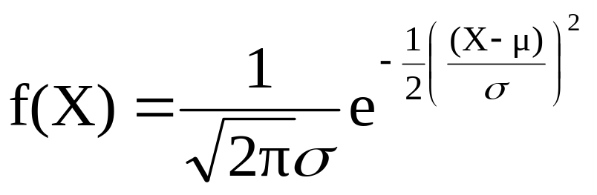
The Normal Distribution
Density Function
The formula for the normal probability density function is
Where e = the mathematical constant approximated by 2.71828
π = the mathematical constant approximated by 3.14159
μ = the population mean
σ = the population standard deviation
X = any value of the continuous variable
Business Statistics: A First Course, 5e © 2009 Prentice-Hall, Inc..
Chap 6-<number>

Slide 9
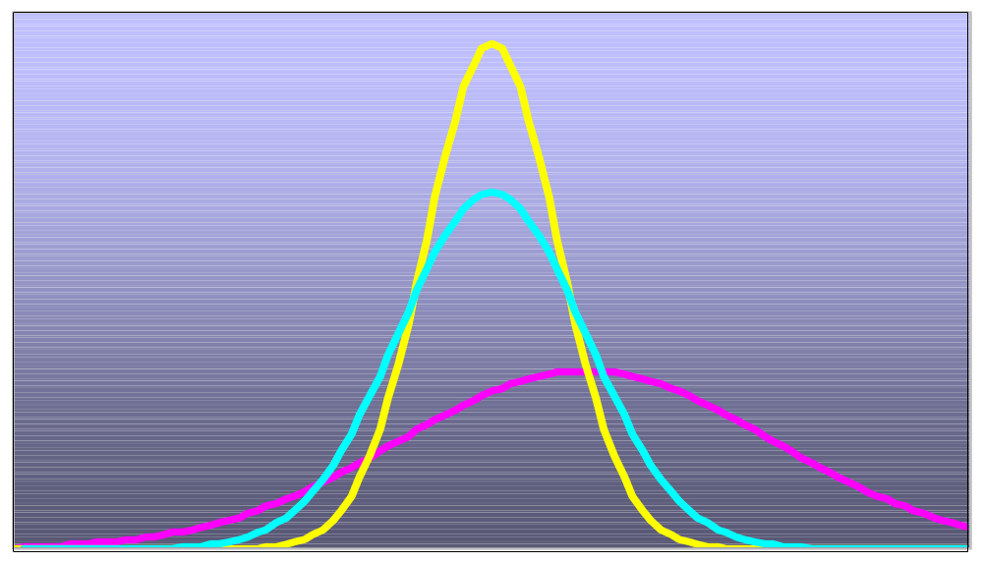
Many Normal Distributions
By varying the parameters μ and σ, we obtain different normal distributions
Business Statistics: A First Course, 5e © 2009 Prentice-Hall, Inc..
Chap 6-<number>

Slide 10
The Normal Distribution Shape
f(X)
Changing μ shifts the distribution left or right.
Changing σ increases or decreases the spread.
σ
μ
X
Business Statistics: A First Course, 5e © 2009 Prentice-Hall, Inc..
Chap 6-<number>

Slide 11
The Standardized Normal
Any normal distribution (with any mean and standard deviation combination) can be transformed into the standardized normal distribution (Z)
Need to transform X units into Z units
The standardized normal distribution (Z) has a mean of 0 and a standard deviation of 1
Business Statistics: A First Course, 5e © 2009 Prentice-Hall, Inc..
Chap 6-<number>

Slide 12
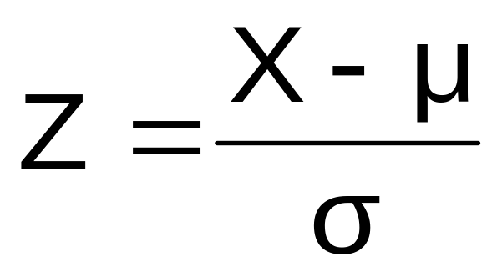
Translation to the Standardized Normal Distribution
Translate from X to the standardized normal (the “Z” distribution) by subtracting the mean of X and dividing by its standard deviation:
The Z distribution always has mean = 0 and standard deviation = 1
Business Statistics: A First Course, 5e © 2009 Prentice-Hall, Inc..
Chap 6-<number>

Slide 13
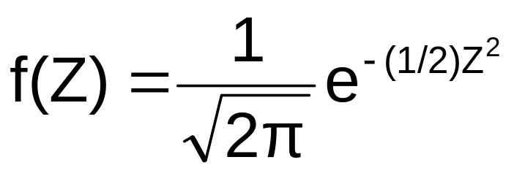
The Standardized Normal Probability Density Function
The formula for the standardized normal probability density function is
Where e = the mathematical constant approximated by 2.71828
π = the mathematical constant approximated by 3.14159
Z = any value of the standardized normal distribution
Business Statistics: A First Course, 5e © 2009 Prentice-Hall, Inc..
Chap 6-<number>

Slide 14
The Standardized
Normal Distribution
Also known as the “Z” distribution
Mean is 0
Standard Deviation is 1
f(Z)
1
Z
0
Values above the mean have positive Z-values, values below the mean have negative Z-values
Business Statistics: A First Course, 5e © 2009 Prentice-Hall, Inc..
Chap 6-<number>

Slide 15
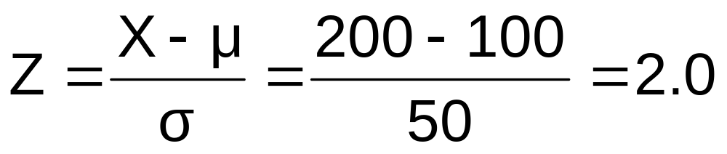
Example
If X is distributed normally with mean of 100 and standard deviation of 50, the Z value for X = 200 is
This says that X = 200 is two standard deviations (2 increments of 50 units) above the mean of 100.
Business Statistics: A First Course, 5e © 2009 Prentice-Hall, Inc..
Chap 6-<number>

Slide 16
Comparing X and Z units
100
200
X
(μ = 100, σ = 50)
0
2.0
Z
(μ = 0, σ = 1)
Note that the shape of the distribution is the same, only the scale has changed. We can express the problem in original units (X) or in standardized units (Z)
Business Statistics: A First Course, 5e © 2009 Prentice-Hall, Inc..
Chap 6-<number>

Slide 17
Probabilities
For a discrete random variable, we can talk about the possibility of a single occurrence, two occurrences, etc.
In contrast, for a continuous random variable, we can only talk about the probability of a range of values.
Business Statistics: A First Course, 5e © 2009 Prentice-Hall, Inc..
Chap 6-<number>

Slide 18
Finding Normal Probabilities
Probability is measured by the area under the curve
f(X)
P
(
≤
≤
)
a
X
b
=
P
(
<
<
)
a
X
b
(Note that the probability of any individual value is zero)
a
b
X
Business Statistics: A First Course, 5e © 2009 Prentice-Hall, Inc..
Chap 6-<number>

Slide 19


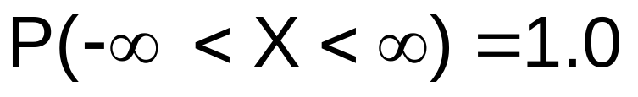
Probability as
Area Under the Curve
The total area under the curve is 1.0, and the curve is symmetric, so half is above the mean, half is below
f(X)
0.5
0.5
μ
X
Business Statistics: A First Course, 5e © 2009 Prentice-Hall, Inc..
Chap 6-<number>

Slide 20
The Standardized Normal Table
The Cumulative Standardized Normal table in the textbook (Appendix table E.2) gives the probability less than a desired value of Z (i.e., from negative infinity to Z)
0.9772
Example:
P(Z < 2.00) = 0.9772
0
2.00
Z
Business Statistics: A First Course, 5e © 2009 Prentice-Hall, Inc..
Chap 6-<number>

Slide 21
The Standardized Normal Table
(continued)
The column gives the value of Z to the second decimal point
Z 0.00 0.01 0.02 …
0.0
0.1
The row shows the value of Z to the first decimal point
.
.
.
The value within the table gives the probability from Z = − ∞ up to the desired Z value
2.0
.9772
P(Z < 2.00) = 0.9772
2.0
Business Statistics: A First Course, 5e © 2009 Prentice-Hall, Inc..
Chap 6-<number>

Slide 22
General Procedure for Finding Normal Probabilities
To find P(a < X < b) when X is distributed normally:
Draw the normal curve for the problem in
terms of X
Translate X-values to Z-values
Use the Standardized Normal Table
Business Statistics: A First Course, 5e © 2009 Prentice-Hall, Inc..
Chap 6-<number>

Slide 23
Finding Normal Probabilities
Let X represent the time it takes to download an image file from the internet.
Suppose X is normal with mean 8.0 and standard deviation 5.0. Find P(X < 8.6)
X
8.0
8.6
Business Statistics: A First Course, 5e © 2009 Prentice-Hall, Inc..
Chap 6-<number>

Slide 24
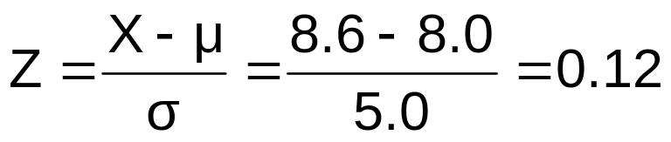
Finding Normal Probabilities
(continued)
Let X represent the time it takes to download an image file from the internet.
Suppose X is normal with mean 8.0 and standard deviation 5.0. Find P(X < 8.6)
μ = 8
σ = 10
μ = 0
σ = 1
8
8.6
X
0
0.12
Z
P(X < 8.6)
P(Z < 0.12)
Business Statistics: A First Course, 5e © 2009 Prentice-Hall, Inc..
Chap 6-<number>

Slide 25
Solution: Finding P(Z < 0.12)
Standardized Normal Probability
Table (Portion)
P(X < 8.6)
= P(Z < 0.12)
Z
.00
.01
.02
.5478
0.0
.5000
.5040
.5080
0.1
.5398
.5438
.5478
0.2
.5793
.5832
.5871
Z
0.3
.6179
.6217
.6255
0.00
0.12
Business Statistics: A First Course, 5e © 2009 Prentice-Hall, Inc..
Chap 6-<number>

Slide 26
Finding Normal
Upper Tail Probabilities
Suppose X is normal with mean 8.0 and standard deviation 5.0.
Now Find P(X > 8.6)
X
8.0
8.6
Business Statistics: A First Course, 5e © 2009 Prentice-Hall, Inc..
Chap 6-<number>

Slide 27
Finding Normal
Upper Tail Probabilities
(continued)
Now Find P(X > 8.6)…
P(X > 8.6) = P(Z > 0.12) = 1.0 - P(Z ≤ 0.12)
= 1.0 - 0.5478 = 0.4522
0.5478
1.000
1.0 - 0.5478 = 0.4522
Z
Z
0
0
0.12
0.12
Business Statistics: A First Course, 5e © 2009 Prentice-Hall, Inc..
Chap 6-<number>

Slide 28
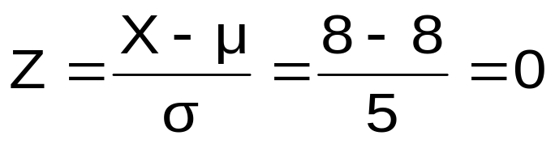
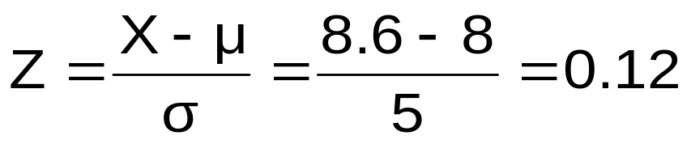
Finding a Normal Probability Between Two Values
Suppose X is normal with mean 8.0 and standard deviation 5.0. Find P(8 < X < 8.6)
Calculate Z-values:
8
8.6
X
0
0.12
Z
P(8 < X < 8.6)
= P(0 < Z < 0.12)
Business Statistics: A First Course, 5e © 2009 Prentice-Hall, Inc..
Chap 6-<number>

Slide 29
Solution: Finding P(0 < Z < 0.12)
P(8 < X < 8.6)
Standardized Normal Probability
Table (Portion)
= P(0 < Z < 0.12)
= P(Z < 0.12) – P(Z ≤ 0)
Z
.00
.01
.02
= 0.5478 - .5000 = 0.0478
0.0
.5000
.5040
.5080
0.0478
0.5000
0.1
.5398
.5438
.5478
0.2
.5793
.5832
.5871
0.3
.6179
.6217
.6255
Z
0.00
0.12
Business Statistics: A First Course, 5e © 2009 Prentice-Hall, Inc..
Chap 6-<number>

Slide 30
Probabilities in the Lower Tail
Suppose X is normal with mean 8.0 and standard deviation 5.0.
Now Find P(7.4 < X < 8)
X
8.0
7.4
Business Statistics: A First Course, 5e © 2009 Prentice-Hall, Inc..
Chap 6-<number>

Slide 31
Probabilities in the Lower Tail
(continued)
Now Find P(7.4 < X < 8)…
P(7.4 < X < 8)
= P(-0.12 < Z < 0)
= P(Z < 0) – P(Z ≤ -0.12)
= 0.5000 - 0.4522 = 0.0478
0.0478
0.4522
The Normal distribution is symmetric, so this probability is the same as P(0 < Z < 0.12)
7.4
8.0
X
-0.12
0
Z
Business Statistics: A First Course, 5e © 2009 Prentice-Hall, Inc..
Chap 6-<number>

Slide 32
Empirical Rules
What can we say about the distribution of values around the mean? For any normal distribution:
f(X)
μ ± 1σ encloses about 68.26% of X’s
σ
σ
X
μ-1σ
μ
μ+1σ
68.26%
Business Statistics: A First Course, 5e © 2009 Prentice-Hall, Inc..
Chap 6-<number>

Slide 33
The Empirical Rule
(continued)
μ ± 2σ covers about 95% of X’s
μ ± 3σ covers about 99.7% of X’s
2σ
2σ
3σ
3σ
μ
x
μ
x
95.44%
99.73%
Business Statistics: A First Course, 5e © 2009 Prentice-Hall, Inc..
Chap 6-<number>

Slide 34
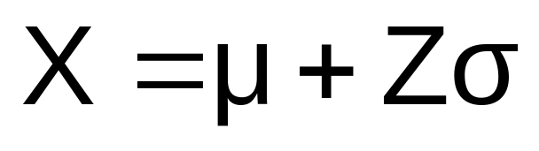
Given a Normal Probability
Find the X Value
Steps to find the X value for a known probability:
1. Find the Z value for the known probability
2. Convert to X units using the formula:
Business Statistics: A First Course, 5e © 2009 Prentice-Hall, Inc..
Chap 6-<number>

Slide 35
Finding the X value for a Known Probability
(continued)
Example:
Let X represent the time it takes (in seconds) to download an image file from the internet.
Suppose X is normal with mean 8.0 and standard deviation 5.0
Find X such that 20% of download times are less than X.
0.2000
?
8.0
X
?
0
Z
Business Statistics: A First Course, 5e © 2009 Prentice-Hall, Inc..
Chap 6-<number>

Slide 36
Find the Z value for
20% in the Lower Tail
1. Find the Z value for the known probability
Standardized Normal Probability
Table (Portion)
20% area in the lower tail is consistent with a Z value of -0.84
Z
…
.03
.04
.05
-0.9
…
.1762
.1736
.1711
0.2000
-0.8
…
.2033
.2005
.1977
-0.7
…
.2327
.2296
.2266
?
8.0
X
-0.84
0
Z
Business Statistics: A First Course, 5e © 2009 Prentice-Hall, Inc..
Chap 6-<number>

Slide 37
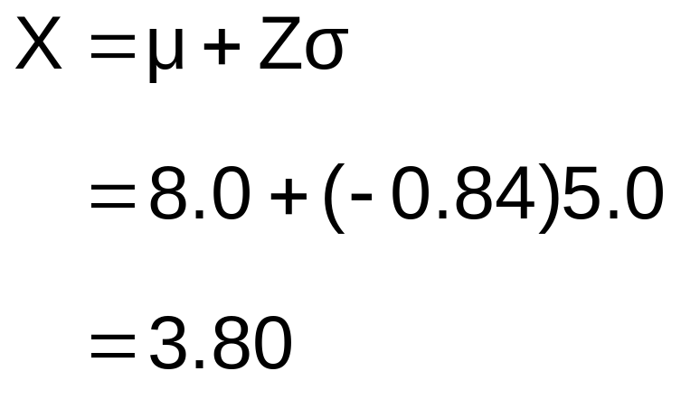
Finding the X value
2. Convert to X units using the formula:
So 20% of the values from a distribution with mean 8.0 and standard deviation 5.0 are less than 3.80
Business Statistics: A First Course, 5e © 2009 Prentice-Hall, Inc..
Chap 6-<number>

Slide 38
Evaluating Normality
Not all continuous distributions are normal
It is important to evaluate how well the data set is approximated by a normal distribution.
Normally distributed data should approximate the theoretical normal distribution:
  The normal distribution is bell shaped (symmetrical) where the mean is equal to the median.
  The empirical rule applies to the normal distribution.
  The interquartile range of a normal distribution is 1.33 standard deviations.
Business Statistics: A First Course, 5e © 2009 Prentice-Hall, Inc..
Chap 6-<number>

Slide 39
Evaluating Normality
(continued)
Comparing data characteristics to theoretical properties
Construct charts or graphs
  For small- or moderate-sized data sets, construct a stem-and-leaf display or a boxplot to check for symmetry
  For large data sets, does the histogram or polygon appear bell-shaped?
Compute descriptive summary measures
  Do the mean, median and mode have similar values?
  Is the interquartile range approximately 1.33 σ?
  Is the range approximately 6 σ?
Business Statistics: A First Course, 5e © 2009 Prentice-Hall, Inc..
Chap 6-<number>

Slide 40
Evaluating Normality
(continued)
Comparing data characteristics to theoretical properties
Observe the distribution of the data set
  Do approximately 2/3 of the observations lie within mean ±1 standard deviation?
  Do approximately 80% of the observations lie within mean ±1.28 standard deviations?
  Do approximately 95% of the observations lie within mean ±2 standard deviations?
Evaluate normal probability plot
  Is the normal probability plot approximately linear (i.e. a straight line) with positive slope?
Business Statistics: A First Course, 5e © 2009 Prentice-Hall, Inc..
Chap 6-<number>

Slide 41
Constructing
A Normal Probability Plot
Normal probability plot
  Arrange data into ordered array
  Find corresponding standardized normal quantile values (Z)
  Plot the pairs of points with observed data values (X) on the vertical axis and the standardized normal quantile values (Z) on the horizontal axis
  Evaluate the plot for evidence of linearity
Business Statistics: A First Course, 5e © 2009 Prentice-Hall, Inc..
Chap 6-<number>

Slide 42
The Normal Probability Plot
Interpretation
A normal probability plot for data from a normal distribution will be approximately linear:
X
90
60
30
-2
-1
0
1
2
Z
Business Statistics: A First Course, 5e © 2009 Prentice-Hall, Inc..
Chap 6-<number>

Slide 43
Normal Probability Plot
Interpretation
(continued)
Left-Skewed
Right-Skewed
X
90
X
90
60
60
30
30
-2
-1
0
1
2
Z
-2
-1
0
1
2
Z
Rectangular
Nonlinear plots indicate a deviation from normality
X
90
60
30
-2
-1
0
1
2
Z
Business Statistics: A First Course, 5e © 2009 Prentice-Hall, Inc..
Chap 6-<number>

Slide 44
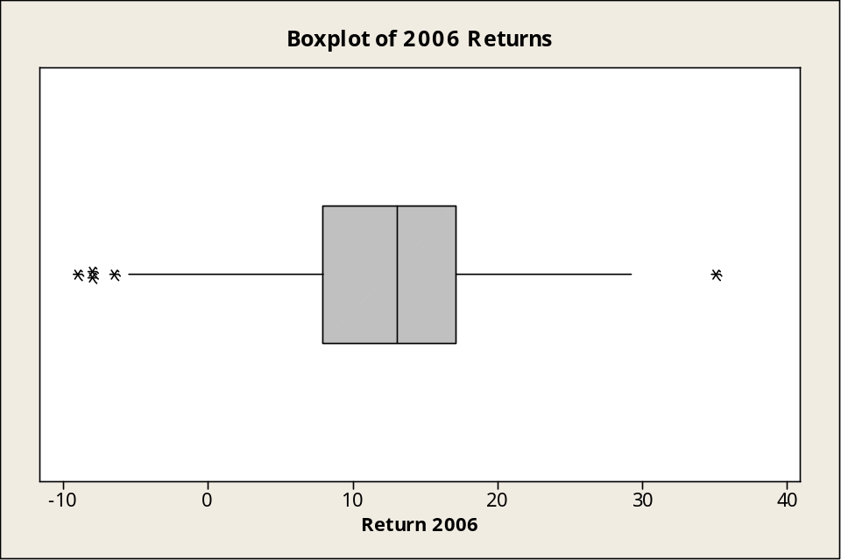
Evaluating Normality
An Example: Mutual Funds Returns
The boxplot appears reasonably symmetric, with four lower outliers at -9.0, -8.0, -8.0, -6.5 and one upper outlier at 35.0. (The normal distribution is symmetric.)
Business Statistics: A First Course, 5e © 2009 Prentice-Hall, Inc..
Chap 6-<number>

Slide 45
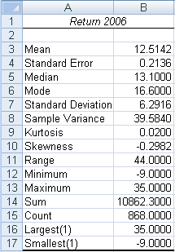
Evaluating Normality
An Example: Mutual Funds Returns
(continued)
Descriptive Statistics
The mean (12.5142) is slightly less than the median (13.1). (In a normal distribution the mean and median are equal.)
The interquartile range of 9.2 is approximately 1.46 standard deviations. (In a normal distribution the interquartile range is 1.33 standard deviations.)
The range of 44 is equal to 6.99 standard deviations. (In a normal distribution the range is 6 standard deviations.)
72.2% of the observations are within 1 standard deviation of the mean. (In a normal distribution this percentage is 68.26%.
87% of the observations are within 1.28 standard deviations of the mean. (In a normal distribution percentage is 80%.)
Business Statistics: A First Course, 5e © 2009 Prentice-Hall, Inc..
Chap 6-<number>

Slide 46
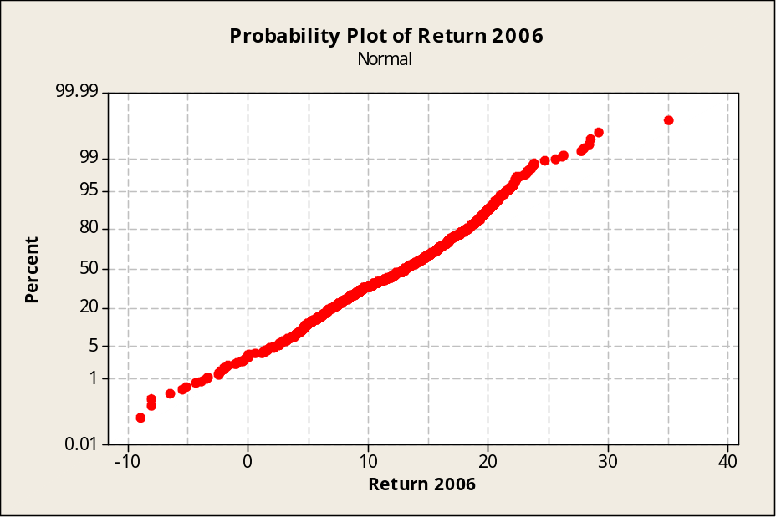
Evaluating Normality
An Example: Mutual Funds Returns
(continued)
Plot is approximately a straight line except for a few outliers at the low end and the high end.
Business Statistics: A First Course, 5e © 2009 Prentice-Hall, Inc..
Chap 6-<number>

Slide 47
Evaluating Normality
An Example: Mutual Funds Returns
(continued)
Conclusions
  The returns are slightly left-skewed
  The returns have more values concentrated around the mean than expected
  The range is larger than expected (caused by one outlier at 35.0)
  Normal probability plot is reasonably straight line
  Overall, this data set does not greatly differ from the theoretical properties of the normal distribution
Business Statistics: A First Course, 5e © 2009 Prentice-Hall, Inc..
Chap 6-<number>

Slide 48
Chapter Summary
Presented normal distribution
Found probabilities for the normal distribution
Applied normal distribution to problems
Showed how to assess whether or not a distribution is normal
Business Statistics: A First Course, 5e © 2009 Prentice-Hall, Inc..
Chap 6-<number>

