Slide 1
Basic Business Statistics
11th Edition
Chapter 8
Confidence Interval Estimation
Basic Business Statistics, 11e © 2009 Prentice-Hall, Inc.
Chap 8-<number>

Slide 2
Learning Objectives
In this chapter, you learn:
To construct and interpret confidence interval estimates for the mean and the proportion
How to determine the sample size necessary to develop a confidence interval for the mean or proportion
How to use confidence interval estimates in auditing
Basic Business Statistics, 11e © 2009 Prentice-Hall, Inc..
Chap 8-<number>

Slide 3
Chapter Outline
Content of this chapter
Confidence Intervals for the Population Mean, μ
  when Population Standard Deviation σ is Known
  when Population Standard Deviation σ is Unknown
Confidence Intervals for the Population Proportion, π
Determining the Required Sample Size
Basic Business Statistics, 11e © 2009 Prentice-Hall, Inc..
Chap 8-<number>

Slide 4
Point and Interval Estimates
A point estimate is a single number,
a confidence interval provides additional information about the variability of the estimate
Lower
Confidence
Limit
Upper
Confidence
Limit
Point Estimate
Width of
confidence interval
Basic Business Statistics, 11e © 2009 Prentice-Hall, Inc..
Chap 8-<number>

Slide 5
Point Estimates
We can estimate a
Population Parameter …
with a Sample
Statistic
(a Point Estimate)
Mean
μ
X
Proportion
π
p
Basic Business Statistics, 11e © 2009 Prentice-Hall, Inc..
Chap 8-<number>

Slide 6
Confidence Intervals
How much uncertainty is associated with a point estimate of a population parameter?
An interval estimate provides more information about a population characteristic than does a point estimate
Such interval estimates are called confidence intervals
Basic Business Statistics, 11e © 2009 Prentice-Hall, Inc..
Chap 8-<number>

Slide 7
Confidence Interval Estimate
An interval gives a range of values:
  Takes into consideration variation in sample statistics from sample to sample
  Based on observations from 1 sample
  Gives information about closeness to unknown population parameters
  Stated in terms of level of confidence
    e.g. 95% confident, 99% confident
    Can never be 100% confident
Basic Business Statistics, 11e © 2009 Prentice-Hall, Inc..
Chap 8-<number>

Slide 8

Confidence Interval Example
Cereal fill example
Population has µ = 368 and σ = 15.
If you take a sample of size n = 25 you know
  368 ± 1.96 * 15 / = (362.12, 373.88) contains 95% of the sample means
  When you don’t know µ, you use X to estimate µ
    If X = 362.3 the interval is 362.3 ± 1.96 * 15 / = (356.42, 368.18)
    Since 356.42 ≤ µ ≤ 368.18 the interval based on this sample makes a correct statement about µ.
But what about the intervals from other possible samples of size 25?
Basic Business Statistics, 11e © 2009 Prentice-Hall, Inc..
Chap 8-<number>

Slide 9
Confidence Interval Example
(continued)
Sample # | X | Lower Limit | Upper Limit | Contain µ?
1 | 362.30 | 356.42 | 368.18 | Yes
2 | 369.50 | 363.62 | 375.38 | Yes
3 | 360.00 | 354.12 | 365.88 | No
4 | 362.12 | 356.24 | 368.00 | Yes
5 | 373.88 | 368.00 | 379.76 | Yes
Basic Business Statistics, 11e © 2009 Prentice-Hall, Inc..
Chap 8-<number>

Slide 10
Confidence Interval Example
(continued)
In practice you only take one sample of size n
In practice you do not know µ so you do not know if the interval actually contains µ
However you do know that 95% of the intervals formed in this manner will contain µ
Thus, based on the one sample, you actually selected you can be 95% confident your interval will contain µ (this is a 95% confidence interval)
Note: 95% confidence is based on the fact that we used Z = 1.96.
Basic Business Statistics, 11e © 2009 Prentice-Hall, Inc..
Chap 8-<number>

Slide 11
Estimation Process
Random Sample
I am 95% confident that μ is between 40 & 60.
Population
Mean
X = 50
(mean, μ, is unknown)
Sample
Basic Business Statistics, 11e © 2009 Prentice-Hall, Inc..
Chap 8-<number>

Slide 12
General Formula
The general formula for all confidence intervals is:
Point Estimate ± (Critical Value)(Standard Error)
Where:
    Point Estimate is the sample statistic estimating the population parameter of interest
    Critical Value is a table value based on the sampling distribution of the point estimate and the desired confidence level
    Standard Error is the standard deviation of the point estimate
Wh
Basic Business Statistics, 11e © 2009 Prentice-Hall, Inc..
Chap 8-<number>

Slide 13
Confidence Level
Confidence Level
  Confidence the interval will contain the unknown population parameter
  A percentage (less than 100%)
Basic Business Statistics, 11e © 2009 Prentice-Hall, Inc..
Chap 8-<number>

Slide 14
Confidence Level, (1-α)
(continued)
Suppose confidence level = 95%
Also written (1 - α) = 0.95, (so α = 0.05)
A relative frequency interpretation:
  95% of all the confidence intervals that can be constructed will contain the unknown true parameter
A specific interval either will contain or will not contain the true parameter
  No probability involved in a specific interval
Basic Business Statistics, 11e © 2009 Prentice-Hall, Inc..
Chap 8-<number>

Slide 15
Confidence Intervals
Confidence
Intervals
Population
Mean
Population
Proportion
σ Known
σ Unknown
Basic Business Statistics, 11e © 2009 Prentice-Hall, Inc..
Chap 8-<number>

Slide 16
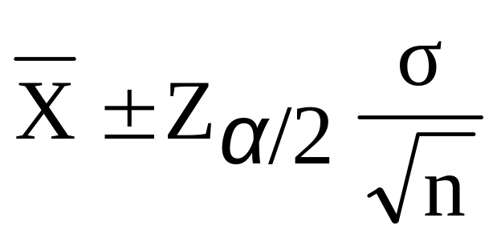


Confidence Interval for μ
(σ Known)
Assumptions
  Population standard deviation σ is known
  Population is normally distributed
  If population is not normal, use large sample
Confidence interval estimate:
where is the point estimate
Z_{α/2} is the normal distribution critical value for a probability of α/2 in each tail
is the standard error
Basic Business Statistics, 11e © 2009 Prentice-Hall, Inc..
Chap 8-<number>

Slide 17
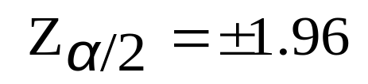

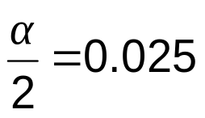
Finding the Critical Value, Z_{α/2}
Consider a 95% confidence interval:
Z units:
Z_{α/2} = -1.96
0
Z_{α/2} = 1.96
X units:
Lower
Confidence
Limit
Upper
Confidence
Limit
Point Estimate
Point Estimate
Basic Business Statistics, 11e © 2009 Prentice-Hall, Inc..
Chap 8-<number>

Slide 18

Common Levels of Confidence
Commonly used confidence levels are 90%, 95%, and 99%
Confidence Coefficient,
Confidence Level
Z_{α/2} value
80%
90%
95%
98%
99%
99.8%
99.9%
0.80
0.90
0.95
0.98
0.99
0.998
0.999
1.28
1.645
1.96
2.33
2.58
3.08
3.27
Basic Business Statistics, 11e © 2009 Prentice-Hall, Inc..
Chap 8-<number>

Slide 19



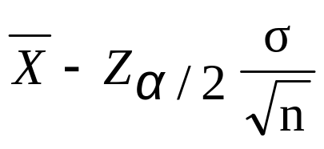
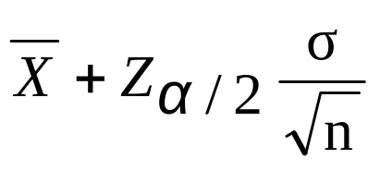
Intervals and Level of Confidence
Sampling Distribution of the Mean
x
Intervals extend from
to
x₁
x₂
(1-α)x100%
of intervals constructed contain μ;
(α)x100% do not.
Confidence Intervals
Basic Business Statistics, 11e © 2009 Prentice-Hall, Inc..
Chap 8-<number>

Slide 20

Example
A sample of 11 circuits from a large normal population has a mean resistance of 2.20 ohms. We know from past testing that the population standard deviation is 0.35 ohms.
Determine a 95% confidence interval for the true mean resistance of the population.
Basic Business Statistics, 11e © 2009 Prentice-Hall, Inc..
Chap 8-<number>

Slide 21
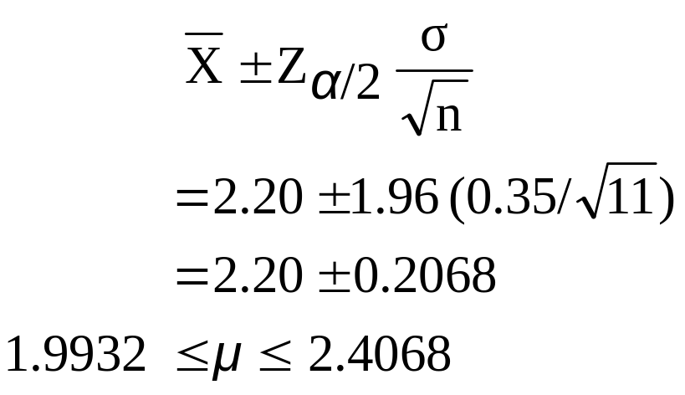

Example
(continued)
A sample of 11 circuits from a large normal population has a mean resistance of 2.20 ohms. We know from past testing that the population standard deviation is 0.35 ohms.
Solution:
Basic Business Statistics, 11e © 2009 Prentice-Hall, Inc..
Chap 8-<number>

Slide 22
Interpretation
We are 95% confident that the true mean resistance is between 1.9932 and 2.4068 ohms
Although the true mean may or may not be in this interval, 95% of intervals formed in this manner will contain the true mean
Basic Business Statistics, 11e © 2009 Prentice-Hall, Inc..
Chap 8-<number>

Slide 23
Confidence Intervals
Confidence
Intervals
Population
Mean
Population
Proportion
σ Known
σ Unknown
Basic Business Statistics, 11e © 2009 Prentice-Hall, Inc..
Chap 8-<number>

Slide 24
Do You Ever Truly Know σ?
Probably not!
In virtually all real world business situations, σ is not known.
If there is a situation where σ is known then µ is also known (since to calculate σ you need to know µ.)
If you truly know µ there would be no need to gather a sample to estimate it.
Basic Business Statistics, 11e © 2009 Prentice-Hall, Inc..
Chap 8-<number>

Slide 25
Confidence Interval for μ
(σ Unknown)
If the population standard deviation σ is unknown, we can substitute the sample standard deviation, S
This introduces extra uncertainty, since S is variable from sample to sample
So we use the t distribution instead of the normal distribution
Basic Business Statistics, 11e © 2009 Prentice-Hall, Inc..
Chap 8-<number>

Slide 26
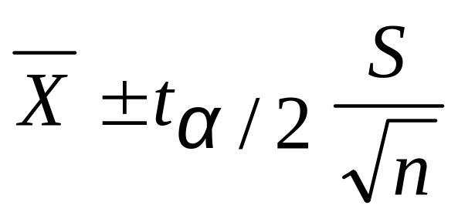
Confidence Interval for μ
(σ Unknown)
(continued)
Assumptions
  Population standard deviation is unknown
  Population is normally distributed
  If population is not normal, use large sample
Use Student’s t Distribution
Confidence Interval Estimate:
(where t_{α/2} is the critical value of the t distribution with n -1 degrees of freedom and an area of α/2 in each tail)
Basic Business Statistics, 11e © 2009 Prentice-Hall, Inc..
Chap 8-<number>

Slide 27
Student’s t Distribution
The t is a family of distributions
The t_{α/2} value depends on degrees of freedom (d.f.)
  Number of observations that are free to vary after sample mean has been calculated
d.f. = n - 1
Basic Business Statistics, 11e © 2009 Prentice-Hall, Inc..
Chap 8-<number>

Slide 28
Degrees of Freedom (df)
  Idea: Number of observations that are free to vary
  after sample mean has been calculated
  Example: Suppose the mean of 3 numbers is 8.0
    Let X₁ = 7
    Let X₂ = 8
    What is X₃?
If the mean of these three values is 8.0,
then X₃ must be 9
(i.e., X₃ is not free to vary)
Here, n = 3, so degrees of freedom = n – 1 = 3 – 1 = 2
(2 values can be any numbers, but the third is not free to vary for a given mean)
Basic Business Statistics, 11e © 2009 Prentice-Hall, Inc..
Chap 8-<number>

Slide 29
Student’s t Distribution
Note: t Z as n increases
Standard Normal
(t with df = ∞)
t (df = 13)
t-distributions are bell-shaped and symmetric, but have ‘fatter’ tails than the normal
t (df = 5)
t
0
Basic Business Statistics, 11e © 2009 Prentice-Hall, Inc..
Chap 8-<number>

Slide 30
Student’s t Table
Upper Tail Area
Let: n = 3
df = n - 1 = 2
α = 0.10
α/2 = 0.05
df
.25
.10
.05
1
1.000
3.078
6.314
2
0.817
1.886
2.920
3
0.765
1.638
2.353
α/2 = 0.05
The body of the table contains t values, not probabilities
0
2.920
t
Basic Business Statistics, 11e © 2009 Prentice-Hall, Inc..
Chap 8-<number>

Slide 31
Selected t distribution values
With comparison to the Z value
Confidence t t t Z
Level (10 d.f.) (20 d.f.) (30 d.f.) (∞ d.f.)
0.80 1.372 1.325 1.310 1.28
0.90 1.812 1.725 1.697 1.645
0.95 2.228 2.086 2.042 1.96
0.99 3.169 2.845 2.750 2.58
Note: t Z as n increases
Basic Business Statistics, 11e © 2009 Prentice-Hall, Inc..
Chap 8-<number>

Slide 32
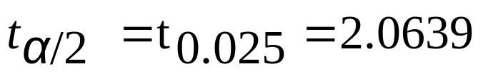
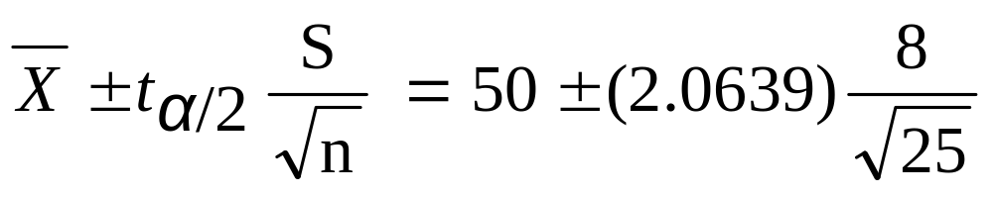
Example of t distribution confidence interval
A random sample of n = 25 has X = 50 and
S = 8. Form a 95% confidence interval for μ
  d.f. = n – 1 = 24, so
  The confidence interval is
46.698 ≤ μ ≤ 53.302
Basic Business Statistics, 11e © 2009 Prentice-Hall, Inc..
Chap 8-<number>

Slide 33
Example of t distribution confidence interval
(continued)
Interpreting this interval requires the assumption that the population you are sampling from is approximately a normal distribution (especially since n is only 25).
This condition can be checked by creating a:
  Normal probability plot or
  Boxplot
Basic Business Statistics, 11e © 2009 Prentice-Hall, Inc..
Chap 8-<number>

Slide 34
Confidence Intervals
Confidence
Intervals
Population
Mean
Population
Proportion
σ Known
σ Unknown
Basic Business Statistics, 11e © 2009 Prentice-Hall, Inc..
Chap 8-<number>

Slide 35
Confidence Intervals for the
Population Proportion, π
An interval estimate for the population proportion ( π ) can be calculated by adding an allowance for uncertainty to the sample proportion ( p )
Basic Business Statistics, 11e © 2009 Prentice-Hall, Inc..
Chap 8-<number>

Slide 36
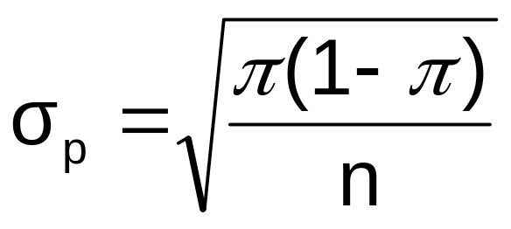
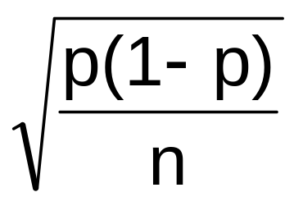
Confidence Intervals for the
Population Proportion, π
(continued)
Recall that the distribution of the sample proportion is approximately normal if the sample size is large, with standard deviation
We will estimate this with sample data:
Basic Business Statistics, 11e © 2009 Prentice-Hall, Inc..
Chap 8-<number>

Slide 37
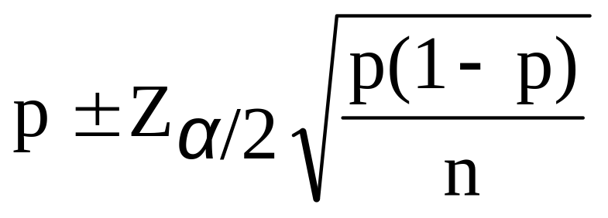
Confidence Interval Endpoints
Upper and lower confidence limits for the population proportion are calculated with the formula
where
  Z_{α/2} is the standard normal value for the level of confidence desired
  p is the sample proportion
  n is the sample size
Note: must have np > 5 and n(1-p) > 5
Basic Business Statistics, 11e © 2009 Prentice-Hall, Inc..
Chap 8-<number>

Slide 38

Example
A random sample of 100 people shows that 25 are left-handed.
Form a 95% confidence interval for the true proportion of left-handers
Basic Business Statistics, 11e © 2009 Prentice-Hall, Inc..
Chap 8-<number>

Slide 39
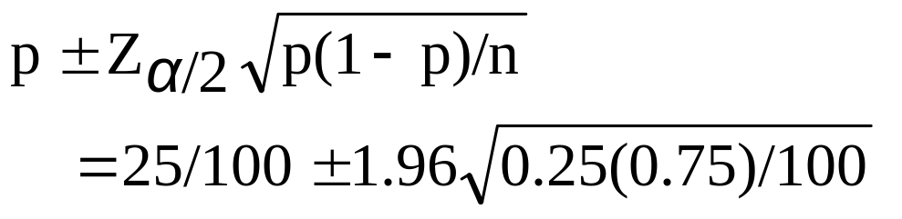
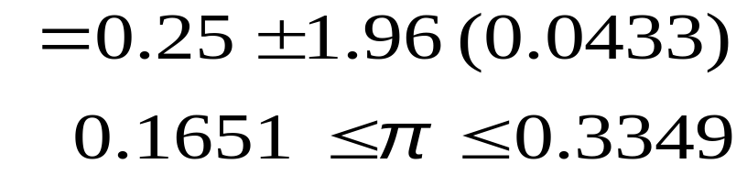
Example
(continued)
A random sample of 100 people shows that 25 are left-handed. Form a 95% confidence interval for the true proportion of left-handers.
Basic Business Statistics, 11e © 2009 Prentice-Hall, Inc..
Chap 8-<number>

Slide 40
Interpretation
We are 95% confident that the true percentage of left-handers in the population is between
16.51% and 33.49%.
Although the interval from 0.1651 to 0.3349 may or may not contain the true proportion, 95% of intervals formed from samples of size 100 in this manner will contain the true proportion.
Basic Business Statistics, 11e © 2009 Prentice-Hall, Inc..
Chap 8-<number>

Slide 41
Determining Sample Size
Determining
Sample Size
For the
Mean
For the
Proportion
Basic Business Statistics, 11e © 2009 Prentice-Hall, Inc..
Chap 8-<number>

Slide 42
Sampling Error
The required sample size can be found to reach a desired margin of error (e) with a specified level of confidence (1 - α)
The margin of error is also called sampling error
  the amount of imprecision in the estimate of the population parameter
  the amount added and subtracted to the point estimate to form the confidence interval
Basic Business Statistics, 11e © 2009 Prentice-Hall, Inc..
Chap 8-<number>

Slide 43
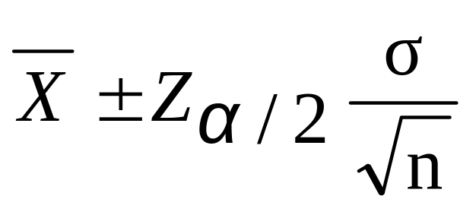
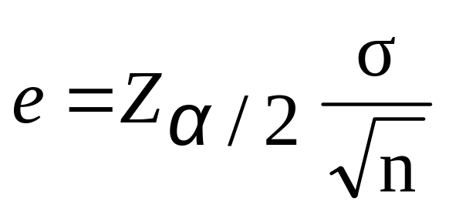


Determining Sample Size
Determining
Sample Size
For the
Mean
Sampling error (margin of error)
Basic Business Statistics, 11e © 2009 Prentice-Hall, Inc..
Chap 8-<number>

Slide 44
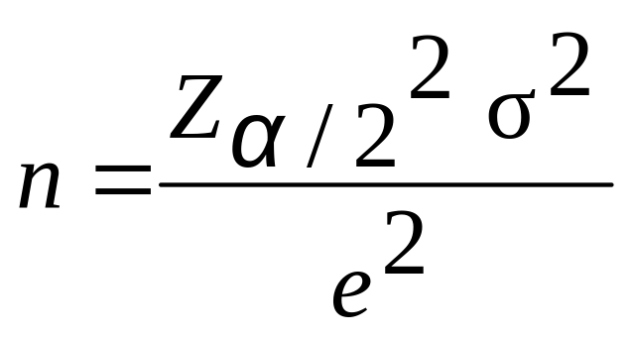
Determining Sample Size
(continued)
Determining
Sample Size
For the
Mean
Now solve for n to get
Basic Business Statistics, 11e © 2009 Prentice-Hall, Inc..
Chap 8-<number>

Slide 45
Determining Sample Size
(continued)
To determine the required sample size for the mean, you must know:
  The desired level of confidence (1 - α), which determines the critical value, Z_{α/2}
  The acceptable sampling error, e
  The standard deviation, σ
Basic Business Statistics, 11e © 2009 Prentice-Hall, Inc..
Chap 8-<number>

Slide 46
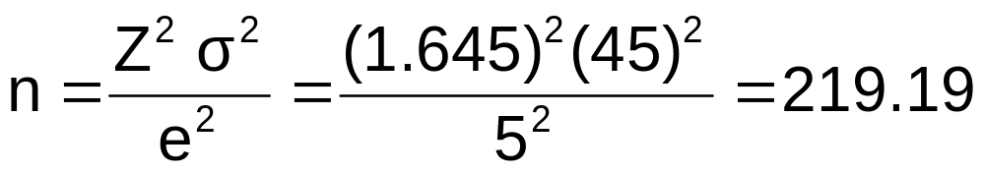
Required Sample Size Example
If σ = 45, what sample size is needed to estimate the mean within ± 5 with 90% confidence?
So the required sample size is n = 220
(Always round up)
Basic Business Statistics, 11e © 2009 Prentice-Hall, Inc..
Chap 8-<number>

Slide 47
If σ is unknown
If unknown, σ can be estimated when using the required sample size formula
  Use a value for σ that is expected to be at least as large as the true σ
  Select a pilot sample and estimate σ with the sample standard deviation, S
Basic Business Statistics, 11e © 2009 Prentice-Hall, Inc..
Chap 8-<number>

Slide 48
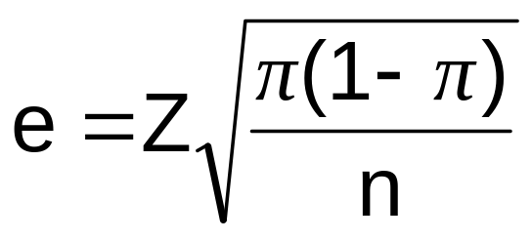
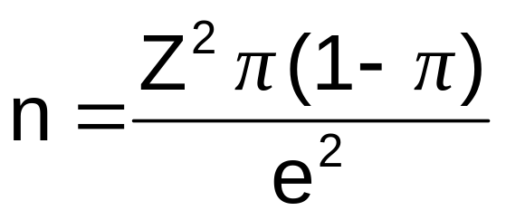
Determining Sample Size
(continued)
Determining
Sample Size
For the
Proportion
Now solve for n to get
Basic Business Statistics, 11e © 2009 Prentice-Hall, Inc..
Chap 8-<number>

Slide 49
Determining Sample Size
(continued)
To determine the required sample size for the proportion, you must know:
  The desired level of confidence (1 - α), which determines the critical value, Z_{α/2}
  The acceptable sampling error, e
  The true proportion of events of interest, π
    π can be estimated with a pilot sample if necessary (or conservatively use 0.5 as an estimate of π)
Basic Business Statistics, 11e © 2009 Prentice-Hall, Inc..
Chap 8-<number>

Slide 50
Required Sample Size Example
How large a sample would be necessary to estimate the true proportion defective in a large population within ±3%, with 95% confidence?
(Assume a pilot sample yields p = 0.12)
Basic Business Statistics, 11e © 2009 Prentice-Hall, Inc..
Chap 8-<number>

Slide 51
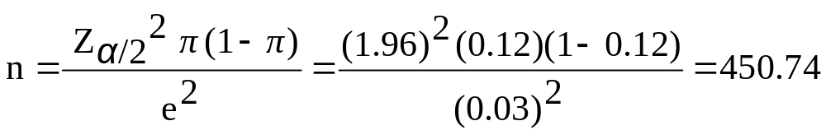
Required Sample Size Example
(continued)
Solution:
For 95% confidence, use Z_{α/2} = 1.96
e = 0.03
p = 0.12, so use this to estimate π
So use n = 451
Basic Business Statistics, 11e © 2009 Prentice-Hall, Inc..
Chap 8-<number>

Slide 52
Applications in Auditing
Six advantages of statistical sampling in auditing
  Sampling is less time consuming and less costly
  Sampling provides an objective way to calculate the sample size in advance
  Sampling provides results that are objective and defensible.
    Because the sample size is based on demonstrable statistical principles, the audit is defensible before one’s superiors and in a court of law.
Basic Business Statistics, 11e © 2009 Prentice-Hall, Inc..
Chap 8-<number>

Slide 53
Applications in Auditing
(continued)
  Sampling provides an estimate of the sampling error
    Allows auditors to generalize their findings to the population with a known sampling error.
    Can provide more accurate conclusions about the population
  Sampling isoften more accurate for drawing conclusions about large populations.
    Examining every item in a large population is subject to significant non-sampling error
  Sampling allows auditors to combine, and then evaluate collectively, samples collected by different individuals.
Basic Business Statistics, 11e © 2009 Prentice-Hall, Inc..
Chap 8-<number>

Slide 54
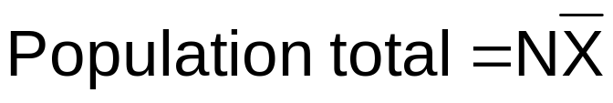
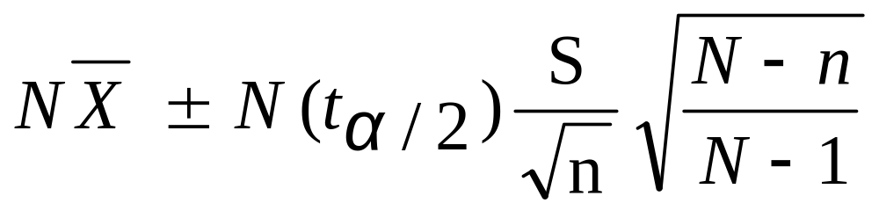
Confidence Interval for Population Total Amount
Point estimate for a population of size N:
Confidence interval estimate:
(This is sampling without replacement, so use the finite population correction in the confidence interval formula)
Basic Business Statistics, 11e © 2009 Prentice-Hall, Inc..
Chap 8-<number>

Slide 55
Confidence Interval for Population Total: Example
A firm has a population of 1000 accounts and wishes to estimate the total population value.
A sample of 80 accounts is selected with average balance of $87.6 and standard deviation of $22.3.
Find the 95% confidence interval estimate of the total balance.
Basic Business Statistics, 11e © 2009 Prentice-Hall, Inc..
Chap 8-<number>

Slide 56
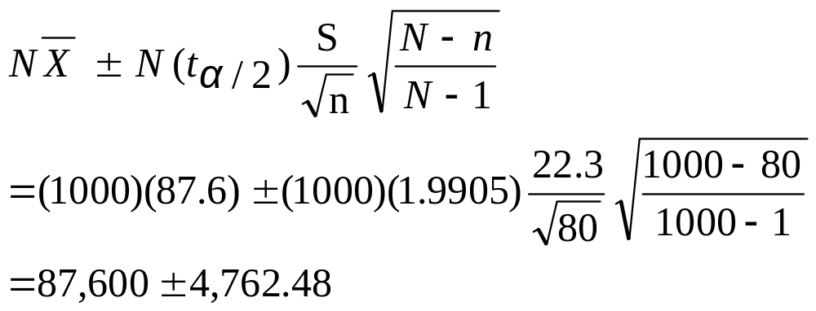
Example Solution
The 95% confidence interval for the population total balance is $82,837.52 to $92,362.48
Basic Business Statistics, 11e © 2009 Prentice-Hall, Inc..
Chap 8-<number>

Slide 57

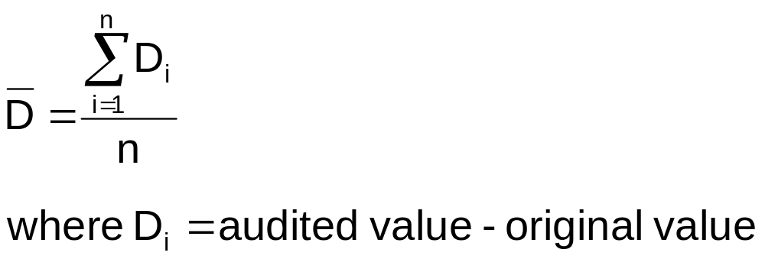
Confidence Interval for
Total Difference
Point estimate for a population of size N:
Where the average difference, D, is:
Basic Business Statistics, 11e © 2009 Prentice-Hall, Inc..
Chap 8-<number>

Slide 58
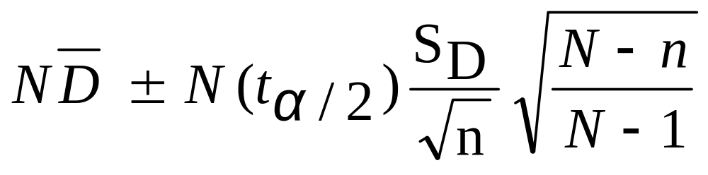
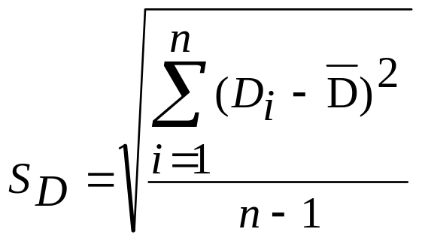
Confidence Interval for
Total Difference
(continued)
Confidence interval estimate:
where
Basic Business Statistics, 11e © 2009 Prentice-Hall, Inc..
Chap 8-<number>

Slide 59
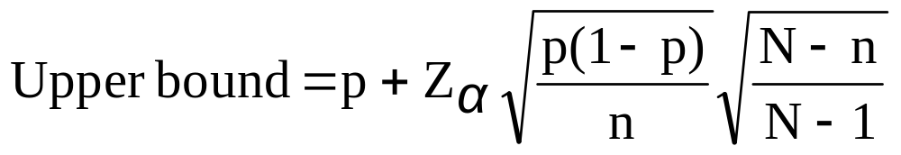
One-Sided Confidence Intervals
Application: find the upper bound for the proportion of items that do not conform with internal controls
where
  Z_{α} is the standard normal value for the level of confidence desired
  p is the sample proportion of items that do not conform
  n is the sample size
  N is the population size
Basic Business Statistics, 11e © 2009 Prentice-Hall, Inc..
Chap 8-<number>

Slide 60
Ethical Issues
A confidence interval estimate (reflecting sampling error) should always be included when reporting a point estimate
The level of confidence should always be reported
The sample size should be reported
An interpretation of the confidence interval estimate should also be provided
Basic Business Statistics, 11e © 2009 Prentice-Hall, Inc..
Chap 8-<number>

Slide 61
Chapter Summary
Introduced the concept of confidence intervals
Discussed point estimates
Developed confidence interval estimates
Created confidence interval estimates for the mean (σ known)
Determined confidence interval estimates for the mean (σ unknown)
Created confidence interval estimates for the proportion
Determined required sample size for mean and proportion settings
Basic Business Statistics, 11e © 2009 Prentice-Hall, Inc..
Chap 8-<number>

Slide 62
Chapter Summary
(continued)
Developed applications of confidence interval estimation in auditing
  Confidence interval estimation for population total
  Confidence interval estimation for total difference in the population
  One-sided confidence intervals for the proportion nonconforming
Addressed confidence interval estimation and ethical issues
Basic Business Statistics, 11e © 2009 Prentice-Hall, Inc..
Chap 8-<number>

