Slide 1
Basic Business Statistics
11th Edition
Chapter 11
Analysis of Variance
Basic Business Statistics, 11e © 2009 Prentice-Hall, Inc.
Chap 11-<number>

Slide 2
Learning Objectives
In this chapter, you learn:
The basic concepts of experimental design
How to use one-way analysis of variance to test for differences among the means of several populations (also referred to as “groups” in this chapter)
When to use a randomized block design
How to use two-way analysis of variance and interpret the interaction effect
How to perform multiple comparisons in a one-way analysis of variance, a two-way analysis of variance, and a randomized block design
Basic Business Statistics, 11e © 2009 Prentice-Hall, Inc..
Chap 11-<number>

Slide 3
Chapter Overview
Analysis of Variance (ANOVA)
One-Way
ANOVA
Randomized
Block Design
Two-Way
ANOVA
F-test
Tukey Multiple
Comparisons
Interaction
Effects
Tukey-
Kramer
Multiple
Comparisons
Tukey Multiple
Comparisons
Levene Test
For
Homogeneity
of Variance
Basic Business Statistics, 11e © 2009 Prentice-Hall, Inc..
Chap 11-<number>

Slide 4
General ANOVA Setting
Investigator controls one or more factors of interest
  Each factor contains two or more levels
  Levels can be numerical or categorical
  Different levels produce different groups
  Think of each group as a sample from a different population
Observe effects on the dependent variable
  Are the groups the same?
Experimental design: the plan used to collect the data
Basic Business Statistics, 11e © 2009 Prentice-Hall, Inc..
Chap 11-<number>

Slide 5
Completely Randomized Design
Experimental units (subjects) are assigned randomly to groups
  Subjects are assumed homogeneous
Only one factor or independent variable
  With two or more levels
Analyzed by one-factor analysis of variance (ANOVA)
Basic Business Statistics, 11e © 2009 Prentice-Hall, Inc..
Chap 11-<number>

Slide 6
One-Way Analysis of Variance
Evaluate the difference among the means of three or more groups
  Examples: Accident rates for 1st, 2nd, and 3rd shift
  Expected mileage for five brands of tires
Assumptions
  Populations are normally distributed
  Populations have equal variances
  Samples are randomly and independently drawn
Basic Business Statistics, 11e © 2009 Prentice-Hall, Inc..
Chap 11-<number>

Slide 7
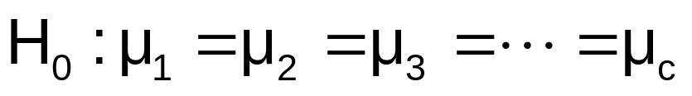
Hypotheses of One-Way ANOVA
  All population means are equal
  i.e., no factor effect (no variation in means among groups)
  At least one population mean is different
  i.e., there is a factor effect
  Does not mean that all population means are different (some pairs may be the same)
Basic Business Statistics, 11e © 2009 Prentice-Hall, Inc..
Chap 11-<number>

Slide 8
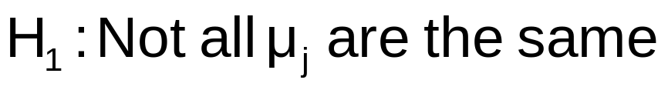
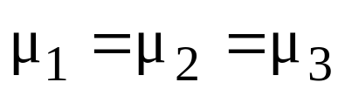
One-Way ANOVA
The Null Hypothesis is True
All Means are the same:
(No Factor Effect)
Basic Business Statistics, 11e © 2009 Prentice-Hall, Inc..
Chap 11-<number>

Slide 9
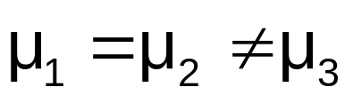
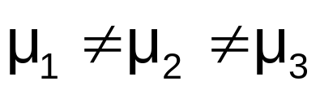
One-Way ANOVA
(continued)
The Null Hypothesis is NOT true
At least one of the means is different
(Factor Effect is present)
or
Basic Business Statistics, 11e © 2009 Prentice-Hall, Inc..
Chap 11-<number>

Slide 10
Partitioning the Variation
Total variation can be split into two parts:
SST = SSA + SSW
SST = Total Sum of Squares
(Total variation)
SSA = Sum of Squares Among Groups
(Among-group variation)
SSW = Sum of Squares Within Groups
(Within-group variation)
Basic Business Statistics, 11e © 2009 Prentice-Hall, Inc..
Chap 11-<number>

Slide 11
Partitioning the Variation
(continued)
SST = SSA + SSW
Total Variation = the aggregate variation of the individual data values across the various factor levels (SST)
Among-Group Variation = variation among the factor sample means (SSA)
Within-Group Variation = variation that exists among the data values within a particular factor level (SSW)
Basic Business Statistics, 11e © 2009 Prentice-Hall, Inc..
Chap 11-<number>

Slide 12
Partition of Total Variation
Total Variation (SST)
=
Variation Due to Factor (SSA)
+
Variation Due to Random Error (SSW)
Basic Business Statistics, 11e © 2009 Prentice-Hall, Inc..
Chap 11-<number>

Slide 13
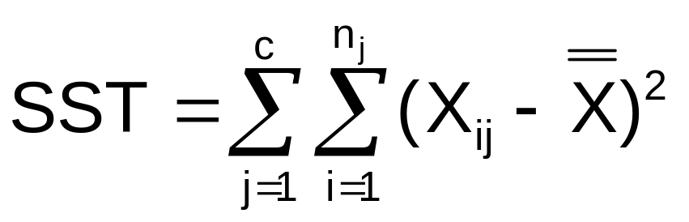

Total Sum of Squares
SST = SSA + SSW
Where:
SST = Total sum of squares
c = number of groups or levels
n_{j} = number of observations in group j
X_{ij} = i^{th} observation from group j
X = grand mean (mean of all data values)
Basic Business Statistics, 11e © 2009 Prentice-Hall, Inc..
Chap 11-<number>

Slide 14
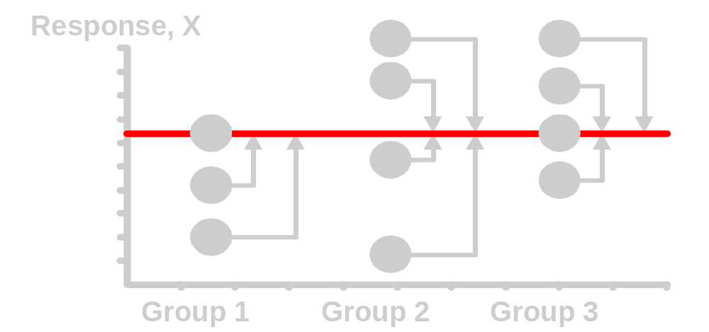
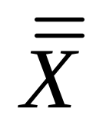
Total Variation
(continued)
Basic Business Statistics, 11e © 2009 Prentice-Hall, Inc..
Chap 11-<number>

Slide 15
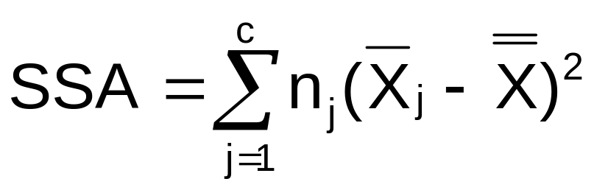
Among-Group Variation
SST = SSA + SSW
Where:
SSA = Sum of squares among groups
c = number of groups
n_{j} = sample size from group j
X_{j} = sample mean from group j
X = grand mean (mean of all data values)
Basic Business Statistics, 11e © 2009 Prentice-Hall, Inc..
Chap 11-<number>

Slide 16
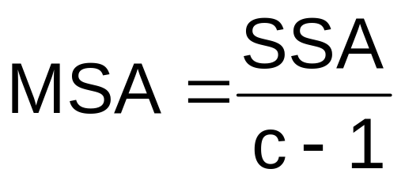


Among-Group Variation
(continued)
Variation Due to
Differences Among Groups
Mean Square Among = SSA/degrees of freedom
Basic Business Statistics, 11e © 2009 Prentice-Hall, Inc..
Chap 11-<number>

Slide 17
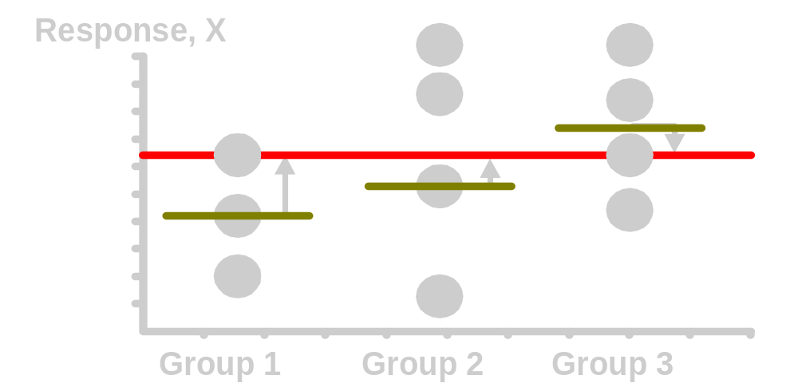
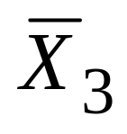
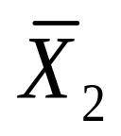
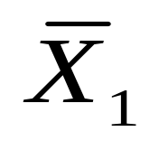
Among-Group Variation
(continued)
Basic Business Statistics, 11e © 2009 Prentice-Hall, Inc..
Chap 11-<number>

Slide 18
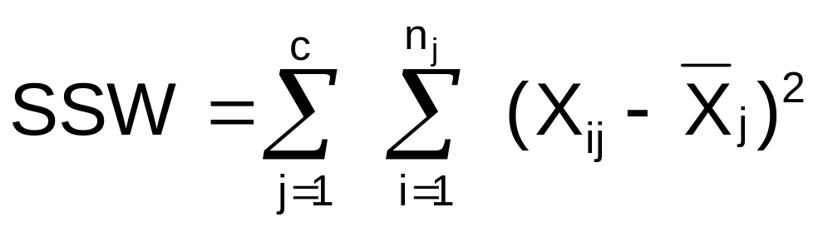
Within-Group Variation
SST = SSA + SSW
Where:
SSW = Sum of squares within groups
c = number of groups
n_{j} = sample size from group j
X_{j} = sample mean from group j
X_{ij} = i^{th} observation in group j
Basic Business Statistics, 11e © 2009 Prentice-Hall, Inc..
Chap 11-<number>

Slide 19
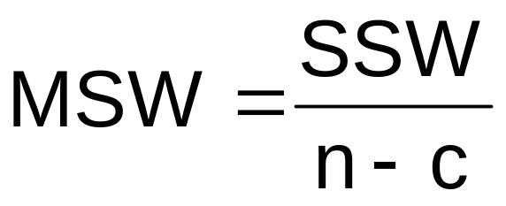

Within-Group Variation
(continued)
Summing the variation within each group and then adding over all groups
Mean Square Within = SSW/degrees of freedom
Basic Business Statistics, 11e © 2009 Prentice-Hall, Inc..
Chap 11-<number>

Slide 20
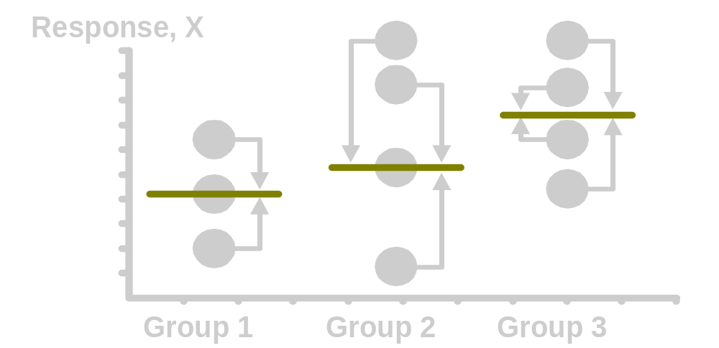
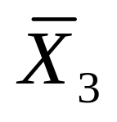
Within-Group Variation
(continued)
Basic Business Statistics, 11e © 2009 Prentice-Hall, Inc..
Chap 11-<number>

Slide 21

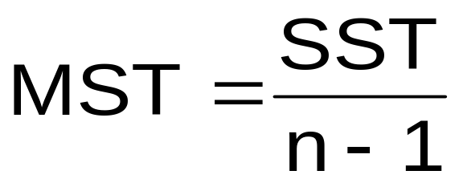
Obtaining the Mean Squares
The Mean Squares are obtained by dividing the various sum of squares by their associated degrees of freedom
Mean Square Among
(d.f. = c-1)
Mean Square Within
(d.f. = n-c)
Mean Square Total
(d.f. = n-1)
Basic Business Statistics, 11e © 2009 Prentice-Hall, Inc..
Chap 11-<number>

Slide 22
One-Way ANOVA Table
Source of Variation
Degrees of
Freedom
Sum Of
Squares
Mean Square
(Variance)
F
Among Groups
SSA
F_{STAT} =
c - 1
SSA
MSA =
c - 1
MSA
Within Groups
SSW
n - c
SSW
MSW =
MSW
n - c
Total
n – 1
SST
c = number of groups
n = sum of the sample sizes from all groups
df = degrees of freedom
Basic Business Statistics, 11e © 2009 Prentice-Hall, Inc..
Chap 11-<number>

Slide 23
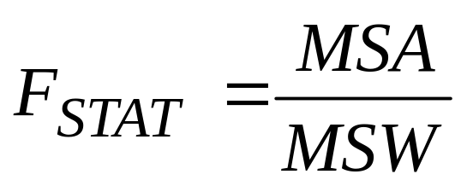
One-Way ANOVA
F Test Statistic
H₀: μ₁= μ₂ = … = μ_{c}
H₁: At least two population means are different
Test statistic
    MSA is mean squares among groups
    MSW is mean squares within groups
Degrees of freedom
  df₁ = c – 1 (c = number of groups)
  df₂ = n – c (n = sum of sample sizes from all populations)
Basic Business Statistics, 11e © 2009 Prentice-Hall, Inc..
Chap 11-<number>

Slide 24
Interpreting One-Way ANOVA
F Statistic
The F statistic is the ratio of the among estimate of variance and the within estimate of variance
  The ratio must always be positive
  df₁ = c -1 will typically be small
  df₂ = n - c will typically be large
Decision Rule:
Reject H₀ if F_{STAT} > F_{α}, otherwise do not reject H₀
α
0
Do not
reject H₀
Reject H₀
F_{α}
Basic Business Statistics, 11e © 2009 Prentice-Hall, Inc..
Chap 11-<number>

Slide 25


One-Way ANOVA
F Test Example
You want to see if three different golf clubs yield different distances. You randomly select five measurements from trials on an automated driving machine for each club. At the 0.05 significance level, is there a difference in mean distance?
Club 1 Club 2 Club 3
254 234 200
263 218 222
241 235 197
237 227 206
251 216 204
Basic Business Statistics, 11e © 2009 Prentice-Hall, Inc..
Chap 11-<number>

Slide 26
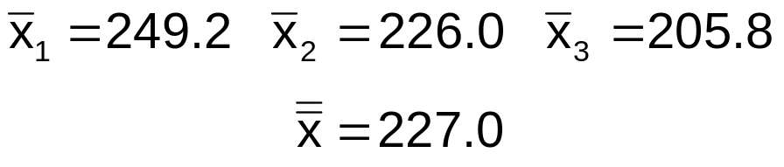
One-Way ANOVA Example: Scatter Plot
Distance
Club 1 Club 2 Club 3
254 234 200
263 218 222
241 235 197
237 227 206
251 216 204
270
260
250
240
230
220
210
200
190
•
•
•
•
•
•
•
•
•
•
•
•
•
•
•
1 2 3
Basic Business Statistics, 11e © 2009 Prentice-Hall, Inc..
Club
Chap 11-<number>

Slide 27
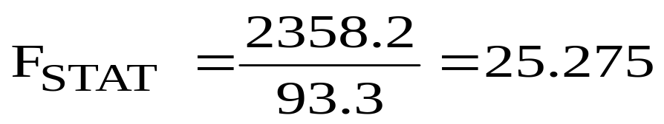
One-Way ANOVA Example Computations
Club 1 Club 2 Club 3
254 234 200
263 218 222
241 235 197
237 227 206
251 216 204
X₁ = 249.2
X₂ = 226.0
X₃ = 205.8
X = 227.0
n₁ = 5
n₂ = 5
n₃ = 5
n = 15
c = 3
SSA = 5 (249.2 – 227)² + 5 (226 – 227)² + 5 (205.8 – 227)² = 4716.4
SSW = (254 – 249.2)² + (263 – 249.2)² +…+ (204 – 205.8)² = 1119.6
MSA = 4716.4 / (3-1) = 2358.2
MSW = 1119.6 / (15-3) = 93.3
Basic Business Statistics, 11e © 2009 Prentice-Hall, Inc..
Chap 11-<number>

Slide 28
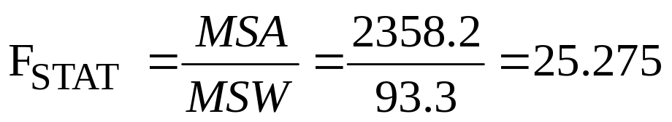
One-Way ANOVA Example Solution
H₀: μ₁ = μ₂ = μ₃
H₁: μ_{j} not all equal
α = 0.05
df₁= 2 df₂ = 12
Test Statistic:
Decision:
Conclusion:
Critical Value:
F_{α} = 3.89
Reject H₀ at α = 0.05
α = .05
There is evidence that at least one μ_{j} differs from the rest
0
Do not
reject H₀
Reject H₀
F_{α} = 3.89
F_{STAT} = 25.275
Basic Business Statistics, 11e © 2009 Prentice-Hall, Inc..
Chap 11-<number>

Slide 29
One-Way ANOVA
Excel Output
SUMMARY
Groups | Count | Sum | Average | Variance
Club 1 | 5 | 1246 | 249.2 | 108.2
Club 2 | 5 | 1130 | 226 | 77.5
Club 3 | 5 | 1029 | 205.8 | 94.2
ANOVA
Source of Variation | SS | df | MS | F | P-value | F crit
Between Groups | 4716.4 | 2 | 2358.2 | 25.275 | 4.99E-05 | 3.89
Within Groups | 1119.6 | 12 | 93.3
Total | 5836.0 | 14
Basic Business Statistics, 11e © 2009 Prentice-Hall, Inc..
Chap 11-<number>

Slide 30
One-Way ANOVA
Minitab Output
One-way ANOVA: Distance versus Club
Source DF SS MS F P
Club 2 4716.4 2358.2 25.28 0.000
Error 12 1119.6 93.3
Total 14 5836.0
S = 9.659 R-Sq = 80.82% R-Sq(adj) = 77.62%
Individual 95% CIs For Mean Based on Pooled StDev
Level N Mean StDev -------+---------+---------+---------+--
1 5 249.20 10.40 (-----*-----)
2 5 226.00 8.80 (-----*-----)
3 5 205.80 9.71 (-----*-----)
-------+---------+---------+---------+--
208 224 240 256
Pooled StDev = 9.66
Basic Business Statistics, 11e © 2009 Prentice-Hall, Inc..
Chap 11-<number>

Slide 31
The Tukey-Kramer Procedure
Tells which population means are significantly different
  e.g.: μ₁ = μ₂ ≠ μ₃
  Done after rejection of equal means in ANOVA
Allows paired comparisons
  Compare absolute mean differences with critical range
μ
=
μ
μ
x
1
2
3
Basic Business Statistics, 11e © 2009 Prentice-Hall, Inc..
Chap 11-<number>

Slide 32
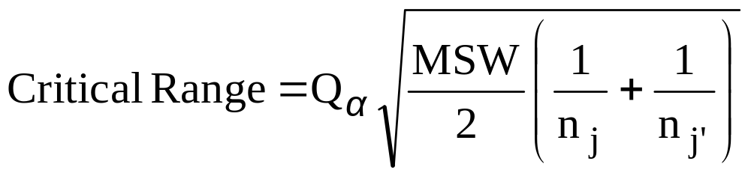
Tukey-Kramer Critical Range
where:
Q_{α} = Upper Tail Critical Value from Studentized Range Distribution with c and n - c degrees of freedom (see appendix E.10 table)
MSW = Mean Square Within
n_{j} and n_{j’} = Sample sizes from groups j and j’
Basic Business Statistics, 11e © 2009 Prentice-Hall, Inc..
Chap 11-<number>

Slide 33
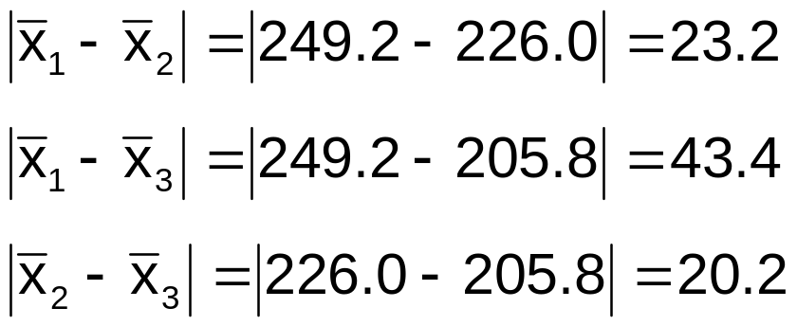
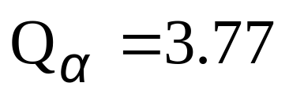
The Tukey-Kramer Procedure: Example
1. Compute absolute mean differences:
Club 1 Club 2 Club 3
254 234 200
263 218 222
241 235 197
237 227 206
251 216 204
2. Find the Q_{α} value from the table in appendix E.10 with
c = 3 and (n – c) = (15 – 3) = 12 degrees of freedom:
Basic Business Statistics, 11e © 2009 Prentice-Hall, Inc..
Chap 11-<number>

Slide 34
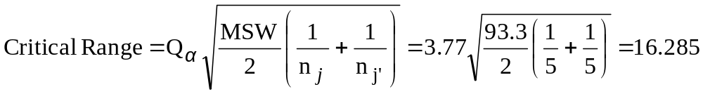
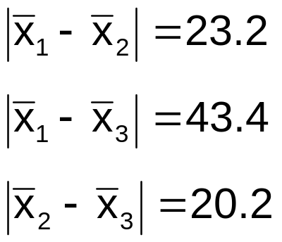
The Tukey-Kramer Procedure: Example
(continued)
3. Compute Critical Range:
4. Compare:
5. All of the absolute mean differences are greater than critical range. Therefore there is a significant difference between each pair of means at 5% level of significance. Thus, with 95% confidence we can conclude that the mean distance for club 1 is greater than club 2 and 3, and club 2 is greater than club 3.
Basic Business Statistics, 11e © 2009 Prentice-Hall, Inc..
Chap 11-<number>

Slide 35
ANOVA Assumptions
Randomness and Independence
  Select random samples from the c groups (or randomly assign the levels)
Normality
  The sample values for each group are from a normal population
Homogeneity of Variance
  All populations sampled from have the same variance
  Can be tested with Levene’s Test
Basic Business Statistics, 11e © 2009 Prentice-Hall, Inc..
Chap 11-<number>

Slide 36
ANOVA Assumptions
Levene’s Test
Tests the assumption that the variances of each population are equal.
First, define the null and alternative hypotheses:
  H₀: σ²₁ = σ²₂ = …=σ²_{c}
  H₁: Not all σ²_{j} are equal
Second, compute the absolute value of the difference between each value and the median of each group.
Third, perform a one-way ANOVA on these absolute differences.
Basic Business Statistics, 11e © 2009 Prentice-Hall, Inc..
Chap 11-<number>

Slide 37
Levene Homogeneity Of Variance Test Example
  H0: σ²₁ = σ²₂ = σ²₃
  H1: Not all σ²_{j} are equal
Calculate Medians
Club 1 | Club 2 | Club 3
237 | 216 | 197
241 | 218 | 200
251 | 227 | 204 | Median
254 | 234 | 206
263 | 235 | 222
Calculate Absolute Differences
Club 1 | Club 2 | Club 3
14 | 11 | 7
10 | 9 | 4
0 | 0 | 0
3 | 7 | 2
12 | 8 | 18
Basic Business Statistics, 11e © 2009 Prentice-Hall, Inc..
Chap 11-<number>

Slide 38
Levene Homogeneity Of Variance Test Example
(continued)
Anova: Single Factor
SUMMARY
Groups | Count | Sum | Average | Variance
Club 1 | 5 | 39 | 7.8 | 36.2
Club 2 | 5 | 35 | 7 | 17.5
Club 3 | 5 | 31 | 6.2 | 50.2
Since the p-value is greater than 0.05 we fail to reject H₀ & conclude the variances are equal.
Source of Variation | SS | df | MS | F | P-value | F crit
Between Groups | 6.4 | 2 | 3.2 | 0.092 | 0.912 | 3.885
Within Groups | 415.6 | 12 | 34.6
Total | 422 | 14
Basic Business Statistics, 11e © 2009 Prentice-Hall, Inc..
Chap 11-<number>

Slide 39
The Randomized Block Design
Like One-Way ANOVA, we test for equal population means (for different factor levels, for example)...
...but we want to control for possible variation from a second factor (with two or more levels)
Levels of the secondary factor are called blocks
Basic Business Statistics, 11e © 2009 Prentice-Hall, Inc..
Chap 11-<number>

Slide 40
Partitioning the Variation
Total variation can now be split into three parts:
SST = SSA + SSBL + SSE
SST = Total variation
SSA = Among-Group variation
SSBL = Among-Block variation
SSE = Random variation
Basic Business Statistics, 11e © 2009 Prentice-Hall, Inc..
Chap 11-<number>

Slide 41
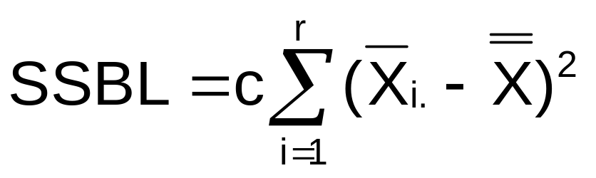

Sum of Squares for Blocks
SST = SSA + SSBL + SSE
Where:
c = number of groups
r = number of blocks
X_{i.} = mean of all values in block i
X = grand mean (mean of all data values)
Basic Business Statistics, 11e © 2009 Prentice-Hall, Inc..
Chap 11-<number>

Slide 42
Partitioning the Variation
Total variation can now be split into three parts:
SST = SSA + SSBL + SSE
SST and SSA are computed as they were in One-Way ANOVA
SSE = SST – (SSA + SSBL)
Basic Business Statistics, 11e © 2009 Prentice-Hall, Inc..
Chap 11-<number>

Slide 43
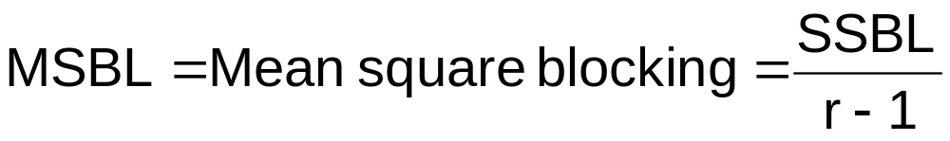
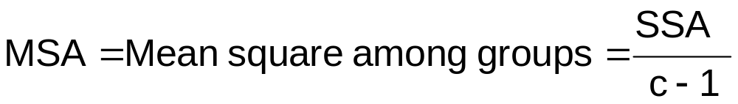
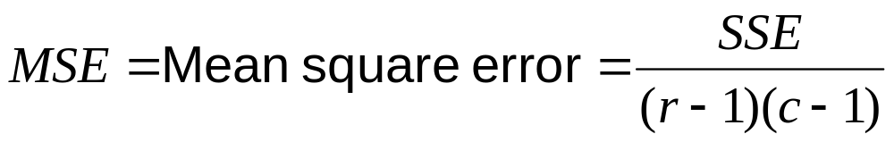
Mean Squares
Basic Business Statistics, 11e © 2009 Prentice-Hall, Inc..
Chap 11-<number>

Slide 44
Randomized Block ANOVA Table
Source of Variation
SS
df
MS
F
Among Blocks
MSBL
SSBL
r - 1
MSBL
MSE
Among Groups
SSA
c - 1
MSA
MSA
MSE
Error
SSE
(r–1)(c-1)
MSE
Total
SST
rc - 1
c = number of populations rc = total number of observations
r = number of blocks df = degrees of freedom
Basic Business Statistics, 11e © 2009 Prentice-Hall, Inc..
Chap 11-<number>

Slide 45
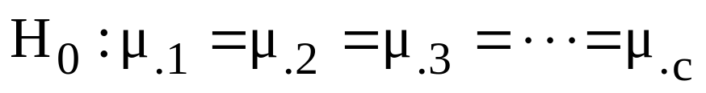
Testing For Factor Effect
MSA
F_{STAT} =
MSE
Main Factor test: df₁ = c – 1
df₂ = (r – 1)(c – 1)
Reject H₀ if F_{STAT} > F_{α}
Basic Business Statistics, 11e © 2009 Prentice-Hall, Inc..
Chap 11-<number>

Slide 46
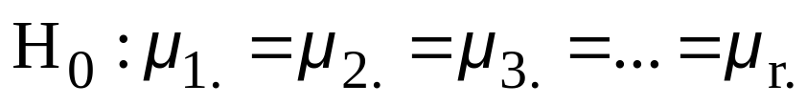
Test For Block Effect
MSBL
F_{STAT} =
MSE
Blocking test: df₁ = r – 1
df₂ = (r – 1)(c – 1)
Reject H₀ if F_{STAT} > F_{α}
Basic Business Statistics, 11e © 2009 Prentice-Hall, Inc..
Chap 11-<number>

Slide 47
The Tukey Procedure
To test which population means are significantly different
  e.g.: μ₁ = μ₂ ≠ μ₃
  Done after rejection of equal means in randomized block ANOVA design
Allows pair-wise comparisons
  Compare absolute mean differences with critical range
μ
=
μ
μ
x
1
2
3
Basic Business Statistics, 11e © 2009 Prentice-Hall, Inc..
Chap 11-<number>

Slide 48

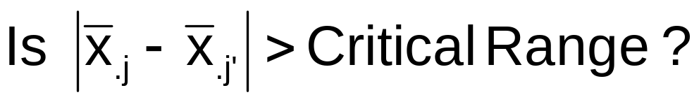
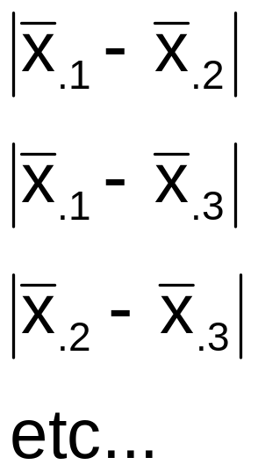
The Tukey Procedure
(continued)
Compare:
If the absolute mean difference is greater than the critical range then there is a significant difference between that pair of means at the chosen level of significance.
Basic Business Statistics, 11e © 2009 Prentice-Hall, Inc..
Chap 11-<number>

Slide 49
Factorial Design:
Two-Way ANOVA
Examines the effect of
  Two factors of interest on the dependent variable
    e.g., Percent carbonation and line speed on soft drink bottling process
  Interaction between the different levels of these two factors
    e.g., Does the effect of one particular carbonation level depend on which level the line speed is set?
Basic Business Statistics, 11e © 2009 Prentice-Hall, Inc..
Chap 11-<number>

Slide 50
Two-Way ANOVA
(continued)
Assumptions
  Populations are normally distributed
  Populations have equal variances
  Independent random samples are drawn
Basic Business Statistics, 11e © 2009 Prentice-Hall, Inc..
Chap 11-<number>

Slide 51
Two-Way ANOVA
Sources of Variation
Two Factors of interest: A and B
r = number of levels of factor A
c = number of levels of factor B
n’ = number of replications for each cell
n = total number of observations in all cells n = (r)(c)(n’)
X_{ijk} = value of the k^{th} observation of level i of factor A and level j of factor B
Basic Business Statistics, 11e © 2009 Prentice-Hall, Inc..
Chap 11-<number>

Slide 52
Two-Way ANOVA
Sources of Variation
(continued)
SST = SSA + SSB + SSAB + SSE
Degrees of Freedom:
SSA
Factor A Variation
r – 1
SST
Total Variation
SSB
Factor B Variation
c – 1
SSAB
Variation due to interaction
between A and B
(r – 1)(c – 1)
n - 1
SSE
Random variation (Error)
rc(n’ – 1)
Basic Business Statistics, 11e © 2009 Prentice-Hall, Inc..
Chap 11-<number>

Slide 53
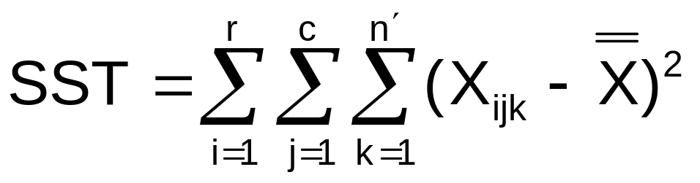
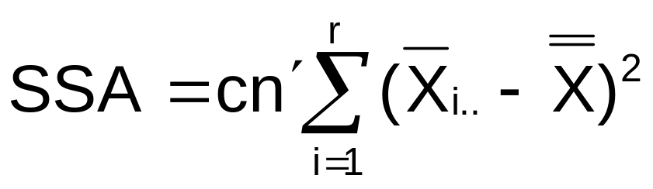
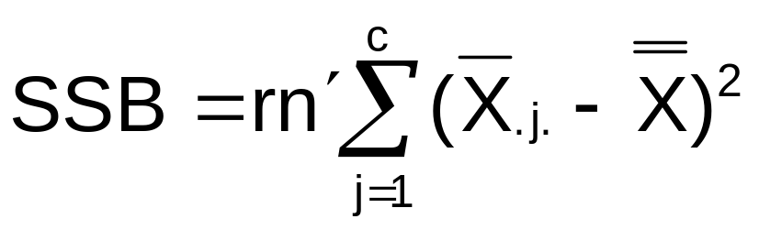
Two-Way ANOVA Equations
Total Variation:
Factor A Variation:
Factor B Variation:
Basic Business Statistics, 11e © 2009 Prentice-Hall, Inc..
Chap 11-<number>

Slide 54
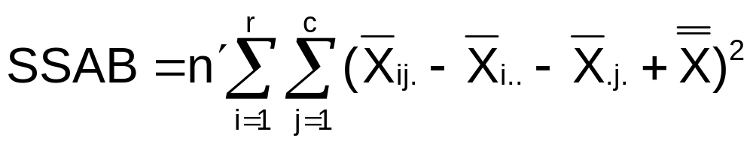
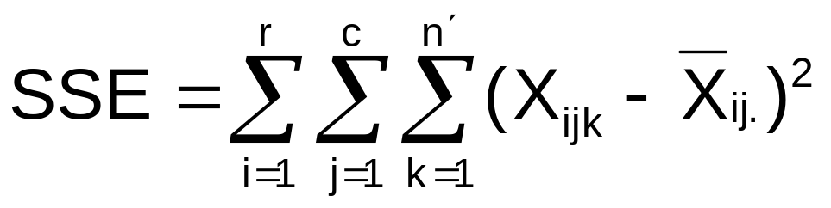
Two-Way ANOVA Equations
(continued)
Interaction Variation:
Sum of Squares Error:
Basic Business Statistics, 11e © 2009 Prentice-Hall, Inc..
Chap 11-<number>

Slide 55
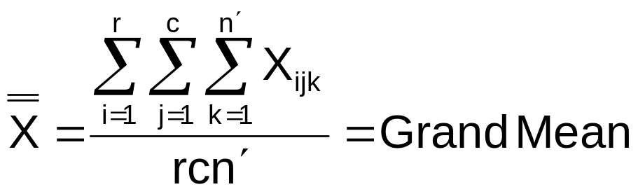
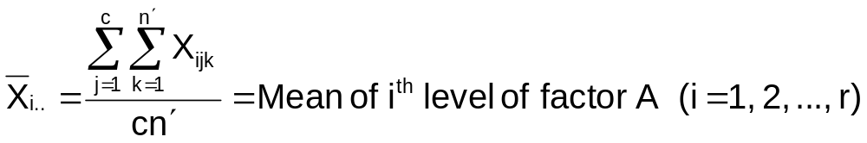
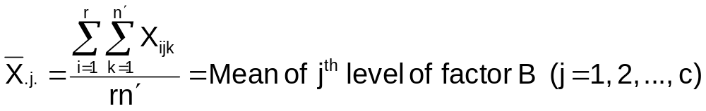
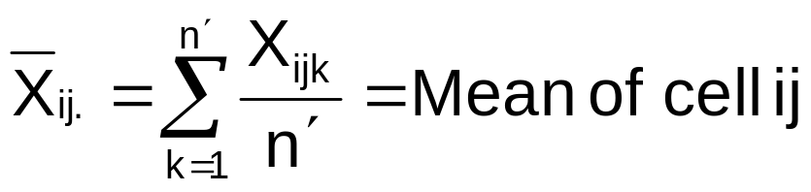
Two-Way ANOVA Equations
(continued)
where:
r = number of levels of factor A
c = number of levels of factor B
n’ = number of replications in each cell
Basic Business Statistics, 11e © 2009 Prentice-Hall, Inc..
Chap 11-<number>

Slide 56
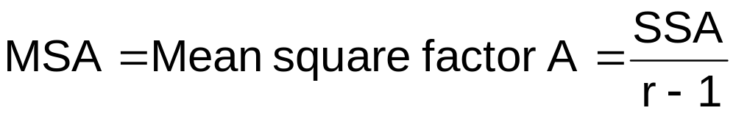
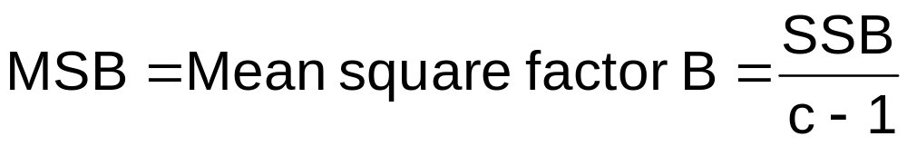
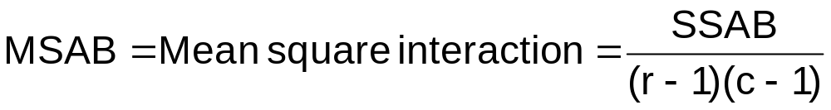
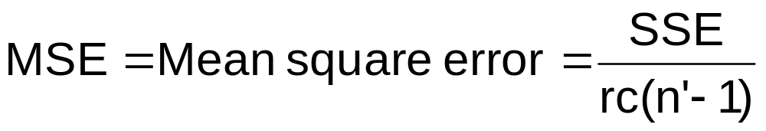
Mean Square Calculations
Basic Business Statistics, 11e © 2009 Prentice-Hall, Inc..
Chap 11-<number>

Slide 57
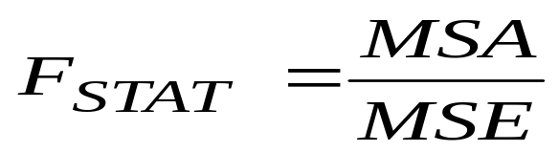


Two-Way ANOVA:
The F Test Statistics
F Test for Factor A Effect
H₀: μ_{1..}= μ_{2..} = μ_{3..}= • • = µ_{r..}
H₁: Not all μ_{i..} are equal
Reject H₀ if F_{STAT} > F_{α}
F Test for Factor B Effect
H₀: μ_{.1.} = μ_{.2.} = μ_{.3.}= • • = µ_{.c.}
H₁: Not all μ_{.j.} are equal
Reject H₀ if F_{STAT} > F_{α}
F Test for Interaction Effect
H₀: the interaction of A and B is equal to zero
H₁: interaction of A and B is not zero
Reject H₀ if F_{STAT} > F_{α}
Basic Business Statistics, 11e © 2009 Prentice-Hall, Inc..
Chap 11-<number>

Slide 58
Two-Way ANOVA
Summary Table
Source of Variation | Sum of Squares | Degrees of Freedom | Mean Squares | F
Factor A | SSA | r – 1 | MSA = SSA /(r – 1) | MSA MSE
Factor B | SSB | c – 1 | MSB = SSB /(c – 1) | MSB MSE
AB (Interaction) | SSAB | (r – 1)(c – 1) | MSAB = SSAB / (r – 1)(c – 1) | MSAB MSE
Error | SSE | rc(n’ – 1) | MSE = SSE/rc(n’ – 1)
Total | SST | n – 1
Basic Business Statistics, 11e © 2009 Prentice-Hall, Inc..
Chap 11-<number>

Slide 59
Features of Two-Way ANOVA
F Test
Degrees of freedom always add up
  n-1 = rc(n’-1) + (r-1) + (c-1) + (r-1)(c-1)
  Total = error + factor A + factor B + interaction
The denominators of the F Test are always the same but the numerators are different
The sums of squares always add up
  SST = SSE + SSA + SSB + SSAB
  Total = error + factor A + factor B + interaction
Basic Business Statistics, 11e © 2009 Prentice-Hall, Inc..
Chap 11-<number>

Slide 60
Examples:
Interaction vs. No Interaction
Interaction is present: some line segments not parallel
No interaction: line segments are parallel
Factor B Level 1
Factor B Level 1
Factor B Level 3
Mean Response
Mean Response
Factor B Level 2
Factor B Level 2
Factor B Level 3
Factor A Levels
Factor A Levels
Basic Business Statistics, 11e © 2009 Prentice-Hall, Inc..
Chap 11-<number>

Slide 61

Multiple Comparisons:
The Tukey Procedure
Unless there is a significant interaction, you can determine the levels that are significantly different using the Tukey procedure
Consider all absolute mean differences and compare to the calculated critical range
Example: Absolute differences
for factor A, assuming three levels:
Basic Business Statistics, 11e © 2009 Prentice-Hall, Inc..
Chap 11-<number>

Slide 62


Multiple Comparisons:
The Tukey Procedure
Critical Range for Factor A:
  (where Q_{α} is from Table E.10 with r and rc(n’–1) d.f.)
Critical Range for Factor B:
    (where Q_{α} is from Table E.10 with c and rc(n’–1) d.f.)
Basic Business Statistics, 11e © 2009 Prentice-Hall, Inc..
Chap 11-<number>

Slide 63
Chapter Summary
Described one-way analysis of variance
  The logic of ANOVA
  ANOVA assumptions
  F test for difference in c means
  The Tukey-Kramer procedure for multiple comparisons
  The Levene test for homogeneity of variance
Considered the Randomized Block Design
  Factor and Block Effects
  Multiple Comparisons: Tukey Procedure
Described two-way analysis of variance
  Examined effects of multiple factors
  Examined interaction between factors
Basic Business Statistics, 11e © 2009 Prentice-Hall, Inc..
Chap 11-<number>

