Slide 1
Splunk KPI Alarming – Machine Learning
Sumer Karir

Slide 2
Purpose
Discover and analyze Machine Learning models to analyze the Attached Users (K) and IP-Sessions (K) in Splunk
Evaluate which Machine Learning models are best which ones produce the most accurate and effective results
Due to Machine Learning algorithms requiring a lot of data, time and processing restrictions must be taken into account
For the Python scripts and examples used in this presentation, hourly data of the National IP-Sessions(K) was analyzed

Slide 3
Machine Learning
Machine Learning is the abaility of a program to learn without the need of being explicitly programmed
It is said to learn from experience (E) with respect to some class of tasks (T) and performance measures (P) if its performance at tasks in T, as measured by P improves with experience E.
Supervised Learning
Given a data set and already know what our correct output should look like, having the idea that there is a relationship between the input and the output. For the case of the Splunk KPIs, we have supervised learning.
Unsupervised Learning
Allows us to approach problems with little to no idea what our results should look like. We can derive structure from data where we don’t necessarily know the effect of the variables.

Slide 4
Time Series Forecasting
Is used to predict future data based on the data points given on the defined interval.
Key characteristics of the data identified from the previous dataset it used to “forecast” future data points within a given confidence interval – usually at 95%
Confidence intervals help identify the underlying causes why a particular point was predicted and how the future Time-Series data points will look like
An important distinction in forecasting is that the future is completely unavailable and must only be estimated from what has already happened
Based on this, we utilize Time-Series Forecasting Machine Learning algorithms and see which computational program suits our Splunk KPI dataset the best

Slide 5
Time Series Forecasting
Is used to predict future data based on the data points given on the defined interval.
Uses Regression models to predict future data points
Key characteristics of the data identified from the previous dataset it used to “forecast” future data points within a given confidence interval – usually at 95%
Confidence intervals help identify the underlying causes why a particular point was predicted and how the future Time-Series data points will look like
An important distinction in forecasting is that the future is completely unavailable and must only be estimated from what has already happened
Based on this, we utilize Time-Series Forecasting Machine Learning algorithms and see which computational program suits our Splunk KPI dataset the best

Slide 6
Auto-Regressive Model
Auto-Regression is a model which uses observations from previous time steps as input to a regression equation to predict the values at the next time step
Uses the same basis as linear regression, but instead of finding a ‘line-of-best-fit’ it finds a dataset of best fit which can further be expanded to predict future outcomes
Uses a neural network to continuously learn and adapt to the incoming data
Autocorrelation is a key feature as it plays into the accuracy of this algorithm
Relationship between previous time-steps (variable 1) and the time-steps to be predicted (variable 2)
Positive Correlation
Both variables go up/down together
Negative Correlation
Variables move in opposite directions
If the correlation is found to be very low, an alternative Time-Series model should be used

Slide 7
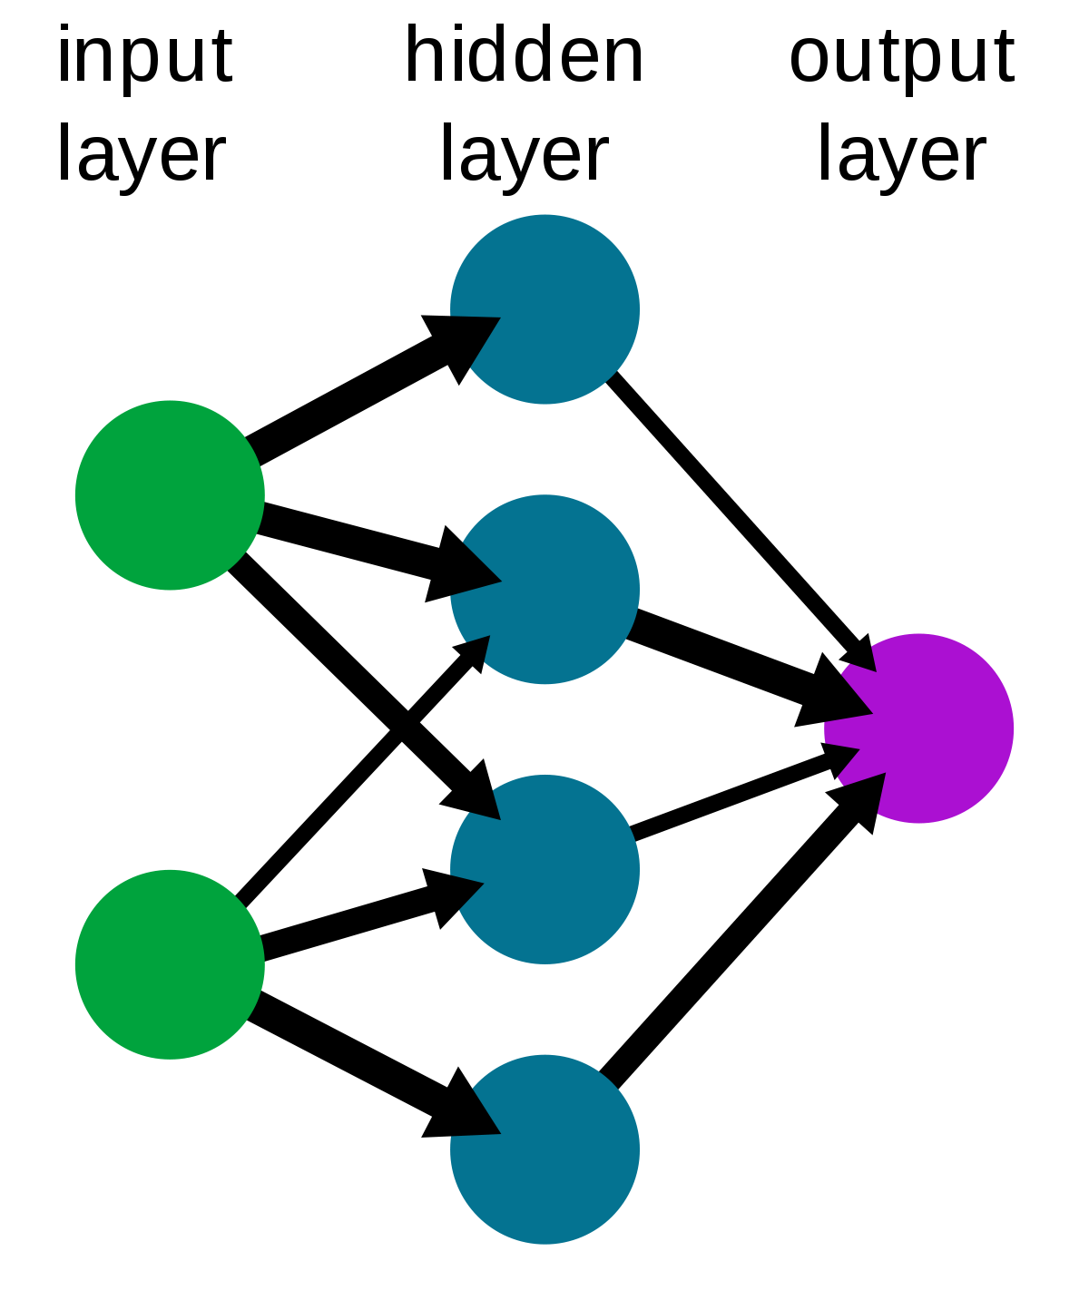
Neural Network
A neural network can be thought of as the decision making matrix of a machine learning algorithm
Based on the numerous different inputs it gets, it decides what outputs should be produced.
The inputs/dataset pass through multiple layers of computation and decisions by the neural network so that the end result in best fitting with the input dataset provided.

Slide 8
Overview and Key Terms
3 Time-Series Machine Learning algorithms are going to be discussed in this presentation
ARIMA (Auto Regressive Integrated Moving Average)
Facebook’s Prophet Model
LSTM (Long Short-Term Model)
Key terms
Trend
a general direction in which a dataset is developing or changing
Seasonality
A characteristic of time-series in which the data experience regular and predictable changes that recur every calendar year or within an expected time span
Confidence-Interval
A way of quantifying the uncertainty of an estimate. Chosen as 95% for purpose of the tests performed on the ML models

Slide 9
ARIMA (Auto Regressive Integrated Moving Average)
ARIMA is a generalization of an autoregressive moving average model and adds the notion of integration
Moving Average: A calculation to analyze data points by creating a series of averages of different subsets of the full dataset
ARIMA models are based on the assumption that past values have some residual effect on current or future values
Break down of ARIMA
AR (Autoregression)
A model that uses the dependent relationship between an observation and some number of lagged observations
I (Integrated)
Differencing of raw observations to make the time-series more stationary
MA (Moving Average)
Uses dependency between an observation and a residual error applied to lagged observations

Slide 10
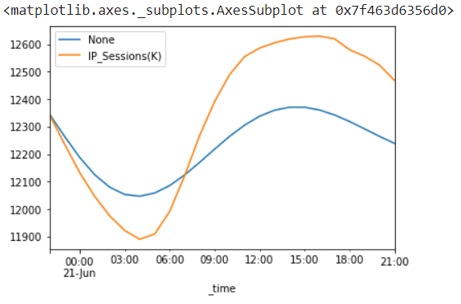
ARIMA (Auto Regressive Integrated Moving Average)
ARIMA model is applied to the National IP_Sessions(K)
Hourly data used between 2021-June-14T21:00 to 2021-June-21T00:00
Orange – IP_Sessions(K) Actual
Blue – IP_Sessions(K) Forecasted

Slide 11
ARIMA (Auto Regressive Integrated Moving Average) - Advantages
The ARIMA model performs well with stationary data
With the absence of seasonal and yearly trends, it can conform to a particular model and use that to predict future values
ARIMA models are based on the assumption that past values have some residual effect on current or future values
Taking IP_Sessions(K) as an example, we must observe the past IP_Sessions(K) and if there is any discrepancy in the data we can arrive to the conclusion that there is either an outage or overflow
ARIMA model has been tested by trading firms and it has been proven to be robust and efficient.
For data that Rogers is analyzing, an example being IP_Sessions(K), there shouldn’t be any sudden spikes or drops. Therefore the ARIMA model is a good option.

Slide 12
ARIMA (Auto Regressive Integrated Moving Average) - Disadvantages
As of right now Splunk only has data from the last 90 days.
Because of this we can not observe past data. If we do decide to store data from past years, Seasonal/Yearly trends will take effect and we need to account for those when predicting future models
Since ARIMA performs best on stationary data, it could perform poorly in a year’s time where yearly trends can be observed
Cannot add Exogenous Variables
Means that we cannot add regressors or additional variables for data points for which we do not have future values.

Slide 13
Facebook Prophet
Facebook created an opensource package called FBProphet which is a time-series forecasting tool
FBProphet uses decomposable time series model with 3 main components: seasonal, trends, holidays or events effect and error which are combined into this equation:
f(x) = g(x) + s(x) + h(x) + e(t)
Uses time as a regressor and tries to fit several linear and non-linear time functions as components
It first tries fitting a linear model and increases the power of the function by ‘n’ to fit all of the data points
It then aggregates the functions by what it believes is the most optimum data function that can be uses to accommodate as many data points as possible without being too CPU heavy
It then accounts for trends and seasonality throughout days/weeks/months/years

Slide 14
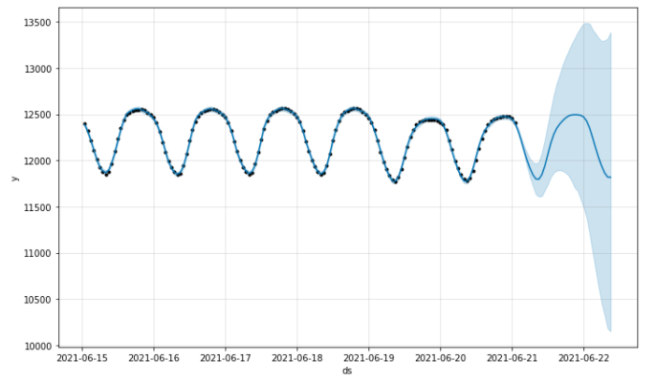
Facebook Prophet
FbProphet model is applied to the National IP_Sessions(K)
Data used between 2021-June-14T21:00 to 2021-June-21T00:00
Blue highlighted area is the forecasted dataset

Slide 15
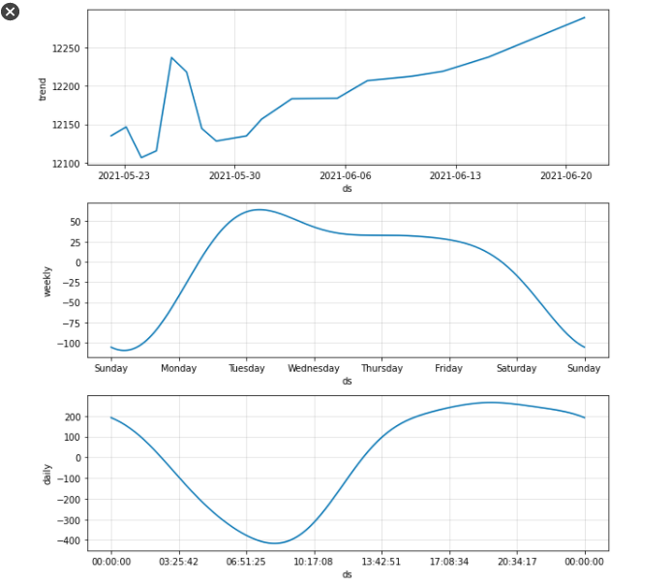
Facebook Prophet – Trend and Seasonality
The graphs below display the trends and seasonality observed and analyzed by the ML algorithm
‘30dayshourly.csv’ was used to display weekly trends
Trend
Algorithm realizes that the total number of IP_Sessions(K) increases over time
Weekly Seasonality
Algorithm realizes that the total number of IP_Sessions(K) increases at the starting of the week and falls off as the weekend approaches
Daily Trend
Algorithm realizes the times when the algorithm is at its highest and lowest during the day

Slide 16
Facebook Prophet - Advantages
One of the most accurate Time-Series ML algorithm used to forecast IP_Sessions(K) data
This means that this model works well with periodic data
Accounts for and accommodates for trends and seasonality
Modifies data produced in accordance to previous data points recorded at a particular time interval
Is a good fit for the periodic style data on Splunk due to the weekly trend which is inhibited by the data set. Is also able to identify time interval trends as shown on the last slide
Works best with hourly data over a monthly duration

Slide 17
Facebook Prophet - Disadvantages
Cannot add Exogenous variables
Regressors or additional variables cannot be added for data points which the ML algorithm will predict for
This can be seen as a disadvantage because we may want to integrate the monitoring of users on a node to help predict or catch any potential outages
Integration into Splunk
How will an open-source library be integrated into the Splunk platform
Automation
The data provided was manually exported from Splunk as a .csv file
We will want to automate this process for the most efficient results and workflow

Slide 18
LSTM (Long Short-Term Model)
A type of recurrent neural network (RNN)
A type of neural network where the connections between nodes from a directed graph along a temporal sequence
This allows LSTM to exhibit dynamic behaviour
LSTMs are designed to avoid the long-term dependency problem
There are 3 gates
Input
Discover which value from the input should be used to modify the memory
Forget
Discover what details to be discarded from the block
Output
The input and the memory of the block is used to decide the output

Slide 19
LSTM (Long Short-Term Model)
LSTM uses recent data to forecast the next data point
It uses long-term data and condenses it down to small-intervals to make data-forecasting faster and more efficient
Ex.
Input: [1, 2, 3]
Predicting 4: Input - [1, 2, 3] Output – 4
Predicting 5: Input - [2, 3, 4] Output – 5
Predicting 6: Input - [3, 4, 5] Output – 6
We take 48 points as input because we want to have 2 days of data to forecast the next day

Slide 20
LSTM (Long Short-Term Model)
LSTM uses recent data to forecast the next data point
It uses long-term data and condenses it down to small-intervals to make data-forecasting faster and more efficient
Ex.
Input: [1, 2, 3]
Predicting 4: Input - [1, 2, 3] Output – 4
Predicting 5: Input - [2, 3, 4] Output – 5
Predicting 6: Input - [3, 4, 5] Output – 6
We take 48 points as input because we want to have 2 days of data to forecast the next day

Slide 21
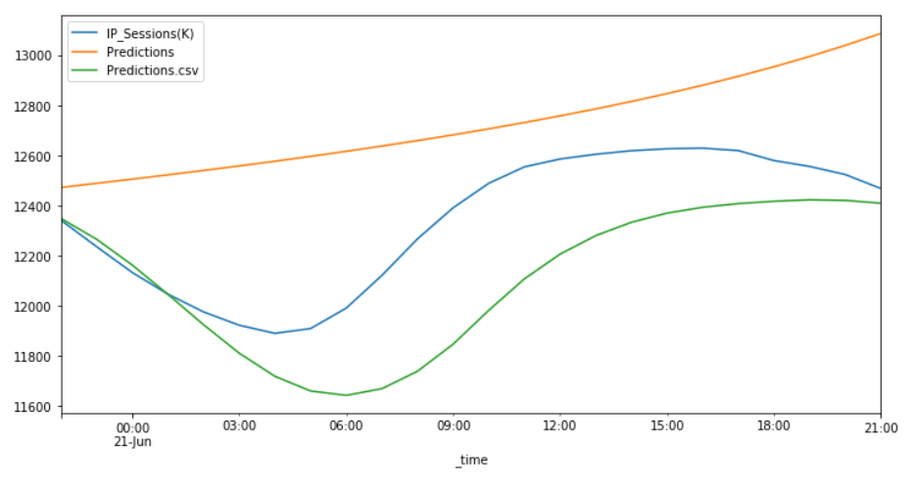
LSTM (Long Short-Term Model)
LSTM model is applied to the National IP_Sessions(K)
Data used between 2021-June-14T21:00 to 2021-June-21T00:00
Blue – IP_Sessions(K) Actual
Yellow – IP_Sessions(K) Trend
Green – IP_Sessions(K) Forecasted

Slide 22
LSTM (Long Short-Term Model) - Advantages
Fastest algorithm
Requires the least amount of CPU processing power
Has a dynamic neural network which will adapt and change according to every data-point
This makes every forecasted data-point independent of past data points but still obeys the trend observed
Uses the most recent data
In our case, we observe the last 48 hours compared to the last week in the 2 ML models shown before

Slide 23
LSTM (Long Short-Term Model) - Disadvantages
Cannot process very long sequences
If longer sequences are chosen, the output is skewed
Training an RNN is a very difficult task
In order to train an RNN to predict accurate data, you will need long-term data which can be used to predict short-term results
Unfortunately, an LSTM primarily uses short-term data and Splunk only stores data for 90 days
Least accurate model

Slide 24
Comparing All Models
Time | Actual | ARIMA | FbProphet | LSTM
2021-06-22T05:00:00 | 11,903.559 | 12,041.213 | 12,198.42 | 12,236.32
2021-06-22T06:00:00 | 11,939.414 | 12,069.163 | 11,945.56 | 12,336.23
2021-06-22T07:00:00 | 12,030.864 | 12,110.59 | 12,073.25 | 12,394.94
2021-06-22T08:00:00 | 12,172.434 | 12,160.473 | 12,050.56 | 12,302.05
2021-06-22T09:00:00 | 12,314 | 12,213.639 | 12,363.204 | 12,360.45

Slide 25
Verdict
ARIMA
Margin-of-Error: 0.6942%
FbProphet
Margin-of-Error: 0.854%
LSTM
Margin-of-Error: 2.114%

Slide 26
Conclusion
ARIMA or FbProphet are both great Machine Learning models which can be used to forecast Time-Series in Splunk
ARIMA
ARIMA offered accuracy in the test performed and performed well with the weekly stationary data
FbProphet
FbProphet also performed quite well with a slightly higher margin of error
This would be a great model for Time-Series where long-term data (2-years+) is present so that the model can forecast for holidays and seasonal scenarios
All the Python scripts and multiple hourly data sets have been attached and are at your disposal

