Slide 1
EI-Email Analytics
03-12-2019

Slide 2




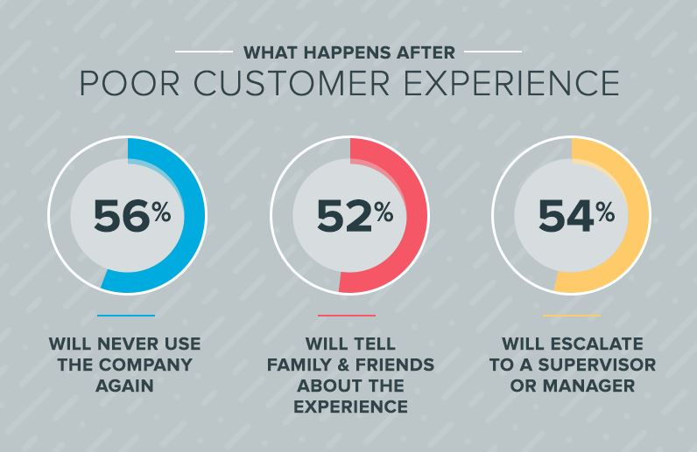


Email Analytics- Overview
EI Email Analytics is smart way of tracking subscribers interaction with Customer Support Team.
Tracking Customer complaints/Experience is the quickest and easiest way to tell right away if customer is satisfied with Services or not.
To Enable advanced email analytics to understand imperative nature of highly important transactional emails like Billing Issue, password resets, login information.

Slide 3
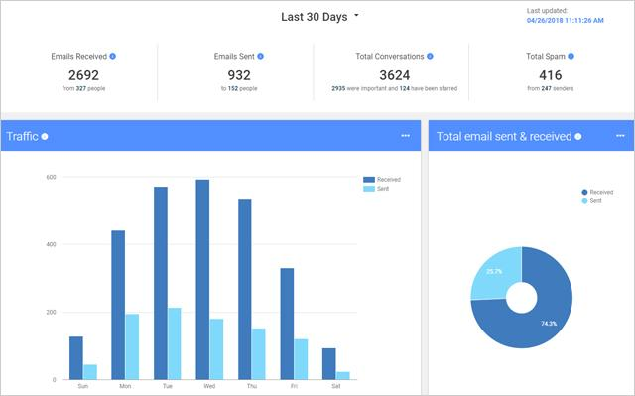
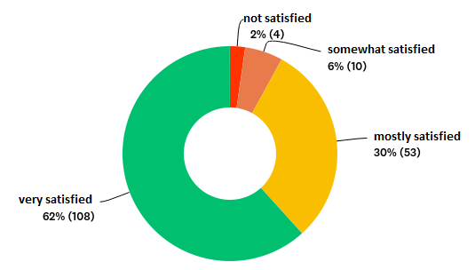
Email Analytics- Benefits
EI Email Analytics Metrics:
Track email workload, average response times, Top senders & Top receivers
Histograms on cumulative sent and received emails.
Drill down to statistics with specific individuals, see their response time for these contacts and the optimal time to expect a reply.
Easily understand how much overall volume a certain address or domain is generating in inbox.
Spam/Phishing Email Block.
Generates Sentiment for the every email conversation from the customer.

Slide 4
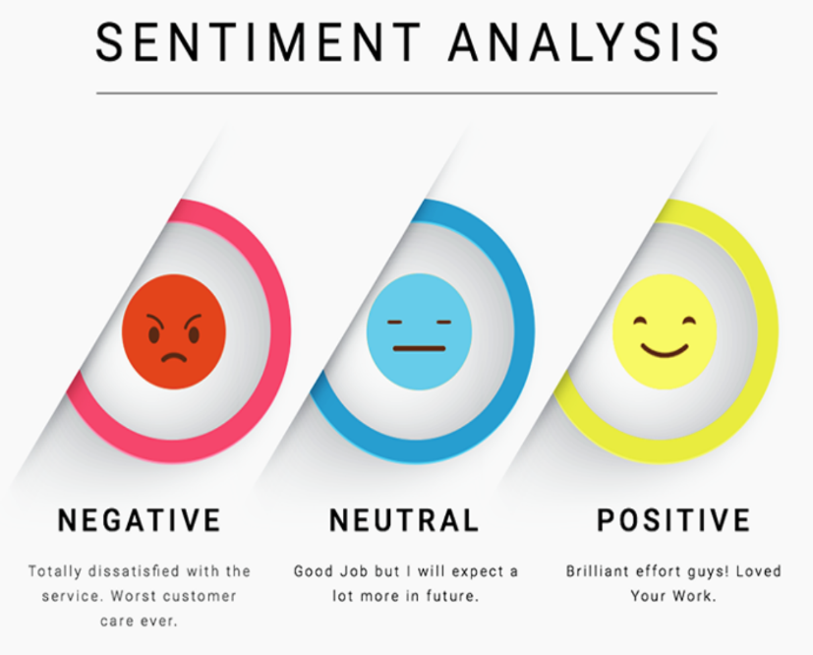
Sentiment Analysis- Overview
Sentiment analysis is the automatic process of identifying positive, negative and neutral emotions in text.
Sentiment analysis allows business to understand how customers feel about their EI products and services and extract valuable insights that lead to better decision-making.
Top Benefits in Customer Support :
Sentiment analysis is useful in customer support because it helps you do all of this:
Prioritize order for responding to tickets, being sure to address the most urgent needs first.
Increase efficiency by automatically assigning tickets to a particular category or team member.

Slide 5
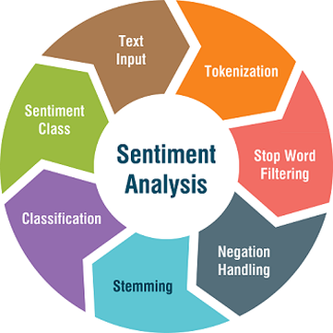
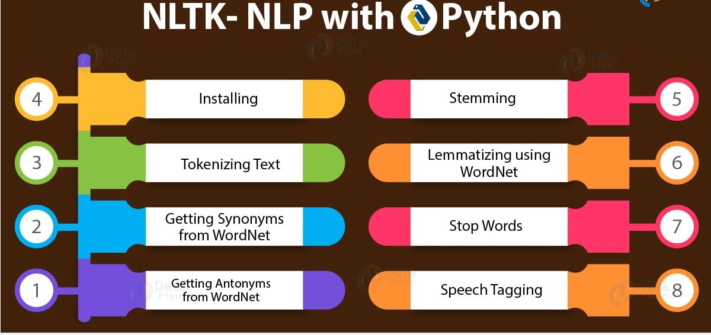
Sentiment Analysis- Python NLTK(NLP)
Natural language processing (NLP) is about developing applications and services that are able to understand human languages.
Examples of natural language processing (NLP) like speech recognition, speech translation, understanding complete sentences & synonyms of matching words.
Python NLTK (NLP):
Natural language toolkit (NLTK) is the most popular library for natural language processing (NLP).

Slide 6
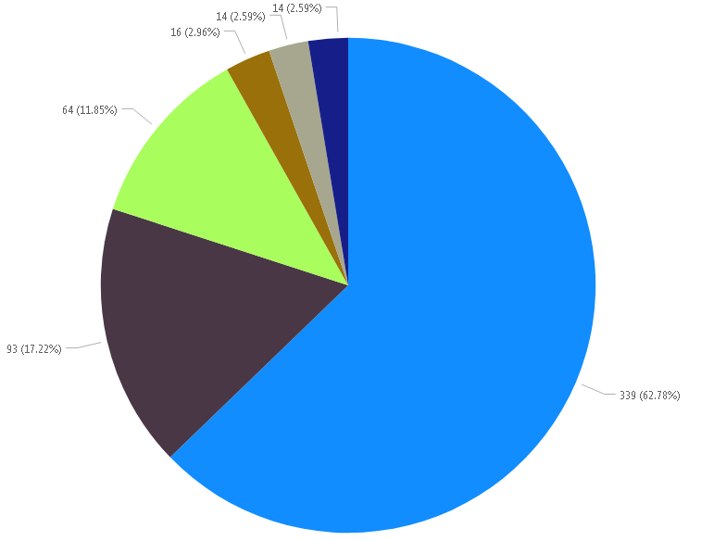
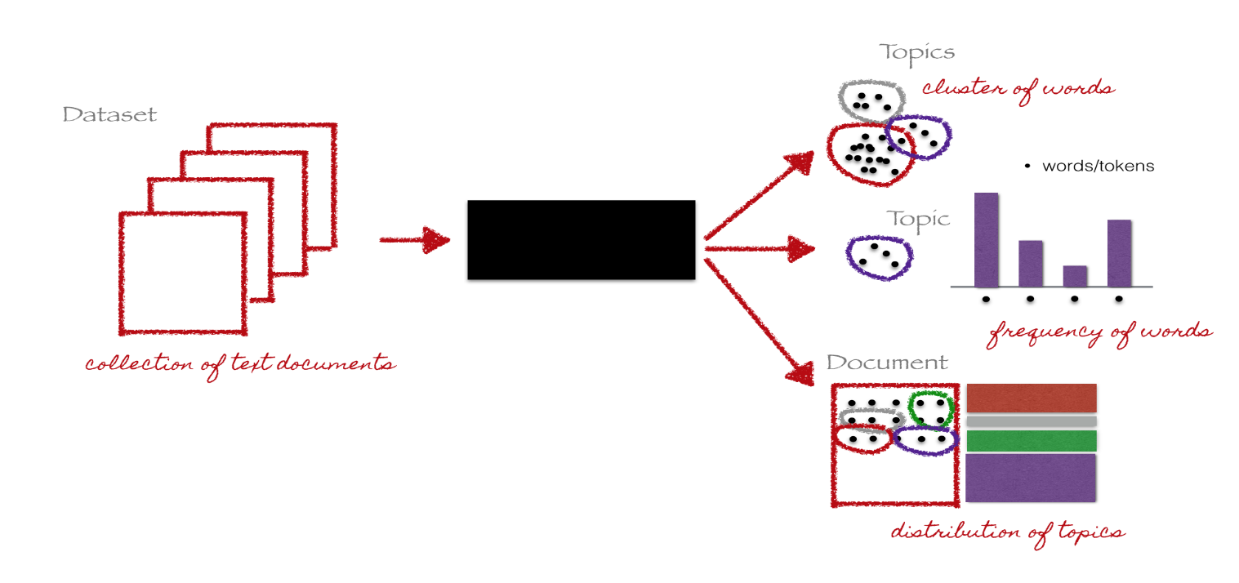
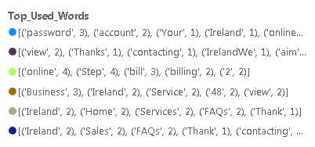
Latent Dirichlet Allocation(LDA) – Topic Modelling
Topic modeling is the process of identifying topics in a set of documents.
We have a collection of words will be group together in such a way that each group represents a topic in a document.
LDA is a form of unsupervised natural language process that views documents as bags of words (i.e order does not matter).

Slide 7
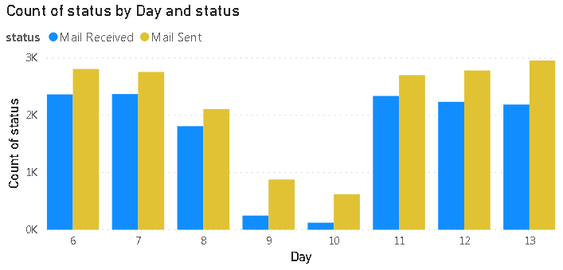
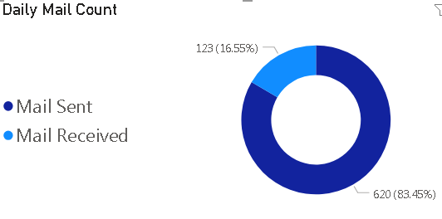
Power BI Desktop – Email Analytics Report
Power BI desktop is a Data Visualization and Business Intelligence tool that converts data from different data sources to interactive dashboards and BI reports.
EI Daily & Weekly Email Flow:

Slide 8
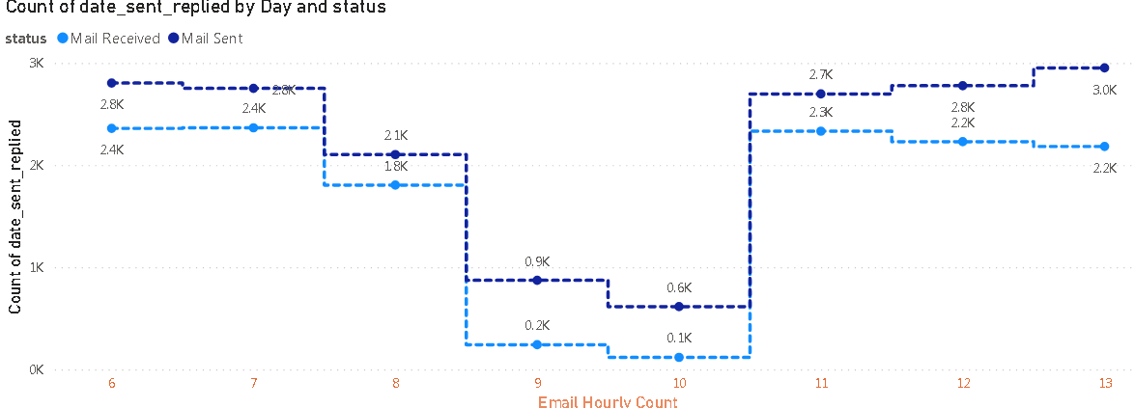
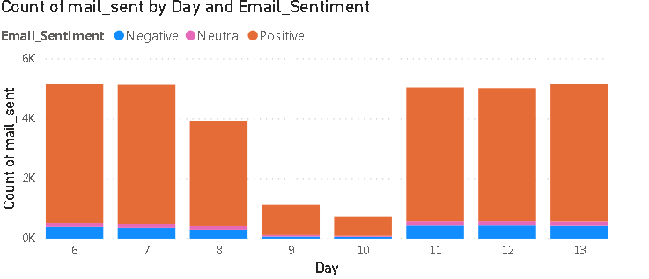
Power BI Desktop – Email Analytics Report
EI Hourly Email Flow: EI Sentiment for Customer Conversation:

Slide 9
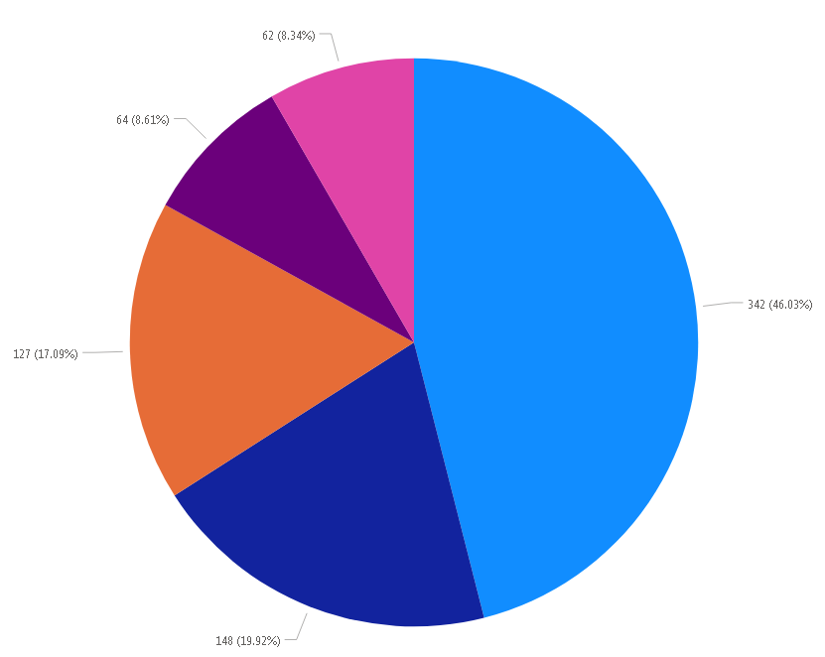
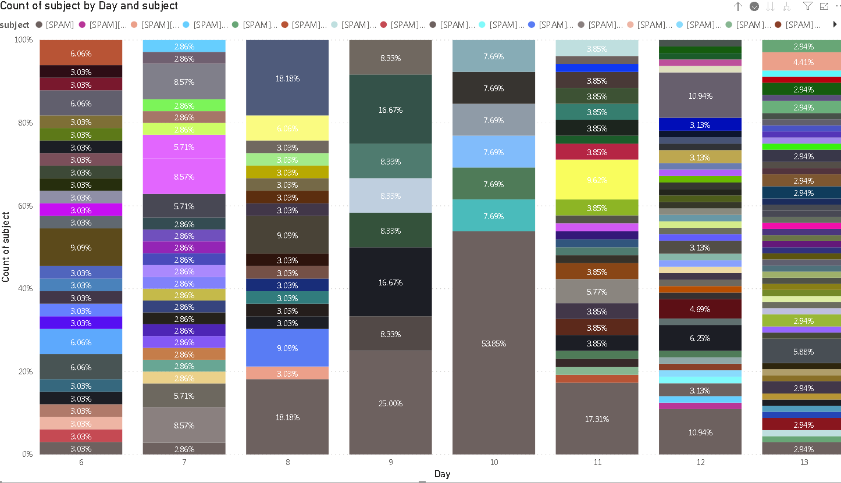
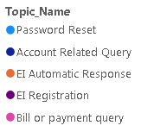
Power BI Desktop – Email Analytics Report
EI Email Spam: EI Email Topic Modeling:

Slide 10
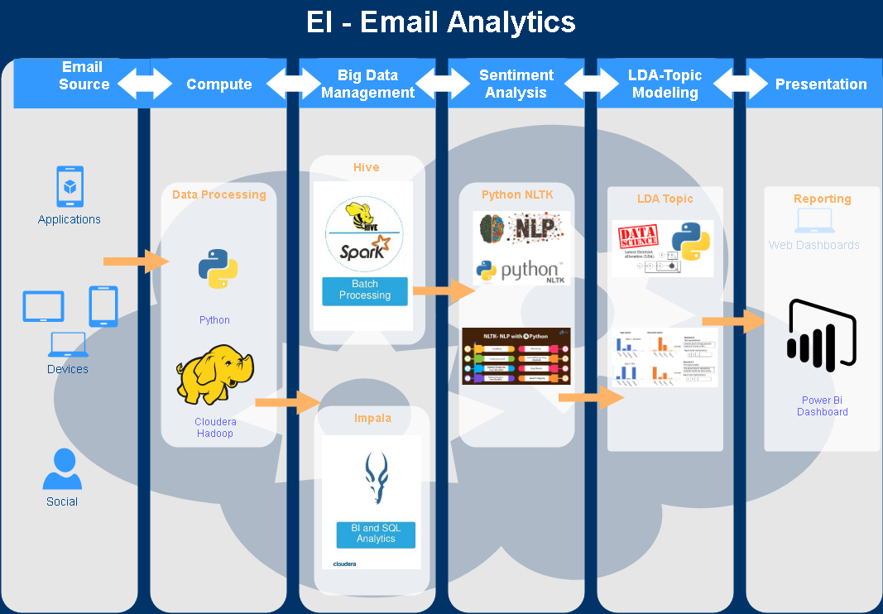
EI – Email Analytics Architecture

Slide 11
END

