Slide 1

Indian Institute of Information Technology, Allahabad
Software Engineering
Submitted to: Prof. Sonali Agarwal Mam
Guided By: TA Ashutosh Kumar Sir, TA Amit Kumar Sir
SOFTWARE REQUIREMENT SPECIFICATION
Big Data Analytics Lab Website
GROUP MEMBERS -
Harsh Sharma - IIT2021131
Sumit Prakash - IIT2021152
Aryan Pandey - IIT2021153
Saransh Yadav - IIT2021162
Saransh Gupta - IIT2021163
Kushagra Jain - IIT2021191

Slide 2
BDA LAB
1. Introduction:
The purpose of this software requirement specification document is to provide a
comprehensive guide for the development of Big Data Analytics Lab website. The
system will enable users to view ongoing projects, past publications and courses to which
BDA lab is associated with.
1.1 Purpose:
The purpose of the Big Data Analytics lab website is to provide a streamlined and
efficient way for users to view all the ongoing projects at IIIT Allahabad in the field of
Big Data Analytics, view the past publications of authors of IIITA and can request for
collaboration in their topic of interest by contacting them.
From the Students’ point of view,
The current processes of individually contacting the faculties to know about their
past publications and ongoing research work is very time consuming and not so efficient.
The current online process can be difficult for some users to navigate.
Finding information about the faculty can be troublesome.
Before the website was made, students had to look for different faculty profiles individually to
find resources.
There is no central system to contact and get all the information about the
BDA LAB.
BDA LAB 1

Slide 3
From the Professor’s point of view,
Currently, the organization does not have a website for Big Data Analytics Lab.
Professors have to constantly update the info on their respective faculty profiles.
Managing and updating all the research works under BDA is cumbersome.
Complete details of all the professors associated with BDA lab is not in one place
single place and so managing is difficult.
They have no way to search for information about a particular author or faculty.
So, this project is an attempt to overcome these drawbacks in BDA Lab of IIIT Allahabad.
1.2 Scope:
The scope of this document includes the functional and non-functional requirements for
the system, as well as the design specifications.
In Scope :
1. View all publications and projects.
2. Search for projects and publications of a particular author.
3. New users can sign up and existing users/authors can log in.
4. Admin can add or delete projects, courses, publications.
5. Users can view and edit their profile.
Out of Scope:
1. Ability to find the details about the users who haven’t registered.
2. Workshops are not conducted by BDA lab.
1.3 Definitions, Acronyms, and Abbreviations:
BDA LAB 2

Slide 4
Acronyms and Abbreviations:
1. “BDA Lab”: Website name(Big Data Analytics Lab)
2. SRS: Software Requirement Specification
3. IIITA: Indian Institute of Information Technology Allahabad
Definitions:
1. Projects - ongoing projects in the field of Big Data Analytics.
2. Courses - list of courses associated with BDA lab.
3. “BDA Lab website”: A Website for Big Data Analytics Lab of IIIT Allahabad that will be
accessible to a range of users, researchers of other colleges, professors, authors, administrators,
and members of the organising committee.
.
1.4 References
1. IEEE SRS Format
1.5 Overview
The system will enable users to view all the ongoing projects with the details of all the members
working on it. Also, they can view all the past publications made by the authors of IIIT Allahabad
in the field of Big Data Analysis. Users can request for collaboration by contacting them using their
contact details provided in the website. Administrators will have access to a dashboard
where they can manage the projects, courses and publications being displayed in the website.
BDA LAB 3

Slide 5
The backend of BDA lab website will be developed in node.js and MongoDB, and
hosted on a secure and reliable web server. The system will be designed with
accessibility and user experience in mind, ensuring that all users, regardless of their
accessibility needs or technical expertise, are able to easily navigate and use the
system.
By implementing the BDA Lab website, the organisation aims to aggregate all the people
associated with BDA lab and the information at one place. The system is intended to provide
a better user experience for all users and to help the organisation achieve its mission of providing
providing high-quality, accessible website for BDA lab.
2. Overall Description:
2.1 Product Perspective:
2.2 Product Functions:
BDA Lab website supports the following use cases:
Functional Requirements:
S No | Use Cases | Description of use cases
 | User:
1 | View Publications | Displays the details of all past publications under BDA lab.
2 | About Us | Displays information about the organization, its
BDA LAB 4

Slide 6
 |  | mission, and its history.
3 | View Team | Displays details of the team members
4 | Search feature | Displays all the projects and publications of a particular author.
5 | View Projects | Displays the list of ongoing projects
6 | User/ Author login | To view all the projects and publications of the user.
7 | Edit Profile | To edit user profile.
8 | Sign up | To create a new user account.
 | Admin:
9 | Add/ Delete courses | Adding or deleting the courses associated with BDA Lab.
10 | Add / Delete Publications | Adding/Deleting publications.
11 | Add/Delete Projects | Adding or deleting projects.
BDA LAB 5

Slide 7
2.3 User Characteristics:
The user should be familiar with the OS-based devices.
2.4 Principal Actors:
The two principal actors in “BDA Lab website” are “Admin” and “User/ Author”
2.5 General Constraints:
1. Working on “BDA Lab website” requires an internet connection
2. BDA Lab is a web-based application so every user must know its link address.
2.6 Assumptions and Dependencies:
1. Availability of internet connection
2. User must have an account and the knowledge to fill in the forms.
3. Admin must have an account in order to access the database.
APPENDIX A: USE CASE DIAGRAM
BDA LAB 6

Slide 8
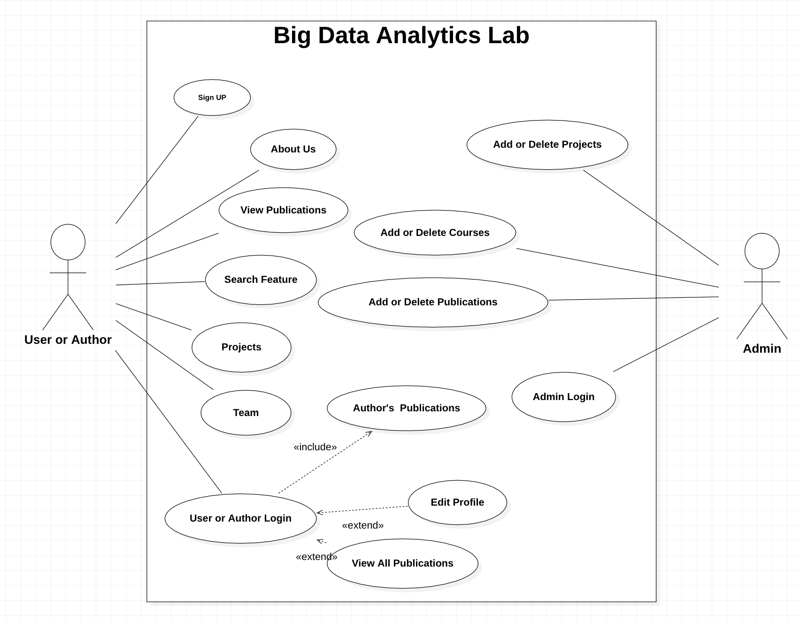
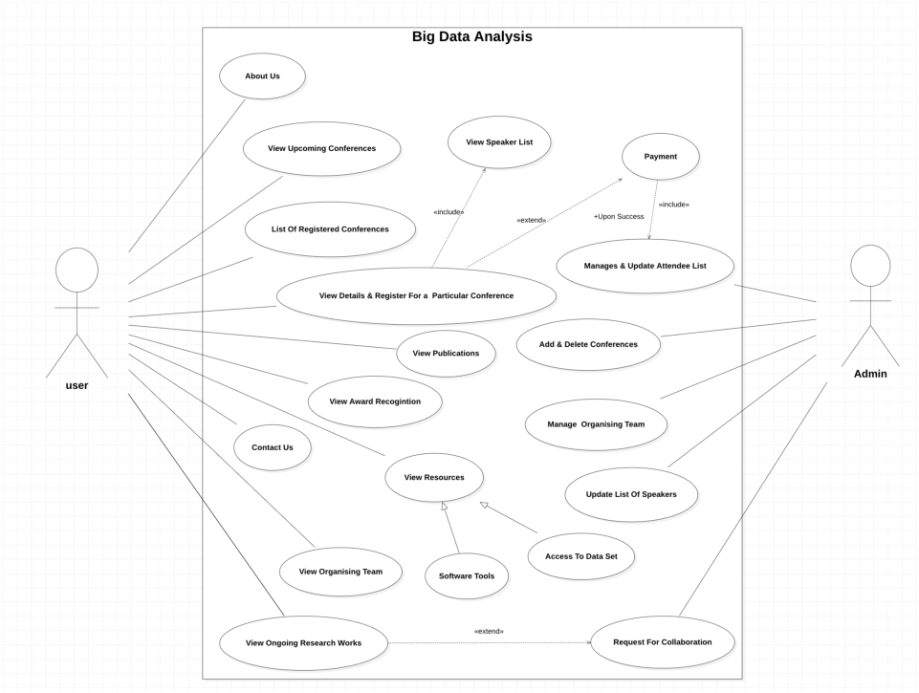
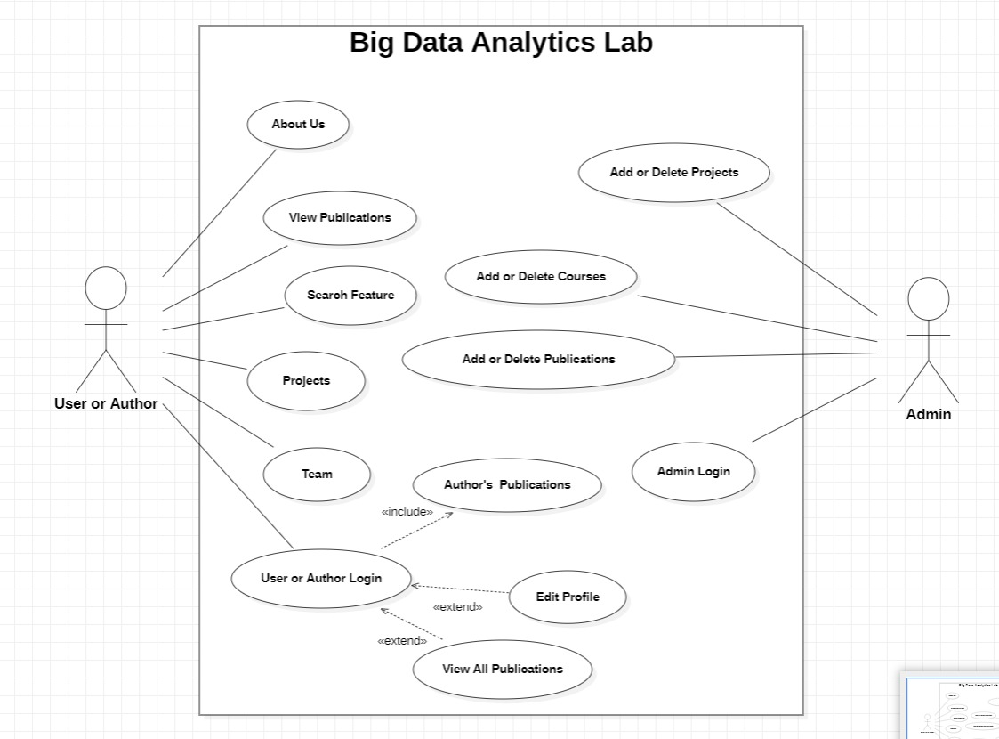
BDA LAB 7

Slide 9
3. Specific Requirements
3.1 Functional Requirements
We describe the functional requirements by giving various use cases.
USE CASE 1:
Name: View publications
Actor: User
Preconditions: The user is at the home page or profile page
Main success scenarios:
1. The user searches for a publication
2. The system displays a list publications
3. The user selects a publication to view more details
4. The system displays the list of authors, abstract etc.
Extension: None
Post-condition: The user is able to view details of the publication
USE CASE 2:
Name: About Us
Actor: User
Preconditions: None
Main success scenarios:
1. The user navigates to the "About Us" page
BDA LAB 8

Slide 10
2. The system displays information about the organisation, its mission, and its
history
Extension: None
Post-condition: The user has information about the organisation and its activities
USE CASE 3:
Name: View Team
Actor: User
Preconditions: None
Main success scenarios:
1. The user navigates to the "Team" page
2. The system displays information about the team
Extension: None
Post-condition: The user has information about the team
USE CASE 4:
Name: Search feature
Actor: User
Preconditions: The user has to click on search text box.
Main success scenarios:
1. The user searches for projects and publications of a particular author.
2. The user then selects the document for which he/she wants to see detailed information
BDA LAB 9

Slide 11
USE CASE 5:
Name: View Projects
Actor: User
Preconditions: None
Main success scenarios:
1. The user navigates to the “Projects” button in the homepage
2. The user searches for a project.
Extension: None
Post-condition: The user gets to see the list of projects.
USE CASE 6:
Name: User/ Author log in
Actor: User
Preconditions: The user is at the homepage
Main success scenarios:
1. The user navigates to the log in button at the homepage and clicks it.
2. Enter the correct user id and password
Extension: None
Post-condition: The user has redirects to user dashboard.
BDA LAB 10

Slide 12
USE CASE 7:
Name: Edit profile
Actor: User
Preconditions: The user is logged into the system
Main success scenarios:
1. The user navigates to edit profile button
Extension: None
Post-condition: The user is able to edit profile.
USE CASE 8:
Name: User/ Author log in
Actor: User
Preconditions: The user is at the homepage
Main success scenarios:
1. The user navigates to the log in button at the homepage and clicks it.
2. Enter the correct user id and password
Extension: None
Post-condition: The user has redirects to user dashboard.
BDA LAB 11

Slide 13
USE CASE 9:
Name: Add / Delete courses
Actor: Admin
Preconditions: The admin is logged into the system
Main success scenarios:
1. The admin navigates to courses and clicks add/delete button.
Extension: None
Post-condition: The course or courses selected are deleted.
USE CASE 10:
Name: Add / Delete publications
Actor: Admin
Preconditions: The admin is logged into the system.
Main success scenarios:
1. The admin navigates to publications and clicks add/delete button.
2. Enter the correct user id and password
Extension: None
Post-condition: The publication or publications selected are deleted.
BDA LAB 12

Slide 14
USE CASE 11:
Name: Add / Delete projects
Actor: Admin
Preconditions: The admin is logged into the system
Main success scenarios:
1. The admin navigates to projects and clicks add/delete button.
Extension: None
Post-condition: The project or projects selected are deleted.
BDA LAB 13

Slide 15
3.2 Non-Functional Requirements
Performance: The system handles large volumes of data efficiently, processing and analyzing it
within acceptable time
Security: The system implement appropriate measures to protect sensitive data, including
authentication, authorization, encryption, and secure communication protocols.
Usability: The BDA lab have a user-friendly interface and provide intuitive tools and
functionalities, allowing users to easily access, query, and analyze dataRegistration
will be much easier as there will be a one-stop solution for the same
Maintainability: The system is designed in a modular and maintainable manner, allowing for
updates, bug fixes, and enhancements without disrupting the overall functionality.
3.3 Hardware Requirements:
1. Internet Connection
2. Any other OS-based device
3.4 Software
Requirements:
1. Web Browser
2. Technologies used - HTML, CSS, JavaScript, node.js, MongoDB
3.5 Design Constraints:
Security: The files in which the information regarding securities should be secured
against malicious deformations.
Fault Tolerance: Data should not become corrupted in case of a site crash.
Availability: users must have the access to the website anytime they want.

