Slide 1

E-Commerce Business Intelligence & Predictive Analytics Platform
Data Analytics Capstone Project — ShopSmart
Prepared By: Sumi Gour
Sumbitted To: AcceleratorX

Slide 2
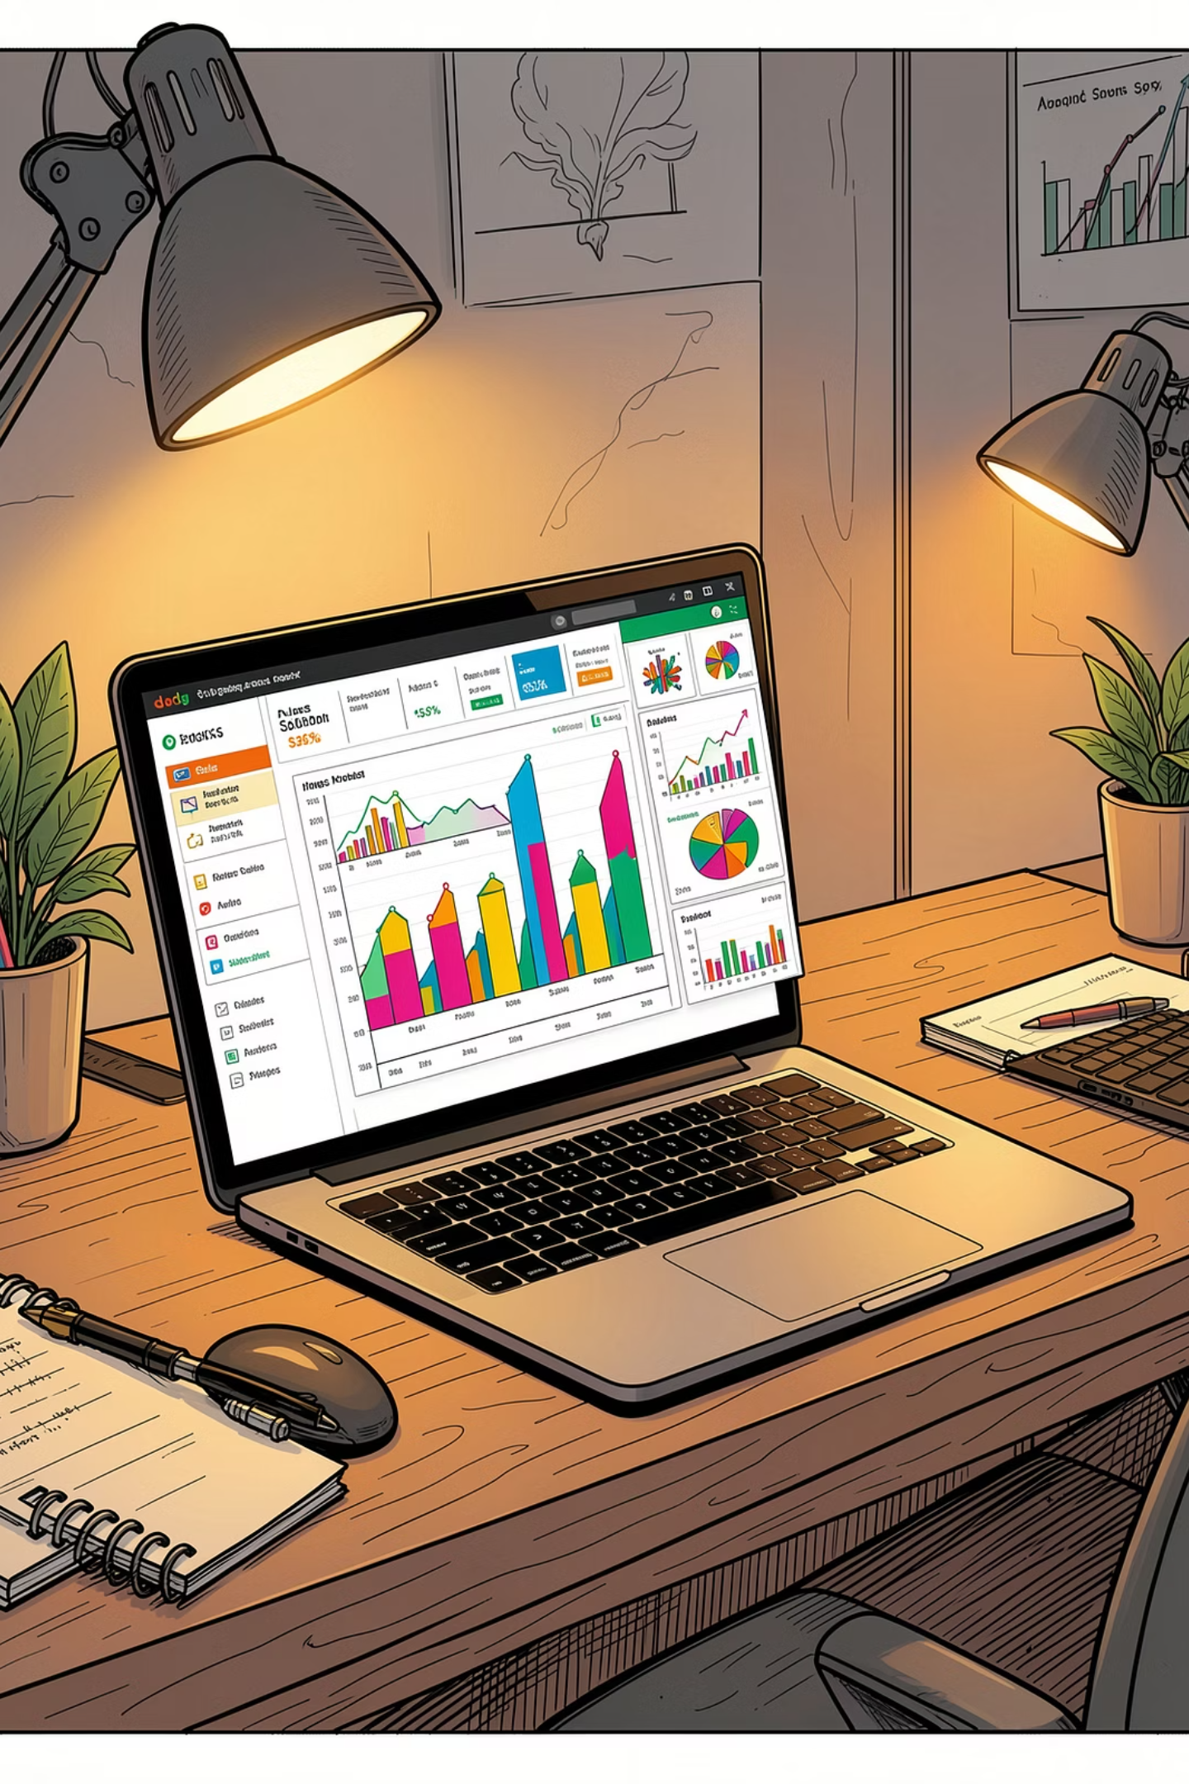
Excel Sales Analysis
and SQL databse
A comprehensive review of 5,000 sales transactions — uncovering revenue trends, top-performing regions, and best-selling products through structured Excel analysis.

Slide 3

Project Summary
This analysis transformed raw sales data into an actionable business dashboard using Excel's core analytical tools.
5,000 Transactions
Formulas & Pivot Tables
Full-year sales data cleaned, structured, and analyzed for patterns and anomalies.
Advanced Excel functions used to aggregate, filter, and summarize transactional data.
Interactive Dashboard
Revenue & Product Analysis
Visual charts and KPI cards built for at-a-glance performance monitoring.
Deep-dive into revenue drivers, regional performance, and product-level trends.

Slide 4


Key Insights
₹69.17L
#1
Dec
Total Revenue
West Region
Peak Month
Generated across all regions and product lines for the year.
Highest-revenue region, outperforming all others in total sales volume.
December recorded the highest monthly sales, driven by year-end demand.
TOP PRODUCT
HP Laptop 9 — Best-Selling Product
The HP Laptop 9 led all product categories in units sold, reflecting strong market demand and effective positioning.
Revenue grew steadily throughout the year, with top products and regions driving overall business growth. The dashboard is designed to support ongoing data-driven decision-making.

Slide 5
Conclusion & Next Steps
What the Data Tells Us
Recommended Next Steps
Revenue showed consistent upward momentum across the year, with a strong finish in December.
Drill into West region data to replicate success in underperforming regions
Investigate December demand drivers to inform future seasonal planning
Expand the dashboard to include real-time data refresh capabilities
Conduct product margin analysis alongside revenue to assess profitability
The West region and HP Laptop 9 were the primary growth engines for total revenue.
The dashboard provides a scalable framework for ongoing performance monitoring and reporting.

Slide 6
SQL Analytics -key Findings
Six analytical query types were executed to extract actionable insights from the database.
Revenue Aggregation
Monthly Revenue Breakdown
Product-Order Joins
SUM and AVG functions to calculate total revenue and average order value.
INNER JOIN queries linking product and order tables.
GROUP BY analysis tracking revenue trends across months.
Customer Segmentation
Customer Ranking
Subqueries
ROW_NUMBER() to rank customers by spend and identify top performers.
Nested queries isolating best-performing customers and products.
CASE statements classifying buyers as low, medium, or high-value.

Slide 7
Key Business Insights
$7.06M
$1,413
Total Revenue
Avg. Order Value
Generated across all orders in the dataset
Per transaction across all customers
127
$29.8K
Top Customer Spend
Top Product ID
Customer #3858 — highest individual spend
Highest-selling product by volume
Revenue Timing
Customer Behavior
Month 12 recorded the highest monthly revenue — a critical window for promotions and inventory planning.
Segmentation revealed three distinct buyer tiers. Frequent buyers demonstrate stronger purchase consistency, signaling loyalty program potential.

Slide 8
Statistical Analysis
A data-driven exploration of e-commerce performance — uncovering customer behavior patterns, revenue drivers, and actionable business insights through rigorous statistical methods.

Slide 9
Project Overview
This project applied a full suite of statistical techniques to real e-commerce transaction data, translating raw numbers into strategic recommendations.
Tools & Methods
Customer Behavior
Excel-based analysis with regression models, hypothesis testing, and A/B testing frameworks
Spending patterns, segmentation, and behavioral differences across customer cohorts
Revenue & Sales
Correlation & Regression
Monthly trend analysis, order value distribution, and performance benchmarking
Linear regression and correlation analysis to quantify key business relationships

Slide 10
Customer & Revenue Insights
5,000
Total Transactions
Full dataset analyzed across the study period
Key Spending Patterns
$2,725
Customer spending varies significantly across transactions, indicating diverse purchasing behaviors
High-value customers contribute a major share of total revenue, highlighting the importance of retention strategies
Monthly revenue trends show growth during peak periods, suggesting seasonal demand patterns
Mean Order Value
Average spend per transaction ($2,725.01)

Slide 11

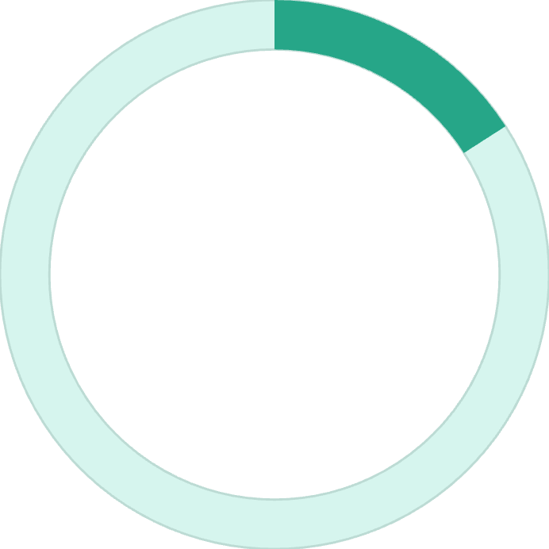
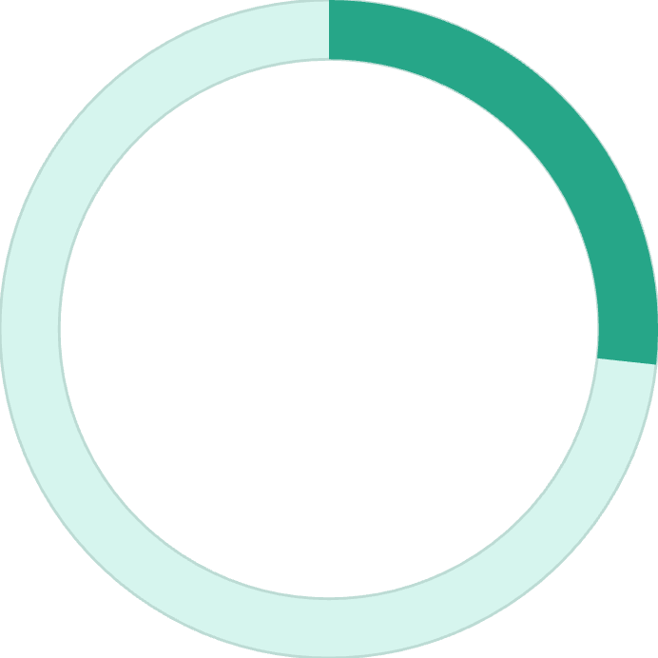
Hypothesis Testing & A/B Test Results
Email Campaign Impact
Checkout A/B Test
A t-test compared spending between email subscribers and non-subscribers.
A redesigned checkout flow was tested against the original. The variant showed a strong, significant lift in conversions.
P-value = 0.8127 — No statistically significant difference in spending between email and non-email users. Email status alone does not predict purchase value.
15.92%
26.73%
Control Rate
Variant Rate
Original checkout design conversion
New checkout design conversion

Slide 12
Regression Analysis & Conclusion
Price vs. Sales Correlation
Linear Regression: Revenue Driver
Business Takeaway
Statistical analysis confirms that data-driven decisions — not assumptions — should guide pricing, UX, and marketing strategy.
Correlation coefficient of 0.0122 reveals a near-zero relationship between price and sales quantity — pricing alone does not drive volume in this dataset.
An R² of 0.97958 indicates that 97.96% of revenue variance is explained by order volume — a powerful, reliable predictor for forecasting.

Slide 13
Python Analysis & Visualization Project
Customer Analytics, EDA & Churn Prediction
An end-to-end data science workflow exploring customer behavior, revenue patterns, and predictive churn modeling.

Slide 14
Project Objectives
Five core deliverables guided this project from raw data to actionable business intelligence.
1
Data Loading & Cleaning
Import and preprocess datasets using Pandas, handling missing values and data types.
2
Feature Engineering
Build RFM metrics — Recency, Frequency, and Monetary value — to segment customers.
3
Business Visualizations
Create charts and dashboards that translate data into clear business narratives.
4
Exploratory Data Analysis
Uncover patterns, anomalies, and relationships across transactional data.
5
Churn Prediction Model
Train and evaluate a machine learning model to identify at-risk customers.

Slide 15
Revenue Insights
Key Findings
Year-End Surge
Revenue climbed strongly toward the end of the year, consistent with seasonal purchasing behavior.
Gold Customer Dominance
Gold-tier customers contributed the highest total spending, validating loyalty segmentation strategy.
Frequency–Value Correlation
Customers who purchased more frequently also spent more per transaction — a positive correlation between frequency and monetary value.

Slide 16



Category Insights
Product category analysis reveals where revenue is concentrated and how customers purchase.
Laptops Lead Revenue
Mobile Devices Follow
Small Basket Sizes
Laptops generated the highest category revenue, reflecting strong demand for high-ticket electronics.
Smartphones and tablets also performed well, contributing meaningful secondary revenue streams.
Most orders contained 1–3 units, suggesting customers favor targeted, single-item purchases over bulk buying.

Slide 17
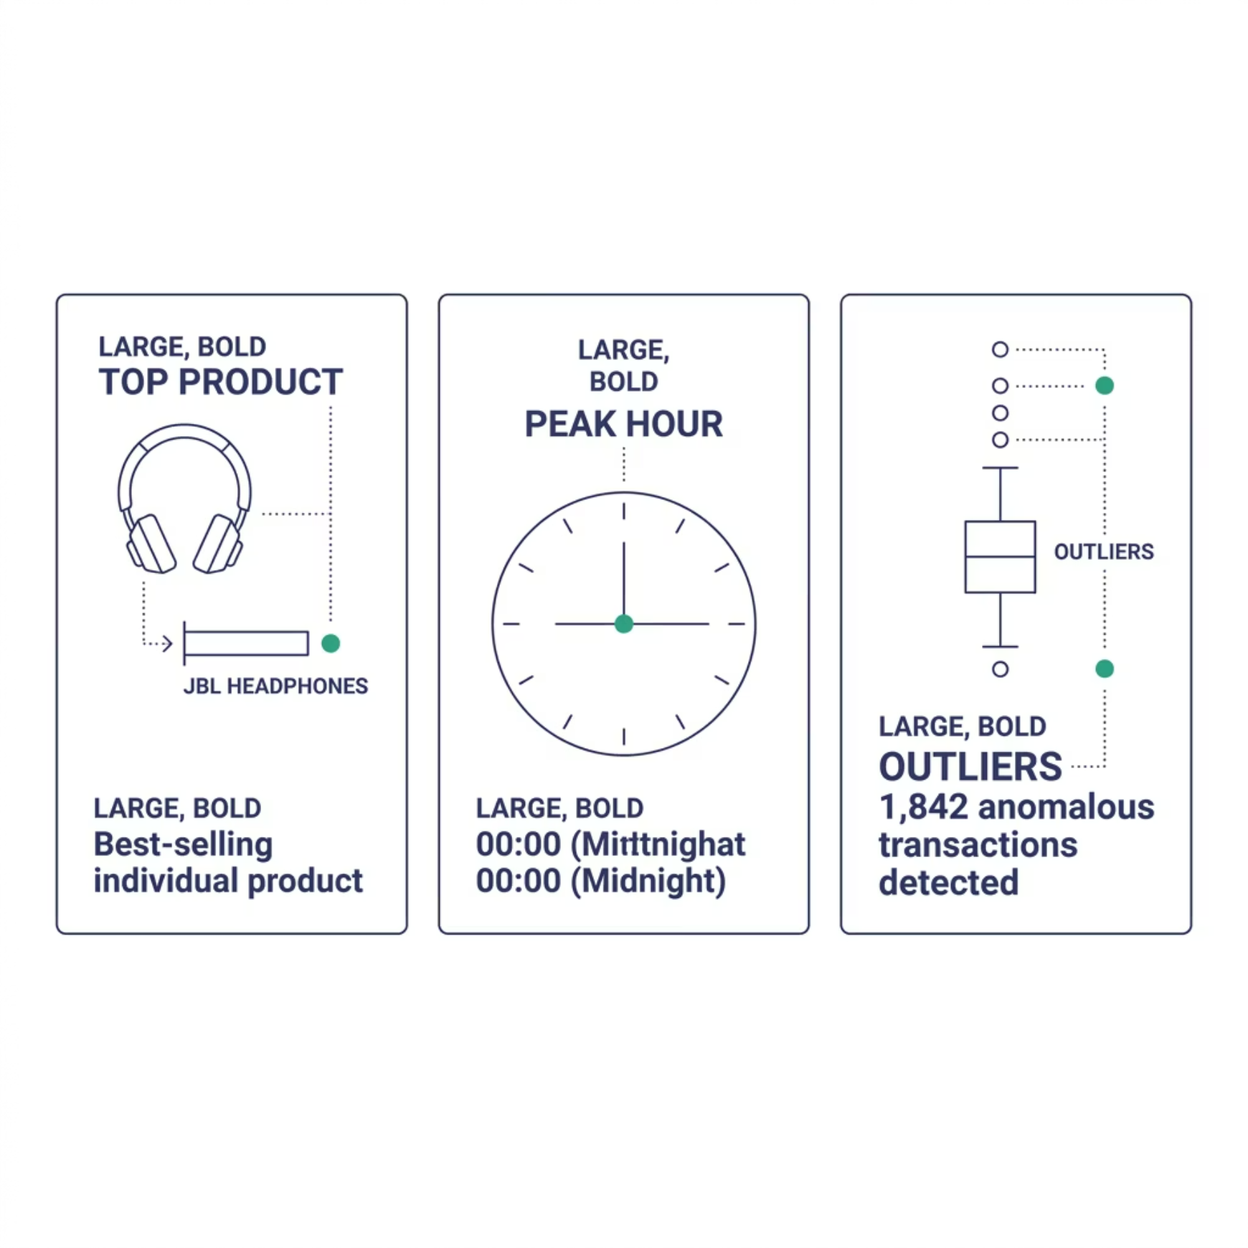


EDA Findings
What the Data Revealed
Exploratory analysis surfaced three notable patterns that inform both business strategy and data quality decisions.
1,842 outlier transactions were flagged — these may represent bulk orders, returns, or data entry errors and should be reviewed before modeling.
The midnight shopping peak suggests mobile or after-hours browsing behavior worth exploring in future segmentation work.

Slide 18
Machine Learning Results
Random Forest Churn Model
A Random Forest classifier was trained to predict customer churn using RFM features and transactional signals.
Algorithm
Accuracy
Confusion Matrix
Random Forest — robust to class imbalance and feature interactions
Very high accuracy achieved on the held-out test set
Strong precision and recall across both churn and non-churn classes

Slide 19
Interactive Dashboard Project
A comprehensive analytics solution built in Tableau / Power BI to monitor business performance, analyze product trends, and validate strategic decisions through A/B testing — all in one interactive environment.

Slide 20
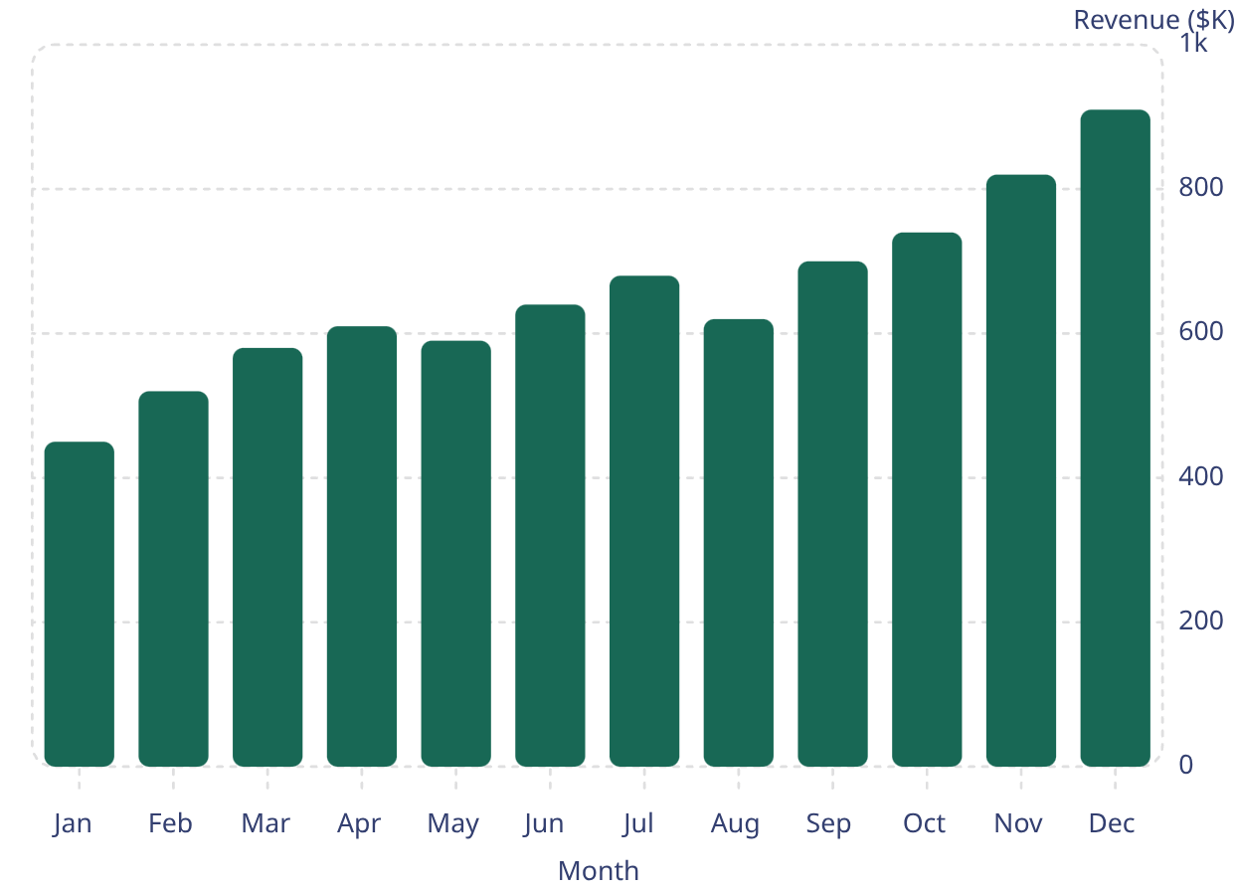
BUSINESS OVERVIEW
Business Performance at a Glance
Revenue grew steadily throughout the year, peaking in December. The Laptop category led all product segments.
7.06M
5K
2.50K
Total Revenue
Total Orders
Avg. Order Value
Strong overall business growth
Orders during the analysis period
Healthy per-transaction spending
Monthly Revenue Trend
Revenue climbed steadily month-over-month, with the strongest performance in December. Laptops dominated category revenue.

Slide 21
PRODUCT ANALYSIS
Understanding Customer Behavior
Retention, engagement, and funnel metrics reveal a loyal, growing customer base — with VIP segments driving outsized value.
45.26% Retention Rate
Nearly half of customers returned for repeat purchases
~50% Funnel Conversion
Strong conversion from browsing to completed purchase
VIP Customer Value
VIP segment delivered the highest average order value
MAU Growth
Monthly active users climbed significantly toward year-end

Slide 22
Key Takeaways
This project delivers a unified analytics platform — turning raw data into clear, interactive insights that drive smarter decisions.
Interactive Business Monitoring
Real-time KPIs enable efficient performance tracking across revenue, orders, and categories.
Deeper Customer Understanding
Product analytics revealed retention patterns, VIP value, and funnel behavior to guide engagement strategy.
Evidence-Based Strategy
A/B testing identified the higher-performing variant, reducing guesswork in product decisions.

Slide 23

Simple Data Pipeline using dbt
SQL · dbt · Power BI — End-to-End Data Engineering Project

Slide 24
Project Objective
This project demonstrates a complete modern data pipeline — from raw transaction data to business-ready insights — using SQL, dbt, and Power BI.
Build the Pipeline
Ensure Quality
Construct a dbt-based transformation layer with staging, intermediate, and mart models
Apply data quality tests to guarantee accuracy and consistency across all models
Visualize Insights
Deliver a Power BI dashboard with monthly revenue trends and KPI tracking

Slide 25
dbt Models Implementation
Three layered models transform raw data into analytics-ready tables
int_customer_metrics.sql — Intermediate Layer
mart_monthly_revenue.sql — Mart Layer
stg_orders.sql — Staging Layer
Cleaned and standardized raw transaction records
Normalized order dates and removed invalid entries
Derived a calculated revenue column
Aggregated customer-level metrics
Computed total spend and total orders per customer
Generated monthly revenue summaries
Calculated month-on-month comparison metrics

Slide 26
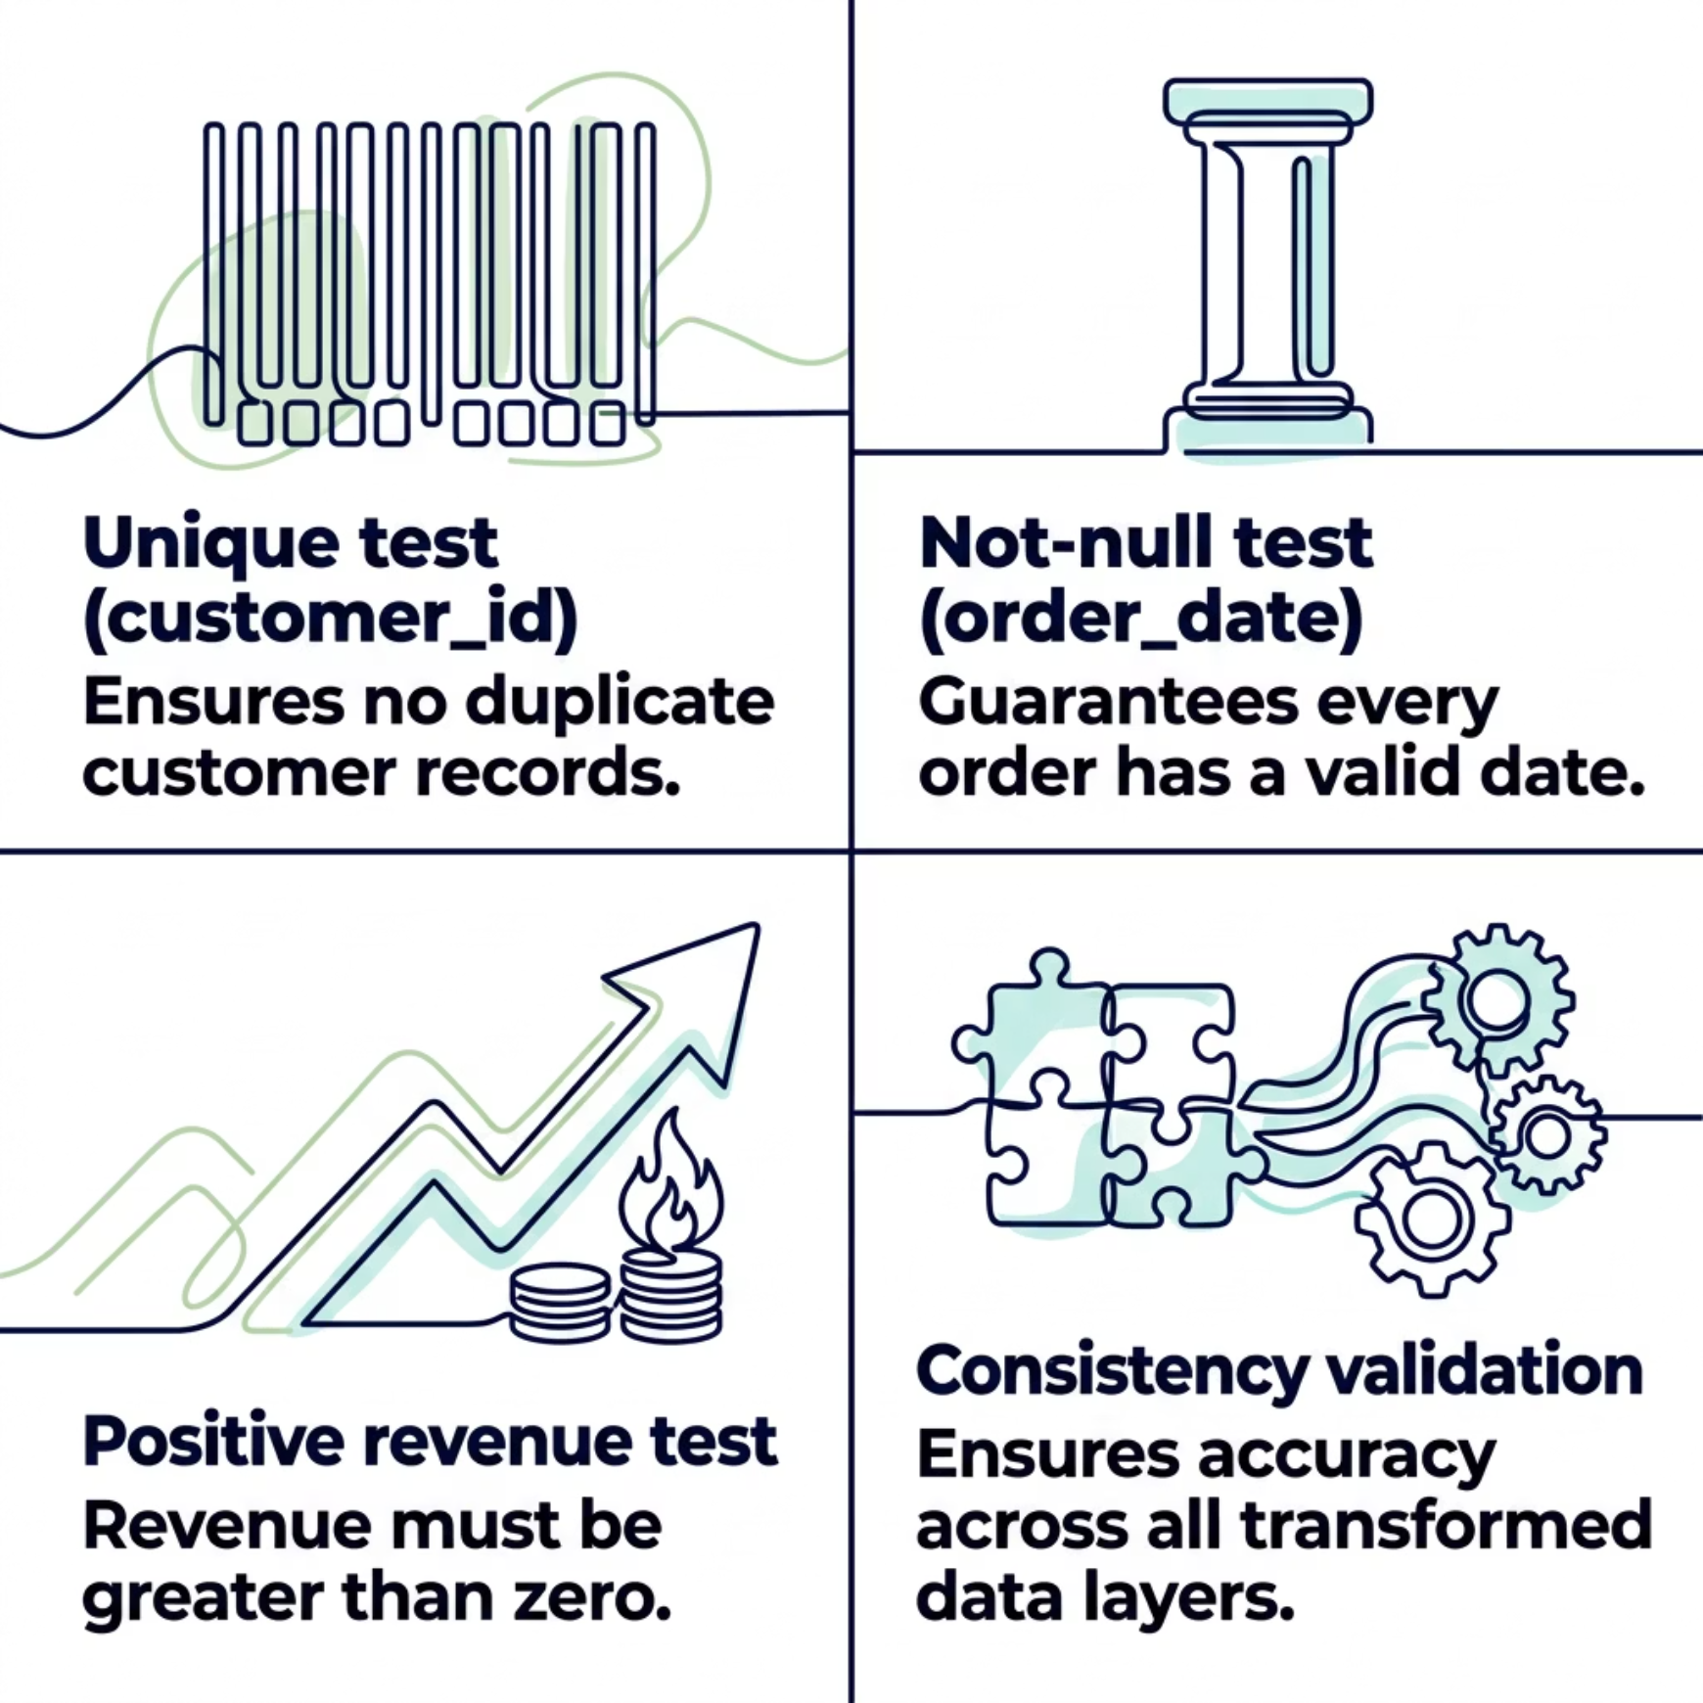
Data Quality Tests
Why Testing Matters
dbt's built-in testing framework validates data at every layer, catching issues before they reach the dashboard. Tests are defined directly in YAML schema files alongside model definitions.
All tests run automatically during dbt build, blocking bad data from propagating downstream.

Slide 27
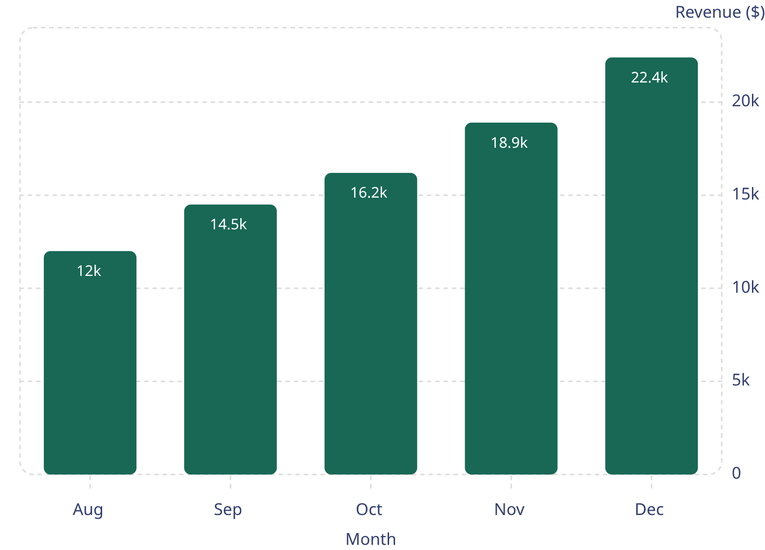
Dashboard & Key Insights
Dashboard Features
Monthly revenue trend analysis with visual charts
Current month vs. prior month comparison
Revenue change KPI tracking
Total orders breakdown
Key Insights
Revenue showed continuous growth toward year-end
December 2023 recorded the highest monthly revenue
Positive month-on-month growth confirmed across all periods
Dashboard enables rapid identification of sales performance trends
Illustrative trend — replace with actual project data.

