Slide 1
Lending Club Case Study
Sumit Roy
Nisha Chandora

Slide 2
Case Specifics
The company is the largest online loan provider in various categories
The company aims to identify the risky loan applicants to reduce its credit loss
Loan dataset:
Information about past loan applicants whose application was accepted
Approved loan is categorized as Fully paid, Current or Charged-off (defaulted)
Objective: To determine the driving factors resulting in loan defaults
Method: Conducting EDA to understand the applicants attributes and loan attributes in determining the risky applicants who tend to default.
Data Clean-up and Preparation process:
Analysis process:
Importing the Data
Removing NULL values
Removing irrelevant columns
Correcting data types and deriving new columns
Filter Data for requirement.
Removing Duplicate Data
Univariate Analysis
Univariate Segmented Analysis
Derived Matrices
Insights drawn
Bivariate Analysis

Slide 3
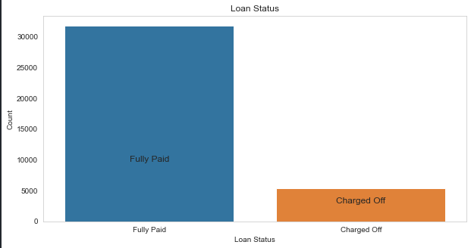
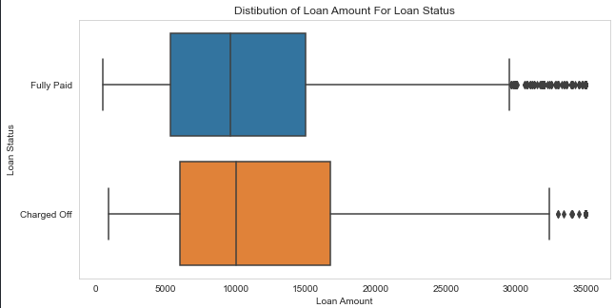
Loan Status And Amount
Loan Status: The charged-off loans comprise of about 14.4% of the total loans approved (disregarding the current status).
Loan Amount: The loan amount ranges from 5000 to 35000 with a median value close to 10000. The loan amount is fairly small for majority of the clients. Fewer clients have taken loan of higher amounts.
Larger the amount of loan, higher the chances of default.

Slide 4
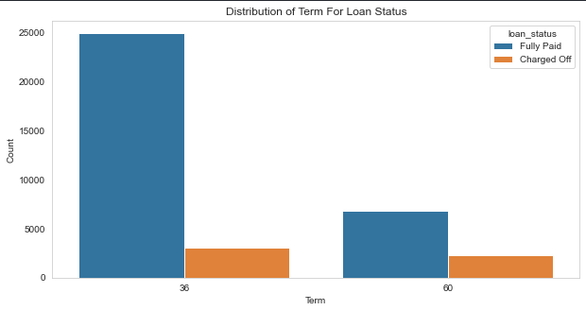
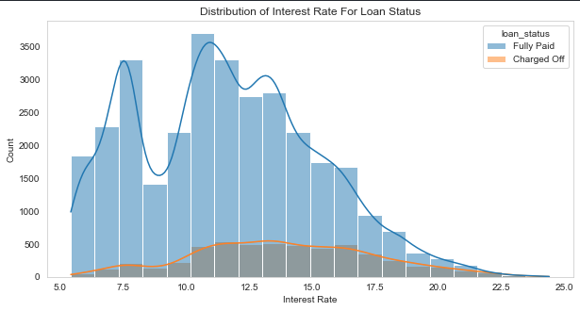
Term And Interest Rate
Loan Term: The number of loans taken for 36 month term is higher than 60 months but have lower rate of defaulting comparatively.
Interest Rate: The count of loan taken varies with interest rate, showing peak around in 5-15 bracket and decreasing slowly. Conversely, the percentage of defaulting increases with interest rate.

Slide 5
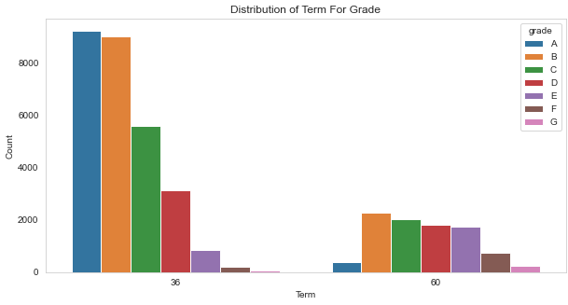
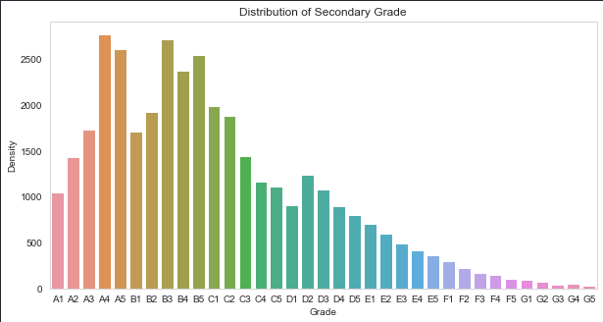
Grade And Sub-grade
Grade: The loan approved are mostly higher grade loans as they are of low risk thus low chance of defaulting. The 60-month term loans have larger number of lower grade loans with higher risk.
Sub-grade: This provides more insight that the loans with high grade are more skewed towards lower sub-grades.

Slide 6
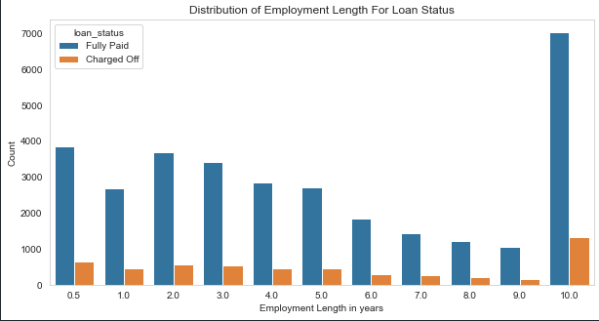
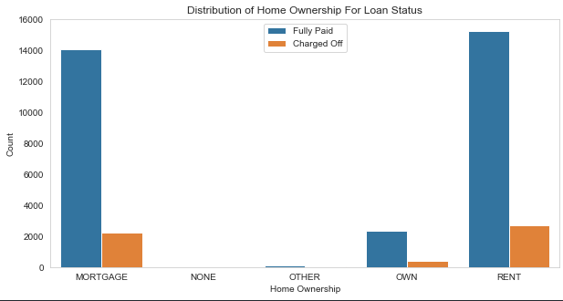
Employment Length & Homeownership
Employment Length: Majority of clients have 10+ years of experience and have highest number of defaulted loan.
Home Ownership: Majority of clients have rented or mortgaged property and have a higher tendency of defaulting.

Slide 7
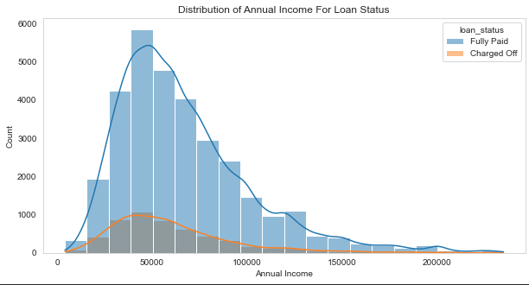
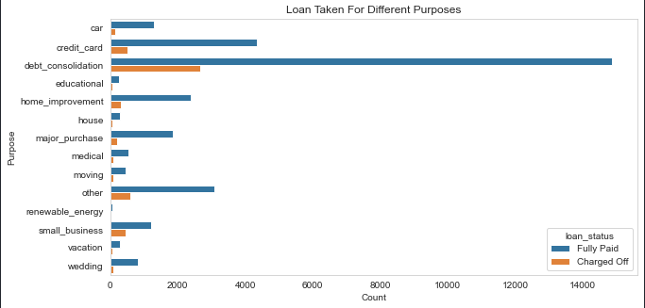
Annual Income & Purpose
Annual Income : There is concentration of clients at low annual income levels (less than 1M). Income lesser than 50k has higher chance of defaulting.
Purpose: Loans are taken mostly for debt consolidation followed by credit card payment. Although, the debt consolidation has highest fully paid loan yet it also has highest number of defaulted loans.

Slide 8
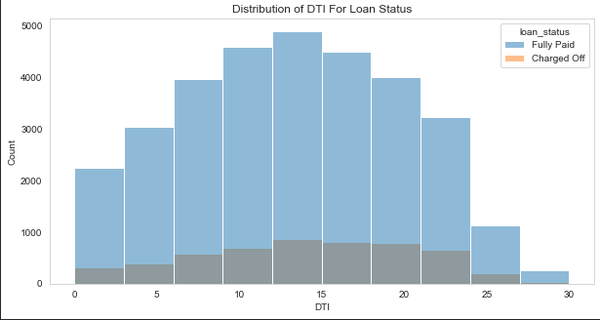
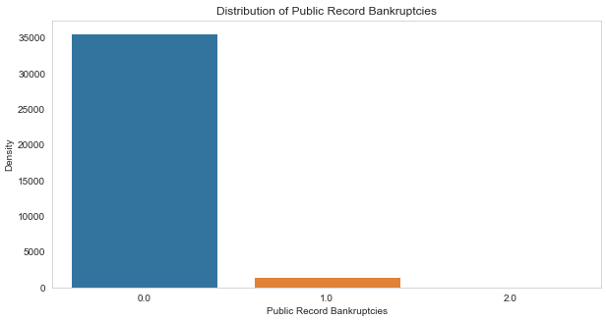
DTI Ratio & Bankruptcy
DTI: Majority of clients have a Debt to Income ratio higher than 10, which shows that lending to such clients can be risky.
Public Recorded Bankruptcy: Majority of clients did not declare bankruptcy.

Slide 9
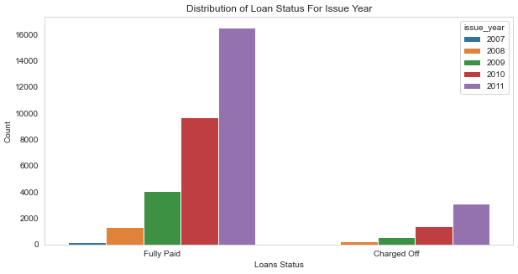
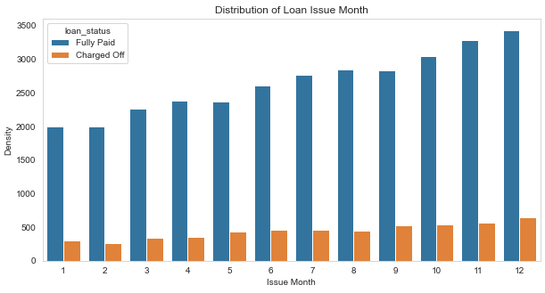
Loan Trend Over Years
With each passing year loan taken has increased significantly. We are seeing large increase in DTI ratio and increase in defaulting rate.
We see a gradual increase in loan taken through the year, with lesser defaulting rate in April ,August, December.

Slide 10
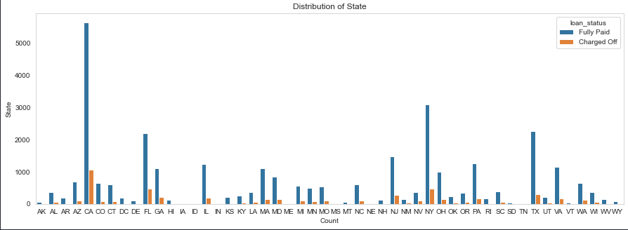
Location Based
The metropolitan cities like California, New York, Texas, Florida have large number of loans, and high number of defaulted loans.
Although, state of Nebraska has fewer loans approved compared to other states, the rate of default is whooping high at 40%, followed by Nevada state with 22% charged off loans.

Slide 11
Diving Deep
Although number of defaulters with 10+ years of employment experience is higher yet, the rate of default (i.e. ratio of no. of defaulter to total no. of loans at particular experience level) is higher for less experienced people (less than 4years of exp.).
Similarly, the number of loans taken and defaulted for debt-consolidation purpose is more, however the percentage of default (no. of defaulter to total no. of loans for particular purpose) is higher for small-business category followed by renewable energy loans and educational loans.
People with high DTI (≥20) and People who have high loan to annual income ratio (≥0.2) show higher risk of defaulting.
Although high grades loans like A, B, C are more popular among applicants, the lower grade loans like E,F,G have higher rate of defaults.
Though the number of clients having verified source of income is higher, the defaulters are also high in this category. The impact of Verified/Non-verified Source Income along with DTI , Employee Experience level and Grade of loans on Loan Status was studied and similar pattern was observed.

Slide 12
Conclusion and Recommendations
To conclude, major driving factors indicating tendency to default are:
Grade, Tenure and Purpose of loan
Verification Status and Home-ownership of applicant
Annual Income To Loan Ratio and DTI of applicant
Recommendations:
Long term loans are defaulted more often, hence such applications must be scrutinized thoroughly.
Clients opting for low grade loan have higher tendency to default, hence several other factors (like employment experience, source income verification, term of loan, DTI) must be closely analyzed while approving such loans.
Having Public Recorded Bankruptcy can be good indicator of future default.
Applicants with very high Debt to Income ratio or Loan to Annual Income ratio can cause greater credit loss to Lending Club.
Applications for small business loans must be examined in details as they have higher rate to default.
Analysis of location and home ownership (esp. Mortgage and Rent) is to be considered for future loan approvals.

Slide 13
Thank You

