Slide 1


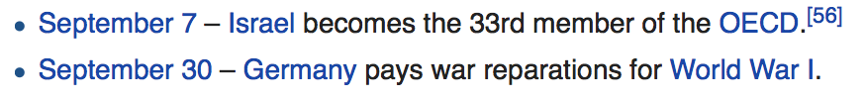

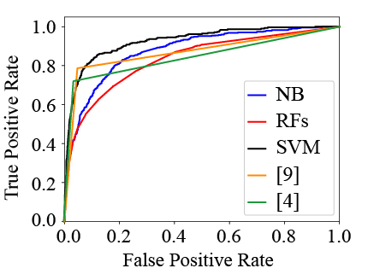
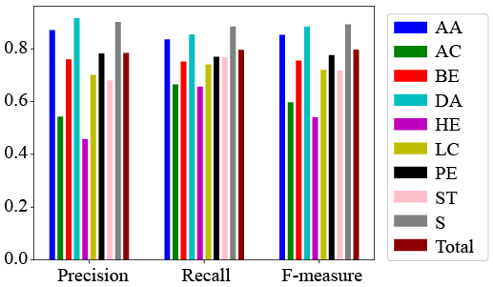
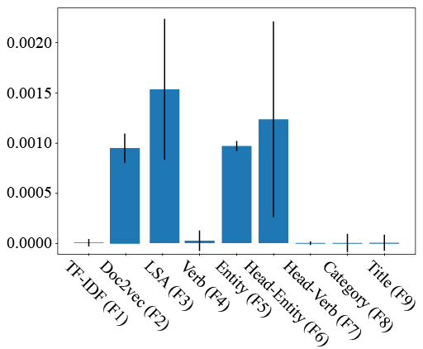
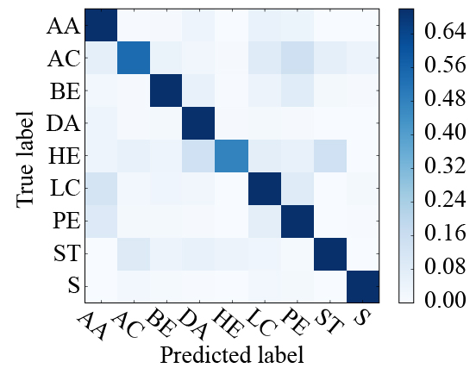
ECIR’18, 27 March 2018 ＠Grenoble, France
Classifying Short Descriptions of Past Events
Yasunobu Sumikawa
Tokyo University of Science
Adam Jatowt
Kyoto University
Introduction
Method
Evaluations
Past events can be referred with short texts.
Ex.: chronological ordered lists.
Feature Vector Creation
Baselines
TF-IDF + SVM: SVM on TF-IDF weighted BOW vectors
designed for long text.
MaxEnt: Entropy-based classifier that is one of the most
commonly used method for short text.
Person, Organization, Place, Event, Other
Contributions:
Identifying what features are useful for this task.
Our classifier is the best for micro-avg. F-score.
This is useful for constructing thematic timelines or event lists (e.g., list of disasters/accidents in Asia, timeline of armed conflicts in USA).
Yodie
{0, 1, 0, 0, 1}
Results
Tab.2 Micro-average F-scores for baselines
The Beatles release their back catalogue on iTunes.
TF-IDF + SVM | MaxEnt
54.5% | 64.0%
Stanford POS tagger
ESA
{0, 0, 1, 0, 0, …, 0}
Tab.3 Micro-average F-scores for our approaches
Event Classes and Example Descriptions
All+Naïve Bayes | All+RFs | All+SVM
58.3% | 54.6% | 79.7%
1. Armed Conflicts and Attacks (AA, 8886 events),
Ex. “Bombs across Iraq detonate, killing 18 people.”
2. Arts and Culture (AC, 1800 events),
Ex. “The Beatles release their back catalogue on iTunes.”
3. Business and Economy (BE, 2517 events),
Ex. “Brazil’s economy falls into recession.”
4. Disasters and Accidents (DA, 4961 events),
Ex. “A bus crashes into a ravine in Tibet, killing
at least 44 people.”
5. Health and Environment (HE, 487 events),
Ex. “The number of Zika virus infected in Singapore
rises above 40.”
6. Law and Crime (LC, 4984 events),
Ex. “The Constitutional Council of France upholds
a ban on fracking.”
7. Politics and Elections (PE, 5517 events),
Ex. “Voters in Costa Rica go to the polls for a
general election.”
8. Science and Technology (ST, 1066 events),
Ex. “Iran successfully puts the Fajr satellite in orbit
using a Safir-B1 rocket.”
9. Sport (S, 2400 events)
Ex. “The Winter Olympics in Sochi, Russia officially
concludes.”
429 VerbNet classes
We combine all the 9 feature vectors: TF-IDF, Doc2Vec, LSA, Verb, Entity, Head-Verb, Head-Entity, Wikipedia Category, Titles of Wikipedia articles.
Dimension Reduction
To reduce sparsity, we select k-important (k = 2,000) features by using the forests of trees.
(a) Micro-average ROC curves
(b) Accuracies for All+SVM
Statistics of Dataset
Tab.1 Statistics
Num. of entities | 17,503
Num. of concepts | 2,540
Num. of Wiki. Category | 16,809
Num. of typed events | 32,618
Timespan range | 2010/1/1 ~ 2016/12/17
(c) Feature importance
(d) Mis-predicted by All+SVM
Conclusions
* Current events portal of Wikipedia.
Average lengths: 25 words.
We introduce classification technique for short, retrospective
descriptions of events and report satisfactory results (F-score of about 0.8) over the dataset of 32k event descriptions.

