Slide 1
EDES 301 <Eggcellent Timer> Proposal
<09.30.24>
<Sumin Jeong>

Slide 2
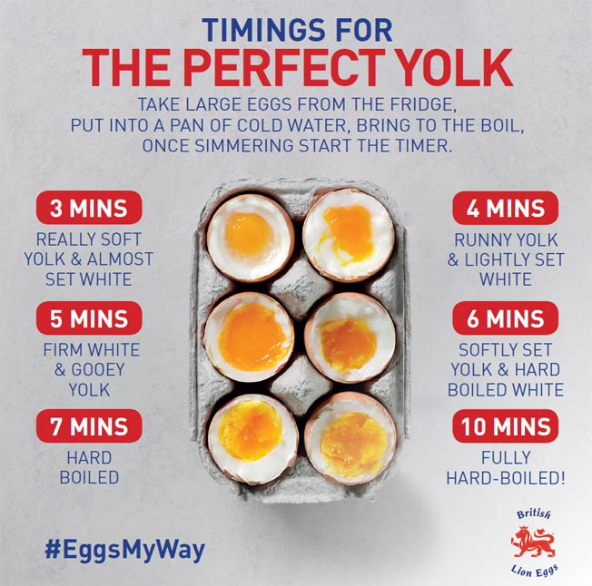
Background Information
Egg cooking timer
There are buttons for each timer, depending on the degree
of how much you want the egg to be boiled
Ex) 6 min button for soft yolk, 10 min for fully hard-boiled, etc.
There is a display that shows the timer counting down,
and alarms when it is done
In terms of how the device would look like, I got motivation from this project:
https://www.hackster.io/sp94/engi-301-sunrise-alarm-clock-e4a65d

Slide 3
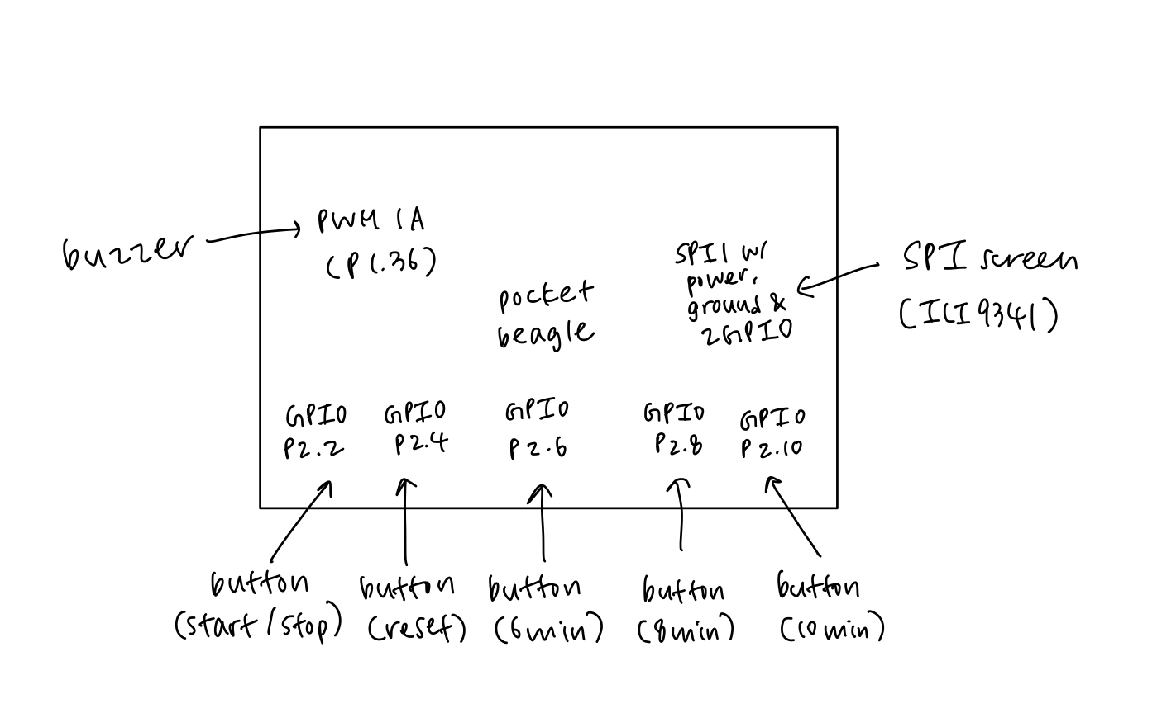
System Block Diagram

Slide 4
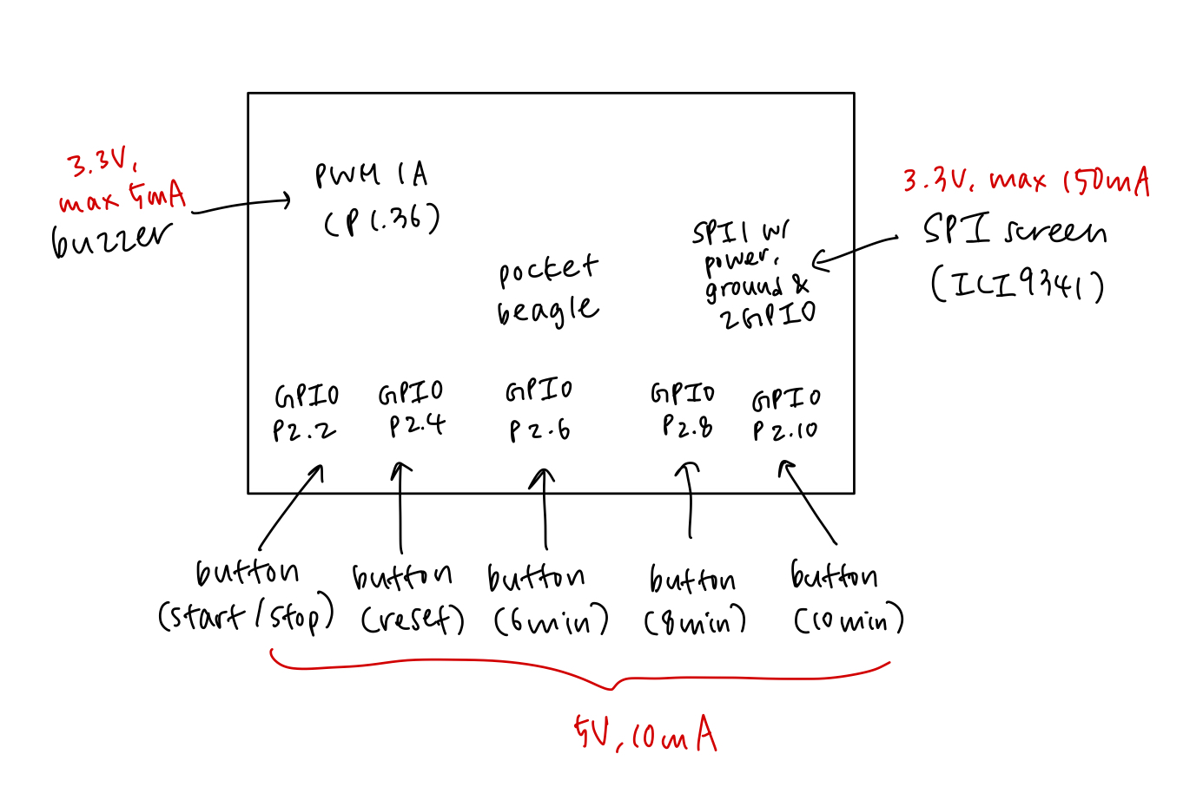
Power Block Diagram

Slide 5
Components / Budget
Component | EDES301 to Buy? | Cost
1x LCD Touchscreen (https://www.adafruit.com/product/1770) |  | $29.95
1x Buzzer (https://www.adafruit.com/product/1536) |  | $0.95
5x Arcade buttons (https://www.adafruit.com/product/3491) | Yes | $12.50
See Next Slide for Instructions

