Slide 1

Airbnb Case Study
Presented By
Praveen N. Sharma
Sanjukta Sengupta
INSIGHTS

Slide 2

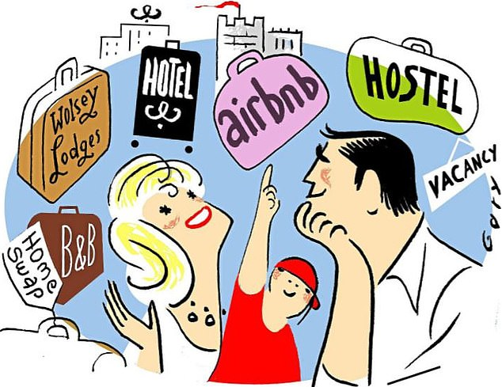
AGENDA
Objective
Inferences and Visualization
Methodology

Slide 3
For the past few months, Airbnb has seen a major decline in revenue. Now that the restrictions have started lifting and people have started to travel more, Airbnb wants to make sure that it is full prepared for this change.
So, analysis has been done on a dataset consisting of various Airbnb listings in New York to increase the revenue.
OBJECTIVE

Slide 4

Inferences
and Visualization

Slide 5
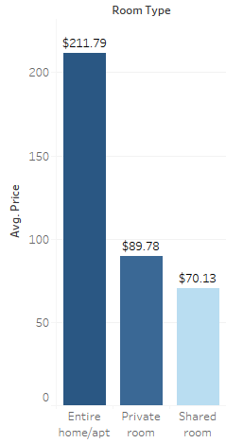
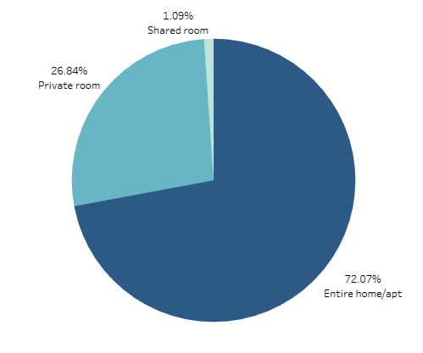
AVERAGE RENT OF ROOM TYPE
PREFERENCE OF ROOM TYPE
Average price of Entire Home/Apt costs $211.79 and it’s the highest while shared room are the lowest with lesser availability
The majority of people prefers to stay in Entire Home/Apartment is 72.07% of the Total Stays

Slide 6
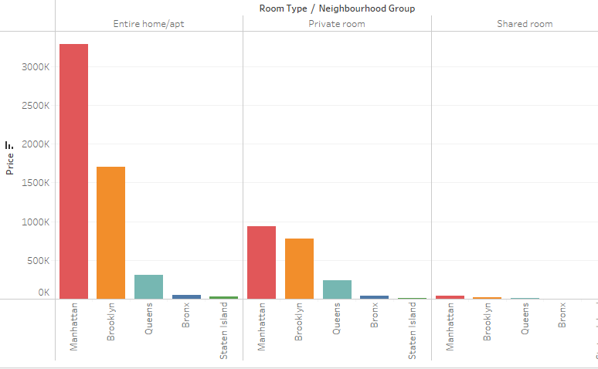
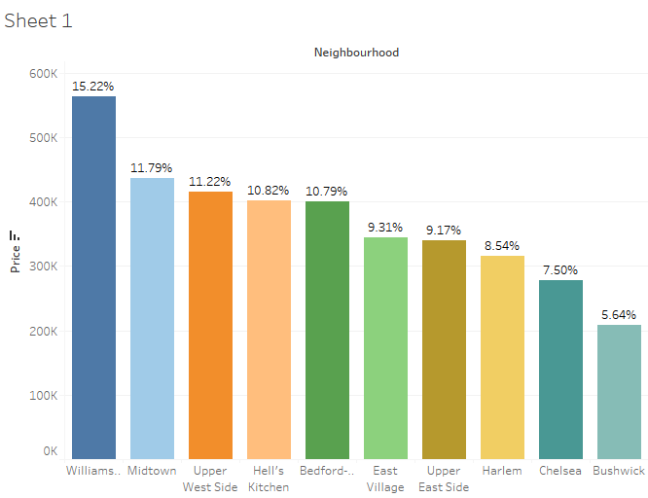
ROOM TYPE PREFERENCE BASED ON NEIGHBORHOOD
TOP 10 LOCATIONS BASED ON PRICE
Brooklyn and Manhattan have most number of room listed in neighborhood groups. The Majority of People like to stay in Entire home/ Apt or Private room.
Here it can be seen even though the room price in Williamsburg is at high price and accounts for 15.2%, but the ambience attracts the people.

Slide 7
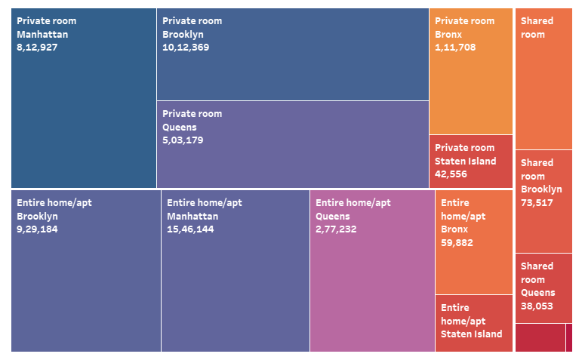

TREE MAP COMPREHENDS
There are three types of the room from which people preferred the private rooms in the Manhattan because it is the centre of New York city and People can enjoy the view from there rooms at this location.

Slide 8
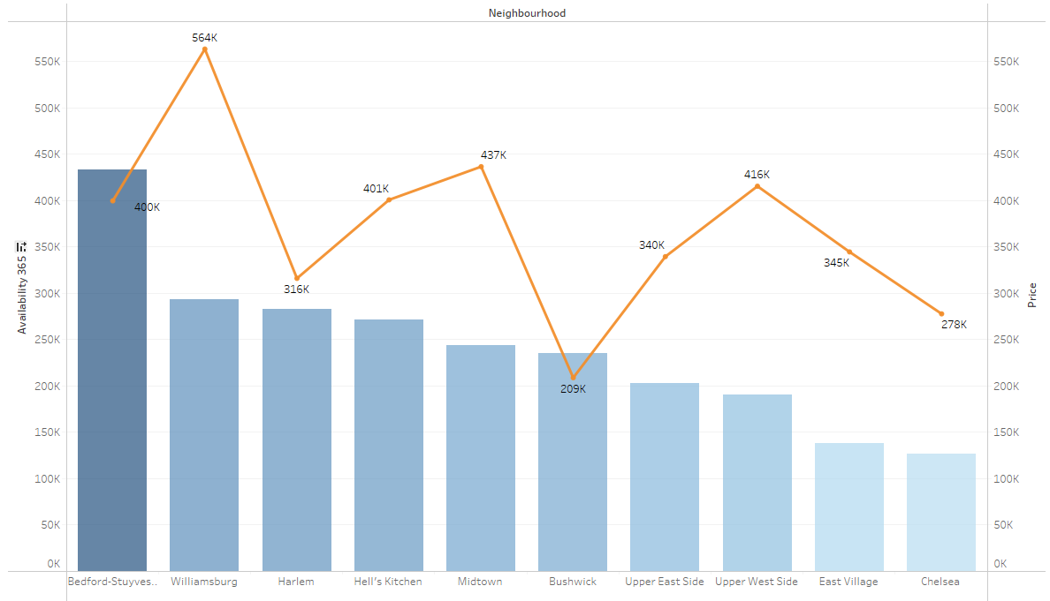
AFFORDABLE LOCATION IN TERMS OF ROOM TYPE AND PRICE
Bushwick is affordable in price and rooms are easily available.
People love to see the an evolving, industrial area marked by imaginative street art and converted warehouses.

Slide 9
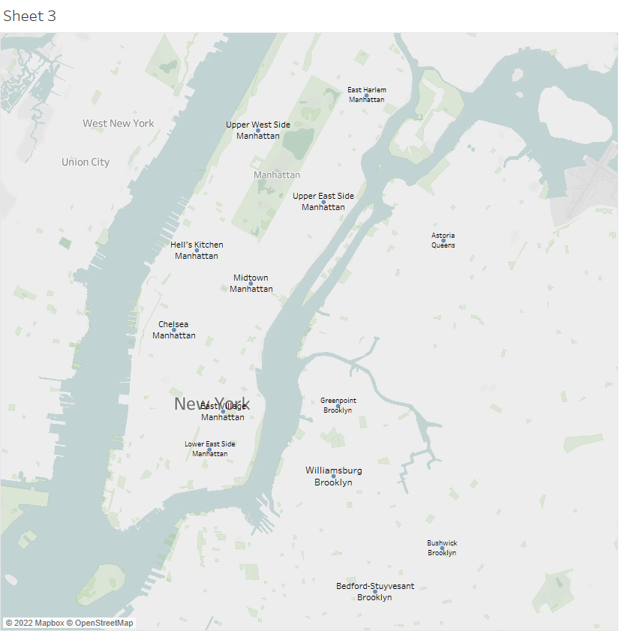
TOP 15 LOCATIONS BASED ON CUSTOMER REFERENCE
These are Top 15 locations where people like to stay for longer period of time.
Most of these places are in Manhattan area.
The majority of locations are in Manhattan.

Slide 10

Methodology

Slide 11
We have used Tableau application to analyse the database to gain insights about different Airbnb properties in New York.
Basically there are five neighbourhood groups in New York, where the Airbnb are present and there are as follows Manhattan, Brooklyn, Queens, Bronx and Staten Island.
EXPLORATORY DATA ANALYSIS:
Checked the Null values in the dataset. It was found that some columns have null values i.e. names, host_name, last_review, and review_per_month.
Checked for the outliers in the dataset.
DATA ANALYSIS:
Analysed the data using different columns based on the price, availability_365, minimum nights, and the reviews of the customers been received
INFERENCES AFTER ANALYSING THE DATA:
It was seen that people like to visit the center of New York from where they can see the beauty of the city.
The number of listings of shared rooms is limited but their average price is placed less and availability is high.
A number of reviews and reviews per month were more at lesser price as compared to the higher price as there is lesser chance of people going for a high price room.
Minimum number of night spent is at Bushwick
Manhattan and Brooklyn are very costly neighnourhood_groups.
People show interest in the host Blueground and spend more nights here. The minimum number of nights to stay reduces with a price increase.
To Focus on the prime locations : Manhattan and Brooklyn where people have shown interest after analysing.

Slide 12
Thank You

