Slide 1

AIRBNB CASE STUDY
BY:-
PRAVEEN N SHARMA
SANJUKTA SENGUPTA

Slide 2


Agenda
Objective
Visualization and Inferences
Methodology

Slide 3
For the past few months, Airbnb has seen a major decline in revenue. Now that the restrictions have started lifting and people have started to travel more, Airbnb wants to make sure that it is full prepared for this change.
So, analysis has been done on a dataset consisting of various Airbnb listings in New York.
OBJECTIVE

Slide 4

Inferences
and Visualization

Slide 5
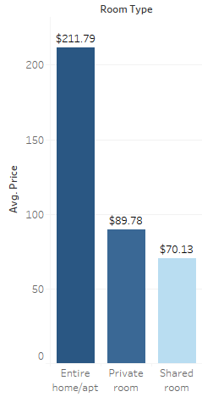
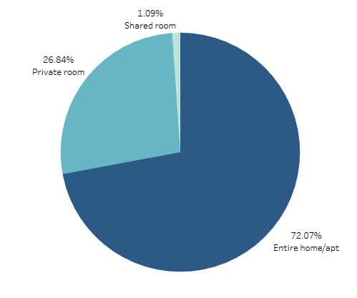
AVERAGE RENT OF ROOM TYPE
PREFERENCE OF ROOM TYPE
Average price of Entire Home/Apt costs the highest while shared room are the lowest with lesser availability
The majority of people prefers to stay in Entire Home/Apartment is 72.07% of the Total Stays and accounts for most number of stays.

Slide 6
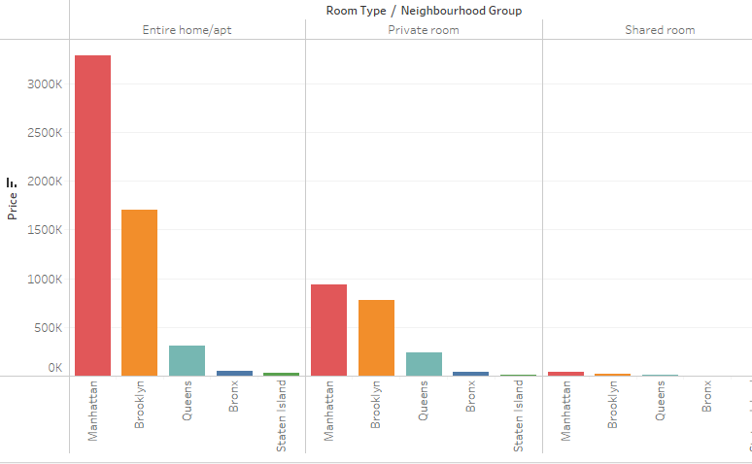
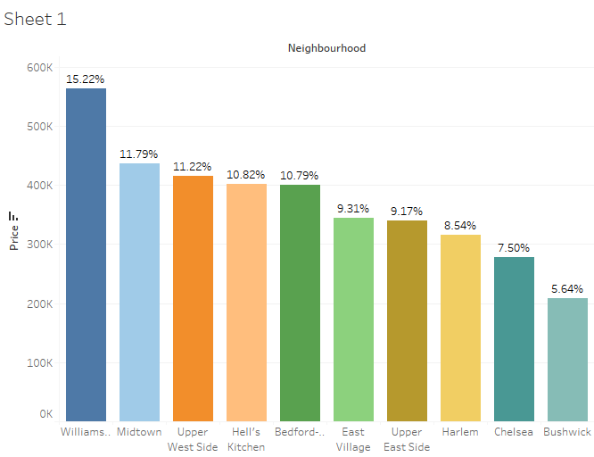
Brooklyn and Manhattan are the two preferable top leading neighbourhood groups in terms of room listings as well as majority of customers opt for entire home/apt or private room.
These are the top 10 locations on the basis of the price, as compared to the price, Williamsburg is at the higher price,but the surrounding ambience attracts the people.

Slide 7
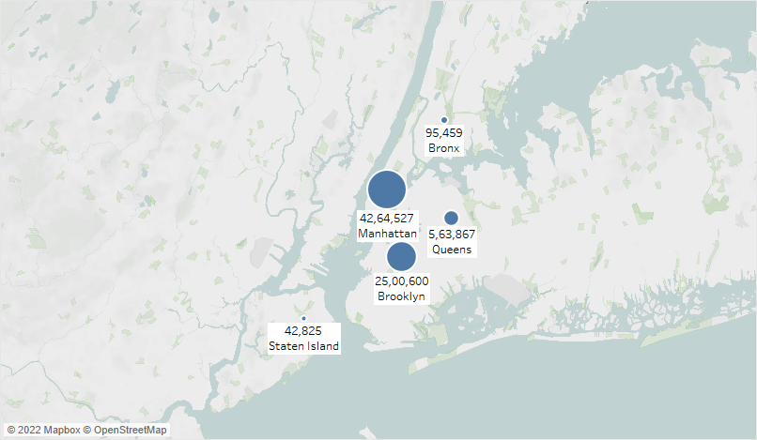
PREFERABLE LOCATIONS BASED ON CUSTOMER REFERENCE
Price of the accommodation in the city of Manhattan is on the higher end and considered affordable for the higher class people.
The scenic beauty off Manhattan is attracting the customers to rent the property.

Slide 8
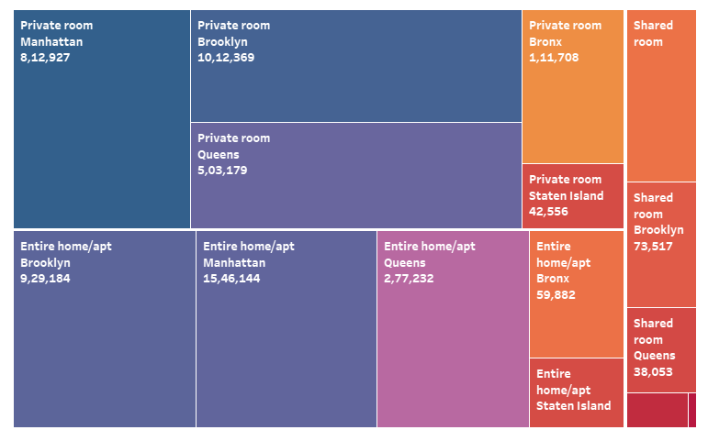

PREFERENCE OF ROOM TYPE
Three types of the room are available, out of which customer preferred the Private rooms in the city of Manhattan, as it is the centre of New York city and People can enjoy the scenic view from there rooms.

Slide 9
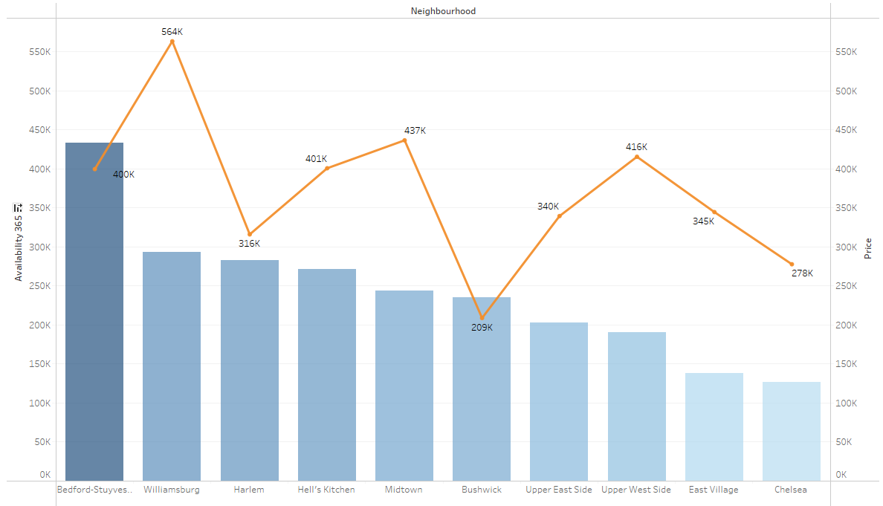
Manhattan and Brooklyn are most costly locations in New York. Customers who are not able to afford to stay in the above prime location, prefer to reside close to Brooklyn, Williamsburg, and Queens. Bushwick is affordable in comparison to price and rooms, which are easily available. Customers crave to see the ever-growing and evolving, industrial area marked by unconventional street graphics and convertible warehouses.

Slide 10
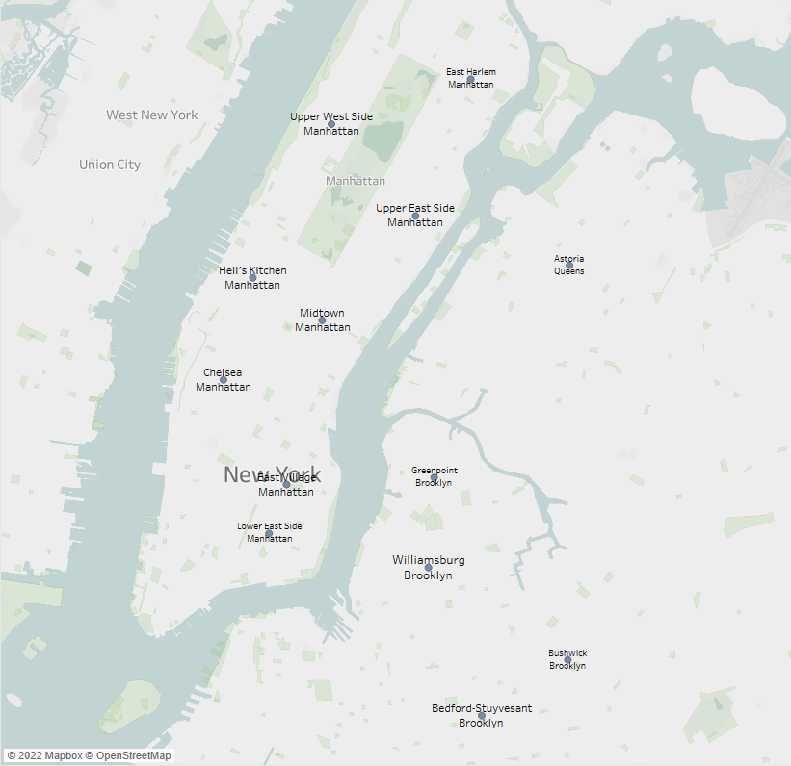
TOP 15 LOCATIONS BASED ON CUSTOMER REFERENCE
These are Top preferable15 locations where people like to stay for longer duration of time.
Most of these places are in and near Manhattan area.
The majority of locations are in Manhattan.

Slide 11

Methodology

Slide 12
We have used Tableau application to analyse the database to gain insights about different Airbnb properties in New York.
Basically there are five neighbourhood groups in New York, where the Airbnb are present and there are as follows Manhattan, Brooklyn, Queens, Bronx and Staten Island.
EXPLORATORY DATA ANALYSIS:
Checked the Null values in the dataset. It was found that some columns have null values i.e. names, host_name, last_review, and review_per_month.
Checked for the outliers in the dataset.
DATA ANALYSIS:
Analysed the data using different columns based on the price, availability_365, minimum nights, and the reviews of the customers been received
INFERENCES AFTER ANALYSING THE DATA:
It was seen that people like to visit the center of New York from where they can see the beauty of the city.
The number of listings of shared rooms is limited but their average price is placed less and availability is high.
A number of reviews and reviews per month were more at lesser price as compared to the higher price as there is lesser chance of people going for a high price room.
Minimum number of night spent is at Bushwick
Manhattan and Brooklyn are very costly neighnourhood_groups.
People show interest in the host Blueground and spend more nights here. The minimum number of nights to stay reduces with a price increase.
To Focus on the prime locations : Manhattan and Brooklyn where people have shown interest after analysing.

Slide 13
THANK YOU

