Slide 1

EC 614: Adaptive Signal Processing Techniques Course Instructor: Dr. Debashis Ghosh
Department of Electronics & Computer Engg.
Indian Institute of Technology Roorkee

Slide 2
Syllabus
Definitions, assumptions and requirements of adaptive signal processing applicable to different application examples; Linear filter structures; Adaptive beamforming (4 lectures).
Optimum linear combiner and Wiener-Hopf equations, orthogonality principle, minimum mean square error and error performance surface; Multiple linear regression model; Linearly constrained minimum-variance filter (6 lectures).

Slide 3
Syllabus (contd.)
Forward and backward prediction error filters; Levinson—Durbin algorithm; Properties of prediction-error filters; Autoregressive modeling of a stationary stochastic process; All-pole, all-pass lattice filter (8 lectures).
Steepest-descent algorithm and its stability; Principles of stochastic gradient descent, LMS algorithm and its variants (4 lectures).
Least Squares method, its efficient implementation: Minimum sum of error squares, normal equations and linear least-squares filters, Singular value decomposition, cyclic Jacobi, Householder methods (8 lectures).

Slide 4
Syllabus (contd.)
RLS adaptive filtering algorithms; Exponentially weighted RLS algorithm; Kalman filter and its variants; Square-root adaptive filters, adaptive beamforming (8 lectures).
Implementation examples: Adaptive modeling and system identification, inverse adaptive modeling, equalization and deconvolution, adaptive control systems, adaptive interference cancellation (4 lectures).

Slide 5
Suggested Texts / References
S. Haykin, “Adaptive Filter Theory”, Pearson Education.
B. Widrow and S.D. Stearns, “Adaptive Signal Processing”, Pearson Education.
D.G. Manolakis, V.K. Ingle and M.S. Kogon, “Statistical and Adaptive Signal Processing”, Artech House.
H. Sayed Ali, “Fundamentals of Adaptive Filtering”, Wiley-Interscience, IEEE Press.
H. Sayeed Ali, “Adaptive Filters”, 1st Edn., John Wiley & Sons.
P.S.R. Diniz, “Adaptive Filtering: Algorithms and Practical Implementation”, Springer.

Slide 6
Basics
Problem: Equalise through an FIR filter the distorting effect of a communication channel that may be changing with time.
If the channel were fixed then a possible solution could be based on the Wiener filter approach
We need to know in such case the correlation matrix of the transmitted signal and the cross correlation vector between the input and desired response.
When the filter is operating in an unknown environment these required quantities need to be found from the accumulated data.
The problem is particularly acute when not only the environment is changing but also the data involved are non-stationary

Slide 7
Basics
In such cases we need temporally to follow the behaviour of the signals, and adapt the correlation parameters as the environment is changing.
This would essentially produce a temporally adaptive filter.
Algorithm

Slide 8
Applications of Adaptive DSP
Digital communications
Channel equalization
Adaptive noise cancellation
Adaptive echo cancellation
System identification
Smart antenna systems
Blind system equalization
And many, many others

Slide 9
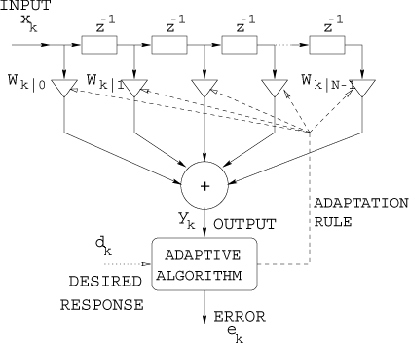
Application: Channel Equalization

Slide 10
Example: Weiner Filter
FIR filter tap weights can be found using the Weiner-Hopf equation: Rw_{opt} = p
where correlation matrix R = E [ x(n) x^{H}(n) ] and cross-correlation vector p = E [ x(n) d*(n) ]
Based on the minimization of the mean-square error J(n) = E [ e(n) e*(n) ] where e(n) = d(n) – w^{H}.x(n)
For changing signal statistics and/or channel condition, the filter weights are required to be updated continuously over time.

Slide 11
Example: Weiner Filter
One approach may be using steepest-descent method.
We will study later that the weight updation may be done as
δw(n) = w(n+1) – w(n)
= μ [ p – Rw(n) ]
= μ E [ x(n)d*(n) – x(n)x^{H}(n)w(n) ]
= μ E [ x(n) { d*(n) –x^{H}(n)w(n) } ]
= μ E [ x(n) e*(n) ]

Slide 12
Application: Noise Cancellation
REFERENCE SIGNAL
Noise
FIR filter
-
+
Adaptive Algorithm
Signal +Noise
PRIMARY SIGNAL

Slide 13
Application: Echo Cancellation
Tx1
Tx2
Echo canceller
Echo canceller
Hybrid
Hybrid
Adaptive Algorithm
Local Loop
Adaptive Algorithm
-
+
-
+
Rx1
Rx2

Slide 14
Application: System Identification
FIR filter
-
+
Signal
Adaptive Algorithm
Unknown System

Slide 15
Application: Blind Equalization
Signal
Unknown System
FIR filter
-
+
Adaptive Algorithm
Delay

Slide 16
Application: Adaptive Predictors
Signal
Delay
FIR filter
Adaptive Algorithm
-
+

Slide 17
Application: Smart antenna arrays
Linear Combiner
Interference

Slide 18
Algorithm for adaptation
Basic principles:
Form an objective function (performance criterion)
Find gradient of objective function with respect to FIR filter weights
There are several different approaches that can be used at this point, e.g. steepest-descent method.
Form a differential / difference equation from the gradient.

Slide 19
Adaptive Filters
An adaptive filter is in reality a nonlinear device, in the sense that it does not obey the principle of superposition.
Adaptive filters are commonly classified as:
Linear
An adaptive filter is said to be linear if the estimate of quantity of interest is computed adaptively (at the output of the filter) as a linear combination of the available set of observations applied to the filter input.
Nonlinear
Neural Networks

Slide 20
Linear Filter Structures
The operation of a linear adaptive filtering algorithm involves two basic processes:
a filtering process designed to produce an output in response to a sequence of input data
an adaptive process, the purpose of which is to provide mechanism for the adaptive control of an adjustable set of parameters used in the filtering process.
These two processes work interactively with each other.

Slide 21
Linear Filter Structures
The impulse response of a linear filter determines the memory order of the filter:
Infinite impulse response (IIR) filter
Finite impulse response (FIR) filter
There are three types of filter structures with finite memory :
transversal filter,
lattice predictor,
and systolic array.

Slide 22
Transversal or Tapped Delay Line Filter

Slide 23
Lattice Predictor
It has the advantage of simplifying the computation

Slide 24
Systolic Array
Represents a parallel computing network ideally suited for mapping a number of linear algebra computations, e.g. matrix multiplication, triangularization, back substitution, etc.
Two basic processing elements:
(a) Boundary cell and (b) Internal cell

Slide 25
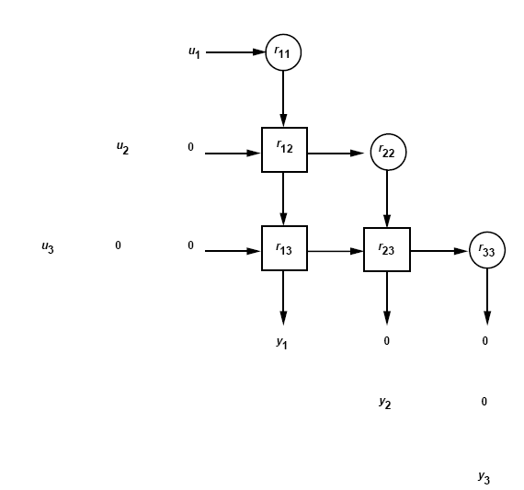
Triangular Systolic Array
The use of systolic arrays has made it possible to achieve very high throughput, which is required for many advanced signal processing algorithms to operate in real time

Slide 26
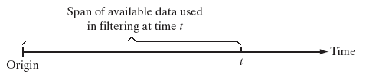

The three basic forms of estimation
The function of receiver is to operate on the received signal and deliver a reliable estimate of the original message.
Filters may be used for the purpose of estimation using one of the following three information-processing operations.
Filtering
Smoothing

Slide 27

The three basic forms of estimation
Prediction
Given an optimality criterion we can design optimal filters
Requires a priori information about the environment
Example: Under certain conditions the so called Wiener filter is optimal in the mean-squared sense
Adaptive filters are self-designing using a recursive algorithm
Useful if complete knowledge of environment is not available a priori.

Slide 28
Linear Filters
For stationary inputs, the resulting solution is commonly known as the Wiener filter, which is said to be optimum in the mean-square sense.
A plot of the mean-square value of the error signal vs. the adjustable parameters of a linear filter is referred to as the error-performance surface.
The minimum point of this surface represents the Wiener solution.

Slide 29
Linear Filters
The Wiener filter is inadequate for dealing with situations in which non-stationarity of the signal and/or noise is intrinsic to the problem.
A highly successful solution to this more difficult problem is found in the Kalman filter, a powerful device with a wide variety of engineering applications.

Slide 30
Linear Adaptive Filtering Algorithms
Stochastic Gradient Approach
Least-Mean-Square (LMS) algorithm
Gradient Adaptive Lattice (GAL) algorithm
Notes:
An introductory discussion of linear adaptive filters would be incomplete without saying something about their tracking behavior. In this context, we note that stochastic gradient algorithms such as the LMS algorithm are model independent; generally speaking, we would expect them to exhibit good tracking behavior, which indeed they do. In contrast, RLS algorithms are model dependent; this, in turn, means that their tracking behavior may be inferior to that of a member of the stochastic gradient family, unless care is taken to minimize the mismatch between the mathematical model on which they are based and the underlying physical process responsible for generating the input data.

Slide 31
Linear Adaptive Filtering Algorithms
Least-Squares Estimation
Recursive least-squares (RLS) estimation
Standard RLS algorithm
Square-root RLS algorithms
Fast RLS algorithms
Notes:
An introductory discussion of linear adaptive filters would be incomplete without saying something about their tracking behavior. In this context, we note that stochastic gradient algorithms such as the LMS algorithm are model independent; generally speaking, we would expect them to exhibit good tracking behavior, which indeed they do. In contrast, RLS algorithms are model dependent; this, in turn, means that their tracking behavior may be inferior to that of a member of the stochastic gradient family, unless care is taken to minimize the mismatch between the mathematical model on which they are based and the underlying physical process responsible for generating the input data.

Slide 32
Stochastic Gradient Approach
Most commonly used type of Adaptive Filters
Define cost function as mean-squared error
Difference between filter output and desired response
Based on the method of steepest descent
Move towards the minimum on the error surface to get to minimum
Requires the gradient of the error surface to be known

Slide 33
Least-Mean-Square (LMS) Algorithm
Most popular adaptation algorithm is LMS
Derived from steepest descent
Doesn’t require gradient to be known: it is estimated at every iteration
Consists of two basic processes
Filtering process
Calculate the output of FIR filter by convolving input and taps
Calculate estimation error by comparing the output to desired signal

Slide 34
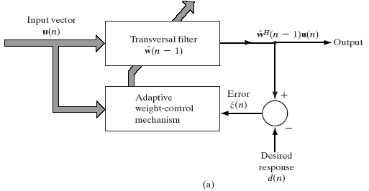
Least-Mean-Square (LMS) Algorithm
Adaptation process
Adjust tap weights based on the estimation error

Slide 35
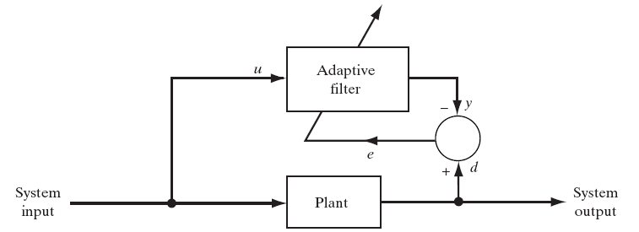
Four classes of applications
Used to provide a linear model of an unknown plant
Applications:
System identification

Slide 36
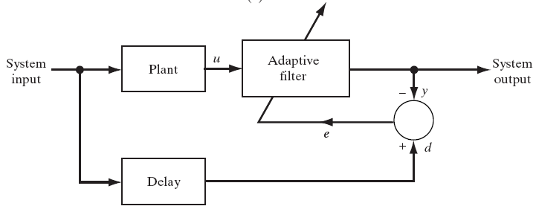
Four classes of applications
Used to provide an inverse model of an unknown plant
Applications:
Equalization

Slide 37
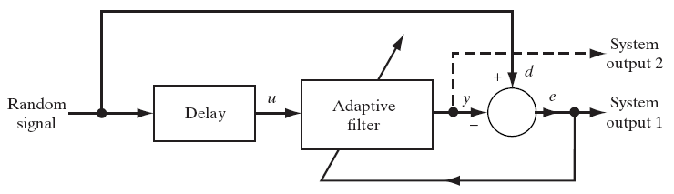
Four classes of applications
Used to provide a prediction of the present value of a random signal
Applications:
Linear predictive coding

Slide 38
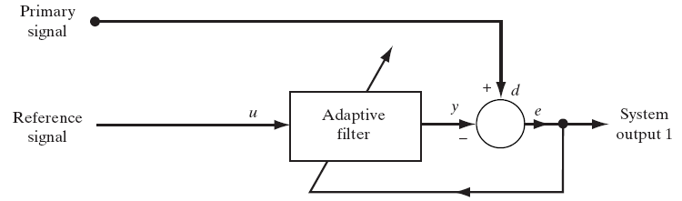
Four classes of applications
Used to cancel unknown interference from a primary signal
Applications:
Echo cancellation

Slide 39

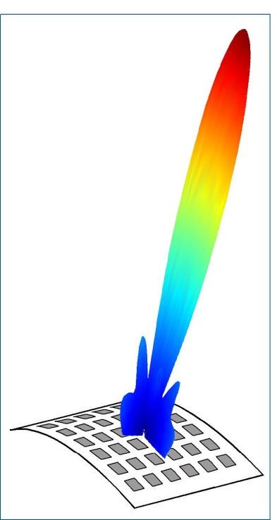
Beamforming
Smart Antenna systems:
Switched beam: finite number of fixed predefined patterns
Adaptive array: Infinite number of (real time) adjustable patterns

Slide 40
Beamforming
Adaptive filtering: An array of independent sensors placed at different locations in space essentially samples the received signal spatially.
Applications: Radar, Sonar, Speech enhancement, etc.
Smart Antenna systems: Using a variety of new signal-processing algorithms, the adaptive system takes advantage of its ability to effectively locate and track various types of signals to dynamically minimize interference and maximize intended signal reception.

Slide 41
Beamforming
Beamforming: spatial filtering
The sensor outputs are individually weighted and then summed to produce overall beamformer output.
The term derived from the fact that early antennas were designed to form a pencil like beam so as to receive signal radiating from a specific direction and to attenuate signals originating from other directions that are of no interest.
Beamforming applies to both transmission as well as reception.

Slide 42
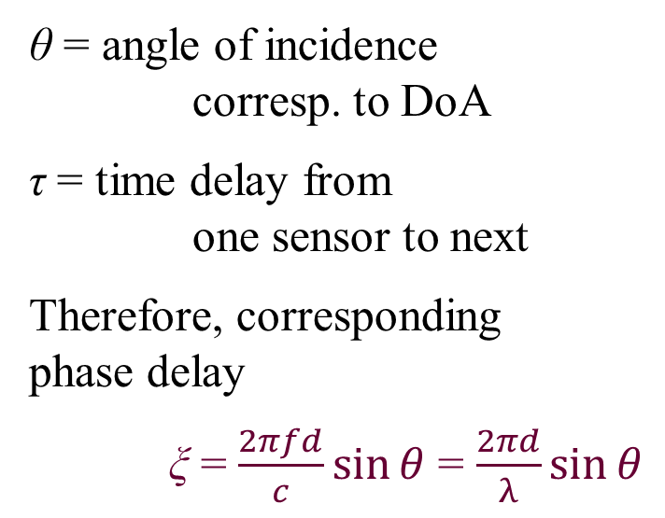
Beamforming: Uniform line array
s(t)
x₀(t)
d
x₁(t)
θ
x₂(t)
x_{M}(t)
τ
(M-1)τ

Slide 43
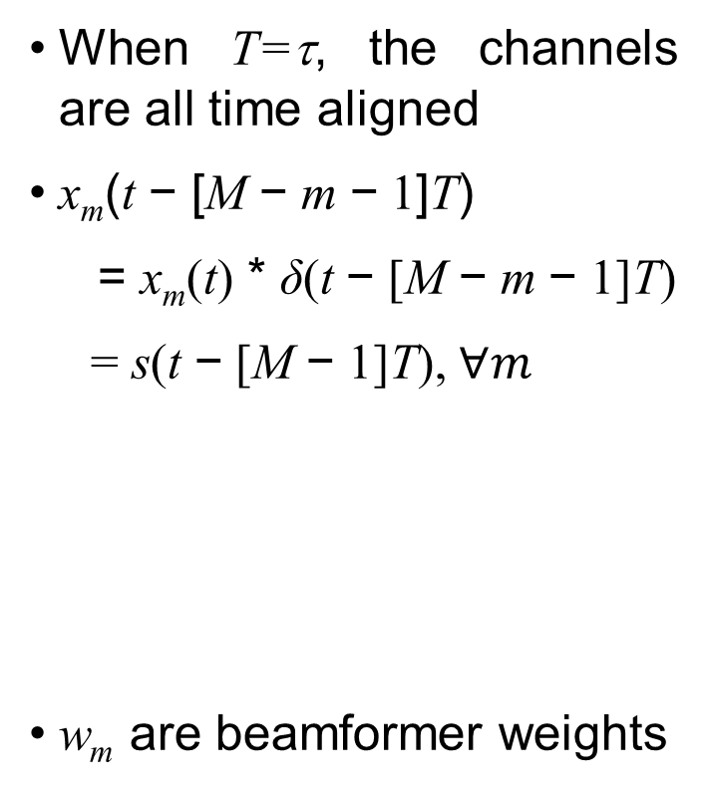
Beamforming: Delay-sum
Timed array
δ(t-[M-1]T)
x
w₀
δ(t-[M-2]T)
x
+
w₁
δ(t)
x
w_{M-1}

Slide 44
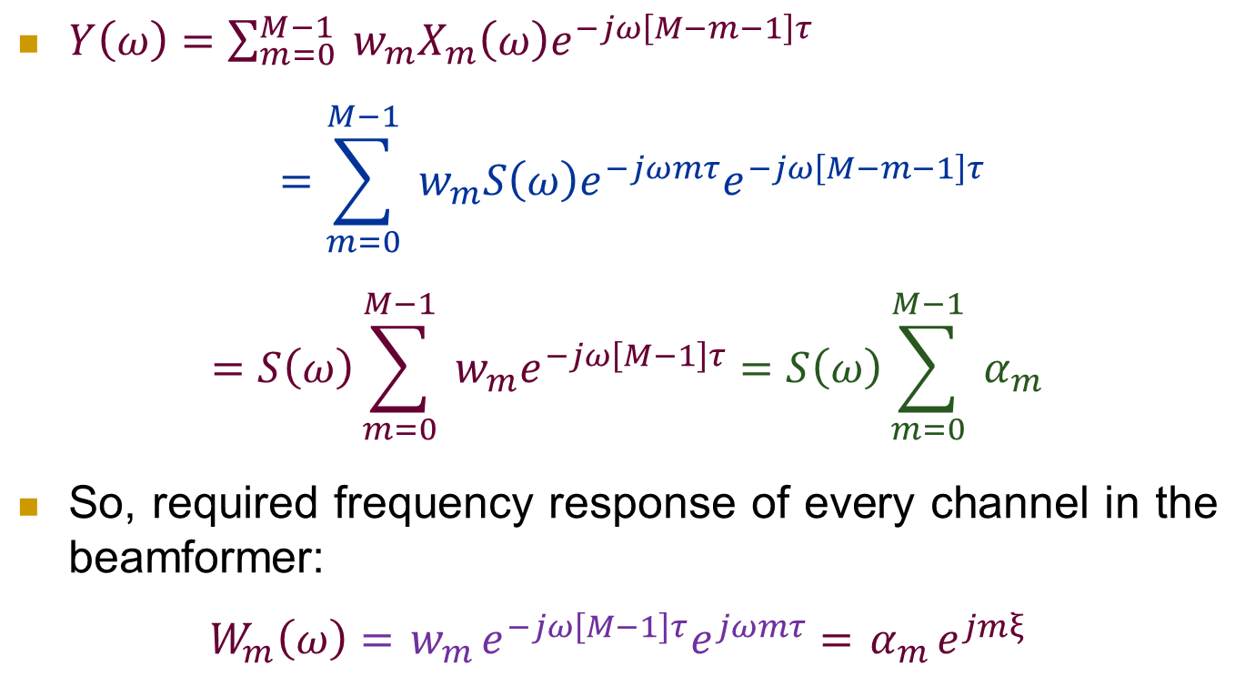
Beamforming: Delay-sum

Slide 45
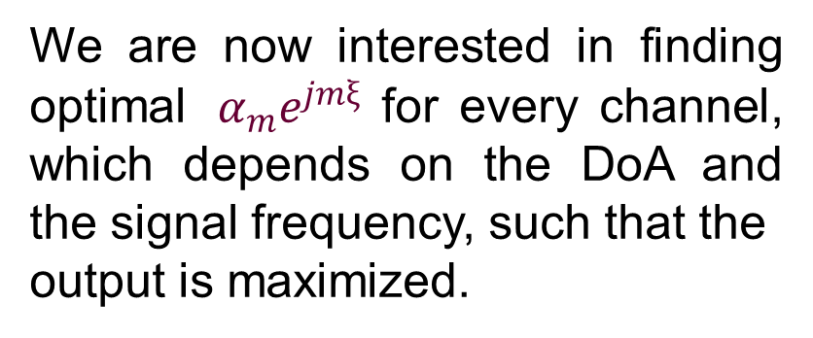



Beamforming: Narrowband phased array
x₀[n]
x
x₁[n]
x
+
We may eliminate time delays and use complex weights, w = [w₀, …, w_{M-1}]^{T}, to both steer (phase align) and weight (control beam shape)
x_{M-1}[n]
x

Slide 46



Beamforming: Similar to FIR filter
Represent signal delay across array as a delay line
Sample: x[n] = x₀(nT) = s(nT)
y[n] = x[n]*w[n]
Looks like an FIR filter.
Design w with FIR methods so as to maximize the output
Tapped delay line
x[n]
x
δ(t-τ)
x
+
y(t)
δ(t-τ)
x

Slide 47
Beamforming: Narrowband
Narrowband assumption: If BW of s(t) << c / (M-1)d Hz.
This means the phase difference between upper and lower band edges for propagation across the entire array is small.
Most communication signals fit this model.
Check that d must be less than half-wavelength (λ/2); this ensures one-to-one correspondence between θ (lying in the range [−π/2, +π/2] ) and ξ (lying in the range [−π, +π] ).
If signal is not narrowband, bandpass filter it and build a new beamformer for each subband.

Slide 48
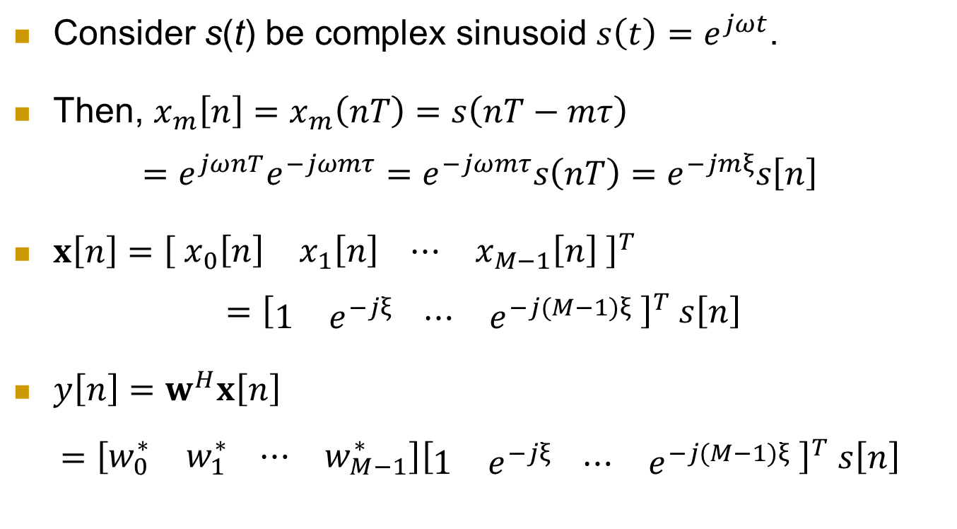
Beamforming

Slide 49
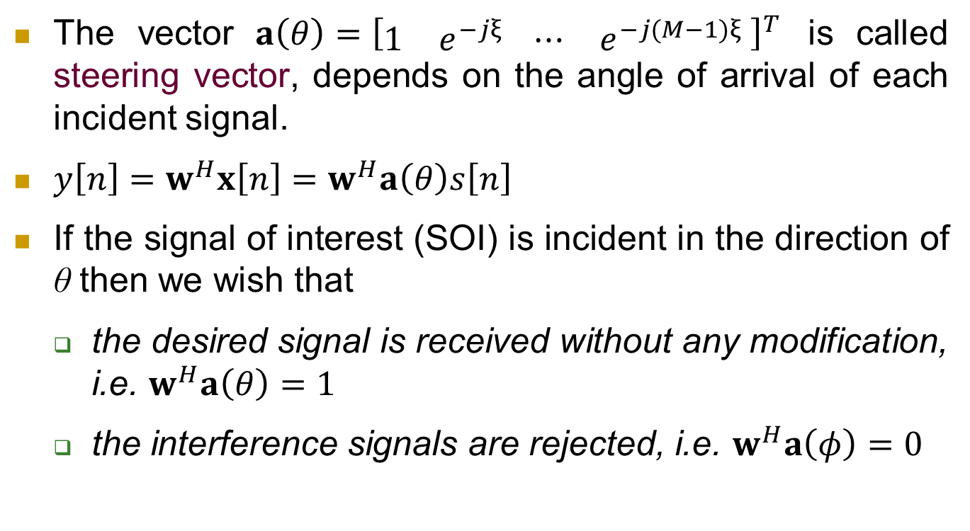
Beamforming

Slide 50
Beamforming
An optimal weight vector satisfying our requirement is of the form
Amplitude components control the sidelobe level and main beam width.
α_{m} = amplitude weight for sensor m,
mξ = phase weight for sensor m,
f₀ = bandpass center frequency, θ₀ = direction of max response

Slide 51
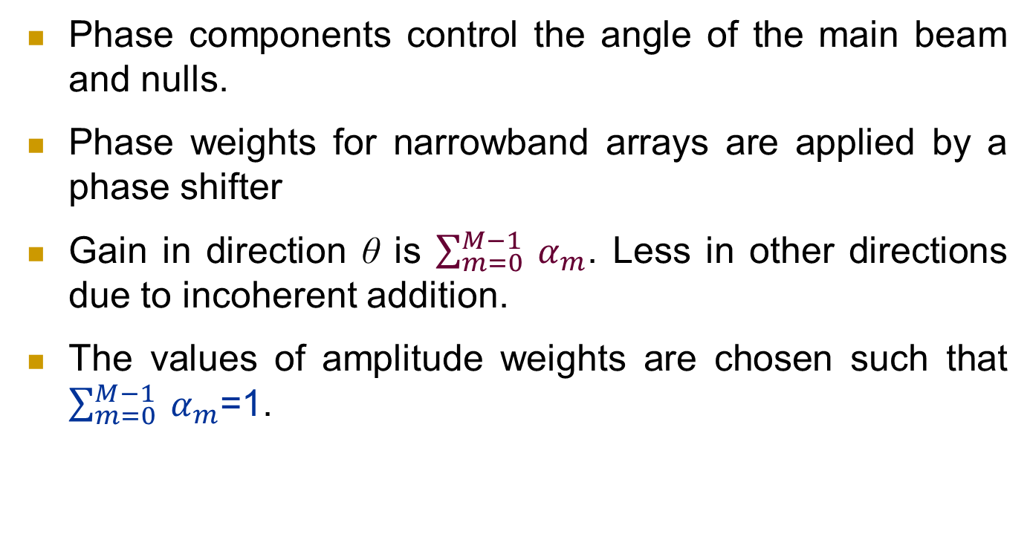
Beamforming

Slide 52
Beamforming
Thus, we define beamforming as
Beam forming is a method used to create the radiation pattern of an array antenna by adding constructively the weights of the signals in the direction of SOI and nulling the pattern in the direction of SNOI (interference)
This array can be antennas in the smart antennas context, or any other types of sensors (radars, medical sensors, …, etc), can be an array of microphones in the speech signal processing context.

Slide 53
Beamforming
Beamforming can be used at both the transmitting and receiving ends in order to achieve spatial selectivity
That is, an appropriate feeding allows antenna arrays to steer their beam and nulls towards certain directions, this is often referred to as spatial filtering.

Slide 54
Beamforming

Slide 55
Factors for choice of filter / algorithm
Choice of Adaptive filters:
Computational cost
Performance
Robustness
Choice of recursive algorithm:
Rate of convergence
Misadjustment
Tracking

Slide 56
Factors for choice of filter / algorithm
Robustness
Computational requirements
Structure
Numerical properties

