Slide 1

Linear Prediction Course Instructor: Dr. Debashis Ghosh
Department of Electronics & Computer Engg.
Indian Institute of Technology Roorkee

Slide 2
Syllabus
Forward and backward prediction error filters; Levinson—Durbin algorithm; Properties of prediction-error filters; Autoregressive modeling of a stationary stochastic process; All-pole, all-pass lattice filter (8 lectures).

Slide 3
Introduction
Linear Prediction – Observing the past or future samples and predict the current sample as a linear combination of the observed samples.
Forward Prediction – predicting from past samples, i.e. observing the past and predict the future.
Backward Prediction – predicting from future samples, i.e. observing the future and predict the past.

Slide 4
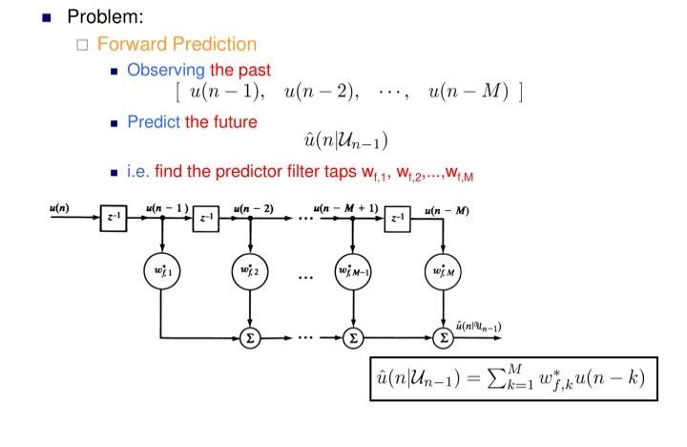

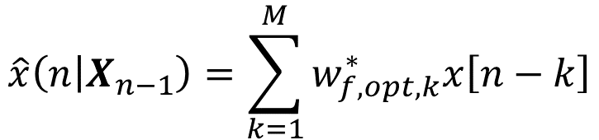
Forward linear prediction
$$\left[\begin{matrix}x\left[n−1\right] & x\left[n−2\right]\end{matrix} \begin{matrix}… & x\left[n−M\right]\end{matrix}\right]$$
$$\hat{x}\left(n | X_{n−1}\right)$$
x[n]
x[n − 1]
x[n − 2]
x[n − M + 1]
x[n − M]
One-step predictor
$$\hat{x}\left(n | X_{n−1}\right)=\sum_{k=1}^{M}{w_{f,opt,k}^{∗}x\left[n−k\right]}$$

Slide 5
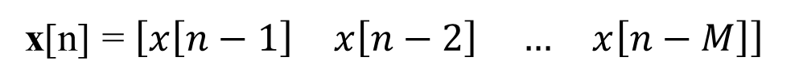
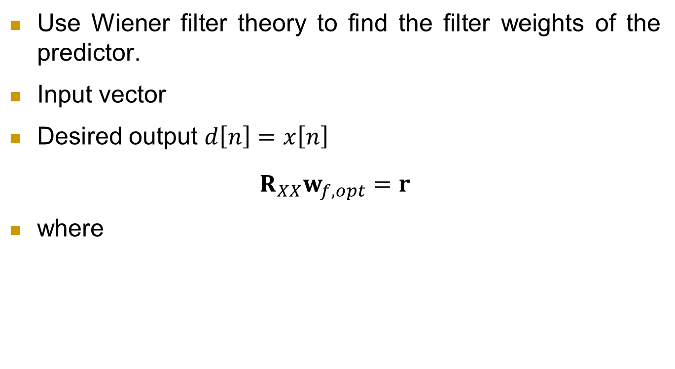
Forward linear prediction
Use Wiener filter theory to find the filter weights of the predictor.
Input vector
Desired output $d\left[n\right]=x\left[n\right]$
$$R_{XX}w_{f,opt}=r$$
where
x[n] = $\left[\begin{matrix}x\left[n−1\right] & x\left[n−2\right]\end{matrix} \begin{matrix}… & x\left[n−M\right]\end{matrix}\right]$
$${w_{f,opt}=\left[\begin{matrix}w_{f,opt,1} & w_{f,opt,2}\end{matrix} \begin{matrix}… & w_{f,opt,M}\end{matrix}\right]}_{}^{T}$$
$$r={\left[\begin{matrix}r\left(−1\right) & r\left(−2\right)\end{matrix} \begin{matrix}… & r\left(−M\right)\end{matrix}\right]}^{T}$$
$$={\left[\begin{matrix}r^{∗}\left(1\right) & r^{∗}\left(2\right)\end{matrix} \begin{matrix}… & r^{∗}\left(M\right)\end{matrix}\right]}^{T}$$

Slide 6
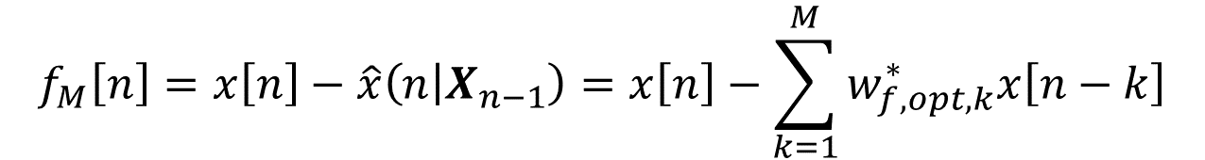
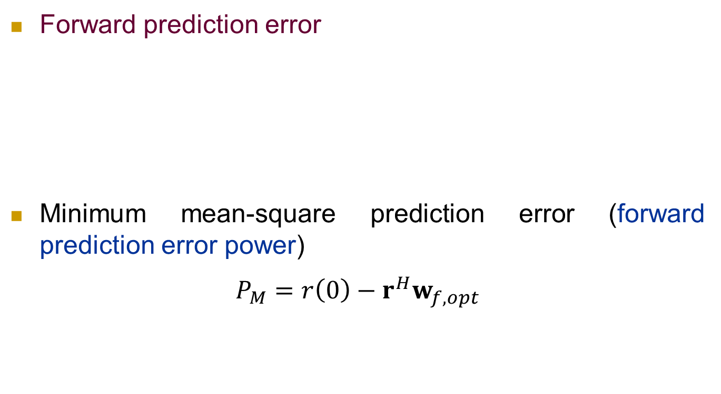
Forward linear prediction
Forward prediction error
Minimum mean-square prediction error (forward prediction error power)
$$P_{M}=r\left(0\right)−r^{H}w_{f,opt}$$
$$f_{M}\left[n\right]=x\left[n\right]−\hat{x}\left(n | X_{n−1}\right)=x\left[n\right]−\sum_{k=1}^{M}{w_{f,opt,k}^{∗}x\left[n−k\right]}$$

Slide 7
Relation b/w linear prediction and AR Modelling
Note that the Wiener-Hopf equations for a linear predictor is mathematically identical with the Yule-Walker equations for the model of an AR process.
If AR model order M is known, model parameters can be found by using a forward linear predictor of order M.
If the process is not AR, predictor provides an (AR) model approximation of order M of the process.

Slide 8
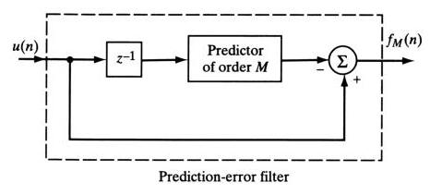
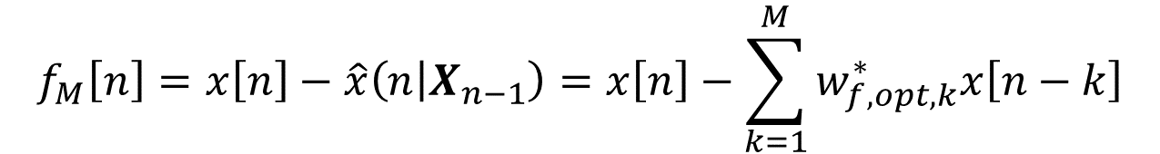
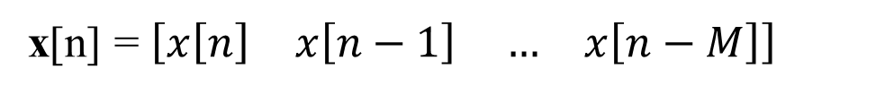
Forward prediction-error filter
Input vector here:
Desired output = prediction error
x[n] = $\left[\begin{matrix}x\left[n\right] & x\left[n−1\right]\end{matrix} \begin{matrix}… & x\left[n−M\right]\end{matrix}\right]$
$$f_{M}\left[n\right]=x\left[n\right]−\hat{x}\left(n | X_{n−1}\right)=x\left[n\right]−\sum_{k=1}^{M}{w_{f,opt,k}^{∗}x\left[n−k\right]}$$

Slide 9
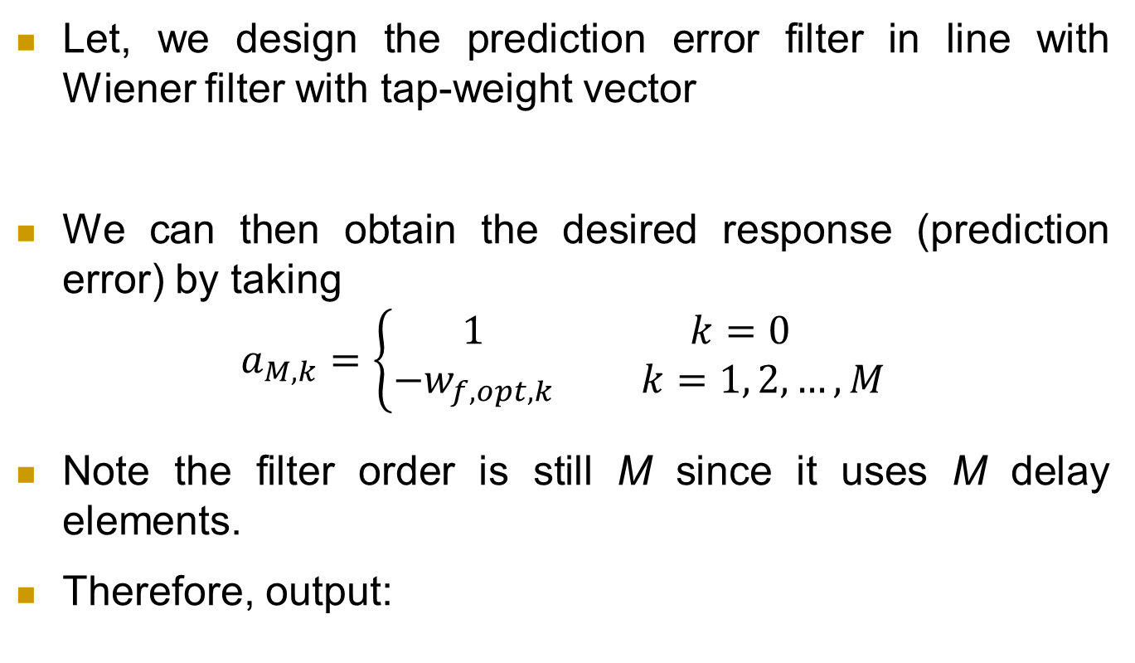
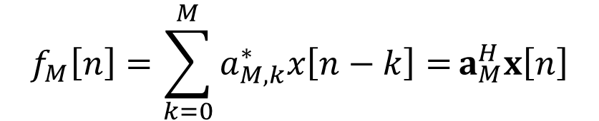
Forward prediction-error filter
Let, we design the prediction error filter in line with Wiener filter with tap-weight vector
We can then obtain the desired response (prediction error) by taking
$$a_{M,k}=\left\{\begin{matrix}1 & k=0 \\ −w_{f,opt,k} & k=1, 2, …, M\end{matrix}\right.$$
Note the filter order is still M since it uses M delay elements.
Therefore, output:
$${a_{M}=\left[\begin{matrix}a_{M,0} & a_{M,1}\end{matrix} \begin{matrix}… & a_{M,M}\end{matrix}\right]}_{}^{T}$$
$$f_{M}\left[n\right]=\sum_{k=0}^{M}{a_{M,k}^{∗}x\left[n−k\right]=}a_{M}^{H}x\left[n\right]$$

Slide 10
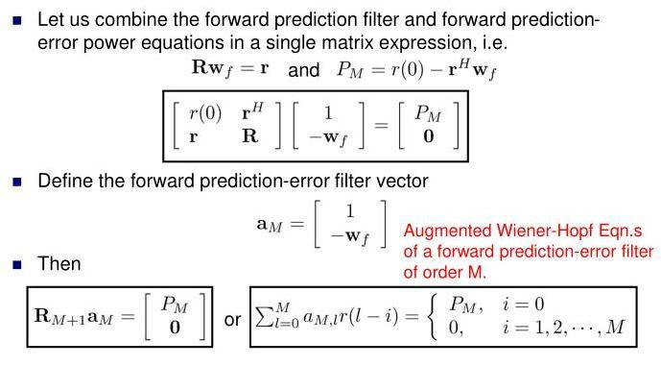
Augmented W-H equations for forward prediction

Slide 11
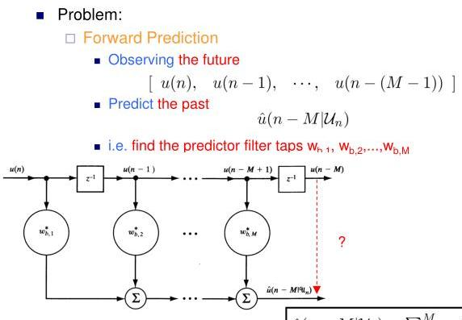

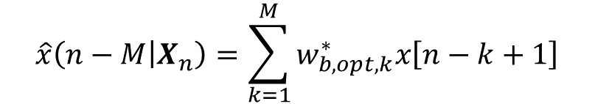
Backward linear prediction
Backward Prediction
$$\left[\begin{matrix}x\left[n\right] & x\left[n−1\right]\end{matrix} \begin{matrix}… & x\left[n−M+1\right]\end{matrix}\right]$$
$$\hat{x}\left(n−M | X_{n}\right)$$
x[n]
x[n − 1]
x[n − M + 1]
x[n − M]
$$\hat{x}\left(n−M | X_{n}\right)=\sum_{k=1}^{M}{w_{b,opt,k}^{∗}x\left[n−k+1\right]}$$

Slide 12
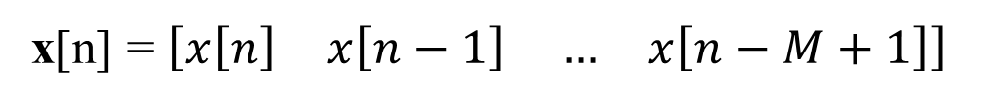
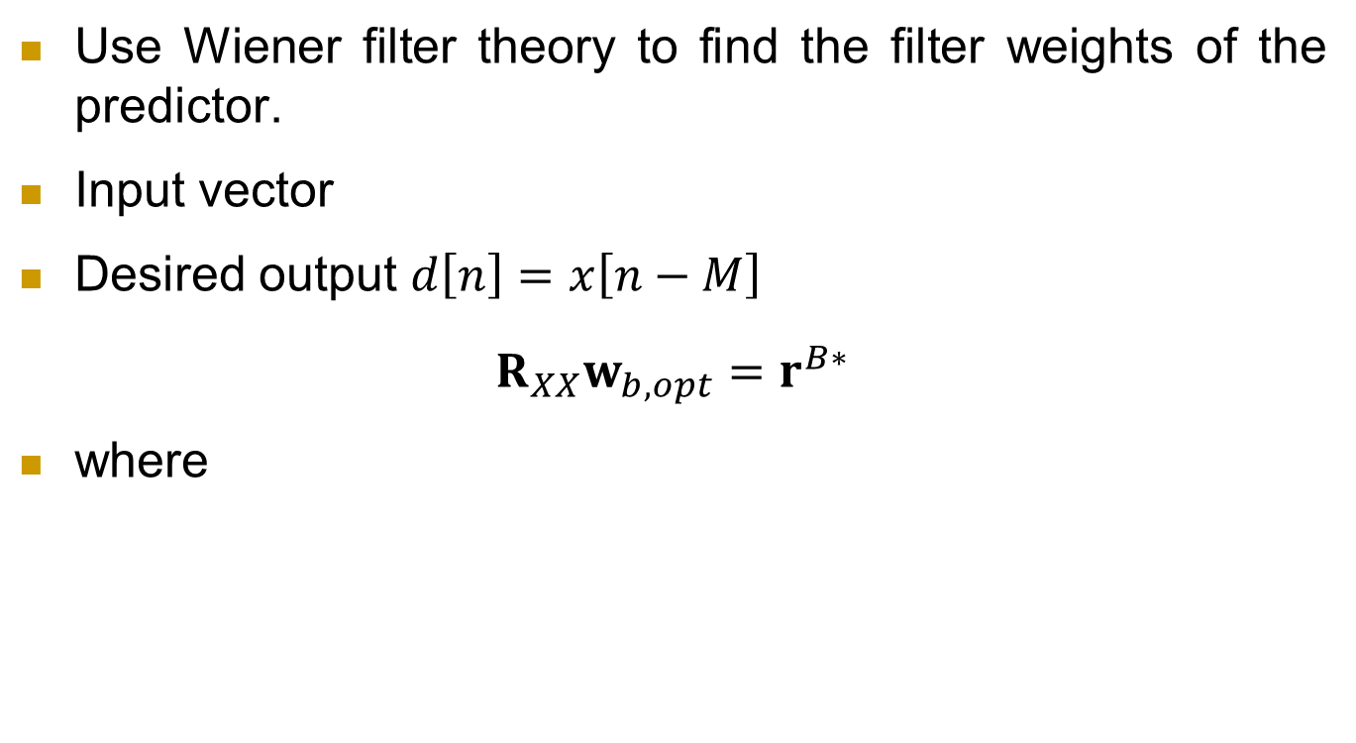
Backward linear prediction
Use Wiener filter theory to find the filter weights of the predictor.
Input vector
Desired output $d\left[n\right]=x\left[n−M\right]$
$$R_{XX}w_{b,opt}=r^{B∗}$$
where
x[n] = $\left[\begin{matrix}x\left[n\right] & x\left[n−1\right]\end{matrix} \begin{matrix}… & x\left[n−M+1\right]\end{matrix}\right]$
$${w_{b,opt}=\left[\begin{matrix}w_{b,opt,1} & w_{b,opt,2}\end{matrix} \begin{matrix}… & w_{b,opt,M}\end{matrix}\right]}_{}^{T}$$
$$r^{B∗}={\left[\begin{matrix}r\left(M\right) & r\left(M−1\right)\end{matrix} \begin{matrix}… & r\left(1\right)\end{matrix}\right]}^{T}$$

Slide 13
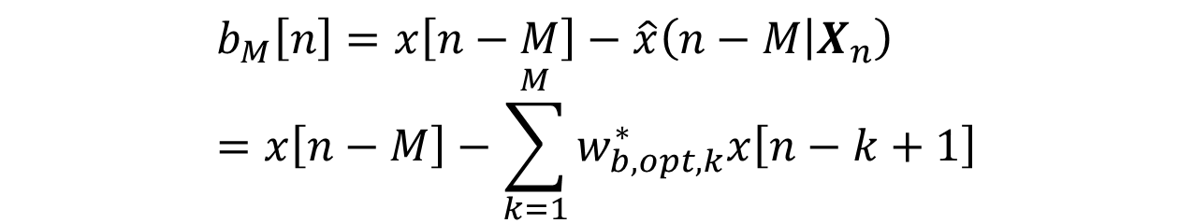
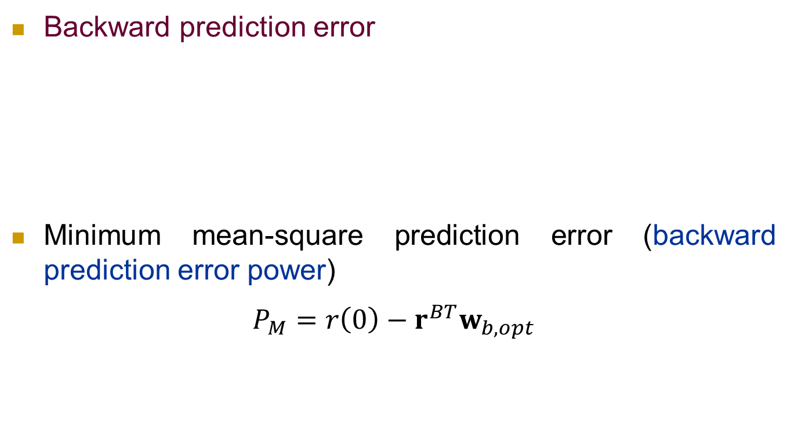
Backward linear prediction
Backward prediction error
Minimum mean-square prediction error (backward prediction error power)
$$P_{M}=r\left(0\right)−r^{BT}w_{b,opt}$$
$$b_{M}\left[n\right]=x\left[n−M\right]−\hat{x}\left(n−M | X_{n}\right)=x\left[n−M\right]−\sum_{k=1}^{M}{w_{b,opt,k}^{∗}x\left[n−k+1\right]}$$

Slide 14
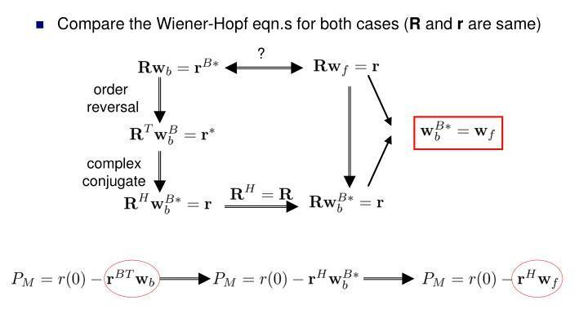
Relation b/w forward and backward prediction

Slide 15
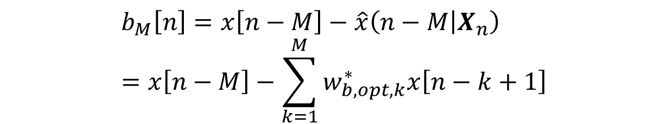
Backward prediction-error filter
Input vector here:
Desired output = prediction error
x[n] = $\left[\begin{matrix}x\left[n\right] & x\left[n−1\right]\end{matrix} \begin{matrix}… & x\left[n−M\right]\end{matrix}\right]$
$$b_{M}\left[n\right]=x\left[n−M\right]−\hat{x}\left(n−M | X_{n}\right)=x\left[n−M\right]−\sum_{k=1}^{M}{w_{b,opt,k}^{∗}x\left[n−k+1\right]}$$

Slide 16
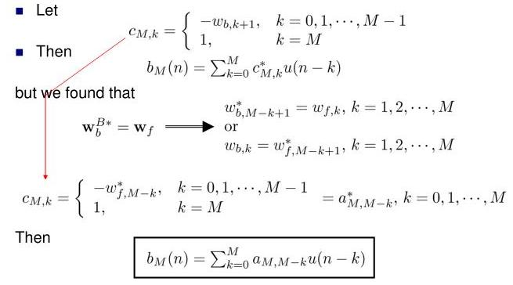
Backward prediction-error filter

Slide 17
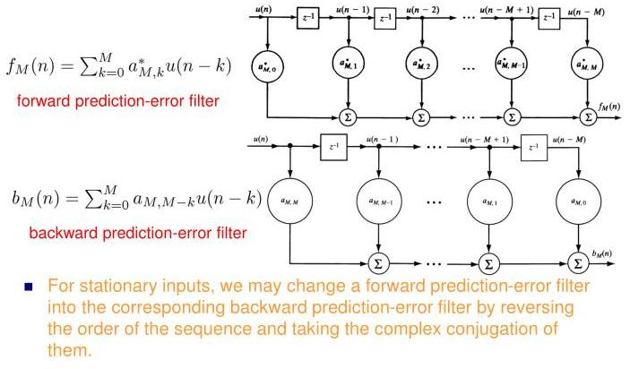
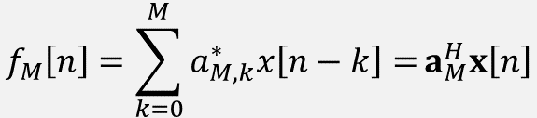
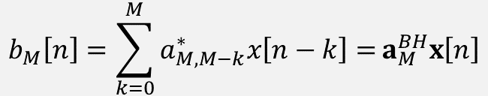
Backward prediction-error filter
$$f_{M}\left[n\right]=\sum_{k=0}^{M}{a_{M,k}^{∗}x\left[n−k\right]=}a_{M}^{H}x\left[n\right]$$
$$b_{M}\left[n\right]=\sum_{k=0}^{M}{a_{M,M−k}^{∗}x\left[n−k\right]=}a_{M}^{BH}x\left[n\right]$$

Slide 18
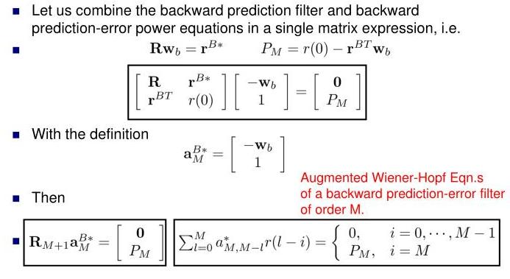
Augmented W-H equations for backward prediction

Slide 19
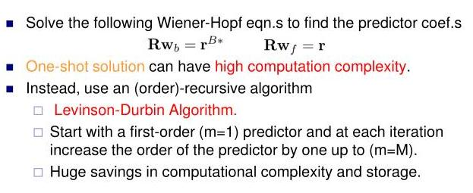
Levinson-Durbin algorithm

Slide 20
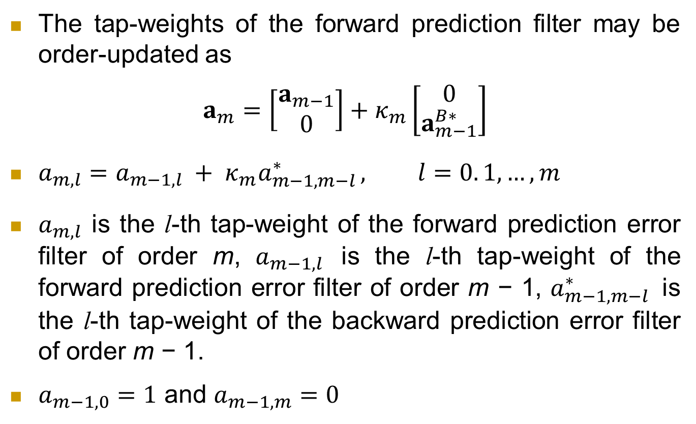
Levinson-Durbin algorithm
The tap-weights of the forward prediction filter may be order-updated as
$$a_{m}=\left[\begin{matrix}a_{m−1} \\ 0\end{matrix}\right]+κ_{m}\left[\begin{matrix}0 \\ a_{m−1}^{B∗}\end{matrix}\right]$$
$a_{m,l}=a_{m−1,l} + κ_{m}a_{m−1,m−l }^{∗}, l=0. 1, …, m$
$a_{m,l}$ is the l-th tap-weight of the forward prediction error filter of order m, $a_{m−1,l}$ is the l-th tap-weight of the forward prediction error filter of order m − 1, $a_{m−1,m−l }^{∗}$ is the l-th tap-weight of the backward prediction error filter of order m − 1.
$a_{m−1,0}=1$ and $a_{m−1,m}=0$

Slide 21
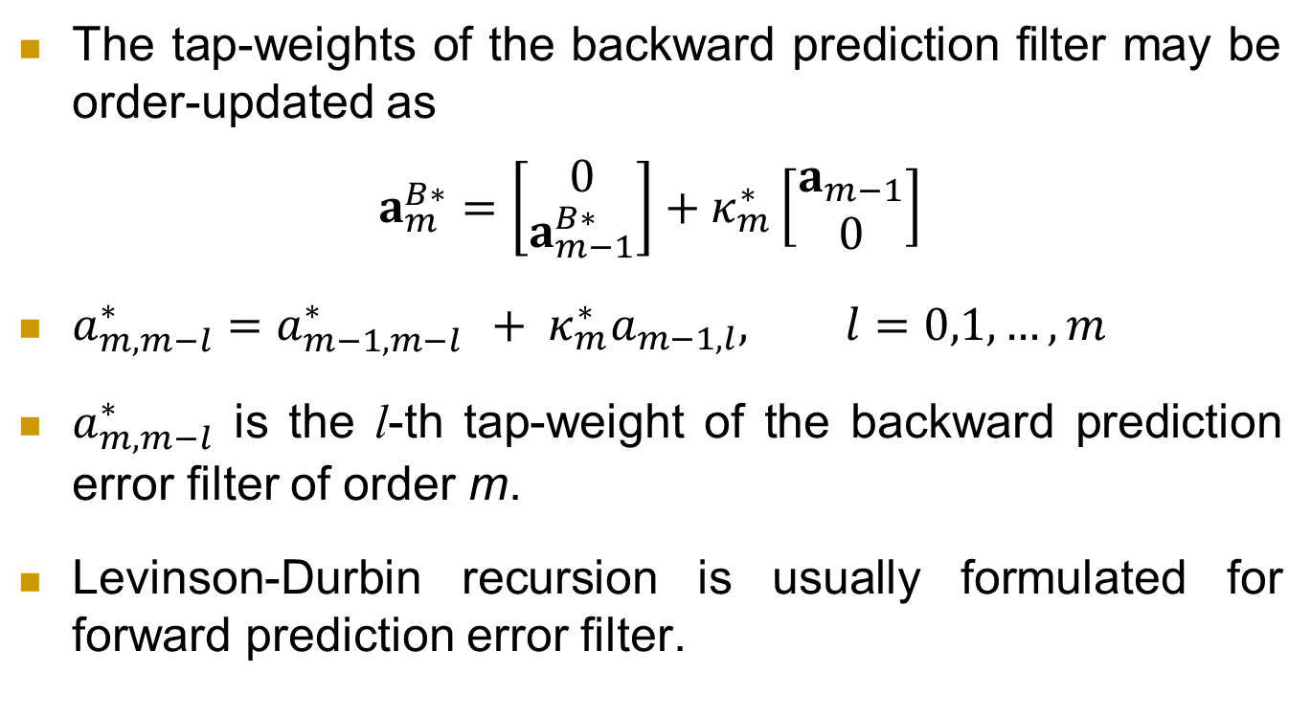
Levinson-Durbin algorithm
The tap-weights of the backward prediction filter may be order-updated as
$$a_{m}^{B∗}=\left[\begin{matrix}0 \\ a_{m−1}^{B∗}\end{matrix}\right]+κ_{m}^{∗}\left[\begin{matrix}a_{m−1} \\ 0\end{matrix}\right]$$
$a_{m,m−l}^{∗}=a_{m−1,m−l }^{∗} + κ_{m}^{∗}a_{m−1,l}, l=0,1, …, m$
$a_{m,m−l}^{∗}$ is the l-th tap-weight of the backward prediction error filter of order m.
Levinson-Durbin recursion is usually formulated for forward prediction error filter.

Slide 22
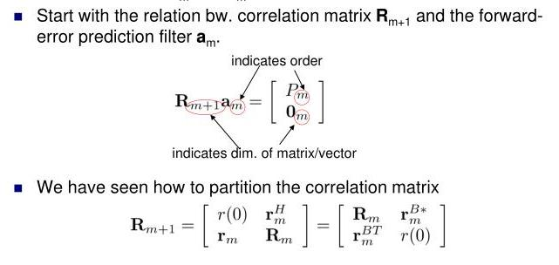
Levinson-Durbin algorithm

Slide 23
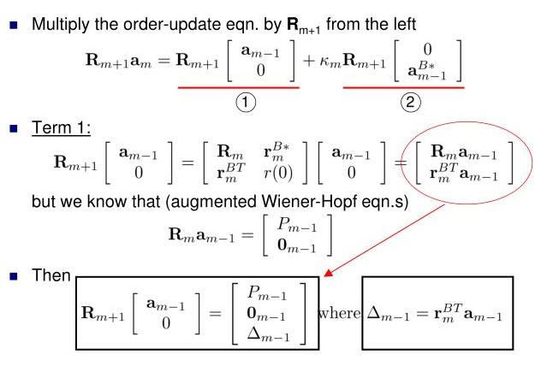
Levinson-Durbin algorithm

Slide 24
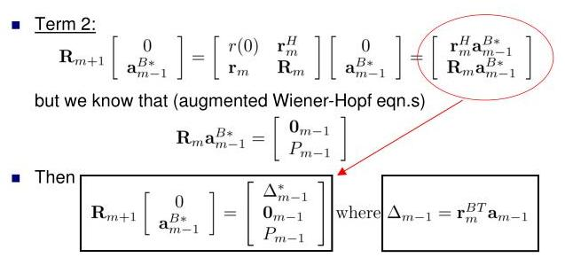
Levinson-Durbin algorithm

Slide 25
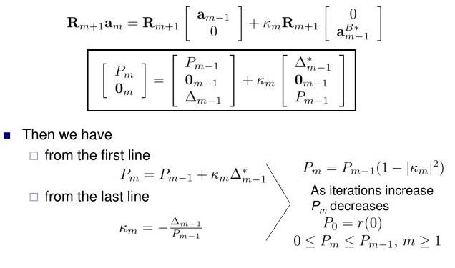
Levinson-Durbin algorithm

Slide 26
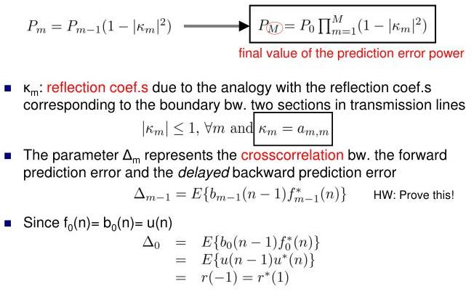
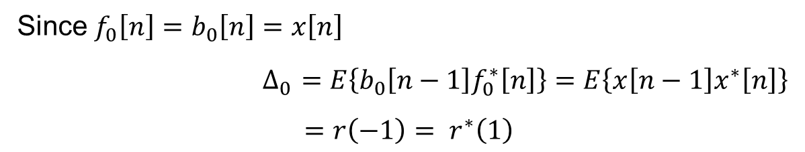
Levinson-Durbin algorithm
Since $f_{0}\left[n\right]=b_{0}\left[n\right]=x\left[n\right]$
$∆_{0 }=E\left\{b_{0}\left[n−1\right]f_{0}^{∗}\left[n\right]\right\}=E\left\{x\left[n−1\right]x^{∗}\left[n\right]\right\}$
$=r\left(−1\right)= r^{∗}\left(1\right)$

Slide 27
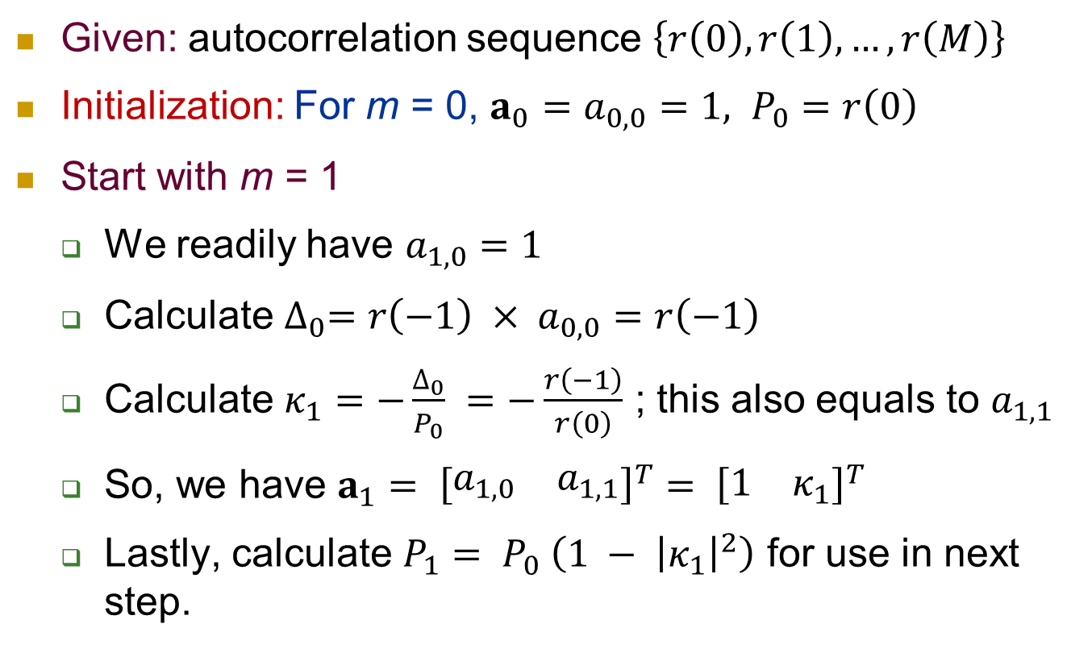
Steps of Levinson-Durbin algorithm
Given: autocorrelation sequence $\left\{r\left(0\right), r\left(1\right), …, r\left(M\right)\right\}$
Initialization: For m = 0, ${a_{0}=a}_{0,0}=1, P_{0}=r\left(0\right)$
Start with m = 1
We readily have $a_{1,0}=1$
Calculate $∆_{0}=r\left(−1\right) × a_{0,0}=r\left(−1\right)$
Calculate $κ_{1}=−\frac{∆_{0}}{P_{0}} =−\frac{r\left(−1\right)}{r\left(0\right)}$ ; this also equals to $a_{1,1}$
So, we have $a_{1}= {\left[\begin{matrix}a_{1,0} & a_{1,1}\end{matrix}\right]}^{T}= {\left[\begin{matrix}1 & κ_{1}\end{matrix}\right]}^{T}$
Lastly, calculate $P_{1}= P_{0} \left(1 − {\left|κ_{1}\right|}^{2}\right)$ for use in next step.

Slide 28
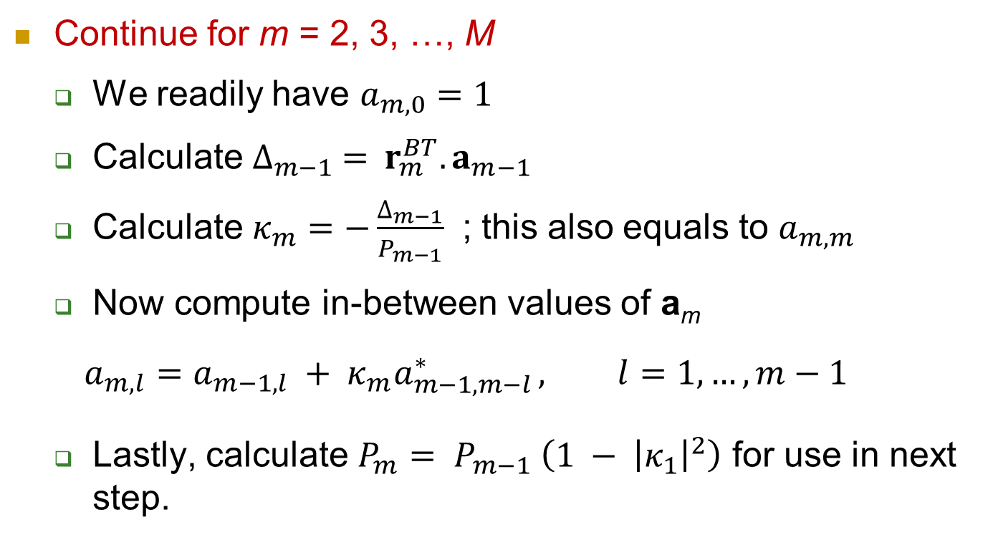
Steps of Levinson-Durbin algorithm
Continue for m = 2, 3, …, M
We readily have $a_{m,0}=1$
Calculate $∆_{m−1} ={ r}_{m}^{BT}.a_{m−1}$
Calculate $κ_{m}=−\frac{∆_{m−1}}{P_{m−1}}$ ; this also equals to $a_{m,m}$
Now compute in-between values of a_{m}
$$a_{m,l}=a_{m−1,l} + κ_{m}a_{m−1,m−l }^{∗}, l=1, …, m−1$$
Lastly, calculate $P_{m}= P_{m−1} \left(1 − {\left|κ_{1}\right|}^{2}\right)$ for use in next step.

Slide 29

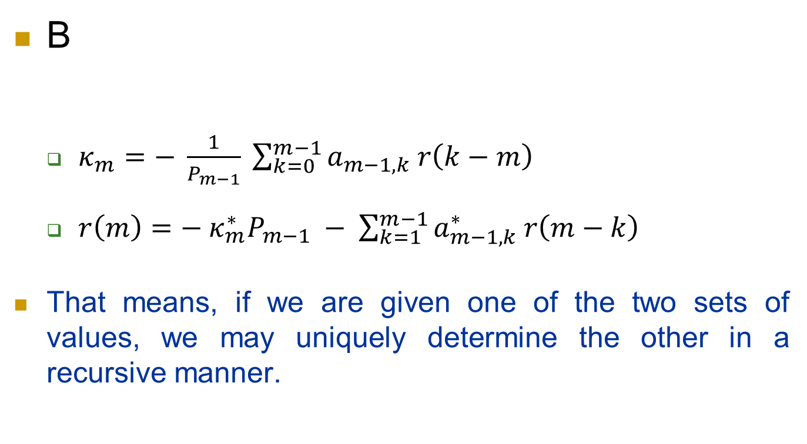
Properties of prediction-error filters
B
$κ_{m}=− \frac{1}{P_{m−1}} \sum_{k=0}^{m−1}{a_{m−1,k} r\left(k−m\right)}$
$r\left(m\right)=− κ_{m}^{∗}P_{m−1} − \sum_{k=1}^{m−1}{a_{m−1,k}^{∗} r\left(m−k\right)}$
That means, if we are given one of the two sets of values, we may uniquely determine the other in a recursive manner.

Slide 30
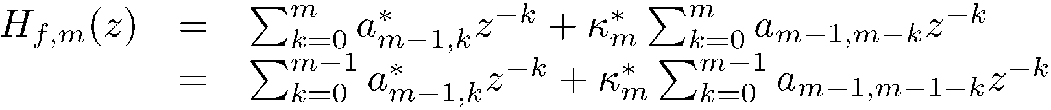
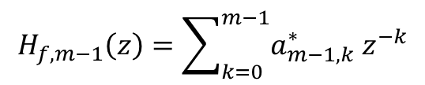

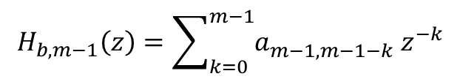
Properties of prediction-error filters
Property 2a: Transfer function of a forward prediction error filter
Utilizing Levinson-Durbin recursion
but we also have
Then
$$× z^{−1}$$
$$H_{f,m−1}\left(z\right)=\sum_{k=0}^{m−1}{a_{m−1,k}^{∗}{ z}^{−k}}$$
$$H_{b,m−1}\left(z\right)=\sum_{k=0}^{m−1}{a_{m−1,m−1−k}^{}{ z}^{−k}}$$

Slide 31
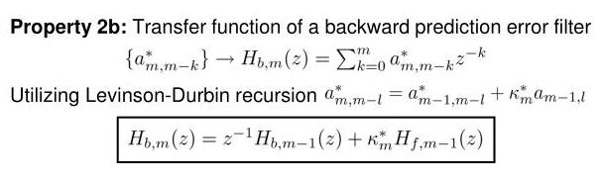
Properties of prediction-error filters
G
Given the reflection coefficients κ_{m} and the transfer functions of the forward and backward prediction-error filters of order m – 1, we can uniquely determine the transfer function of the corresponding forward (and backward) prediction-error filter of order m.

Slide 32
Properties of prediction-error filters
Property 3: Both the forward and backward prediction error filters have the same magnitude response
Property 4: Forward prediction-error filter is minimum-phase.
Property 5: Backward prediction-error filter is maximum-phase.
Property 6: Forward prediction-error filter is a whitening filter – a prediction-error filter is capable of whitening an input stationary discrete-time stochastic process, provided that the order of the filter is high enough.

Slide 33
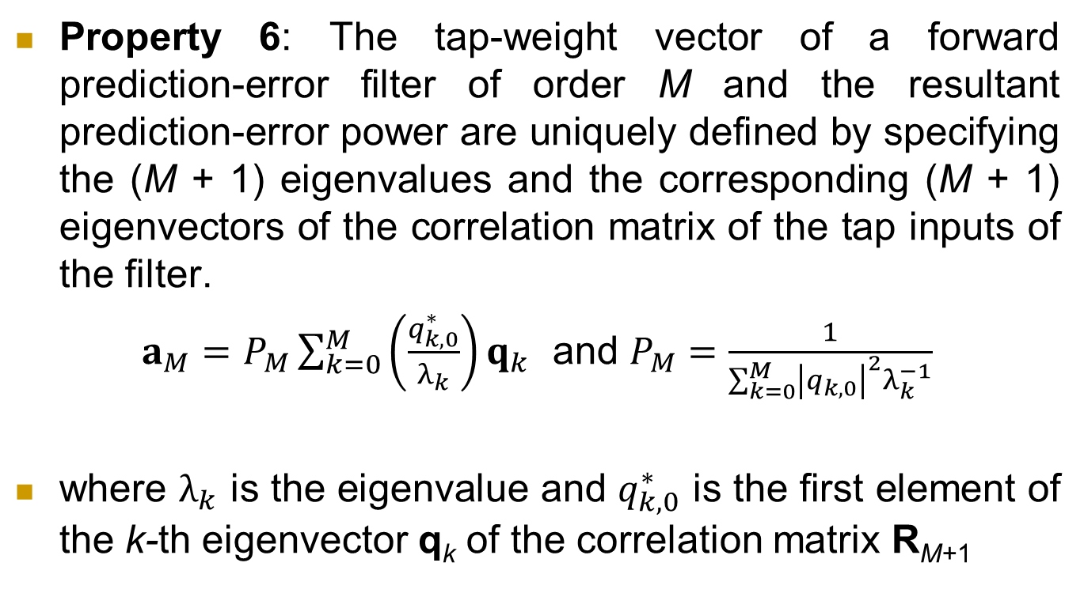
Properties of prediction-error filters
Property 6: The tap-weight vector of a forward prediction-error filter of order M and the resultant prediction-error power are uniquely defined by specifying the (M + 1) eigenvalues and the corresponding (M + 1) eigenvectors of the correlation matrix of the tap inputs of the filter.
$a_{M}=P_{M}\sum_{k=0}^{M}{\left(\frac{q_{k,0}^{∗}}{λ_{k}}\right)q_{k}}$ and $P_{M}=\frac{1}{\sum_{k=0}^{M}{{\left|q_{k,0}\right|}^{2}λ_{k}^{−1}}}$
where $λ_{k}$ is the eigenvalue and $q_{k,0}^{∗}$ is the first element of the k-th eigenvector q_{k} of the correlation matrix R_{M+1}

Slide 34
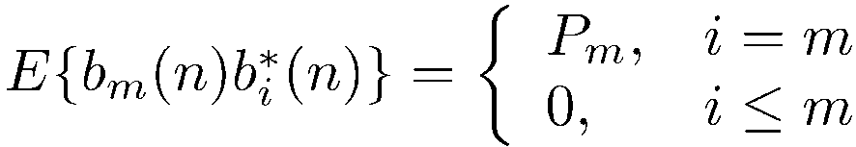
Properties of prediction-error filters
Property 7: Backward prediction errors are orthogonal to each other.

Slide 35
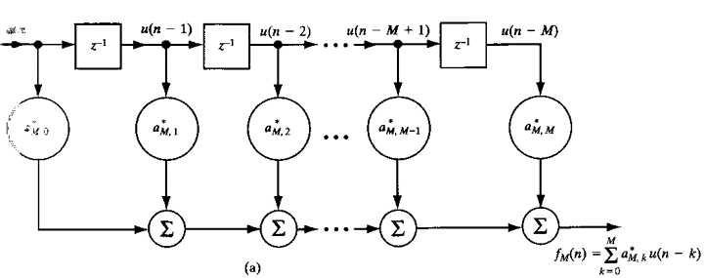
AR modeling of stationary stochastic process
Analysis filter: The input process x[n] is whitened by choosing the filter order M sufficiently large so that the output prediction error process f_{M}[n] consists of uncorrelated samples.
It is an all-zero FIR filter.

Slide 36
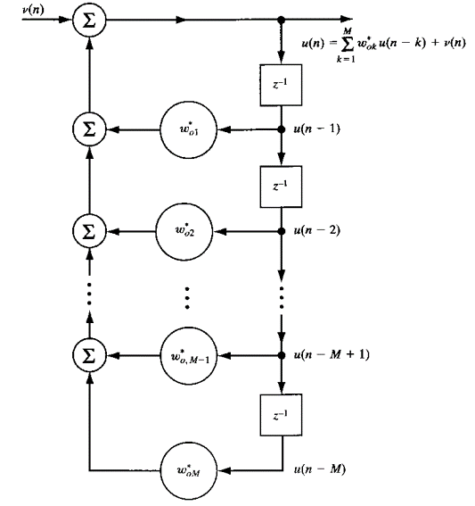
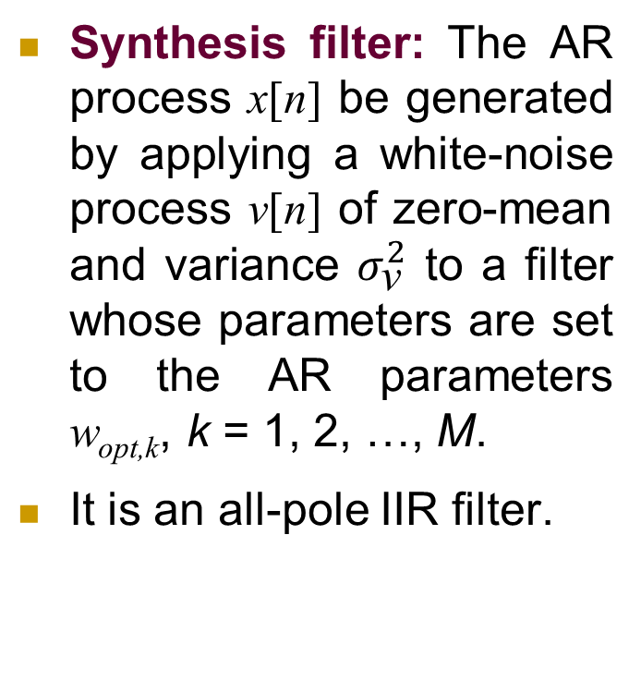
AR modeling of stationary stochastic process
Synthesis filter: The AR process x[n] be generated by applying a white-noise process ν[n] of zero-mean and variance $σ_{\text{ν}}^{2}$ to a filter whose parameters are set to the AR parameters w_{opt,k}, k = 1, 2, …, M.
It is an all-pole IIR filter.

Slide 37
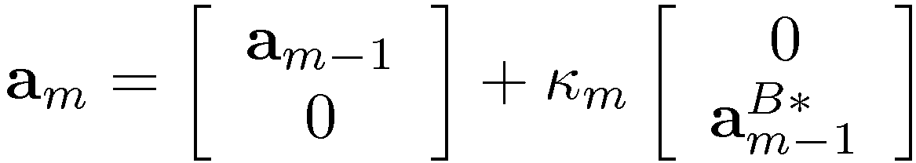
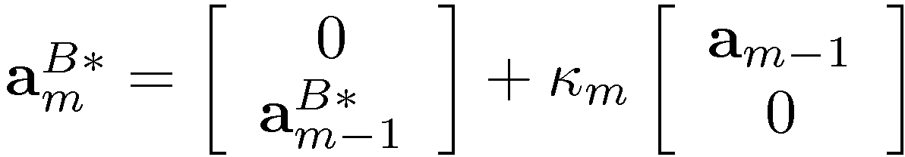
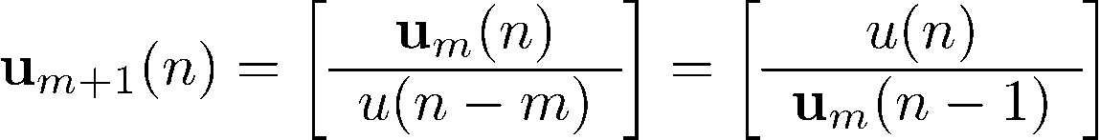


Lattice Predictors
A very efficient structure to implement the forward and backward predictors.
Rewrite the prediction error filter coef.s
The input signal to the predictors {u(n), n(n-1),...,u(n-M)} can be stacked into a vector
Then the output of the predictors are
(forward)
(backward)

Slide 38
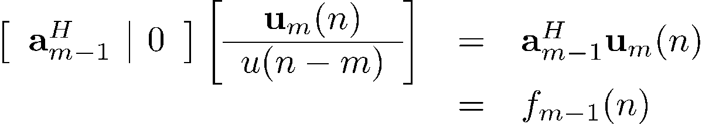

Lattice Predictors
Forward prediction-error filter
First term
Second term
Combining both terms

Slide 39

Lattice Predictors
Similarly, Backward prediction-error filter
First term
Second term
Combining both terms

Slide 40



Lattice Predictors
Forward and backward prediction-error filters
in matrix form
and
Last two equations define the m-th
stage of the lattice predictor

Slide 41


Lattice Predictors
For m = 0 we have ,
Hence for M stages

Slide 42
Lattice Predictors
Highly efficient structure for generating sequence of forward prediction errors and corresponding sequence of backward prediction errors simultaneously.
The various stages are decoupled from each other; the backward prediction errors produced at different stages are orthogonal to each other (property 7).
Modular in structure – order can be easily increased.
Similar structure in every stage – useful for VLSI implementation.

