Slide 1


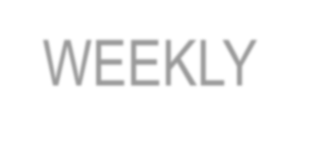
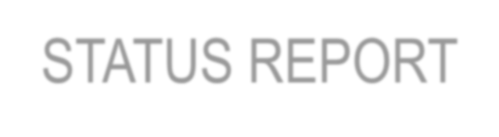

Student Depression Analysis Dashboard
Sumit Dabas
211302002

Slide 2
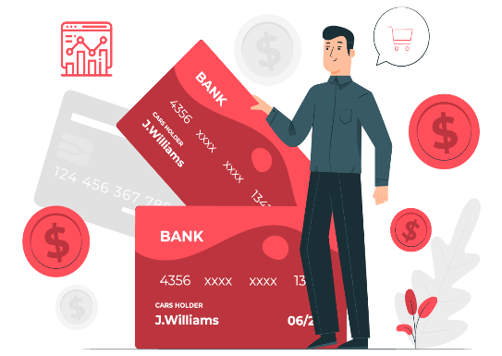
Introduction
The Student Depressio Analysis Dashboard will be designed to analyze and visualize student stress and depression behaviour.
Develop an interactive dashboard using Student data from SQL database, to provide real-time insights.
The dashboard utilizes data analytics and visualization tools to provide clear insights.
Shared actionable insights with stakeholders or hospitals based on dashboard findings to support decision-making processes.
It helps stakeholders to track student mental health, identify stress and make informed health decisions.

Slide 3




Contents
Project Objective
Data Loading
Data processing & Querying
Dashboard & insights
Export & share insights.

Slide 4





Project Objective
To develop a comprehensive credit card weekly dashboard that provides real-time insights into key performance metrics and trends, enabling stakeholders to monitor and analyze credit card operations effectively.

Slide 5



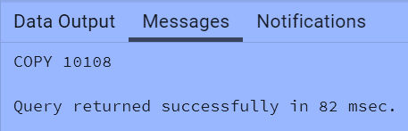

Import data to SQL database
Get data
Create SQL DB and load data
import csv file into SQL DB
→ After that, connect SQL server to Power BI.

Slide 6


Project Methodologies
1. Project Overview: Project Introduction and methodologies.
2. Data Extraction: Connect Power Bi to SQL Database and import data in Power BI for further analysis.
3. Data Processing & SQL Queries: Perform required calculations and process data and use formulas to clean the data, modify the data and make new columns from the existing data.
Dashboard & Insights- Will create 2 dashboards, one dashboard with the help of Tableau and other dashboard with the help of Power Bi and observe insights.
Export & Share- Export Power BI dashboard and share to stakeholders and health organizatons.

Slide 7

DAX Queries
AgeGroup = SWITCH(
TRUE(),
'public cust_detail'[customer_age] < 30, "20-30",
'public cust_detail'[customer_age] >= 30 && 'public cust_detail'[customer_age] < 40, "30-40", 'public cust_detail'[customer_age] >= 40 && 'public cust_detail'[customer_age] < 50, "40-50", 'public cust_detail'[customer_age] >= 50 && 'public cust_detail'[customer_age] < 60, "50-60", 'public cust_detail'[customer_age] >= 60, "60+",
"unknown"
)
IncomeGroup = SWITCH( TRUE(),
'public cust_detail'[income] < 35000, "Low",
'public cust_detail'[income] >= 35000 && 'public cust_detail'[income] <70000, "Med", 'public cust_detail'[income] >= 70000, "High",
"unknown"
)

Slide 8
DAX Queries
week_num2 = WEEKNUM('public cc_detail'[week_start_date])
Revenue = 'public cc_detail'[annual_fees] + 'public cc_detail'[total_trans_amt] + 'public cc_detail'[interest_earned]
Current_week_Reveneue = CALCULATE( SUM('public cc_detail'[Revenue]), FILTER(
ALL('public cc_detail'),
'public cc_detail'[week_num2] = MAX('public cc_detail'[week_num2])))
Previous_week_Reveneue = CALCULATE( SUM('public cc_detail'[Revenue]), FILTER(
ALL('public cc_detail'),
'public cc_detail'[week_num2] = MAX('public cc_detail'[week_num2])-1))

Slide 9
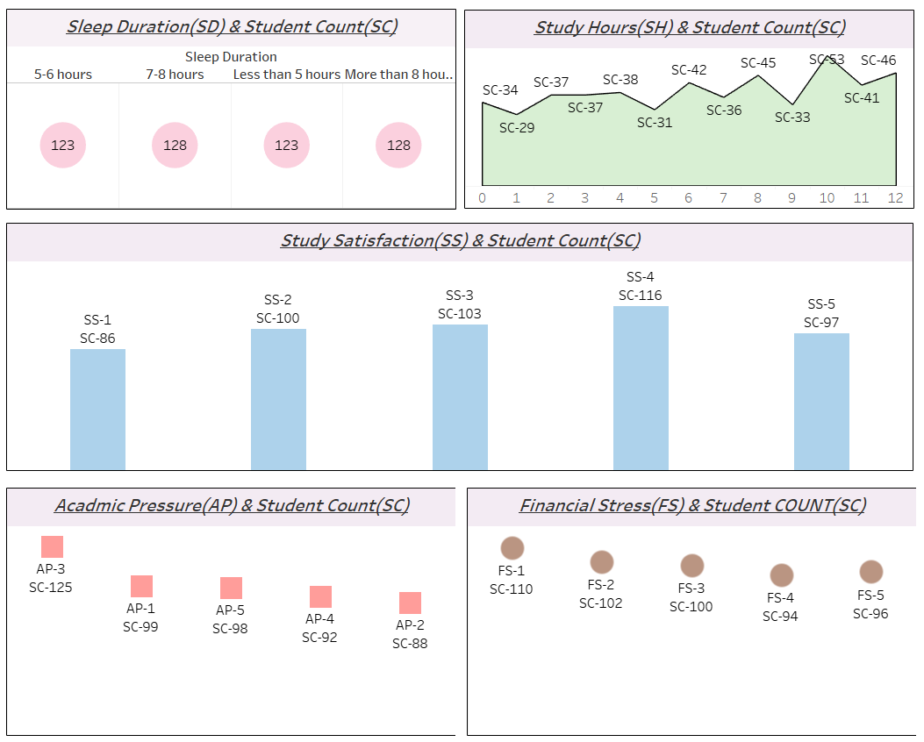

Slide 10
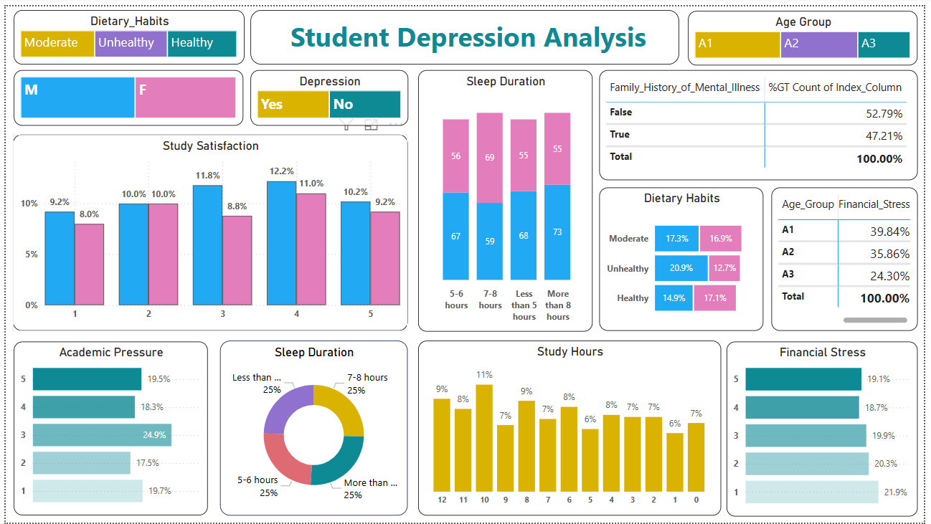

Slide 11


Project Insights
Total Revenue
Total Interest
Total Income
Gender
Age Group
Revenue by Expenditure
Customer Acquisition Cost
Credit Card
Top States
CSS (Rating)
Education Level
Marital Status
Customer Profession
Revenue by Customer Job

Slide 12
Project Insights
Overall Revenue is 57M
Total Interest is 8M
Total Transaction Amount is 46M
Male Customer are contributing more in revenue 31M, Female 26M
Blue & Silver credit card are contributing to 93% of overall transactions.
TX, NY, CA are contributing the highest which is 68%.
Overall Activation rate is 57.5%
Overall Delinquent rate is 6.06%
Self employed customer has highest Delinquent rate.

Slide 13

Future Scope
Syncing Behaviour: We can integrate the upcoming generated data with the existing data in database and update the values and insights directly. There will be no need to do the entire process again and again.
Forcasting: We can further forcast our model to predict future data values based on the existing data which could helps to predict future health mental issues and help in decision making for mental health and control student habits to free from depression.

Slide 14
Thank You

