Slide 1


Flight Price Predication
Group Members:
Akash Khatri - C0896274
Rohan Ladhani - C0894459
Sumit Gajjar - C0896272
Pratikkumar Mishra - C0891298
Sahil Sharma - C0907757

Slide 2
Table of Content
01
Introduction
07
Co-Relations
02
Dataset
08
KMean Clustering
03
data pre-processing
09
Model Evaluation and Validation
04
Handling Outliers
10
Conclusion
05
EDA
11
Future work
06
Power-bi dashboard
12
reference

Slide 3
Introduction
This Project delves into airline pricing dynamics using an extensive dataset, encompassing data preprocessing, exploratory analysis, visualization, feature selection, outlier detection, and precise predictive modeling.
The initial data exploration involves identifying categorical values, managing duplicates and missing data. Visualization reveals insights into flight classes, airline frequency distributions, and pricing variations based on stops and flight duration.
The study addresses outlier analysis, particularly skewed ticket costs influenced by class differences. Employing SVM, RandomForest, and Linear regression models, it achieves highly accurate ticket price predictions, establishing a foundation for predictive modeling in the dynamic aviation sector

Slide 4
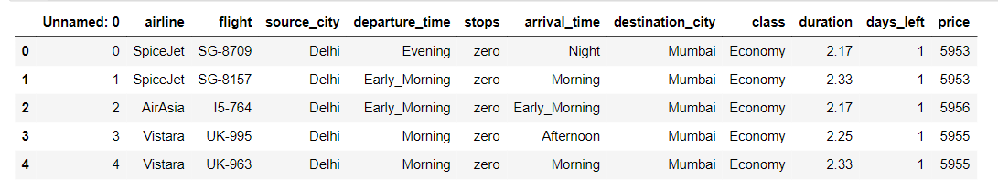
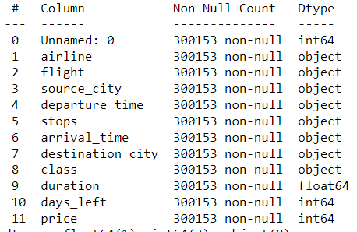

Dataset
There are 12 columns and 300153 rows in our dataset.

Slide 5
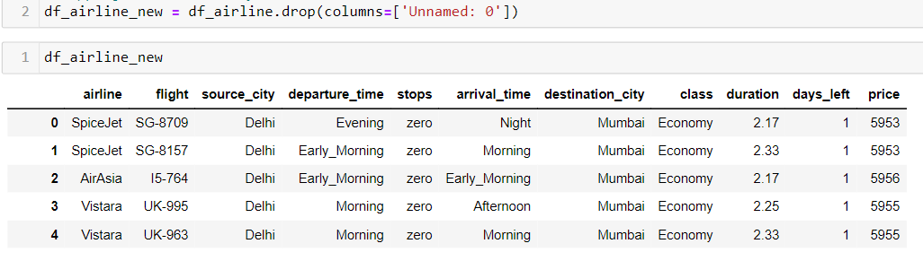
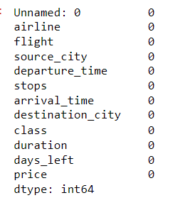

data preprocessing
Remove Unnecessary Columns
Finding missing values and duplicates values

Slide 6
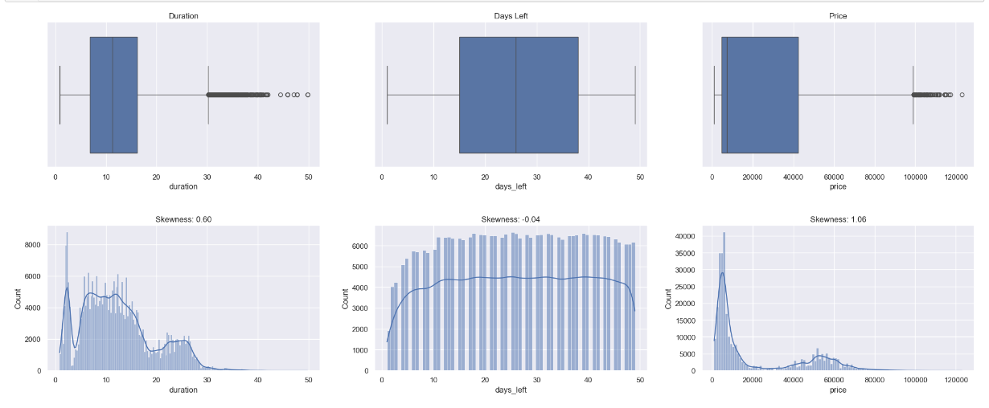
Handling Outliers
The plot indicates a positively skewed distribution in the target variable 'price,' mainly attributed to the 'Business' class; additionally, outlier values are retained as they are significantly influenced by the 'class' feature, where business class prices notably surpass economy class prices, while the skewness in the 'duration' is primarily driven by the number of stops, encompassing 'zero,' 'one,' and 'two_or_more.'

Slide 7
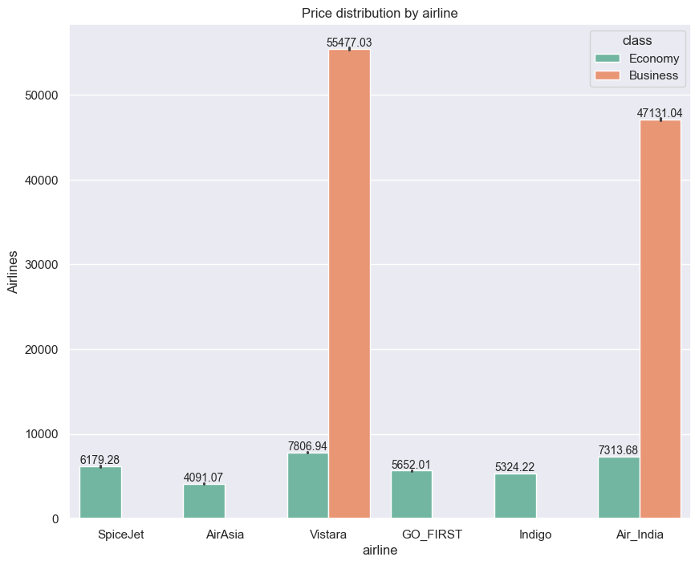
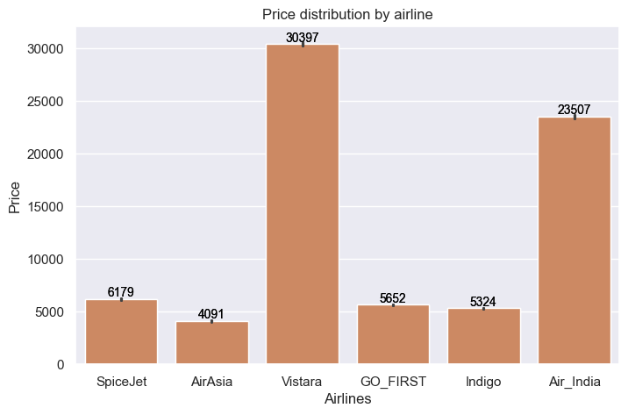
EDA
How does the type of airline affect the price of a ticket?
When the airline and class are included, they have an impact on the cost of the flight. AirAsia has the lowest average cost in economy class, whereas Vistara has the highest average cost.
Vistara has the highest average business class cost among the airlines, while Air India has the second lowest average cost. Notably, business class is available on just two carriers.

Slide 8
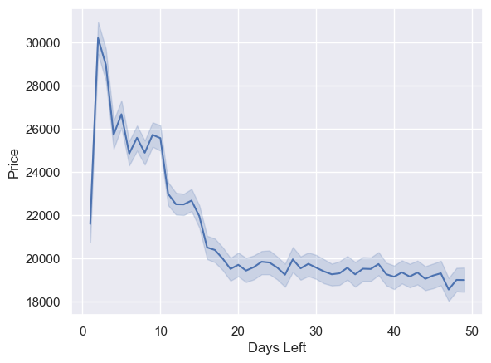
EDA
How does the ticket price affected when tickets are bought in 1 or 2 days before departure?
The graph shows that costs rose gradually until 20 days before the flight, at which point they significantly dropped, with prices going down by up to three times. This pattern indicates that in order to fill empty seats and guarantee a high level of occupancy on their aircraft, airlines may lower ticket rates near the departure date.

Slide 9
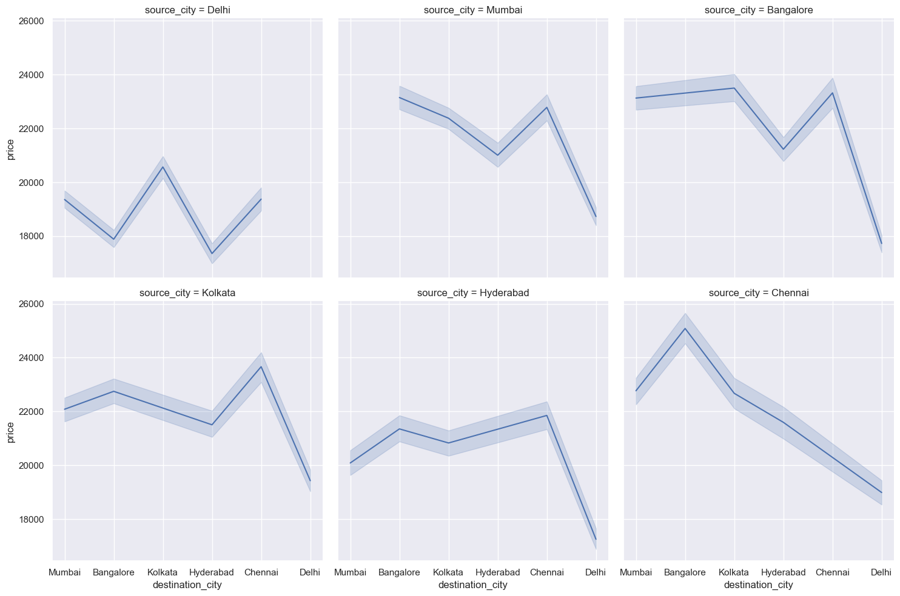
EDA
How does the ticket price changes with change in Source city and Destination city?
This graph suggests that flights departing from and arriving in Delhi are frequently less expensive, whereas flights departing and arriving in Bangalore are typically more expensive.

Slide 10

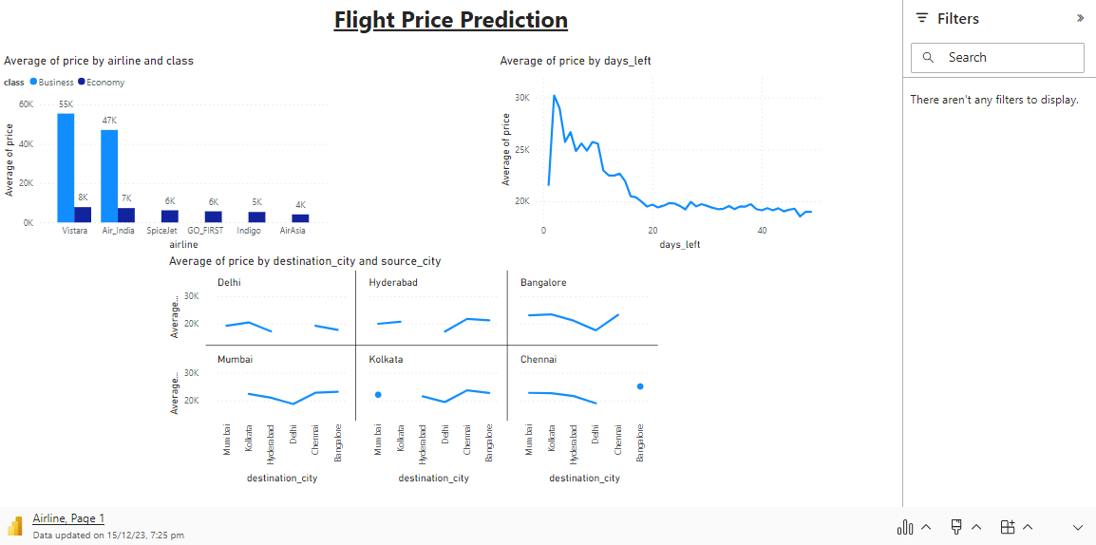
Microsoft Power BI
Power bi Dashboard

Slide 11
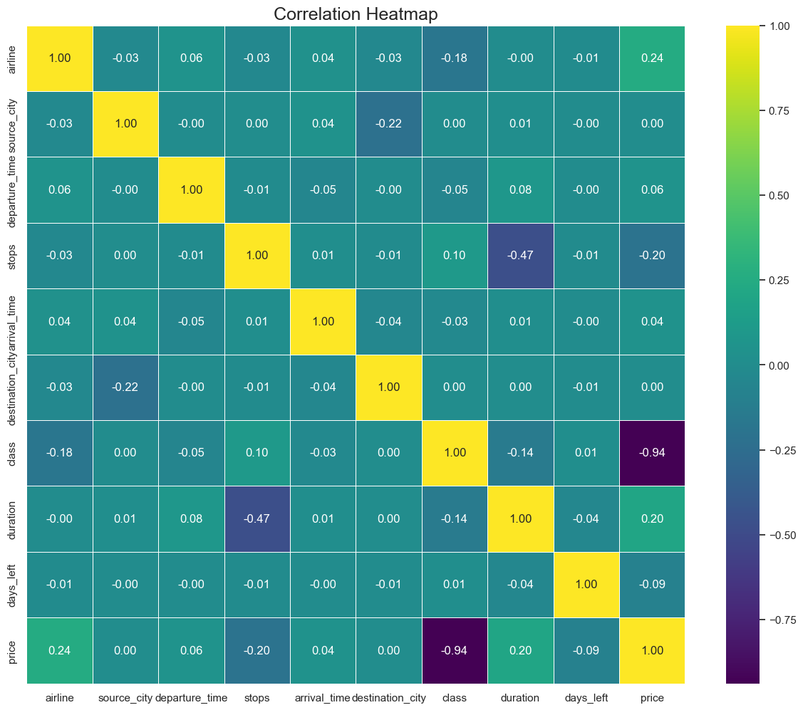
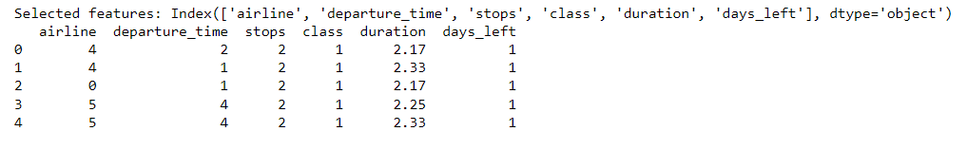
Co-Relations
We use F-statistic (ANOVA) for feature selection and we get ‘airline’, ‘departure time’, ‘stops’, ‘class’, ‘duration’, ‘days_left’ as a best feature.

Slide 12
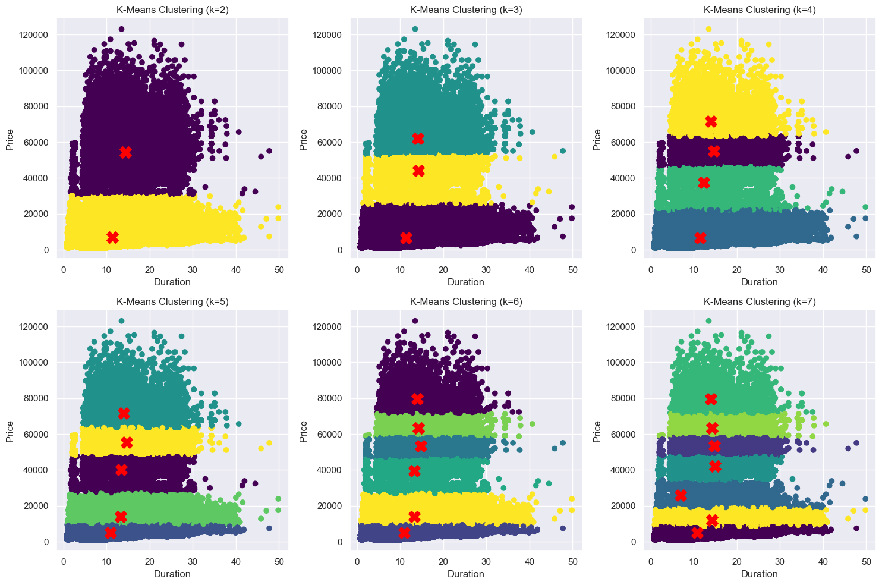
KMean Clustering

Slide 13
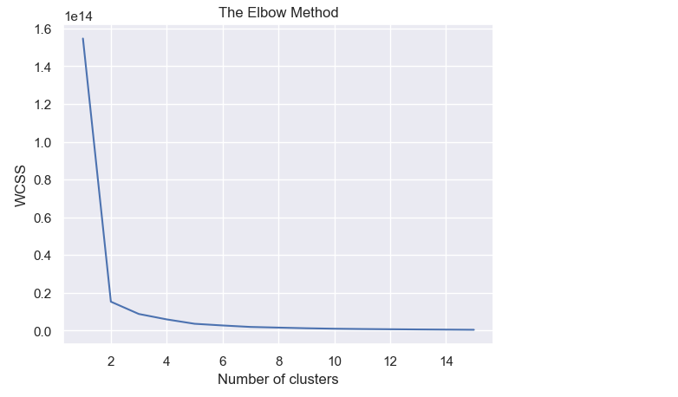
Elbow Method

Slide 14
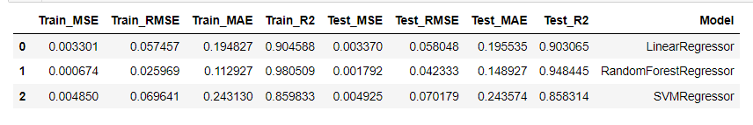
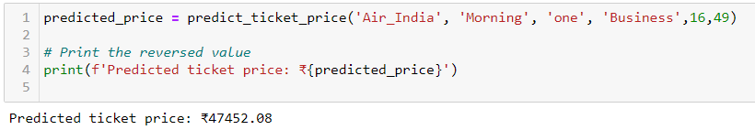
Model Evaluation
Validation

Slide 15
Conclusion
In our flight fare prediction project, we applied three regression models to a dataset featuring various parameters like journey date, source, destination, and route. After evaluating each model's performance on training and testing sets, considering prediction errors and model fit, we found SVMRegressor to be the most effective.
With the lowest prediction error and superior model fit, SVMRegressor accurately captured feature-flight fare relationships and demonstrated robust generalization to new data. Consequently, we recommend employing SVMRegressor for optimal performance and accuracy in this dataset.

Slide 16
Future work
Future efforts in this project may focus on diverse strategies to enhance model performance and tackle identified challenges. Exploring advanced machine learning algorithms or ensemble methods could enhance the model's generalization capabilities.
Feature engineering, involving the addition of relevant variables or interaction terms, may offer a more nuanced understanding of data patterns. A comprehensive hyperparameter tuning process could optimize the model's parameters for improved performance.
Analyzing and addressing potential bias or variance issues through targeted adjustments and data preprocessing aim to enhance accuracy, generalization, and interpretability, ensuring a more robust predictive tool.

Slide 17
reference
Gulati, A. P. (2022, August 31). Flight fare prediction using machine learning. Analytics Vidhya.
https://www.analyticsvidhya.com/blog/2022/01/flightfare-prediction-using-machine-learning/
Groves, W., & Gini, M. (2013). An agent for optimizing airline ticket purchasing. ResearchGate.
https://www.researchgate.net/publication/262172314_An_agent_for_optimizing_airline_ticket_purchasing

Slide 18
Thanks!

