Slide 1

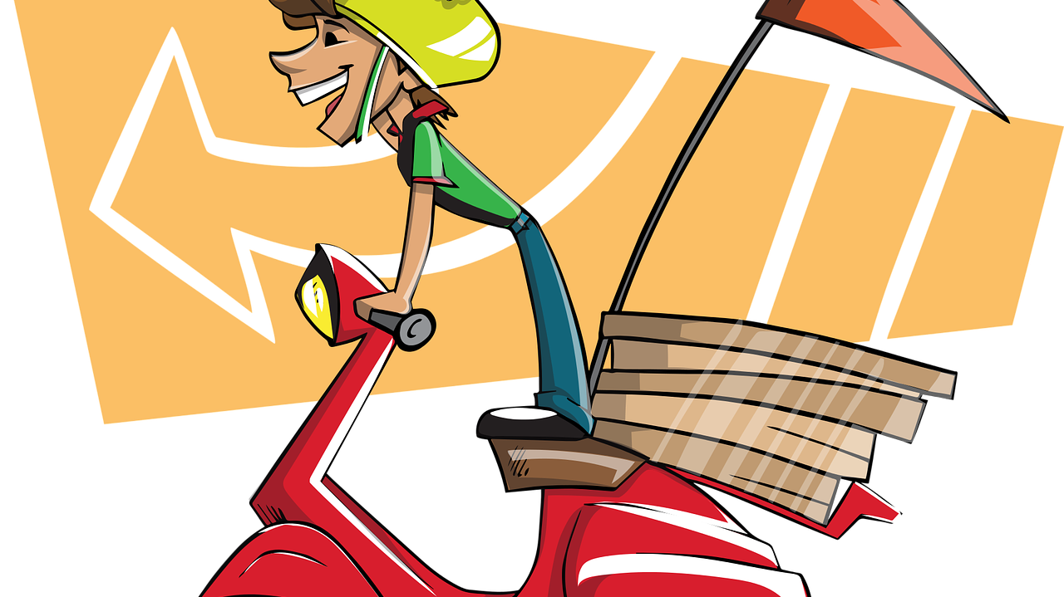
Food ordering/route planning
Matlab project 29-10-2020
Sara Lute
Sumit Mohanty
Kaiyu Wei

Slide 2
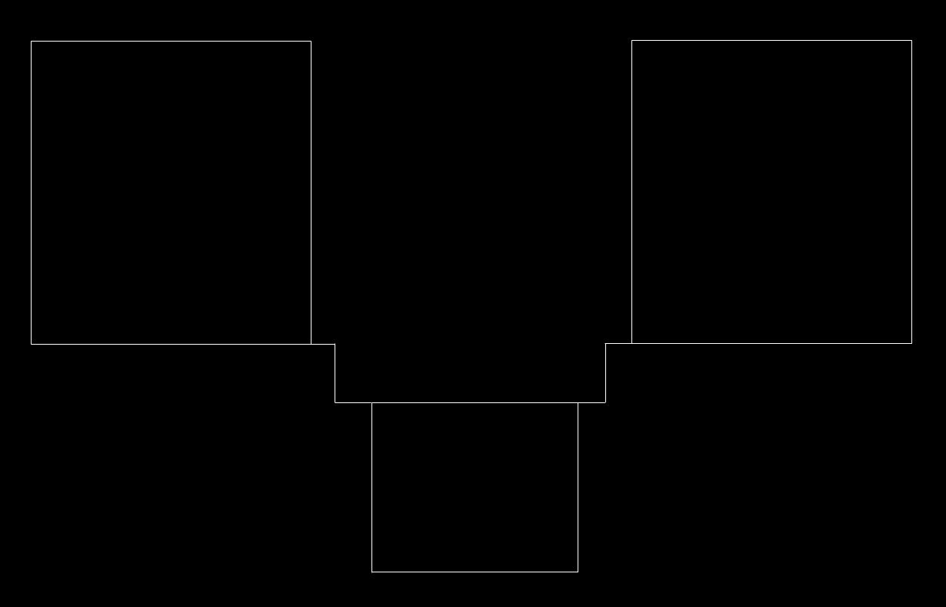
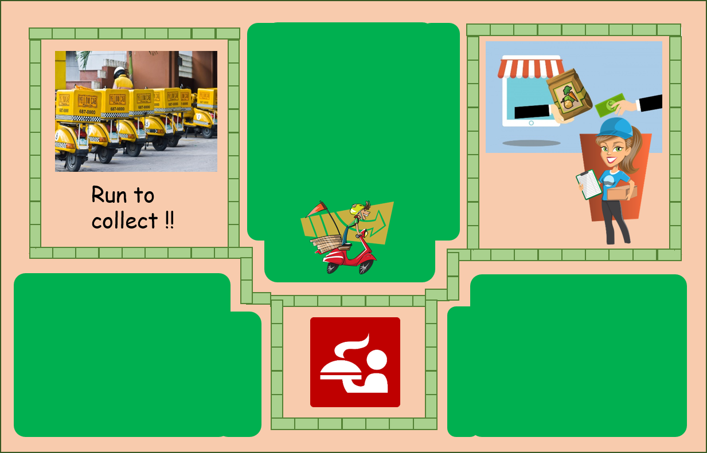
7 deliverymen, 5 restaurants, any house in the neighborhood

Slide 3
Main
setupBook
getAddress
getOrder
findAccount
DeliveryMan
TrackDelivery
DeliveryManProgress
desiredDirection
searchNeighborhood
computeDirection

Slide 4
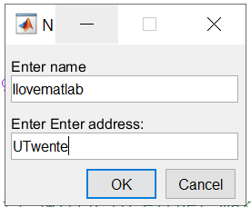
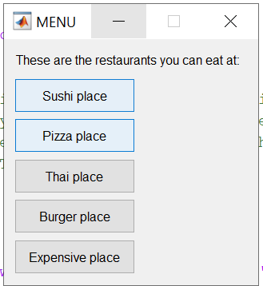
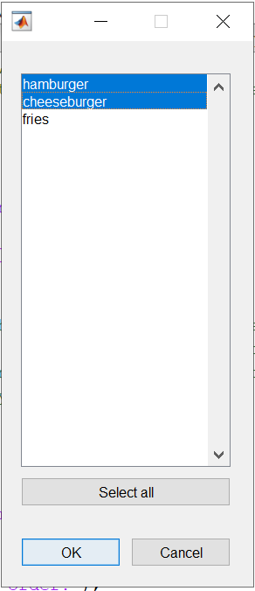
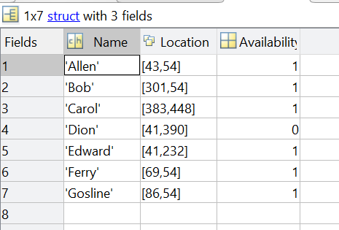
Automatically get the closest delivery man
Create your account
Select your food

Slide 5


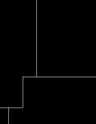
Tracking progress of delivery
Based on line follower principle
Binarize the roads of city as Black (0) and White (1) → Follow the white
function : Hop one step towards destination along white line
The function divides the task into three sub-functions :
DeliveryManProgress
While (x_{src}, y_{src}) = x_{dest}, y_{dest})
While (x_{src}, y_{src}) = x_{dest}, y_{dest})
searchNeighborhood
desiredDirection
computeDirection
0 | 1 | 0
0 | 1 | 0
0 | 1 | 0
0 | 0 | 0
0 | 0 | 1
0 | 1 | 0
0 | 0 | 0
0 | 0 | 0
0 | 1 | 0
X
=
Pick up order: delivery man’s position to restaurant
Deliver order: restaurant to customer

Slide 6
Tracking progress of delivery
Function communicates route through three possible flags
Represent three cases given the choice delivery man has to move
flag == 0
flag == 2
flag == 1
0 | 0 | 0
0 | 0 | 0
0 | 1 | 0
0 | 0 | 0
0 | 0 | 1
0 | 1 | 0
0 | 0 | 0
0 | 0 | 0
0 | 0 | 0
desired Direction.m
Only one direction available to go
At a corner i.e. two possible directions to go
No possible direction i.e. Source and destination become parallel
computeDirection.m
Take one step in desired direction e.g. go along y
Switch direction i.e. if previous was y, then change to x direction
Continue along the previous direction till turn occurs i.e. along y
Force flag == 0 afterwards
Forces delivery man on this condition till flag == 2 is encountered

Slide 7
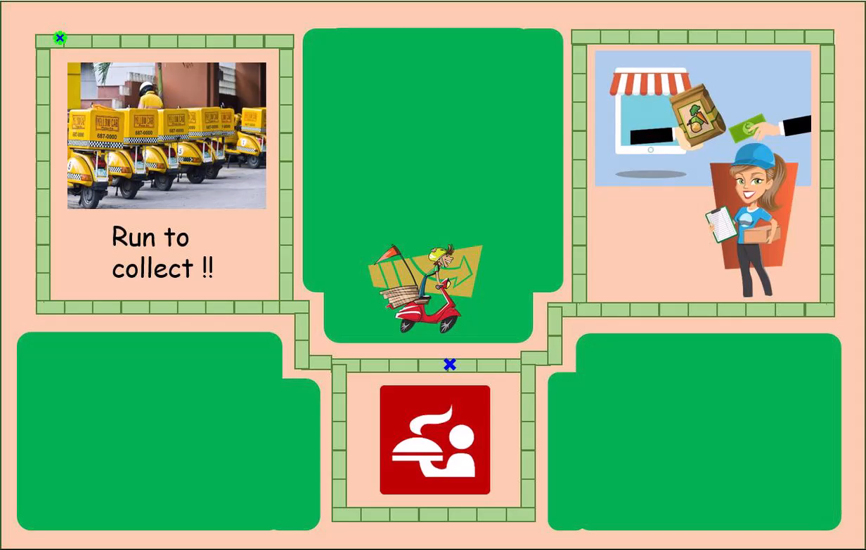


Demo of tracking delivery
Report time scaled to number of steps taken

Slide 8
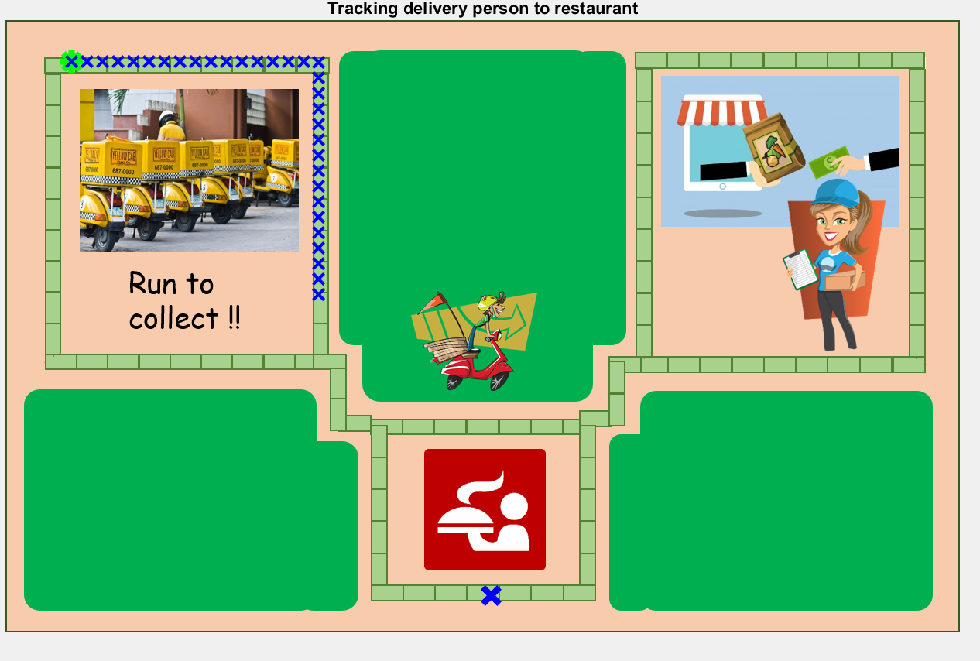
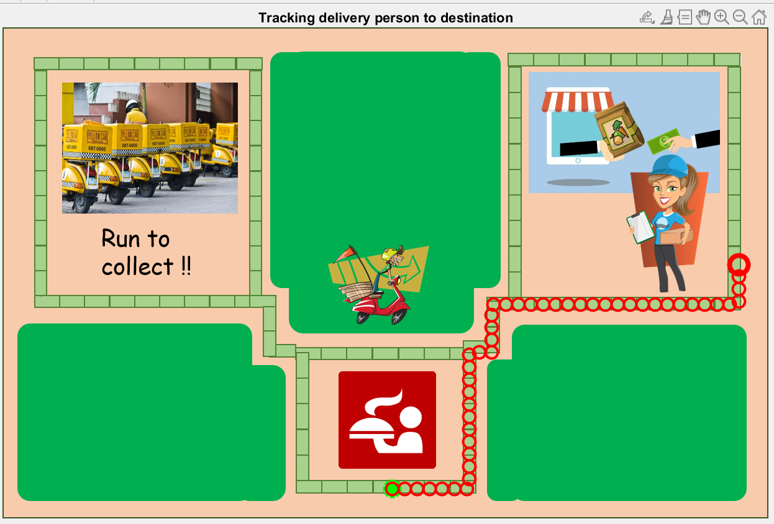
Deliveryman is going to get your food
Deliveryman is on the way to you
Enjoy your food, yummy!

