Slide 1
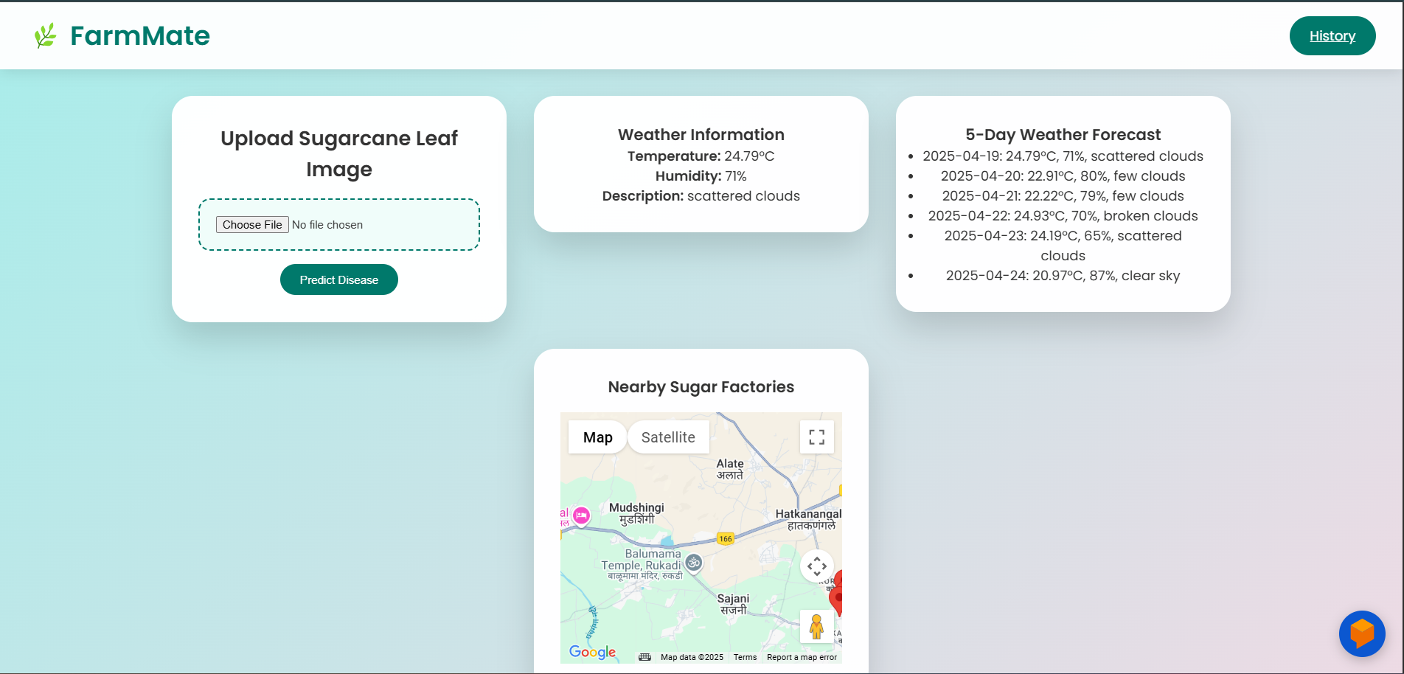
FarmGenious:
Smart Sugarcane Disease Detection System
FarmMate revolutionizes sugarcane farming. It uses an advanced tech stack and AI for disease detection. Empowering farmers with real-time data and intelligent recommendations.
TT
by Tech Warriors

Slide 2
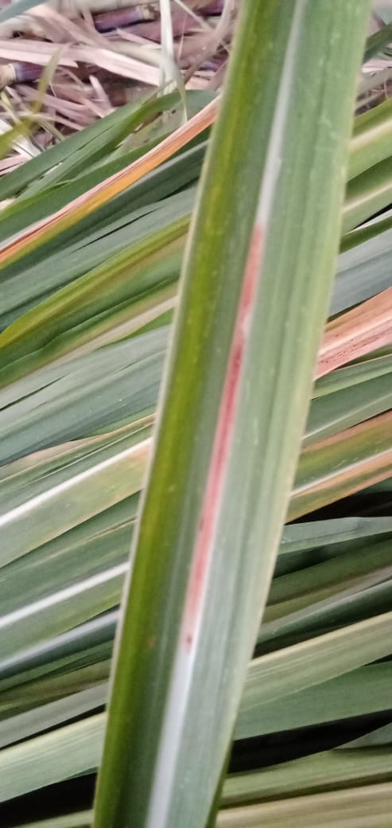
Challenges for Sugarcane Farmer’s
Difficult Early Detection
Incorrect Fertilizer Usage
Weather Risk Unawareness
Early disease detection is challenging, leading to widespread crop damage.
Farmers often misuse fertilizers, harming the environment and crops.
Lack of weather information leads to poor farming decisions and losses.

Slide 3
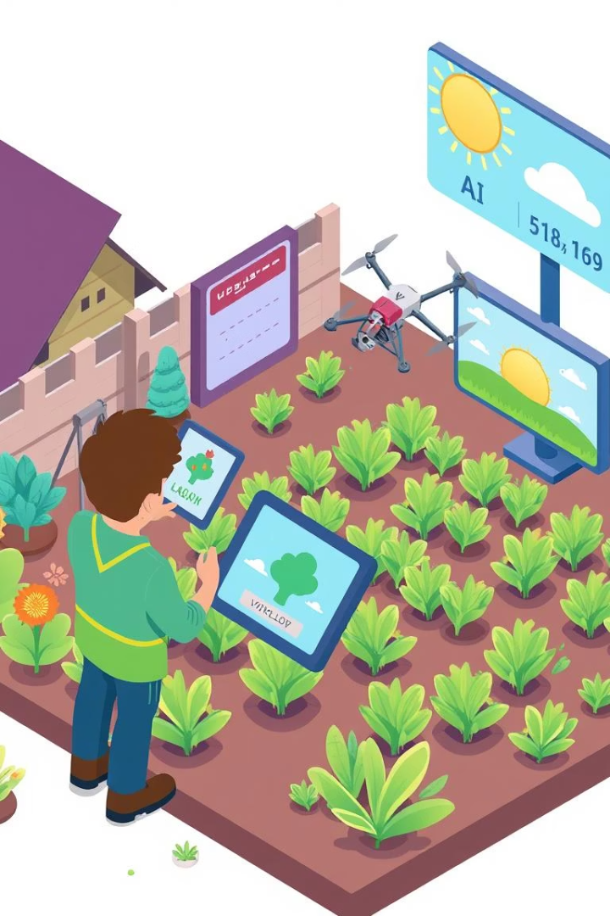



Introducing FarmGenious:
AI-Powered Disease Detection
Fertilizer Recommendations
Detects sugarcane leaf diseases using AI.
Provides fertilizer advice based on diagnosis.
Real-Time Weather Forecast
Integrates weather forecasts for informed decisions.

Slide 4




FarmGenious System Architecture
Image Upload
Recommendation
Upload sugarcane leaf image.
Generate fertilizer recommendation.
AI Prediction
Weather Data
AI model predicts disease.
Fetch weather data via API.

Slide 5
Machine Learning Model Details
Base Model
Trained On
Accuracy
MobileNetV2 (Transfer Learning).
Five sugarcane disease categories.
~95% on the validation dataset.
MobileNetV2 is a lightweight deep CNN architecture pre-trained on the large-scale ImageNet dataset. It balances accuracy and speed, making it ideal for mobile and web deployment. We froze base layers initially to retain general image features and trained only custom top layers on sugarcane disease data.
The model was trained to classify sugarcane leaves into 5 specific disease types:
Healthy 2.Mosaic Virus 3.Red Rot 4.Rust 5.Yellow Leaf Disease Data augmentation techniques (rotation, flipping, zooming, shifting, brightness variation) were applied to simulate real-world scenarios and increase model robustness. The input images were resized to 224×224 pixels to match the model’s expected input size.
After training for 30 epochs, the model achieved a high validation accuracy close to 95%, confirming the effectiveness of transfer learning. The model was evaluated using unseen validation data, ensuring generalization and low overfitting. Final model selection was based on performance metrics like categorical accuracy and loss convergence.

Slide 6
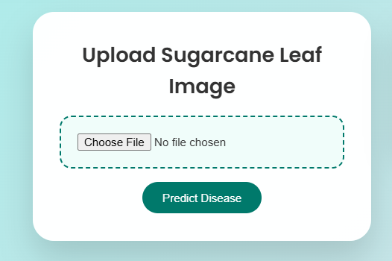
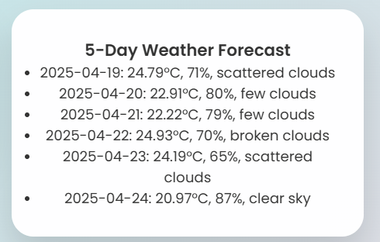


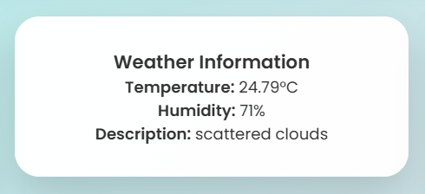
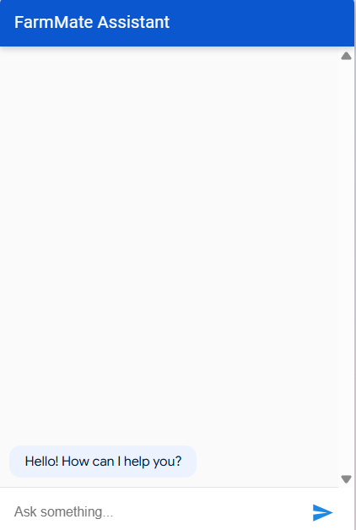


Web Application Features
Image Upload
Fertilizer Advice
Factory Locator
Weather Forecast

Slide 7
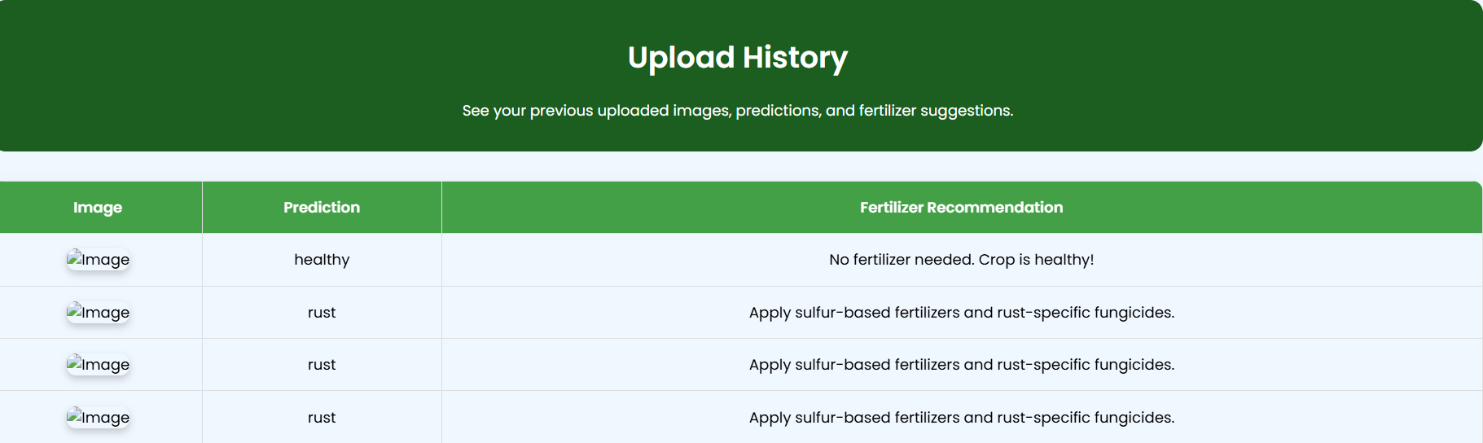
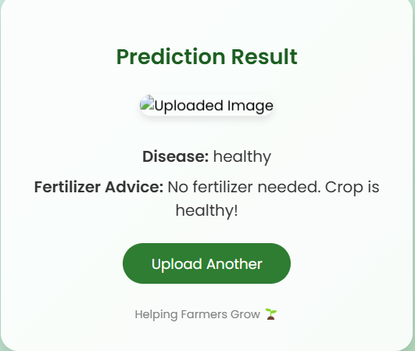
FarmGenious UI Snapshots
History Page
Result Page
Home Page
Disease, fertilizer, voice.
Image upload, weather.
Past diagnoses.

Slide 8
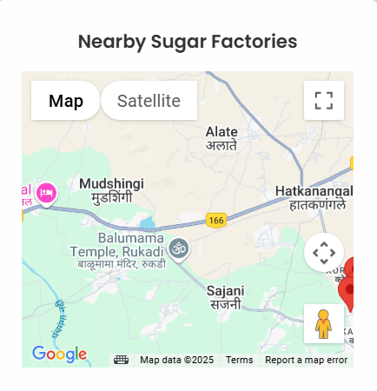
Weather & Market Integration
OpenWeatherMap API
5-Day Forecast
Emergency Alerts
Google Maps API
Factory Locator
Market Rates
Integrated for real-time, informed farming decisions.

Slide 9
Results and Impact
Faster Prediction
Farmers can upload a sugarcane leaf image and receive a disease diagnosis within seconds.
The use of a lightweight MobileNetV2 model ensures high-speed prediction without needing heavy computing resources.
Immediate results help farmers take timely action and reduce crop loss significantly.
Accurate Fertilizer
Based on the predicted disease, the system recommends specific fertilizer treatments instead of generic ones.
This precision farming approach helps optimize fertilizer application, leading to:
Better soil health
Lower costs on unnecessary chemicals
Improved crop recovery and yield
Informed Decisions
Integration with real-time weather forecasting (OpenWeatherMap API) enables farmers to plan actions around rain, drought, or heatwaves.
Emergency alerts (e.g., heavy rain warnings) help prevent fertilizer wastage and crop damage.
Farmers can strategically plan irrigation, pesticide spraying, and harvesting based on reliable data, improving overall farm management.

Slide 10
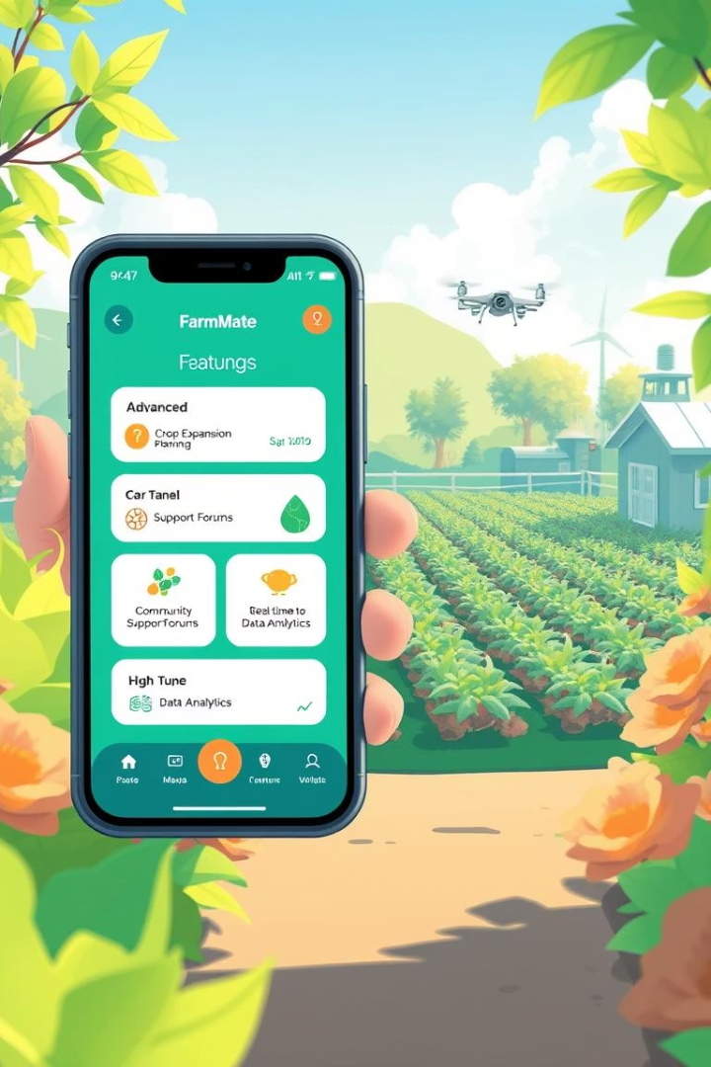
Future Scope & Enhancements
Crop Expansion
Mobile App
Extend to cotton, rice, etc.
Android/iOS version.
Advanced Prediction
Disease stage prediction.
Let's make farming smarter! Community alerts and support.

