Slide 1
ibuild
ibuild is a component to assist in building other components
It provides a rules.mak file to be included by other components makefiles
A component merely has to specify a number variables: CSOURCES, ASMSOURCES, COMPONENT_DEPS, TARGET, etc.
ibuild takes care of dependencies, compiling, linking, components, etc.

Slide 2
Sample Makefile
# define the source code
# Just provide a list of source files for C code and assembly code
# NOTE: all sources must be in the src directory of this component
CSOURCES =
ASMSOURCES =
# define the name of the target file to produce
# libraries MUST be named "lib<name of component>.a"
# elf files can have any name
TARGET =
# define the type of target to build (lib or elf)
TARGET_TYPE =
# the names of the dependencies of this component
COMPONENT_DEPS =
# If this is a project component uncomment the following
#include project.mak
# Pull in the ibuild make rules
include $(TOP_LEVEL_COMPONENTS_DIR)/s_ibuild/build/rules.mak

Slide 3
Sample project.mak (1)
#Define the project name and the component directory
export PROJECT=
export TOP_LEVEL_COMPONENTS_DIR=$(shell pwd)/../components
# Define all of the following tools
# Note: CROSS is only a convience for this file only
CROSS=mips64-octeon-linux-gnu-
export AR=${CROSS}ar
export CC=${CROSS}gcc
export LD=${CROSS}ld
export AS=${CROSS}as
export OBJCOPY=${CROSS}objcopy
export MKDIR=mkdir -p
export RMDIR=rmdir
export RM=rm -f
export SED=sed
export AWK=awk

Slide 4
Sample project.mak (2)
# Compiler flags: broken up into different groups for convenience, only CFLAGS is exported
export CFLAGS=${OPTIMIZATIONFLAGS} ${WARNINGFLAGS} ${INCLUDEFLAGS} \
${DEFNFLAGS}
# Linker flags
export LDFLAGS=
# This defines the version of ibuild that we are configured to use
# a future version of ibuild may require different variables to be set
export IBUILD_PROJECT_MAK_CONFIGURED_VERSION=1

Slide 5
Including Header files in C
ibuild automatically adds the -I flags to the compiler so all exported header files from dependent components and this component can be used with
#include <header_in_a_components_inc_dir.h>
And all local header files to this component can be included with
#include "header_in_this_components_src_dir.h"

Slide 6
Linking Component Dependencies
ibuild knows about all component dependencies, so it can
  Add “-L<path>” to the linker file
  Add “-l<component dependency>”

Slide 7
Directory Layout – Input Files
ibuild requirements:
/inc – contains all exported header files
/src – contains all source files & local headers
/build – contains the component makefile
/test – Future addition
Additional Icron convention:
/doc – contains all component documentation
/components – project components only
/etc – contains files that don't fit in the above

Slide 8
Directory Layout – Output Files
ibuild creates:
/<project>_obj – contains object files
/<project>_lib – contains the library files
/<project>_bin – contains the elf files
Using <project> allows for multiple build outputs. For example:
lg1_asic & lg1_fpga

Slide 9
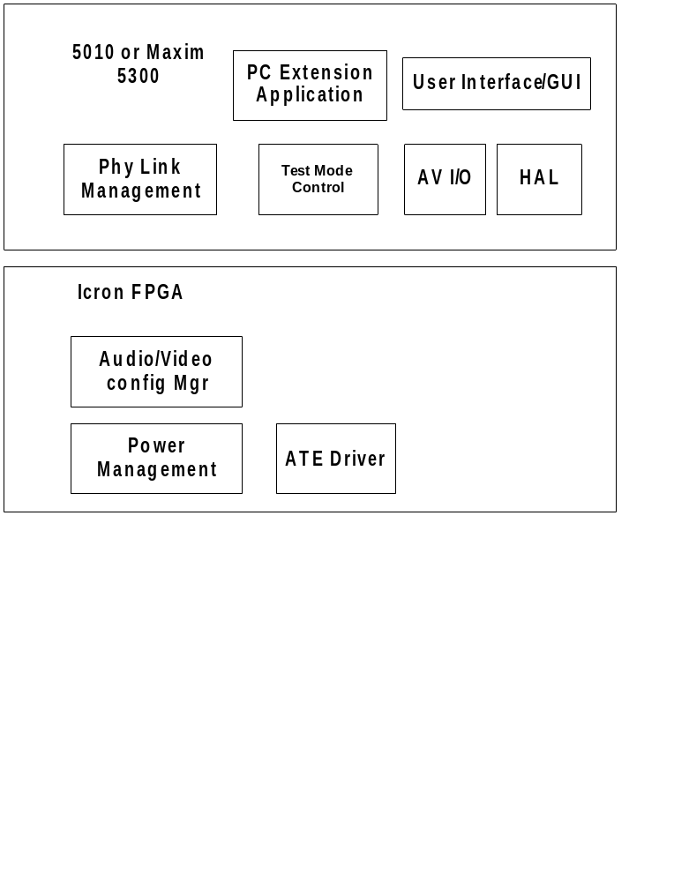
Project with Multiple Processors

Slide 10
Partial Implementations - Libraries
The higher level build has to define the project.mak file
Then build the ibuild components with make
The libraries will be available for linking as
  $(component)/$(project)_lib/lib$(component).a

Slide 11
Partial Implementations - ELF
Add “-I” flags to CFLAGS to pick up additional non-ibuild include directories
Add “-L” & “-l” flags to LDFLAGS to add the non-ibuild libraries
Add default rule to makefile which
  Builds non-ibuild components
  Recalls make to build the target $(TARGET)

Slide 12
Status – Implemented Features
Library targets
Elf targets
Building C files
Automating directory paths for includes
Automated linker command line for library path's and library's to link against
Building component dependencies
Pretty output (default) & verbose output (make V=1)

Slide 13
Status - TODO
Cleanup of variable names $(IBUILD_RULES)
Precompiled headers support
Better assembly file support
Lint support (splint)
Test rules
  Unit tests using $(HOSTCC)
  Test harnesses that define a test project
Option to preserve intermediary files
Support for building components in parallel
Better support for multiple project builds

Slide 14
Where is it?
On clover: add module gnu/git (done automatically for the eagle project)
On windows:
  Install msysgit
  Add clover alias to ssh://clover/data/engdev/.gitrepos/
    This is a pain as there is a '.' in the name.
    .gitconfig may have to edited directly
Run “git clone clover:s_ibuild”
  Note: A user's guide is in the /doc/ directory

Slide 15
Questions?

