Slide 1
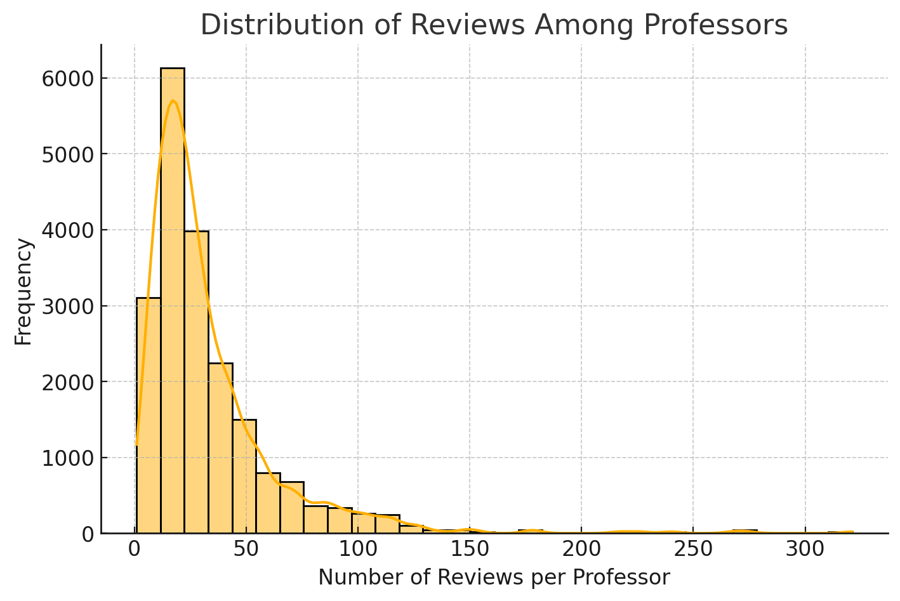
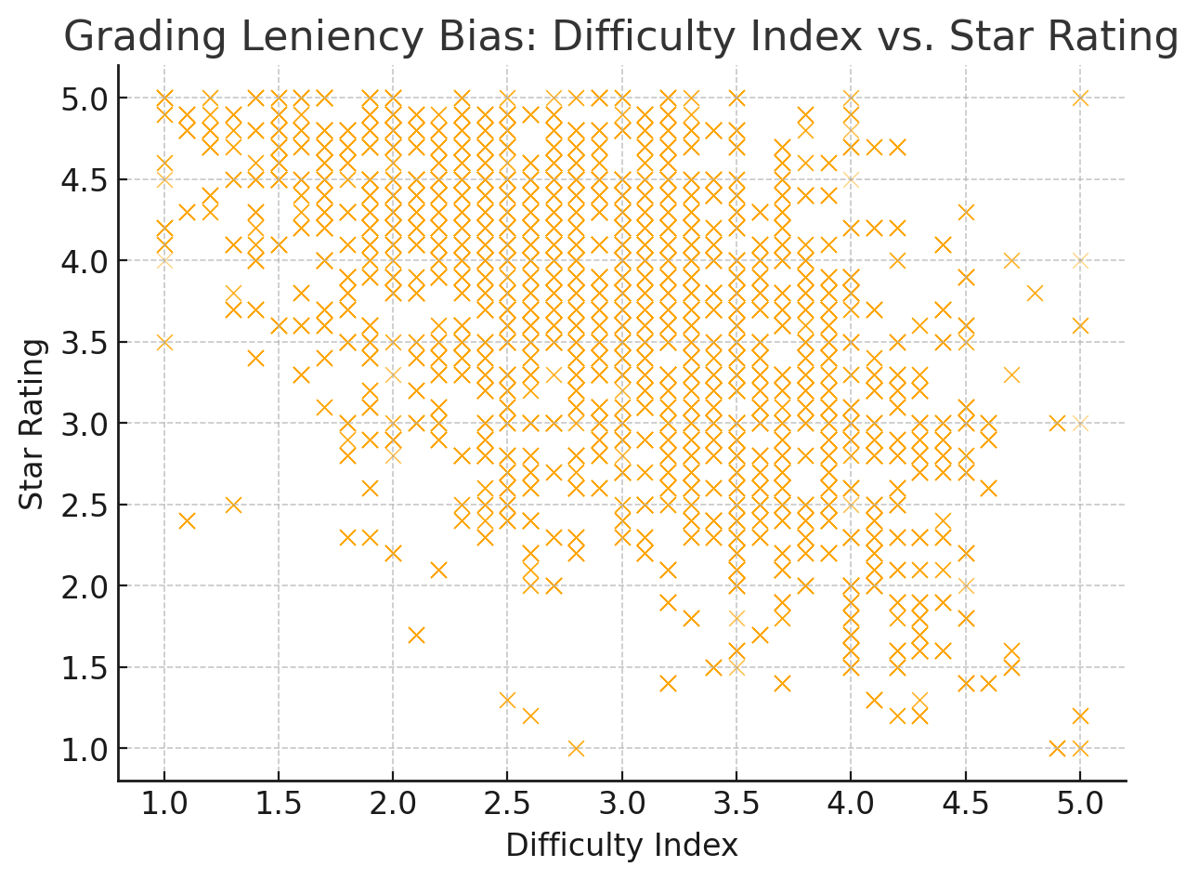
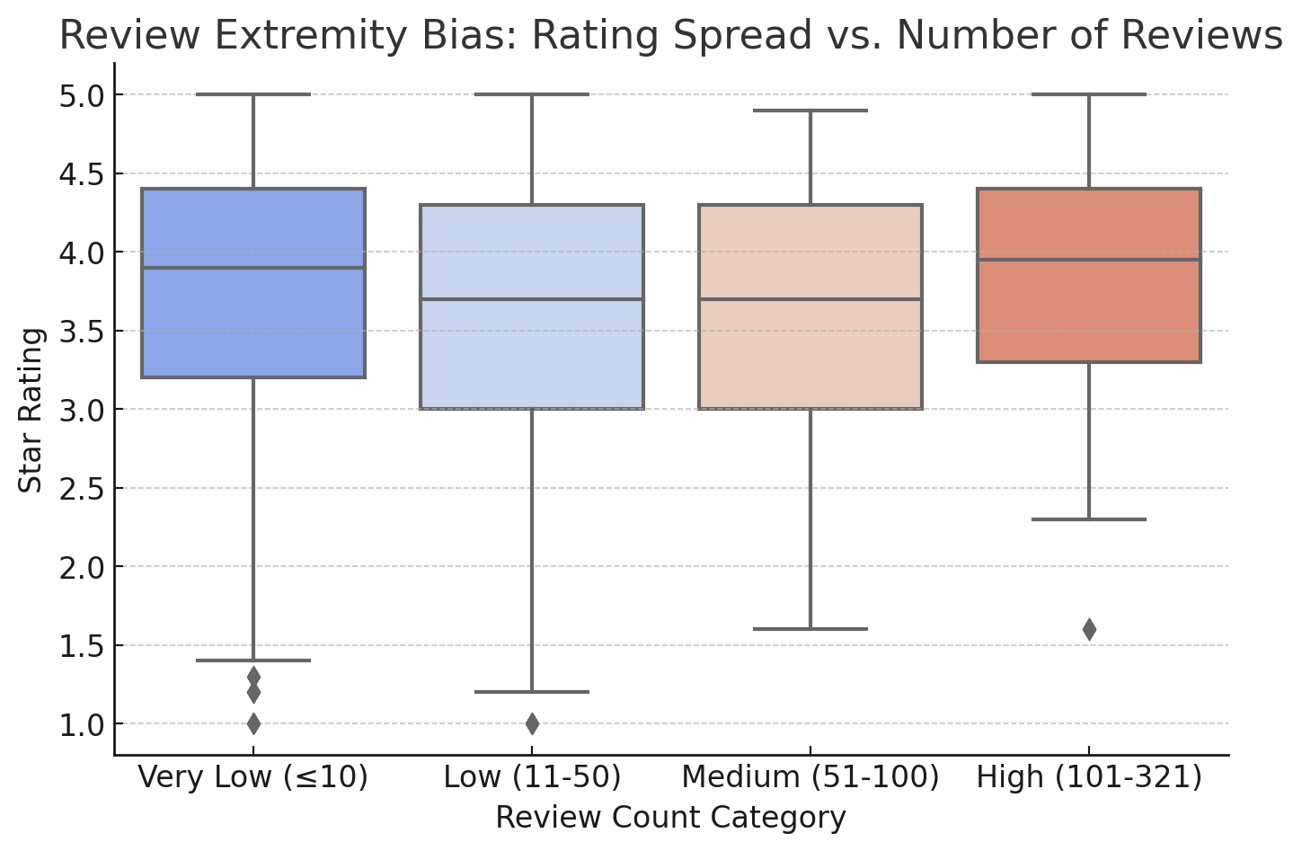
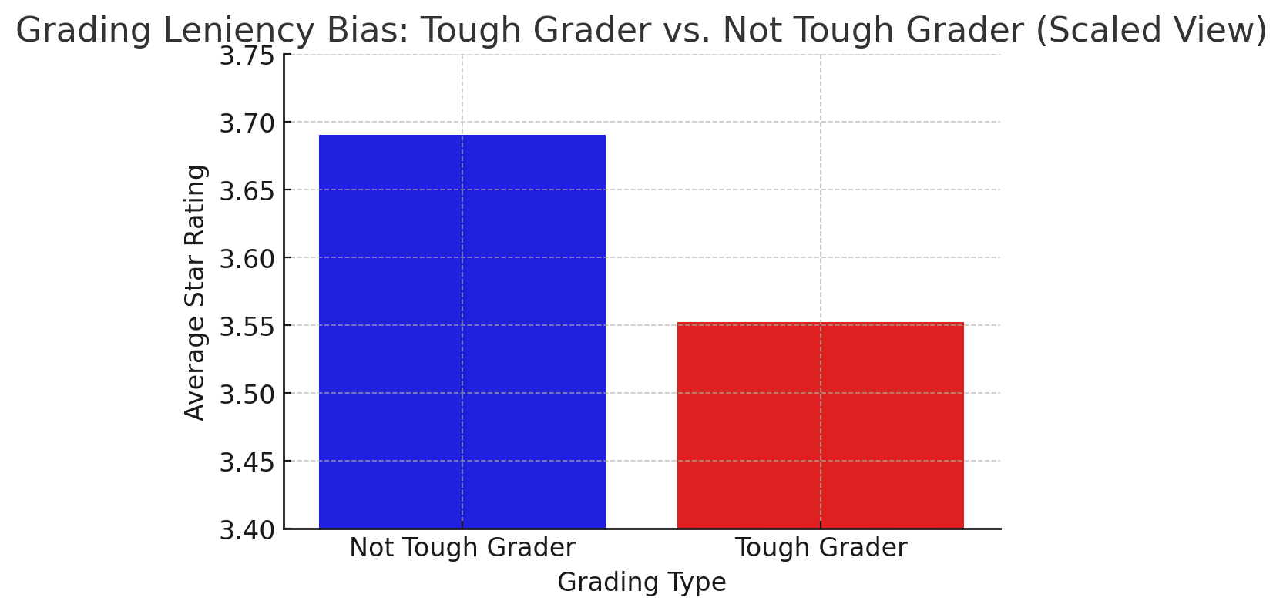
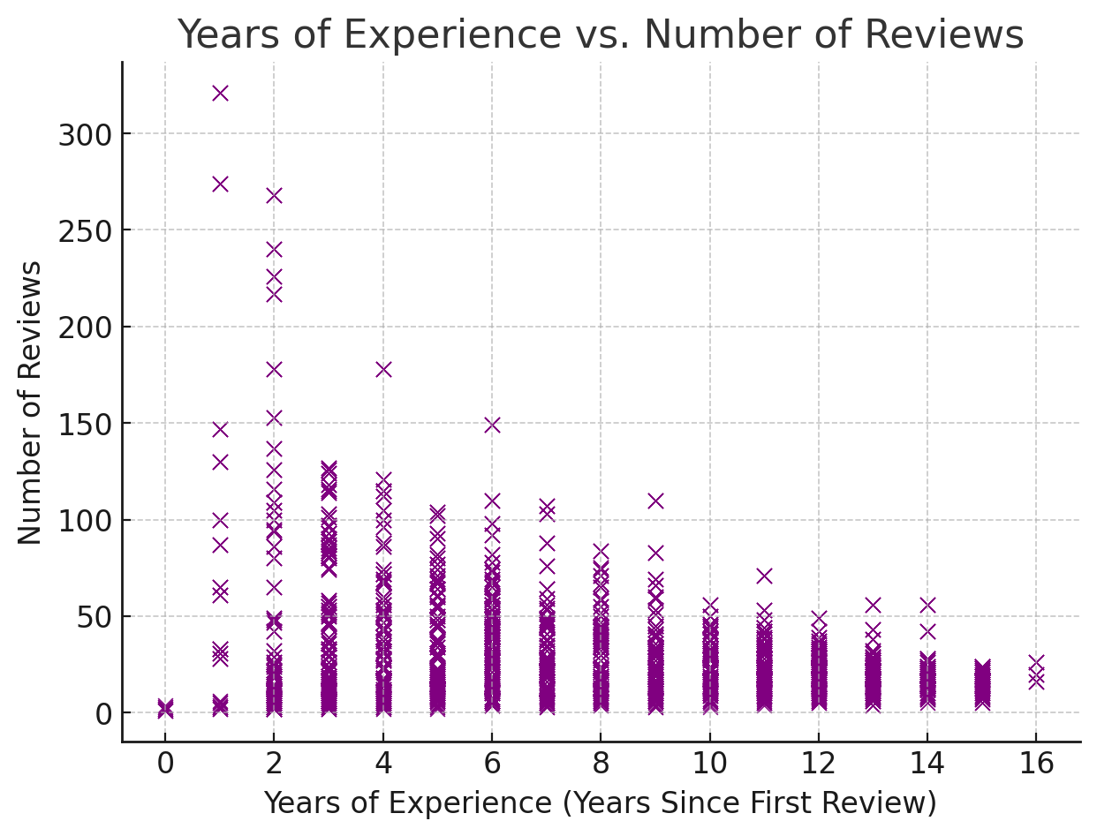
Difficulty Index vs. Star Rating (Do easier graders get higher ratings?)
Tough Grader vs. Not Tough Grader Average Ratings
Tough Graders: Average rating: 3.55
Not Tough Graders: Average rating: 3.69
Difference: 0.14 points lower for tough graders, confirming that stricter graders are penalized in ratings.
Behind the Ratings: Investigating Biases in the Student Evaluation on Rate My Professor
Sumit Sah, Pujan Lamsal, Shreejal Bhattarai, Samrakshan Rijal
College of Science and Engineering, Texas State University
Millions of students use Rate My Professors (RMP) to choose courses, but do these ratings truly reflect teaching quality? Our research reveals that RMP ratings are influenced by systemic biases that distort evaluations, leading to misleading assessments of professors..
In this project, we explore the three primary biases present in Rate My Professors (RMP) ratings and their influence on perceptions of teaching quality. Our analysis centers on grading leniency bias, sampling bias, and review extremity bias, illustrating how these systemic issues contribute to unfair evaluations that can mislead students and harm professors' reputations.
Research Questions:
Grading Leniency Bias: How does grading leniency influence a professor's rating? Are professors with lower difficulty ratings consistently rated higher, regardless of their teaching effectiveness?
Sampling Bias: To what extent does sampling bias affect the reliability of RMP ratings? Are a small percentage of highly-reviewed professors driving overall perceptions?
Review Extremity Bias: How does the number of reviews impact rating extremity? Do professors with fewer reviews exhibit more extreme ratings compared to those with more reviews?
Methods
Data Cleaning and Preparation: Removed duplicate rows, handled missing values, and standardized column names.
Exploratory Data Analysis (EDA): Analyzed rating distributions, review counts, and professor attributes using Python (Pandas, Matplotlib, Seaborn).
Statistical Analysis: Compared averages, standard deviations, and distributions to identify patterns in grading leniency, sampling, and review extremity biases.
Visualization: Created scatter plots, boxplots, and histograms to illustrate findings clearly.
We analyzed:
Difficulty Index vs. Star Ratings (Scatter Plot) to observe the relationship.
Compared average ratings between Tough Graders vs. Not Tough Graders (Bar Plot).
Visualized Review Count Distribution (Histogram) to identify imbalance.
Grouped professors by review counts (Very Low, Low, Medium, High). Plotted Rating Spread vs. Review Group (Box Plot) to highlight variability.
Results
Grading Leniency Bias Analysis Result:
- A clear negative trend(-0.54): Professors with lower difficulty scores receive higher ratings, indicating that students rate easier graders more favorably.
Tough Graders: 3.50; Not Tough Graders: 3.7 (Difference 0.2, confirming strict graders are penalized in ratings.)
2. Sampling Bias Analysis Result:
- The histogram shows a right-skewed distribution, meaning most professors receive very few reviews, while a small group has many reviews.
- Total unique professors: 1413, Professors with < 41 reviews: 1060(75% of total)
Analyzed review counts to find that 75% of professors had 41 or fewer reviews, while maximum review a professor got was 351.
3 Review Extremity Bias Analysis Result:
- Professors with fewer reviews (<= 10) have highest rating variability, with many extreme high and low ratings.
- Professors with more than 100 revies show the lowest variability, indicating more stable and reliable ratings.
Findings
Our analysis, combined with insights from the research paper Rate My Professors: A Study Of Bias and Inaccuracies In Anonymous Self-Reporting, highlights several key biases and their impact on professor evaluations:
Grading Leniency Bias: Professors with lower difficulty scores received higher ratings. "Tough Graders" averaged 3.55, while "Not Tough Graders" averaged 3.69, reflecting a 0.14-point penalty for stricter grading.
Sampling Bias: 75% of professors received 41 or fewer reviews, indicating dominance by a small group of highly-reviewed professors. Surprisingly, there was almost no correlation (0.018) between experience and review count, showing that more experienced professors did not get more reviews.
Review Extremity Bias: Professors with fewer than 10 reviews had the highest rating variability (SD: 0.90), suggesting that fewer reviews lead to more extreme ratings.
Platform Bias: According to Katrompas & Metsis (2020), RMP ratings were 10.01% lower than official university evaluations, with 94.24% higher variance..
Implications:
Impact on Students: Misleading ratings may cause students to avoid experienced or strict professors, affecting their learning outcomes.
Impact on Professors: Effective but strict educators face reputation damage, which may harm their careers and evaluations.
Impact on Universities: Poorly rated but effective professors may face lower enrollment, reducing course diversity and educational quality.
Best Solutions Proposed: 1. Use University Evaluations as a Primary Source: Since they are mandatory and reach more students, university evaluations reduce sampling bias and provide reliable ratings. 2. Implement Mandatory Ratings on RMP: Require students to rate professors after each course to increase review volume and reduce sampling bias. 3. Verified Reviews and Weighted Ratings: Use university logins for authenticity and adjust ratings based on review volume and consistency to reduce biased reviews. 4. Student Awareness Campaign: Promote honest, constructive reviews through awareness programs, educating students on the value of fair feedback.
Data Sources
We used the Rate My Professors (RMP) dataset from Mendeley:
https://data.mendeley.com/datasets/fvtfjyvw7d/2.
The dataset contains 20,000 entries, covering over 1,400 professors from 500 universities across the U.S, and is updated until 2020. It was the most recent dataset we could find. We attempted web scrapping for newer data, but were unsuccessful due to access request issues. It includes ratings, difficulty scores, review counts, and university details, enabling a comprehensive analysis of bias trends.
References/Data Cite
Katrompas, A., & Metsis, V. (2020). Rate My Professors: A Study Of Bias and Inaccuracies In Anonymous Self-Reporting. Texas State University.
Feistauer, D., & Richter, T. (2016). "How reliable are students' evaluations of teaching quality?" Assessment & Evaluation in Higher Education.

