Slide 1
IndiaHacks 2017: Artificial Intelligence
By Sumit Kumar Gupta

Slide 2
Problem 1
Its very difficult to find the information from government exams websites .
Example-http://www.sscnr.net.in/newlook/site/index.html
And let’s look into Customer Care link under the website:
HELPLINE 011-69999845, 011-69999846
E-mail Ids enquirysscnr@gmail.com
Information & Facilitation Centre 011-24363343
Customer care number is always busy and only lucky guys get receive information from MailId communication ☺
Now more than lakhs of non IT student’s with thousand questions in mind reach to whom ?Are the two customer care numbers are enough to solve student’s queries?
Answer is -No

Slide 3
Solution
There are thousands of exams of central and state level where students need to know about the exams like procedure of submission of form exam fees ,exam date,admit card,results or any new announcement of exams .
One or more than one customer care numbers are not sufficient to handle lakhs of student’s queries.
Sometimes student’s queries get unanswered.
Solution:ChatBot
Students can chat like watsup or facebook to get their queries resolved.
Students can save their time and focus on preparation.

Slide 4
Problem 2
I don’t find any changes in the FAQ in any websites,while Frequently Asked Questions must be changed according to user’s questions .
Solution:ChatBot

Slide 5
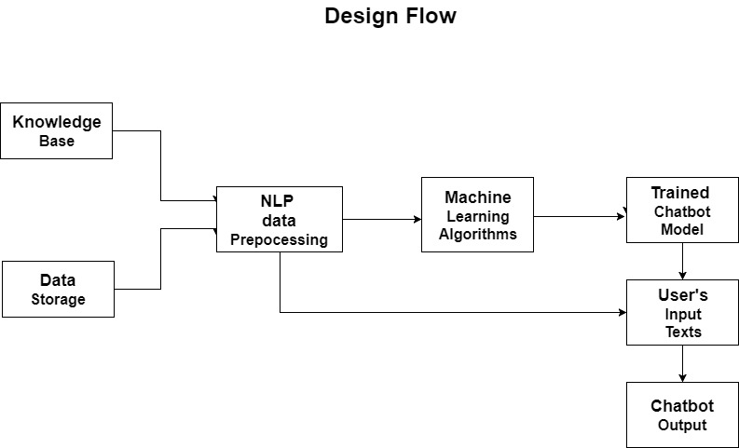
Project Documents
FAQ Update
NLP process
Question saved into csv

Slide 6
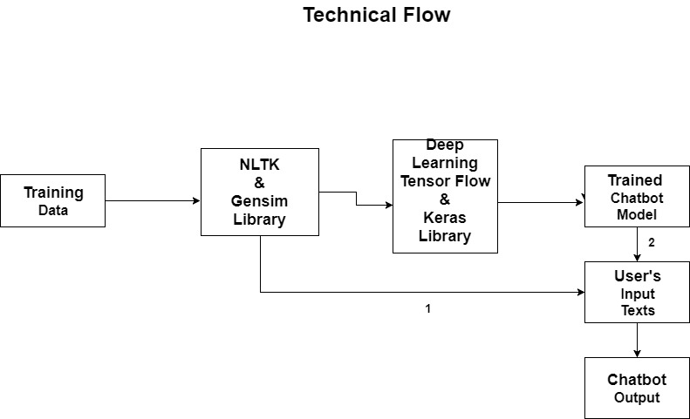
Project Documents
FAQ Update
NLP &
Pandas
Question saved into csv

Slide 7
Language and Library Used
Python
NLTK
Gensim
Word2vec
Numpy
Deep Learning
Keras
TensorFlow backend
Pandas

Slide 8
Build Phase
I have taken HackerEarth discussion forum questions and answers for model training .
https://www.hackerearth.com/sprints/artificial-intelligence-indiahacks-2017/discussion/#discussion
Screen Shots of coding has been attached in the forum .
It includes both solution CHATBOT and FAQ Updation .

Slide 9
Testing
Enter the message : Hi
ChatBot replied :hi +padding text(which can be removed)
Enter the message:How are you?
ChatBot replied : m do do well +padding(which can be removed)
ChatBot needs to be trained more .☺

Slide 10
Testing( FAQ Update)
Discussion forum of HackerEarth
As per Students questions :
When will the shortlist announce for idea Phase?
Will we get the accommodation and travel reimbursement?
Python Script also state the same questions:
When will the shortlist announce for idea Phase?
Will we get the accommodation and travel reimbursement?
And recommend to update the original FAQ

Slide 11
Advantages
Students can get their queries resolved .
Students don’t need to invest their time to search queries on internet or call to customer care number.
Government does not need to invest money on creation of flashy websites to convey the information to students.
It can be used in private exams as well .
It can be installed on the web so many thousands students simultaneously can use .

Slide 12
Feature can be added
Visually impaired can talk to BOT using Speech->Text->Text->Speech and get their queries resolved.
CHATBOT can use different languages apart from ENGLISH.
CHATBOT can recommend some useful links or books for the study .
It can also sense the sentiments of students and can answer accordingly.

Slide 13
Thank You

