Slide 1
Kafka for Developers using
Schema Registry
Dilip Sundarraj

Slide 2
About Me
Dilip
Building Software’s since 2008
Teaching in UDEMY Since 2016

Slide 3
What’s Covered ?
Fundamentals of Data Serialization and different Serialization formats available
Introduction to AVRO and its importance
Build a real time Kafka Producer and Consumer application that exchanges data using AVRO Serialization format
Introduction of Schema Registry and its vital role for the evolution of the data
Integrate Schema Registry into the Producer and Consumer application
Different Techniques to evolve the data using Schema Registry
Build a Kafka Producer and Consumer Spring Boot app that integrates with Schema Registry
Gradle and Maven

Slide 4
Targeted Audience
Experience Java Developers
Any developer who is interested in AVRO and its benefits
Any developer who is Interested in using AVRO for sharing data using Kafka
Any developer who is interested in learning about Schema Registry and how to build Kafka Producer and consumer applications that interacts with Schema Registry

Slide 5
Source Code

Slide 6
Thank You!

Slide 7
Prerequisites
Java 17 (Java 11 or Higher is needed)
Docker
Prior Java Experience is a must
Prior Kafka Experience is a must
Prior Spring Framework/SpringBoot is a nice to have
Intellij or any other IDE

Slide 8
Data Contract
&
Serialization
in Kafka

Slide 9
Data Contracts
Producer decides the Data Contract or Structure
Kafka
Producer
Consumer
Producers and Consumers are decoupled and independent of each other
Consumer is indirectly coupled with the data format that’s been sent by the producer

Slide 10
Serialization
Wikipedia:
In computing, serialization is the process of translating a data structure or object state into a format
that can be stored (in a file or memory data buffer) or transmitted (over a computer network) and reconstructed later (possibly in a different computer environment)

Slide 11
Serialization - Explained
Java App
Java App
Application A
Application B
REST
Data
Serialization
De-Serialization
Transforming the Java Object to JSON or Bytes
Transforming the JSON or Bytes to Java Object

Slide 12
How Serialization is related to Kafka?

Slide 13
Serialization in Kafka
Kafka
Broker
Producer
Consumer
Serialization
De-Serialization
Data is stored in Byte Array.

Slide 14
Next Steps ?
Different Serialization Formats:
Faster data transfer
Compact data storage
How to remove the Consumer Dependency on the data format from the Producer using Schema Registry?
1
2

Slide 15
Serialization Formats

Slide 16
Serialization in Kafka
Kafka
Broker
Producer
Consumer
Serialization
De-Serialization
Data is store is Byte Array.

Slide 17
Different Serialization Formats
Binary Serialization Format
Plaintext Serialization Format

Slide 18
Binary Serialization
Plaintext Serialization
This serializes the data to byte array
Not Human readable
This is more efficient because the data is compact and less memory overhead
Serialization in generally faster
This serializes the data into an ecoded text.
Human Readable
Data is verbose and it can be inefficient
Serialization in slower compared to Binary Serialization

Slide 19
Binary Serialization
Plaintext Serialization
AVRO
ProtocolBuf
Thrift
JSON
XML
JSON Schema
Schema IDL
Schema IDL
Define a Schema for the data structure and make sure the data is always aligned
to that schema.

Slide 20
Serialization Formats popular in Kafka
- Human readable ,and its widely in spaces outside Kafka.
JSON
AVRO
ProtocolBuf
Thrift
- Binary Serialization System and natively supported in Schema Registry.
- Built by google and really popular in gRPC space.
- Built by Facebook and open sourced in 2020

Slide 21
Why AVRO over other formats?
AVRO Schema can still defined in JSON
Protocolbuf and Thrift have their own language which requires a steep learning curve.
Compared with JSON, Avro data is compact and processing records are really faster compared to JSON.

Slide 22
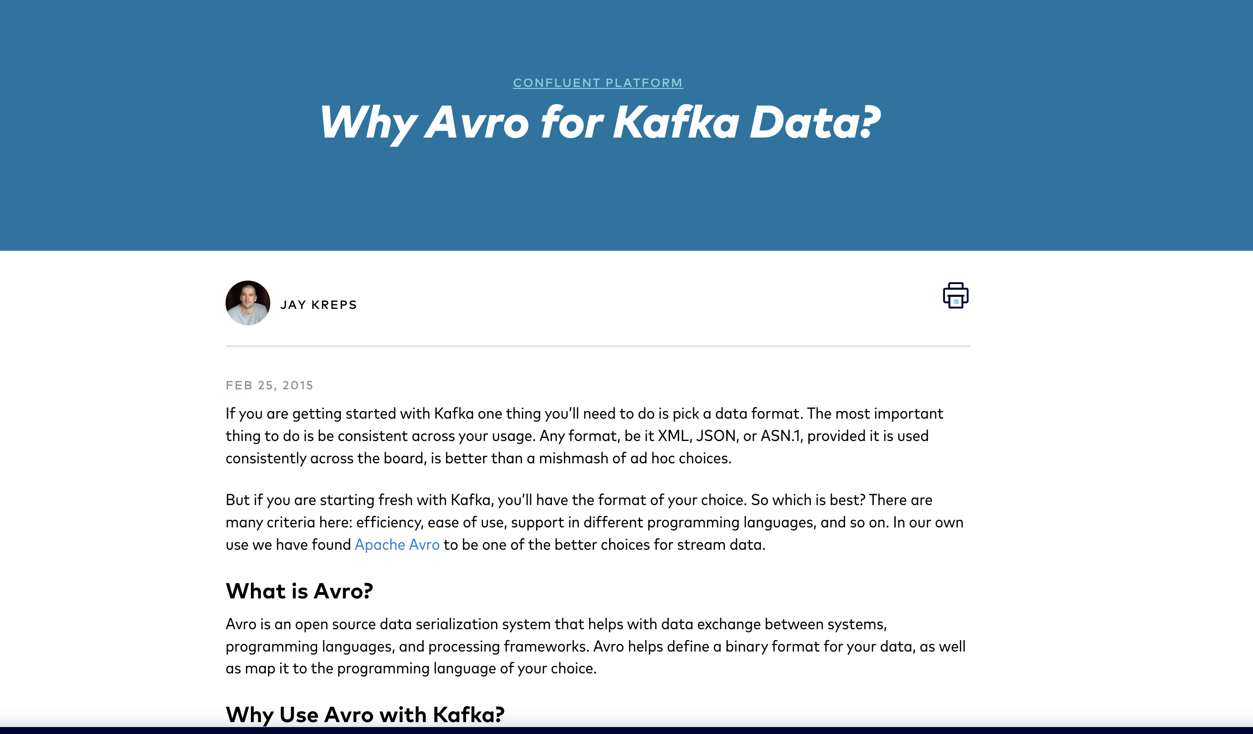
https://www.confluent.io/blog/avro-kafka-data/

Slide 23
AVRO

Slide 24
What is AVRO ?
AVRO is a data serialization system and it helps to exchange data between two systems using the Binary Serialization format.
AVRO is a compact and fast binary data format
It takes up less space
It has a direct impact on memory and speed of transfer of data
It has the support for most of popular programming languages like Java, C++, Go , Python and more.
AVRO also has the capability to make Remote procedure call.

Slide 25
Why AVRO ?
AVRO has the support for Schema IDL
Data Owner defines a Schema in JSON format for the data structure that they would want to communicate to the other system
Schema Registry
Schema
Kafka
Producer
Consumer
This architecture also makes Data Changes and Schema Evolution fairly less complicated
We can also communicate AVRO Records without a Schema Registry

Slide 26
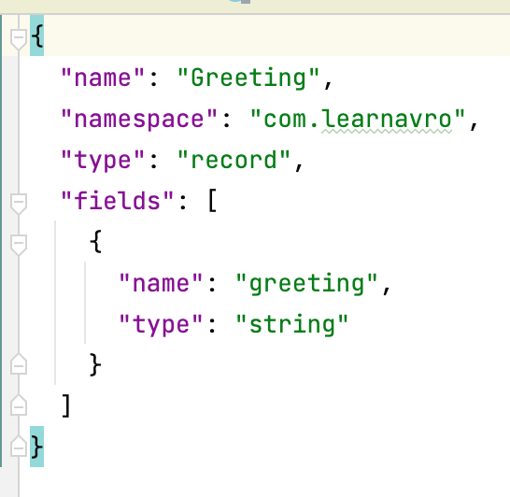
Why AVRO ?
AVRO has the support for rich data structures
Primitive Types
String, bytes, int ,long, float, double, boolean and null
Complex Types
enum
arrays
maps
record
union
fixed
- This type is normally used to hold multiple complex types.
- This is used to represent a field can hold multiple types.
[String , null]
- This is used to represent a field can be of a fixed size, specifying the number of bytes of the value

Slide 27
Let’s build a simple
AVRO
Schema

Slide 28
Build an AVRO Schema - UseCase
Sample AVRO Message
{
"greeting": "Good Morning!, AVRO"
}
Property Name
Property Type is “STRING”

Slide 29
Avro Messages
using
Console
AVRO Producer/Consumer

Slide 30
Produce/Consume AVRO Messages using CLI
1
Schema Registry
3
Schema
Console AVRO Producer
Kafka
Console AVRO Consumer
Record Processed Successfully
2

Slide 31
How to use AVRO
in a
Java Project?

Slide 32
Working with AVRO
Place the AVRO schema file in a the src directory of the Java Project
src/avro [Default Path]
Generate Java Classes from the .avsc file
Use the Generated Java Classes in the Producer & Consumer

Slide 33
Coffee Order Service

Slide 34

Coffee Order Service
Coffee Order Service
(Producer)
Create Order
Order Create
Coffee Order Consumer
Order Updates
Order Updates
1
2

Slide 35
Sample Coffee Order Message
{
"id": 164,
"name": "Dilip Sundarraj",
"nickName": "",
"store": {
"id": 205,
"address": {
"addressLine1": "1234 Address Line 1",
"city": "Chicago",
"state_province": "IL",
"country": "USA",
"zip": "12345"
}
},
"orderLineItems": [{
"name": "Caffe Latte",
"size": "MEDIUM",
"quantity": 1
}],
"ordered_time": "2022-06-16T18:40:55.472",
"status": "NEW"
}

Slide 36
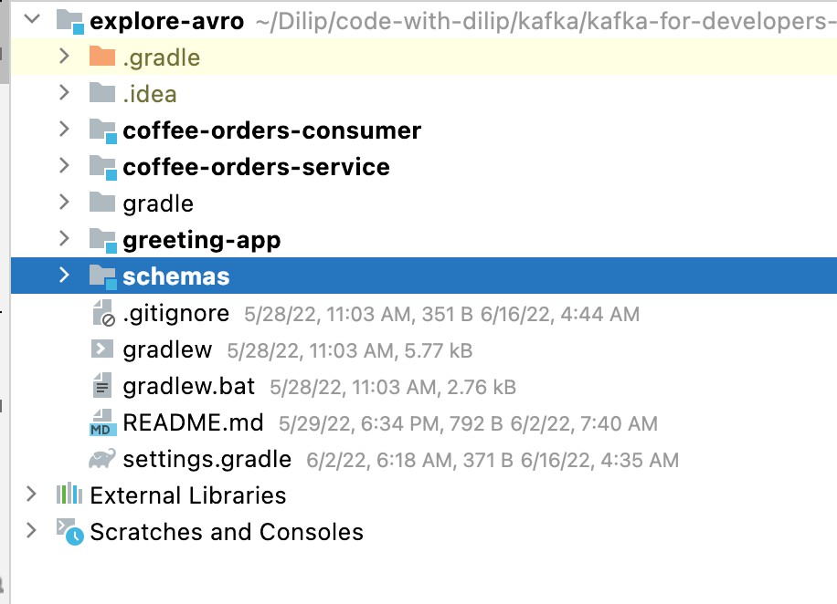
Project SetUp
The is a multi module project
Avoids Code duplication

Slide 37
Logical Types in AVRO
Logical Types are used to represent Decimals, UUID, Date, Timestamp, Time.
AVRO uses some additional attributes to represent a particular logical type
{
"name" : "cost",
"type":{
"type": "bytes",
"logicalType": "decimal",
"precision": 3,
"scale": 2
}
}
$3.99

Slide 38
What’s inside an AVRO Record ?

Slide 39
What’s inside an AVRO record ?
ByteArraySerializer
ByteArrayDeSerializer
Kafka
Producer
Consumer
schema
binary
data
This pattern makes the message bulky
Providing the schema with every event in Kafka leads to inefficient network bandwidth and adds storage overhead.

Slide 40
Evolving a Schema
Kafka
Producer
Consumer
schema
binary
data
Update the consumer first and then produce the message.
Consumer processes the record without any issues
Lets not update the Consumer at all and publish the new AVRO record

Slide 41
Schema Registry

Slide 42
Why Schema Registry ?
Kafka
Producer
Consumer
Producers and consumers are decoupled and they exchange data using the Kafka Broker
But the consumer is indirectly coupled to producer to understand the data format
Anytime business requirements change data may be needed to change.

Slide 43
Handling Data Changes
Kafka
Producer
Consumer
Business needed to make change and the producer modified the data

Slide 44
Kafka Architecture in Prod
Consumer
Producer
Kafka
Consumer
Producer
Consumer
Producer
Consumer
Producer
Consumer
Producer
Consumer
Producer
Consumer
Producer
There is no limit on number of data types that can be exchanged between the apps
With this kind of architecture the failure is very likely in the consumer side
Publishing any new changes requires approval from all the consuming apps

Slide 45
Schema Registry to the rescue.

Slide 46
Schema Registry
Schema Registry is a product from Confluent
It serves two purposes:
Enforcing Data Contracts
Handling Schema Evolution
This one is under a Confluent Community License
You are allowed to use in production
But not allowed to build competing products using Schema Registry

Slide 47
Kafka Architecture with Schema Registry
Schema Registered
SchemaVersion ID
Schema Registry
Retrieve the schema using SchemaVersion ID
from the message
1
4
Kafka
Producer
Consumer
2
3
Record Processed
Successfully
5
Record published with SchemaVersion ID
returned from Schema Registry
Compatibility of the new record is validated with the schema that’s returned
AVRO record is lighter because there is no schema present in every record

Slide 48
Schema Registry Internals
&
Interacting with Schema Registry

Slide 49
Where does the Schema gets Stored ?
Schema Registry
1
2
Kafka
Producer
Consumer
_schemas

Slide 50
Different ways to Interact with Schema Registry?
Schema Registry
Producer
Consumer
Rest Client
REST API
Insomnia or Postman

Slide 51
Schema Registry REST API
Schema Registry REST Resources
Subjects
Schemas
Config
Compatibility
- Fundamentally a scope in which the Schema’s evolve.
- This resource is used to represent a Schema.
- This resource is used to update cluster level config for the Schema Registry
- This resource is used to check the compatibility between Schemas

Slide 52
Data Evolution using Schema Registry

Slide 53
Data Life Cycle
New Data Created
Data Evolves
Data Obsolete

Slide 54
Data Evolution
New Data Created
Add New Fields
Remove Fields
Change Fields

Slide 55
Data/Schema Evolution
Subject
Schema Version =1.0
Schema Version =2.0
Schema Version =3.0
Schema Version =4.0
New Data Created
Add New Fields
Remove Fields
Change Fields

Slide 56
Data/Schema Evolution
Anytime the data/schema evolves, the downstream consumers should be able to handle the old and new schema seamlessly

Slide 57
Compatibility Types
in
Schema Registry

Slide 58
Compatibility is configured through “/config” endpoint.

Slide 59
Backward Compatibility
BACKWARD (Default)
This means the consumers using the new Schema can read the data produced with the old schema
Schema Modification
V1
V2
Producer
Consumer
V1
V2
V2
Consumers using the new schema can read the old and new schema seamlessly.

Slide 60
Backward Compatibility
Rules:
Delete Fields
Add Optional Fields
Upgrade First
Consumers
If the consumer using the new schema needs to be able to process data written by all registered schemas, not just the last two schemas, then use BACKWARD_TRANSITIVE

Slide 61
Forward Compatibility
FORWARD compatibility means the data produced with a new schema can be read by consumers using the last schema.
Schema Modification
V1
V2
Producer
Consumer
V2
V1
V2
Consumers using the previous schema can read the new schema without any issues
Compatibility check happens between the last schema and the current schema

Slide 62
Forward Compatibility
Rules:
Add Fields
Delete Optional Fields
Upgrade First
Producers
FORWARD_TRANSITIVE
If data produced with a new schema needs to be read by consumers using all registered schemas, not just the last two schemas, then use FORWARD_TRANSITIVE

Slide 63
FULL Compatibility
FULL compatibility means its both forward and backward compatible
It means the Old data can be read with the New schema or New data can also be read with the Old schema.
Schema Modification
V1
V2
V3
Producer
Consumer
V1
V2
V2
V3

Slide 64
FULL Compatibility
Rules:
Restrictive compared to the Backward and Forward compatibility
Add Optional Fields
Delete Optional Fields
Upgrade First
Producers or Consumer(Any order)
FULL_TRANSITIVE
If data produced with a new or old schema needs to be read by consumers using all the registered schemas, then use FULL_TRANSITIVE.

Slide 65
None Compatibility
NONE
This means the schema compatibility checks are disabled
When to use this NONE compatibility check?
Changing the type of the field
Example : String to Integer
Changing the name of the field from one to another
Example : name -> fullname

Slide 66
None Compatibility
Upgrade First
Producers and Consumers needs to upgrade at the same time.
Recommended Option
Use case like these will require us to create a new schema and new topic.
Introduce a new field and delete the old field

Slide 67
Schema Naming Strategies

Slide 68
Schema Naming Strategies
Collection of messages with key and values
Schema defines the structure of the data
Its a named ordered history of Schema Versions
Topic
Schema
Subject
coffee-orders-sr
CoffeeOrder
coffee-orders-sr-key
coffee-orders-sr-value
{topic-name}-key
{topic-name}-value
Topic Name Strategy (Default Naming Strategy)

Slide 69
Different Subject Naming Strategies
TopicNameStrategy
RecordNameStrategy
TopicRecordNameStrategy

Slide 70
Different Subject Naming Strategies
TopicNameStrategy
RecordNameStrategy
TopicRecordNameStrategy
Use it when single type of message should be published in a topic
This means that the schemas of all messages in the topic must be compatible with each other.
Subject name is derived using this technique:
{topic-name}-key
{topic-name}-value
Use it when you have use case where multiple types of related events can be published into the topic and the ordering of events needs to be maintained.
Thus, the schema registry checks the compatibility for a particular record type, regardless of topic.
Subject name is derived from the fully qualified record name.
com.learnavro.domain.generated.CoffeeOrder
Usecase:
CoffeeOrder and the related update events
For Banking , related transactions needs to be ordered.
Use it when you have use case where multiple types of related events can be published into the topic.
Schema registry checks compatibility to the current topic only
Subject name is derived from the topic and fully qualified record name.
{topic-name}-{RecordName}
coffee-orders-sr-com.learnavro.domain.generated.CoffeeOrder

Slide 71
Coffee Order Service
Coffee Order Service
(Producer)
Create Order
Order Create
Coffee Order Consumer
Order Updates
Order Updates

Slide 72
Sample CoffeeOrder Update JSON
{
"id": 358,
"status": "READY_FOR_PICK_UP"
}
Possible Values are :
PROCESSING, READY_FOR_PICK_UP

Slide 73
Coffee Order Service
Schema Registry
SpringBoot App
SpringBoot App
Coffee Order Service
(Producer)
Coffee Order Consumer
Create Order
Order Create
Rest
Order Updates
Order Updates
Build a RESTFUL Service
SpringBoot is a popular JVM framework

