Slide 1
Foodzone App (HungerBox replica)

Slide 2
List Of Applications
Bank Service
User Registration(Generate Acc No. & Card No.)
Payment Gateway
View previous transactions
FoodZone service
User Registration
Load Menu Items for different outlets into DataBase
Search food outlets
Search menu items
Place order
Search Order and OrderItems
View Order History

Slide 3
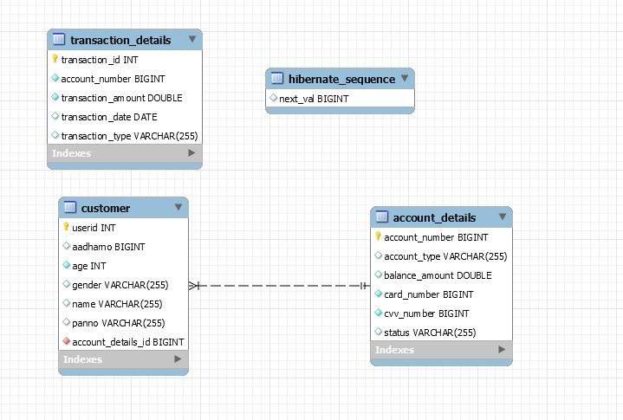
Entity Relationship
Bank Service

Slide 4
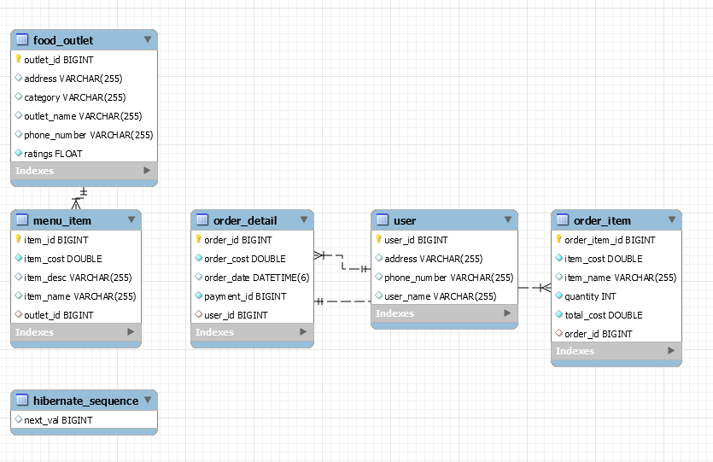
Entity Relationship
Foodzone Service

Slide 5
Request
Foodzone-Eureka- Server(Service Registry)
Api Gateway(Zuul Proxy)
Bank-Service-1
Foodzone-service
Ribbon (Client Side Load Balancer)
Bank-Service-2
Feign Client(Proxy of Bank Service)

Slide 6
Thank You

