Slide 1
DBMS
Concept of DBA

Slide 2
DBA
A Database Administrator (DBA) is individual person or group of persons, responsible for controlling, maintenance, coordinating, and operation of database management system. Managing, securing, and taking care of database system is prime responsibility.
They are responsible and in charge for authorizing access to database, coordinating, capacity, planning, installation, and monitoring uses and for acquiring and gathering software and hardware resources as and when needed.

Slide 3
Their role also varies from configuration, database design, migration, security, troubleshooting, backup, and data recovery. Database administration is major and key function in any firm or organization that is relying on one or more databases. They are overall commander of Database system.

Slide 4
Types of DBA
Administrative DBA – Their job is to maintain server and keep it functional. They are concerned with data backups, security, trouble shooting, replication, migration etc.
Data Warehouse DBA – Assigned earlier roles, but held accountable for merging data from various sources into data warehouse. They also design warehouse, with cleaning and scrubs data prior to loading.

Slide 5
Development DBA – They build and develop queries, stores procedure, etc. that meets firm or organization needs. They are par at programmer.
Application DBA – They particularly manages all requirements of application components that interact with database and accomplish activities such as application installation and coordinating, application upgrades, database cloning, data load process management, etc.

Slide 6
Architect – They are held responsible for designing schemas like building tables. They work to build structure that meets organization needs. The design is further used by developers and development DBAs to design and implement real application.
OLAP DBA – They design and builds multi-dimensional cubes for determination support or OLAP (Online Analytical Processing) systems.

Slide 7
Importance of DBA
Database Administrator manages and controls three levels of database like internal level, conceptual level, and external level of Database management system architecture and in discussion with comprehensive user community, gives definition of world view of database. It then provides external view of different users and applications.

Slide 8
Database Administrator ensures held responsible to maintain integrity and security of database restricting from unauthorized users. It grants permission to users of database and contains profile of each and every user in database.
Database Administrator also held accountable that database is protected and secured and that any chance of data loss keeps at minimum.

Slide 9
Role & Duties of DBA
Decides hardware – They decides economical hardware, based upon cost, performance and efficiency of hardware, and best suits organization. It is hardware which is interface between end users and database.
Manages data integrity and security – Data integrity need to be checked and managed accurately as it protects and restricts data from unauthorized use. DBA eyes on relationship within data to maintain data integrity.

Slide 10
Database design – DBA is held responsible and accountable for logical, physical design, external model design, and integrity and security control.
Database implementation – DBA implements DBMS and checks database loading at time of its implementation.

Slide 11
Query processing performance – DBA enhances query processing by improving their speed, performance and accuracy.
Tuning Database Performance – If user is not able to get data speedily and accurately then it may loss organization business. So by tuning SQL commands DBA can enhance performance of database.

Slide 12
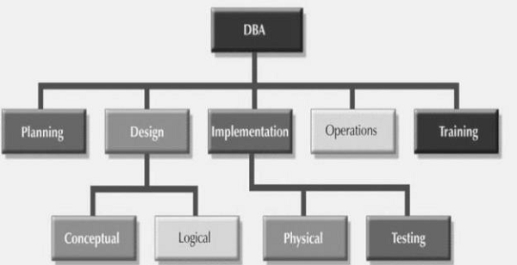

Slide 13
Responsibilities of DBA
The responsibilities of DBA are as follows −
Makes the decision concerning the content of the database.
Plans the storage structure and access strategy.
Provides the support to the users.
Defines the security and integrity checks.
Interpreter backup and recovery strategies.
Monitoring the performance and responding to the changes in the requirements.

Slide 14
Skills required for DBA
The skills required to be a successful DBA are as follows −
Database designing.
Knowledge of Structured Query Language (SQL).
Know about distributed architecture.
Knowledge on different operating servers.
Idea on Relational Database Management System (RDBMS).
Ready to face challenges and solve the problems quickly.

Slide 15
Thank YOU

