Slide 1
DBMS
Concept of Transaction

Slide 2
Transaction in DBMS
Transactions are a set of operations used to perform a logical set of work. A transaction usually means that the data in the database has changed. One of the major uses of DBMS is to protect the user’s data from system failures. It is done by ensuring that all the data is restored to a consistent state when the computer is restarted after a crash. The transaction is any one execution of the user program in a DBMS. Executing the same program multiple times will generate multiple transactions.

Slide 3
Example -ATM transaction steps.
Transaction Start.
Insert your ATM card.
Select language for your transaction.
Select Savings Account option.
Enter the amount you want to withdraw.
Enter your secret pin.
Wait for some time for processing.
Collect your Cash.
Transaction Completed.

Slide 4
Three operations can be performed in a transaction as follows:
Read/Access data (R).
Write/Change data (W).
Commit
Example –
Transfer of 50₹ from Account A to Account B. Initially A= 500₹, B= 800₹. This data is brought to RAM from Hard Disk.

Slide 5
R(A) -- 500 // Accessed from RAM.
A = A-50 // Deducting 50₹ from A.
W(A)--450 // Updated in RAM.
R(B) -- 800 // Accessed from RAM.
B=B+50 // 50₹ is added to B's Account.
W(B) --850 // Updated in RAM.
commit // The data in RAM is taken back to Hard Disk.
Note – The updated value of Account A = 450₹ and Account B = 850₹.

Slide 6
All instructions before commit come under a partially committed state and are stored in RAM. When the commit is read the data is fully accepted and is stored in Hard Disk.
If the data is failed anywhere before commit we have to go back and start from the beginning. We can’t continue from the same state. This is known as Roll Back.
Commit: It is used to save the work done permanently.
Rollback: It is used to undo the work done.

Slide 7
Uses of Transaction Management
The DBMS is used to schedule the access of data concurrently. It means that the user can access multiple data from the database without being interfered with each other. Transactions are used to manage concurrency.
It is also used to satisfy ACID properties.
It is used to solve Read/Write Conflict.
It is used to implement Recoverability, Serializability and Cascading.
Transaction Management is also used for Concurrency Control Protocols and Locking of data.

Slide 8
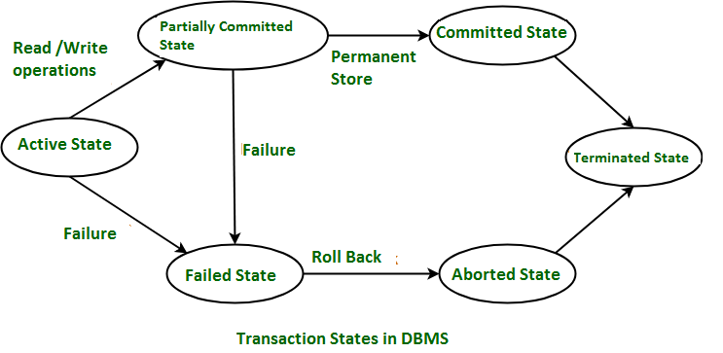
Transaction State
Transactions can be implemented using SQL queries and Server. In the below-given diagram, you can see how transaction states works.

Slide 9
Disadvantages of using Transaction
It may be difficult to change the information within the transaction database by end-users.
We need to always roll back and start from the beginning rather than continue from the previous state.

Slide 10
Transaction Property
The transaction has the four properties. These are used to maintain consistency in a database, before and after the transaction.
Properties of Transaction-
Atomicity
Consistency
Isolation
Durability

Slide 11
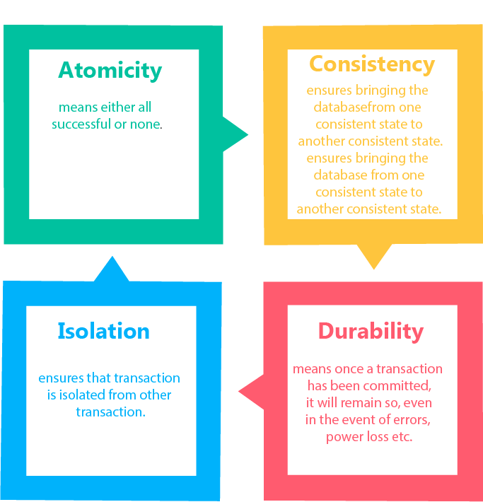

Slide 12
Atomicity
It states that all operations of the transaction take place at once if not, the transaction is aborted.
There is no midway, i.e., the transaction cannot occur partially. Each transaction is treated as one unit and either run to completion or is not executed at all.
Atomicity involves the following two operations:
Abort: If a transaction aborts then all the changes made are not visible.
Commit: If a transaction commits then all the changes made are visible.

Slide 13
Example: Let's assume that following transaction T consisting of T1 and T2. A consists of Rs 600 and B consists of Rs 300. Transfer Rs 100 from account A to account B.
T1 | T2
Read(A) A:=A - 100 Write(A) | Read(B) Y:=Y + 100 Write(B)
After completion of the transaction, A consists of Rs 500 and B consists of Rs 400.

Slide 14
If the transaction T fails after the completion of transaction T1 but before completion of transaction T2, then the amount will be deducted from A but not added to B. This shows the inconsistent database state. In order to ensure correctness of database state, the transaction must be executed in entirety.

Slide 15
Consistency
The integrity constraints are maintained so that the database is consistent before and after the transaction.
The execution of a transaction will leave a database in either its prior stable state or a new stable state.
The consistent property of database states that every transaction sees a consistent database instance.
The transaction is used to transform the database from one consistent state to another consistent state.

Slide 16
For example: The total amount must be maintained before or after the transaction.
Total before T occurs = 600+300=900
Total after T occurs= 500+400=900
Therefore, the database is consistent. In the case when T1 is completed but T2 fails, then inconsistency will occur.

Slide 17
Isolation
It shows that the data which is used at the time of execution of a transaction cannot be used by the second transaction until the first one is completed.
In isolation, if the transaction T1 is being executed and using the data item X, then that data item can't be accessed by any other transaction T2 until the transaction T1 ends.
The concurrency control subsystem of the DBMS enforced the isolation property.

Slide 18
Durability
The durability property is used to indicate the performance of the database's consistent state. It states that the transaction made the permanent changes.
They cannot be lost by the erroneous operation of a faulty transaction or by the system failure. When a transaction is completed, then the database reaches a state known as the consistent state. That consistent state cannot be lost, even in the event of a system's failure.
The recovery subsystem of the DBMS has the responsibility of Durability property.

Slide 19
Thank YOU

