Slide 1
Service Period Bandwidth Allocation and RSNA Authentication for 802.11ad Infrastructure
By
Sumit Kumar | Venkatesh Prasad S | Vinay B | Yogananda G K R

Slide 2
ABSTRACT
The IEEE 802.11ad standard operates at 60GHz band.
It provides a high speed data transmission of around 7Gbps.
The use of the 60 GHz unlicensed band avoids the overcrowded 2.4 GHz and 5 GHz bands.
The bandwidth allocation and authentication done for previous standards (being the essential parts of any standard) do not support the newly unexplored applications.
Incorporating Robust Security Network Associations(RSNA) for authentication (along with GCM protocol) and a suitable modification of round robin for effective bandwidth allocation is an appropriate and solution.

Slide 3
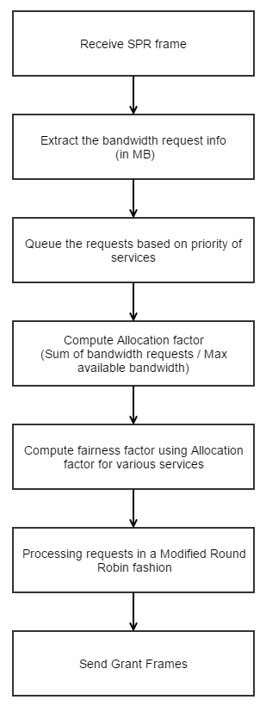
BANDWIDTH ALLOCATION FLOWCHART
Issue Poll frames and accept SPR(service period request) frames.
Extract information like bandwidth, service type etc.
Classify requests according to their requests and queue them.
Compute allocation factor and fairness factor.
Process the requests in a round robin manner.
Issue grant frames in their own format.

Slide 4
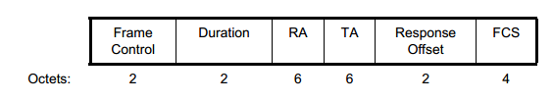

FRAME FORMATS FOR POLL AND SPR
AP polls the STAs
The access point polls for requests from the STAs. It sends a poll frame to all the authorized STAs.
STA responds with an SPR
The STA responds to the poll request from the AP with an SPR frame. STA requests the bandwidth required for a type of service required, to the AP in the SPR frame.

Slide 5
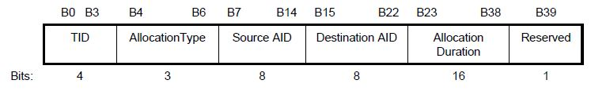
DYNAMIC ALLOCATION FIELD
When the Dynamic Allocation Info field is transmitted within an SPR frame, the Allocation Duration field contains the requested duration.
When the Dynamic Allocation Info field is transmitted within a Grant frame, the Reserved field contains the granted duration of the SP allocation.

Slide 6
FRAME FORMAT FOR GRANT
AP grants the request
If the AP has sufficient bandwidth, the service requested by the STA is granted through the Grant frame
The grant frame is similar to the SPR frame. It differs only in contents of the Dynamic allocation Info field.
The grant frame will contain the service order according to which the STAs will be served.

Slide 7
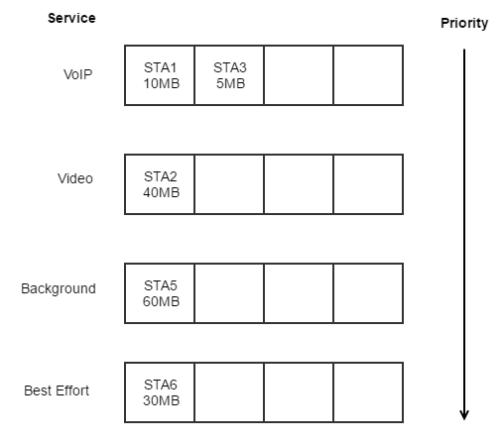
PRIORITY QUEUES
The incoming requests are sorted to their respective queues.
The bandwidth is allocated according to their priority in a round robin fashion.
The fairness factor is determined by the number of service requests in each queue.
Once allocated, the service request is removed from the queue.

Slide 8
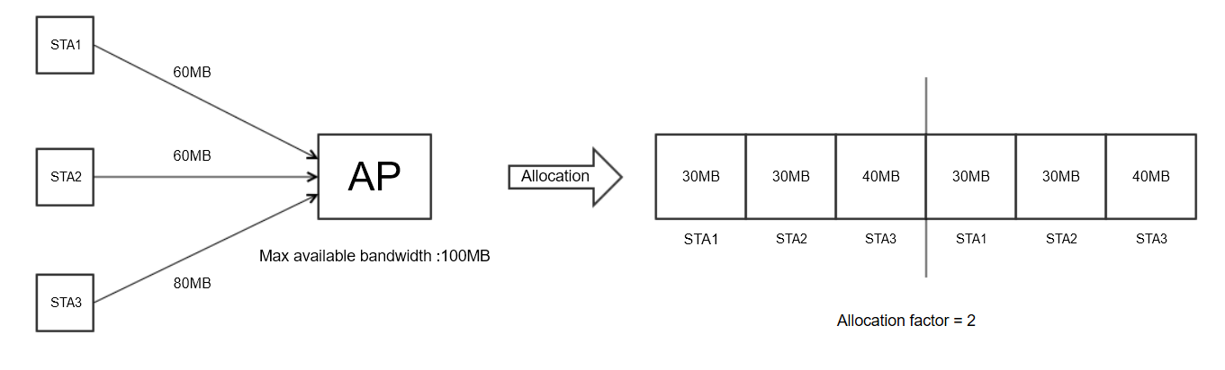
ALLOCATION AND FAIRNESS FACTOR
Allocation factor is given by the ratio of Sum of bandwidth requests to the maximum available bandwidth.
Fairness factor is dynamically computed using a function of the number of service requests in the priority queues.

Slide 9
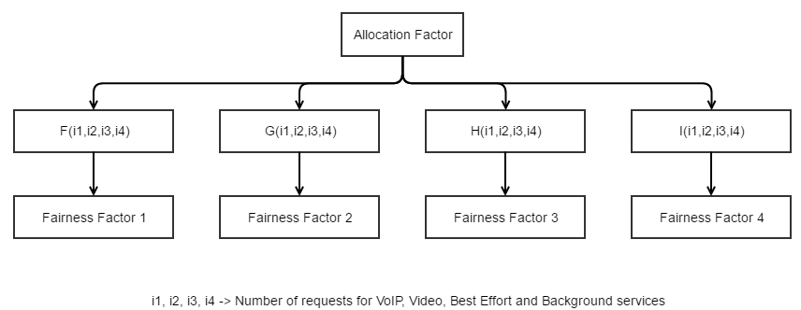
FAIRNESS FACTOR
The fairness factors for various services ensure dynamic modification of the allocation factor.

Slide 10
OVERVIEW OF AUTHENTICATION
EAPOL key frames
The four way handshake
Generation of keys using PRF(pseudo random number generator function)

Slide 11
EAPOL FRAME
IEEE Standard uses EAPOL-Key frames to exchange Information between STAs and AP.
EAPOL-Key Frames are used to implement various messages exchanges:
- 4-Way Handshake.
- Group Key Handshake. Etc.
Each frame is identified by its descriptor type.

Slide 12
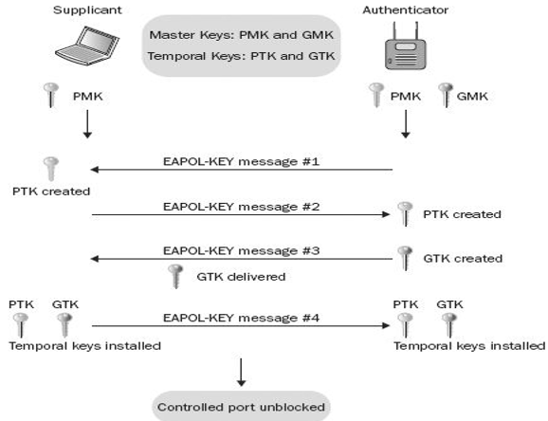
Four way handshake
4-way handshake
RSNA defines a protocol using IEEE 802.1x EAPOL-key frames called as 4-way handshake.
The handshake completes the IEEE 802.1x authentication process.
Figure: The 4-way handshake

Slide 13
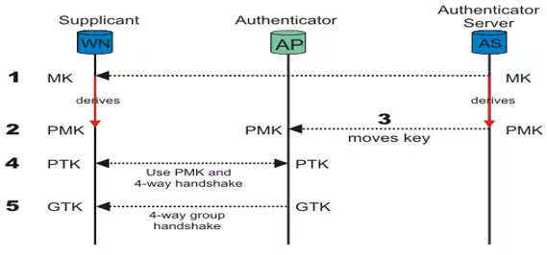
Generation of Keys
Creation/Movement of keys among devices
PTK Generation>>>
PTK = EAPOL-PRF(PMK, ANonce, SNonce, AP-Mac-address, STA-Mac-address)

Slide 14
TEST FRAMEWORK
The test framework consists of establishment of sockets on APs and STAs, packing/unpacking of frames for transmission of the messages for the four way handshake authentication process.
For bandwidth allocation, creation and maintenance of queues for requests with different priorities and mechanism for fair allocation of bandwidth to service various requests.
The development of the both modules require C/C++ support on the hosts (APs/STAs); the hosts being Unix, Linux and their flavors with wireless NICs.
The stations should have RSNA compatibility assuming the implementation of GCMP at hardware.

Slide 15
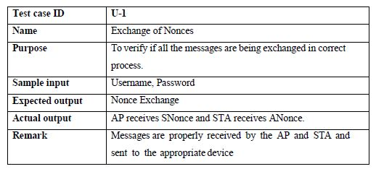
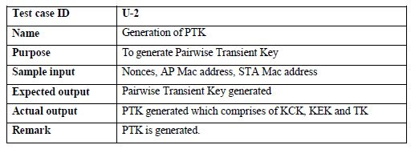
TEST CASES
Tests for units 1 and 2

Slide 16
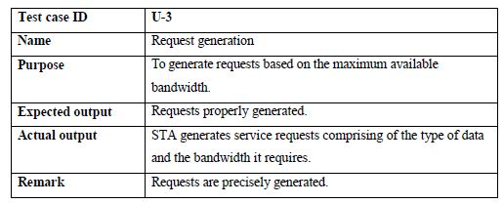
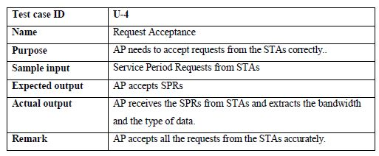
TEST CASES
Tests for units 3 and 4

Slide 17
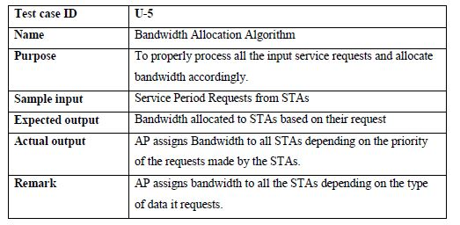
TEST CASES
Tests for unit 5

Slide 18
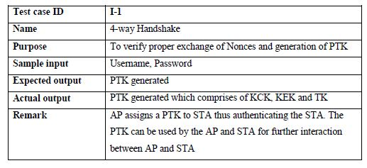
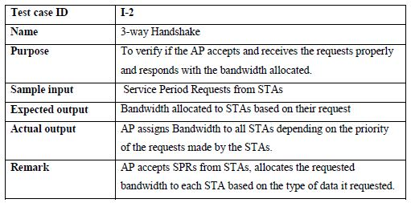
TEST CASES
Integration Test for modules 1 and 2

Slide 19
CONCLUSION
The scheduling algorithm ensures the fair weighted sharing of bandwidth among the concerned nodes.
In the process, VoIP services are allocated on a complete basis.
Secure authentication of stations/clients is achieved using RSN associations in a 802.11ad Infrastructure.

Slide 20
Thank you

