Slide 1

Credit card fraud detection using autoencoders
Submitted by: Team Alpha Neurons
Sonal Shreya
Sumit Kumar Singh
Santhoshini Bojanapally
Sainaga Soujanya

Slide 2

OBjective
to create and test out a fraud detection system, using Autoencoders, specifically simple Autoencoders and Variational Autoencoders (VAE). The process used for this is anomaly detection
Card fraud continues to be a significant threat in the banking and financial services industry, accounting for billions of dollars in loss yearly. Accurate identification of fraudulent transactions can help to mitigate financial loss and ensure consumer protection.

Slide 3

DATASET loading and Processing

Slide 4

DATASET- Kaggle Credit card
It has 30 numerical features. Time, Amount, Class, Principal components V1 to V28 [obtained using PCA]
Through our models we will be predicting the class [0 or 1] for transactions
This dataset contains transactions made by credit cards in September 2013 by European cardholders over two days, where we have 492 frauds out of 284,807 transactions.

Slide 5

Data Processing
Below Transformations were applied to the dataset
Standardization of amount and time.
Scaled the features using StandardScaler
The standard transactions to be isolated for training (unsupervised learning)
Test set construction — containing both fraud and non-fraud examples
Split the input data into train and test sets while retaining the same distribution of the target class
Created Test and Train tensors using data loaders

Slide 6

Experiment Tracking with Weights & Biases (WandB)
.
:
WandB Setup: Track experiment parameters and metrics. Project : Autoencoder
Logged Hyperparameters [For Autoencoder]
Input Size: 30 [Number of features]
Epochs: 20 (initial training) + 10 (Hyperparameter-tuning)
Loss Function: Mean Squared Error for simple Autoencoder and combination of Reconstruction error and KL divergence for VAE
Optimizer: Adam.
Learning Rate: 0.001 (initial), 0.0001,0.0005 (Hyperparameter tuning)
Models Used: Simple Autoencoder and Variational Autoencoder with hyper-parameter tuning
Output Size: 1
BatchSize : 32 (initial), 64,128 (Hyperparameter Tuning)

Slide 7

Architecture overview- Simple Autoencoder
We initially experimented with Simple Autoencoder model where we will compress the input into smaller format and reconstruct it back to the original form it has the below layers
Input : dimension 30
Encoder: Dense(32) → Dense(16, RELU) → Dense(8, RELU) [This is our bottleneck]
Decode: Dense(8, RELU) -> Dense(16, RELU),Dense(30, Linear) [To match the input dimension]
We are using Mean Squared Error (MSE) Loss as the loss function.
The Optimizer used is Adam optimizer
The learning rate is set to 0.001
The model will be trained for 20 epochs .

Slide 8
Model Performance & Results
Metric | Value | Interpretation
Anomaly Threshold | 3.53673 | Transactions with error > threshold are classified as fraud
Accuracy | 98.1% | High accuracy, but may be misleading due to class imbalance
AUC (ROC Curve) | 0.95 | Excellent discrimination between fraud and non-fraud
F1 Score | 0.42 | Moderate balance between precision and recall
Loss | 0.71789 | Average reconstruction error from the autoencoder
Precision | 28.5% | Only 28.5% of predicted fraud cases were actual fraud
Recall | 80.7% | 80.7% of actual fraud cases were successfully identified
Weighted Precision | 0.99 | Very high overall precision considering both fraud and non-fraud classes

Slide 9
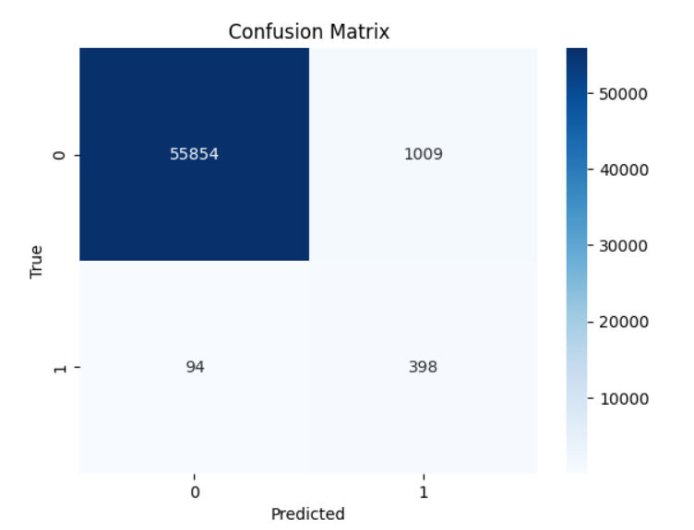
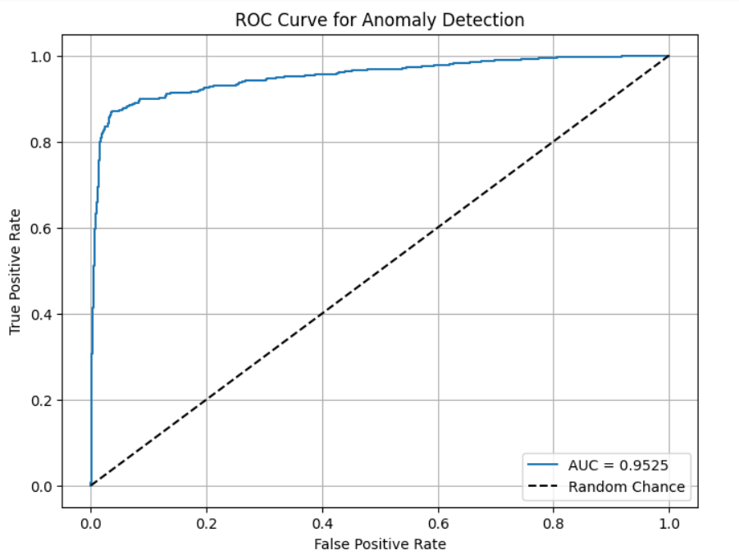
MODEL EVALUATION METRICS and results

Slide 10
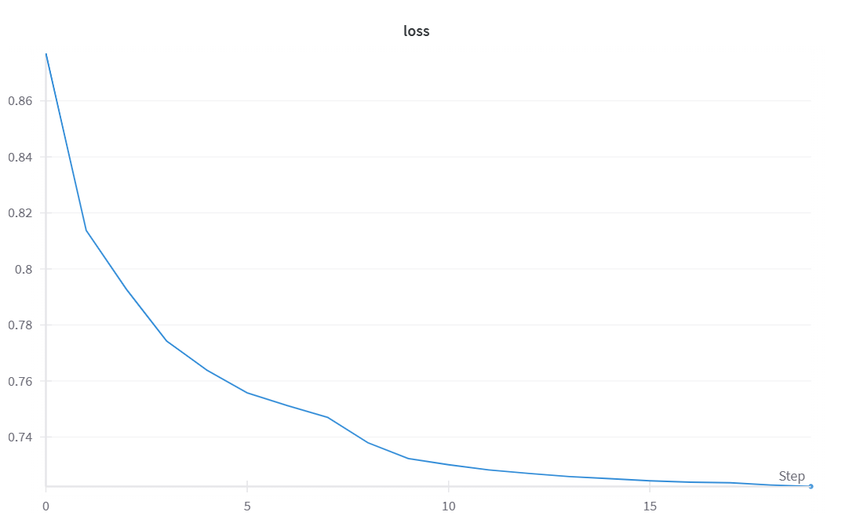
MODEL EVALUATION METRICS and results- CONTD
Training Loss Vs Epoch

Slide 11
Architecture overview- Variational Autoencoder
Variational Autoencoders (VAEs) are effective for credit card fraud detection because they excel at anomaly detection and work well with imbalanced and unlabeled data
Input : dimension 30
Encoder: Linear(32->64, RELU) , Linear(64->32, RELU) . Reparametrizing Layer: To allow gradient backpropagation through the stochastic sampling process.
Decoder: Linear (latent_dim → 32, ReLU), Linear (32 → 64, ReLU), Linear (64 → 30) → Output layer
To computes the loss for a Variational Autoencoder (VAE) we are combining two components: the reconstruction loss and the Kullback-Leibler (KL) divergence.
The Optimizer used is Adam optimizer
The learning rate is set to 0.001
The model will be trained for 10 epochs .

Slide 12
Model Performance & Results
Metric | Value | Interpretation
Anomaly Threshold | 3.85 | Estimated based on 95th percentile reconstruction error
Accuracy | 97.84% | High accuracy, but may be inflated by imbalanced data
AUC (ROC Curve) | 0.95 | Excellent discrimination between fraud and non-fraud
Precision | 0.25 | Only 25% of predicted frauds were actually fraud
Recall | 79.8% | High sensitivity — model detects most fraud cases
F1 Score | 0.385 | Moderate trade-off between precision and recall
Weighted Precision | 0.98 | High overall precision when considering both classes

Slide 13
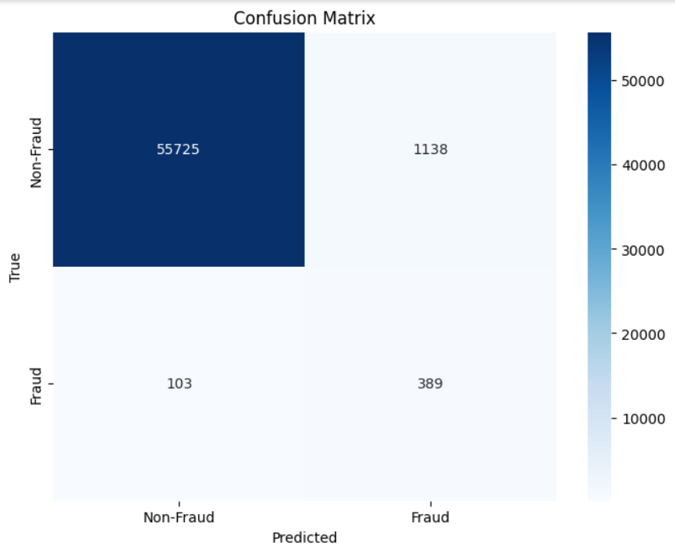

Slide 14

HyperParameter Tuning
We used the grid search approach, iterating over multiple combinations of hidden size, learning rate and number of epochs.
Hyperparameters used:
learning_rate: [0.001, 0.0005, 0.0001]
Batch size: [64,128]
Result : Tuning led to marginal but meaningful gains in detection performance
Helps validate stability, robustness, and threshold sensitivity

Slide 15
Performance Comparison
Metric | Base VAE | Tuned VAE | Change
Accuracy | 97.84% | 97.83% | Slightly decreased
Precision | 25% | 25.45% | Slight increase
Recall | 79.8% | 79.86% | Marginal increase
F1 Score | 0.385 | 0.385 | Slightly decreased
Weighted Precision | 0.98 | 0.98 | Still high
AUC (estimated) | 0.94 | 0.96 | Very close
Anomaly Threshold | 3.85 | 3.85 | Still same

Slide 16
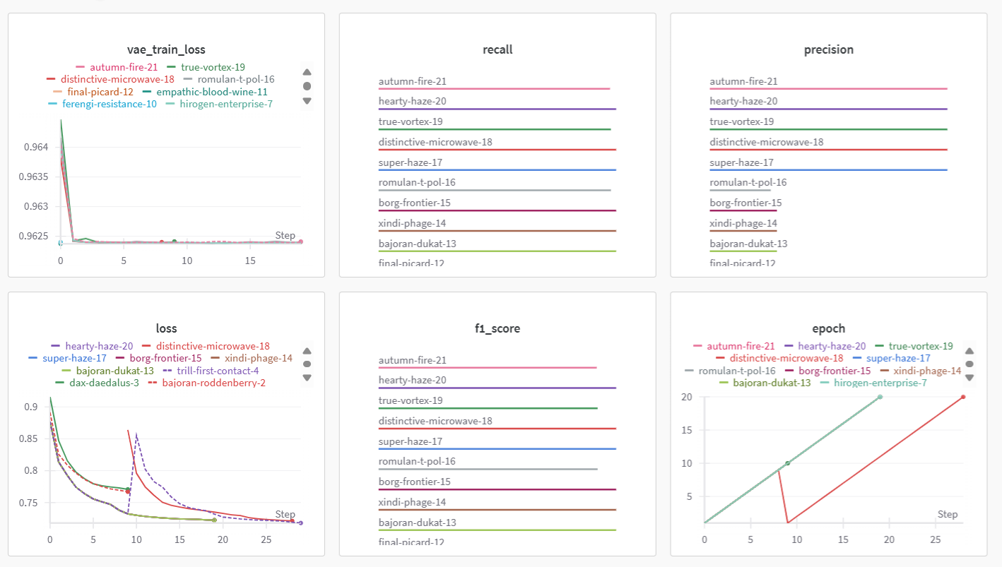

Slide 17
Challenges encountered
Class Imbalance
Challenge: Fraudulent transactions make up a very small percentage of the dataset, which leads to imbalanced model performance and poor generalization.
Mitigation: We used weighted precision to balance the performance for both classes.
Resampling techniques like oversampling the minority class or undersampling the majority class could be explored in future iterations to further address the imbalance

Slide 18

Challenges Encountered
Threshold Sensitivity
Challenge: Determining the optimal anomaly threshold for classifying fraud was difficult and influenced precision, recall, and overall model performance.
Mitigation:
We fine-tuned the anomaly threshold using grid search techniques to find the best balance between precision and recall.

Slide 19
Conclusion
Summary of Findings:
Both Autoencoder and VAE models show similar effectiveness in fraud detection, especially in terms of Recall and F1 Score.
The simple Autoencoder slightly outperforms the VAE in Precision and Accuracy.
High Weighted Precision across both models is largely due to data imbalance, with non-fraud cases dominating.
The clean and structured nature of our dataset favors the simpler Autoencoder model.
While VAE introduces probabilistic modeling and has the potential to generalize better in more complex scenarios, it doesn't significantly outperform in this specific dataset.

Slide 20

Future Scope
Advanced hyperparameter testing with more aggressive search strategies and wider ranges of latent dimension, learning rates and loss
Try other advanced architectures like transformer-based Autoencoders for capturing sequential fraud patterns.
Evaluate more on noisy, real-world dataset to validate VAE’s generalization capabilities

Slide 21

THANK YOU
ANY QUESTION?

