Slide 1

Generating Architectural Floor Plans with Hugging Face Diffusers
Submitted by: Team Alpha Neurons
Sonal Shreya
Sumit Kumar Singh
Santhoshini Bojanapally
Sai Naga Saujanya Gullapaly

Slide 2

OBjective
Explain diffusion models from the perspective of use in architectural image synthesis.
Generate floor plans from text prompts using diffusers
Look at how different models and schedulers perform.

Slide 3
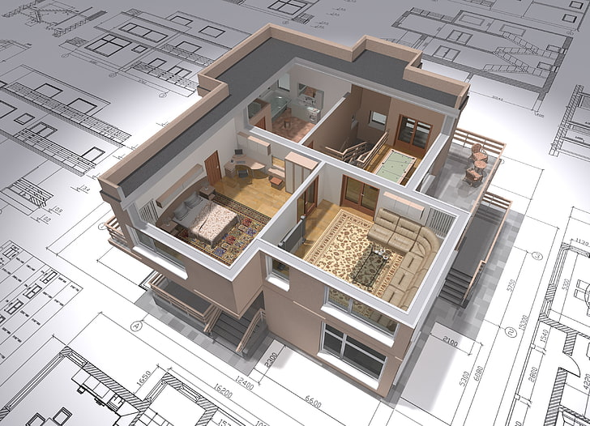
Introduction
We plan utilize text-to-image generative models within the context of architectural design.
In particular, we compare several diffusion models used to generate floor plans of different residential and community areas like 2BHK, 3BHK apartments and studio configurations and fitness center.
These generative pipelines blocks can be run and analyzed using the powerful Hugging Face diffusers library.

Slide 4
Conceptual Differences: GANs vs Diffusion Models
Aspect | GANs | Diffusion Models
Core Idea | A generator creates images, and a discriminator tries to tell if they're real or fake (adversarial training). | A model learns to denoise data by reversing a noise-adding process over many steps (generative denoising).
Training Paradigm | Adversarial training between two networks (G & D). | Likelihood-based training (score matching or variational inference).
Generation Process | Single-step forward pass from noise to image. | Multi-step process from pure noise to image via iterative denoising.
Output Control | Difficult to guide precisely unless with special techniques (e.g., conditional GANs). | Highly controllable via conditioning (e.g., text prompts, masks, edge maps).
Theoretical Foundation | Less grounded in probability theory. | Strong foundation in diffusion/stochastic processes and probabilistic modeling.

Slide 5
Base Model Analysis: Stable Diffusion v1.5)
A latent diffusion model that generates high-quality images from text prompts using VAE, UNet, and CLIP in a compressed latent space—making it efficient and resource-friendly.
Using pre-trained pipeline from Hugging Face's diffusers library.
Model is run multiple times using prompts for:
A 2 Bedroom-Hall-Kitchen (2BHK) apartment
Fixed Seed=42 for consistent reproducibility
A Fitness center layout
A 3 Bedroom-Hall-Kitchen (3BHK) apartment
A Studio apartment

Slide 6
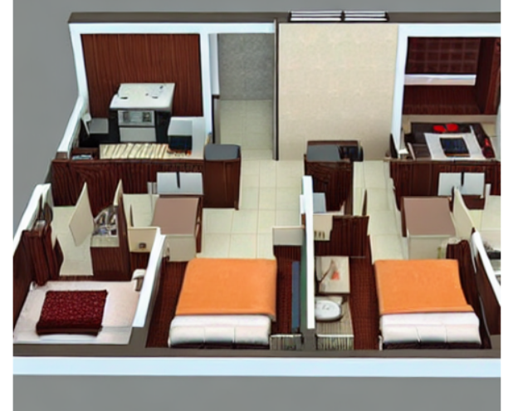
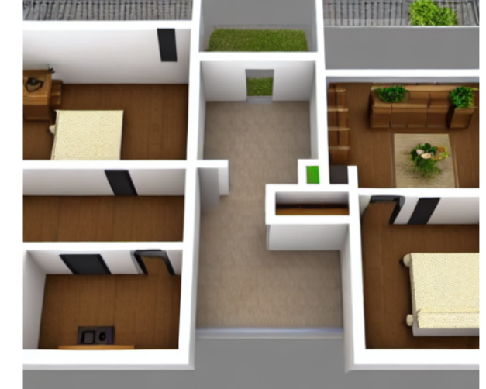
Layout Generated by the model
3 Bedroom layout
2 Bedroom layout

Slide 7
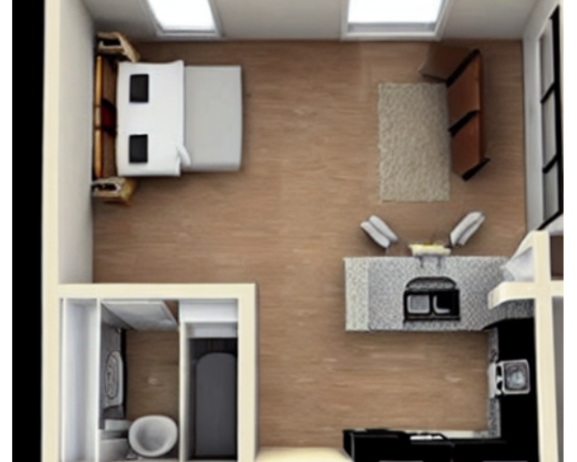
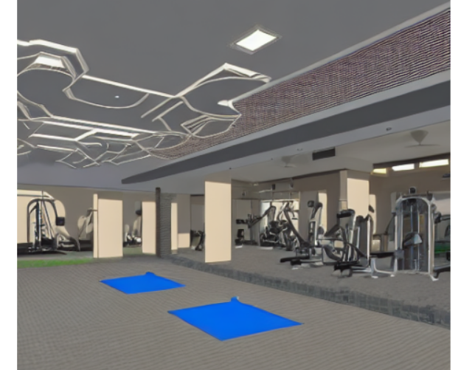
Layout generated by the model
Studio Apartment Layout
Fitness Center layout

Slide 8
Results from Base Model
Prompt | Image Quality | Prompt Adherence | Stylistic Note | Result Summary
2BHK apartment floor plan with two bedrooms, living room, kitchen, two bathrooms and a balcony | Clean layout with clear walls and minimal textures | Accurate 2BHK structure with key rooms visible | Bird’s-eye schematic layout | Good proportions; suitable for draft designs
3BHK apartment layout with master bedroom, two guest bedrooms, three bathrooms, dining area, living room, and kitchen | High detail, realistic furnishing | Strong; includes all key rooms and dining space | Interior render style; virtual staging look | Most realistic output; strong object placement
Studio apartment plan with open bedroom-living space, compact kitchen, and bathroom | Bright, simple, well-lit layout | Perfect match for open-plan studio layout | Minimalist and clean; Airbnb-style presentation | Very efficient and visually appealing layout
Fitness center blueprint with main hall, gym, zumba area, restrooms and lobby | Stylized with lighting effects and open spacing | High adherence; clear gym, zumba, and lobby zones | Interior walkthrough feel; modern presentation | Visually strong; suitable for architectural use

Slide 9
Comparison using Stable Diffusion Models
We have used the below mentioned Stable diffusion models, fed them the same prompts and same seed
Model | Highlights
SD v1.4 | Rich photorealism and detailed interior rendering (CompVis).
SD v1.5 | Balanced results, improved prompt comprehension, cleaner layouts (RunwayML).
SD 2.1 Base | High resolution, enhanced attention, better handling of complex layouts (StabilityAI).

Slide 10
Evaluation for different models
Prompt | Best Visual Quality | Best Layout Accuracy | Best Balanced Output
2BHK Apartment | SD v1.4 – photorealistic, warm-toned | SD 2.1 – top-down, precise divisions | SD v1.5 – clean and practical
3BHK Apartment | SD v1.4 – detailed, furnished interiors | SD 2.1 – spatially structured layout | SD v1.5 – clear zones, minimal style
Studio Apartment | SD v1.4 – open, modern lighting | SD 2.1 – compact and efficient use of space | SD v1.5 – simple and functional
Fitness Center | SD v1.4 – realistic gym setup | SD 2.1 – blueprint-style zoning | SD v1.5 – interprets zones with style
SD 2.1 Base stands out in architectural accuracy, making it ideal for structured planning and spatial layouts.

Slide 11
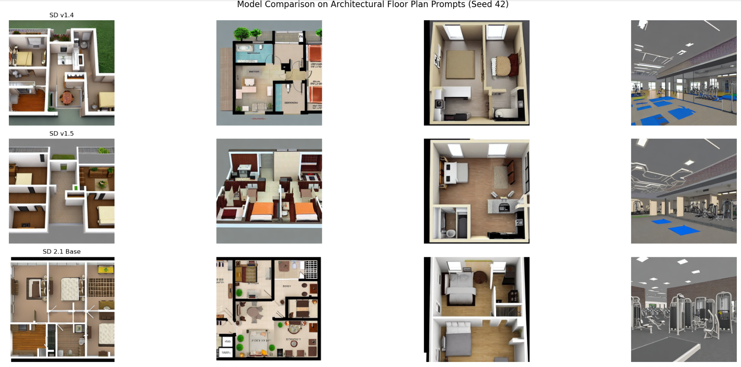

Slide 12
Comparing Schedulers
Scheduler | Description | Strengths | Weaknesses
DDIM | Denoising Diffusion Implicit Models. A non-Markovian, faster sampling alternative. | Smooth and consistent outputs for simple prompts. | Struggles with complex prompts and text fidelity; prone to distortion.
PNDM | Pseudo Numerical Methods for Diffusion Models. A deterministic sampler derived from ODE solvers. | Clean, well-structured outputs with high spatial accuracy. Best overall fidelity. | Slightly slower but more reliable.
Euler Ancestral | Ancestral sampler with added noise at each step to enhance diversity. | Creative, stylized, and artistic renderings. Great for early-stage concepts. | Less precise; not ideal for blueprint-level outputs.
We found that PNDM aligns best with our objective of generating blueprint-style architectural layouts,
offering the most structurally accurate and spatially coherent results.

Slide 13
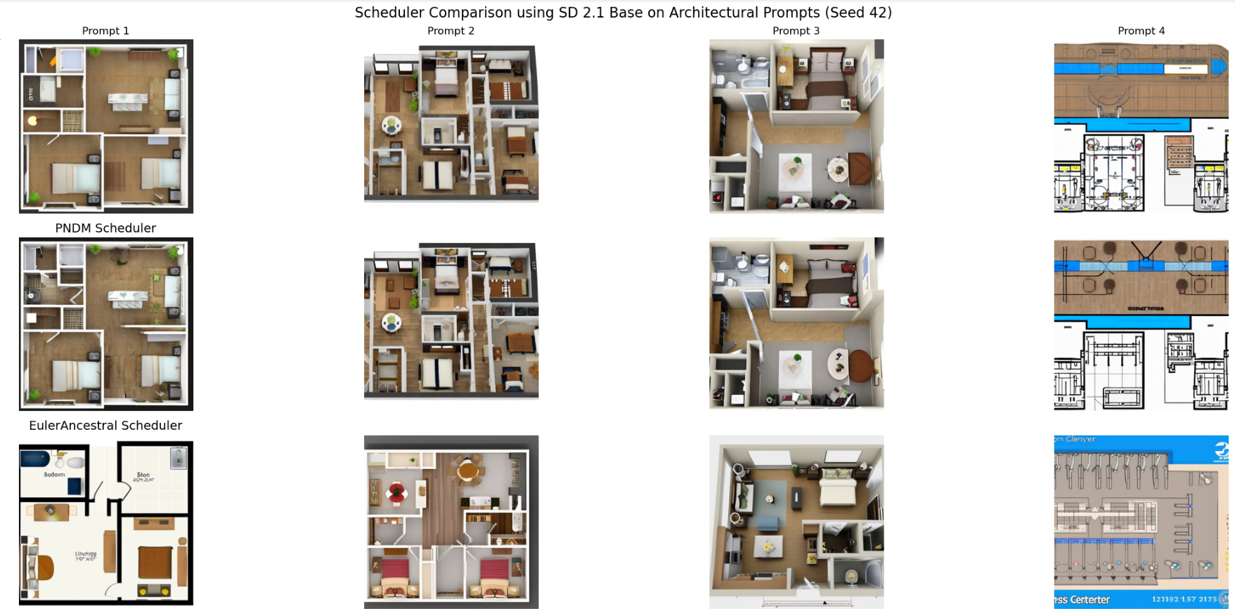

Slide 14
Hyperparameter Tuning for Architectural Floorplans (SD 2.1 Base)
Parameter | Purpose | Values Tested
num_inference_steps | Controls refinement and structural detail | 20, 50, 100
guidance_scale | Controls prompt adherence vs. creativity | 5.0, 7.5, 12.0
Tested Prompt: “A top-down architectural floor plan of a 3BHK modern apartment”

Slide 15
KEY INSIGHTS post tuning
Thereby, we infer that using 50 inference steps balances speed and layout clarity, setting the guidance scale between 7.5–9.0 ensures optimal prompt fidelity, and avoiding extreme values helps maintain structural accuracy unless stylized or rapid experimental outputs are specifically desired.
Use Case | Steps | Guidance Scale | Inference
Best for Blueprint Clarity | 50 | 7.5 | Well-balanced, clean layout; ideal for architectural use.
Best for Realism & Render | 100 | 5.0 | Photorealistic and smooth, but less structured layout.
Best for Label/Text Fidelity | 50 | 12.0 | Strong prompt adherence with visible room labels and zoning.
Least Structurally Effective | 20 | 7.5 | Fast output, but lacks definition and room segmentation.

Slide 16

Conclusion
This experiment demonstrates that Stable Diffusion 2.1 Base, paired with the PNDM scheduler, and tuned to 50 inference steps with a guidance scale of 7.5, is the most effective configuration for generating blueprint-style architectural floorplans.
It offers the best balance between visual clarity, structural accuracy, and prompt alignment, making it a strong candidate for AI-assisted architectural design tools.

Slide 17
Future SCOPE
Fine-Tuning with Real Data: Enhance model performance by fine-tuning on actual architectural floorplans using techniques like LoRA or DreamBooth.
Controlled Generation with ControlNet: Guide layout generation using sketches, edge maps, or masks for greater accuracy and customization.
Integration with CAD/BIM Workflows: Convert outputs into vector formats for seamless use in architectural design tools and professional planning systems.

Slide 18

THANK YOU
ANY QUESTION?

