Slide 1


LISTUAL Not be habitual make it a ritual
Efforts by:
Ridhi Singla

Slide 2
All about LISTUAL
Listual is a productivity tool that offers a framework for considering the long-term efficiency of our daily tasks. The choices we make about how we spend our time make all the difference – it’s what distinguishes an effective person from an ineffective one.
A task manager you can trust for life.
Helps you to regain clarity and calmness by getting all those tasks out of your head and onto your to-do list
A two- minute rule to stop procrastinating.

Slide 3
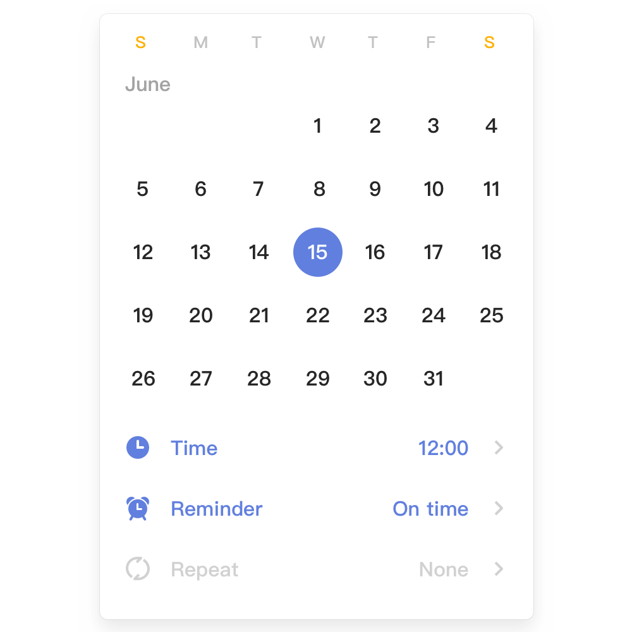
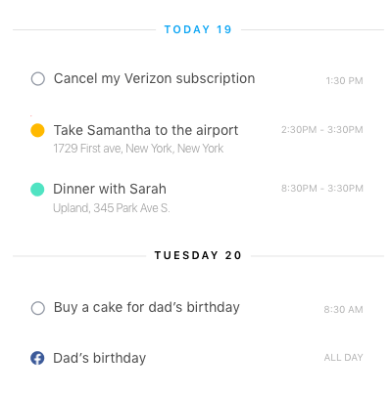

Slide 4
Our Vision
Do you find yourself struggling to maintain lengthy to do lists? Are you trying to multitask many items at once, without making any actual progress? Have you lost track of what tasks require prioritizing? If you answered yes to any of these questions, it might be…
We know that life can be crazy. While there is no way to plan for the unexpected, with Listual by your side you can stay organized through it all.

Slide 5
Some Lesser-Known LISTUAL Features
1. Supports Work-Life Balance
There’s a lot of talk about the importance of not having work monopolize all your time, but leaving yourself a personal life. A happy worker is a productive worker. It’s said that a project leader should work to make their team happy.
One way to do that is by giving them the tools to manage both their work tasks and their home tasks. It’s unrealistic and not even good business to expect a team member to on the clock every second their in the office. They need breaks, time to make personal phone calls, even steep out into the daylight and maybe get a bite to eat or buy something nice.
Therefore, with a project management software that has a to-do list with privacy settings you and your team can stay on the same page and the doctor’s appointment or your kid’s school presentation are only a click away.

Slide 6
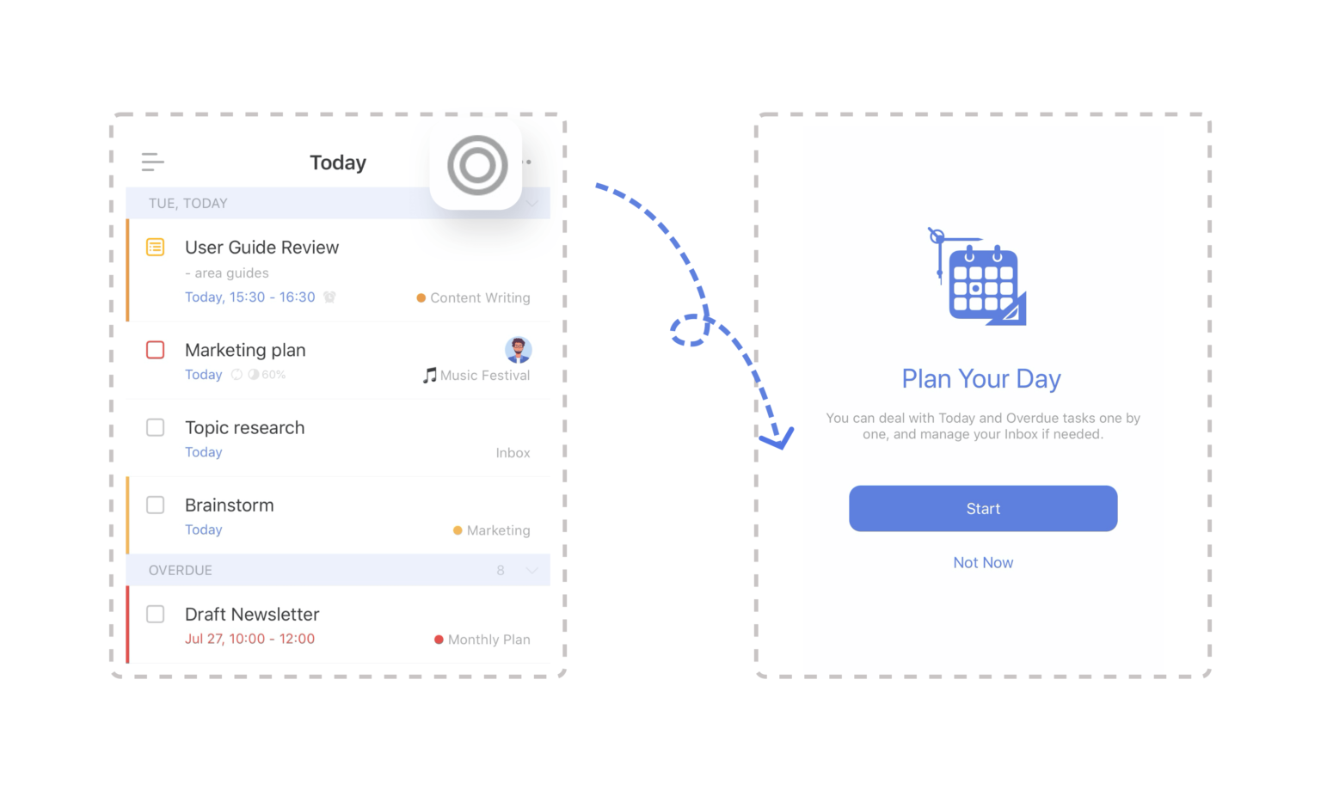

Slide 7
2. Integrates with Other Tools
Your personal to-do list may also be important to your work to-do list. Let’s say a team member is not going to be available one day because of the doctor’s appointment. You need to know that in order to have someone else take over the absentee member’s tasks or make sure their absence isn’t blocking the progress of the project.
By having a to-do list that can be integrated into your software, you can prepare for these temporary disruptions and act accordingly. Your team member should be able to access the software anywhere and at anytime because it’s online. Then with the collaborative features notify you about their appointment.
With the integrated software it’s easy to then adjust your project tasks, move around the necessary files and even mark the dark on the shared calendar so the information is quickly and simply disseminated among your team. A simple to-do list can’t do this. By incorporating your to-do list into a more robust project management software you’ve just removed several unnecessary steps.

Slide 8
3. Managing Teams
To-do lists are really just a smaller task list. With the to-do list being a part of a larger suite of software tools you can apply your to-do list to the product without having to make the process more complicated than it needs to be.
Having everything under one roof, so to speak, means that you can combine different tasks you’ve assigned to your team and items on your to do list that relate to those specific tasks into the various parts of your project management software, whether that be in your schedule or your reports or your files. It’s all there, moved as easily as a keystroke.
Having to-do lists seamlessly part of your larger project management software makes inviting people a breeze, as well. You can send them invites, give them full or partial access to the software and start assigning them tasks or sending them reports. It’s a great way to manage your team and even your stakeholders.

Slide 10
4. Be More Productive and Efficient
A to-do list is a great tool, too great not to have it adaptable to your larger project management software. By having a to-do list that reaches into every aspect of your work you are more efficient and productive. That means less time doing busy work, and more time meeting deadlines within your budget.

Slide 11
Significance of LISTUAL
It is really a good habit to write things down as it helps reduce stress and makes u feel more relaxed.
By writing things, you get a feeling of being in control of your life and actions.
Also, by crossing items off your to-do list gives u sense of accomplishment and progress. This helps u motivate yourself and keep going when things get tough.
One of the most important aspect of maintaining a to-do list is organization. Organizing your tasks with a list can make everything much more manageable and helps u keep grounded.

Slide 12
It helps maintain an order in which you want to complete your tasks.
It is a very effective way of time management. Knowing what u need to do every minute helps one save a lot of time and make most out of every moment.
It really helps you to focus more and more on your work in order to complete your task within a given range of time.
Having so much work at once often leads to forgetting one work or the other which further leads to chaos. Hence, by maintaining a to-do-list , a person can definitely improve his performance and work capability.
Whether you are a professional or a student, it can be tricky to stay on top of all the things you have to do. If you let all this information swirl around in your head, you will end up stressed and frantic. Therefore, the best possible solution is to maintain a to-do list.

Slide 13

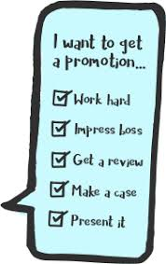


Slide 14
Thank You

