Slide 1

LLOYD INSTITUTE OF ENGINEERING & TECHNOLOGY
Greater Noida | Department of Computer Science & Engineering
B.TECH SECOND YEAR MINI PROJECT · BCC351
IPL MATCH & PLAYER
DATA ANALYTICS
Project Presentation – I | Session 2026–27
GUIDE NAME
SUBMITTED BY
Ms. Ashi Gautam
Sumit Kumar Jha
Roll No. 2301530100144 | Sec B
Department of Computer Science & Engineering

Slide 2
01
OVERVIEW
Presentation Agenda
1
Problem Statement
5
System Workflow / Architecture
2
Objectives
6
Expected Outcome
3
Technology Stack
7
References
4
Literature Survey
BCC351 · B.TECH SECOND YEAR MINI PROJECT PRESENTATION
2

Slide 3
02
SECTION 02
Problem Statement
The supplied IPL ball-by-ball dataset contains 278,205 deliveries from 2008–2025 across 1,169 matches, creating a large volume of player, team, over and delivery-level information. Raw ball-by-ball records are difficult to interpret directly when comparing batting, bowling and team performance. The project addresses this problem by cleaning, transforming and aggregating the data into meaningful performance indicators and visual summaries. It focuses on descriptive analytics such as runs, wickets, strike rate, economy, phase-wise performance and season/team trends. The aim is to provide an easy-to-understand analytical view of IPL match and player performance from the available dataset.
Dataset snapshot • 18 seasons • 1,169 matches • 278,205 deliveries • 703 batters • 550 bowlers
BCC351 · B.TECH SECOND YEAR MINI PROJECT PRESENTATION
3

Slide 4
03
SECTION 03
Objectives
Clean and structure the IPL ball-by-ball dataset for reliable analysis.
Analyze batting and bowling performance using meaningful statistical metrics.
01
02
03
Compare team and player performance across seasons, phases and match situations.
04
Create clear visualizations/dashboard views that communicate actionable insights.
BCC351 · B.TECH SECOND YEAR MINI PROJECT PRESENTATION
4

Slide 5
04
SECTION 04
Technology Stack
Python
Core analysis and data-processing language
Pandas + NumPy
Data cleaning, transformation and statistical computation
Matplotlib + Seaborn
Exploratory analysis and performance visualizations
Power BI
Interactive dashboard and KPI presentation
Jupyter Notebook
Exploration, experimentation and reproducible analysis
CSV Dataset
Ball-by-ball IPL data: 278,205 deliveries, 1,169 matches
Scope: descriptive analytics and visualization based on the supplied ball-by-ball dataset.
BCC351 · B.TECH SECOND YEAR MINI PROJECT PRESENTATION
5

Slide 6
05
SECTION 05
Literature Survey
S.No | Paper Title | Author(s) | Journal / Year | Key Findings
[1] | Analysis and Comparative Study of 10 Years Cricket Sports Data of IPL using R Programming | Parag C. Shukla; Hetal R. Thaker | IJCET, 2018 | Compares IPL players, teams and fielding performance using historical sports data.
[2] | Data Analytics in the Game of Cricket: A Novel Paradigm | V. Vishwarupe et al. | Procedia Computer Science, 2022 | Shows how data analytics and advanced measurements can extend cricket performance analysis.
[3] | Novel Method for Ranking Batsmen in Indian Premier League | M. K. Manju; A. O. Philip | Data Science & Management, 2023 | Uses performance, expertise and team interaction for richer IPL batsman evaluation.
[4] | Statistical Analysis of IPL Player Performance using Advanced Computational Methods | Nirat J. Patel | IJCA, 2024 | Applies statistical methods to IPL batting/bowling performance using ball-by-ball data.
BCC351 · B.TECH SECOND YEAR MINI PROJECT PRESENTATION
6

Slide 7
06
SECTION 06
System Workflow / Architecture
1
IPL Ball-by-Ball
CSV Dataset
2
Data Cleaning
& Validation
3
Feature Engineering
& Aggregation
4
EDA + KPI
Computation
5
Charts / Power BI
Dashboard
6
Player & Team
Insights
Core analytical views: season-wise trends • player batting metrics • bowling metrics • team comparisons • over/phase analysis • boundary/extras/wicket patterns
Output: concise visual insights from the supplied dataset; predictive modelling is not assumed at this stage.
BCC351 · B.TECH SECOND YEAR MINI PROJECT PRESENTATION
7

Slide 8
07
SECTION 07
Expected Outcome
A cleaned and analysis-ready IPL ball-by-ball dataset with consistent derived metrics.
✓
Player-level batting and bowling performance summaries for comparison.
✓
Team- and season-level visual trends highlighting scoring, wickets and match patterns.
✓
An interactive/visual analytical view that makes IPL performance insights easier to interpret.
✓
BCC351 · B.TECH SECOND YEAR MINI PROJECT PRESENTATION
8

Slide 9
08
SECTION 08
References
[1] P. C. Shukla and H. R. Thaker, "Analysis and Comparative Study of 10 Years Cricket Sports Data of Indian Premiere League (IPL) using R Programming," International Journal of Computer Engineering and Technology, vol. 9, no. 5, pp. 10–15, 2018.
[2] V. Vishwarupe, M. Bedekar, P. M. Joshi, M. Pande, V. Pawar, and P. Shingote, "Data Analytics in the Game of Cricket: A Novel Paradigm," Procedia Computer Science, vol. 204, pp. 937–944, 2022, doi: 10.1016/j.procs.2022.08.114.
[3] M. K. Manju and A. O. Philip, "Novel method for ranking batsmen in Indian Premier League," Data Science and Management, vol. 6, no. 3, pp. 158–173, 2023, doi: 10.1016/j.dsm.2023.06.004.
[4] N. J. Patel, "Statistical Analysis of IPL Player Performance using Advanced Computational Methods," International Journal of Computer Applications, vol. 186, no. 30, pp. 48–52, 2024, doi: 10.5120/ijca2024923882.
[5] Supplied project dataset: IPL ball-by-ball CSV file provided for this mini project.
NOTE: All references must be cited in IEEE format.
BCC351 · B.TECH SECOND YEAR MINI PROJECT PRESENTATION
9

Slide 10
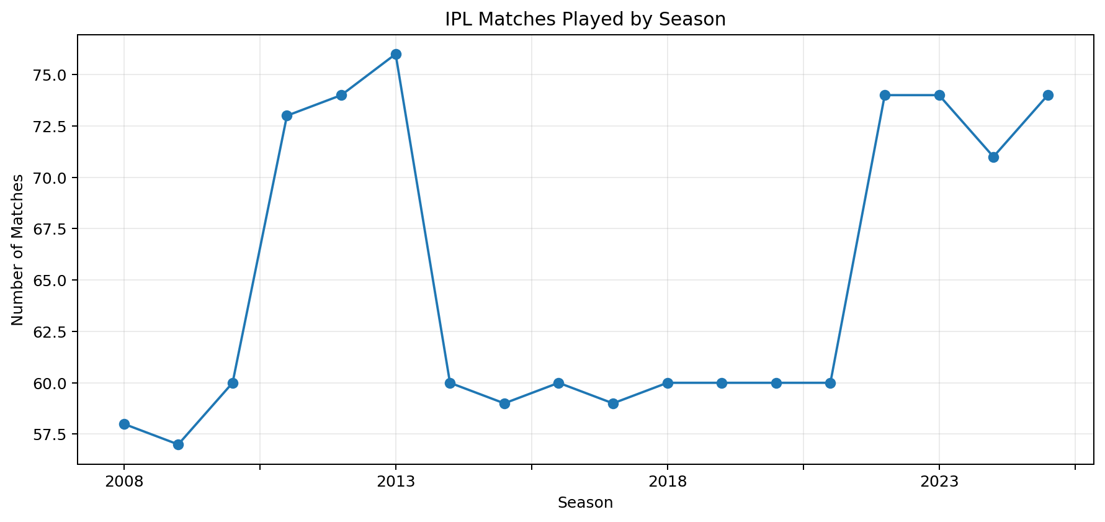
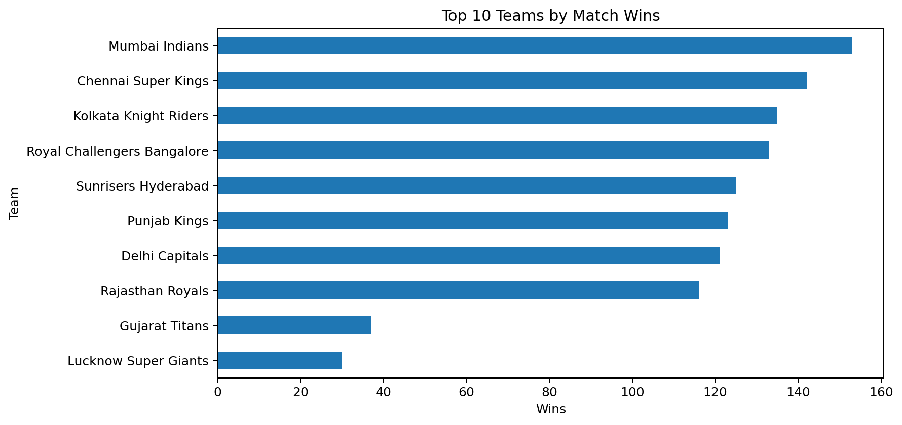
EDA Snapshot — Match & Team Analysis
Based on the current cleaned match-level dataset (1,169 matches)

Slide 11
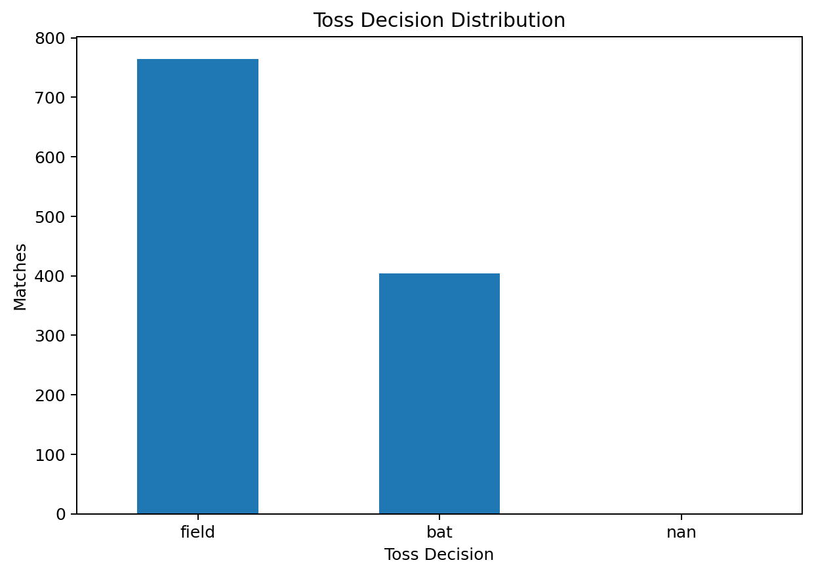
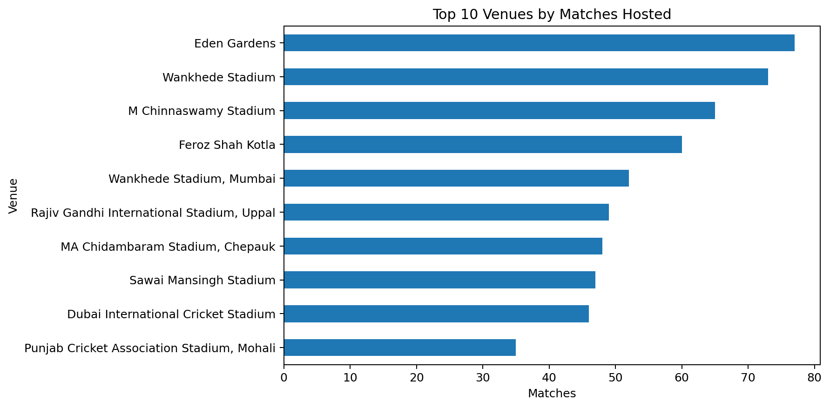
EDA Snapshot — Toss & Venue Analysis
Descriptive analysis of match context and venue distribution

Slide 12
Current Project Focus
Descriptive analytics of IPL match, player and team performance
DATA PREPARATION
Cleaning, validation and structuring of IPL ball-by-ball records
PERFORMANCE METRICS
Runs, wickets, strike rate, economy and phase-wise analysis
COMPARATIVE ANALYSIS
Player, team and season-level performance comparisons
VISUALIZATION
EDA charts followed by KPI and Power BI dashboard views

Slide 13
THANK YOU
Questions & suggestions are welcome
Lloyd Institute of Engineering & Technology, Greater Noida

