Slide 1





Performing EDA ON Anime Dataset
Team : Sumit.Suryavanshi Guide: Mr.Mario Thokcham
Email Id: sumitsuryavanshi2005@gmail.com
Notes:
Slides: Prepare a short slide deck (10-12 slides) summarizing the project objectives, methodology, and key results.

Slide 2
Anime EDA Insight
OUTLINE
Abstract of the Project
Problem Statement
Proposed Solution
System Architecture
Live Demo of the Project
Embedded Video of Project
Conclusion
Future Scope

Slide 3
Abstract
Anime EDA Insight
Objective : Understand trends in anime popularity, ratings, genres, and release years.
Dataset : Kaggle anime dataset with 100 entries.
Methods : Data cleaning, statistical analysis, and visualization.

Slide 4
Problem Statement
Anime EDA Insight
Anime lacks direct viewership data, making it difficult to measure popularity and trends accurately.
Why this Analysis?
No direct dataset on most-watched anime.
Need to estimate popularity based on ratings, genres, and episode durations.
Challenges Faced:
No direct ‘watch count’ column for viewership insights.
Missing values in some columns.

Slide 5
Proposed Solution
Anime EDA Insight
Data Preprocessing includes data cleaning process
Exploratory Data Analysis
Visualization using bar charts, piechart , heatmaps for insights
Key Insights

Slide 6
System Architecture
Anime EDA Insight
Dataset: Kaggle Anime Dataset (CSV)
Tools: Python, Pandas, NumPy, Matplotlib, Seaborn
Processing: Cleaned missing values, converted data types
Analysis: Found top-rated anime, genre trends, release year insights
Visualization: Bar charts, pie charts, Heatmaps for insights

Slide 7
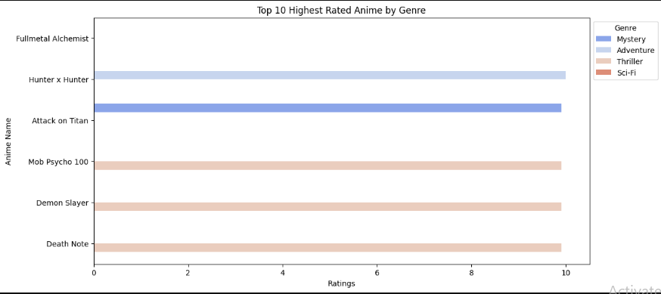
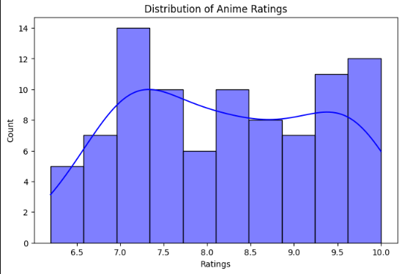
DATA VISUALIZATION
Anime EDA Insight
Top Rated Animes in-terms of Ratings and Genre…

Slide 8
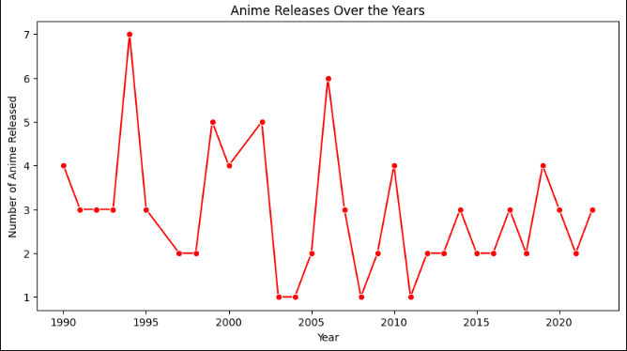
DATA VISUALIZATION
Anime EDA Insight
Anime Release has been decreasing from Year 2010

Slide 9
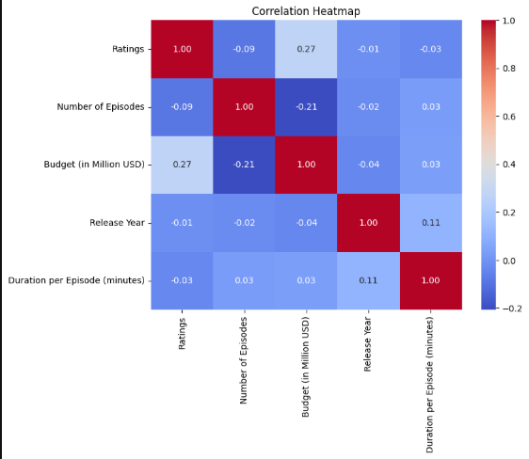
DATA VISUALIZATION
Anime EDA Insight
Budget impacts ratings slightly but isn't the only factor.
Number of episodes and budget are weakly related.
No strong correlation between release year, episode duration, and ratings.

Slide 10
Future Scope
Anime EDA Insight
Industry Applications:
Streaming Platforms: Use genre and rating trends to suggest anime to users.
Content Creators & Reviewers: Helps in understanding audience preferences for better recommendations.
Compare rating trends across different decades to find shifts in audience preferences.

Slide 11
Conclusion
Anime EDA Insight
Total anime analyzed: 100 Animes
Highest rated anime: FullMetal Alchemist
Most common release year: 1994
Average episode duration: 39.89 minutes

Slide 12
Reference
Anime EDA Insight
Dataset of Anime : Kaggle.com Link:
https://www.kaggle.com/datasets/samikshadalvi/100-most-watched-anime-in-the-world
Project Github Link: https://github.com/sumit1965/Anime_EDA-Insight

Slide 13
Anime EDA Insight
Thank you!
Notes:
thank you very much for joining this PPT, keep learning.
13

