Slide 1
Creating Image Thumbnails with AWS Lambda
Sumit Khandelwal

Slide 2
What is AWS Lambda?
AWS Lambda lets you run code without provisioning or managing servers.
You pay only for the compute time you consume - there is no charge when your code is not running.
Just upload your code and Lambda takes care of everything required to run and scale your code with high availability.
Node.js, Java, C# and Python.

Slide 3
Where to use Lambda?
With Lambda, you can run code for virtually any type of application or backend service - all with zero administration.
You can set up your code to automatically trigger from other AWS services or call it directly from any web or mobile app.
Serverless microservices.
Not where you want os customization.

Slide 4
Use case: Thumbnails
Main Components in use case: - Amazon S3 - Amazon CloudWatch - AWS Lambda
Problem Statement: - You are uploading full sized images to Amazon S3. - You require thumbnail of these images.

Slide 5
How it works?
Lambda Function and Trigger
Set up code to trigger from other AWS services, HTTP endpoints, or in-app activity.
Container (execution environment) is launched.
Declarations in Lambda function code remains initialized.
Container provides some disk space in the /tmp directory .
Node > 4.3

Slide 6
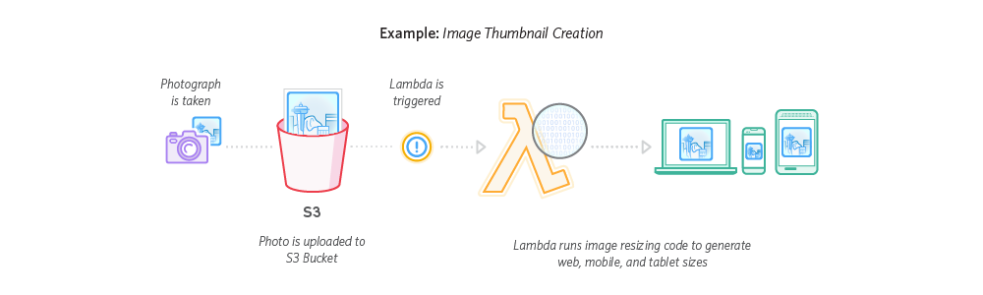
ServerLess Image Resizing

Slide 7
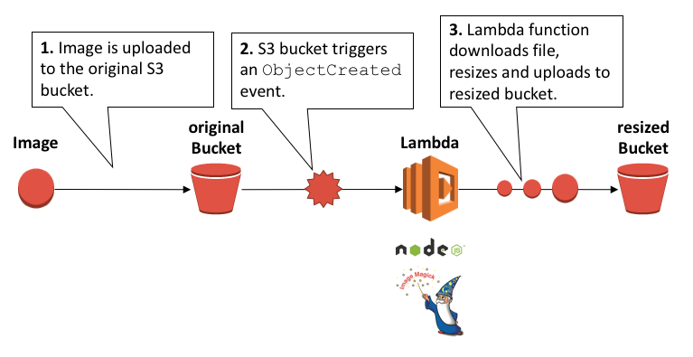
Image Resizing Flow

Slide 8
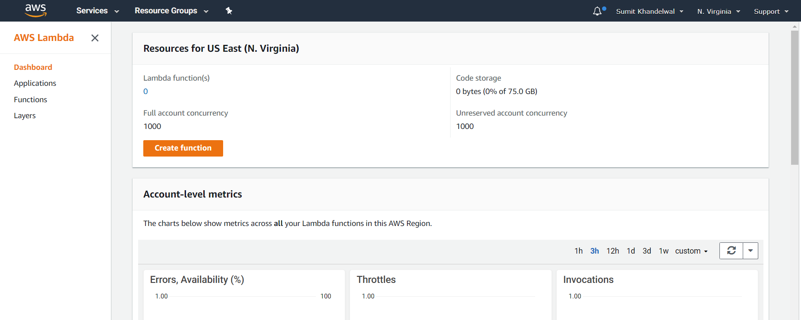
Setup Lambda function
Create Lambda Function

Slide 9
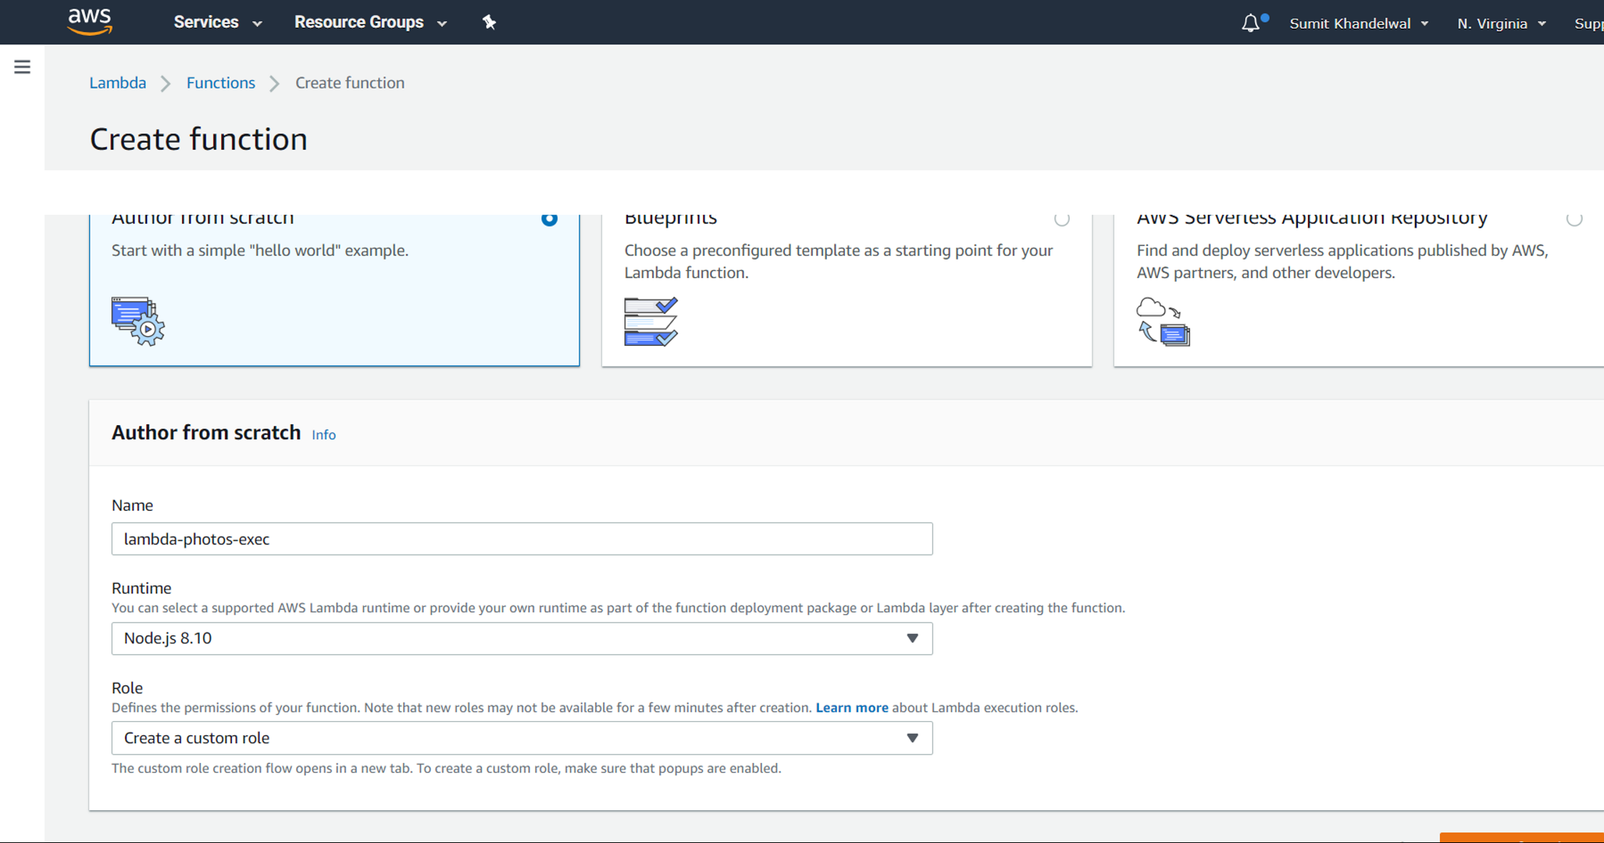
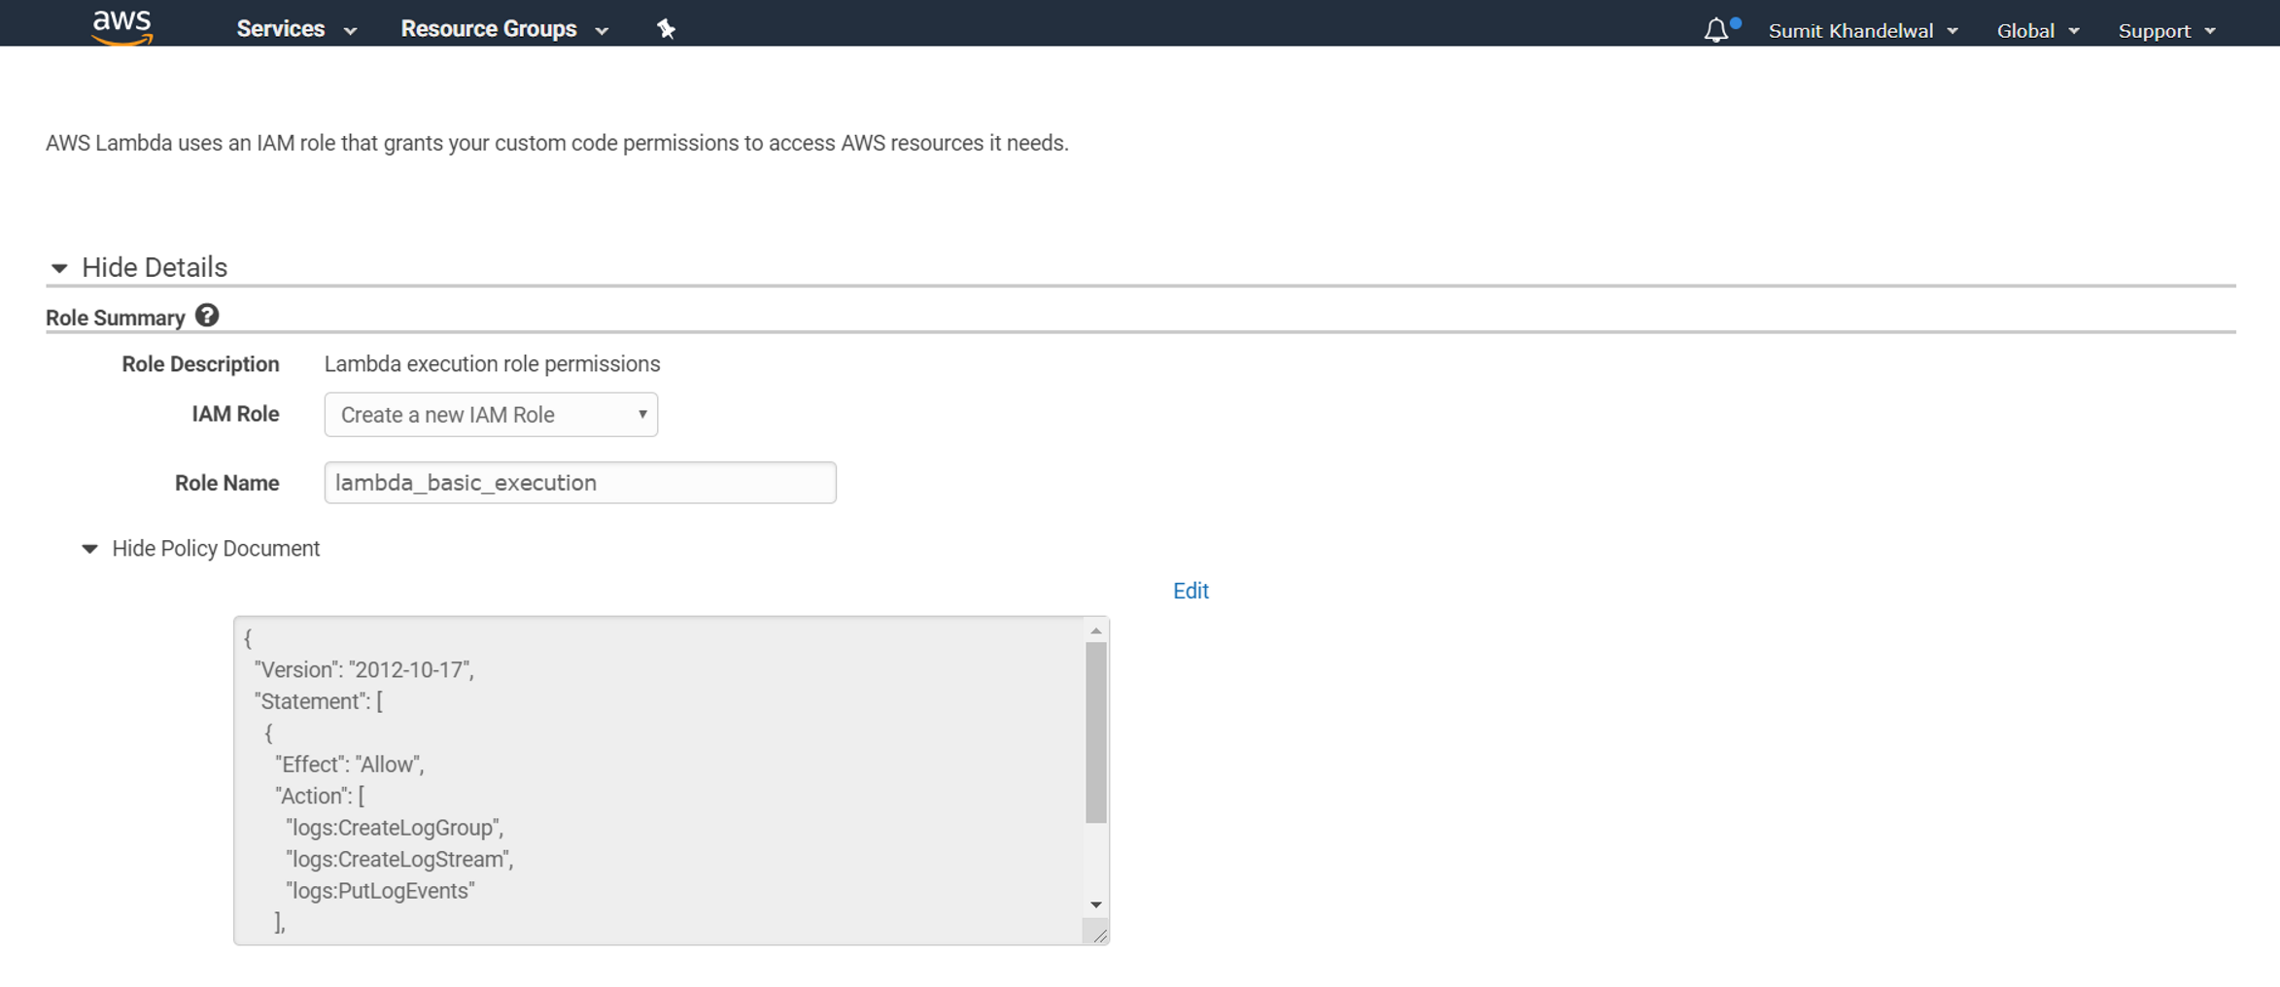
Here we are creating function with Node.js from scratch
Add your function name
Node.js Runtime
Choose Role for execution of Thumbnail
Now create custom role for thumbnail
Select create a new IAM Role
Write Role Name [Note:- Any text you can enter]
Click on “Allow”

Slide 10
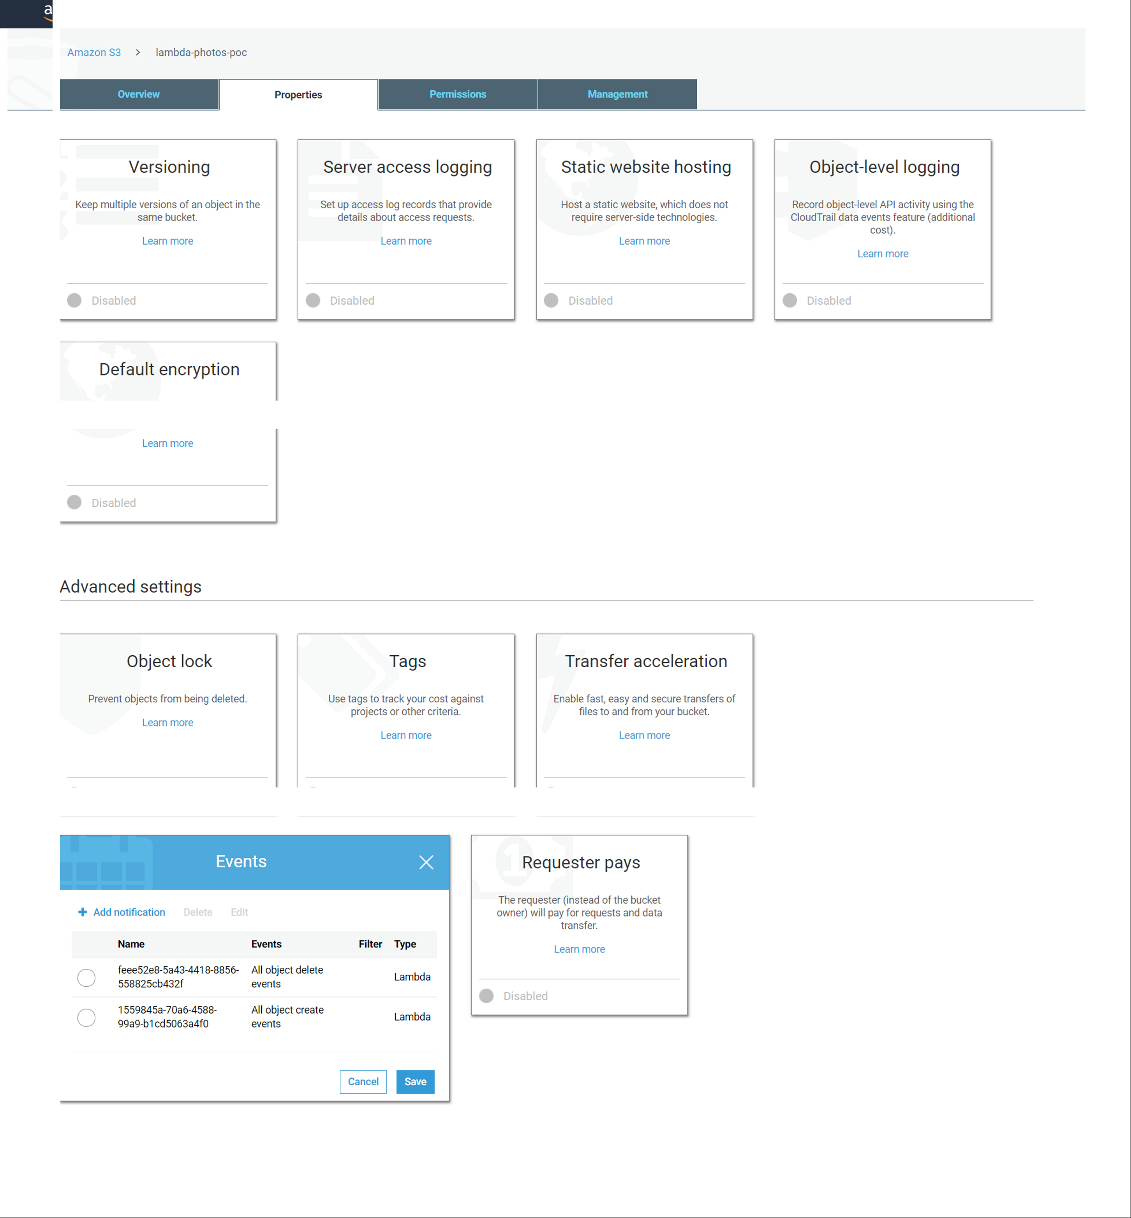
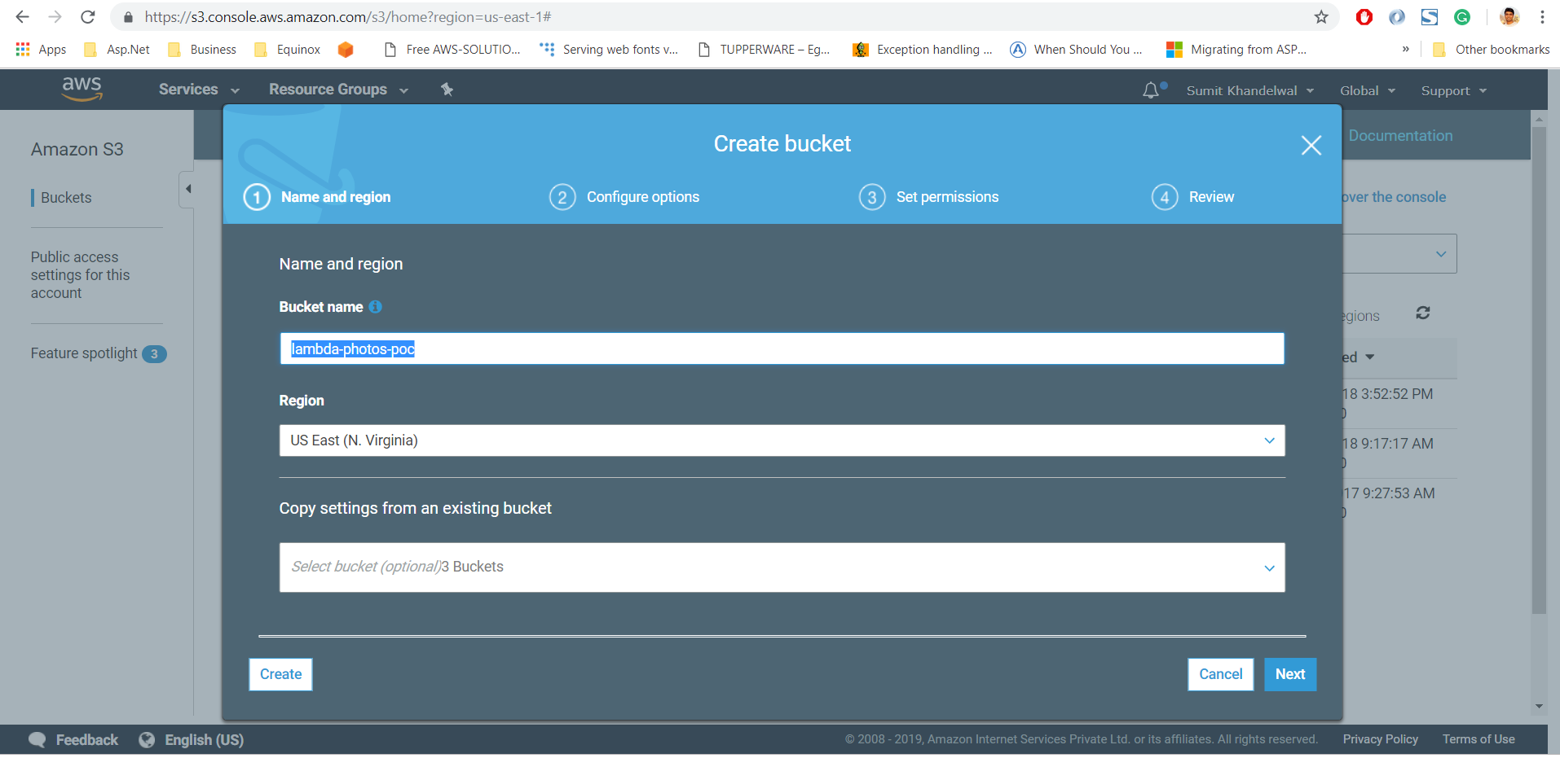
Create Bucket in S3
Create a folder name as ‘lambda-photos-poc’
Give necessary permissions (Read/Write) to your bucket
Add a bucket policy

Slide 11
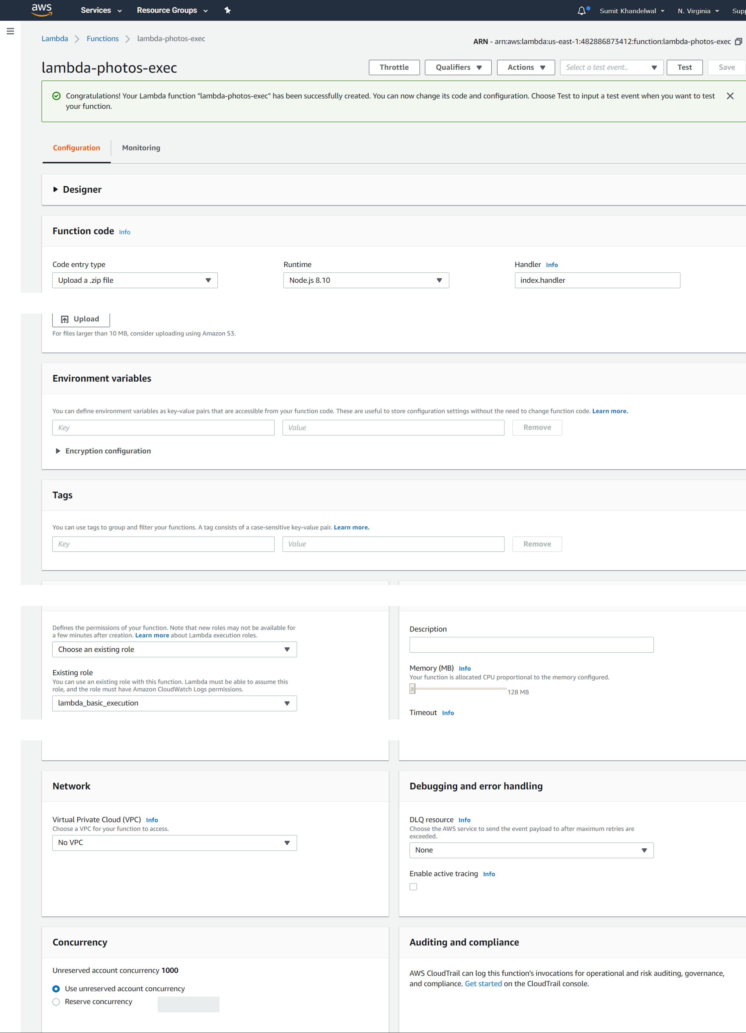
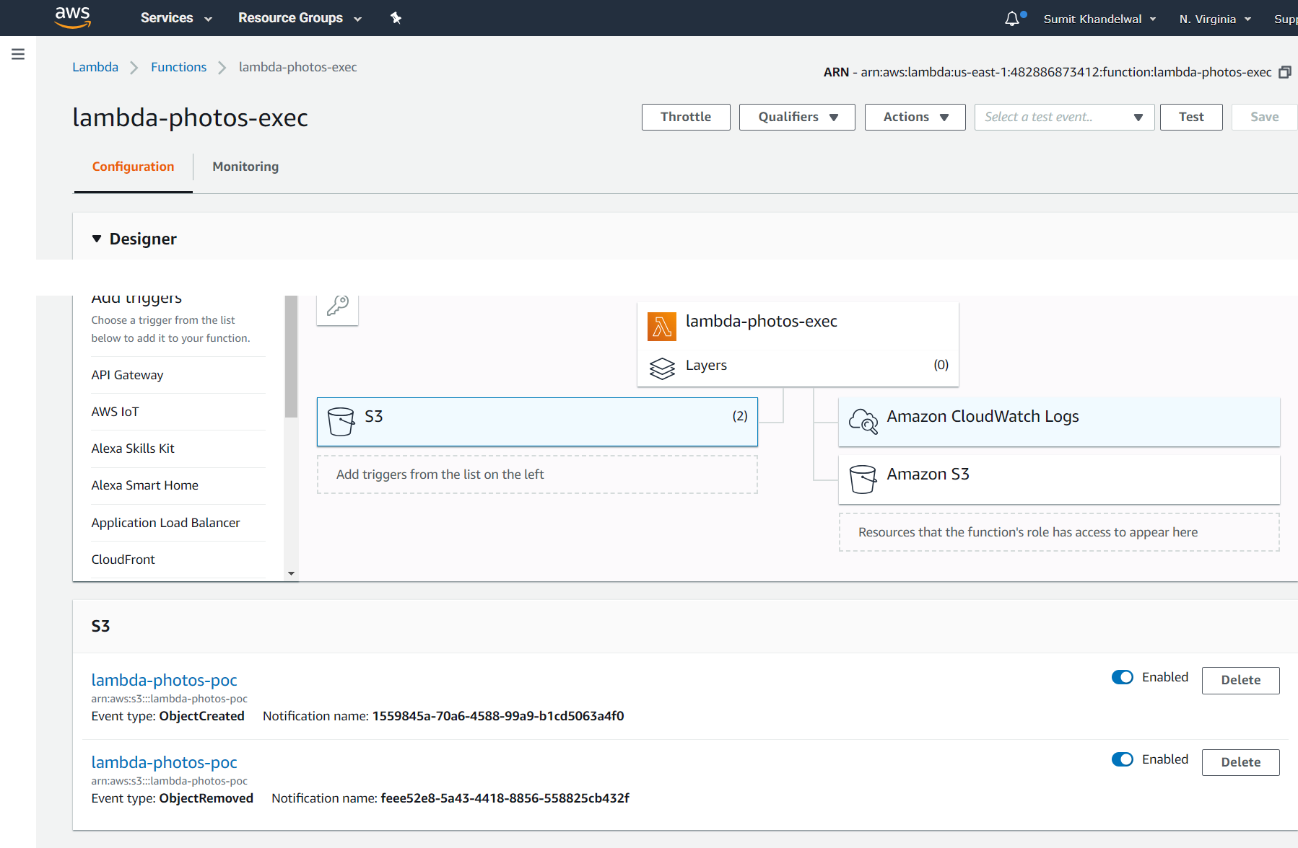
Configure Lambda function
Upload Thumbnail.zip file
https://github.com/sumit1khandelwal/serverless-thumbnail-creation/blob/master/v1/Thumbnail.zip
Now we select our source bucket where original files are created
Select Event Type as Object Created (All)
Prefix and Suffix are not mandatory here
Check Enable Trigger

Slide 12
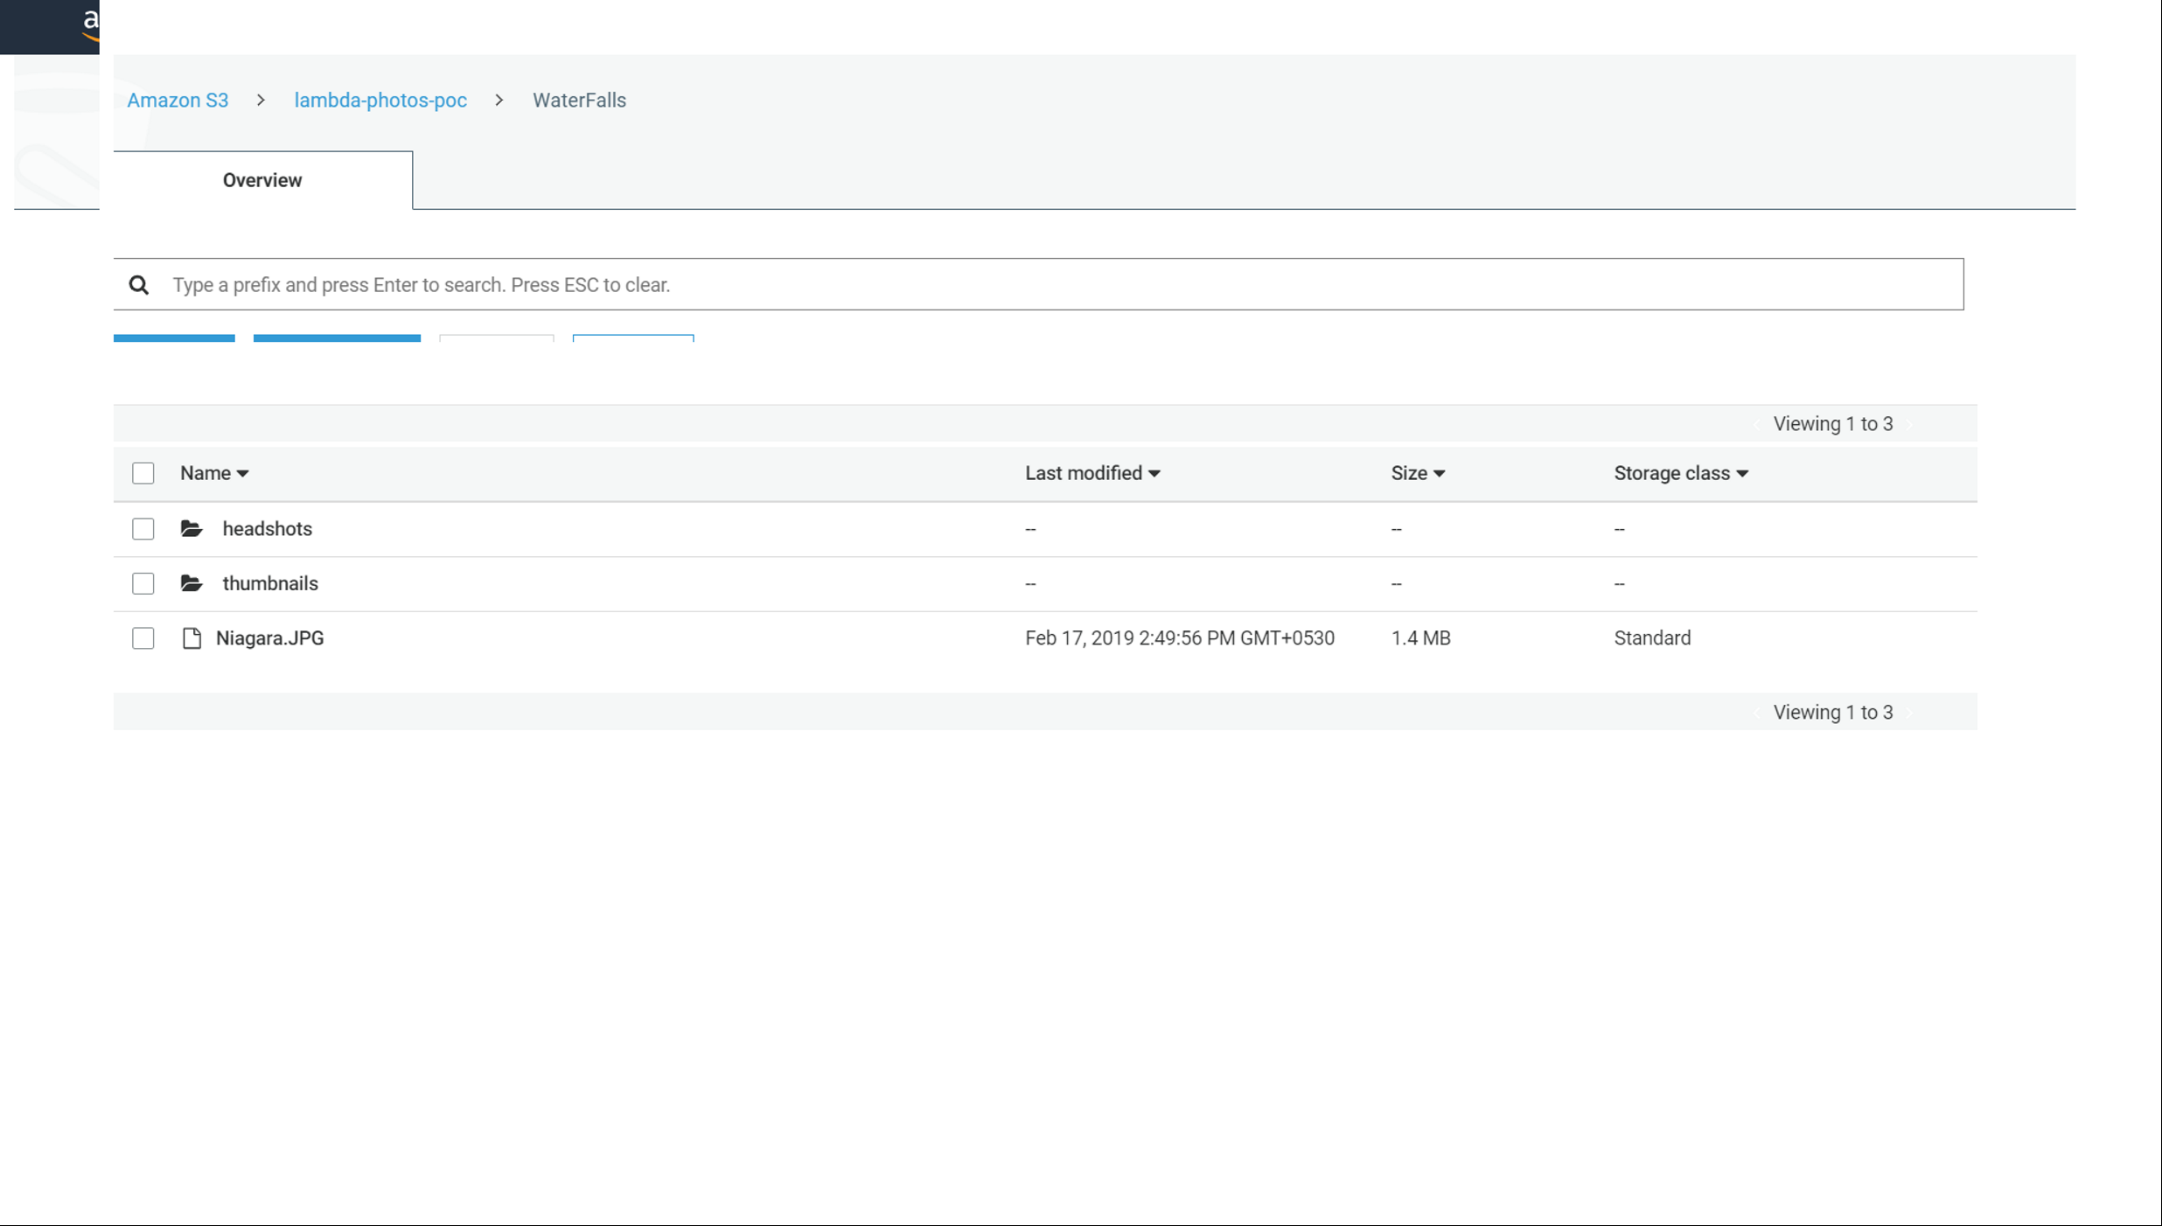
Upload Photos to s3
Upload photos from your code or directly drag and drop into S3
Lambda is Triggered
Image resizing code triggered and generate multiple size images.
Headshots & Thumbnails are automatically created with their respective sizes.
Thumbnails: https://s3.amazonaws.com/lambda-photos-poc/WaterFalls/thumbnails/75*75/Niagara.JPG
Headshot: https://s3.amazonaws.com/lambda-photos-poc/WaterFalls/headshots/375*500/Niagara.JPG

Slide 13
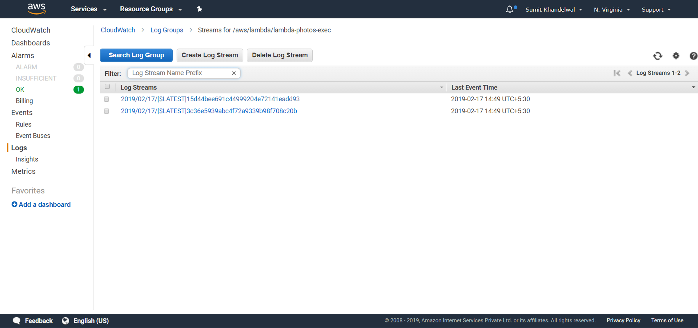
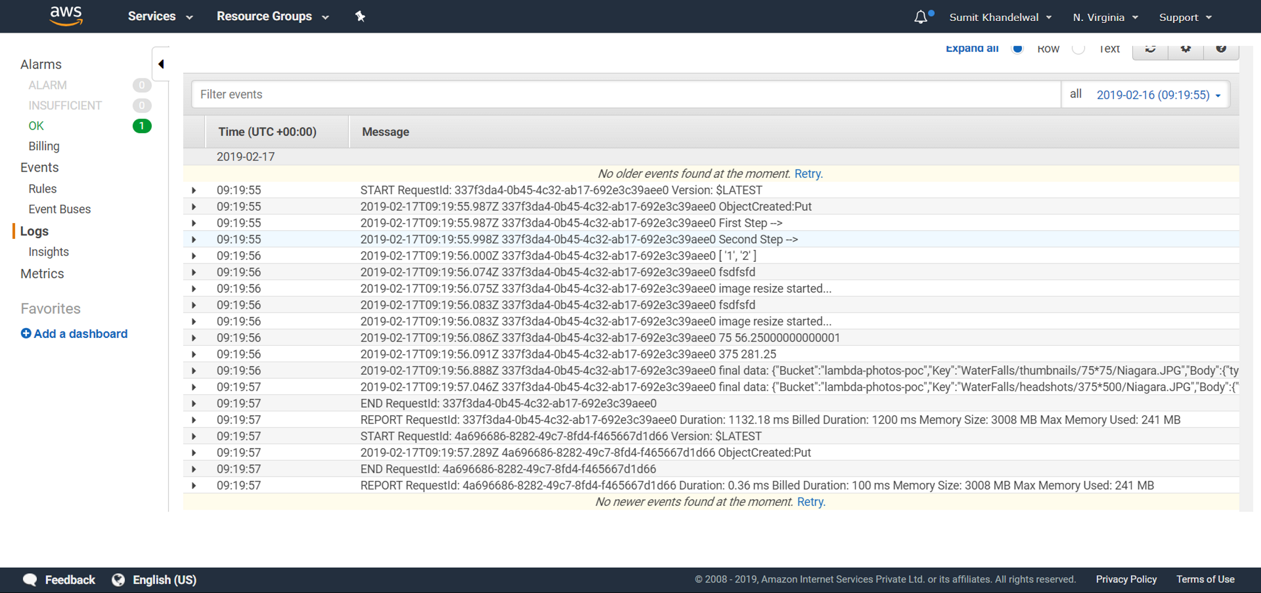
Cloudwatch logs

Slide 14
Questions?

Slide 15
Thank You.

