Slide 1
CODEPIPELINE

Slide 2
AWS CodePipeline
Introduction
AWS CodePipeline is a continuous delivery service that automates the building, testing, and deployment of your software into production.
To create and manage your pipelines you can use the
AWS CodePipeline console
The AWS Command Line Interface (AWS CLI),
or any combination of these

Slide 3
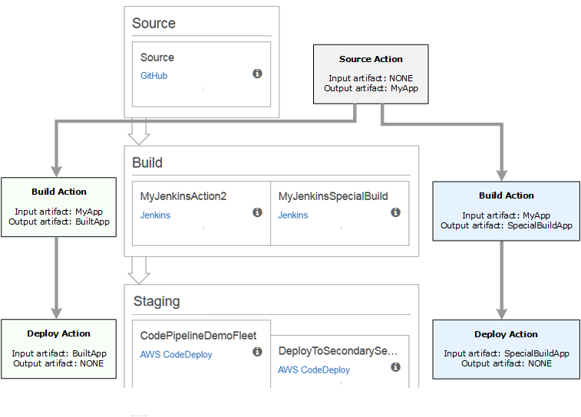
Workflow Of CodePipeline

Slide 4
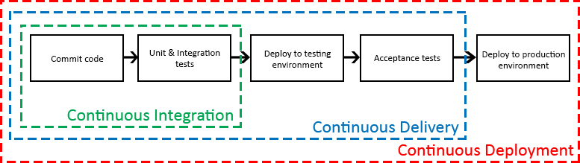
Concepts of CodePipeline

Slide 5
What Can I Do with AWS CodePipeline?
Automate your release processes
Establish a consistent release process
Speed up delivery while improving quality
Use your favorite tools
View progress at-a-glance

