Slide 1
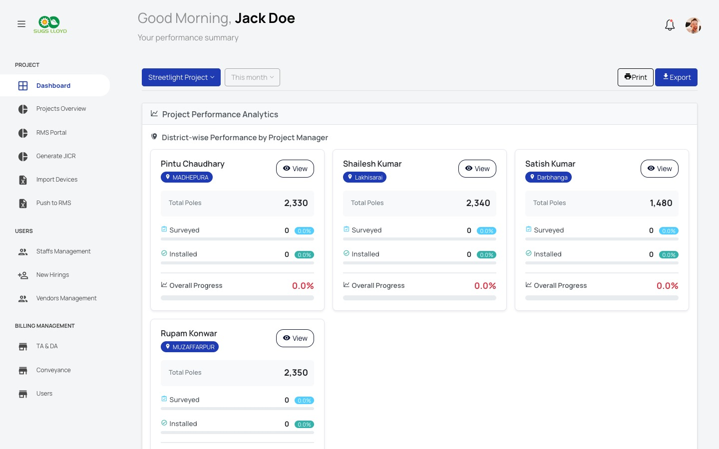
☀
SURYA OPERATIONS
Solar Installation CRM
The complete operations platform for
solar streetlight installers.
Projects, staff, inventory & billing — in one place.
Projects
Staff
Inventory
Billing
Reports
Swipe to explore all features →
SURYA OPERATIONS · 1 / 14

Slide 2
Why Solar Companies Need a Dedicated CRM
The problem with generic tools
GENERIC CRMs
VS
SURYA OPERATIONS
No pole-level tracking
Solar-specific
Built exclusively for solar streetlight installation
✕
✓
No geo hierarchy support
Geo-hierarchy
District → Block → Panchayat → Ward → Pole
✕
✓
No inventory serial / QR
Smart Inventory
QR dispatch, serial tracking, bulk import/export
✕
✓
No engineer dashboards
Team Performance
Real-time leaderboards, progress analytics
✕
✓
No TA / DA billing
Billing Built-in
TA/DA, conveyance claims with approval workflows
✕
✓
No JICR report generation
Gov. Reports
JICR & government report generation built-in
✕
✓
SURYA OPERATIONS · 2 / 14

Slide 3
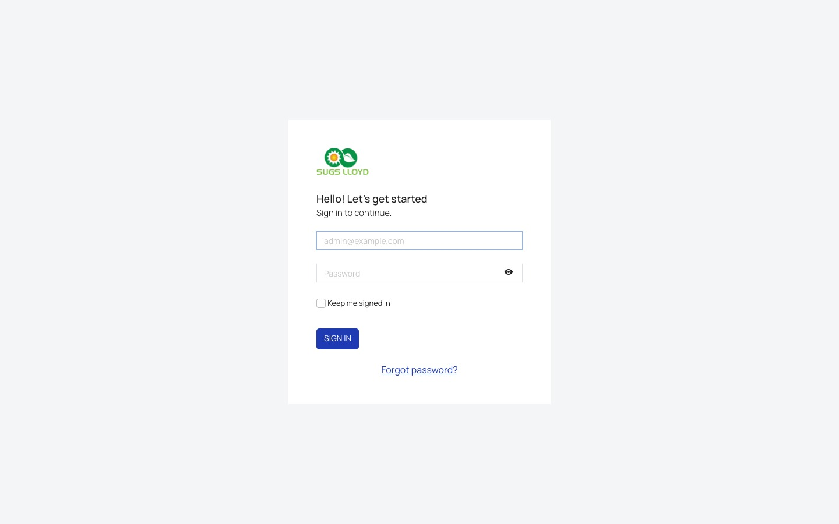
Step 1 — Secure Login
Role-based access for your entire team
Login Screen
➊ Company-branded login form
➋ Role-based access control (Admin, PM, Engineer)
➌ 'Keep me signed in' — secure session management
How to Log In
1
Open the Surya Operations URL in your browser
2
Enter your company email address
3
Enter your password
4
Tick 'Keep me signed in' for convenience
5
Click SIGN IN to access your dashboard
SURYA OPERATIONS · 3 / 14

Slide 4
Dashboard — Your Command Center
Real-time project performance at a glance
Project Performance Dashboard
📊 Performance Analytics
District-wise breakdown of poles surveyed vs. installed per manager
🔄 Live Project Filter
Switch between projects and date ranges instantly
👤 Manager Cards
Each PM's total poles, surveyed %, installed %, overall progress
📥 Export Reports
One-click Print or Export to PDF/Excel
SURYA OPERATIONS · 4 / 14

Slide 5
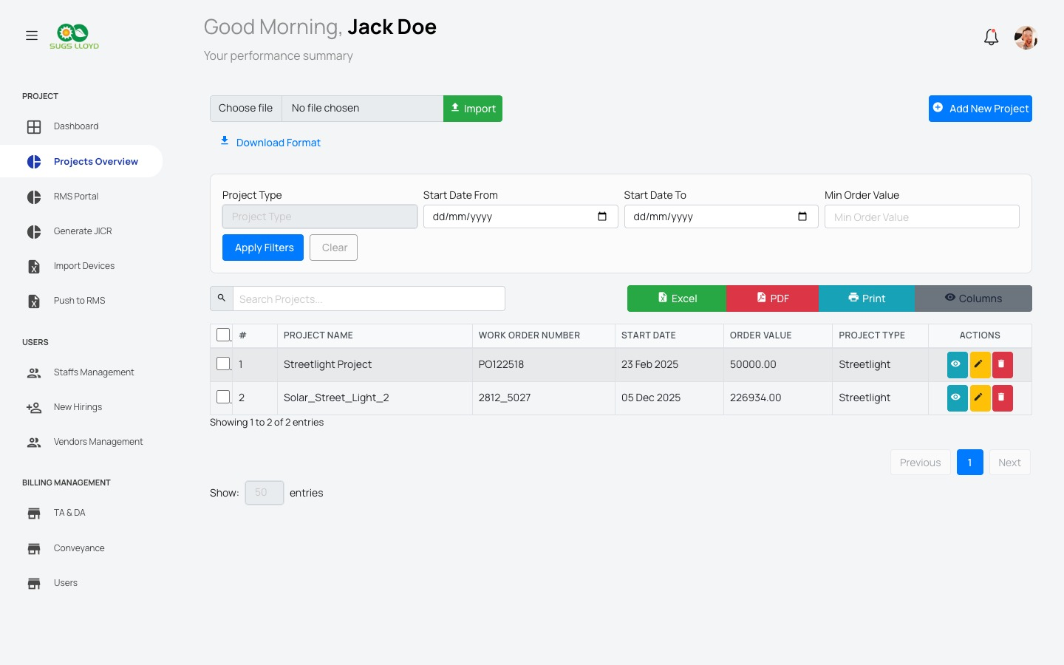
Projects Overview
Manage all your solar contracts in one place
Projects List
How to Create a New Project
1
Click '+ Add New Project' (top right)
2
Enter Project Name and Work Order Number
3
Set Start Date, Order Value, and Project Type
4
Assign Project Managers and Site Engineers
5
Import project sites via Excel template
Work Order No.
Project Type
Order Value
Start Date
SURYA OPERATIONS · 5 / 14

Slide 6
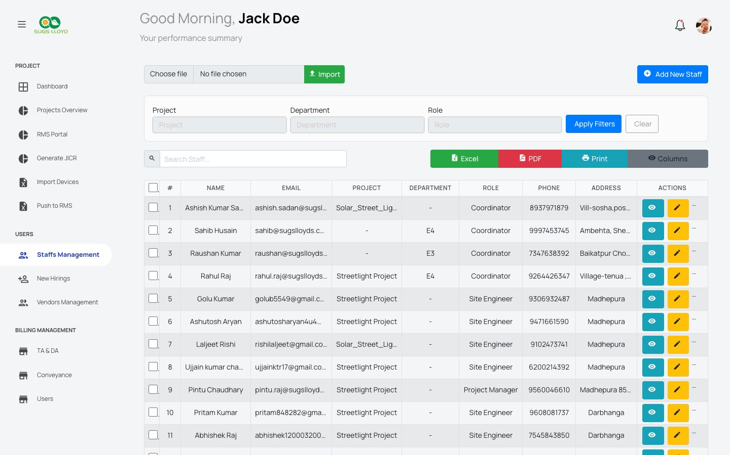
Staff Management
Your entire field team at your fingertips
Staff Directory
Staff Roles
Admin
Project Manager
Full system access
Manages team & progress
Coordinator
Site Engineer
Data entry & scheduling
Field installation work
Key Actions: Add Staff · Import from Excel · Filter by Role/Dept · View Profile · Bulk Delete
Field Engineers
Bulk Import
OTP Mobile
Geo-tagged to districts
Excel template upload
Verified contact updates
SURYA OPERATIONS · 6 / 14

Slide 7
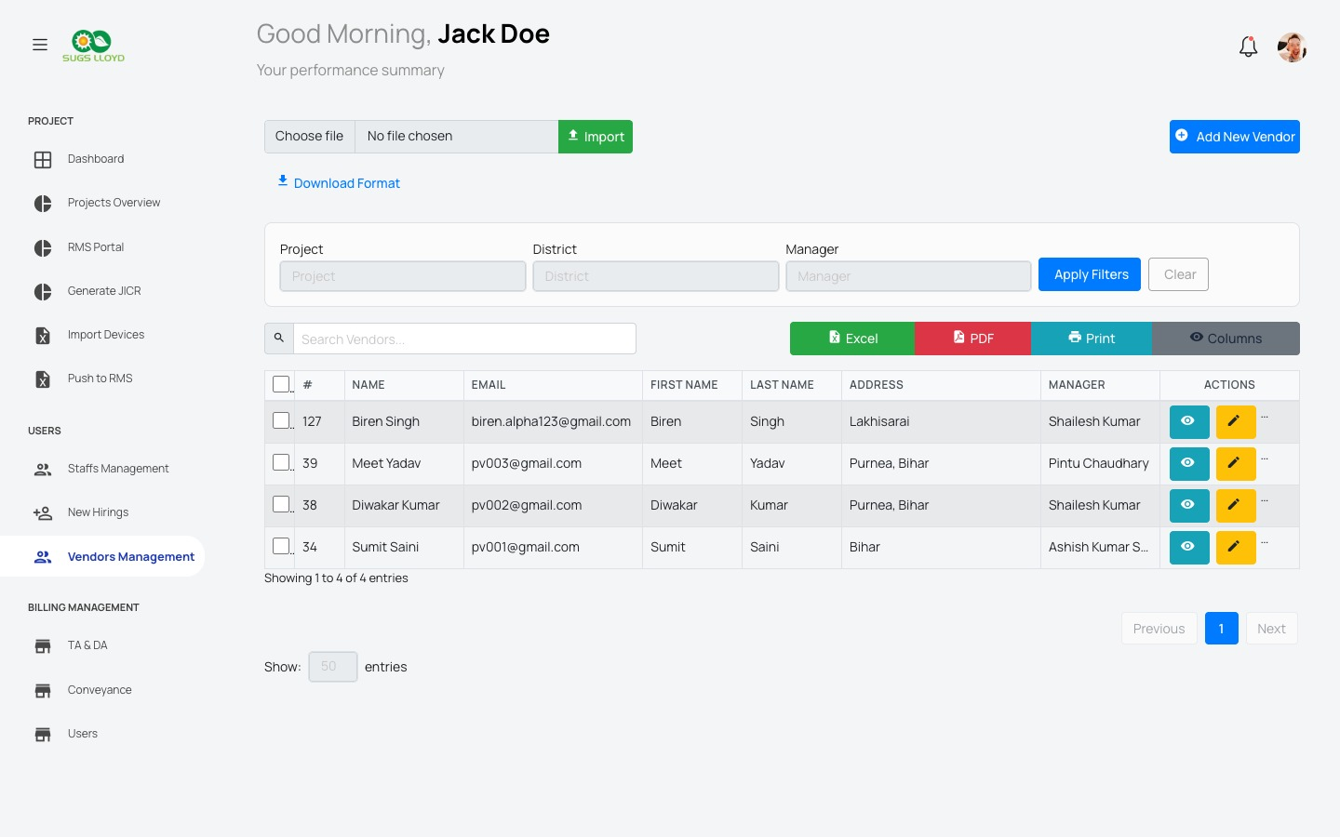
Vendor Management
Track all your installation contractors
Vendor Directory
What You Can Do with Vendors
Add & Profile Vendors
Store contact, address, assigned manager and district
Bulk Assign Projects
Assign multiple vendors to projects at once
Filter by District/Manager
Find the right vendor for the right geography
Import via Excel
Onboard hundreds of vendors in seconds
View Vendor Dashboard
See all assigned projects, tasks, and performance
SURYA OPERATIONS · 7 / 14

Slide 8
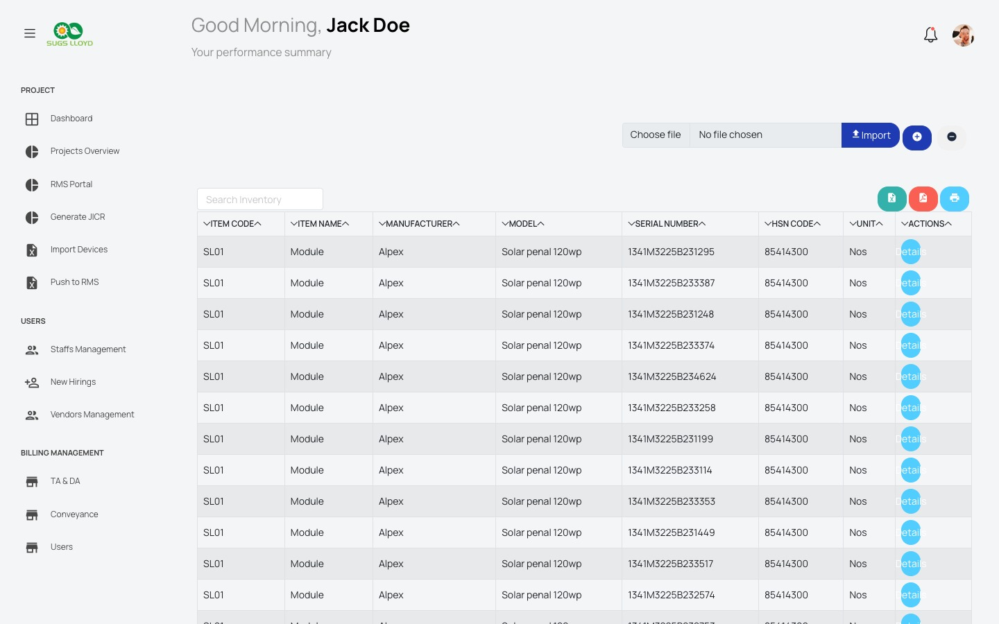
Inventory Management
Solar modules, poles, fixtures — all tracked by serial
Inventory Ledger
Inventory Features
QR Dispatch
Scan & dispatch items to field teams with QR codes
Serial Tracking
Every item tracked by unique serial number
Bulk Import
Upload thousands of inventory items via Excel
Return Workflow
Track returned & replaced items with reasons
Store-wise View
Each project site has its own inventory store
SURYA OPERATIONS · 8 / 14

Slide 9
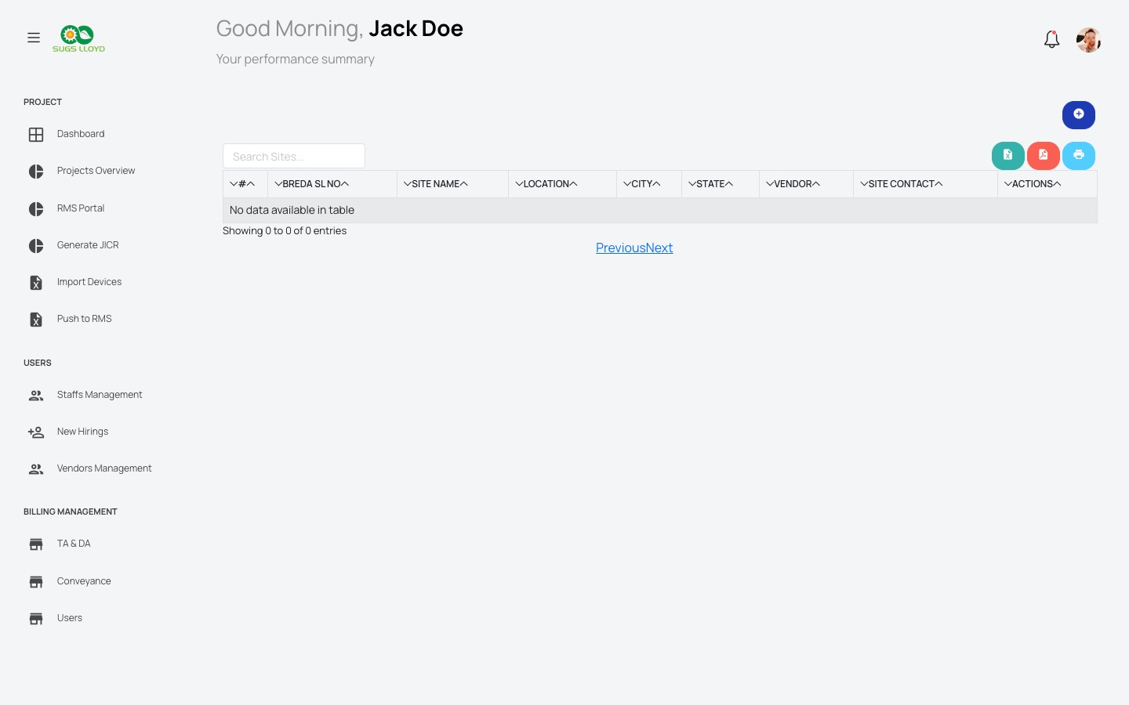
Site Management
Every installation location, every pole — tracked
Sites List
Site Hierarchy
📍 District
→
🏘 Block
→
🌾 Panchayat
→
🏠 Ward
→
💡 Pole
Site Actions
✓
Import sites via GPS-tagged Excel template
✓
Assign vendors and engineers per site
✓
Import poles for each site with survey/install status
✓
Bulk delete or reassign poles across sites
✓
Export pole data to Excel or PDF reports
SURYA OPERATIONS · 9 / 14

Slide 10
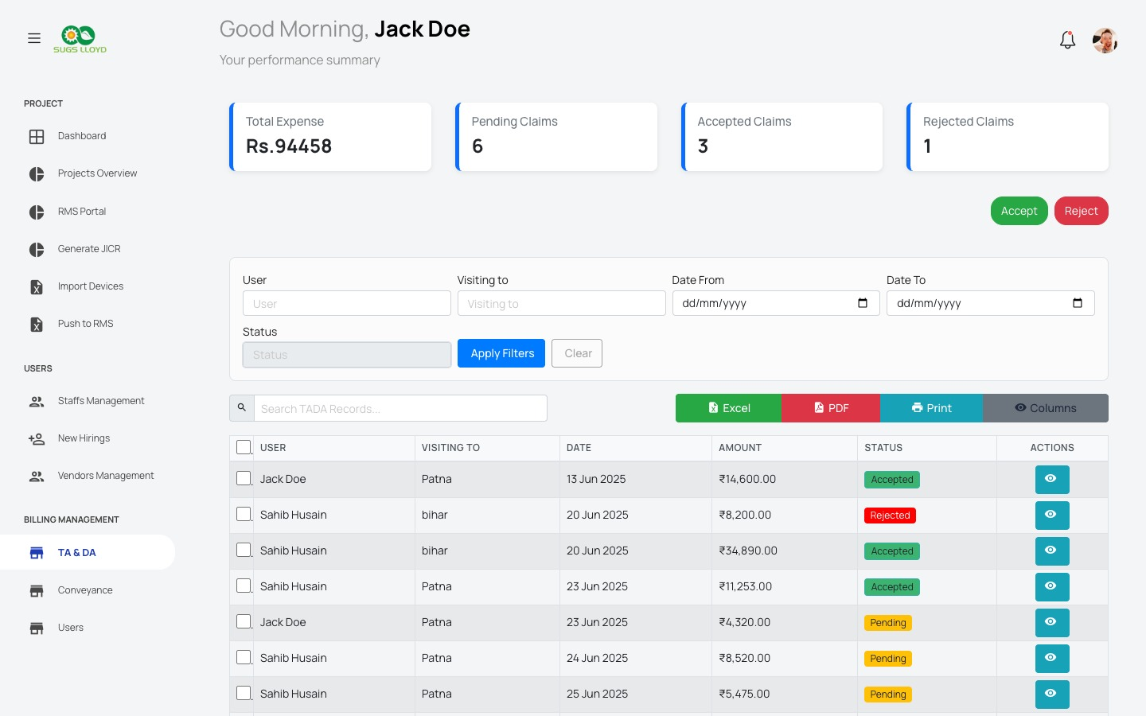
Billing — TA & DA Management
Travel, allowance & expense claim workflows
TA & DA Claims Dashboard
₹94,458
6
3
1
Total Expense
Pending Claims
Accepted
Rejected
How the Billing Workflow Works
1
Field Staff
Submits TA/DA claim with travel details & amount
2
System
Logs claim with date, visiting location, status: Pending
3
Admin Review
Admin views claim details and verifies the submission
4
Accept / Reject
Click Accept (green) or Reject (red) with reason
5
Bulk Actions
Process multiple claims at once for efficiency
SURYA OPERATIONS · 10 / 14

Slide 11
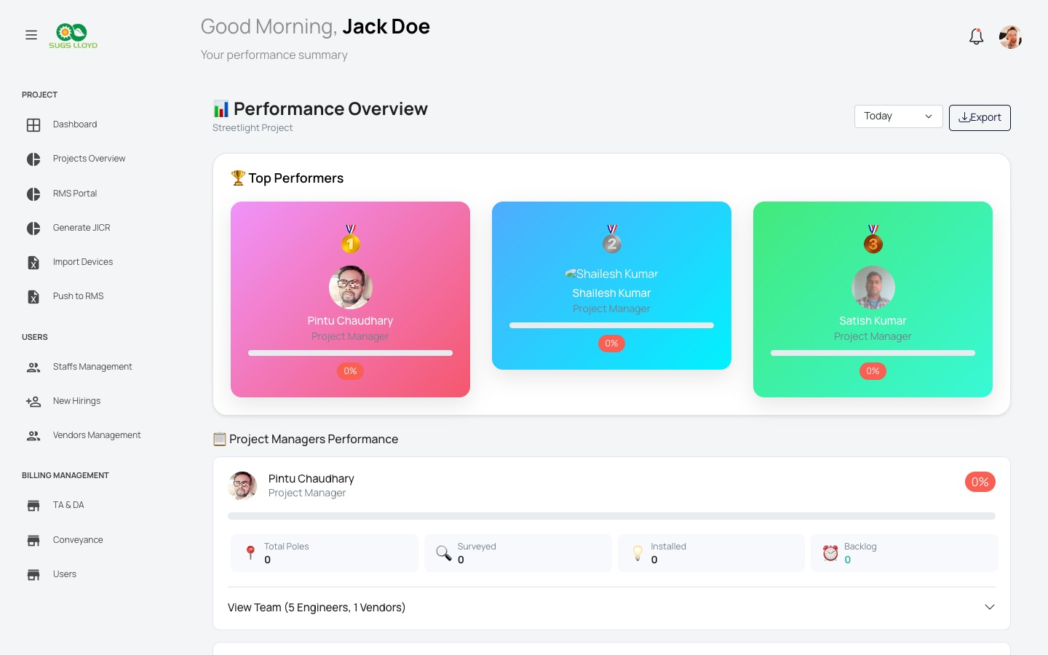
Performance Analytics
Track team productivity with real-time leaderboards
Performance Overview
🥇
Top Performers
Podium view of top 3 project managers by completion %
📊
Manager Breakdown
Poles total, surveyed, installed & backlog per PM
👥
Team Drill-down
Expand any PM to see their engineers & vendor performance
📅
Time Filter
Filter by Today, This Week, This Month, or custom range
📥
Export Report
Download performance data as Excel for management review
SURYA OPERATIONS · 11 / 14

Slide 12
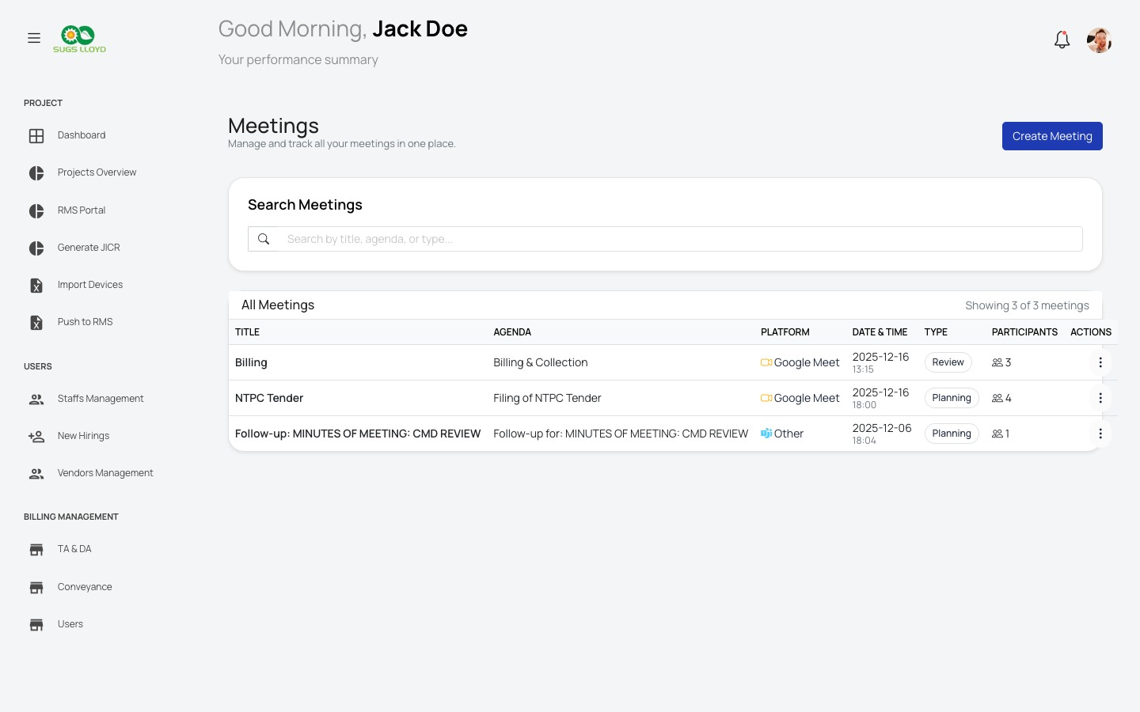
Meetings & Collaboration
Schedule, track, and document all team meetings
Meetings List
Meeting Management Features
Create Meetings
Set title, agenda, platform (Google Meet / Zoom / Other), date & time
Participant Management
Add & remove attendees; track who attended
Discussion Points
Capture action items with status tracking (open/closed)
Follow-up Scheduling
Auto-create follow-up meetings from existing ones
Meeting Notes
Rich text notes saved per meeting with export to PDF
Status Tracking
Review, Planning, Action — track meeting outcomes
SURYA OPERATIONS · 12 / 14

Slide 13
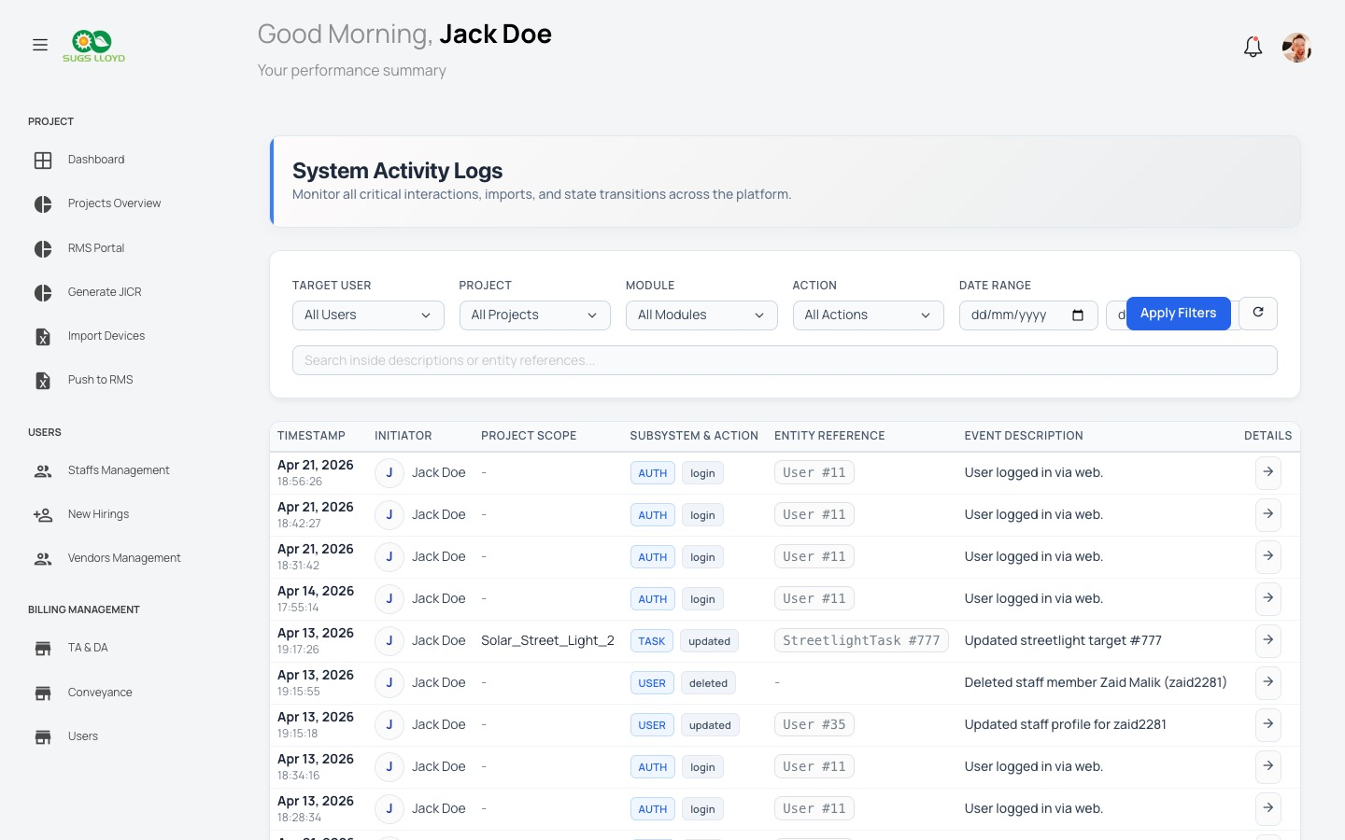
System Activity Logs
Full audit trail — every action, every user, every time
Activity Log Feed
What Gets Logged Automatically
AUTH
• User login
• Logout events
USER
• Staff added/updated/deleted
TASK
• Installation target updates
PROJ
• Project created/modified
INV
• Inventory dispatch/return
SURYA OPERATIONS · 13 / 14

Slide 14
Why Choose Surya Operations?
🌞
📍
Solar-First Design
Geo Hierarchy
Every feature built for solar installation workflows — not adapted from a generic CRM
District → Block → Panchayat → Ward → Pole — the exact structure government projects need
🏷️
📱
Serial & QR Tracking
Field-Ready
Every solar panel and streetlight tracked by serial number with QR dispatch
Mobile-optimized views for site engineers submitting updates from the field
📋
💰
JICR Reports
Billing Workflows
Auto-generate government-format Joint Inspection Completion Reports
TA/DA claims, conveyance billing — all inside the same platform
📊
🔒
Live Analytics
Audit Trail
Real-time performance dashboards, leaderboards, and export-ready reports
Complete activity logs so management always knows who did what and when
Start managing your solar projects smarter. Get Surya Operations.
SURYA OPERATIONS · 14 / 14

