Slide 1




♻
14+ Sites
Mobile App
TrustMeRecycle
B2B2B SaaS
Scrap Collection Made Easy — End-to-End Recycling Logistics for India
Realtime Data
trustmerecycle.in
June 2026

Slide 2
The Problem
🗂️
Fragmented Operations
📦
No Inventory Tracking
Recycling logistics run on spreadsheets, WhatsApp messages, and phone calls — no central visibility.
Godowns overflow silently. Businesses have no live view of stock levels across their collection network.
🚛
Uncoordinated Dispatch
📉
Zero Analytics
Trucks are sent without proof-of-pickup, route data, or weight verification, causing revenue leakage.
No historical data on scrap volumes, material types, or vendor performance — decisions made blind.

Slide 3
Our Solution
One platform. Three roles. Complete recycling lifecycle.
01
02
03
04
Request
Assign
Collect
Verify
Customer submits scrap pickup via mobile app with address, material type & estimated weight
Admin reviews request, assigns nearest available godown & creates a collection job in one click
Vendor dispatches truck with driver details, completes pickup with photo proof & weight entry
System syncs status, updates inventory, triggers notifications and generates audit-ready reports

Slide 4
How It Works
CUSTOMER
ADMIN
VENDOR
Reviews incoming requests
Receives notification
on mobile app
1
Downloads mobile app
1
1
Sign-In with name & phone
Checks godown capacity
& proximity
Views job details:
godown, truck, address
2
2
2
Assigns vendor + godown
(1-click auto job creation)
Travels to customer site
3
Submits pickup request
(address, scrap type,
estimated weight)
3
3
Tracks status in real-time
Dispatches truck with
driver & vehicle details
Captures photo proof
& weighs collected scrap
4
4
4
Views collection history
Exports collection reports
Marks job complete
5
5
5

Slide 5
Platform Overview
Three interfaces. One unified data layer.
🖥️
📱
👤
Admin Web Panel
Vendor Mobile App
Customer Mobile App
/admin — Full control
iOS & Android — Field ops
iOS & Android — Self-serve
✓ Godown & vendor management
✓ Assigned job dashboard
✓ Self-registration flow
✓ Truck dispatch workflow
✓ State → City → Site picker
✓ Pickup request creation
✓ Pickup request assignment
✓ Photo proof capture
✓ Real-time status tracking
✓ Scrap type & pricing CRUD
✓ Weight entry & submission
✓ Collection history view
✓ Collection reports (Excel/PDF)
✓ Offline support + sync
✓ Assigned vendor details
✓ Capacity alerts & analytics
✓ Collection history & export
✓ Preferred date scheduling

Slide 6
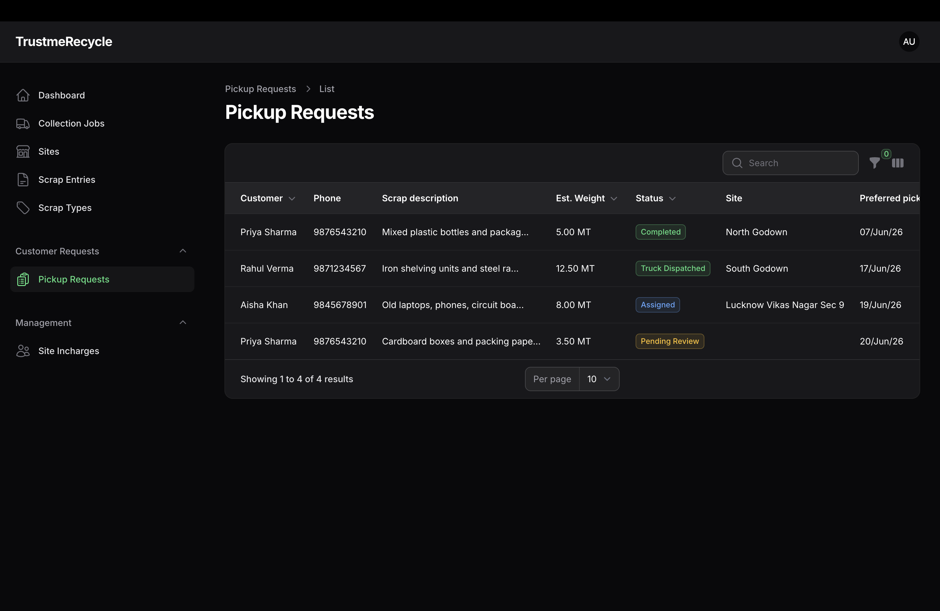
Admin Panel — Customer Pickup Requests
Admin receives & manages scrap pickup requests from Blinkit, Zepto, Zomato, Amazon and Flipkart warehouses
Live data · 4 active requests: Completed | Truck Dispatched | Assigned | Pending Review · Admin assigns to vendor site in one click

Slide 7
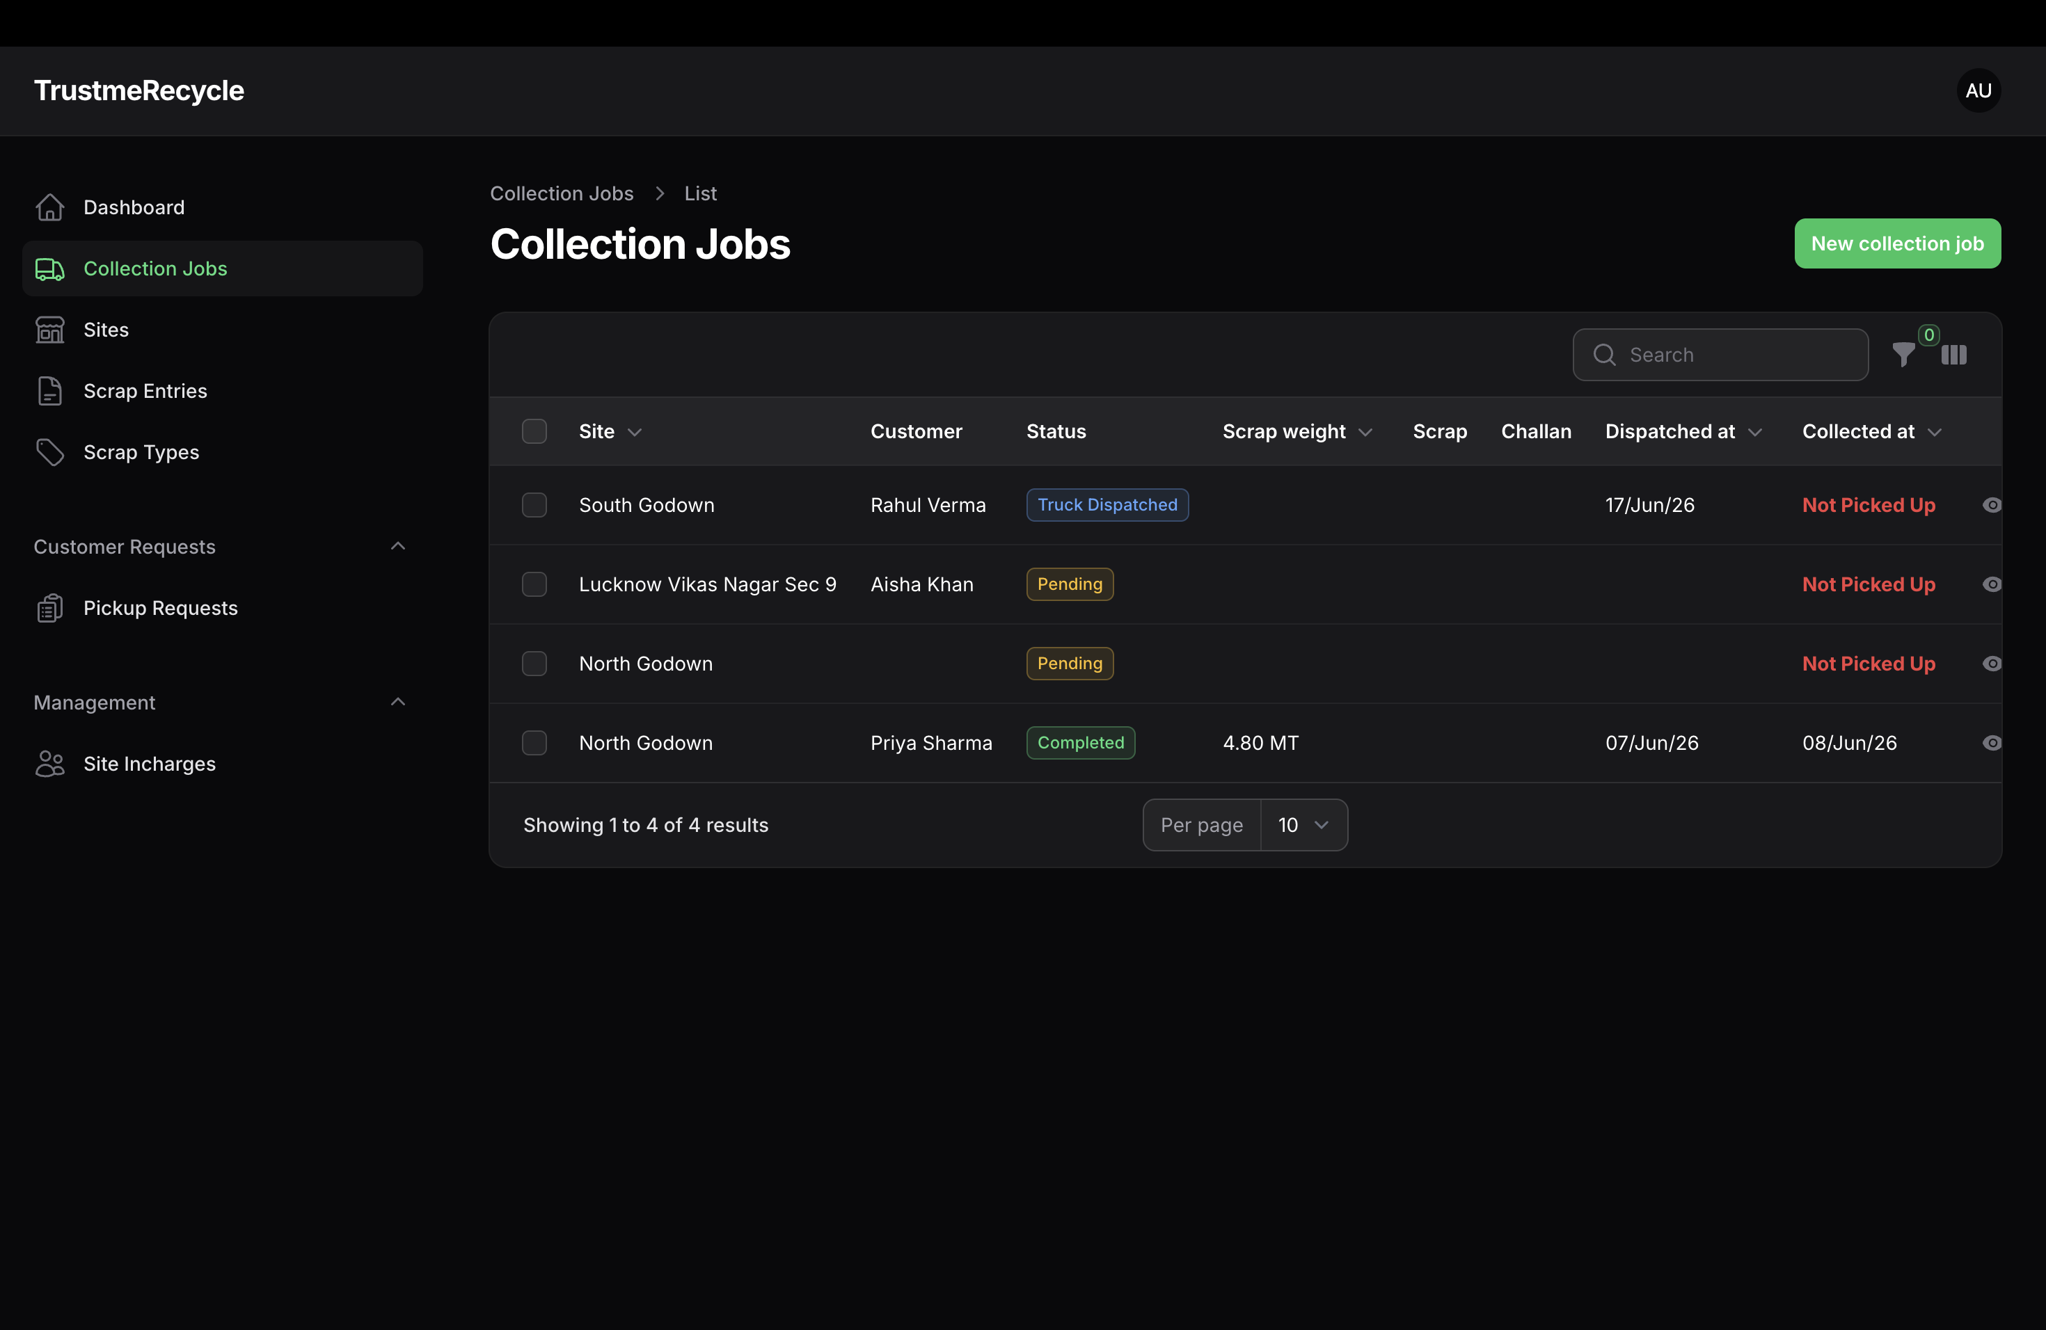
Admin Panel — Collection Job Tracking
Dispatch trucks, assign drivers, track scrap weight collected — full end-to-end job lifecycle
Live data · South Godown: Truck Dispatched · North Godown: Completed 4.80 MT · 2× Pending pickup · 'Not Picked Up' alert triggers follow-up

Slide 8
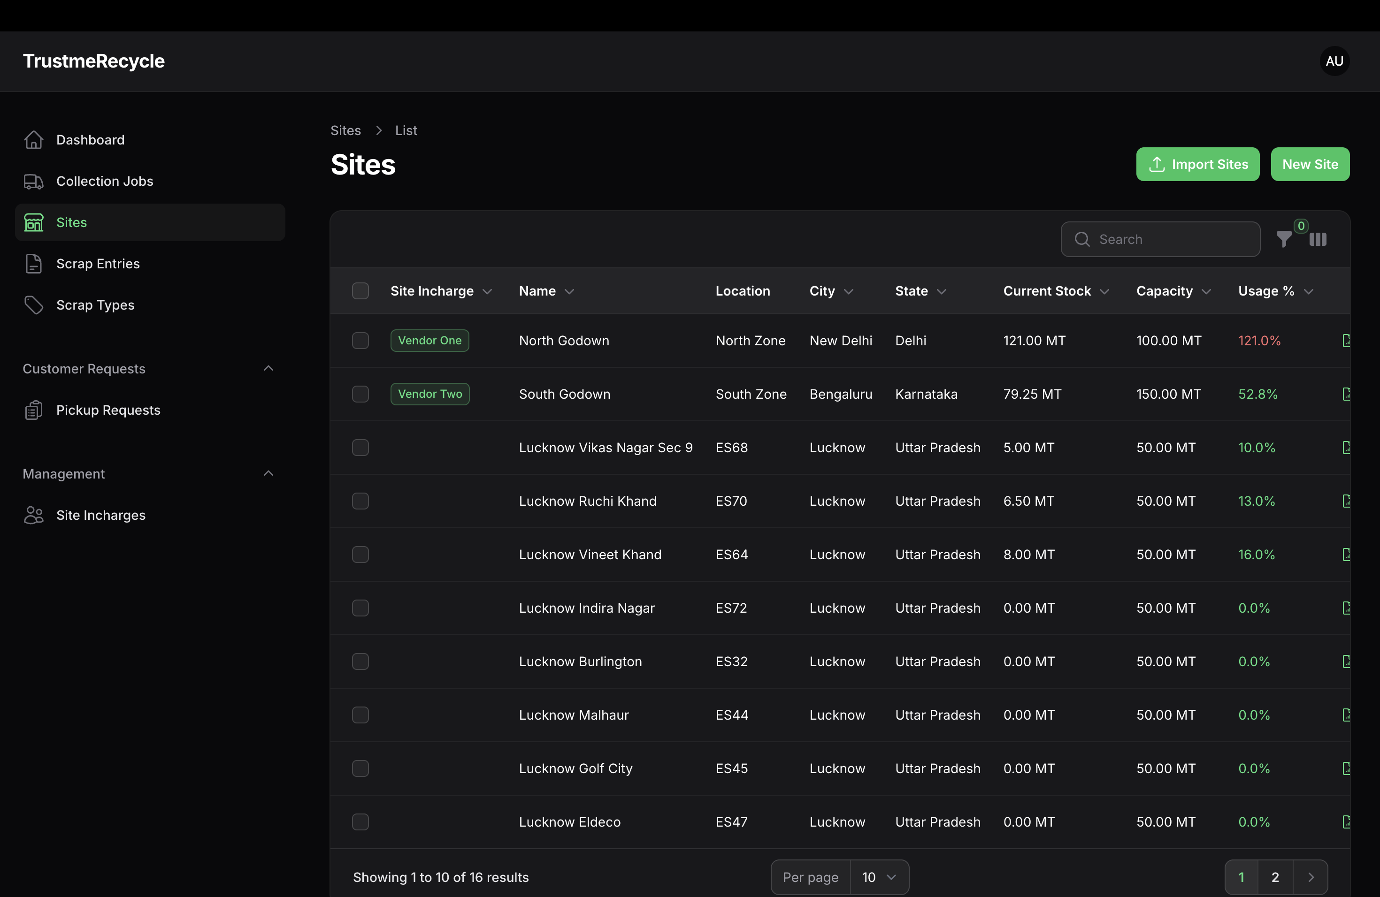
Admin Panel — Real-Time Site Capacity Monitoring
16 active godown sites across Delhi, Bengaluru & Lucknow — automated overflow alerts when capacity exceeds 100%
Live data · North Godown: 121.0% OVER CAPACITY (alert) · South Godown: 52.8% · Per-site View Report & Dispatch Truck actions

Slide 9

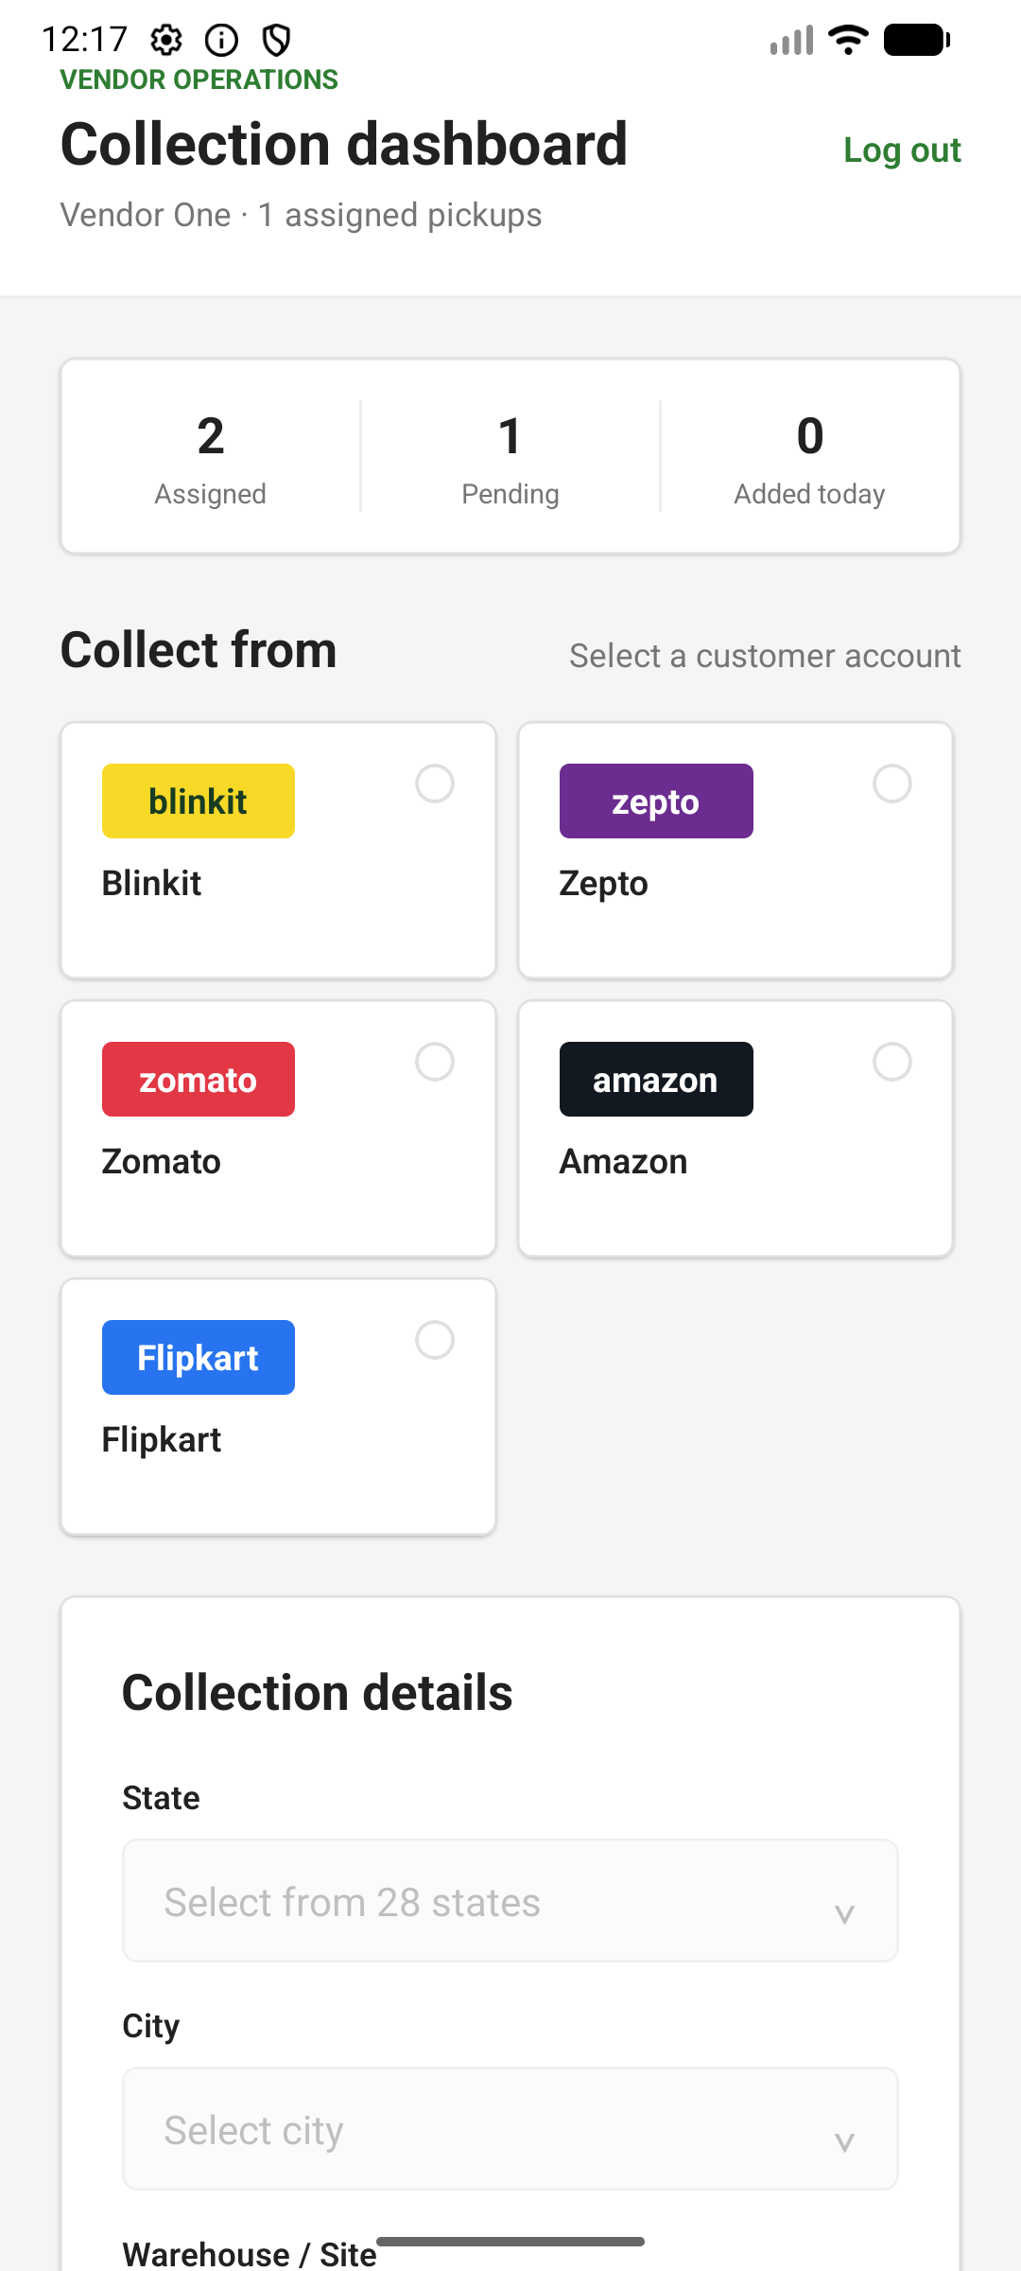
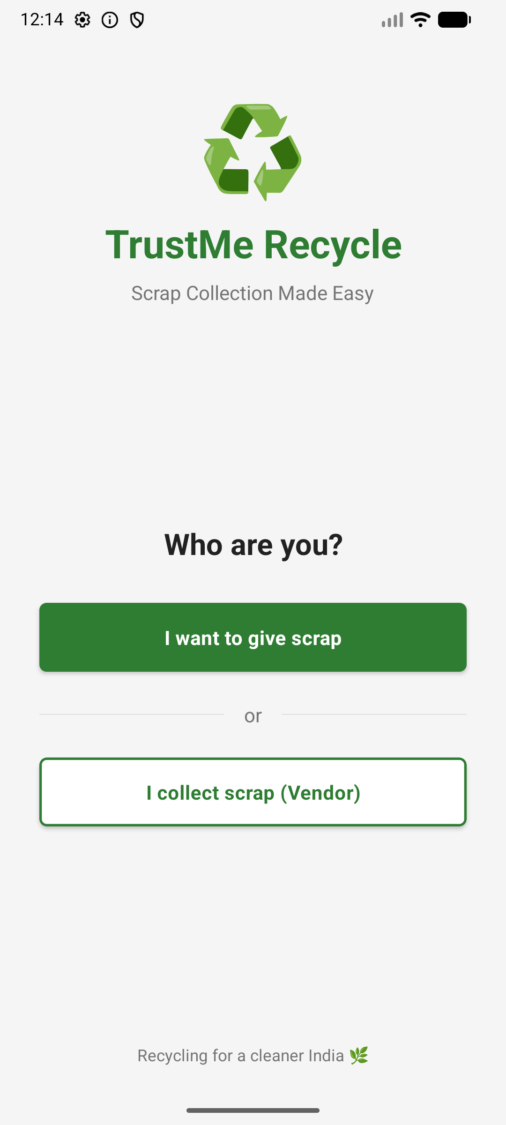
Vendor Mobile App — Role Select & Collection Dashboard
✓ Role-based login
✓ Customer account grid
✓ State › City › Site picker
✓ DONE / PENDING status
✓ Mark as Picked Up
Role Select Screen
Collection Dashboard

Slide 10
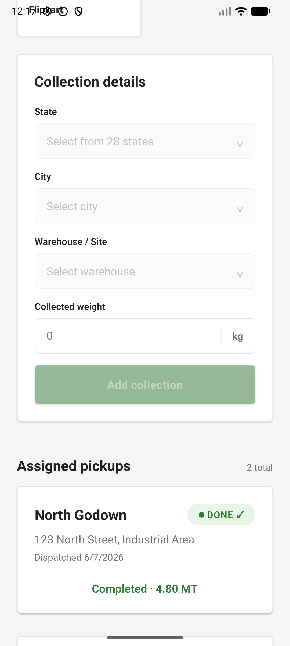
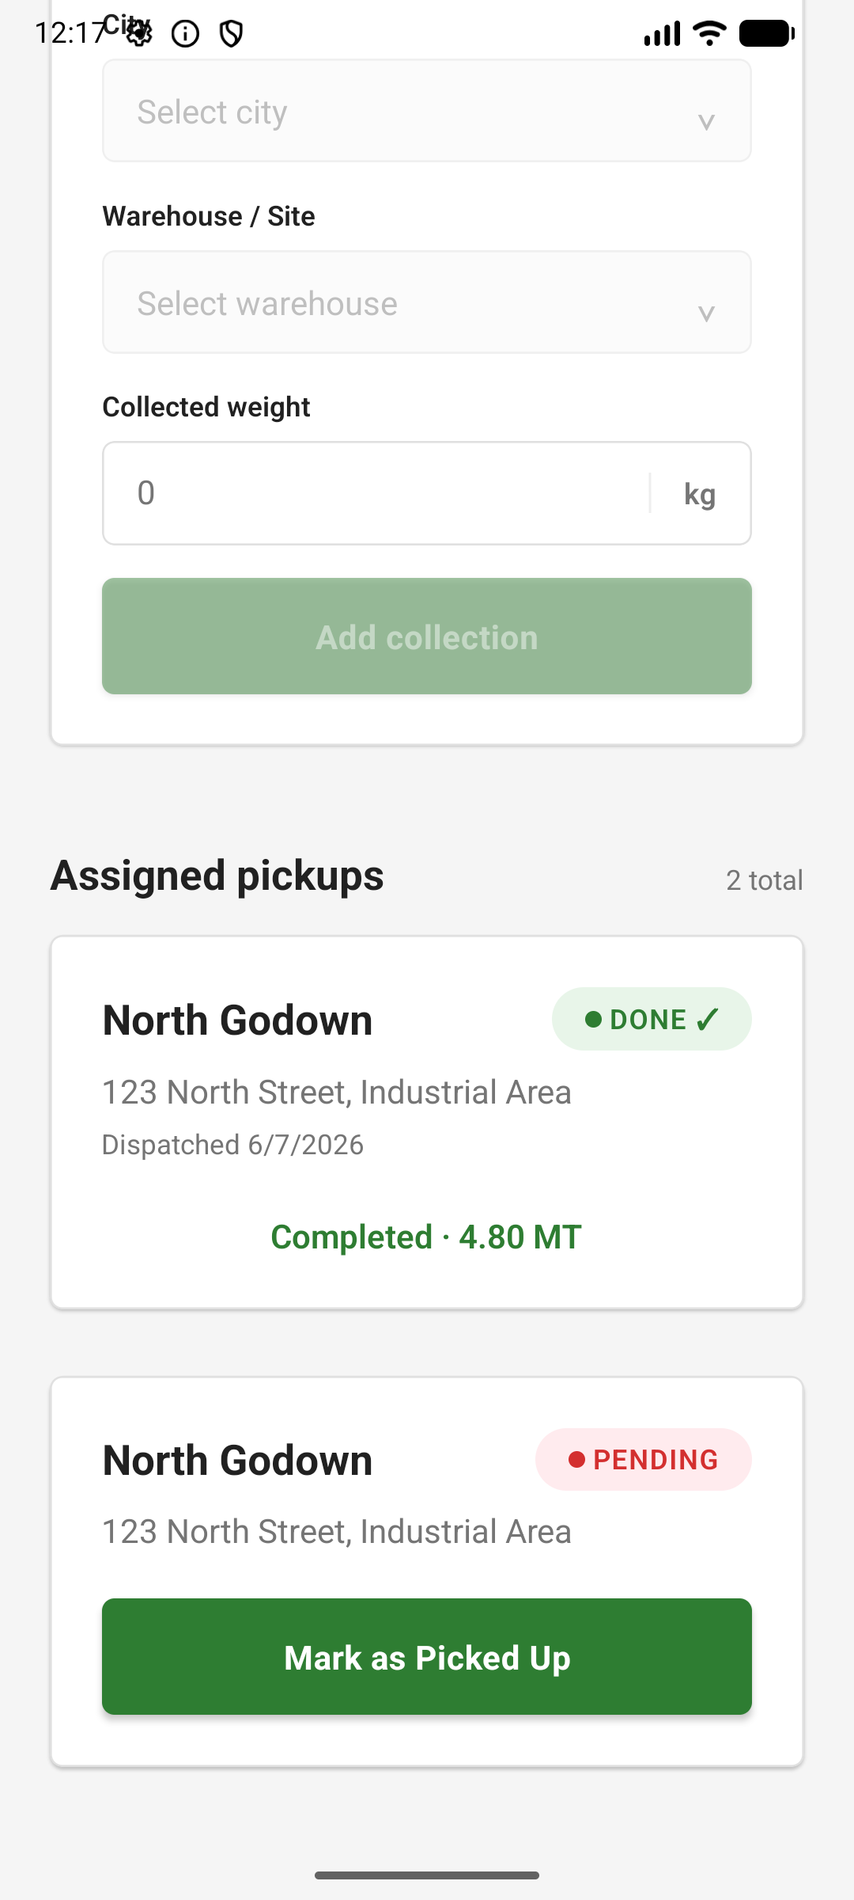
Vendor Mobile App — Assigned Pickups & Job Completion
✓ Role-based login
✓ Customer account grid
✓ State › City › Site picker
✓ DONE / PENDING status
✓ Mark as Picked Up
Assigned Jobs List
Mark as Picked Up

Slide 11
Product Roadmap
NOW
Q3 2026
Q4 2026
2027
Live
Scale
Intelligence
Marketplace
• Admin + vendor web panels
• Customer analytics dashboard
• Route optimization engine
• Open marketplace pricing
• Customer mobile app (iOS/Android)
• Push notifications (FCM)
• Predictive capacity alerts
• Carbon credit tracking
• 14-site godown network
• Multi-language support (Hindi)
• QR-coded challan generation
• Government EPR reporting
• Photo-proof collection flow
• Bulk godown import/export
• Customer invoicing module
• Third-party vendor onboarding
• Excel/PDF reporting
• Vendor performance scoring
• WhatsApp bot integration
• Pan-India expansion

Slide 12
♻
Let's Build a Cleaner India
Together.
🌐 trustmerecycle.in
📧 admin@trustmerecycle.com
© 2026 TrustMeRecycle · Scrap Collection Made Easy
Building the backbone of India's circular economy

