Slide 1
FULL-STACK ACADEMIC RESOURCE PLATFORM
Study Notes Sharing System
A centralized web platform for students to upload, organize, search, and download academic notes and reference materials.
Project Domain: Full-Stack Web Development (FSD) | Architecture: MERN Stack (React, Node, Express, MongoDB) | Format: PDF Sharing
Presented by: Student / Project Team • Department of Computer Science & Engineering

Slide 2
01 / BACKGROUND & MOTIVATION
Problem Statement
Challenges with conventional note-sharing habits among university students.
Fragmented Channels
• Unorganized Platforms: Students heavily rely on WhatsApp groups, Telegram channels, and scattered emails.
• Lost Links: Google Drive links expire, get buried in chat feeds, or lose access permissions.
• Lack of Indexing: Files are shared with arbitrary names with no metadata regarding semester or subject.
Student Friction
• Repeated Requests: Students repeatedly ask for the same materials right before tests and semester exams.
• Search Inefficiency: Finding specific syllabus units requires manually scrolling through hundreds of messages.
• Version Inconsistency: Old, outdated syllabus notes circulate without clear author or date attribution.
Proposed Solution
• Centralized Hub: A single, dedicated portal where academic resources are preserved across batches.
• Structured Catalog: Standardized categorization by Degree, Semester, Subject, and Unit.
• Fast Self-Service: Students can search, filter, preview, and download documents in seconds.

Slide 3
02 / GOALS & SCOPE
Project Objectives
Core capabilities designed to simplify peer-to-peer academic resource distribution.
1. Secure Access & User Authentication
• Identity Management: Enable students to sign up with institute emails and securely authenticate via JWT.
• Role-Based Privileges: Ensure verified students can upload notes and manage only their own submissions.
2. Structured Note Uploading
• Multi-attribute Tagging: Capture Title, Subject, Semester, and Course details during document upload.
• Standardized Format: Support PDF documents with file size checks and persistent storage.
3. High-Speed Discovery & Retrieval
• Multi-filter Search: Filter materials by semester and subject or search by keyword queries.
• Direct File Access: Provide instant one-click downloads directly to the student's device.
4. User Dashboard & Management
• Personal Dashboard: Track all notes uploaded by the logged-in student in a clear view.
• Full Lifecycle Control: Allow users to delete or update obsolete files to keep content fresh.

Slide 4
03 / ARCHITECTURE DESIGN
Three-Tier Client-Server Architecture
Clean separation of presentation, business logic, and persistent storage layers.
Frontend (React.js)
• Single Page Application: Built with React.js for fast, interactive client-side rendering.
• Component Hierarchy: Modular components for Auth, Browse Feed, Upload Form, and User Dashboard.
• State & API Client: Axios client handling REST endpoints with JWT authorization headers.
Backend (Node & Express)
• RESTful API: Express.js server handling routing, controllers, and error handling.
• JWT Authentication: Middleware for protected routes and token verification.
• Multer File Middleware: Validates incoming PDF payloads before delegating to storage.
• Query Engine: Filters notes from MongoDB based on subject, semester, and search query.
Storage & Database
• MongoDB Database: Stores structured collections for Users (credentials) and Notes (metadata & paths).
• Document Isolation: Binary PDF files are stored in dedicated local filesystem or Cloudinary storage.
• URL Mapping: MongoDB keeps lightweight document URLs, ensuring fast database queries.

Slide 5
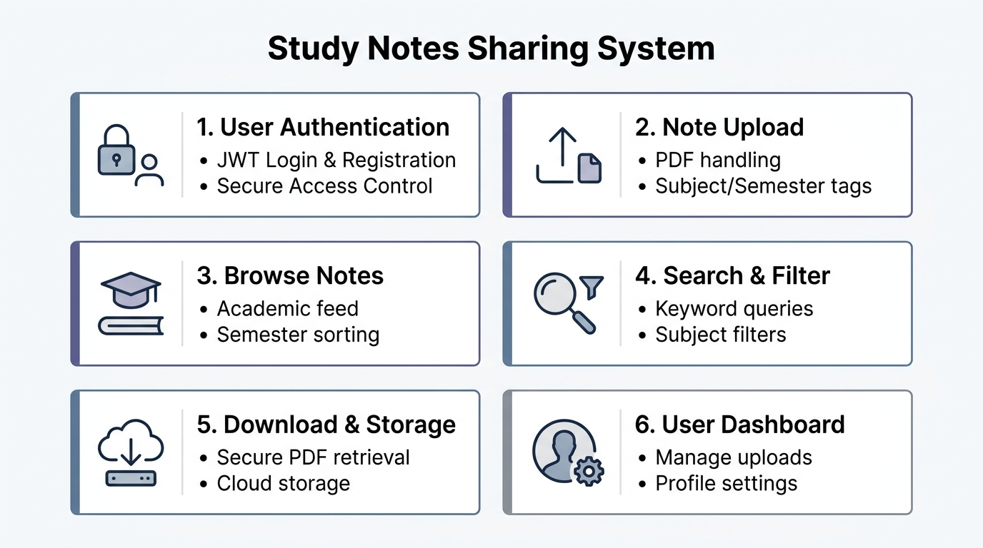
04 / SYSTEM DECOMPOSITION
The 6 Core Functional Modules
Decoupled architecture split into 6 dedicated components for scalability.

Slide 6
05 / FUNCTIONAL BREAKDOWN
Module Specifications (Part 1)
Detailed technical breakdown of user onboarding, upload, and browsing modules.
Module 1: Authentication
• User Registration: Collects student name, email, semester, and secure password.
• Password Hashing: Uses BCrypt salted hashing before persisting to MongoDB.
• JWT Sessions: Signs JSON Web Tokens upon login for stateless, secure API verification.
• Route Guards: Frontend ProtectedRoute blocks unauthenticated access to upload and dashboard.
Module 2: Note Upload
• Metadata Form: Requires Title, Subject name, Semester number, and short description.
• File Validation: Strict MIME-type checking ensures only valid PDF documents are accepted.
• Multipart Processing: Multer handles multipart/form-data streaming efficiently.
• Record Creation: Associates file path and upload timestamp with logged-in user's ID.
Module 3: Browse Notes
• Academic Catalog: Visual grid displaying note cards with subject badges and semester tags.
• Uploader Attribution: Displays who shared the notes and the date of upload.
• Responsive Grid: Adapts cleanly across desktop monitors, tablets, and mobile devices.
• Quick Preview: Provides summary view and direct action buttons for reading and downloading.

Slide 7
05 / FUNCTIONAL BREAKDOWN
Module Specifications (Part 2)
Detailed technical breakdown of search, retrieval, and dashboard management modules.
Module 4: Search & Filter
• Keyword Querying: Backend searches note titles and descriptions using case-insensitive regex.
• Semester Dropdown: Instant filtering to isolate materials relevant to the student's current term.
• Subject Filter: Narrow down results to specific courses (e.g., Data Structures, DBMS).
• Dynamic State: React state updates the feed instantly without reloading the entire page.
Module 5: Download & Storage
• Direct Retrieval: Provides one-click direct file streaming with original filename preservation.
• Storage Layer: Supports local folder storage in development and Cloudinary/S3 in production.
• Bandwidth Optimization: Metadata queried first; raw binary PDF is fetched only on download click.
• Access Reliability: Generates safe, sanitized URLs preventing path traversal attacks.
Module 6: Dashboard & Mgmt
• My Uploads Tab: Dedicated student view showing all documents they personally contributed.
• Self-Deletion: Author can delete obsolete notes; API enforces ownership check before delete.
• Profile Overview: Displays student's enrolled semester, email, and upload count.
• Clean Resource Pruning: Deleting a record removes both the MongoDB entry and the stored PDF file.

Slide 8
06 / DATABASE DESIGN
MongoDB Data Schema
Normalized NoSQL document structures designed for high read efficiency.
User Schema (users collection)
• _id: ObjectId — Unique primary key auto-generated by MongoDB.
• name: String (Required) — Student's full name.
• email: String (Required, Unique) — Academic / personal email address.
• password: String (Required) — Salted BCrypt password hash.
• semester: Number / String — Current academic term of the student.
• createdAt: Date — Account registration timestamp.
• Design Rationale: Passwords are never stored in plaintext. Strict indexing on email prevents duplicate registrations.
Note Schema (notes collection)
• _id: ObjectId — Unique identifier for each note.
• title: String (Required) — Topic or chapter title (e.g. Unit 3 Trees).
• subject: String (Required) — Course name or subject code.
• semester: Number / String (Required) — Relevant semester (1 to 8).
• description: String — Brief summary or syllabus topics covered.
• fileURL: String (Required) — Relative or CDN link to stored PDF file.
• uploadedBy: ObjectId (ref: User) — Foreign key linking to the uploader.
• createdAt: Date — Upload timestamp for recency sorting.

Slide 9
07 / API DESIGN
RESTful Endpoints & Contracts
Standardized HTTP routes facilitating seamless communication between React and Express.
Method | Endpoint Route | Functionality & Purpose | Access Type
POST | /api/auth/register | Registers a new student account with validated details | Public
POST | /api/auth/login | Authenticates credentials and returns signed JWT token | Public
GET | /api/notes | Fetches notes with query params (?subject, ?semester, ?search) | Public
POST | /api/notes | Handles multipart upload of PDF document and metadata | Protected (JWT)
GET | /api/notes/:id | Fetches detailed metadata and download URL for a note | Public
DELETE | /api/notes/:id | Deletes note record and removes associated PDF from storage | Protected (Owner)

Slide 10
08 / SYSTEM WORKFLOWS
End-to-End User Workflows
Sequential operation flows for primary user interactions.
Workflow A: Uploading a Note
• Step 1: Authentication: Student logs into the portal and navigates to the 'Upload Note' section.
• Step 2: Form Input: Student selects a PDF file and inputs Title, Subject, Semester, and Description.
• Step 3: Client Dispatch: React packages the form data into a multipart FormData request with JWT.
• Step 4: Server Processing: Express verifies the JWT token, and Multer saves the PDF to file storage.
• Step 5: Database Persistence: Note metadata and generated file URL are stored in MongoDB.
• Step 6: UI Update: Frontend receives a success response and updates the student's dashboard.
Workflow B: Finding & Downloading Notes
• Step 1: Explore Catalog: Student opens the 'Browse Notes' page to see recent contributions.
• Step 2: Query / Filtering: Student enters a keyword or filters by specific Semester and Subject.
• Step 3: API Query Execution: Express backend queries MongoDB with criteria and returns matching notes.
• Step 4: Card Display: Matching note cards render with author name, semester badge, and date.
• Step 5: File Download: Student clicks 'Download', and the PDF is streamed directly to their local drive.
• Step 6: Offline Use: The document is immediately available for offline studying.

Slide 11
09 / IMPLEMENTATION STACK
Technology Stack
Standard, robust full-stack technologies chosen for stability and rapid development.
Frontend
• React.js: Component-based SPA framework for dynamic, re-rendering UI.
• CSS3 / Vanilla CSS: Modular styling without unnecessary heavy framework dependencies.
• Axios: Promise-based HTTP client for API calls.
• React Router: Declarative client-side routing and protected routes.
Backend
• Node.js: Asynchronous, event-driven runtime environment.
• Express.js: Fast, unopinionated REST API framework.
• Multer: Middleware for handling multipart/form-data file uploads.
• CORS & Dotenv: Cross-origin resource sharing and environment management.
Database & File
• MongoDB: Flexible, scalable NoSQL document database.
• Mongoose: Object Data Modeling (ODM) library for schema validation.
• Local / Cloudinary: Persistent document storage for PDF attachments.
• Database Indexing: Optimized queries on subject and semester fields.
Security & Tools
• JWT (JsonWebToken): Stateless, cryptographically signed token auth.
• BCrypt.js: Secure password hashing algorithm with salt rounds.
• Git & GitHub: Version control and collaborative repository hosting.
• Postman: API endpoint testing and documentation.

Slide 12
10 / ROADMAP & CONCLUSION
Future Enhancements & Conclusion
Key project takeaways and future feature iterations.
Future Enhancements
• Ratings & Peer Reviews: Enable students to rate helpful notes (1 to 5 stars) and leave comments.
• Admin Moderation Panel: Equip college faculty/admins with tools to review, approve, or flag notes.
• Bookmark / Favorites: Allow students to bookmark essential study materials for quick exam revision.
• AI-Powered Summaries: Integrate automated summarization and auto-generated keyword tags for uploaded PDFs.
• Progressive Web App (PWA): Add offline caching and mobile installability for on-the-go studying.
Project Summary & Conclusion
• Key Achievement: Replaced messy messaging links with a structured, centralized academic notes repository.
• Engineering Learning: Successfully implemented complete MERN stack concepts: Auth, REST APIs, CRUD, and file streaming.
• Clean Architecture: Modular 6-module architecture guarantees high maintainability and easy future extensions.
• Practical Impact: Directly saves student study hours and preserves high-quality course notes across semesters.
• Thank You: Questions, comments, and feedback are welcome!

