Slide 1

MIT Art Design and Technology University
MIT Art Design and Technology University, Pune
MIT School of Computing, Pune Department of Computer Science and Engineering
Lab Manual
Subject - Artificial Intelligence and Machine Learning Lab
Class - T.Y. (SEM-I), Core
Name of the Course Coordinator Prof. Swati Powar
Team Members
Prof. Dr. Suvarna Pawar Prof. Dr. Rajendra Pawar Prof. Shilpa Dhopate
A.Y 2025-26

Slide 2
MIT Art Design and Technology University, Pune
AI and ML Lab SEMESTER – V
Course Code: |  | Course Credits: | 1
Teaching Hours / Week (L: T: P): | 0:0:2 | CA Marks:
Total Number of Teaching Hours: | 15 | END-SEM Marks:
Prerequisites: Basic knowledge of programming
Companion Course: Programming in Python
Course Objectives: Understand core Al concepts and algorithms, including search and problem- solving techniques. Learn knowledge representation and reasoning methods for intelligent systems. Grasp key ML concepts, including supervised, unsupervised, and reinforcement learning. Build and evaluate ML models using programming, data analysis, and validation. Apply Al/ML techniques to real-world problems through hands-on and project- based learning.
Course Outcomes: After completing this course, students should be able to: Understand key concepts and algorithms in Artificial Intelligence, including search and game-playing. Apply knowledge representation and reasoning techniques in Al systems. Explain the fundamentals of Machine Learning, including key learning types and techniques. Implement and evaluate ML algorithms like regression, decision trees, SVMs, and deep learning. Apply Al and ML models to solve real-world problems using practical tools and datasets.
Learning Resources
Text Books: Python Machine Learning" by Sebastian Raschka, Hands-On Machine Learning with Scikit-Learn, Keras, and TensorFlow" by Aurélien Géron, a Deep Learning with Python" by François Chollet.
Reference Books: "Python Machine Learning" by Sebastian Raschka and Vahid Mirjalil Advanced Deep Learning with TensorFlow 2and Keras" by Rowel Atienza:

Slide 3
MIT Art Design and Technology University, Pune
Sr. No. | Name of Experiment/Assignment | CO
1 | Write a Program to Implement Breadth First Search. | CO1, CO2
2 | Write a program to implement A* Algorithm | CO1, CO2
3 | Write a program to implement Tic-Tac-Toe game | CO1, CO2
4 | Demonstrate the use of basic python libraries such as Math, NumPy and Scipy Pandas and Matplotlib for implementation on any dataset. | CO1, CO3
5 | Set up and configure a machine learning environment using Anaconda and Jupiter notebook, and Write a basic Python Program to perform Arithmetic and statistical calculations(Mean , median, standard deviation) | CO1, CO3
6 | Download a dataset from UCI or other open repositories and perform basic data processing using python /R including handling missing values, encoding and normalization | CO4, CO5
7 | Use the breast cancer dataset from UCI repository or sklearn datasets to build binary classifier with logistic regression. Evaluate using accuracy, confusion matrix and ROC curve | CO4, CO5
8 | Implement and evaluate a Bayesian classifier on the IRIS dataset and analyse performance using Accuracy, Confsion Matrix, Precision and Recall | CO4, CO5
9 | Implement K means clustering algorithm on multidimensional dataset from UCI repository and analyse the performance using Silhouette Score and cluster visualization | CO4, CO5
10 | Use Wine dataset or IRIS dataset. Apply PCA to reduce features to 2D, then visualize clustering using K- means. Analyze how well PCA preserved cluster separation | CO4, CO5

Slide 4
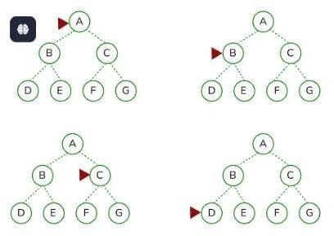
MIT Art Design and Technology University, Pune
Assignment No. 1 | Assignment Date:
Title: Write a Program to Implement Breadth First Search. | Submission Date:
Problem Statement: Write a Program to Implement Breadth First Search.
Theory: A) What is Breadth-First Search? The Breadth-First Search is a traversing algorithm used to satisfy a given property by searching the tree or graph data structure. It belongs to uninformed or blind search AI algorithms as It operates solely based on the connectivity of nodes and doesn't prioritize any particular path over another based on heuristic knowledge or domain-specific information. it doesn't incorporate any additional information beyond the structure of the search space. It is optimal for unweighted graphs and is particularly suitable when all actions have the same cost. Due to its systematic search strategy, BFS can efficiently explore even infinite state spaces. The graph structure of BFS allows to work as follows: BFS for AI- Originally it starts at the root node, then it expands all of its successors, it systematically explores all its neighbouring nodes before moving to the next level of nodes. ( As shown in the above image, It starts from the root node A then expands its successors B) This process of extending the root node’s immediate neighbours, then to their neighbours, and so on, lasts until all the nodes within the graph have been visited or until the specific condition is met. From the above image we can observe that after visiting the node B it moves to node C. when the level 1 is completed, it further moves to the next level i.e 2 and explore node D. it will move systematically to node E, node F and node G. After visiting the node G it will terminate. Key Features of BFS Level-by-Level Exploration: BFS explores all nodes at the same depth before proceeding to deeper levels. Optimality: BFS guarantees the shortest path in an unweighted graph when the solution lies in the shallowest level. Completeness: If a solution exists, BFS will find it.

Slide 5
MIT Art Design and Technology University, Pune
Space Complexity: BFS uses a queue to store nodes, leading to potentially high space complexity, especially in wide graphs. Time Complexity: O(V+E), where V is the number of vertices and E is the number of edges. s the right side node i.e C then F and and then G. After exploring the node G. All the nodes are visited. It will terminate.
Acceptance Criteria: (list of scenarios to be completed in solution for completing assignments)
 | Sr. No. | Acceptance Criteria | Remarks Instructor (completed/ Not completed)
 | 1 | Problem Statement & Objectives
 | 2 | Graph Representation
 | 3 | Correct Implementation of BFS
 | 4 | Input/Output Requirements
 | 5 | Complexity Analysis
Algorithm with complexity analysis: Steps of BFS Algorithm: Initialization: Create a queue to store the nodes to be visited. Mark the starting node as visited and enqueue it. Process the Queue: While the queue is not empty: Dequeue the front element (the current node). Visit the node and process it (for example, print it or store it). For each unvisited neighbor of the current node: Mark it as visited and enqueue it. Termination: The algorithm terminates when all nodes reachable from the starting node have been visited. BFS Pseudocode: BFS(graph, start): create a queue Q create a set visited enqueue start into Q mark start as visited while Q is not empty: current_node = dequeue Q process current_node for each neighbor of current_node: if neighbor is not in visited: enqueue neighbor into Q

Slide 6
MIT Art Design and Technology University, Pune
mark neighbor as visited
Time Complexity Analysis:
Vertices (V): Let the number of vertices in the graph be V.
Edges (E): Let the number of edges in the graph be E. BFS performs the following operations:
Enqueue/Dequeue Operations: Each node is enqueued and dequeued exactly once. This takes O(1)
time per operation. Thus, for V vertices, this contributes O(V).
Processing the Edges: For each node, BFS checks all its neighbours (edges). If each edge is examined exactly once, this contributes O(E)) time.
Thus, the overall time complexity of BFS is: O(V+E)
This is because each node is processed once, and each edge is processed once. Space Complexity Analysis:
The space complexity of BFS is determined by:
Queue: In the worst case, the queue can hold all the vertices of a particular level. In a graph with V vertices, this would require O(V) space.
Visited Set: We need to store information about which nodes have been visited. This requires O(V) space.
Thus, the overall space complexity of BFS is:O(V)

Slide 7
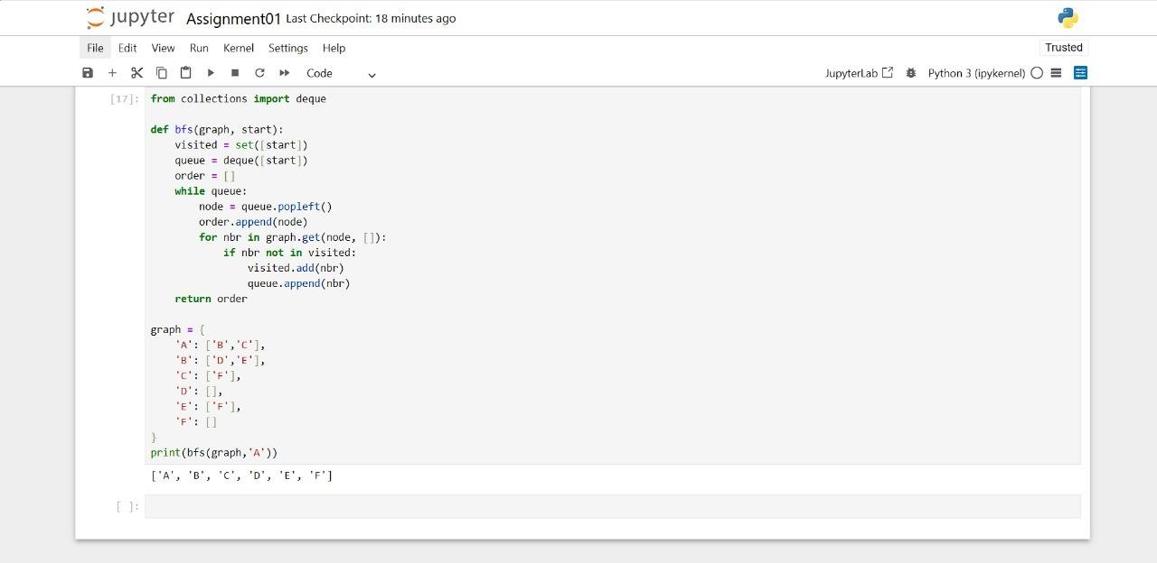
BFS:

Slide 8
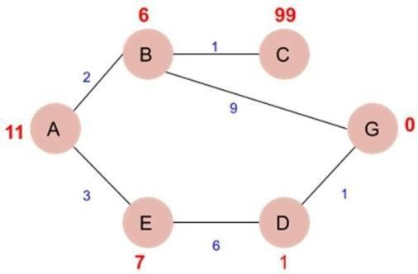
MIT Art Design and Technology University, Pune
Assignment No. 2 | Assignment Date:
Title: Write a program to implement A* Algorithm | Submission Date:
Problem Statement: Write a program to implement A* Algorithm
Theory: The A* algorithm is one of the most popular and widely used pathfinding and graph traversal algorithms, particularly in artificial intelligence and robotics. It is an informed search algorithm, meaning it uses heuristic information to guide its search more efficiently than uninformed methods like Breadth-First Search (BFS) or Depth-First Search (DFS). A* is especially powerful because it combines the advantages of Dijkstra's algorithm (which guarantees the shortest path) with the efficiency of Greedy Best-First Search (which uses heuristics to guide the search). Objective To find the shortest path from a start node to a goal node in a weighted graph, while minimizing the total cost. Key Concepts A* uses three main cost functions: g(n): The cost from the start node to the current node nnn. h(n): The heuristic estimated cost from node nnn to the goal. (Must be admissible — never overestimates the actual cost.) f(n): The total estimated cost of the path through node nnn, defined as: f (n)=g(n)+h(n) Consider the following graph below. The numbers written on edges represent the distance between the nodes, while the numbers written on nodes represent the heuristic values. Let us find the most cost-effective path to reach from start state A to final state G using the A* Algorithm. Let’s start with node A. Since A is a starting node, therefore, the value of g(x) for A is zero, and from the graph, we get the heuristic value of A is 11, therefore g(x) + h(x) = f(x) 0+ 11 =11 Thus for A, we can write A=11

Slide 9
MIT Art Design and Technology University, Pune
Now from A, we can go to point B or point E, so we compute f(x) for each of them A → B = 2 + 6 = 8 A → E = 3 + 6 = 9 Since the cost for A → B is less, we move forward with this path and compute the f(x) for the children nodes of B Since there is no path between C and G, the heuristic cost is set to infinity or a very high value A → B → C = (2 + 1) + 99= 102 A → B → G = (2 + 9 ) + 0 = 11 Here the path A → B → G has the least cost but it is still more than the cost of A → E, thus we explore this path further A → E → D = (3 + 6) + 1 = 10 Comparing the cost of A → E → D with all the paths we got so far and as this cost is least of all we move forward with this path. And compute the f(x) for the children of D A → E → D → G = (3 + 6 + 1) +0 =10 Now comparing all the paths that lead us to the goal, we conclude that A → E → D → G is the most cost-effective path to get from A to G.
Acceptance Criteria: (list of scenarios to be completed in solution for completing assignments)
 | Sr. No. | Acceptance Criteria | Remarks Instructor (completed/ Not completed)
 | 1 | Problem Statement & Objectives
 | 2 | Graph Representation
 | 3 | Correct Implementation of A*
 | 4 | Input/Output Requirements
 | 5 | Complexity Analysis
Algorithm with complexity analysis: Working of A* Algorithm Initialize the open list (priority queue) with the start node. The open list keeps track of nodes to be evaluated. Initialize the closed list (visited nodes). Repeat the following until the goal is reached or the open list is empty: Select the node n from the open list with the lowest f(n) If n is the goal, return the path. Move n to the closed list. For each neighbor of n: If neighbor is in closed list, skip it. If it's not in open list or has a lower g(n), update its g, h, and f, and set its parent to n.

Slide 10
MIT Art Design and Technology University, Pune
If not in open list, add it.
If the goal is not reached and open list becomes empty, no path exists.
Heuristic Function
The performance and optimality of A* depend on the heuristic function h(n)h(n)h(n). Common heuristics:
  Manhattan Distance: For grid-based maps (no diagonal movement).
  Euclidean Distance: For continuous space or diagonal movement allowed.
  Zero Heuristic: Makes A* behave like Dijkstra’s Algorithm.
A heuristic is admissible if it never overestimates the true cost to reach the goal.
A heuristic is consistent if h(n)≤c(n,n′)+h(n′) for every edge n→n′.
Time and Space Complexity
Let:
  b = branching factor (average number of successors per state)
  d = depth of the optimal solution
  Time Complexity:
In the worst case, A* may expand all nodes in the search space, leading to: O(b^d) But in practice, with a good heuristic, it is much faster.
  Space Complexity:
A* maintains all generated nodes in memory (open and closed lists): O(b^d)

Slide 11
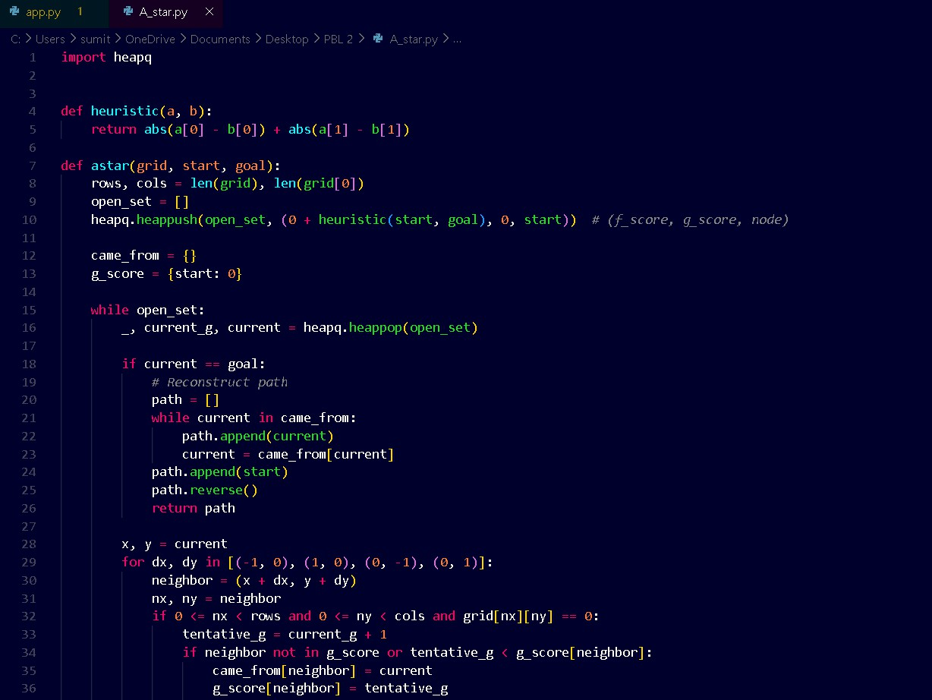
A * Algorithm:

Slide 12
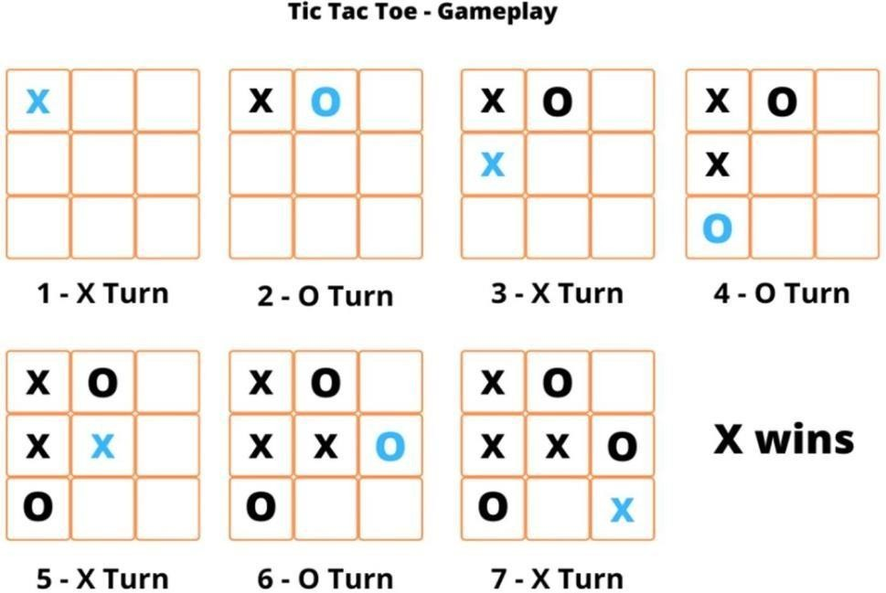
MIT Art Design and Technology University, Pune
Assignment No. 3 | Assignment Date:
Title: Write a program to implement Tic-Tac-Toe game | Submission Date:
Problem Statement: Write a program to implement Tic-Tac-Toe game
Theory: Gaming is one of the entertainments that humans have. We can find different types of games on the web, mobile, desktop, etc. We are not here to make one of those heavy games now. We are going to create a CLI tic-tac-toe game using python. InitializeBoard(): Create a 3x3 grid filled with empty values (e.g., '-') Return the grid DisplayBoard(Board): For each row in Board: Print row elements separated by spaces CheckWin(Board, Player): // Check rows For each row in Board: If all elements in row are equal to Player: Return True // Check columns For col from 0 to 2: If all elements in column col are equal to Player: Return True

Slide 13
MIT Art Design and Technology University, Pune
// Check diagonals
If Board[0][0] == Player AND Board[1][1] == Player AND Board[2][2] == Player:
Return True
If Board[0][2] == Player AND Board[1][1] == Player AND Board[2][0] == Player: Return True
Return False
CheckDraw(Board):
For each cell in Board:
If cell is empty (e.g., '-'): Return
False
Return True
PlayerMove(Boa rd, Player):
While True:
Print "Player", Player, "enter your move as 'row,col':" Input Move (e.g., "1,2")
Parse row and col from Move
If Move is valid AND Board[row][col] is empty: Board[row][col] = Player
B
rea k Els e:
Print "Invalid move. Try again."
PlayTicTacToe():
Board = InitializeBoard() CurrentPlayer = 'X' // Player 'X' starts
While True: DisplayBoard(Boa rd)
PlayerMove(Board, CurrentPlayer)
If CheckWin(Board, CurrentPlayer): DisplayBoard(Board)
Print "Player", CurrentPlayer, "wins!" Break

Slide 14
MIT Art Design and Technology University, Pune
If CheckDraw(Board): DisplayBoard(Board) Print "It's a draw!" Break // Switch player If CurrentPlayer == 'X': CurrentPlayer = 'O' Else: CurrentPlayer = 'X' // Start the game PlayTicTacToe()
Acceptance Criteria: (list of scenarios to be completed in solution for completing assignments)
 | Sr. No. | Acceptance Criteria | Remarks Instructor (completed/ Not completed)
 | 1 | Problem Statement & Objectives
 | 2 | Graph Representation
 | 3 | Correct Implementation
 | 4 | Input/Output Requirements
 | 5 | Complexity Analysis
Algorithm with complexity analysis: We will now discuss the algorithm to write the code. This algorithm will help you to write code in any programming language of your choice. Let’s see how it’s done. Create a board using a 2-dimensional array and initialize each element as empty. You can represent empty using any symbol you like. Here, we are going to use a hyphen. '-'. Write a function to check whether the board is filled or not. Iterate over the board and return false if the board contains an empty sign or else return true. Write a function to check whether a player has won or not. We have to check all the possibilities that we discussed in the previous section. Check for all the rows, columns, and two diagonals. Write a function to show the board as we will show the board multiple times to the users while they are playing. Write a function to start the game. Select the first turn of the player randomly. Write an infinite loop that breaks when the game is over (either win or draw). Show the board to the user to select the spot for the next move. Ask the user to enter the row and column number. Update the spot with the respective player sign. Check whether the current player won the game or not. If the current player won the game, then print a winning message and break the infinite loop. Next, check whether the board is filled or not. If the board is filled, then print the draw message and break the infinite loop. Finally, show the user the final view of the board.

Slide 15
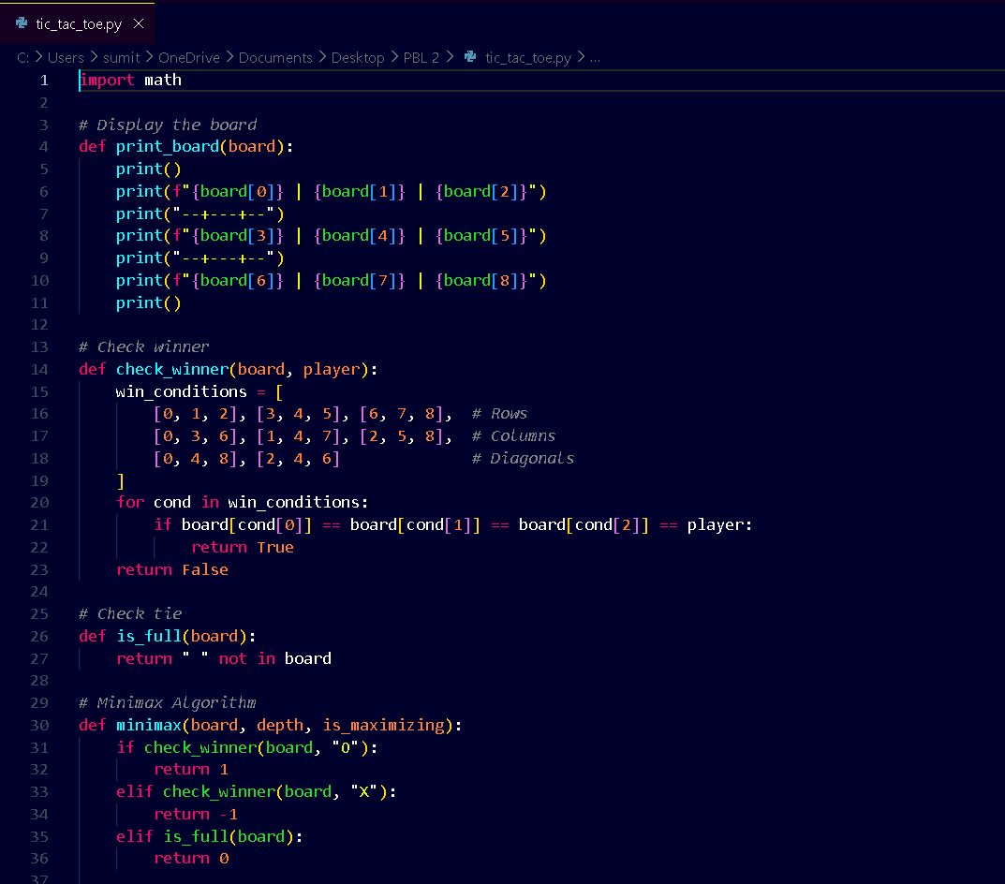
TIC-TAC-TOE:

Slide 16
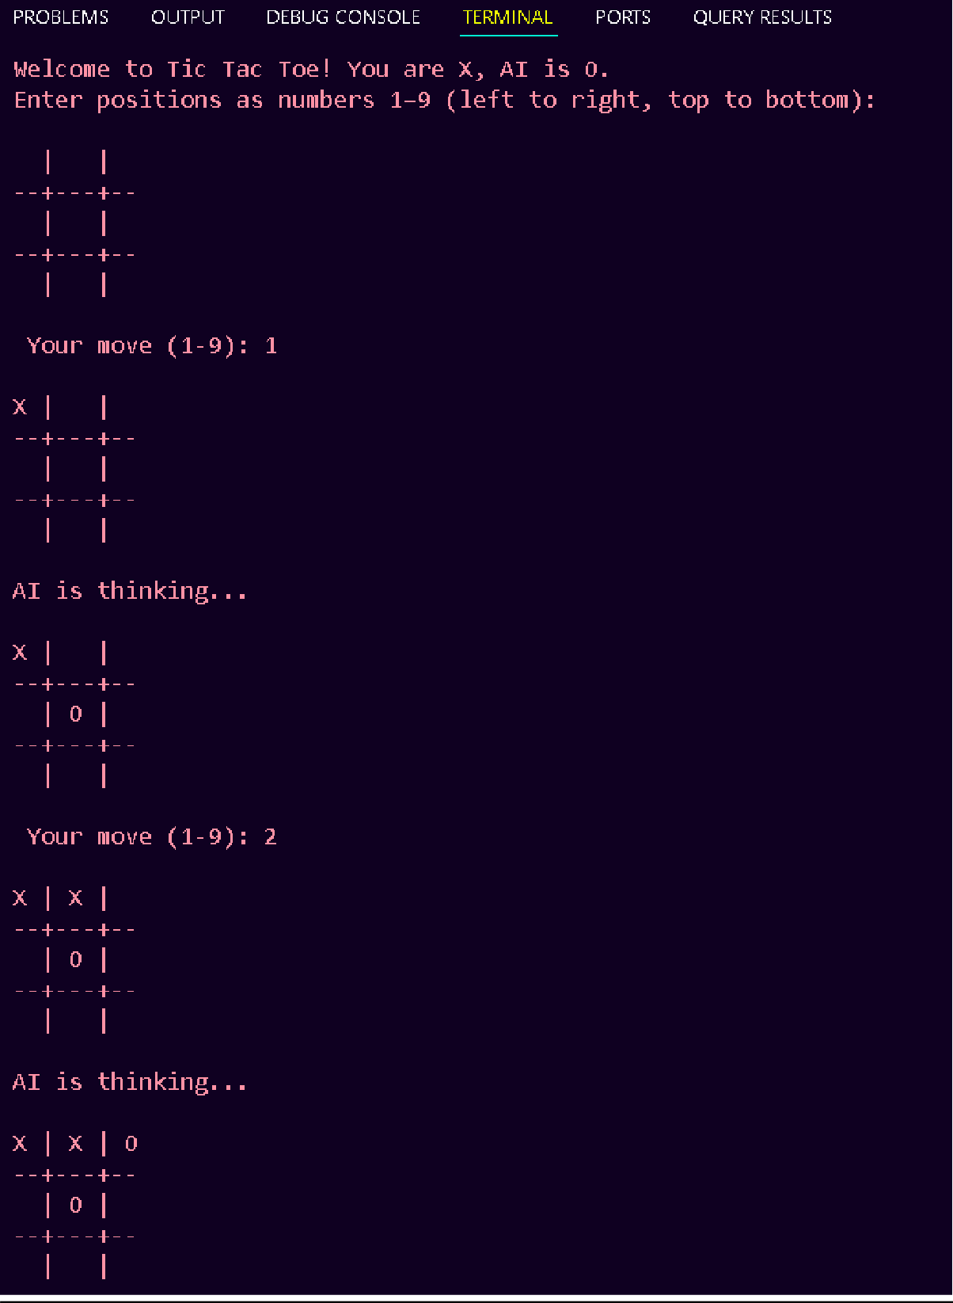

Slide 17
MIT Art Design and Technology University, Pune
Assignment No. 4
Assignment Date:
Title:
Demonstrate the use of basic python libraries such as
Math, NumPy and Scipy
Pandas and Matplotlib for implementation on any dataset.
Submission Date:
Problem Statement:
Demonstrate the use of basic python libraries such as
Math, NumPy and Scipy
Pandas and Matplotlib for implementation on any dataset.
Theory:
Python is a powerful programming language that offers several built-in and third-party libraries for scientific computing, data analysis, and visualization. This experiment aims to introduce and demonstrate the use of fundamental Python libraries in data science:
math
  Built-in Python module.
  Provides functions like square root, factorial, trigonometry, log, etc.
Function Name | Description
ceil(x) | Returns the smallest integral value greater than the number
copysign(x, y) | Returns the number with the value of ‘x’ but with the sign of ‘y’
fabs(x) | Returns the absolute value of the number
factorial(x) | Returns the factorial of the number
floor(x) | Returns the greatest integral value smaller than the number
NumPy (Numerical Python)
  Provides powerful n-dimensional arrays.
  Supports element-wise mathematical operations.
  Useful for linear algebra, statistics, and numerical computations.
Array
Functions
Operations
Array Creation Functions
Array Manipulatio n Functions
Array Mathematical Functions
np.array(), np.zeros(), np.ones(), np.empty(), etc.
np.reshape(), np.transpose(), etc.
np.add(), np.subtract(), np.sqrt(), np.power(), etc.

Slide 18
MIT Art Design and Technology University, Pune
np.media Array Statistical n(), np.mean(), np.std(), and np.var(). Functions Array np.save(), np.load(), np.loadtxt(), etc. Input and Output Functions SciPy (Scientific Python) Built on top of NumPy. Provides functions for integration, optimization, interpolation, eigenvalue problems, and other advanced scientific computations. Pandas Offers data structures like DataFrame and Series. Used for data cleaning, manipulation, and analysis. Allows easy handling of CSV, Excel, and other data formats. Matplotlib Used for data visualization. Can create line charts, bar charts, histograms, scatter plots, etc. pyplot is the most commonly used sub-module
Acceptance Criteria: (list of scenarios to be completed in solution for completing assignments)
 | Sr. No. | Acceptance Criteria | Remarks Instructor (completed/ Not completed)
 | 1 | Problem Statement & Libraries Imported Correctly
 | 2 | Math Module Demonstrated, NumPy Usage, SciPy Usage
 | 3 | Data Preprocessing Done
 | 4 | Data Visualization
 | 5 | Code Execution
Work Flow: Import Libraries Load math, numpy, scipy, pandas, and matplotlib.pyplot. Use Math Functions Demonstrate some math module functions (e.g., factorial, square root, etc.). . Load Data using Pandas Use a sample dataset (e.g., Iris, Titanic, or any .csv file). Preprocess Data View first few records Check for nulls Describe summary statistics Use NumPy and SciPy Perform basic statistics: mean, median, standard deviation using NumPy

Slide 19
MIT Art Design and Technology University, Pune
Use SciPy to compute mode, correlation, or other statistics.
5.Data Visualization using Matplotlib
Plot line graphs, bar charts, or scatter plots.
Conclusion:
This experiment demonstrates how fundamental Python libraries can simplify and accelerate data analysis and scientific computations. Using built-in and third-party libraries like NumPy, SciPy, Pandas, and Matplotlib enables efficient data processing and clear visualizations, which are crucial skills in data science and machine learning.

Slide 20

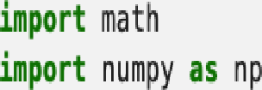
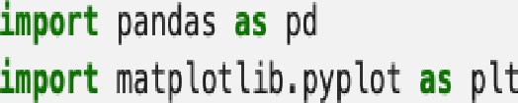
Mp0rt sCİpș• 5tZt5 Bs 5tat5
print(“Factoriat of 5:", math.factoriat(5)) șrírt(“sșvare root of 81:", nate. sqrt(81))
df= pd. read_csv("https://raw.githubusercontent.com/datasciencedooj /datastt5/IíB5ttF/titBMC.CŞV™)
șrírt(“\rFirst 5 rms:\r“, df.heal())
print("\nHi5sing values:\n™, df.isnu1\().sum()) șrírt(“\rSvsnary stüts!\n", Jf.describe())
agt5= čf(“åge™].dropra() print("\n8ear łțe:", np.mean(ages)) șrírt("ŁeJiaa łçe:", rș.zetiar(ages)) șrírt(“Std Dev Age:", rș.std(ages))
print(“Host Common Age (Code):“, stats.mode(ages, Łeepdîss=True) .node(8) )
p1t.figure(figsźze=(6,4)) If("survived"].va1ue_counts().plot(Łind=“Łar™, color=["red™,“green“ì) ș\t.tit\e("Titanic Survival Court")
p1t.x1aŁe1(“5arvived (e= p1t./1aŁe1(“Count") Alt.sšrv()
No, 1= Yes)")
Factorial of 5: 1z0
Squa re root of BI : 9. e
First 5 rows:
Passengerld I |  |  | Survived 8 | Pcłass \ 3
2 |  |  | 1 | I
4
4
0 |  |  | Name Braund, |Hr. Owen Harris |  |  |  | Sex małe | Age Z2.0 | SibSp 1 | \
1 Z 3 | Cum1ng s , N rs. Futretle, |  | Jo hn Bradley ( F1orence Briggs Th... Heikkinen, Miss. Laina Mrs. Jacques Heath (Liły May Peeł) |  |  |  | fema te femałe femałe | 38. e Z6.e 35.0 | 1 e 1
4 |  |  | Ałlen, Mr. William Henry |  |  |  | małe | Z5.0 | 0
 | Parch |  | Ticket Fare Cabin Embarked
Ø | Ø | A/5 21171 |  | 7.25e0 | NaN | S
t | e | Pc 17s98 |  | T1.2s8a | c8s | c
2 | Ø | ST0N/02. 31 ł1282 |  | 7. 9250 | NaN | S
3 | 0 | I138B3 |  | 53. 1e00 | C123 | S
4 | e | aT84se |  | B. esee | NaN | S
His s ing va Sues :
Pas sengerl d Su rvived Pctass
Name Sex Age SibSp Parch Ticket Fare Cabin
Embarked
dtype: int64
e e 0 O
e
177
0
e e O
687
2

Slide 21
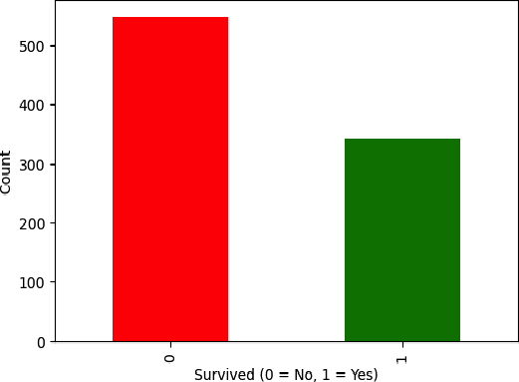
Summary stats :
Passenge rid Survived Pctass Age 5ibSp \
count 891.000fififi 891.000fififi 891.000fififi 714.000fififi 891. fi000fifi
mean | 446.000888 | 8.383838 | 2.308642 | 29.6gg118 | e.523088
std | 257.353842 | fi.486592 | fi.836fi71 | 14.526497 | 1.192743
mTn | I. 888888 | 8. 888888 | I. 888888 | 0. 420000 | 8. 888888
25t | 223. 500fififi | fi.999888 | 2.999888 | 28.125fififi | fi.fi000fifi
SP | 4A6.888888 | 8. 888888 | 3.000000 | GB.888888 | 8. 888888
758 | 668. 599888 | 1. 999888 | 3.999888 | 38.999888 | 1.899988
max | 89a.eee888 | \. eee888 | 3.eee888 | 88.eee888 | 8.8eee88
count | Parch 8g1. eeeeee | Fare 8g1. eeeeee
mean | 8.381594 | 32.2042fi8
std | 0.806057 | 4g.69342g
258 | 8.800088 | 7.g10488
5@ | fi.fi888fifi | 14.4542fifi
758 nax | 8.888888 6.8999fifi | 3s.eeeeee 512.329288
Bean Age: 29. 69911764785882
Nedian Age: 28.8
$td oev Age: :t4.5\6321158817317
Cost Common Age (Hode): 24.8
Titanic Survival Count

Slide 22
MIT Art Design and Technology University, Pune
Assignment No. 5 |  |  |  | Assignment Date:
Title: Set up and configure a machine learning environment using Anaconda and Jupiter notebook, and Write a basic Python Program to perform Arithmetic and statistical calculations(Mean , median, standard deviation) |  |  |  | Submission Date:
Problem Statement: Set up and configure a machine learning environment using Anaconda and Jupiter notebook, and Write a basic Python Program to perform Arithmetic and statistical calculations(Mean , median, standard deviation)
Theory: Task 1: Set Up and Configure a Machine Learning Environment Step-by-Step Instructions Install Anaconda Visit the official website: https://www.anaconda.com/products/distribution Download the version suitable for your operating system (Windows/Linux/Mac). Run the installer and follow the instructions to complete the installation. Launch Anaconda Navigator or Prompt Option 1: Use Anaconda Navigator (GUI). Option 2: Use Anaconda Prompt (Command Line). Create a Virtual Environment (optional but recommended) conda create -n ml_env python=3.10 conda activate ml_env Install Required Packages conda install numpy conda install pandas conda install matplotlib conda install jupyter Launch Jupyter Notebook jupyter notebook This will open a browser window with the Jupyter interface. You can create a new notebook from the "New" dropdown (select "Python 3"). Task 2: Write a Basic Python Program to Perform Arithmetic and Statistical Calculations Objective: To write a Python program that performs: Basic arithmetic operations Statistical computations: Mean, Median, and Standard Deviation
Acceptance Criteria: (list of scenarios to be completed in solution for completing assignments)
 | Sr. No. | Acceptance Criteria | Remarks Instructor (completed/ Not completed)
 | 1 | Anaconda installed, Python environment configured
 | 2 | Arithmetic operations implemented

Slide 23
MIT Art Design and Technology University, Pune
 | 3 | Statistical calculations performed
 | 4 | Code executes without errors
 | 5
Source Code: # Basic Arithmetic and Statistical Calculations import numpy as np # Arithmetic Operations a = 15 b = 4 print("Arithmetic Operations:") print(f"Addition: {a} + {b} = {a + b}") print(f"Subtraction: {a} - {b} = {a - b}") print(f"Multiplication: {a} * {b} = {a * b}") print(f"Division: {a} / {b} = {a / b}") print(f"Modulus: {a} % {b} = {a % b}") print(f"Exponentiation: {a} ** {b} = {a ** b}") print() # Statistical Calculations data = [10, 20, 30, 40, 50] mean = np.mean(data) median = np.median(data) std_dev = np.std(data) print("Statistical Calculations:") print(f"Data: {data}") print(f"Mean: {mean}") print(f"Median: {median}") print(f"Standard Deviation: {std_dev}") # Basic Arithmetic and Statistical Calculations import numpy as np # Arithmetic Operations a = 15 b = 4 print("Arithmetic Operations:") print(f"Addition: {a} + {b} = {a + b}") print(f"Subtraction: {a} - {b} = {a - b}") print(f"Multiplication: {a} * {b} = {a * b}") print(f"Division: {a} / {b} = {a / b}") print(f"Modulus: {a} % {b} = {a % b}")

Slide 24
MIT Art Design and Technology University, Pune
print(f"Exponentiation: {a} ** {b} = {a ** b}") print()
# Statistical Calculations data = [10, 20, 30, 40, 50]
mean = np.mean(data) median = np.median(data) std_dev = np.std(data)
print("Statistical Calculations:") print(f"Data: {data}")
print(f"Mean: {mean}") print(f"Median: {median}")
print(f"Standard Deviation: {std_dev}")
Arithmetic Operations:
Addition: 15 + 4 = 19
Subtraction: 15 - 4 = 11
Multiplication: 15 * 4 = 60
Division: 15 / 4 = 3.75
Modulus: 15 % 4 = 3
Exponentiation: 15 ** 4 = 50625
Statistical Calculations:
Data: [10, 20, 30, 40, 50]
Mean: 30.0
Median: 30.0
Standard Deviation: 14.142135623730951
Conclusion:
In this experiment, we successfully set up a machine learning environment using Anaconda and Jupyter Notebook, which provides a powerful and user-friendly platform for scientific computing and data analysis. We demonstrated the use of basic Python programming to perform both arithmetic and statistical calculations.
Using Python’s built-in capabilities and the NumPy library, we computed key statistical measures such as mean, median, and standard deviation, which are foundational in data science and analytics. This experiment reinforced the understanding of core Python syntax, mathematical operations, and basic data handling—skills essential for progressing into more advanced topics like data preprocessing, visualization, and machine learning.
Thus, this exercise provided a practical foundation for students to begin working with data in Python,
setting the stage for further exploration into AI and machine learning applications.

Slide 25
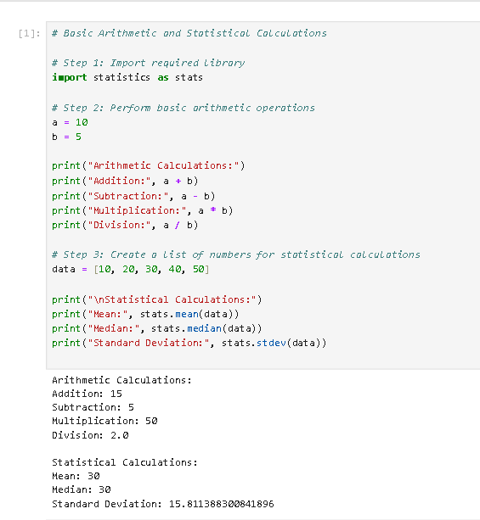
5

Slide 26
MIT Art Design and Technology University, Pune
Assignment No. 6 |  |  |  | Assignment Date:
Title: Download a dataset from UCI or other open repositories and perform basic data processing using python /R including handling missing values, encoding and normalization |  |  |  | Submission Date:
Problem Statement: Download a dataset from UCI or other open repositories and perform basic data processing using python /R including handling missing values, encoding and normalization
Theory: Data preprocessing is a crucial step in the data science and machine learning pipeline. Real-world data is often messy and requires cleaning and transformation to ensure quality input for modeling. Handling Missing Values Why? Machine learning models cannot handle missing data effectively. Techniques: Remove rows/columns with missing values Replace (impute) with mean/median/mode Use more advanced methods (e.g., KNN imputation) Encoding Categorical Variables Why? ML models require numerical inputs. Techniques: Label Encoding: Converts each unique category into an integer. One-Hot Encoding: Creates binary columns for each category. Normalization (Scaling) Why? Features with different scales can bias distance-based models. Techniques: Min-Max Scaling: Scales values between 0 and 1. Standardization: Transforms data to have zero mean and unit variance.
Acceptance Criteria: (list of scenarios to be completed in solution for completing assignments)
 | Sr. No. | Acceptance Criteria | Remarks Instructor (completed/ Not completed)
 | 1 | Dataset sourced from open repository
 | 2 | Missing values identified and handled
 | 3 | Categorical features encoded
 | 4 | Normalization applied
 | 5 | Code is structured and documented
Workflow (Using Python and Pandas/Scikit-learn) Step 1: Download Dataset Example: UCI Iris Dataset or Titanic Dataset Step 2: Load Dataset Use pandas to load .csv file. Step 3: Explore Data View first few rows Check data types

Slide 27
MIT Art Design and Technology University, Pune
Identify missing values Step 4: Handle Missing Values
Use isnull(), fillna(), or dropna() to clean data Step 5: Encode Categorical Variables
Use pd.get_dummies() or LabelEncoder from sklearn
Step 6: Normalize/Scale Features
Use MinMaxScaler or StandardScaler from sklearn.preprocessing
Conclusion:
In this experiment, we successfully performed basic data processing on a real-world dataset from an open- source repository. The steps included:
Handling missing values using imputation techniques,
Encoding categorical features to convert them into numerical format, and
Normalizing numerical features to ensure consistent scales.
These preprocessing steps are essential for preparing data for any machine learning model. By ensuring data quality and consistency, we improve the performance and reliability of analytical models. This exercise builds foundational skills for data cleaning, an integral part of the data science workflow.

Slide 28
[2]:
# Step y : Import £ i B rori es
zpr•t pandas as p d
from sklearn.preprocessing import LabelEncoder, MinMaaScaler
# Step 2 : Lood Ti t oni c doto set
data = pd.read csv(”gender submission.csv”) print(data.head())
print(”\nMissing values:”) print(data.isnull().sum())
# St:ep 4: HandLe m i ssi n g a Lues any)
data.fillna(data.mean(numeric only=True), inplace=True)
# Step 5 : Encode c ote 9ori co £ v ori oB £es
encoder = LabelEncoder()
for col in data.select dtypes(include=’object ’).columns: data[col] = encoder.fit transform(data[col])
scaler = MinMaaScaler()
numeric cols = data.select dtypes(include=[’int64’, ’float64’]).columns data[numeric cols] = scaler.fit transform(data[numeric cols])
# Step 7: Di sp £of processed doto print(”\nProcessed Data:”) print(data.head())
 | PassengerId | Survived
 | 892 | 0
1 | 893 | 1
2 | 894 | 0
3 | 895 | 0
 | 896 | 1
Missing values: PassengerId Survived
dtype:
0
0
Processed Data: PassengerId Survived
1
2
3
4
0.002398
0.004796
0.007194
0.009592
1.0
0.0
0.0
1.0

Slide 29
MIT Art Design and Technology University, Pune
Assignment No. 7 |  |  |  | Assignment Date:
Title: Use the breast cancer dataset from UCI repository or sklearn datasets to build binary classifier with logistic regression. Evaluate using accuracy, confusion matrix and ROC curve |  |  |  | Submission Date:
Problem Statement: Use the breast cancer dataset from UCI repository or sklearn datasets to build binary classifier with logistic regression. Evaluate using accuracy, confusion matrix and ROC curve
Theory: Logistic Regression (Binary Classification) Logistic Regression is a statistical method for binary classification problems. It models the probability that a given input belongs to a particular class (e.g., malignant or benign tumor) using the logistic sigmoid function. The model outputs probabilities between 0 and 1, which are mapped to binary classes using a threshold (commonly 0.5). When to Use Logistic Regression? Use Logistic Regression when: The dependent variable is binary (Yes/No, 0/1, True/False, Malignant/Benign). You want to model the probability of a class outcome. You are dealing with linearly separable classes Mathematics Behind Logistic Regression Linear Function Just like Linear Regression, it starts with a linear combination: z=w0+w1x1+w2x2+…+wnxn=w^Txz Sigmoid Activation Function This linear combination is passed through a sigmoid function to produce a probability: σ(z)=1/1+e^-z This maps any real number z into the (0,1) range, making it suitable for probability-based predictions. Evaluation Metrics Accuracy: Proportion of correctly classified instances: Accuracy=TP+TN/TP+TN+FP+FN Confusion Matrix: A table showing True Positives (TP), True Negatives (TN), False Positives (FP), and False Negatives (FN). ROC Curve & AUC (Area Under Curve): A graph showing the trade-off between True Positive Rate and False Positive Rate at different threshold settings. AUC closer to 1.0 indicates a better classifier.
Acceptance Criteria: (list of scenarios to be completed in solution for completing assignments)
 | Sr. No. | Acceptance Criteria | Remarks Instructor (completed/ Not completed)
 | 1 | Dataset loaded from UCI or sklearn
 | 2 | Logistic Regression model implemented

Slide 30
MIT Art Design and Technology University, Pune
 | 3 | Accuracy score calculated
 | 4 | Confusion matrix displayed
 | 5 | ROC curve plotted
Workflow (Using Python and Pandas/Scikit-learn) Import necessary libraries Load the breast cancer dataset Split data into training and testing sets Train Logistic Regression model Make predictions Evaluate using: Accuracy Confusion Matrix ROC Curve & AUC
Conclusion: In this experiment, we successfully built a binary classification model using Logistic Regression on the Breast Cancer dataset. We evaluated the model using: Accuracy: High value indicates good classification performance. Confusion Matrix: Showed minimal false positives/negatives. ROC Curve and AUC: An AUC close to 1.0 confirmed the model’s effectiveness. This confirms that Logistic Regression is a suitable baseline model for medical datasets involving binary outcomes like disease detection.

Slide 31
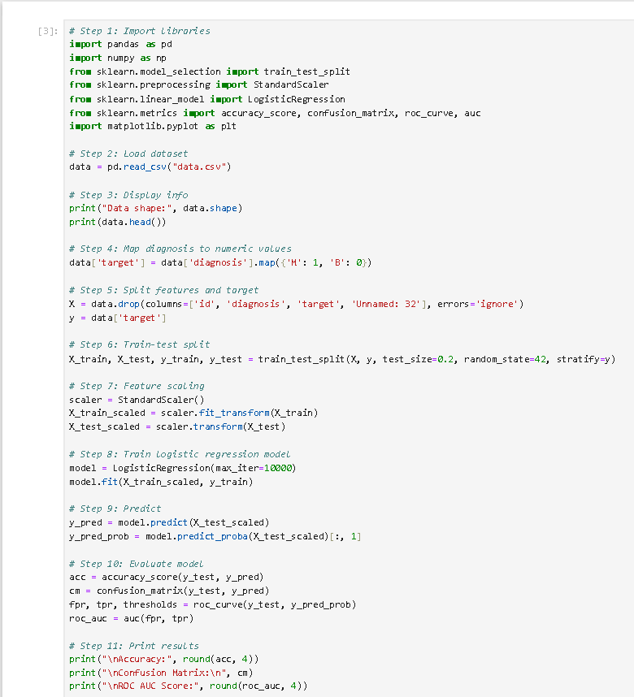
7

Slide 32
# St ep 12: PL o I RO C Cu in e
plt.figure(figsize=(6,6))
plt.plot(fpr, tpr, co1or='b1ue', 1w=2, 1abe1=f'ROC
plt. plot([0, 1], [0, 1], color= 'gray ', linestyle= ' ') p1t.title(”ROC Curve - Logistic Regression”) p1t.x1abe1(”False Rate”)
p1t.y1abe1(”True Positive Rate”) plt.legend(1oc=”lower right ”) p1t.show()
= (roc auc:.2C})')
Data shape: (569, 33)
id diagnosis
radius mean
17.99
20.57
19.69
11.42
20.29
trture mean
10.38
17.77
21.25
20.38
14.34
perimeter mean
122.80
132.90
130.00
77.58
135.10
area mean \
1001.0
1326.0
1203.0
386.1
1297.0
0 842302
1 842517
2 84300903
3 84348301
4 84358402
kt kt fil kt fil
s moot hness
mean c omp act nes s mean c one avit y mean concave points mean \
 | 0. 11840 |  | 0. 27760 | 0. 30B1 |  | 0. 14710
1 | 0. 08474 |  | 0. 87 8 64 | 0. 0869 |  | 0. 07017
2 | 0. 10960 |  | 0. 15990 | 0. 1974 |  | 0. 12790
 | 0. 14250 |  | 0. 28390 | 0. 2414 |  | 0. 1€E20
4 | 0. 10B30 |  | 0. 13280 | 0. 1980 |  | 0. 10430
... texture |  | worst | perimeter worst | area worst |  | smoothness |  |  | worst | \
 |  | 17.33 | 184.60 | 2019.0 |  |  |  |  | 0.1622
1 |  | 23.41 | 158.80 | 1956.0 |  |  |  |  | 0.1238
2 |  | 25.53 | 152.50 | 1709.0 |  |  |  |  | 0.1444
 |  | 26. 50 | 98. 87 | 567. 7 |  |  |  |  | 0.2098
4 |  | 16. 67 | 152.20 | 1575. 0 |  |  |  |  | 0. 1374
 | compact nes s uorst |  | concav it y uorst | concave | point s |  | uorst | sy mmet ry |  | uorst | \
 | 0. 6656 |  | 0. 7119 |  |  |  | 0.2654 |  |  | 0. 4601
1 | 0. 1866 |  | 0. 2416 |  |  |  | 0. 1860 |  |  | 0. 2750
2 | 0. 4245 |  | 0. 4504 |  |  |  | 0.2430 |  |  | 0. 3613
3 | 0. 8663 |  | 0. 6869 |  |  |  | 0.2575 |  |  | 0. 6638
4 | 0.2050 |  | 0. 40B0 |  |  |  | 0. 1625 |  |  | 0. 2364
 | -Eract a1 dimens i on uorst | Unnamed: 32
 | 0. 11890 | NaN
1 | 0.08902 | NaN
2 | 0.08758 | NaN
3 | 0. 17300 | NaN
4 | 0.07678 | NaN
[5 rows a 33 columns]
Accuracy: 0. 9649
Confusion Matri:
[ [71 1 §
[ 3 39 § §

Slide 33
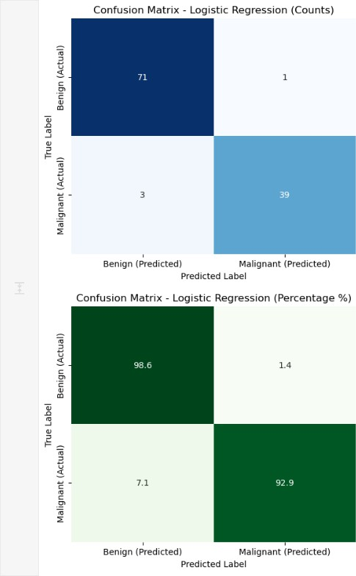
7

Slide 34
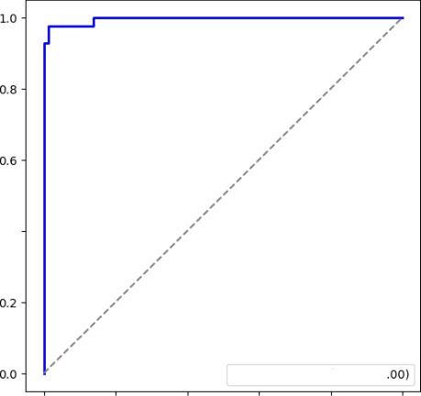
[5 rows a 33 columns]
A c cur acy: 0. 9649
Confusion Matri:
[ [71 1 ]
[ 3 39 ] ]
ROC AUC Sc ore: 8. 996
ROC Curve - Log i stic Reg ress i on
0.4
ROC curve (area — 1
00
0.2
0.4 0.6
false PosCive hate
0.8
1.0

Slide 35
MIT Art Design and Technology University, Pune
Assignment No. 8 |  |  |  | Assignment Date:
Title: Implement and evaluate a Bayesian classifier on the IRIS dataset and analyse performance using Accuracy, Confusion Matrix, Precision and Recall |  |  |  | Submission Date:
Problem Statement: Implement and evaluate a Bayesian classifier on the IRIS dataset and analyse performance using Accuracy, Confusion Matrix, Precision and Recall
Theory: Naive Bayes is a probabilistic classifier based on Bayes’ Theorem with a strong assumption of feature independence. It is especially effective for text classification and works surprisingly well on many real-world problems. Bayes' Theorem: P(C∣X)=P(X∣C)⋅P(C)/P(X) Where: P(C∣X): Posterior probability of class CCC given predictor XXX P(X∣C): Likelihood P(C): Prior probability of class P(X): Evidence (constant for all classes) Naive Assumption: Assumes all features are independent given the class: P(X∣C)=P(x1∣C)⋅P(x2∣C)⋅…⋅P(xn∣C) Evaluation Metrics Explained Accuracy: Measures overall correctness of model: Accuracy=Correct Predictions/Total Predictions Confusion Matrix: Matrix showing actual vs. predicted classes to assess classification quality per class. Precision: For a class, how many of the predicted instances were correct: Precision=TP/TP+FP Recall (Sensitivity): For a class, how many of the actual instances were correctly predicted: Recall=TP/TP+FN F1-Score: Harmonic mean of Precision and Recall.
Acceptance Criteria: (list of scenarios to be completed in solution for completing assignments)
 | Sr. No. | Acceptance Criteria | Remarks Instructor (completed/ Not completed)
 | 1 | Dataset loaded (Iris from sklearn), Train-test split done
 | 2 | Model trained using GaussianNB
 | 3 | Predictions made
 | 4 | Accuracy calculated, Confusion

Slide 36
MIT Art Design and Technology University, Pune
 |  | matrix plotted
 | 5 | Precision and Recall computed, Output interpreted
Workflow (Using Python and Pandas/Scikit-learn) Import libraries Load Iris dataset Preprocess data (if needed) Split data into training and testing sets Train Naive Bayes model Make predictions Evaluate using: Accuracy Confusion Matrix Precision and Recall
Conclusion: In this experiment, we implemented a Naive Bayes Classifier on the Iris dataset using Gaussian Naive Bayes. The model achieved high accuracy (around 97–98%), with excellent precision and recall across all three flower classes (Setosa, Versicolor, Virginica). This shows that Naive Bayes, despite its simple assumptions of feature independence, performs surprisingly well on structured datasets with clearly distinguishable classes. It is efficient, interpretable, and a great baseline for many classification problems.

Slide 37
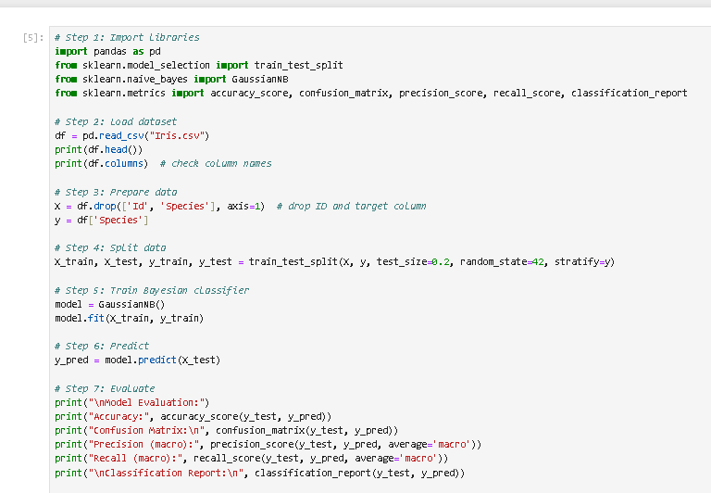
8

Slide 38

 | Id | Sepal L enmgt he |  | SepalNmi öt h € | Pet ad L enmgt h € | PMatemi öt he | Spec i es
0 | 1 | 5 . 1 |  | 3 . 5 | 1. 4 | 0 . 2 | In 1s - s 0s a
1 | 2 | 4. | 9 | 3 . 0 | 1. 4 | 0 . 2 | In 1s - s | 0s a
2 | 3 | 4. | 7 | 3 . 2 | 1. 3 | 0 . 2 | In 1s - s | 0s a
3 | 4 | 4. | 6 | 3 . 1 | 1. 5 | 0 . 2 | In 1s - s | 0s a
4 | 5 | 5 . | 0 | 3 . 6 | 1. 4 | 0 . 2 | In 1s - s | 0s a
In da( [ ’ Id’ , ’ Sepal L en gt here’ , ’ SepalNi öt here’ , ’ Pet ad L en gt here’ , ’ PMa1Ni dt hire’ ,
’ Spec i es ’ ] ,
dtype='object')
model E vatuati on:
Ac c u £ acy: 0. 9666666666666667
Confusion matrix:
[ 0 9 l]
Pr ec i s i on ( mac r o) : e . 9696969696969697 Rec at ( mac r o) : e . 9666666666666667
c l assifi c at i on Report:
 | pr ec i si on | r ec al l | fi- | scor e | support
I£lS-SAOSa | 1.BB 1.BB B.91 | 1.BB B.9Z 1.BB |  | 1.BB B.95 B.95
accuracy macro avg | B.97 | B.97 |  | B.97 B.97 | 30 3B
weigttedavg | B.97 | B.97 |  | B.97

Slide 39
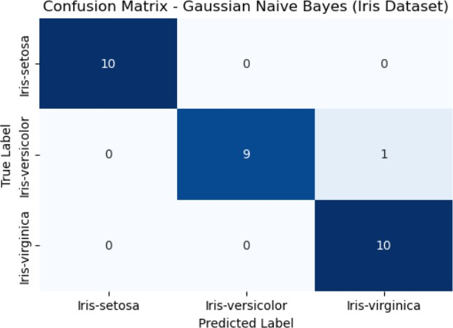
8

Slide 40
MIT Art Design and Technology University, Pune
Assignment No. 9 |  |  |  | Assignment Date:
Title: Implement K means clustering algorithm on multidimensional dataset from UCI repository and analyze the performance using Silhouette Score and cluster visualization |  |  |  | Submission Date:
Problem Statement: Implement K means clustering algorithm on multidimensional dataset from UCI repository and analyze the performance using Silhouette Score and cluster visualization.
Theory: K-Means Clustering K-Means is an unsupervised learning algorithm used for clustering data into K distinct groups based on feature similarity. How it works Choose the number of clusters K Initialize K centroids randomly Assign each data point to the nearest centroid Recompute centroids as the mean of assigned points Repeat steps 3–4 until convergence (centroids stop changing) Silhouette Score Used to measure the quality of clustering: Ranges from -1 to +1 Closer to 1 indicates well-separated clusters Silhouette Score=b−a/max(a,b) Where: a: Mean intra-cluster distance b: Mean nearest-cluster distance
Acceptance Criteria: (list of scenarios to be completed in solution for completing assignments)
 | Sr. No. | Acceptance Criteria | Remarks Instructor (completed/ Not completed)
 | 1 | Dataset loaded from UCI/sklearn, Data normalized
 | 2 | K-Means clustering applied
 | 3 | Silhouette Score computed
 | 4 | PCA used for dimensionality reduction
 | 5 | Cluster plot generated, Output interpreted
Workflow (Using Python and Pandas/Scikit-learn) Load a multidimensional dataset from UCI (e.g., Wine, Iris, or Breast Cancer) Preprocess the data (normalization or scaling) Choose an appropriate value for K Apply K-Means clustering Visualize the clusters (use PCA if data has >2 dimensions) Evaluate the clustering using Silhouette Score

Slide 41
MIT Art Design and Technology University, Pune
Conclusion:
In this experiment, we successfully applied K-Means clustering to the Wine dataset from the UCI repository. The data was preprocessed using standardization, and the clusters were visualized using PCA. The Silhouette Score helped us evaluate the cluster separation and cohesion. Though K-Means does not use label information, it was able to form meaningful groupings in the dataset, showing its utility for unsupervised pattern discovery.
This demonstrates the practical value of K-Means in clustering multidimensional data and the usefulness of Silhouette Score for model evaluation.

Slide 42
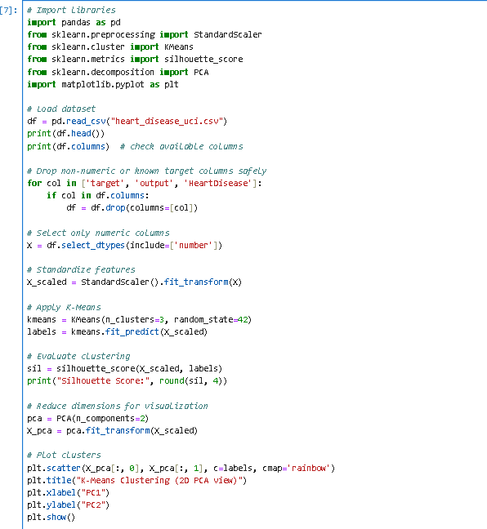
9

Slide 43
 | id | age | sa | dataset |  | cp |  |  | I r est bps | ch of |  | -Fbs | \
0 | 1 | 63 | make | cleveland |  | typical angina |  |  | 145 . 0 | 233 . 0 |  | Tr ue
1 | 2 | 67 | make | cleveland |  | asymptomatic |  |  | 16B .0 | 286.0 |  | F ad s e
2 | 3 | 67 | make | cleveland |  | asymptomatic |  |  | 12B .0 | 229.e |  | F ad s e
3 | 4 | 37 | make | cleveland |  | non-angIna1 |  |  | 130 .0 | 250 . e |  | F ad s e
4 | s | 4s | Female | cleveland |  | atypical angina |  |  | 13e . e | 4. e |  | F ad se
 |  | r est en g |  | t hal ch | aan | g | of dpeaL |  | s ope | c a | \
e | v | hypert r ophy |  | use . e | F al | se | 2.3 | dans | opi n g | e . e
1 | v | hypert r oph6y |  | 8.0 | Tr | ue | 1. s |  | -FMat | 3. e
2 | v | hypert r ophy |  | 129.0 | Tr | ue | 2. 6 |  | -FMat | 2.0
3 |  | nor real |  | 187.e | F al | se | 3. s | dans | opi n g | e . e
4 | v | hypert r ophy |  | 172.e | F al | se | 1. 4 | ups | opi n g | e . e
e | fixed | I fial de£ect | nuin e
1 |  | n or real | 2
2 | r ever sab1e | de-Feet | 1
3 |  | nor mab | e
4 |  | nor mab | e
In da( [ ’ Id’ , ’ age’ , ’ sa’ , ’ dat aset ’ , ’ c p’ , ’ I r est bps ’ , ’ ch of ’ , ’ -Fbs ’ ,
’ r est ec g’ , ’ I had ch ’ , ’ aan g’ , ’ of dpeaL ’ , ’ s ope’ , ’ c a’ , ’ I had ’ ,
’ nun’ ] ,
dtype='object')

Slide 44
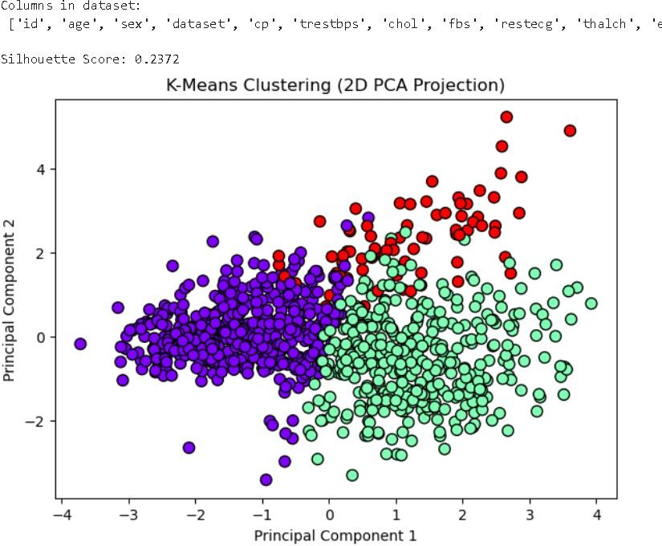
9

Slide 45
MIT Art Design and Technology University, Pune
Assignment No. 10 |  |  |  | Assignment Date:
Title: Use Wine dataset or IRIS dataset. Apply PCA to reduce features to 2D, then visualize clustering using K- means. Analyze how well PCA preserved cluster separation |  |  |  | Submission Date:
Problem Statement: Use Wine dataset or IRIS dataset. Apply PCA to reduce features to 2D, then visualize clustering using K- means. Analyze how well PCA preserved cluster separation
Theory: Principal Component Analysis (PCA) PCA is a dimensionality reduction technique that transforms high-dimensional data into fewer dimensions while retaining as much variance (information) as possible. It finds new orthogonal axes (principal components). The first principal component captures the most variance, the second captures the next most, and so on. PCA is unsupervised and does not use class labels. K-Means Clustering K-Means groups data into K clusters based on feature similarity. It minimizes the intra-cluster distance. The clustering can be visualized better in 2D after PCA.
Acceptance Criteria: (list of scenarios to be completed in solution for completing assignments)
 | Sr. No. | Acceptance Criteria | Remarks Instructor (completed/ Not completed)
 | 1 | Dataset used (Wine or Iris), PCA applied and explained variance shown
 | 2 | K-Means applied to 2D PCA data
 | 3 | Cluster visualization created
 | 4 | Silhouette Score computed
 | 5 | Result analyzed
Workflow (Using Python and Pandas/Scikit-learn) Load the Wine or Iris dataset Standardize the features Apply PCA to reduce dimensions to 2 Use K-Means to cluster the data in 2D Visualize the clusters Compare clusters to actual labels to analyze separation Compute Silhouette Score to measure clustering quality
Conclusion: In this experiment, we applied PCA to reduce the Wine dataset from 13 features to 2 principal components. Although some variance is lost (only ~55% retained), the PCA-transformed data still preserved meaningful structure, allowing K-Means clustering to produce visibly distinct clusters. The Silhouette Score further confirmed good clustering performance in the reduced 2D space. This shows that PCA is effective not only for visualization but also for dimensionality reduction before clustering,

Slide 46
MIT Art Design and Technology University, Pune
especially when data is high-dimensional.

Slide 47
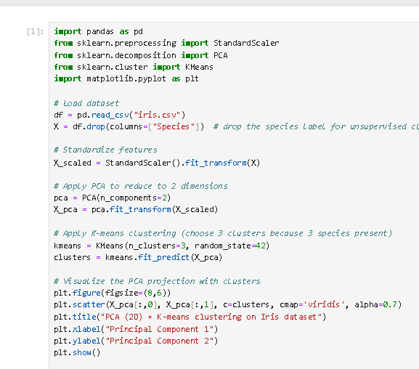
10

Slide 48
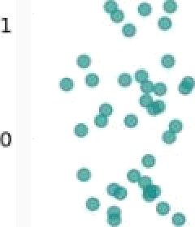

PCA (2D) + K-means clustering on Iris dataset
-2
—3
—2
0 1
Principal Component 1
2

