Slide 1






Google Play Store App Ratings
Sumit Agrawal
Weijia Li
Agenda
● EXPLORATORY DATA ANALYSIS
● FEATURE ENGINEERING
● MODEL TRAINING
● MODEL EVALUATION
● CONCLUSION

Slide 2
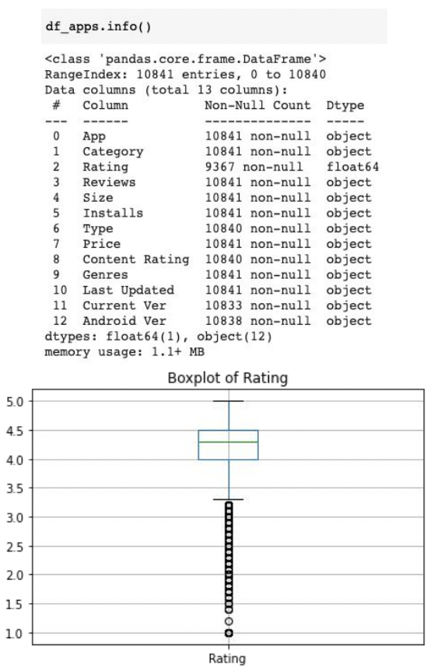
Exploratory Data Analysis
1. Total 10,841 app data and 13 variables
a. 483 duplicates
b. Only “Rating” column is float & the rest are Dtype object.
2. Target variable “Rating” contains 1,474 missing values
3. An outlier with rating greater than 5.
a. After removal, the distribution of “Rating” is highly left skewed
4. Column “Genres” has 120 unique categories
a. Minor genres can be merged to major ones. Eg., group “Racing;Pretend Play” to “Racing”
b. The most popular genre is “Tools”
5. 92% of app type is free
6. Columns such as “App”, “Last Updated”, “Current Ver”, “Android Ver” can be dropped since
1) they have too much distinct categories
2) they do not contain much predictive information

Slide 3
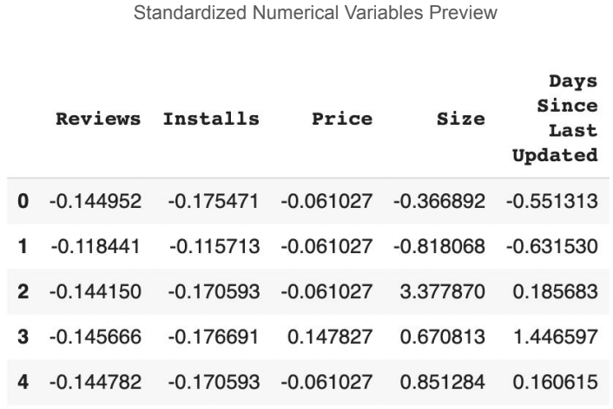
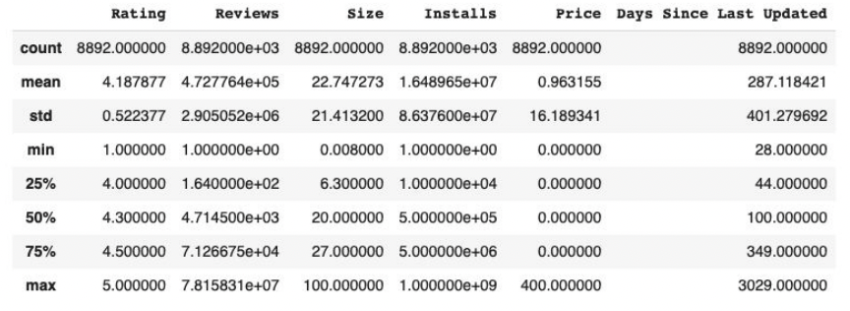
Feature Engineering
● Convert columns including “Price”, “Size”, “Installs” and “Reviews” to numerical values
○ Remove trailing dollar sign in price. E.g., $2.99 → 2.99
○ Convert all app size from KB to MB. E.g., 1024K → 1
○ If size is “Varies with device”, replace with mean size
● Reduce dimension of “Genres” from 120 to 47 by removing the substring after semicolon
● Derive a new column “Days Since Last Updated”
○ Calculate the time difference between “Last Updated” and the date that data was uploaded to Kaggle
● Split data into training (80%) and testing (20%) set
● Scale numeric data with StandardScaler
○ Transform and fit using training data
○ Transform testing data

Slide 4
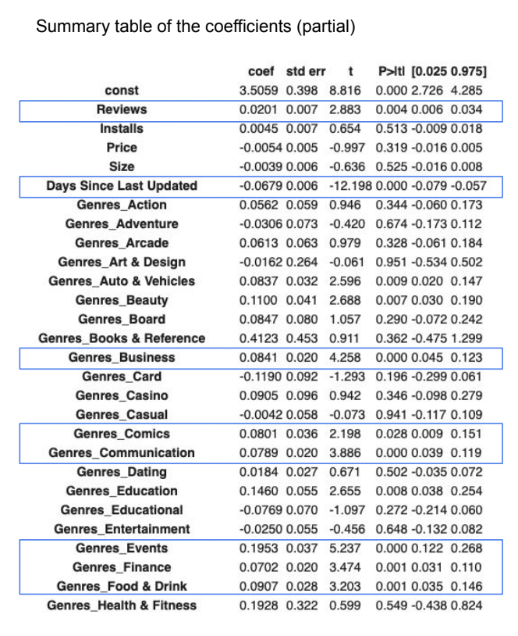
Model Training
Linear Regression
Data split – Random - 80% (Training) / 20% (Test)
Standardized variables - Reviews, Installs, Price, Size, Days Since Last Updated
One-Hot Encoding - Genres, Category, Type, Content Rating
Evaluation Metrics - MAE, MSE, RMSE
Performance on training set:
MAE: 0.3175
MSE: 0.2238
RMSE: 0.4731

Slide 5
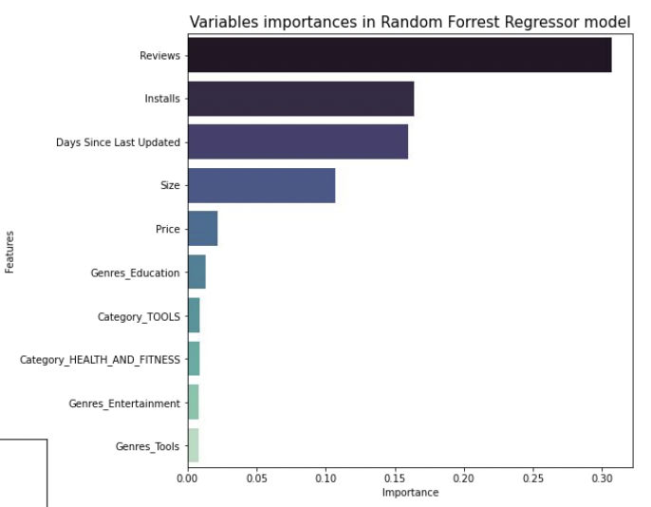
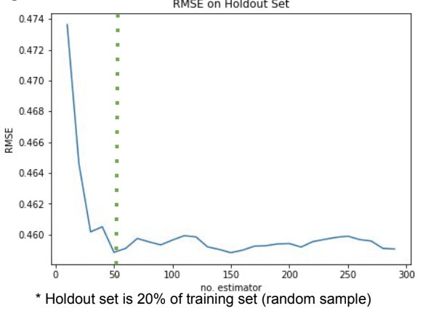
Model Training
Random Forest
Optimal Parameters (Grid Search with 5-Fold CV)
n_estimators: 50 (early stopping)
max_depth: 10
Performance on training set:
MAE: 0.2554
MSE: 0.1493
RMSE: 0.3863
Top 5 important features:
● Reviews
● Installs
● Days Since Last Updated
● Size
● Price

Slide 6
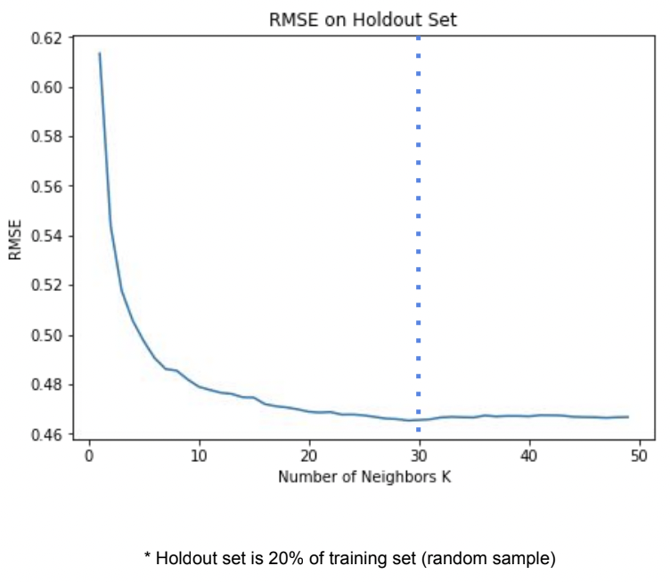
Model Training
K-Nearest Neighbour
Optimal Parameters (Grid Search with 5-Fold CV)
K: 30
Performance on training set:
MAE: 0.3101
MSE: 0.2109
RMSE: 0.4592

Slide 7
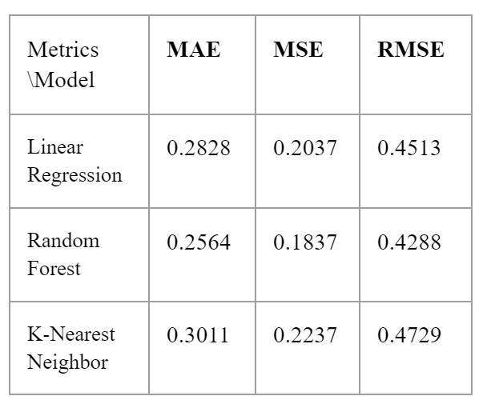
Model Evaluation
Evaluate model performance on testing set
Apply three models on unseen data and compare performance
Conclusion
● Several strong predictors were identified based on p-value and feature importance:
○ Reviews, Days Since Last Updated, Installs, Price, Size etc.
○ Some Genres also show strong predictive power:
■ Food & Drinks
■ Business
■ Health & Fitness
● Random Forest outperforms other models in terms of all three metrics: MAE, MSE and RMSE

