Slide 1
Health Care Analytics
Your’s Life , Our’s Importance

Slide 2

TEAM MEMBERS Mudigonda Pranay Kumar Gulfam Ali Sumit Kumar Nikita Rani Chinmay Rajendra Joshi

Slide 3
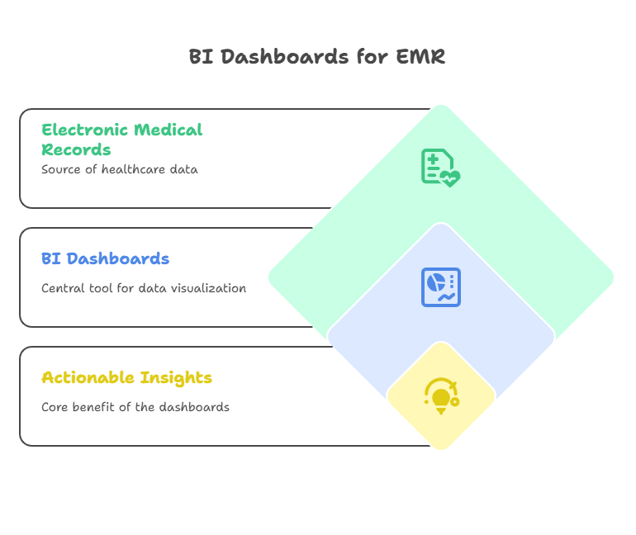
INTRODUCTION

Slide 4
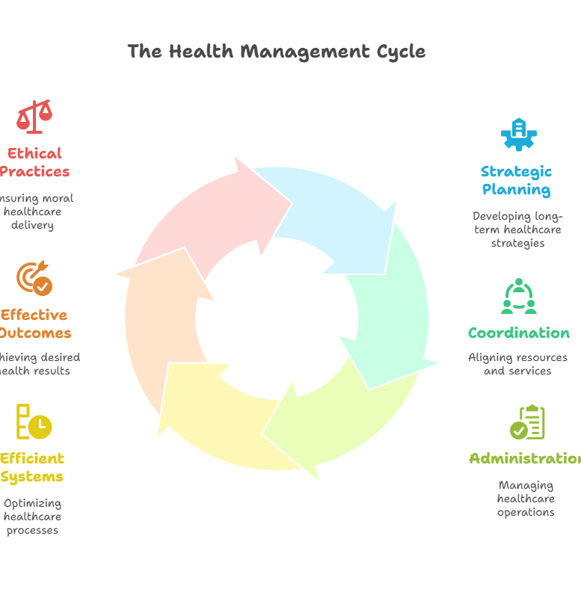
What is Health Management?

Slide 5
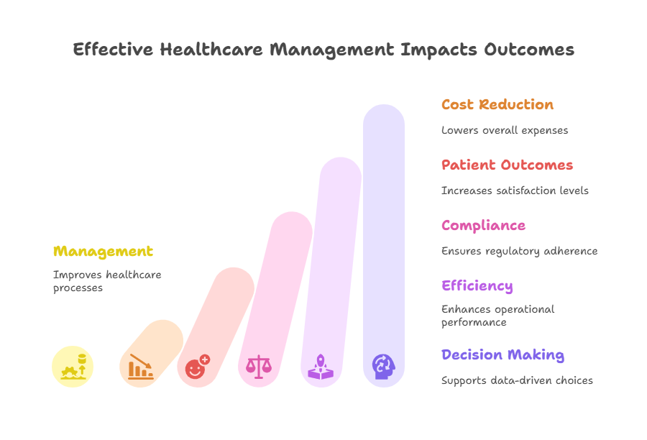
Importance of Health care

Slide 6
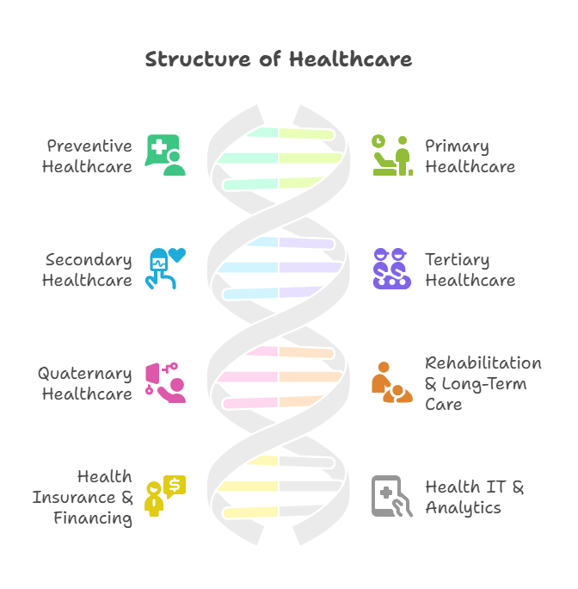
Main Sectors in Health care

Slide 7
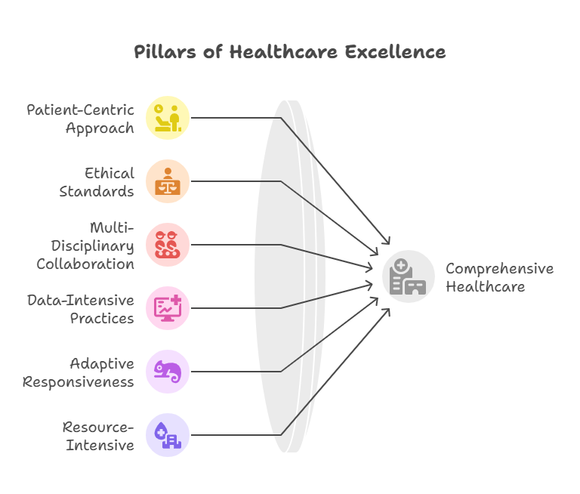
Characteristics of the Health care

Slide 8
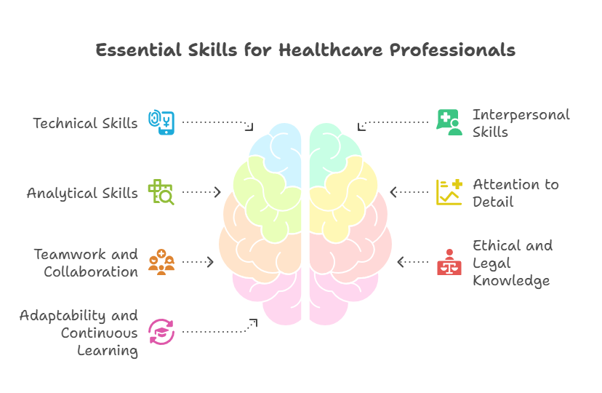
Key Skills in Health care
Working in healthcare requires a combination of technical, interpersonal, and analytical skills. Strong communication skills are essential for interacting effectively with patients, families, and other healthcare professionals.
Empathy and compassion help build trust and provide emotional support to patients. Professionals must have critical thinking and problem-solving abilities to assess symptoms, make quick decisions, and handle emergencies.
Attention to detail is vital for accurate diagnosis, treatment, and documentation. Teamwork and collaboration are also crucial, as healthcare is a multidisciplinary field requiring coordination across various roles.

Slide 9
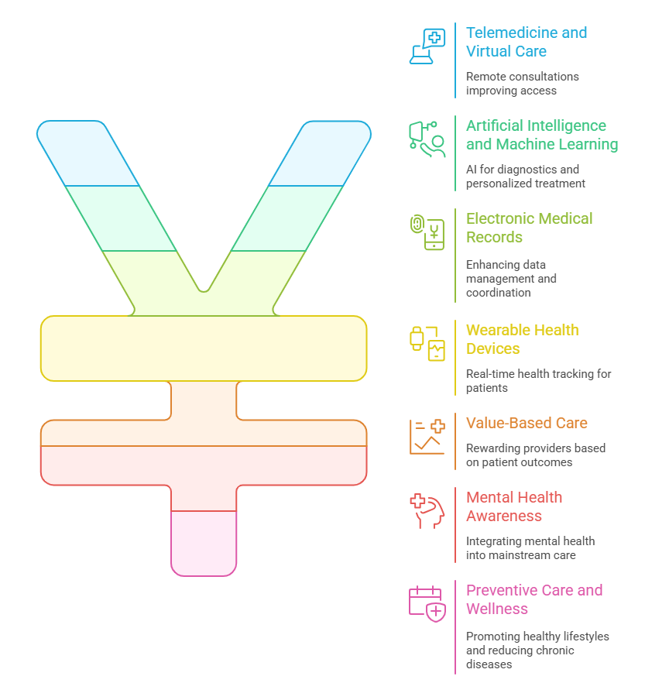
Trends in Health care

Slide 10
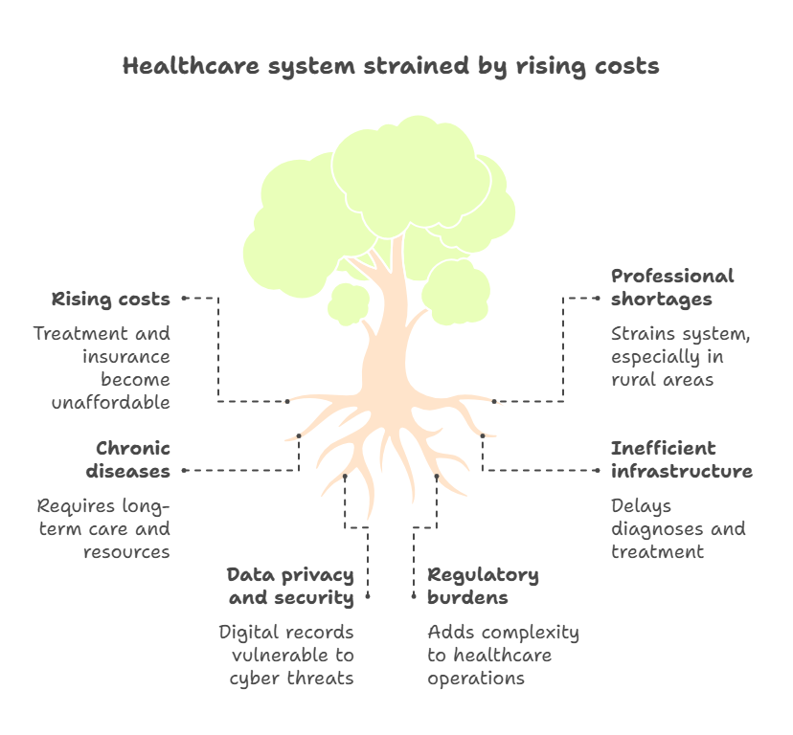
Challenges in Health care

Slide 11
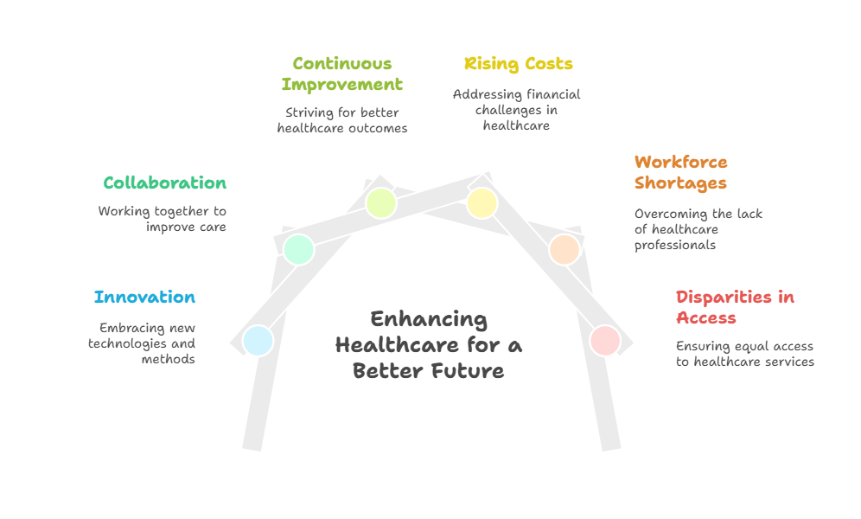
CONCLUSION

Slide 12
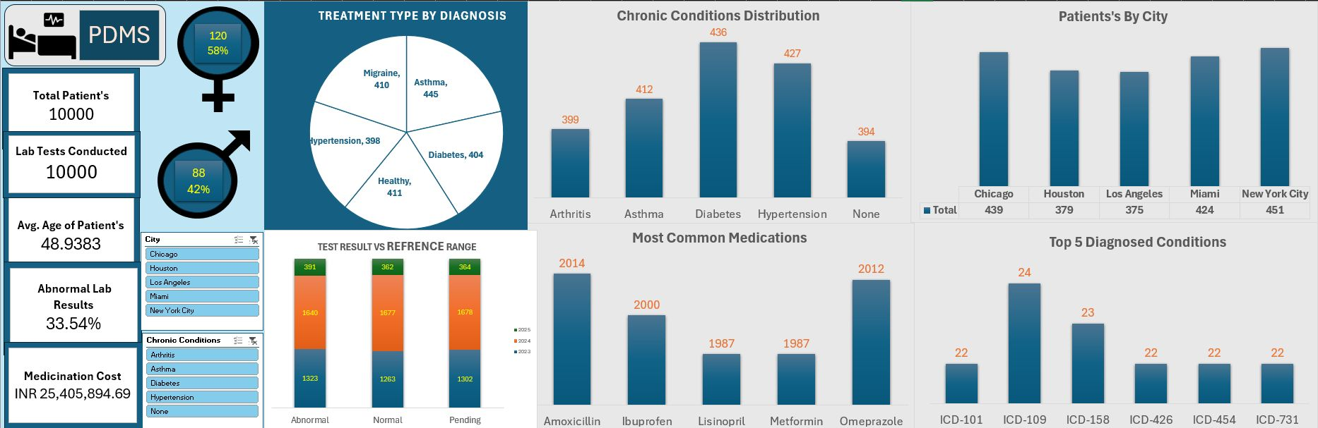
Dashboard-1 (EXCEL)

Slide 13
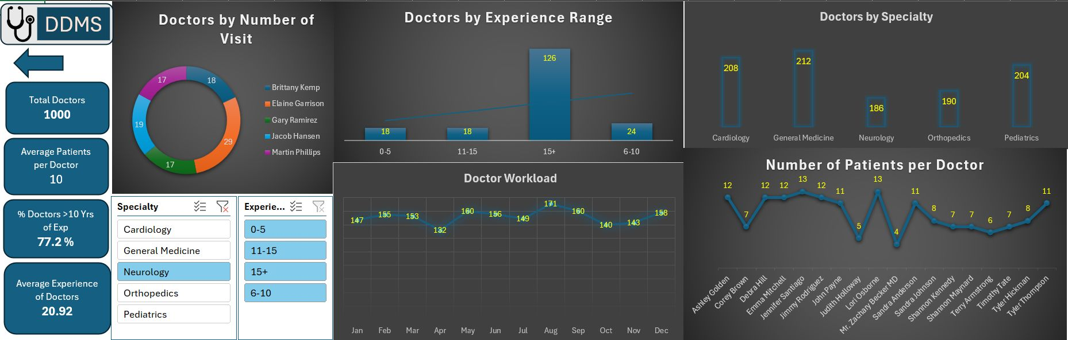
Dashboard-2 (EXCEL)

Slide 14
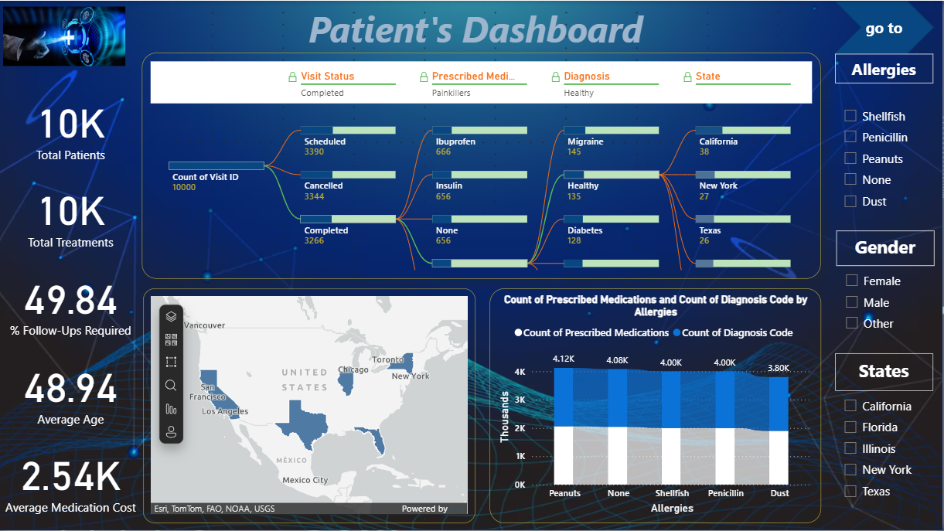
Dashboard-1 (Power BI)

Slide 15
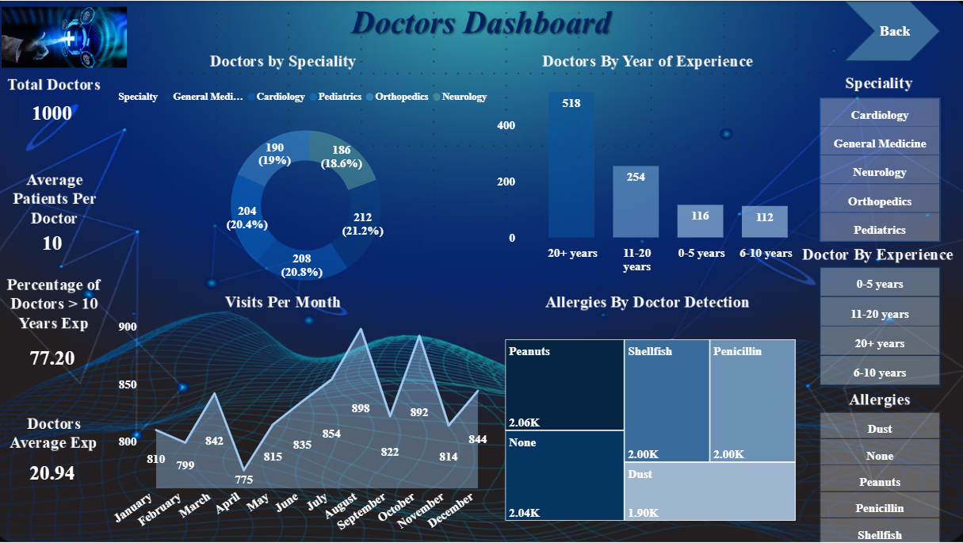
Dashboard-2 (Power BI)

Slide 16
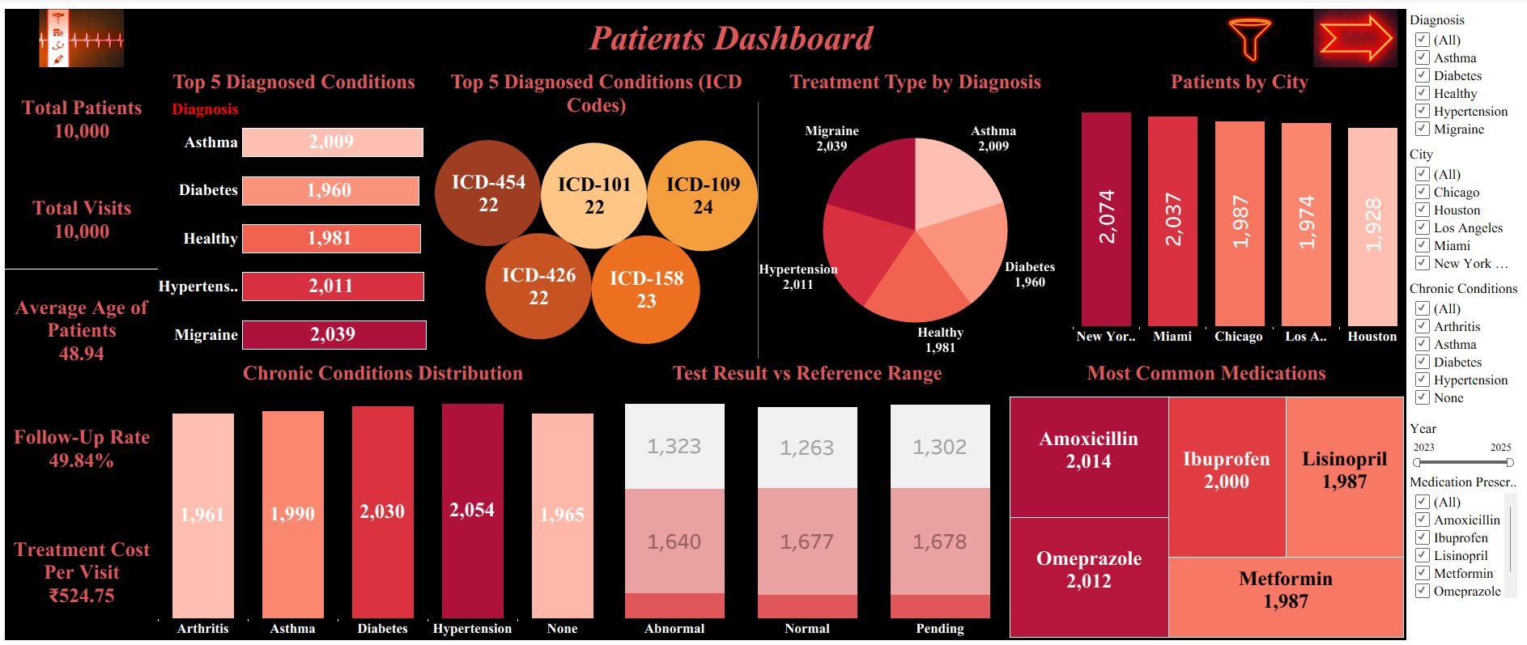
Dashboard-1 (Tableau)

Slide 17
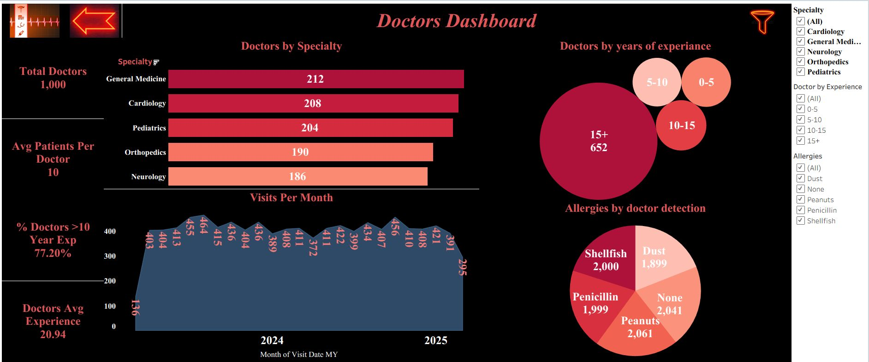
Dashboard-2 (Tableau)

Slide 18
Thank You For Being a Patient Listener

Slide 19

Let’s Talk About Some SQL Code

