Slide 1
Hospitality Analytics
Understanding the Scope, Sectors, and Importance

Slide 2

TEAM MEMBERS Pratik Kamal Vijay Phadtare Mudigonda Pranay Kumar Sumit Kumar KARRI. NAGA SAI RAGHAVA DURGA BALAJI

Slide 3
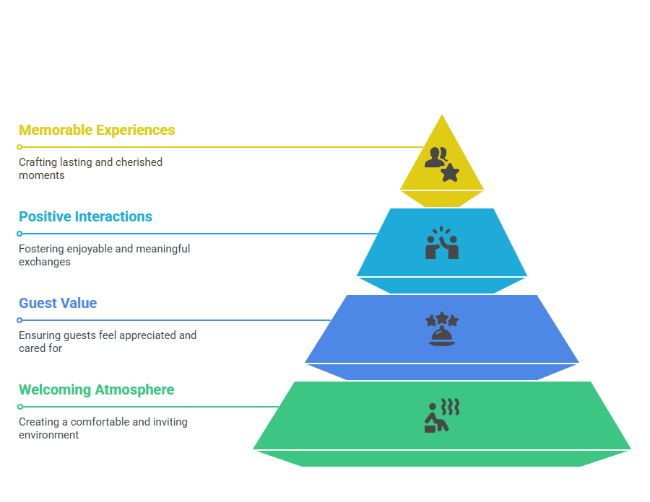
INTRODUCTION

Slide 4
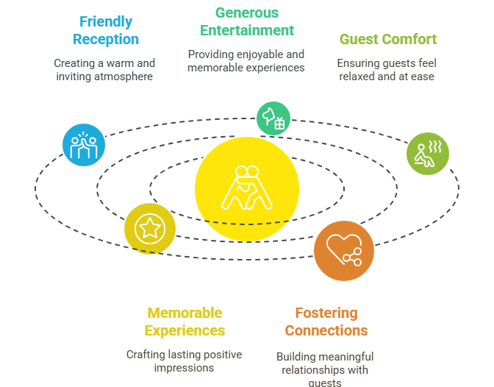
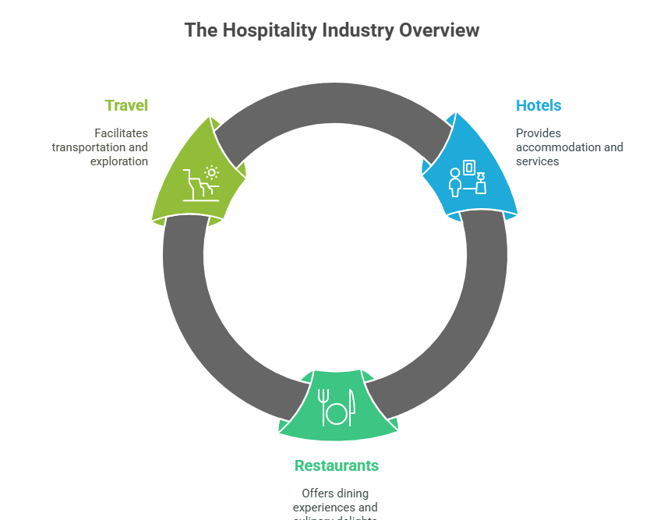
What is Hospitality?

Slide 5
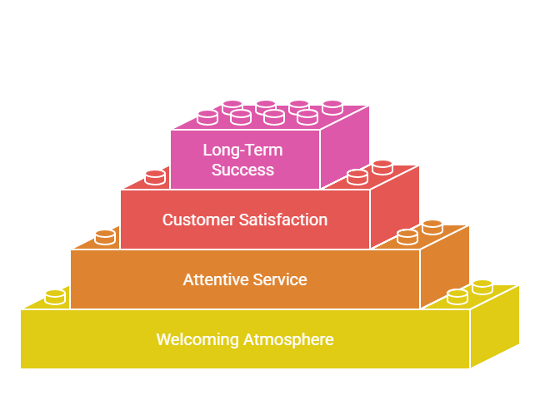
Importance of Hospitality

Slide 6

Main Sectors in Hospitality

Slide 7
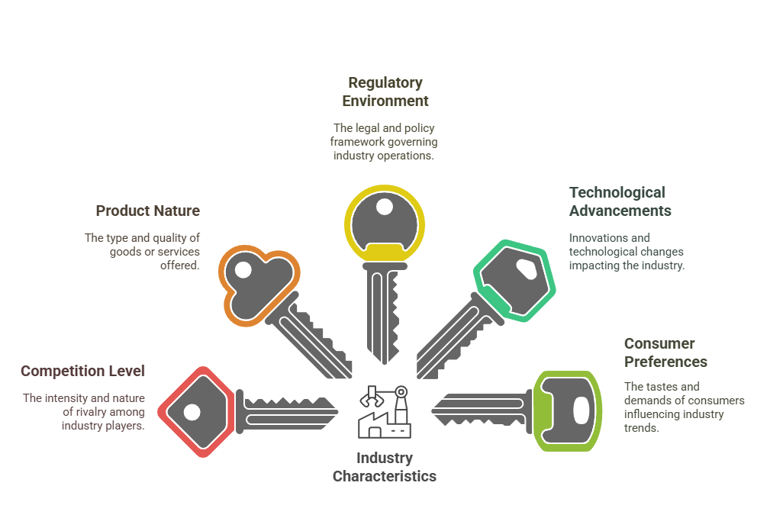
Characteristics of the Industry

Slide 8
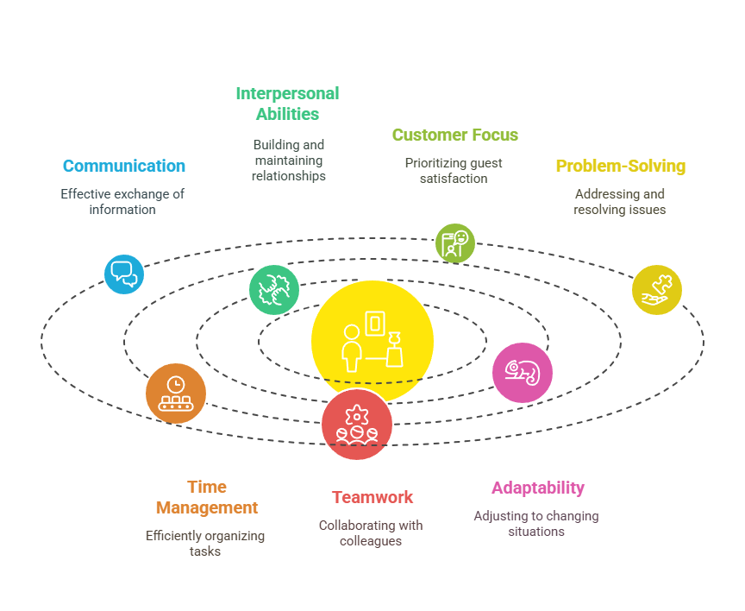
Key Skills in Hospitality
Key skills in hospitality involve a blend of customer service excellence, strong communication, and the ability to create a welcoming atmosphere.
This includes interpersonal skills for interacting with diverse guests, problem-solving to address issues effectively, attention to detail for high standards, teamwork for seamless operations, and adaptability to handle varied situations and guest needs.
Cultural awareness and empathy are also crucial for making guests feel comfortable and valued.

Slide 9
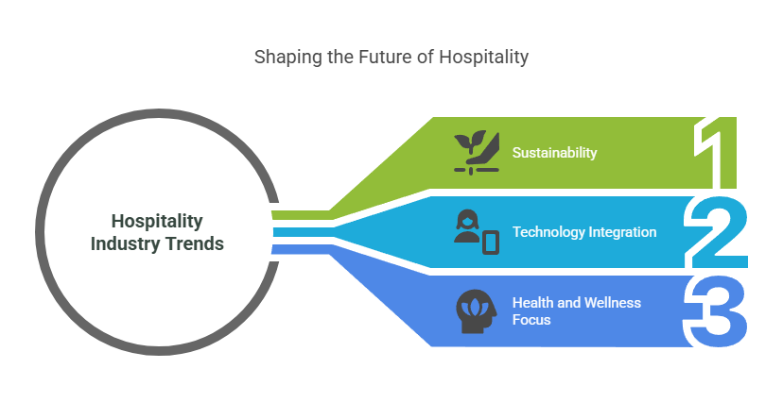
Trends in Hospitality

Slide 10
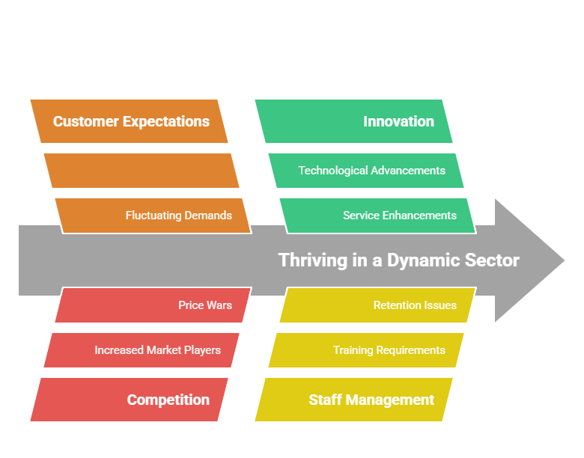
Challenges in Hospitality

Slide 11
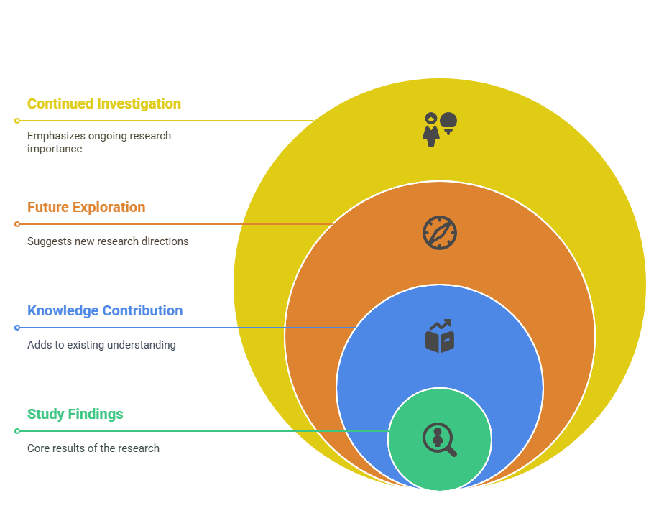
CONCLUSION

Slide 12
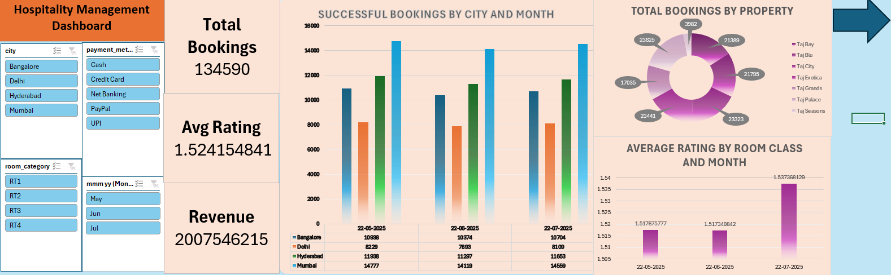
Dashboard-1 (EXCEL)

Slide 13
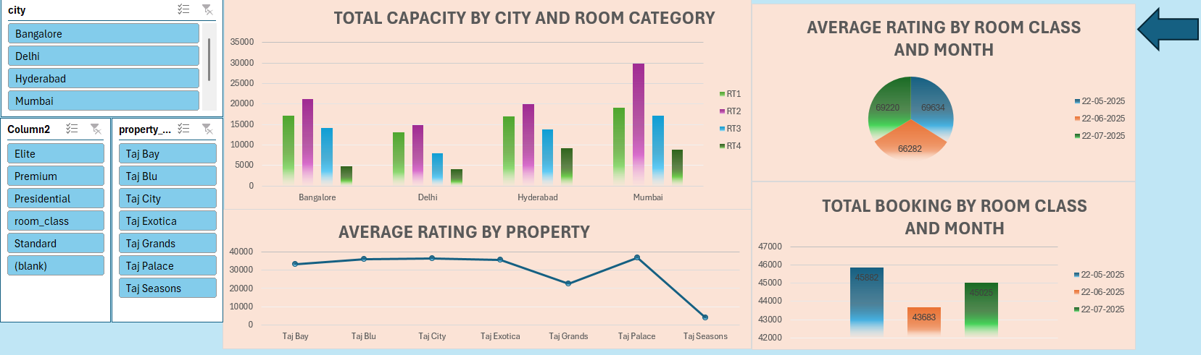
Dashboard-2 (EXCEL)

Slide 14
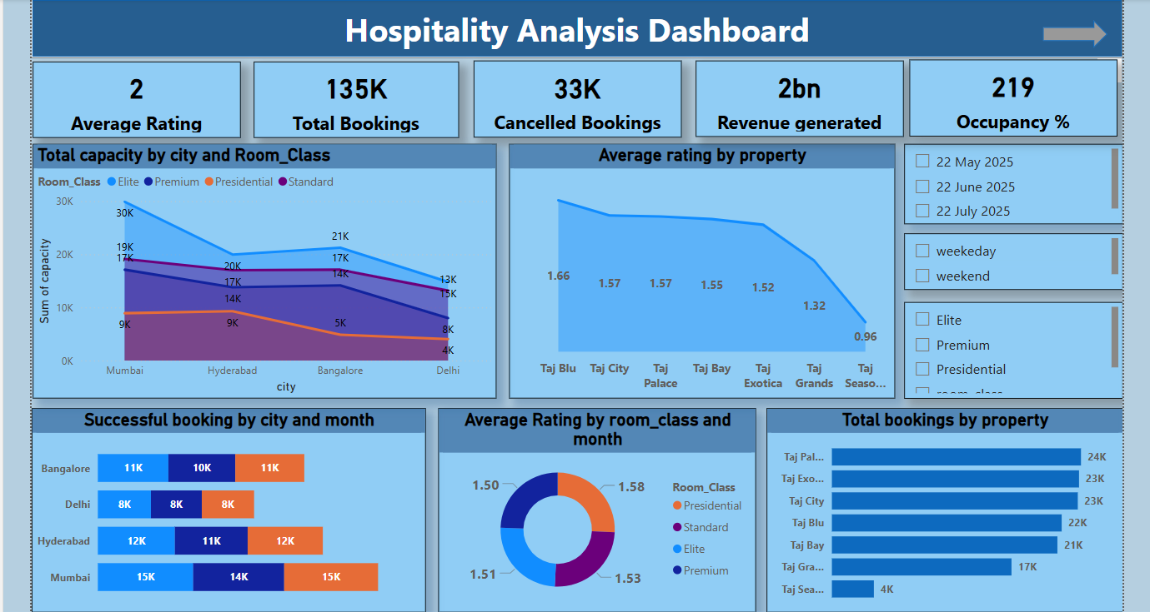
Dashboard-1 (Power BI)

Slide 15
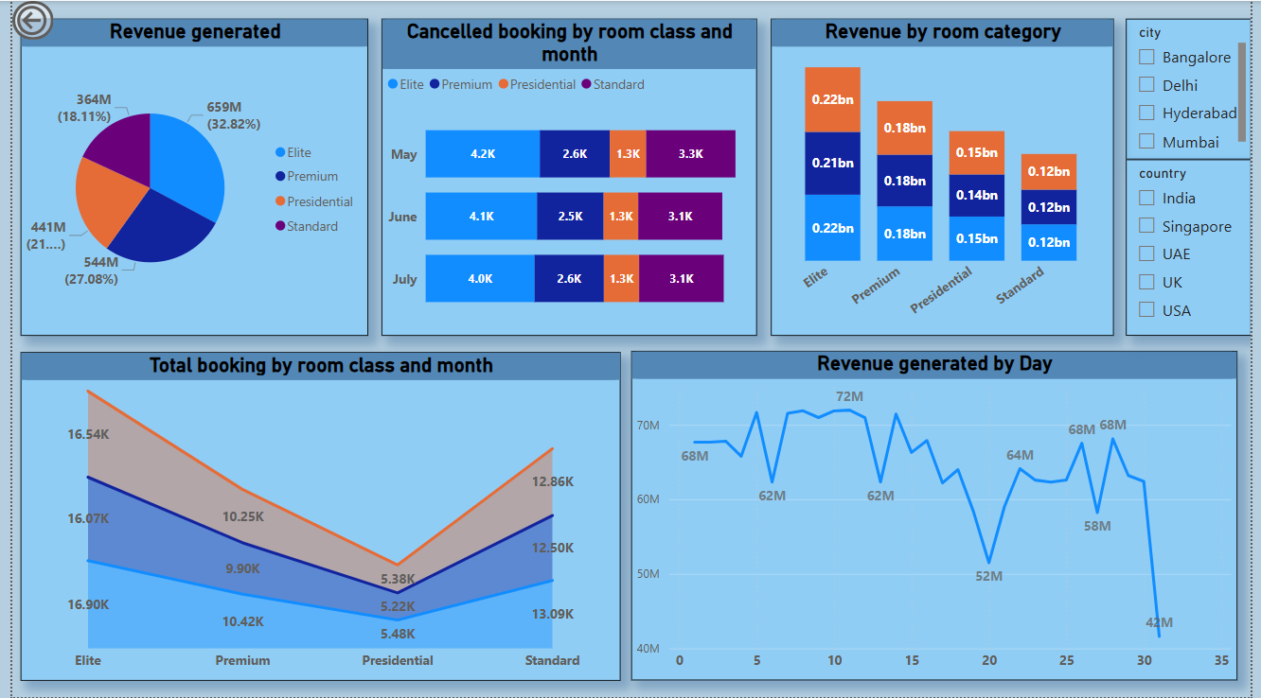
Dashboard-2 (Power BI)

Slide 16
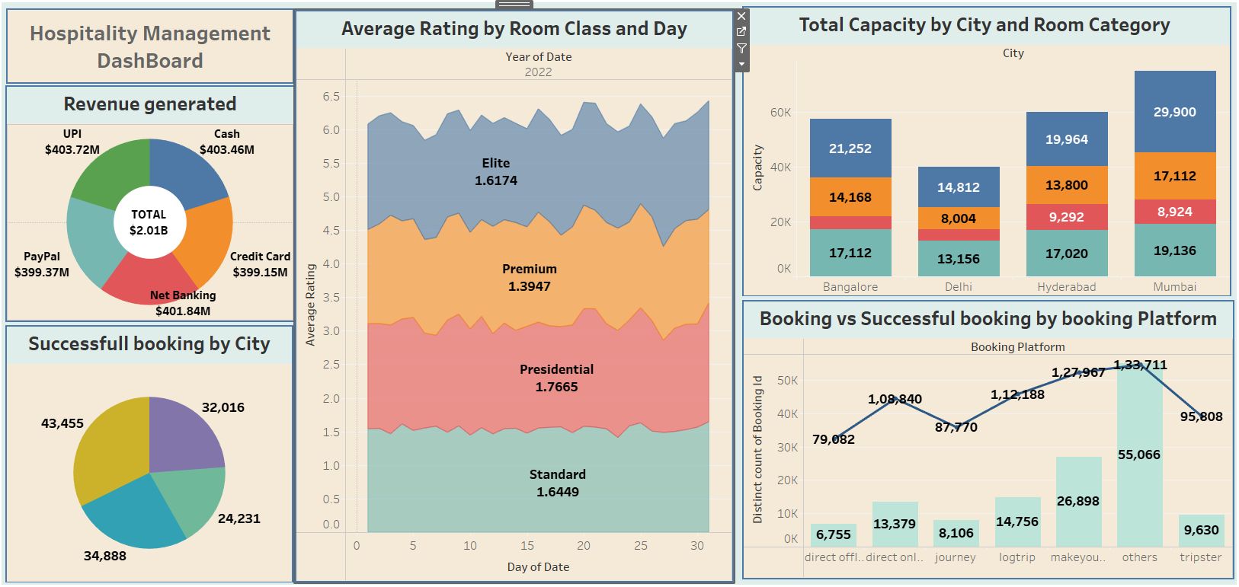
Dashboard-1 (Tableau)

Slide 17
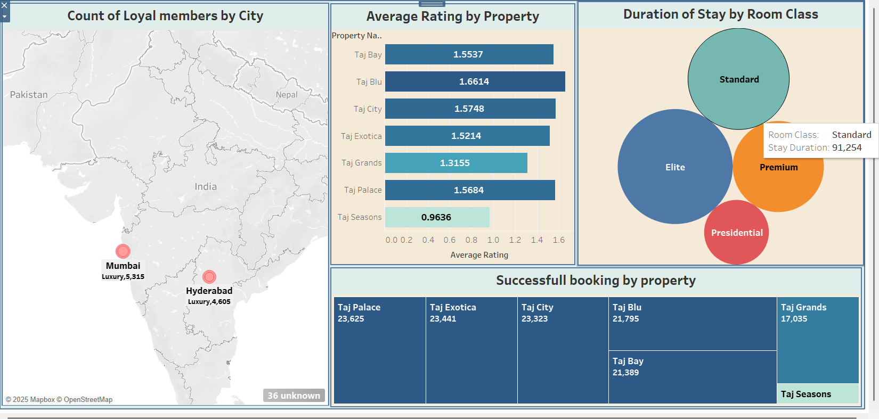
Dashboard-2 (Tableau)

Slide 18
Thank You For Being a Patient Listener

Slide 19

Let’s Talk About Some SQL Code

