Slide 1
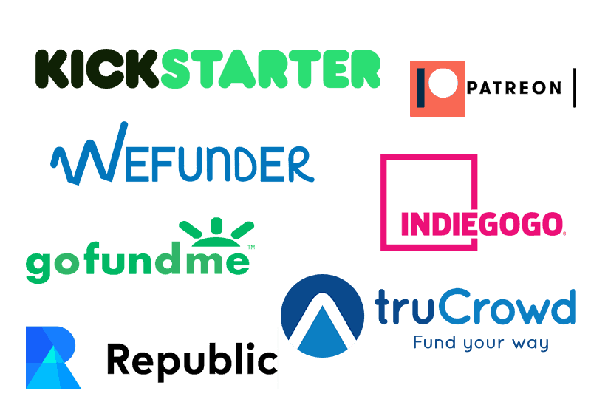
CROWDFUNDING
KICKSTARTER

Slide 2
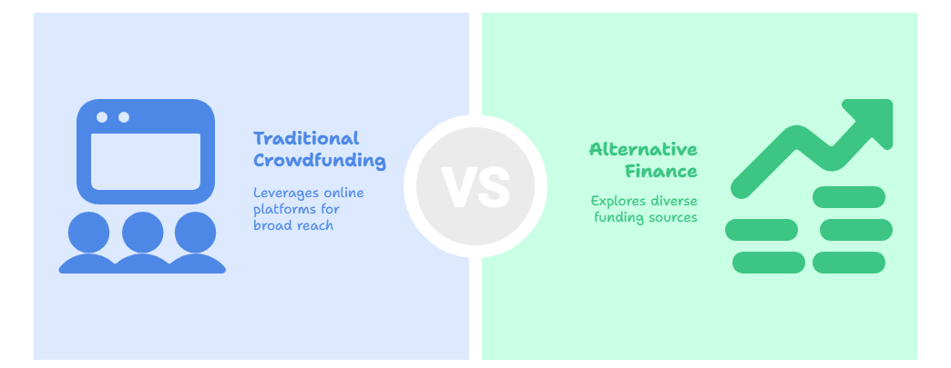
INTRODUCTION

Slide 3
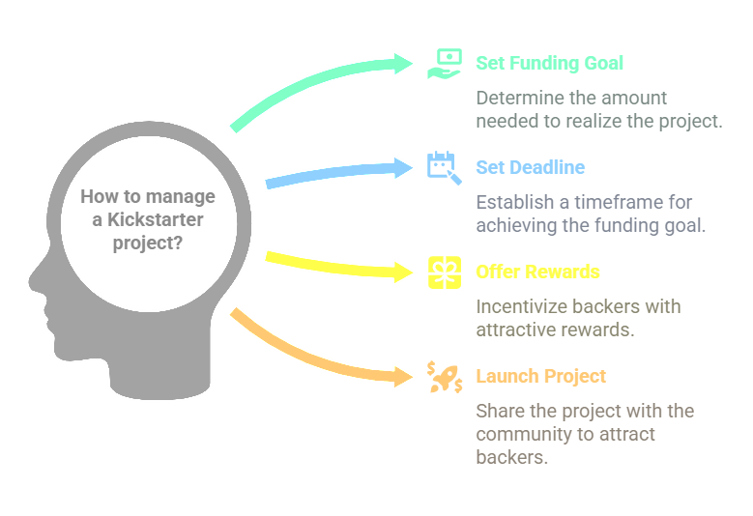
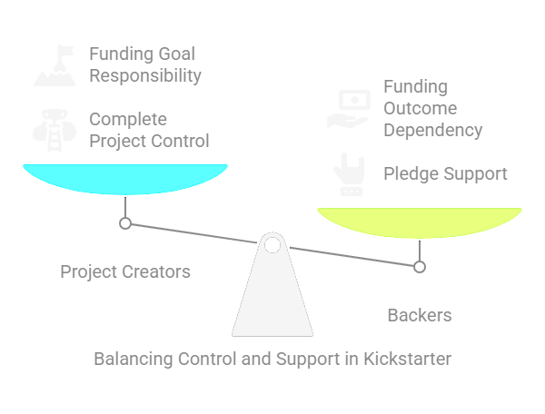
What is Kick Starter

Slide 4
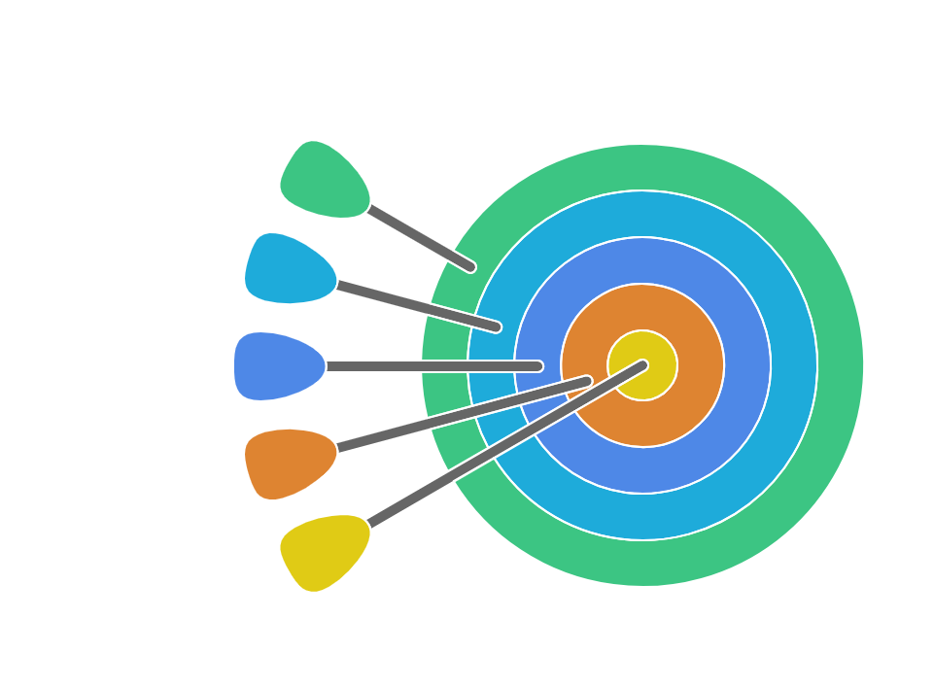
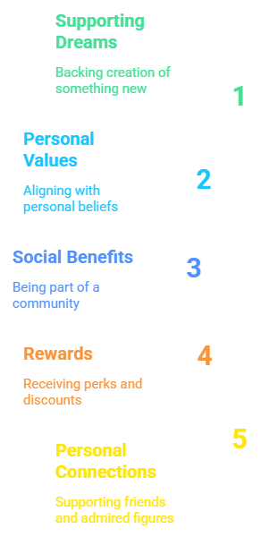
WHY DO PEOPLE BACK PROJECTS ?

Slide 5
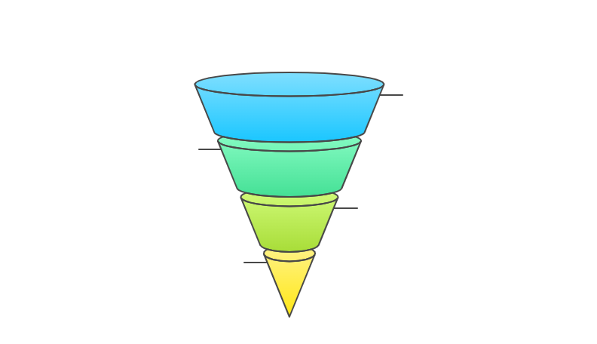
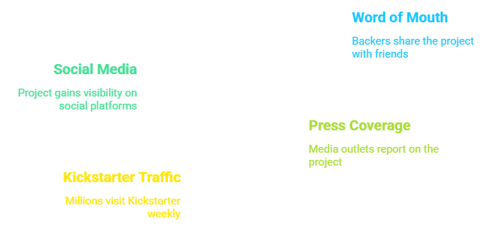
WHERE DO BACKERS COME FROM ?
Most of the initial funding usually comes from the fans and friends of each project .
If they like it, they'll spread the word to their friends, and so on . Press, blogs, Twitter, Facebook, and Kickstarter itself are also big sources of traffic and pledges .
Altogether, millions of people visit Kickstarter every week .

Slide 6
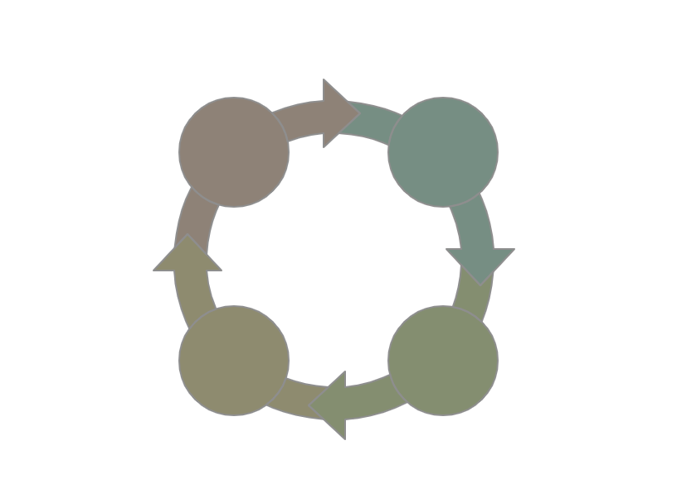
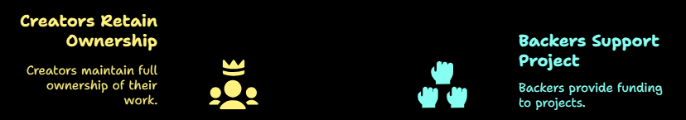
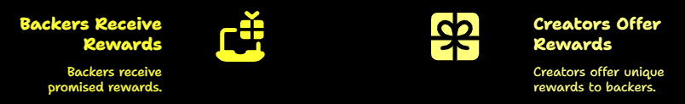
WHAT DO BACKERS GET IN RETURN ?

Slide 7
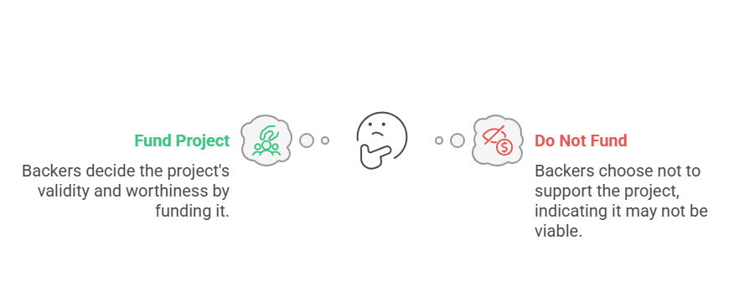
WHO IS RESPONSIBLE FOR COMPLETING A PROJECT AS PROMISED ?
It's the project creator's responsibility to complete their project . Kickstarter is not involved in the development of the projects themselves .
Kickstarter doesnot guarantee projects or investigate a creator's ability to complete t their project.
On Kickstarter, backers ultimately decide the validity and worthiness of a project by whether they decide to fund it .

Slide 8
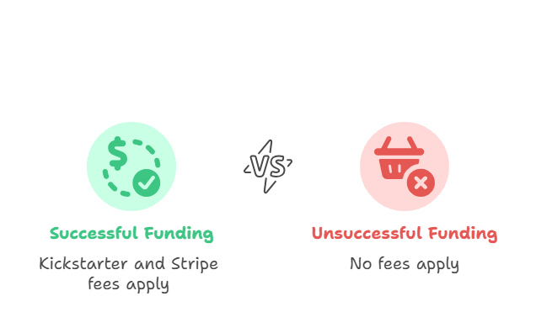
HOW DOES KICKSTARTER MAKE MONEY ?
If a project is successfully funded, Kickstarter applies a 5% fee to the funds collected. All pledges are processed securely by our third-party payments partner, Stripe .
These payment processing fees work out to roughly 3-5%. View the fee breakdowns.
If the project does not reach its funding goal, there are no fees.

Slide 9

Final Insights & Recommendations
Target Low to Mid-Range Funding Goals (especially $1K–$10K) for higher success rates.
Optimize Campaign Launches in March or Q1 for better visibility and support.
Consider Popular Categories like Games, Design, and Music for higher engagement.
Leverage Urban Hubs (LA, NYC, London) to tap into engaged backer communities.
Focus on Clear Outcomes – Keep project timelines near ~30 days for best results.
Monitor Recent Trends – Drop in 2019 may warrant exploring newer platforms or updated marketing strategies.

Slide 10
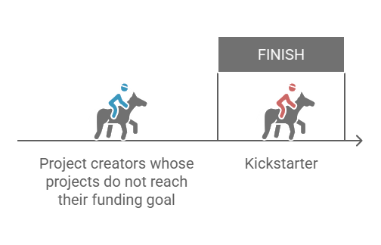
CONCLUSION

Slide 11
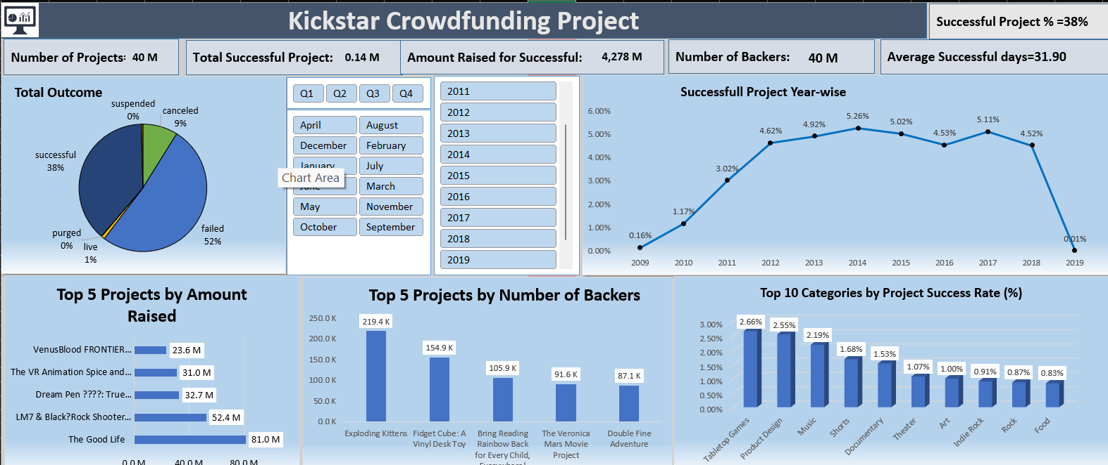
Dashboard-1 (EXCEL)

Slide 12
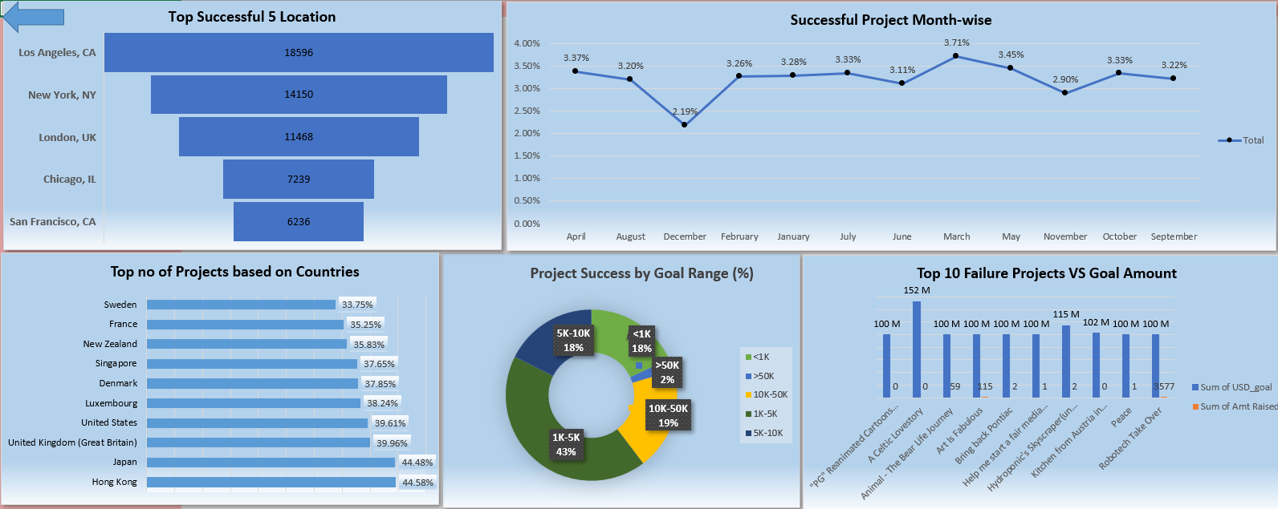
Dashboard-2 (EXCEL)

Slide 13
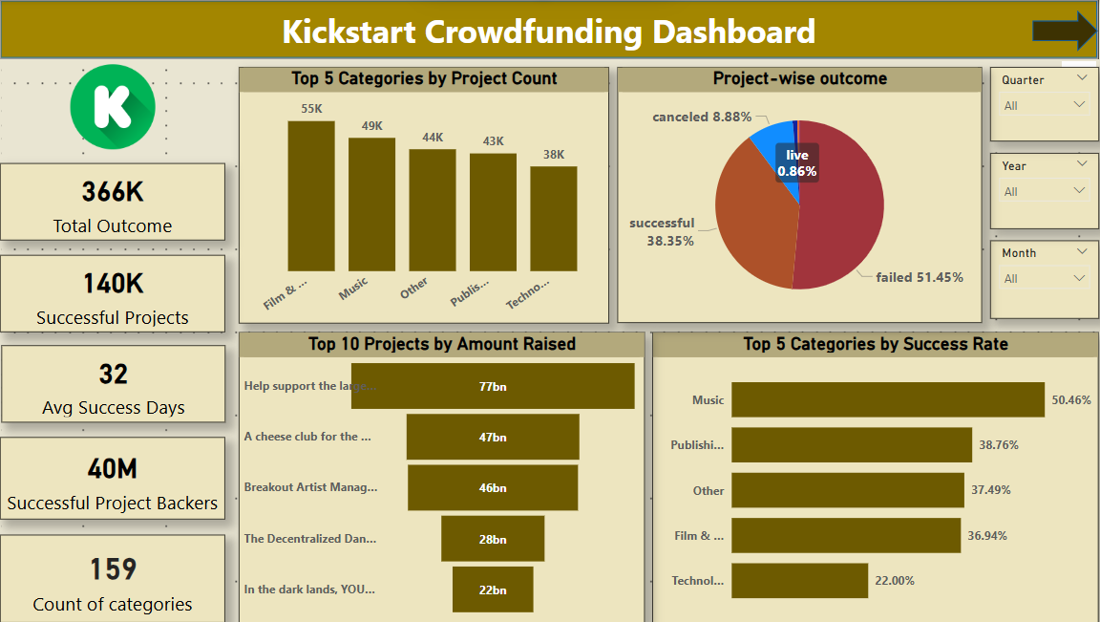
Dashboard-1 (Power BI)

Slide 14
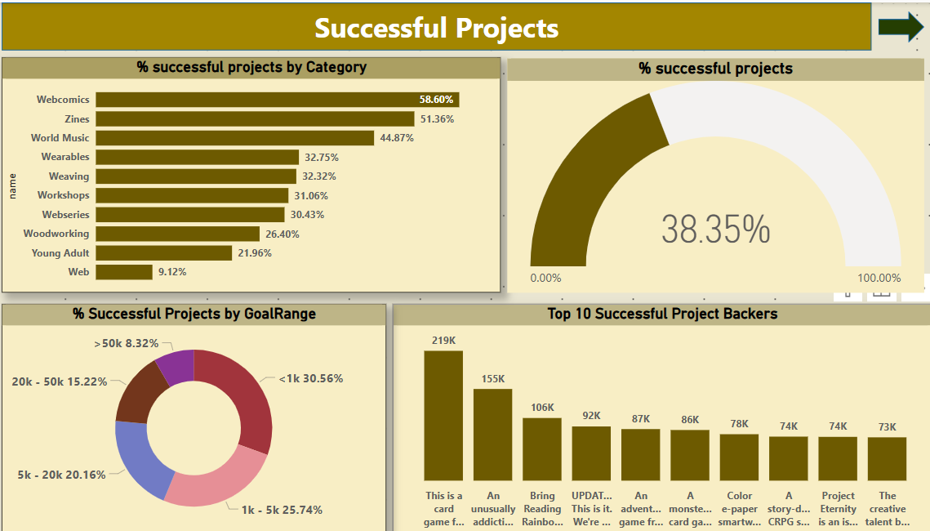
Dashboard-2 (Power BI)

Slide 15
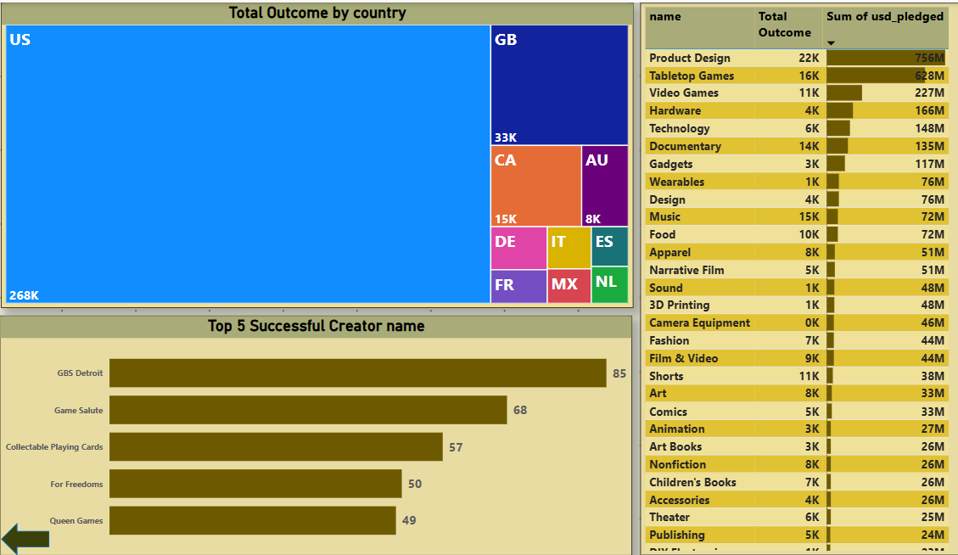
Dashboard-3 (Power BI)

Slide 16
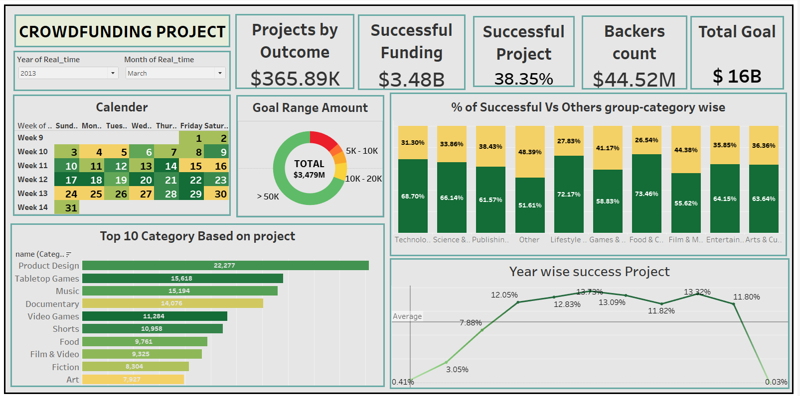
Dashboard-1 (Tableau)

Slide 17
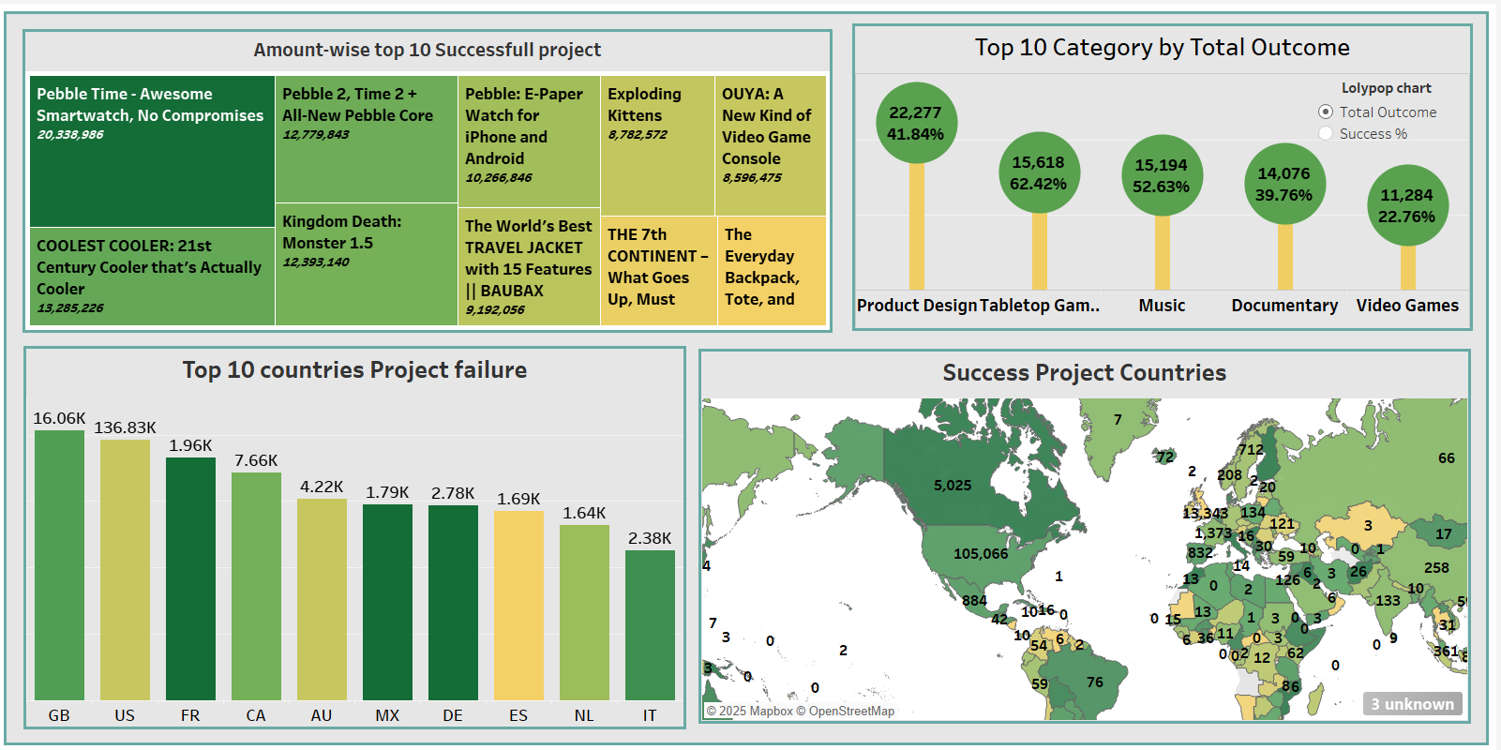
Dashboard-2 (Tableau)

Slide 18
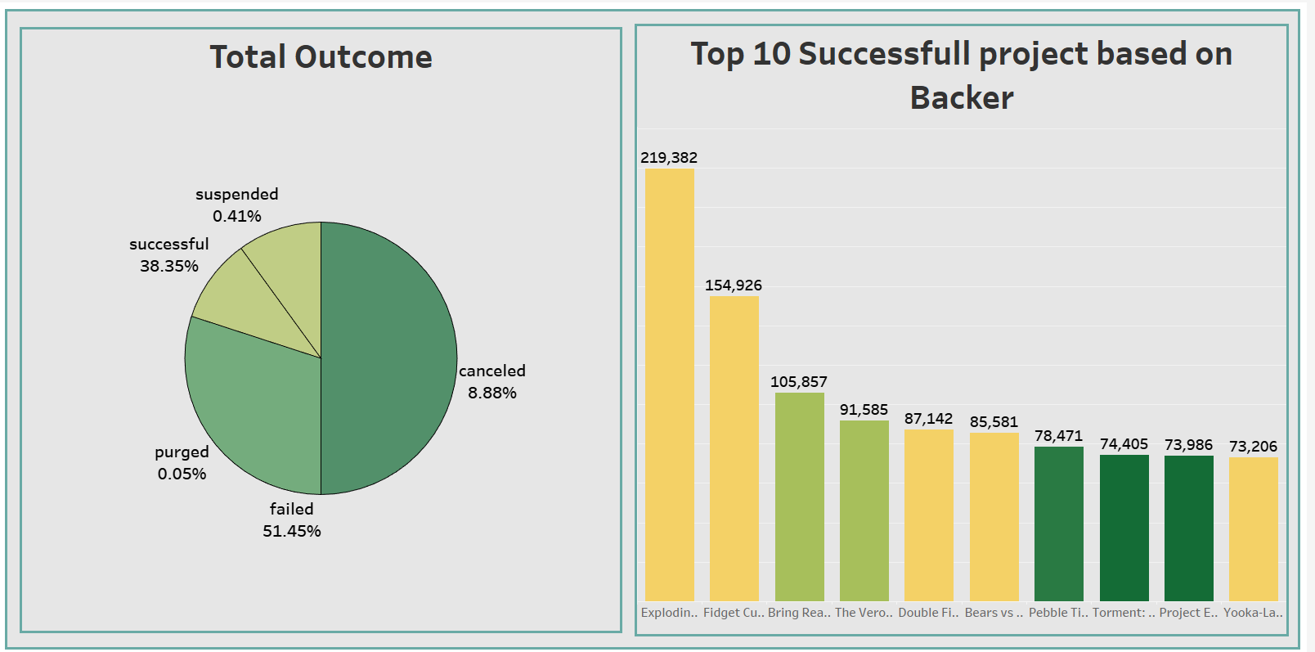
Dashboard-3 (Tableau)

Slide 19

Let’s Talk About Some SQL Code

Slide 20
Thank You For Being a Patient Listener

