Slide 1

RCC INSTITUTE OF INFORMATION TECHNOLOGY DEPT OF ELECTRONICS AND COMMUNICATION ENGINEERING
CA-1 PRESENTATION
NAME: Sk Sumit Ahmed
YEAR: 3rd
SEM: 6th
CLASS ROLL NUMBER: ECE2023065
UNIVERSITY ROLL NUMBER: 11700323087
PAPER NAME: Computer Network
PAPER CODE: EC602

Slide 2
OSI layer structure
Content
Overview: What is the OSI Model?
The Layered Approach: Why do we split it up?
The 7 Layers: A Top-Down Walkthrough.
Real-World Analogy: The "Letter Writing" Concept.
Data Flow: Encapsulation & Decapsulation.
Comparison: OSI vs. TCP/IP.
Conclusion.
References.

Slide 3
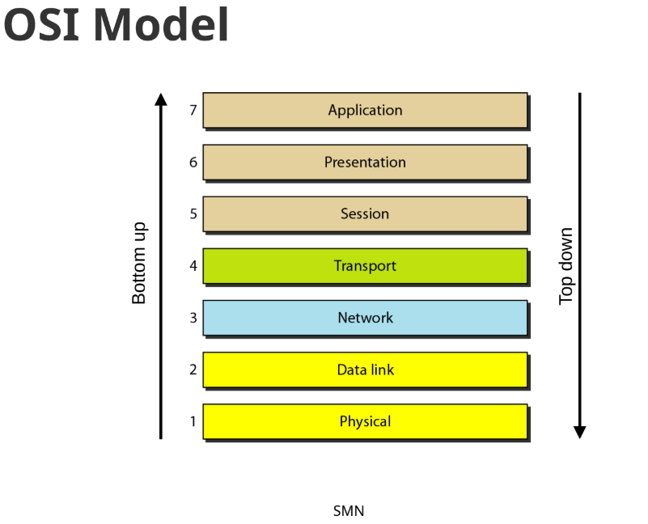
What is the OSI Model?
Definition: The Open Systems Interconnection (OSI) model is a theoretical framework that describes how data flows between computers.
Purpose:
It divides the complex problem of networking into seven smaller, manageable problems.
This separation is called "Layering".
It serves as a standard so different computer systems can communicate.

Slide 4
The "Letter Writing" Analogy (Upper Layers)
Content: To understand the layers, let's use the analogy from our lecture notes: Sending a Letter
Layer 7: Application -> "You write the letter."
This is the user interaction phase
Layer 6: Presentation -> "You write in English."
This ensures the format (language/syntax) is understood by the receiver
Layer 5: Session -> "You arrange a meeting."
This establishes the start and end of the communication

Slide 5

The "Letter Writing" Analogy (Lower Layers)
Layer 4: Transport <- "You choose the delivery speed."
Deciding between fast delivery (UDP) or safe/registered delivery (TCP)⁹
Layer 3: Network <- "The postal system finds the route."
Routing the letter to the correct address
Layer 2: Data Link <- "The postal worker ensures delivery."
Local delivery to the specific mailbox
Layer 1: Physical <- "The letter moves via road or air."
The actual physical movement of data (cables, Wi-Fi)

Slide 6
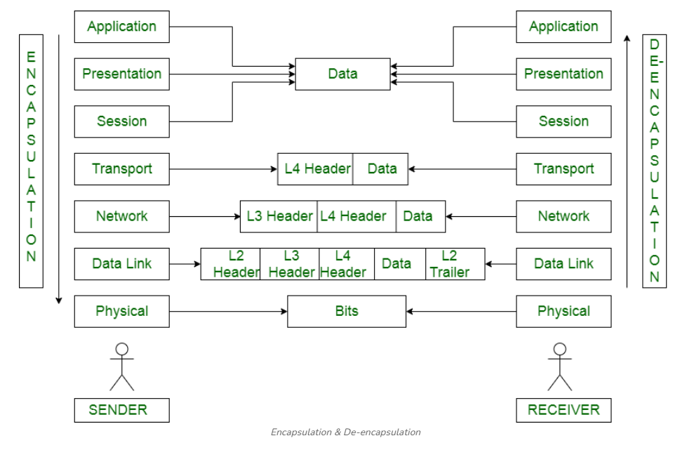
How Data Moves (Encapsulation)
🔹Going Down: As data moves from Application to Physical, each layer adds a "Header" (meta-data). This is like putting the letter in an envelope, then stamping it.
Going Up: When the receiver gets it, they strip away these headers layer by layer to get the original message.

Slide 7
Comparison - OSI vs. TCP/IP
While OSI is 7 layers, the practical model we use for the Internet is TCP/IP (4 Layers)
Feature | OSI Model | TCP/IP Model
Layers | 7 Layers | 4 Layers
Focus | Theoretical / Learning | Practical / Real-World
Usage | Understanding concepts | Actual Internet (HTTP, IP)

Slide 8
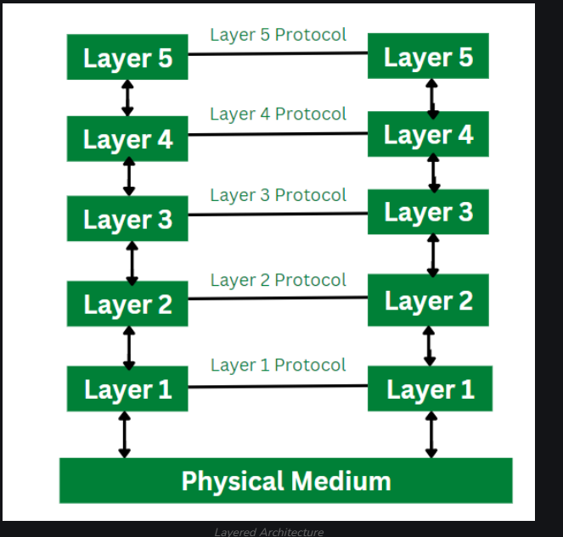
Why Use a Layered Architecture?
Simplicity: It breaks networking into smaller pieces that are easier to design and troubleshoot.
Flexibility: If we want to upgrade the hardware (Physical Layer), we don't have to rewrite the Application software (Layer 7).
Debugging: It's easier to find errors. (e.g., Is the cable broken? Or is the server down?) .

Slide 9
.
Conclusion
The OSI Model provides the universal standard for how different systems communicate.
It moves data from the Application (Software) down to the Physical (Hardware) using specific protocols at every step.
Key Takeaway: "OSI is for learning how the network works; TCP/IP is for actually building the network".
References
Lecture Notes: Dr. Sujoy Mondal, Dept. of ECE, RCCIIT - "Computer Network: Introduction".
Textbook: B. A. Forouzan, "Data Communications and Networking" (3rd Ed.), TMH.
Textbook: W. Stallings, "Data and Computer Communications" (5th Ed.), PHI.
Online Resource: NPTEL Course - Computer Networks and Internet Protocol, IIT Kharagpur.

