Slide 1


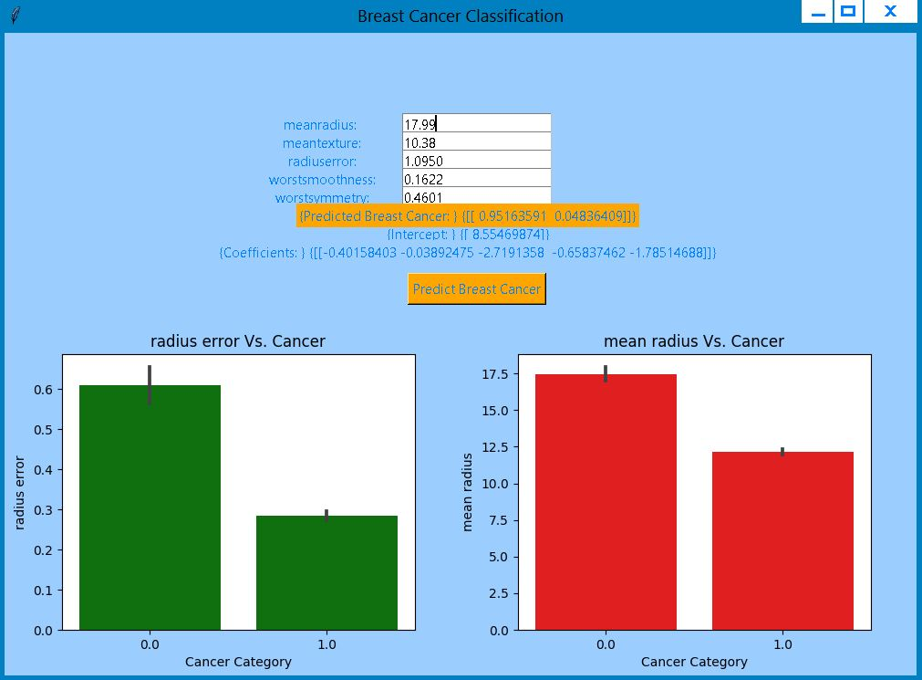
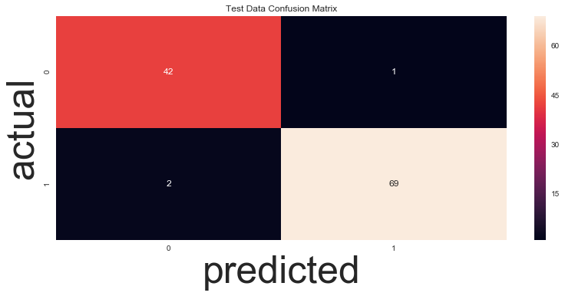
PREDICTIVE MODELLING And
CLUSTER ANALYSIS
Ravinder Singh(CSE), Sumit Anand(CSE), Akshay Kumar(CSE)
Abstract
Society Welfare
Predictive Modelling is a process that uses data mining and probability to forecast outcomes. Each Model is made up of predictors, which are variables likely to influence future results. After collecting data a statistical model is formulated. As additional data becomes available, the statistical analysis model is validated or revised.
Cluster Analysis or Clustering is the task of grouping a set of objects in such a way that objects in the same group are more similar to each other than to those in other groups. It is main task of exploratory data mining and a technique for statistical data analysis. Used in Machine Learning, Pattern Recognition, Image Analysis, etc.
Early prediction of breast cancer can help many women to take curable and measurable actions to avoid the breast cancer.
If you are over 40, get a yearly mammogram. A recent Swedish Cancer Institute study revealed that women between the ages of 40-49 who’ve had yearly mammograms and subsequent breast cancer diagnosis fare better than those that don’t. All women 18 and over should do an monthly beast self-exam and get an annual clinical breast exam. All lumps are not breast cancer, but you should not ignore suspicious lumps.
Improve product and services for welfare of society.
While you are improving your product, conducting a customer segmentation project will help you create a customized and more focused marketing message. The message will target each of your best segments, resulting in higher interest in your product.
Better Products more customer satisfaction and more the development of society.
Technology Used
Python
Machine Learning
Logistic Modelling
Clustering Modelling
Data Visualization(Seaborn)
Data Munging
Results/Application
Description
This is a copy of UCL ML Breast Cancer Wisconsin(Diagnostic)datasets.
Features are computed from a digitized image of a fine needle aspirate(FNA) of a breast mass. They describe characteristics of
the cell nuclei present in the image.
Attribute Information
- Radius(mean of distances from centre to points on the perimeter)
- Texture(standard deviation of grey-scale values)
- Perimeter
- Area
- Smoothness (local variation in radius lengths)
- Compactness (perimeter^2/area-1.0)
- Concavity(severity of concave portions of the contour)
- Concave points(number of concave portions of the contour)
- Symmetry
- Fractal dimension(“Coastline approximation”-1)
- Class:
- WDBC-Malignant
- WDBC-Benign
2. To develop a customer segmentation to define marketing strategy. The sample data-set summarizes the usage behaviour of about 9000 active credit card holders during the last 6 months. The file is at a customer level with 18 behavioural variables.

