Slide 1

Selenium + JAVA Online Training
Week 1 - Day 1
By- Pallavi
From www.SoftwareTestingHelp.com
SoftwareTestingHelp.org
By SoftwareTestingHelp.com World’s #1 Software Testing Portal

Slide 2
Guidelines
6 week, 3 days in a week. Each session is for 2 hours. We will have a break of 10 minutes in between
Setting the GoTo Webinar-
Please select “Mic & Speakers” in Audio section.
We will be taking up questions towards end of the session. Please send your questions to “Organizer” through the Questions/Chat window. We will take up as many questions as possible. In case we are not able to take up all the questions, we will respond on your e-mail.
You will be muted throughout the presentation. Only in the Q&A time you are requested to ask question
Recordings of each session and other materials will be shared at the end of each session
Email Contact- sthseleniumcourse@gmail.com
SoftwareTestingHelp.org
By SoftwareTestingHelp.com World’s #1 Software Testing Portal

Slide 3

Agenda
Need of Test Automation
Why Open Source Test Automation
Introduction to Various tools of Test Automation – Open Source
Introduction of Selenium
SoftwareTestingHelp.org
By SoftwareTestingHelp.com World’s #1 Software Testing Portal

Slide 4

What is Software Test Automation?
Software test automation refers to the activities and efforts that intend to automate engineering tasks and operations in a software test process using well-defined strategies and systematic solutions.
Objectives of software test automation:
-Decrease Cost
Decrease Time to Delivery
Effective utilization of resources
Reduce redundancy of task
SoftwareTestingHelp.org
By SoftwareTestingHelp.com World’s #1 Software Testing Portal

Slide 5
Requirements for Software Test Automation
Dedicated Work Force
Dedicated Budget and Schedule
Well Defined plan and Strategy
Trained Human Resources
Senior Management Commitment
Effective Tools for Creation and Maintenance
SoftwareTestingHelp.org
By SoftwareTestingHelp.com World’s #1 Software Testing Portal

Slide 6
Web Functional Testing Tools
Commercial or Proprietary
Open Source
HP QTP
Smart Bear
Test Complete
IBM RFT
Boralnd SILK
WATIR
SELENIUM
SAHI
SOAPUI
SoftwareTestingHelp.org
By SoftwareTestingHelp.com World’s #1 Software Testing Portal

Slide 7
Why Open Source Tools
Low Cost
Customizable
Faster Time to Market
Ease of Procurement
Contributing back to Community
SoftwareTestingHelp.org
By SoftwareTestingHelp.com World’s #1 Software Testing Portal

Slide 8
Open Source Tools- Web Functional
Watir – Web Application Testing in Ruby
http://watir.com/
Selenium- Browser Automation
http://docs.seleniumhq.org/
Sahi – Tester’s Web Automation tool
http://sahi.co.in/
More Available on - http://www.opensourcetesting.org/functional.php
SoftwareTestingHelp.org
By SoftwareTestingHelp.com World’s #1 Software Testing Portal

Slide 9

What is Selenium?
Selenium is a portable software testing framework for web applications.
The tests can be written as HTML tables or coded programming language.
Selenium can be deployed on Windows, Linux, and Macintosh.
Selenium is used for UAT (User Acceptance Test)
SoftwareTestingHelp.org
By SoftwareTestingHelp.com World’s #1 Software Testing Portal

Slide 10
History of Selenium
In 2004 invented by Jason R. Huggins and team.
Original name is JavaScript Functional Tester [JSFT]
Open source browser based integration test framework built originally by Thoughtworks
SoftwareTestingHelp.org
By SoftwareTestingHelp.com World’s #1 Software Testing Portal

Slide 11
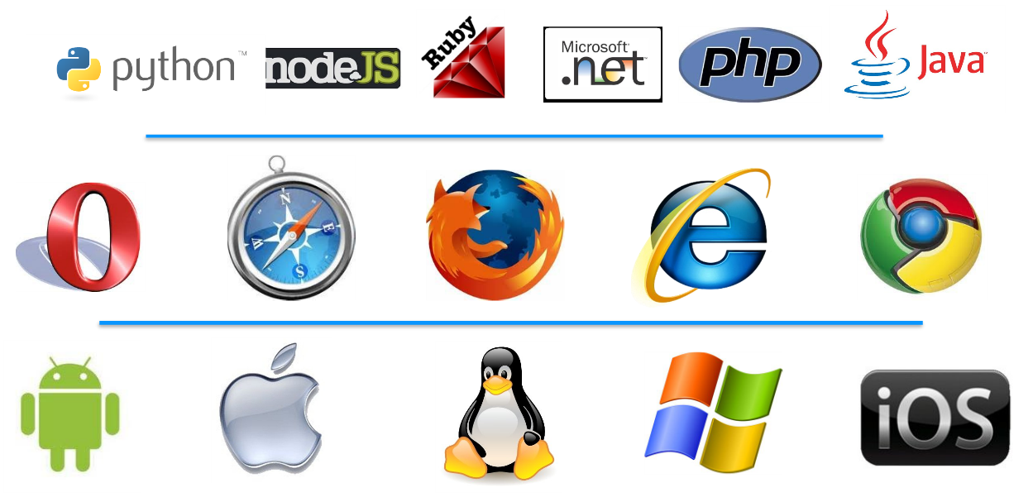
Features
Supports Multi Browsers and Multi OS.
Scripting in several languages - Java, C#, ruby, Python.
Assertion, verification and inbuilt reporting.
SoftwareTestingHelp.org
By SoftwareTestingHelp.com World’s #1 Software Testing Portal

Slide 12
License Information
Selenium was developed by a team of programmers and testers at ThoughtWorks.
Selenium is open source software, released under the Apache 2.0 license and can be downloaded and used without charge.
Home Page- http://www.seleniumhq.org/
SoftwareTestingHelp.org
By SoftwareTestingHelp.com World’s #1 Software Testing Portal

Slide 13
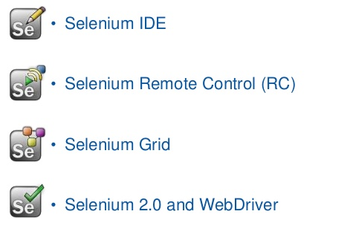
Components of Selenium
SoftwareTestingHelp.org
By SoftwareTestingHelp.com World’s #1 Software Testing Portal

Slide 14
Selenium IDE
An integrated development environment for Selenium tests.
A Firefox extension, and allows you to record, edit, and replay the test.
Allows you to save tests as HTML, Java, Ruby scripts, or any other format
It allows you to automatically add assertions to all the pages.
SoftwareTestingHelp.org
By SoftwareTestingHelp.com World’s #1 Software Testing Portal

Slide 15
Selenium RC
A solution to cross browser testing.
A server, written in Java and so available on all the platforms.
Acts as a proxy for web requests from them.
Client libraries for many popular languages.
SoftwareTestingHelp.org
By SoftwareTestingHelp.com World’s #1 Software Testing Portal

Slide 16
Selenium WebDriver
Selenium-WebDriver makes direct calls to the browser using each browser’s native support for automation.
Selenium RC ‘injected’ javascript functions into the browser when the browser was loaded and then used its javascript to drive the AUT within the browser.
WebDriver does not use this technique. Again, it drives the browser directly using the browser’s built in support for automation.
SoftwareTestingHelp.org
By SoftwareTestingHelp.com World’s #1 Software Testing Portal

Slide 17
Selenium Grid
Selenium-Grid allows the Selenium-RC solution to scale for test suites or test suites to be run in multiple environments.
With Selenium-Grid multiple instances of Selenium-RC are running on various operating system and browser configurations.
Tests are sent to the hub they are then redirected to an available Selenium-RC, which will launch the browser and run the test.
This allows for running tests in parallel, with the entire test suite theoretically taking only as long to run as the longest individual test
SoftwareTestingHelp.org
By SoftwareTestingHelp.com World’s #1 Software Testing Portal

Slide 18
Preparing Your System
Requirements –
Availability of Firefox Browser
Web Application URL under test
http://www.carguruji.com/shop/
Demo of Installation of Selenium IDE
SoftwareTestingHelp.org
By SoftwareTestingHelp.com World’s #1 Software Testing Portal

Slide 19
Application Under Test
We will be using an eCommerce Website for the sessions on selenium and java.
The url of the website is - http://www.carguruji.com/shop/
Important scenarios are as follows-

Slide 20
Scenarios
Register a new user
Login – Logout
Change profile information
Search for product
Buy Product

Slide 21
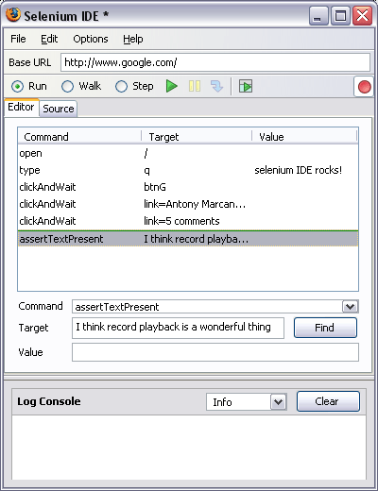
Selenium IDE - UI
Start and Stop
Recording
Replay
Toolbar
Selenese
Script
Editor
Accessor
Area
Selenium Log
SoftwareTestingHelp.org
By SoftwareTestingHelp.com World’s #1 Software Testing Portal

Slide 22
Record and Replay Selenium IDE
Once the system is prepared, open firefox
Open the url of the application under test and launch the selenium ide.
Perform steps of the scenario example login of user, simultaneously the steps will be captured in IDE
Stop test and replay to see the recorded scenario.
SoftwareTestingHelp.org
By SoftwareTestingHelp.com World’s #1 Software Testing Portal

Slide 23
Selenium IDE Features
Record and playback
Intelligent field selection will use IDs, names, or XPath as needed
Auto complete for all common Selenium commands
Walk through test cases and test suites.
Debug and set breakpoints
Save tests as HTML, Ruby scripts, or other formats
Option to automatically assert the title of every page
Rollup common commands
SoftwareTestingHelp.org
By SoftwareTestingHelp.com World’s #1 Software Testing Portal

Slide 24

Q&A
SoftwareTestingHelp.org
By SoftwareTestingHelp.com World’s #1 Software Testing Portal

Slide 25

SoftwareTestingHelp.org
By SoftwareTestingHelp.com World’s #1 Software Testing Portal

