Slide 1





BRIEF STUDY ON HYDROGEN MOLECULAR ION
A BRIEF STUDY ON HYDROGEN MOLECULAR ION
SUMITAVA KUNDU
B.Sc 3RD YEAR
ROLL NO- 0157
ST.XAVIER’S COLLEGE , KOLKATA
SUPERVISOR – DR.SUDIPTO ROY

Slide 2

The hydrogen molecular ion, dihydrogen cation, or 𝐻2+, is the simplest molecular ion. It is composed of two positively charged protons and one negatively charged electron, and can be formed from ionization of a neutral hydrogen molecule

Slide 3
Here I shall consider Born-Oppenheimer approximation and formulate the electronic Hamiltonian for 𝐻2+in atomic units. Then considering the LCAO-MO (Linear Combination of Atomic Orbitals- Molecular Orbitals), I will consider a short treatment on energy calculation. Then I shall plot energy for ground state and first excited state and formulated the wave functions, and probability density for it
Aim:
AIM
:

Slide 4
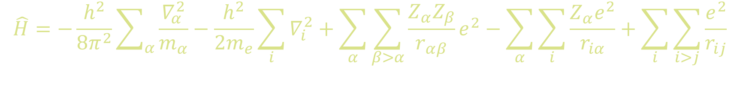
The Born-Oppenheimer approximation is:
$$\hat{H}=−\frac{h^{2}}{8π^{2}}\sum_{α}{\frac{∇_{α}^{2}}{m_{α}}}−\frac{h^{2}}{2m_{e}}\sum_{i}{∇_{i}^{2}}+\sum_{α}{\sum_{β>α}{\frac{Z_{α}Z_{β}}{r_{αβ}}}}e^{2}−\sum_{α}{\sum_{i}{\frac{Z_{α}e^{2}}{r_{iα}}}}+\sum_{i}{\sum_{i>j}{\frac{e^{2}}{r_{ij}}}}$$

Slide 5
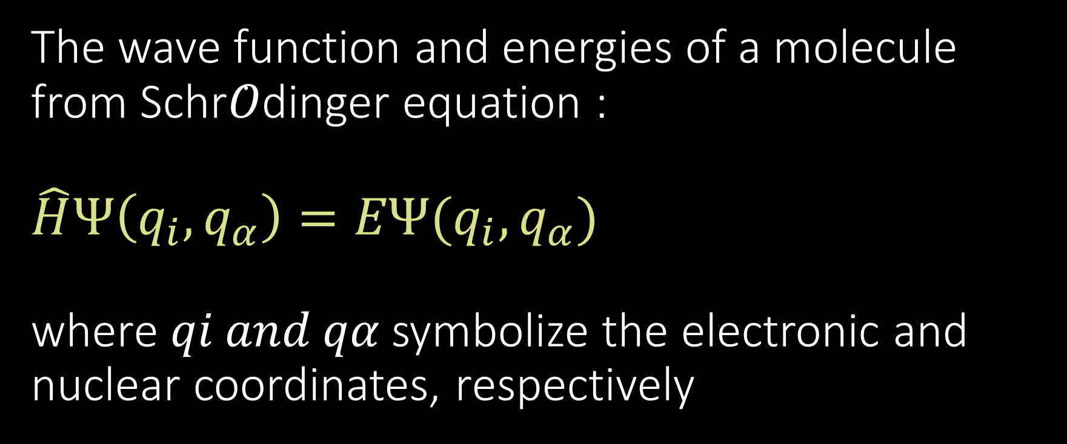
The wave function and energies of a molecule from Schr𝑂̈dinger equation : $\hat{H}Ψ\left(q_{i},q_{α}\right)=EΨ(q_{i},q_{α})$ where 𝑞𝑖 𝑎𝑛𝑑 𝑞𝛼 symbolize the electronic and nuclear coordinates, respectively

Slide 6
Considering the nuclei as fixed, we eliminate the nuclear kinetic energy terms to obtain the Schr𝑂̈dinger equation for electronic motion: Where the purely electronic Hamiltonian 𝐻̂𝑒𝑙 is:
$${(\hat{H}}_{el}+V_{NN})ψ_{el}=Uψ_{el}$$
${\hat{H}}_{el}=\frac{h^{2}}{8m_{e}π^{2}}\sum_{i}{∇_{i}^{2}} −\sum_{α}{\sum_{i}{\frac{Z_{α}e^{2}}{r_{iα}}}}$ +$\sum_{j}{\sum_{i>j}{\frac{e^{2}}{r_{ij}}}}$

Slide 7

Let the nuclei are at a and b; R is the inter-nuclear distance; $r_{a}$and $r_{b}$are the distances from the electron to nuclei a and b. Since, nuclei are fixed, we have a one particle problem whose purely electronic Hamiltonian is:
Electronic energy with (U) and internuclear repulsion for the ground electronic state

Slide 8


The 𝐻2+ electronic Schr𝑂̈dinger equation is not separable in spherical coordinates. However, separation of variable is possible in confocal elliptical coordinates 𝜉, 𝜂,𝑎𝑛𝑑 𝜙 At R=∞ the 𝐻2+ ground state is dissociated into a proton and a ground state hydrogen atom; hence 𝐸𝑒𝑙(∞)=-1/2 hartree. At R=0, the two protons have come together to form the 𝐻𝑒+ ion with ground state energy: - $\frac{1}{2}{(2)}^{2}$ hartrees = - 2 hartrees. Addition to the inter-nuclear repulsion 1/R (in atomic units) to 𝐸𝑒𝑙(𝑅) gives the U(R) potential energy curve for nuclear motion.
$$ψ_{el}=L\left(ξ\right)M(η){(2π)}^{−1/2}e^{imφ}$$

Slide 9
Electronic energy with (U) and without internuclear repulsion for the ground electronic state

Slide 10
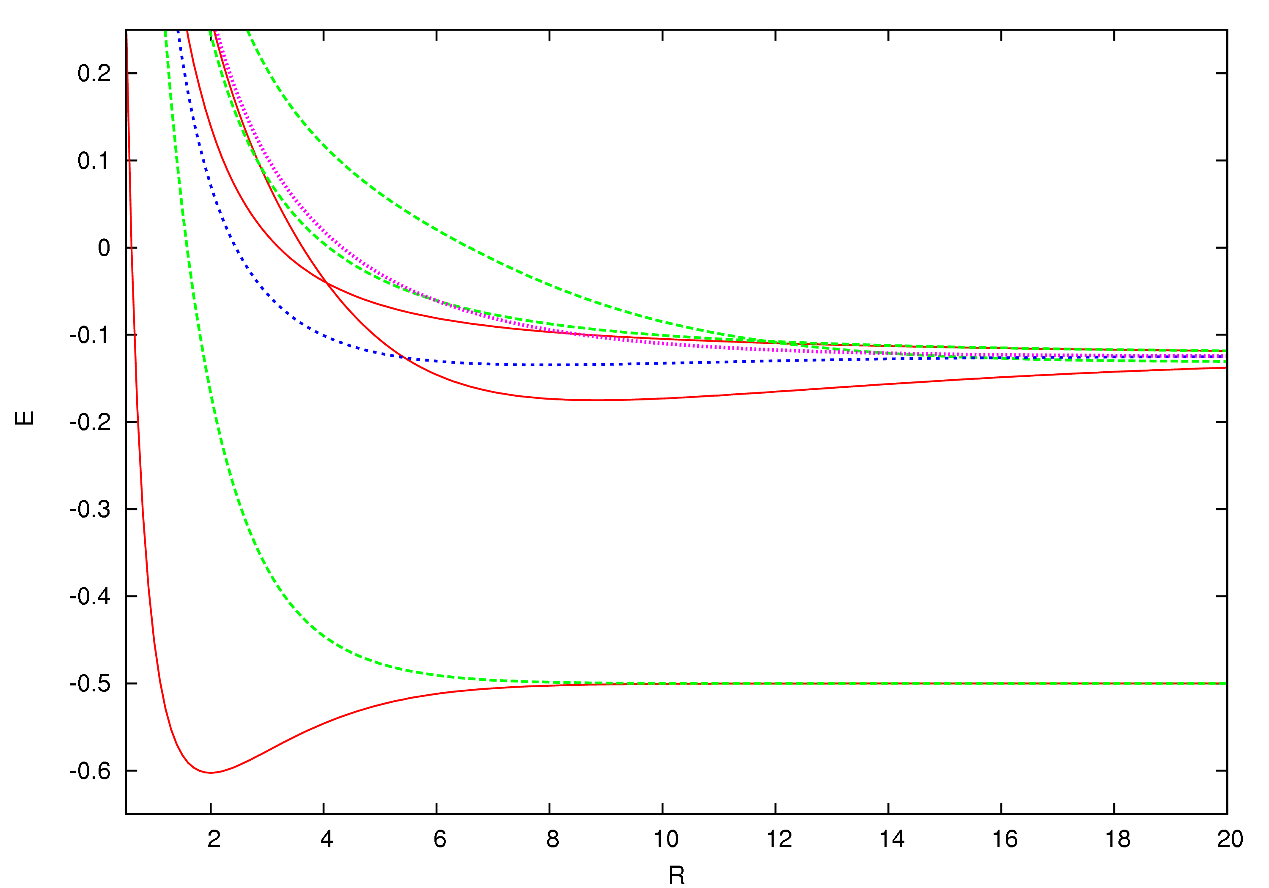


If we plot the electronic energy including nuclear repulsion for a bound state of a diatomic molecule against the nuclear distance R ----------
$$σ_{u}^{∗}1s$$
$$σ_{g}1s$$

Slide 11

Now we are going to calculate the energy equation for hydrogen molecular ion
When the nuclear is near the nucleus a, nucleus b is far away that we essentially have a hydrogen atom with origin at a. Thus $r_{a}$ is small .For Z=1 , ground state wave function becomes
$$π^{−\frac{1}{2}}e^{−r_{a}}$$
Similarly, we conclude that when the electron is near nucleus b then the wave function will be
$$π^{−\frac{1}{2}}e^{−r_{b}}$$
Then we can try a variation function
$c_{1}π^{−\frac{1}{2}}e^{−r_{a}}$ +$c_{2}π^{−\frac{1}{2}}e^{−r_{b}}$
Where $c_{1}$ and $c_{2}$ are variational parameters.

Slide 12

We have improved a trail function .Considering the limiting behavior of the $H_{2}^{+}$ ground state electronic wave function As R goes to zero.In the limiting case, we get the ${He}^{+}$ ion ,which has the ground state wave function
$$2^{3/2}π^{−1/2}e^{−2r}$$
Contradiction:
Hence, as R goes to zero the trail function goes to$(c_{1}+c_{2})π^{−1/2}e^{−2r}$ .
If we compare this equation with the previous equation then see our trail function has the wrong limiting behavior at R=0
It should go to $e^{−2r}$

Slide 13

To get rid of this contradiction ,take a variational parameter k, k=k(R)
For the correct limiting behavior at R=0 and R= $∝$ ,we have k(0)=2 and k($∝$)=1 for the ground electronic state.
We thus take the trial function as
$φ=c_{a}1s_{a}$+$c_{b}1s_{b}$
Where
$1s_{a}=k^{3/2}π^{−1/2}e^{−kr_{a}}$ , $1s_{b}=k^{3/2}π^{−1/2}e^{−r_{b}}$
$k^{3/2}$ is the normalization constant

Slide 14

The secular equation is
$\left|\begin{matrix}H_{aa}−WS_{aa} & H_{ab}−WS_{ab} \\ H_{ba}−WS_{ba} & H_{bb}−WS_{bb}\end{matrix}\right|$=0
Calculating this we get the expression for $W_{1}$ and $W_{2}$
$W_{1}=\frac{H_{aa}+H_{ab}}{1+S_{ab}}$ and $W_{2}=\frac{H_{aa}−H_{ab}}{1−S_{ab}}$
Then we have evaluated the expression for $S_{ab}$, $H_{aa},H_{ab}$
And substitute those to the following equations

Slide 15

Solving this equations we get that
$$φ_{1}=\frac{1s_{a}+1s_{b}}{\sqrt{2}{(1+s_{ab}^{})}^{1/2}}$$
And
$$φ_{2}=\frac{1s_{a}−1s_{b}}{\sqrt{2}{(1−s_{ab}^{})}^{1/2}}$$

Slide 16

Now our final expression for energy is
$$W_{1,2}=−\frac{1}{2}k^{2}+\frac{k^{2}−k−R^{−1}(1+kR)e^{−2kR}±k(k−2)(1+kR)e^{−kR}}{1±e^{−kR}(1+kR+k^{2}R^{2}/3)}$$
We can add 1/R term to $W_{1,2}$ to get $U_{1,2}(R)$.
Then I have varied the parameter k at many fixed values of R to minimize first $U_{1}\left(R\right)$ and then $U_{2}(R)$

Slide 17

For the $1s_{a}+1s_{b}$ function , k increases almost monotonically from 1 to 2 as R decreases from $∝$ to 0.
And for the $1s_{a}−1s_{b}$ function k decreases almost monotonically from 1 to 0.4 as R decreases from $∝$ to 0.
Here is a question:
Why the parameter k for the $σ_{u}^{∗}1s$ state goes to 0.4, rather than to 2, as R goes to 0.
The answer is that this state of $H_{2}^{+}$ does not go to the ground state (1s) of ${He}^{+}$ as R goes to 0.

Slide 18
Now we have plotted U (hartree) vs R value then we have got the following curve ---------

Slide 19
Here we have calculated the value of U(R)= 16.3402eV for R=2.00 bohr (True value 15.96eV) and ground state binding energy 𝐷𝑒 = 0.103 hartree = 2.8027 eV, where the exact value is 𝐷𝑒 = 0.1026 hartree = 2.79 eV.
So, our estimation is almost same to the theoretical value
Here this is our success !!!!!!!

Slide 20

AN EMPERICAL FORMULA :
Here, we are trying to introduce an empirical formula in terms of k and R , where k varies from 1 to 2, and R varies from ∞ to zero.
$$k\left(R\right)=1+b∗e^{−R/c}$$
Now we substitute this expression of k into the energy equation. So, we have got the expression of $W_{1,2}$ in terms of R only. Then added the (1/R) term to get the U value

Slide 21
Here this is our required data set
K R U
1.95 0.2 3.07175
1.85 0.4 0.70131
1.75 0.6 0.00018
1.65 0.8 -0.29631
1.55 1.0 -0.44093
1.45 1.2 -0.51587
And so on !!!!
These R and k values are those values for which U is minimum

Slide 22

Where we have got b=1.031196 and c=1.539080
At R= ∞ , k(R) = 1 and at R = 0 , k(R) =1+1.031196 = 2.031196 ~ 2.00
This is plotted for the function ($1s_{a}+1s_{b}$) function

Slide 23

Now our task is to plot the probability density of the wave function. The 𝐻2+ ground state probability density is then
$φ_{1}^{2}=\frac{{(1s_{a}^{}+1s_{b}^{})}^{2}}{2(1+s_{ab})}$ = $\frac{k^{3}π^{−1}{(e^{−k\left|z−a\right|}+e^{−k|z−b|})}^{2}}{2(1+s_{ab})}$
Putting R=2.00 and k =1.25 , we find that 𝑆𝑎𝑏= 0.46. At 2-D x=y=0 then if we plot $φ_{1,2}$ then it is like this (we have considered a=1 and b=2)

Slide 24

This is the plot for probability density along the inter-nuclear axis for the LCAO-MO function for N($1s_{a}+1s_{b}$)

Slide 25
For the function ($1s_{a}−1s_{b}$) the plot is like this :

Slide 26
CONCLUSION :
Here, I have plotted the electronic energy vs R for the ground states and first excited states. And it is almost same as we get it from the theoretical discussions. My calculated ground sate U(R) curve has a minimum at 2.00 bohrs ,where the true value is also 2.00 bohrs and has U(𝑅𝑒) = -15.96 eV . Our predicted value of dissociation energy 𝐷𝑒 = 2.36 eV. Where the true value is 2.79 eV.
Then I have plotted the probability density for the two LCAO-MO functions and got the curves which almost satisfies my discussions.

Slide 27
ACKNOWLEDGEMENT :
I would like to express my special thanks of gratitude to my supervisor,
Dr. Sudipto Roy and all my teachers as well as our principal Father Felix Raj, SJ who gave me the golden opportunity to do this wonderful project on this topic, which also helped me in doing a lot of Research and i came to know about so many new things I am really thankful to them.
Secondly i would also like to thank my parents and friends who helped me a lot in finalizing this project within the limited time frame.

Slide 28
REFERENCES :
1. Quantum Chemistry by Ira N. Levine
2. Molecular Quantum Mechanics by Peter atkins &Ronald Friedman
3. Journal of Chemical Education: JChemED.chem.wisc.edu
4. APS Journals Archive: published by H.C.Urey, Johns Hopkins University, Baltimore,Md
5. Arfken, G. Mathematical Methods for Physicists; Chapter 2.
6. Pryce, J. D. Numerical Solution of Sturm–Liouville Problems;
7. Morse, P. M.; Feshbach, H. Methods of Theoretical Physics;Vol. 2, Chapter 10.
8. Journal of Chemical Education-The hydrogen Molecular Ion Revisited Jean-Philippe GRIV

Slide 29
THANK YOU

