Slide 1
Department of Undergraduate Studies NEPAL COLLEGE OF INFORMATION TECHNOLOGY Balkumari, Lalitpur, Nepal
A Proposal on
ONLINE NOTICE BOARD SYSTEM
(ONBS)
Submitted By
Avash Lal Shrestha, 10406
Bibek Chaudhary, 10409
Sunny Kumar Tamang, 10443
Sandhya Gurung, 10437

Slide 2
Introduction
ONBS is online application for teachers and students to publish and update notice and related Information. ONBS is a web application that can be accessed by the users within the Internet to view and to edit the content of the system. The notice can be modify anytime if needed with just some changes in notice with the help of ONBS.
To provide a range of functionalities to teachers for managing the notices. It includes adding, editing and deleting the notices. ONBS will be developed using a high level object oriented programming language ASP.NET with .net framework version 4.0

Slide 3
Objective
To provide an easy access to notices for all the students anywhere using internet.
To provide students with an interface to view notices and teachers to add notice regarding related issues.
To provide wide range of functionalities to teachers for managing the notices. It includes adding, editing and deleting the notices.
To provide admin with the authority of assigning permissions on particular user to a particular functions.
To provide backup of the previous notices.

Slide 4
Problem Statement
Students are Not able to be updated about notice without visiting college
Content In notice Board are in messy form.
Lack of space Leads to overlapping of Notice.
Problem in finding related Notice.
Old notices are hard to find as they are not archived.
Due to technical Problems Notice are not published on time.

Slide 5
Solution
ONBS helps to post New Notice anytime from any where.
Student can check notice from any where any time.
Less effort to find a notice.
Reduces the Crowd.
Easy to change contents of Notice that has been published earlier.

Slide 6
Methodology
ONBS will be developed in ASP.NET.
Microsoft visual studio will be used for developing this application.
.Net Framework 4.0 will be used.
CSS will be used for styling the web application.
jQuery will be used to provide further user interface functionalities.
Microsoft SQL server management Studio will be used as database Manager.

Slide 7
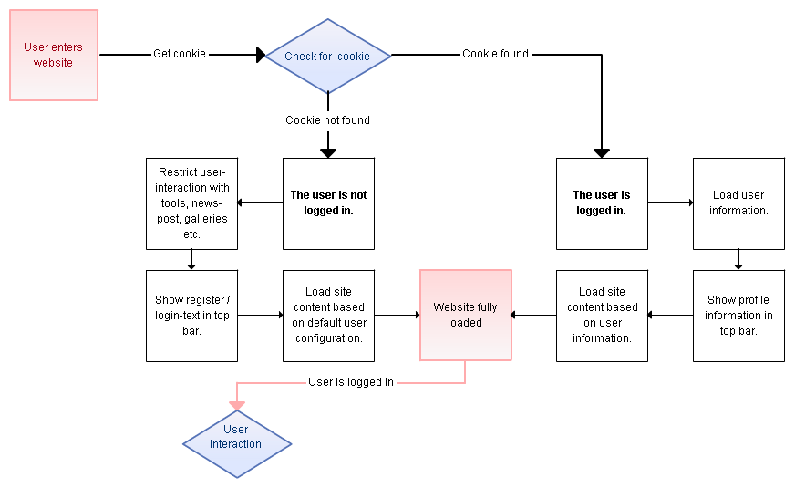
Context Diagaram

Slide 8
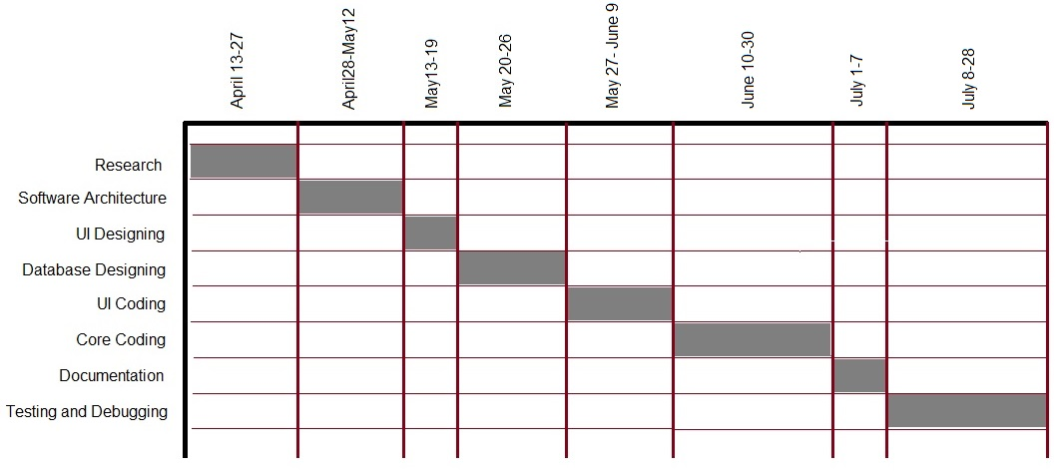
Time schedule ( Gantt Chart )

Slide 9
Conclusion
It will be an online Application to Manage Notice System.
It will be addition to current Notice system but with Higher efficiency and accessibility
It will be live by the end of July
It can be run in any device with Browser and connection to Internet

Slide 10
References
http://www.asp.net/web-forms/tutorials
http://www.tutorialspoint.com/asp.net
http://www.w3school.com
Asp.net for Dummies
jQuery for Dummies
XHTML and CSS for Dummies
https://www.youtube.com/user/kudvenkat

Slide 11

Feedback and Sugestions ☺

Slide 12


