Slide 1


Slide 2
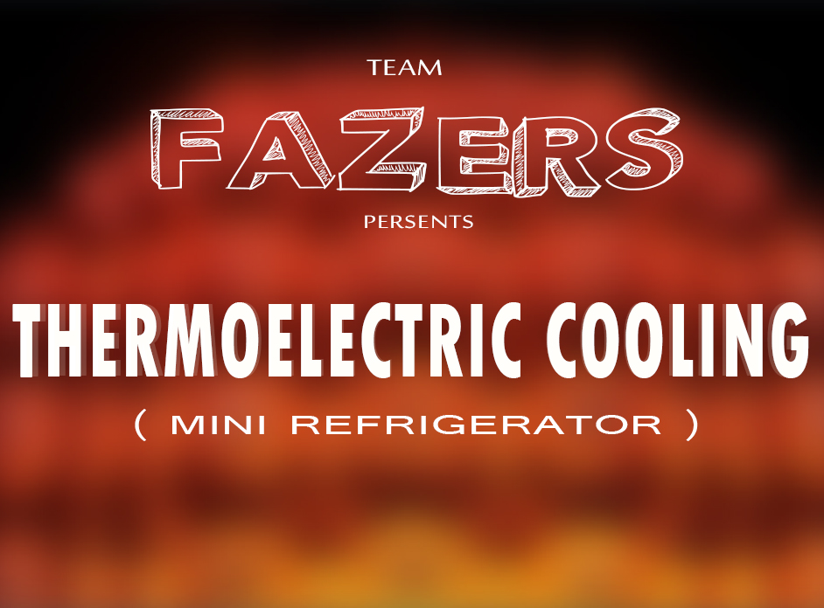

Slide 3

PROBLEM
(Evident Analysis)
The refrigerator is an obvious contributor to global warming because it usually sucks in electricity that was made by burning fossil fuels. But it turns out that the refrigerator does harm to the environment. Due to the presence of CFC’s and HFC’s gases in refrigerator the ozone layer is depleting day by day. While the Montreal Protocol has repaired the ozone layer, a grave downside of the treaty has emerged. CFCs were replaced by hydro fluorocarbons (HFCs), compounds that may not harm the ozone layer, but have proven to be powerful greenhouse gases with remarkable heat-trapping capability.

Slide 4
AFFECTED COMMUNITY
Due to the gases used in refrigerator it affects the environment and various health problems –
Skin Cancer
Eye lens
Migration
Rashes
The refrigerator are non recyclable which causes land pollution
It is not easily affordable for poor peoples
High repairing cost
High power consumption
It is affecting the ozone layer
Ozone layer depletion increases the amount of UVB that reaches the Earth’s surface. Laboratory and epidemiological studies demonstrate that UVB causes non-melanoma skin cancer and plays a major role in malignant melanoma development. In addition, UVB has been linked to the development of cataracts, a clouding of the eye’s lens.

Slide 5
Introduction to Thermo Electric
Refrigeration
When a close circuit of two dissimilar metals and two junctions is formed, a current will flow between the junctions or circuits. This phenomenon is known as seebeck effect. Jean. C. Peltier, a French watch maker and an amateur scientist dicovered a reverse effect of seebeck. He discovered that using joint dissimilar metals heat pump can be made.
He found that by the uses of two dissimilar metals if current is pass between the junctions, the junction will create a temperature difference between them.
One junction becomes hot and other junction becomes cool.

Slide 6
THERMOELECTRIC REFRIGERATION
Thermoelectric cooling uses the peltier effect to create a heat flux between the junctions of two different types of materials. This effect is commonly used in campaign and poratble collers for cooling electronic components and small instruments.
The two dissimilar conductors are doped in a ceramic wafer this ceramic wafer component is peltier module for which produces the cooling effect which we use as component for refrigeration

Slide 7
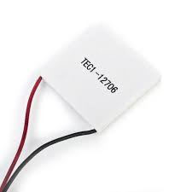
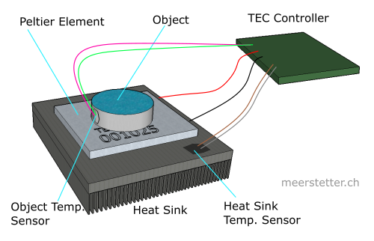
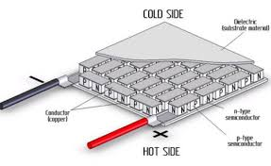
PRINCIPLE OF WORKING
PELTIER EFFECT-
the thermoelectric refrigerator works on the peltier effect that The Peltier Seebeck effect or thermoelectric effect, is the direct conversion of thermal differentials to electric voltage and vice versa.
Related effects are the thomson effect and joule heating. The peltier seebeck and the thomson effect are reversible ( in fact, the peltier and seebeck effect are reversible of one another). Joule heating cannot be reversible under the laws of the thermodynamics

Slide 8
SPECIFICATION OF REFRIGERATOR
Module
Model number: TEC1-12706
Voltage: 12 volt
U max (V) : 15.4v
I max (A) : 10 Amp
Q max (W) : 100 W
Internal Resistance : 1.98 ohm +/-10%
Dimensions : 40mm * 40mm * 3.66mm
Power supply : 350mm
POWER CALCULATIONS
Electrical Data- Source: 12volts DC battery
Power source: 12volts dc battery Module: 12 volts
Rated Supply: 12volts 7.5 amp Fans:7 amps
No. of phase: 1 phase
Fan speed-
Minimum Speed: 1000RPM
Maximum Speed: 3000RPM

Slide 9
Comparison With Normal Refrigerator
S.NO | Criteria | Thermoelectric Refrigerator | Normal Refrigerator
1 | Cooing method | Non cyclic Refrigeration | Vapour compression cycle
2 | Components | Thermoelectric Module | Condenser Compressor Evaporators
3 | Main Advantage | Portable | Non portable
4 | Power Consumption | 12 V | 220 V
5 | COP | Comparatively less | High COP
6 | Uses | Melting of chocolates insulin prevention etc | Ice cold water etc

Slide 10
ADVANTAGES
These are environment friendly. (No CFC’s)
These are light in weight.
Give fast temperature response
it is portable, small in size.
Can be used during travelling
Can be used at military base.
Have no vibrations.
Creates no noise.
APPLICATIONS
For preservation of insulin and other drugs.
for preservation of food stuffs.
For cold water.
for beverages.

Slide 11
***THANK YOU***
TEAM FAZERS-

