Slide 1

Customer Shopping Behavior Analysis
Uncovering insights from 3,900 transactions across product categories — spending patterns, customer segments, and subscription behavior to guide strategic decisions.

Slide 2
Dataset at a Glance
3,900
18
Purchases
Features
Total transactional records analyzed
Columns covering demographics, purchases, and behavior
37
50
Missing Values
Locations
Only in Review Rating — imputed by category median
Unique customer locations across the dataset
Key features include customer demographics (Age, Gender, Subscription Status), purchase details (Category, Amount, Season), and shopping behavior (Discount Applied, Review Rating, Shipping Type).

Slide 3

Data Preparation in Python
Cleaning & Standardization
Loaded via pandas, checked with df.info() and .describe(). Renamed columns to snake_case for consistency.
Feature Engineering
Created age_group by binning ages and purchase_frequency_days from purchase data. Dropped redundant promo_code_used.
Database Integration
Cleaned DataFrame loaded into PostgreSQL for structured SQL analysis.

Slide 4
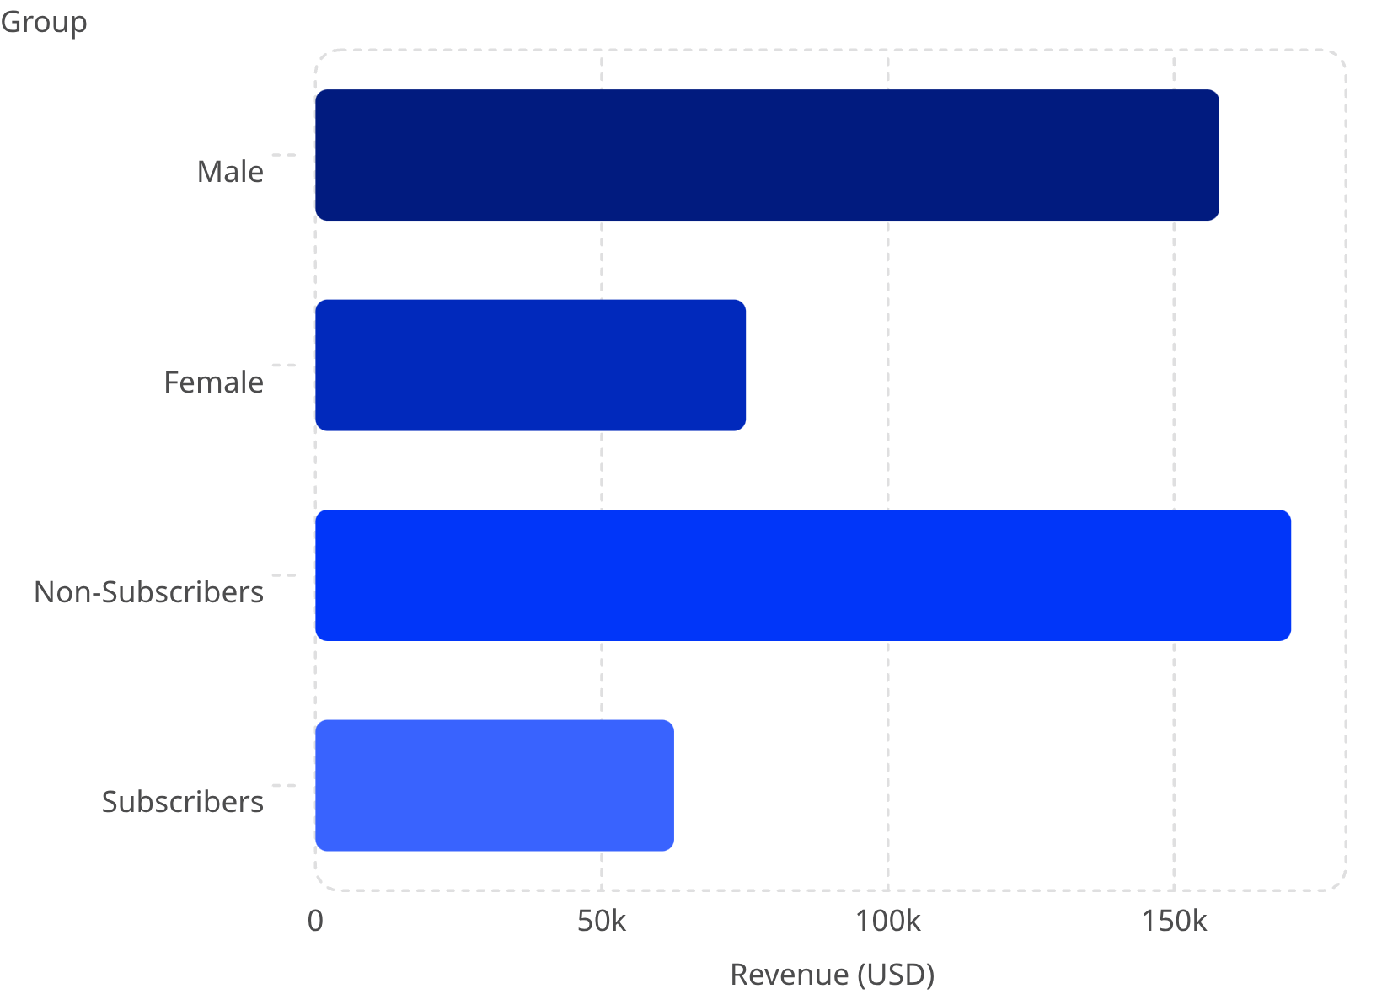
Revenue by Gender & Subscription
Key Findings
Male customers generated $157,890 vs. $75,191 for females — more than double.
Non-subscribers (73% of customers) contributed $170,436 in total revenue, while subscribers (27%) contributed $62,645.
Average spend is nearly identical: $59.87 (non-subscribers) vs. $59.49 (subscribers).

Slide 5
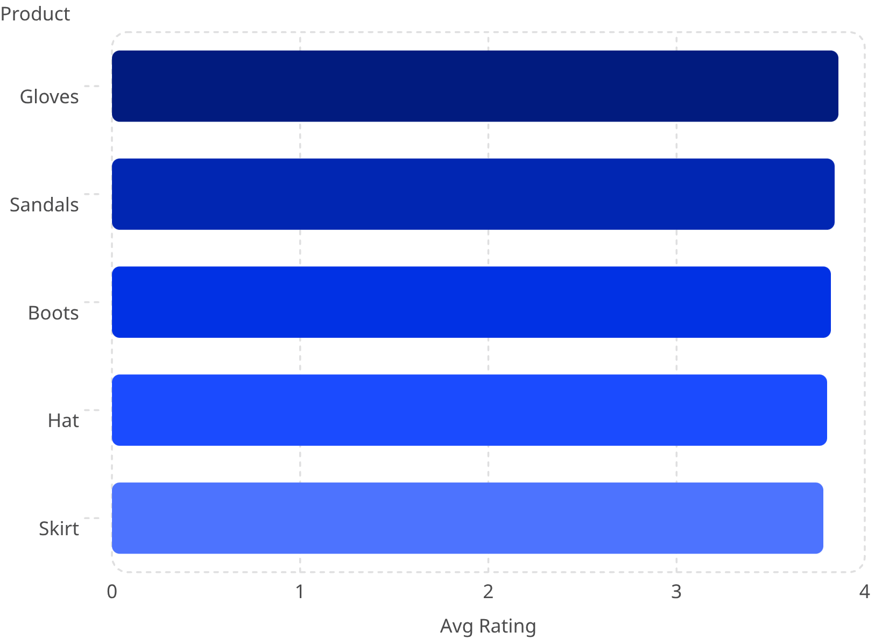
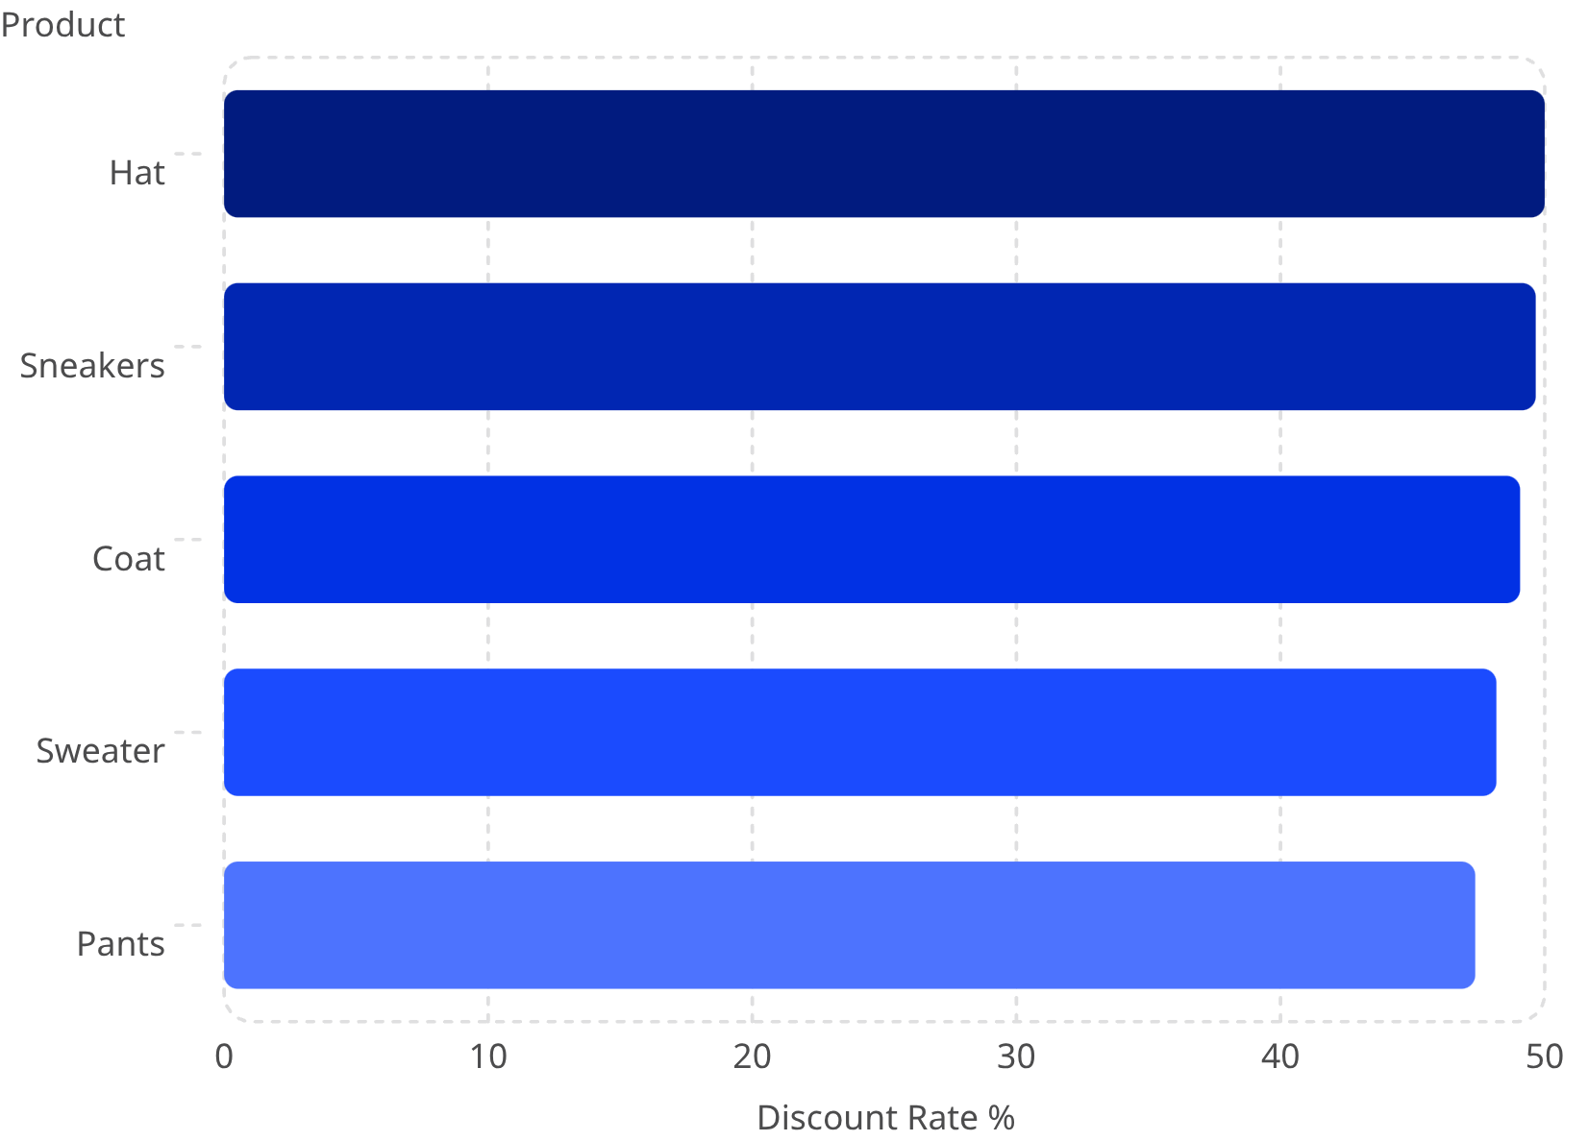
Top Products by Rating & Discount Dependency
Top 5 Products by Rating
Most Discount-Dependent Products
Average purchase amounts were similar across shipping types — $58.46 (Standard) vs. $60.48 (Express). 839 customers used discounts while still spending above the average purchase amount.

Slide 6
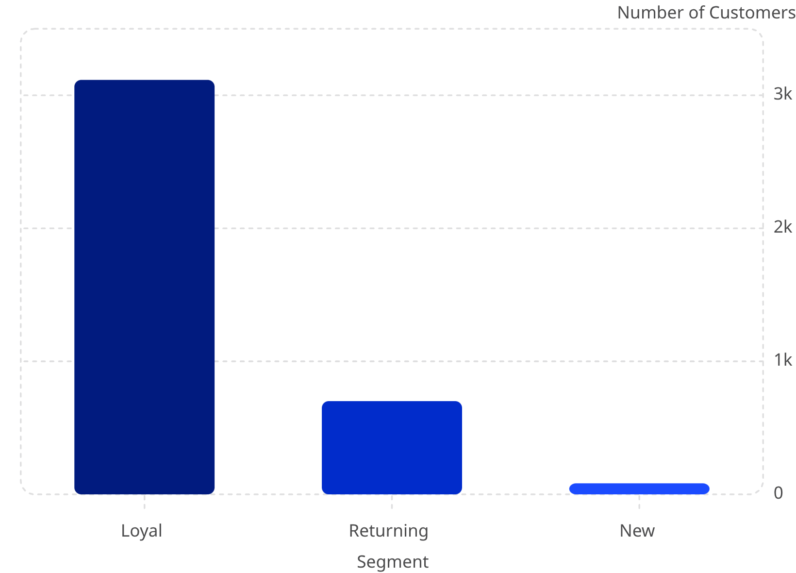
Customer Segmentation
Segment Breakdown
Customers classified into three tiers based on purchase history:
Loyal — 3,116 customers: The dominant segment, representing the core revenue base
Returning — 701 customers: Moderate purchase history with growth potential
New — 83 customers: Smallest segment, representing acquisition opportunities
Of customers with >5 purchases, 958 are subscribers vs. 2,518 non-subscribers.

Slide 7
Top Products by Category
Accessories
Clothing
Jewelry — 171 orders
Sunglasses — 161 orders
Belt — 161 orders
Blouse — 171 orders
Pants — 171 orders
Shirt — 169 orders
Footwear
Outerwear
Sandals — 160 orders
Shoes — 150 orders
Sneakers — 145 orders
Jacket — 163 orders
Coat — 161 orders
Clothing is the dominant category by order volume, with Blouse and Pants tied at 171 orders each. Outerwear has the fewest top products listed.

Slide 8
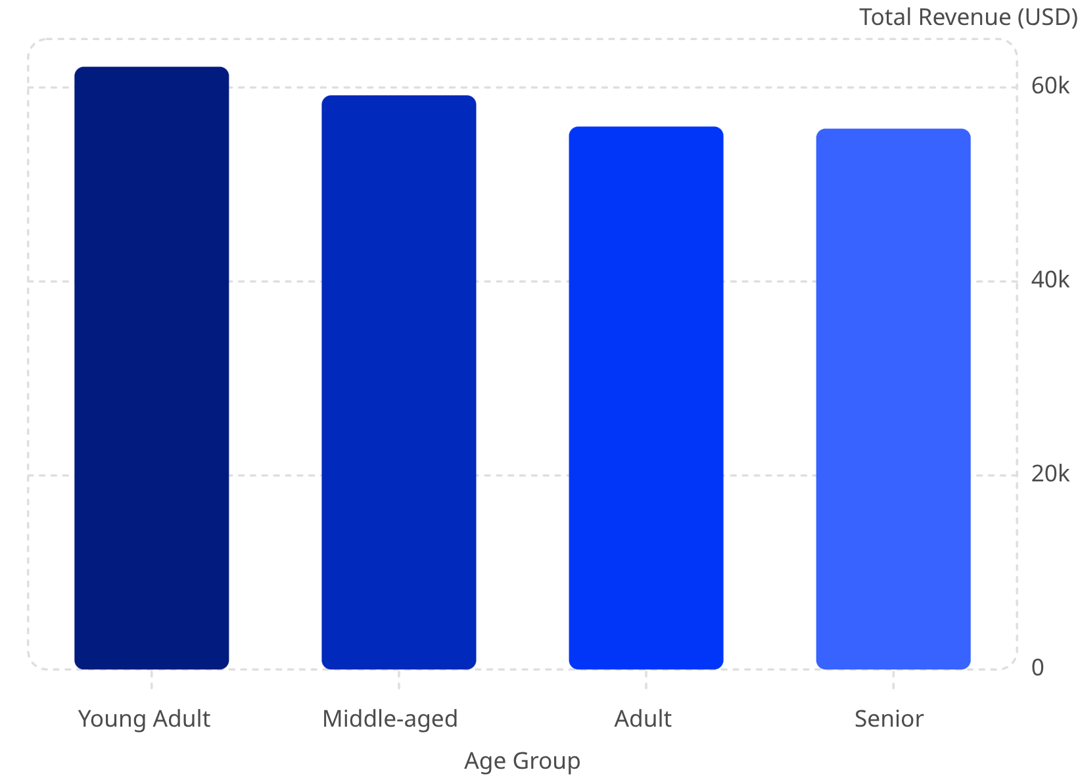
Revenue by Age Group
Age Group Insights
Young Adults lead in revenue contribution at $62,143, followed by Middle-aged ($59,197), Adult ($55,978), and Senior ($55,763).
Revenue distribution across age groups is relatively balanced, with only a $6,380 gap between the highest and lowest contributors.

Slide 9
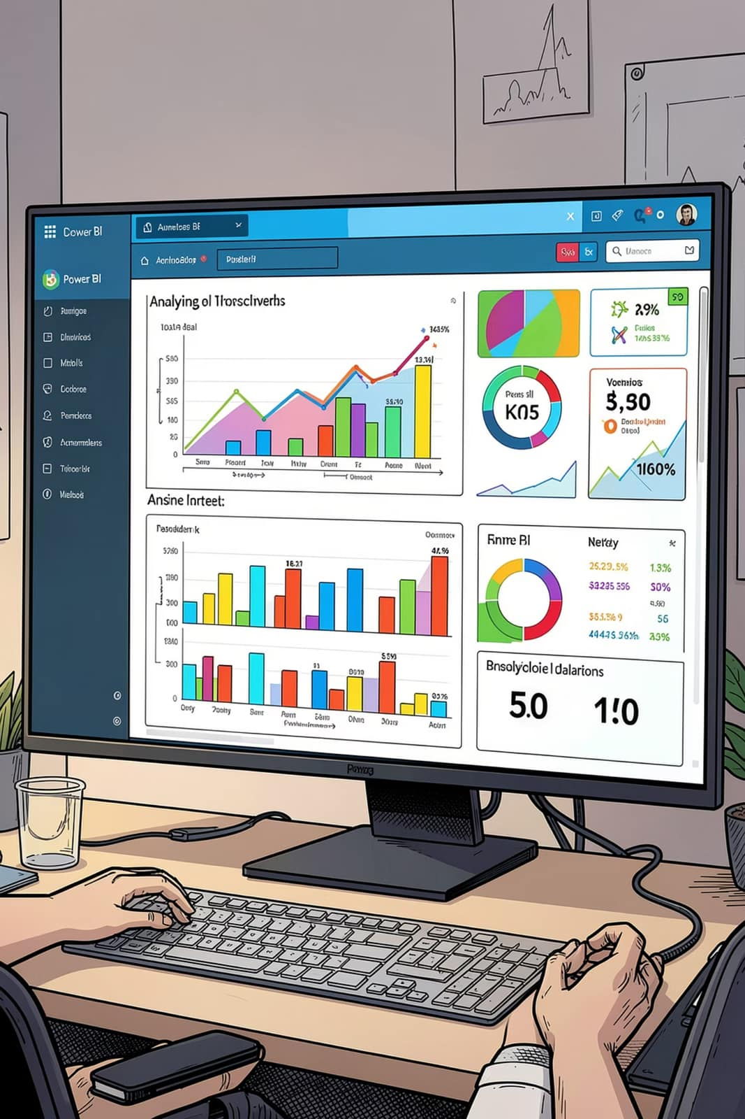
Power BI Dashboard
3.9K Customers
Total customer base tracked
$59.76 Avg Purchase
Mean transaction value
3.75 Avg Rating
Overall review score
27% Subscribers
Subscription penetration rate
Interactive filters cover Subscription Status, Gender, Category (Accessories, Clothing, Footwear, Outerwear), and Shipping Type. Visuals include revenue and sales breakdowns by category and age group.

Slide 10
Business Recommendations
Boost Subscriptions
Loyalty Programs
Review Discount Policy
Promote exclusive subscriber benefits to grow the 27% penetration rate.
Reward repeat buyers to advance them into the "Loyal" segment (3,116 customers).
Balance sales boosts with margin control — Hats and Sneakers are ~50% discount-dependent.
Targeted Marketing
Product Positioning
Focus on high-revenue age groups (Young Adults lead) and express-shipping users.
Highlight top-rated products (Gloves, Sandals, Boots) and best-sellers in campaigns.

