Slide 1

TCO Calculator Model for Cloud Workloads
- Empowering Businesses to Make Informed Decisions on IT Deployment

Slide 2

Introduction
Tool designed to help organizations make informed decisions when comparing on-premises and cloud-based infrastructure costs
This tool takes into account server workload, storage, and labor costs, offering insights into the most cost-effective solutions for your specific needs.

Slide 3

What is TCO:
Total Cost of Ownership encompasses all direct and indirect costs associated with an asset or acquisition over its entire life cycle
TCO is a financial metric that estimates and compares the costs of a product or service.

Slide 4

OUR TCO CALCULATOR:
Our TCO Calculator model provides a comprehensive analysis, comparing the cost of different cloud vendors and on-premises deployments.
It factors in server specifications, storage requirements, and labor costs, alongside network demands, to deliver a detailed total cost of ownership estimation.
This tool will aid businesses in making informed infrastructure decisions, tailored to their specific workload needs and budget constraints

Slide 5
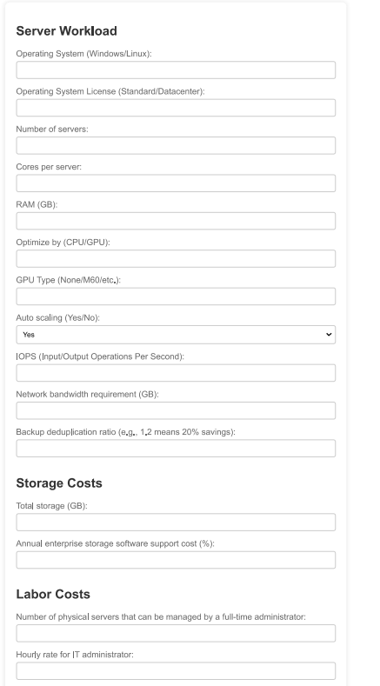
TCO Calculator Components
Inputs:
Server Workload
Storage Costs
Labor Costs

Slide 6

TCO Calculator Components
Functions:
Predict deployment CU
Currency convertor
Estimate TCO costs
This Photo by Unknown author is licensed under CC BY-SA.

Slide 7

Methodology
It utilizes a detailed, object-oriented approach to estimate the total cost of ownership for both cloud and on-premises deployments
It gathers input on server workloads, including operating system, server count, auto-scaling capabilities, and specific workload types, alongside storage and labor costs.
This data feeds into functions that calculate server, storage, and labor costs based on whether the deployment is in the cloud or on-premises.
This Photo by Unknown author is licensed under CC BY-SA.

Slide 8
Methodology
For cloud deployments, it further adjusts calculations based on the selected cloud provider (AWS, Azure, GCP)
The model also integrates real-world dynamics such as currency conversion based on user location, enhancing its applicability globally.
The calculator offers businesses a full view of their potential expenditure, aiding in more informed decision-making regarding infrastructure deployments.
This Photo by Unknown author is licensed under CC BY-SA.

Slide 9
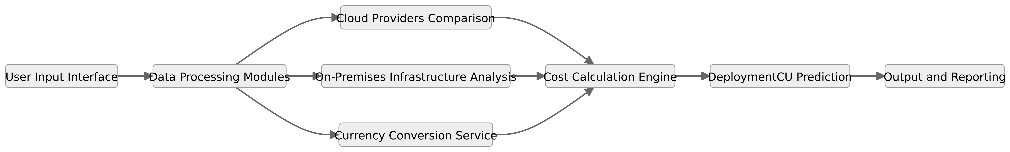
Architecture Diagram:

Slide 10

FEATURES
This Photo by Unknown author is licensed under CC BY-SA.

Slide 11
Cloud Providers Comparison
Provides a comprehensive comparison between cloud-based and on-premises deployment costs, enabling users to identify the most cost-effective option tailored to their specific needs.
Offers clear financial insights and highlights operational advantages, directing users towards choices that match their strategic and financial goals.

Slide 12

Currency Conversion:
Global Applicability: capability to provide cost estimates in local currencies, enhancing its utility for international businesses
Exchange Rate Integration: real-time currency conversion based on current exchange rates

Slide 13

Prediction model
Deployment CU Prediction: Introducing the feature that uses machine learning model to predict the optimal Compute Units based on input data, aiding in precise resource allocation
Model Training and Accuracy: Trained an ML model on synthesized dataset with accuracy 96.89%
ML model predicts the appropriate deployment capacity based on your load and other defined parameters.

Slide 14

AI chatbot:
Designed to answer your queries about TCO costs and guide you on actions related to optimizing TCO.
Capable of giving audio, video response
This Photo by Unknown author is licensed under CC BY-ND.

Slide 15
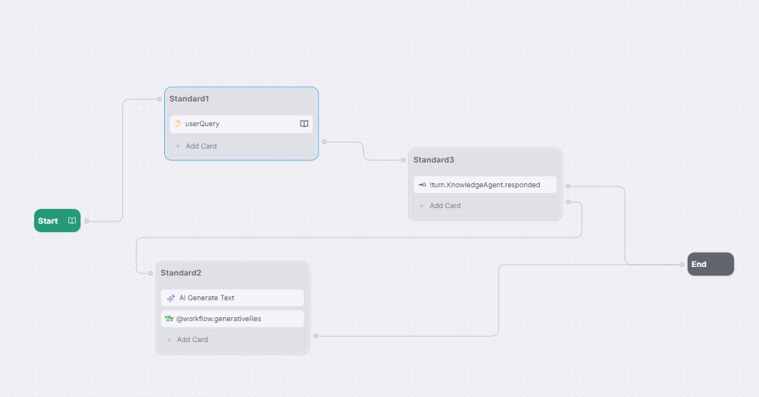
ChatBot Architecture:

Slide 16

Auto-Scaling:
On the basis of the network traffic the model will predict will auto scaling needed or not
We implemented a script that will fetch the network traffic and depending upon the threshold set it will predict auto scaling need.

