Slide 1


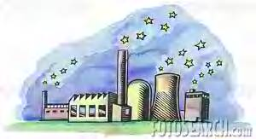
Kaye O’Brien
ECE 8814 8814
Pollution
and some Solutions
Kaye O’Brien
ECE 8814

Slide 2



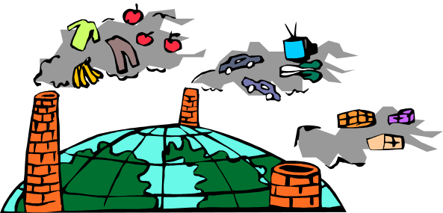
Table of Contents
Pollution and Some Solutions…………………Slide 1
Table of Contents……………..……………………..Slide 2
Kinds of Pollution……………………………………….Slide 3
What does Pollution Look Like?………………Slides 4-8
Air Pollution…………………………………………………Slide 9-12
Water Pollution……………………………………………Slide 13-15
Solid Waste………..……………………………………….Slide 16-18
Video………………………………………………………………Slide 19
Hyperlink to a website-………………………………Slide 20
  How does pollution affect us
Song- “Bad Pollution”………………………………… Slide 21
Health Risks………………………………………………….Slide 22
Charts…………………………………………………………….Slides 23-26
  Pie graph…………………………………………………Slide 23
  Bar graphs……………………………………………..Slides 24-26
Photographs of Local Pollution………………….Slide27
Solutions to Pollution………………………………….Slides 28-35
  Water ……….…………………………………….Slide 30
  Air ……….……………………………………………Slide 32
  Solid Waste………………………………..…..Slides 34 & 35
Conclusion………………………………………………………Slide 36

Slide 3
What kinds of pollution are there?
Water
Pollution
Solid
Waste
Air

Slide 4

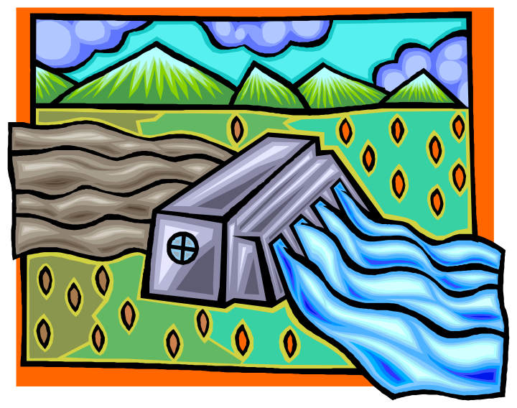
Pollution
What does it look like?

Slide 5
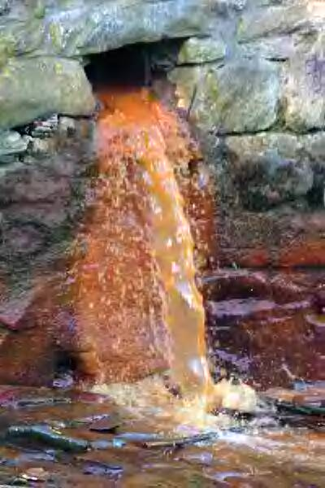
Click here only to go back to slide 24
Industry-
Water pollution

Slide 6
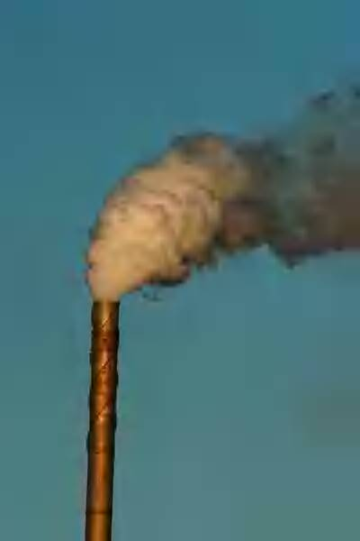
Click here only to go to slide 26
Chimney-
Steam and smoke-
Air pollution

Slide 7
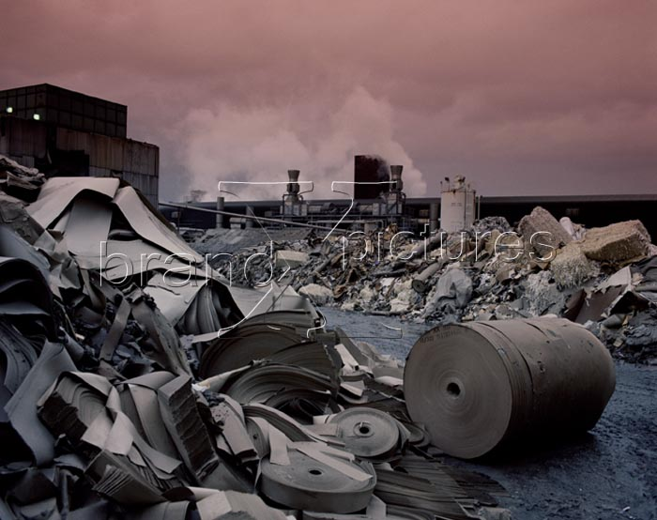

Solid Waste
Pollution
Click here only to go back to slide 28

Slide 8
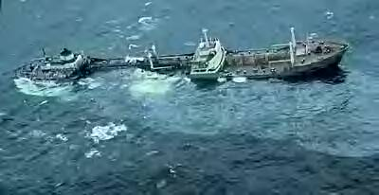
Oil Spill—Water Pollution
The Argo Merchant
A boat ran aground near Nantucket Island, Massachusetts.

Slide 9

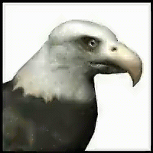
What happened to the clean air?

Slide 10
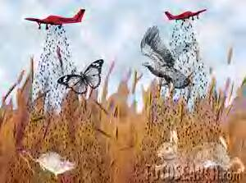
Stop polluting the air! Leave us alone!

Slide 11
Air Pollution
How | Why
A cloud of smoke from the exhaust of a vehicle | Increasing traffic
Smoke from a factory chimney | Growing cities
Eruption of a volcano | Rapid economic development
Cigarette smoke | Industrialization
Burning leaves | Apathetic people

Slide 12

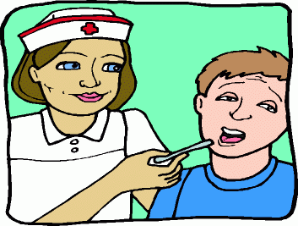
Effects of Air Pollution
Health problems
Damage to the environment
Damage to property
Thinning of the protective
ozone layer of the atmosphere
which is leading to climate changes

Slide 13

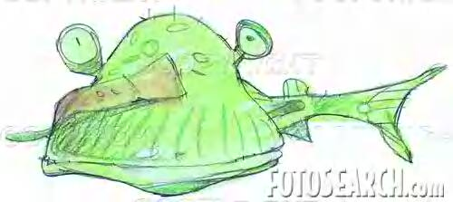
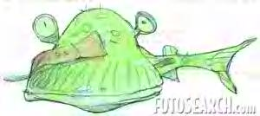
Ouch!What happened to my home?!
Water Pollution

Slide 14
Water Pollution
How
Toxic substances dissolve in water or gets deposited on the bed.
Toxic substances enter lakes, rivers, streams, etc.
Pollutants go down into the ground.
Sources
City sewage
Industrial waste
Agricultural run-off

Slide 15
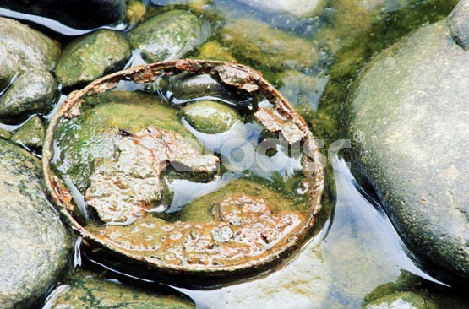
Effects of Water Pollution
Devastating to people and animals, fish, and birds.
Unsuitable for drinking, recreation, agriculture, and industry.
Destroys water life.

Slide 16
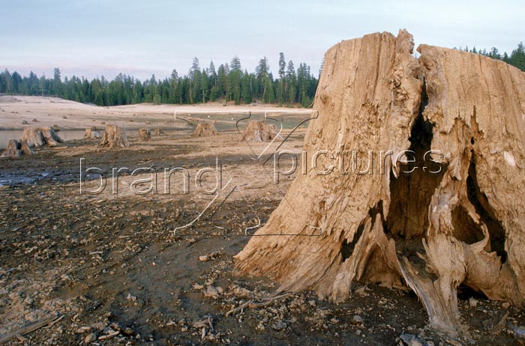
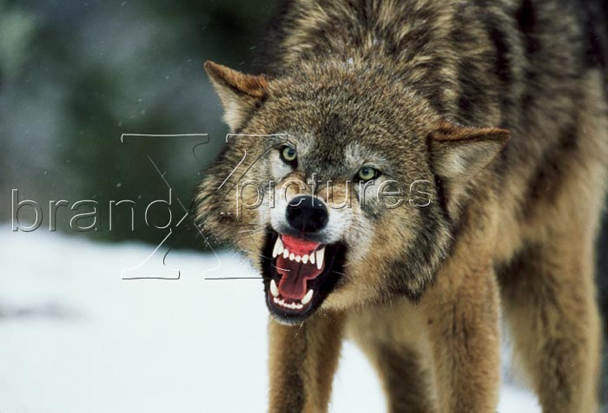
What happened to my home?

Slide 17

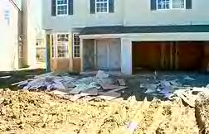
Clean up this here mess!

Slide 18

Solid Waste
Types of waste
Household waste
Industrial waste
Biomedical or hospital waste
Why
Population increases
Increased plastics products
Changes in lifestyle
Landfills not well equipped to protect against contamination

Slide 19

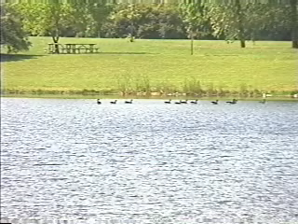
Click picture to watch a video.

Slide 20
Read about how pollution affects us!
http://www.epa.gov/superfund/kids/story/page-8.htm

Slide 21

Let’s hear it for:
“Bad Pollution”

Slide 22
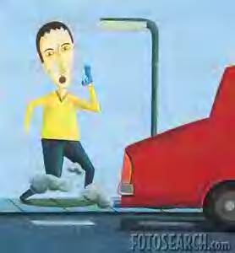
Our health and future are at risk!

Slide 23
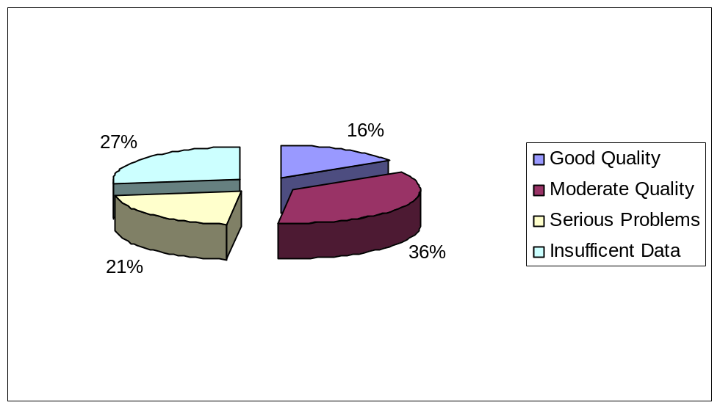
How Healthy are the Nation's Waters?
The Environmental Protection Agency found that 40% of the nation’s assessed waterways remain too polluted for fishing and swimming. Over 290,000 miles of 840,000 miles of assessed rivers and streams do not meet water quality standards. Nearly half of all lakes, reservoirs, and ponds assessed half of them are polluted.

Slide 24
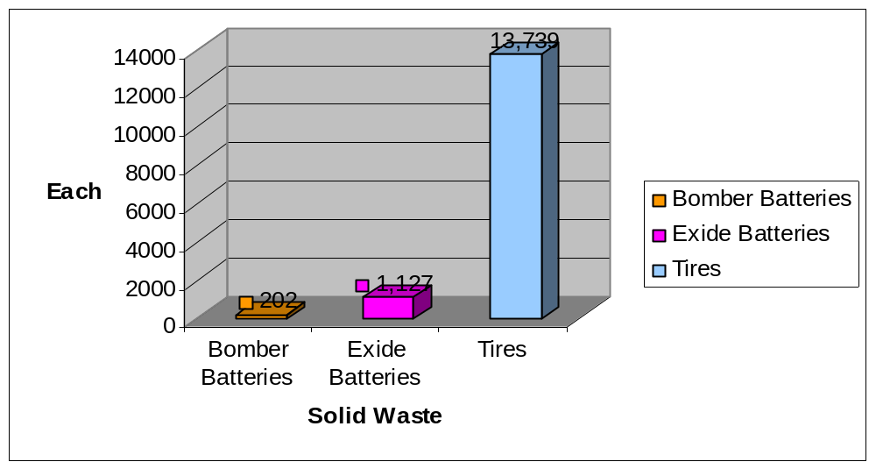
Solid Waste in Cobb County
Data collected from July 1, 2004 to June 30, 2005
If your habits are like other Americans,
you generate about 4 pounds of solid trash per day. Americans are generating waste products faster than nature can break them down and using up resources faster than they can be replaced.

Slide 25
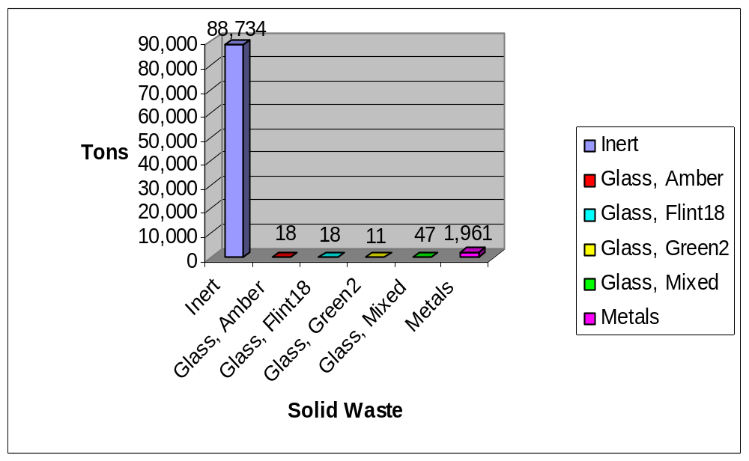
Solid Waste in Cobb County
Data collected from July 1, 2004 to June 30, 2005

Slide 26
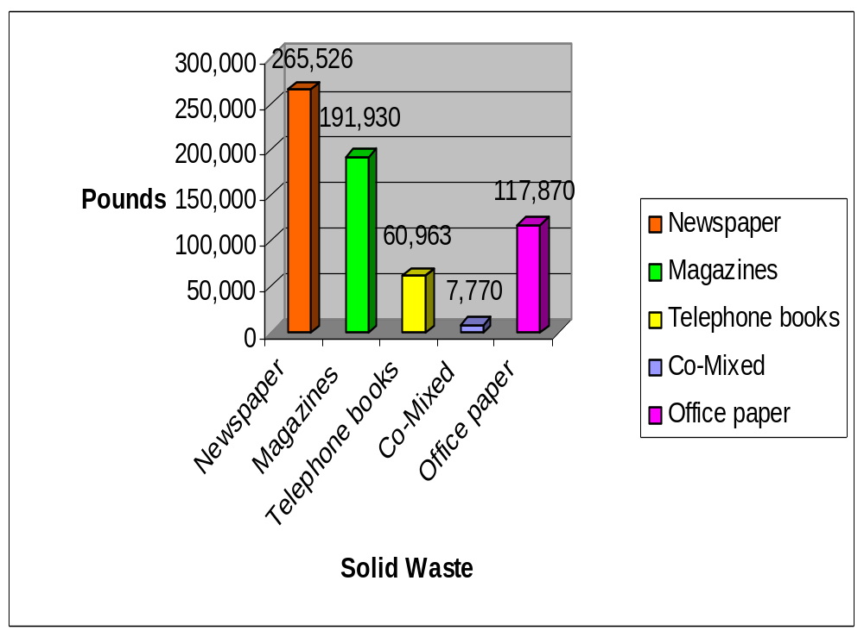
Solid Waste in Cobb County
Data collected from July 1, 2004 to June 30, 2005

Slide 27
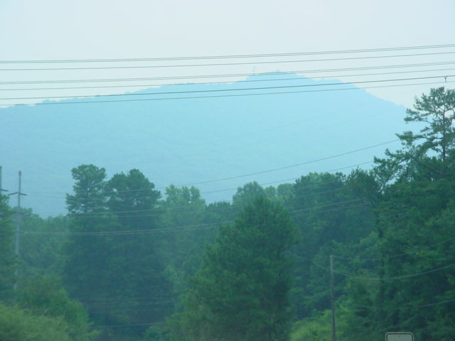
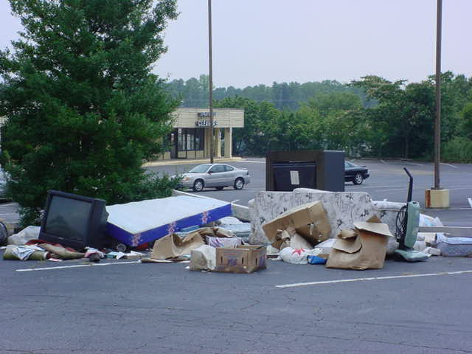
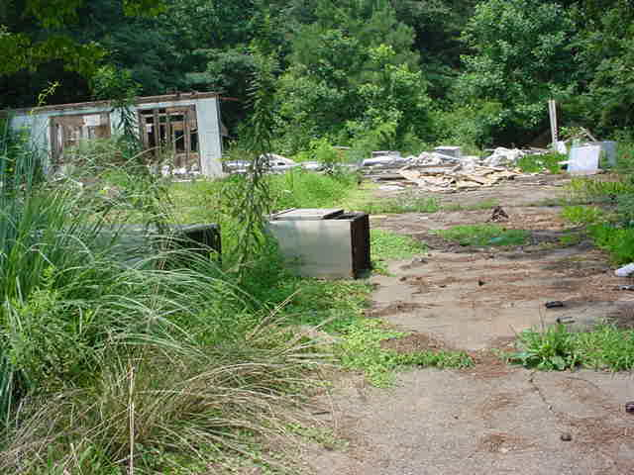
We Know Better Now!
Smog around Kennesaw Mountain
Trash dumped in parking lot in East Cobb
Vacant house trashed in Marietta

Slide 28

WHAT ARE WE GOING TO DO?

Slide 29

Remember what water pollution
looks like?
Click here to see water pollution
What are we going to do?

Slide 30

Water Solutions
Keep lakes clean
Take your used motor oil to a drop off place
Use latex paint instead of oil and rinse your brushes
in the sink rather than the yard
Fill a spray bottle with soapy water instead of bug spray
Plant trees to prevent soil erosion
Keep litter, pet waste, leaves, and grass clippings out
of gutters and storm drains.

Slide 31

What does air pollution look like?
What can we do?
Click here to see what air pollution looks like.

Slide 32

Air Pollution
Solutions
Encourage your family to walk more
Take the school bus
Reduce the amount of spray bottles
Do not burn leaves in your yard- put them in a compost
Keep your family cars in tune
Put catalytic converters on cars
Share your room with others when the air conditioner is on
Take care of your trees

Slide 33


What does solid waste pollution look like?
Frankly, my dear, what can we do about it?
Click here to see what solid waste pollution looks like.

Slide 34
Solid Waste
Solutions
Carry your own bag with you when you go shopping
Say no to all plastic bags as often as possible
Reduce the use of paper bags also
Dig a compost pit in your garden and put all the biodegradables in it
When you go out do not throw paper and other wrappings or even leftover food here and there-put it in the garbage
AND…

Slide 35

Reduce
Recycle
Reuse

Slide 36
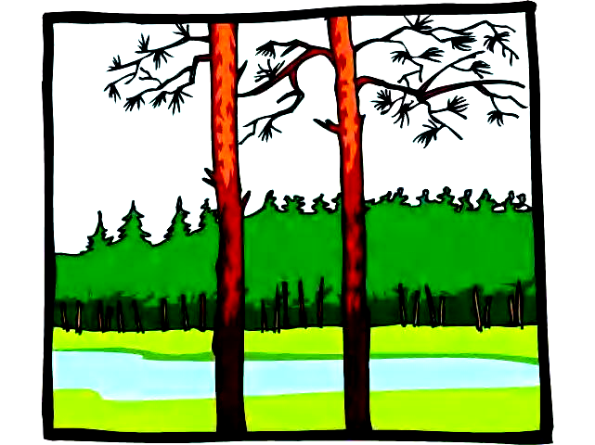






To cherish what remains of the Earth and to foster its renewal is our only legitimate hope of survival.
Wendell Berry

